Slide 1
Lecture 3: Markov Decision Processes and Dynamic Programming
Optimal policies for Lagrangian turbulence – Dr. Robin Heinonen
Aqtivate workshop on data-driven and model-based tools for complex flows and complex fluids
June 3-7

Slide 2
Intro
Last time we noted that Pontryagin Maximum Principle is unsuitable for control of stochastic systems. Turbulence is inherently stochastic
Need a framework for optimization and decision making in the face of randomness
Appropriate framework is called a Markov decision process. Can describe virtually all decision problems
We will discretize time for this discussion, but it is possible to generalize to continuous time

Slide 3



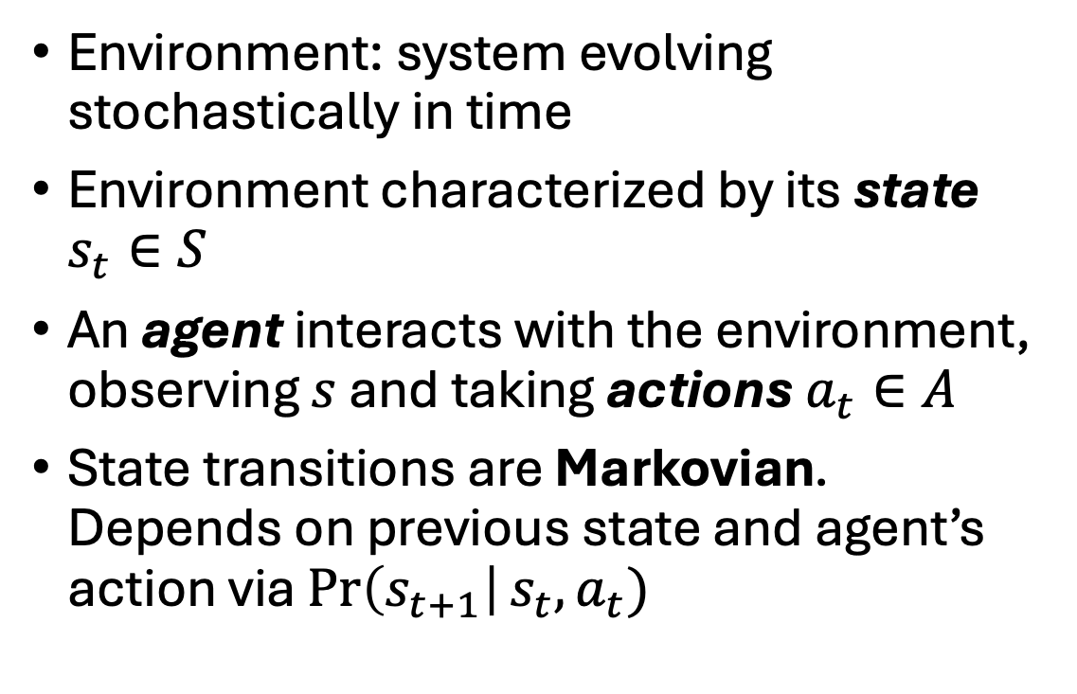
Environments and agents
state obs,
reward
agent
state
Environment: system evolving stochastically in time
Environment characterized by its state $s_{t}∈S$
An agent interacts with the environment, observing $s$ and taking actions $a_{t}∈A$
State transitions are Markovian. Depends on previous state and agent’s action via $\operatorname{Pr}\left(s_{t+1}\right|s_{t},a_{t})$
actions
environment
(some black box of physics)

Slide 4

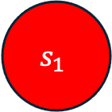

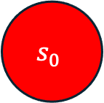


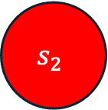
Environments and agents
$$s_{0}$$
$$\operatorname{Pr}\left(s_{1}\right|s_{0},a_{0})$$
$$s_{1}$$
$$\operatorname{Pr}\left(s_{2}\right|s_{1},a_{1})$$
$$s_{2}$$
environment
…
$$a_{0}$$
$$a_{1}$$
agent

Slide 5
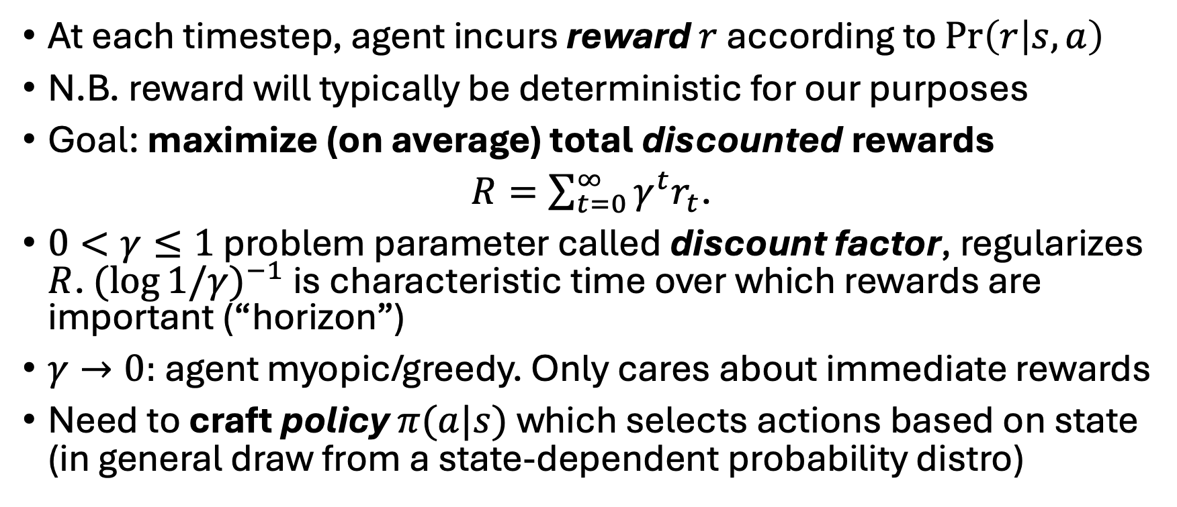
Rewards and policies
At each timestep, agent incurs reward $r$ according to $\operatorname{Pr}\left(r | s,a\right)$
N.B. reward will typically be deterministic for our purposes
Goal: maximize (on average) total discounted rewards
$R=\sum_{t=0}^{∞}{γ^{t}r_{t}}$.
$0<γ≤1$ problem parameter called discount factor, regularizes $R$. $({\log{1/γ)}}^{−1}$ is characteristic time over which rewards are important (“horizon”)
$γ→0:$agent myopic/greedy. Only cares about immediate rewards
Need to craft policy $π(a|s)$which selects actions based on state (in general draw from a state-dependent probability distro)

Slide 6
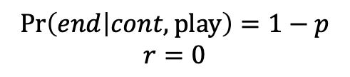
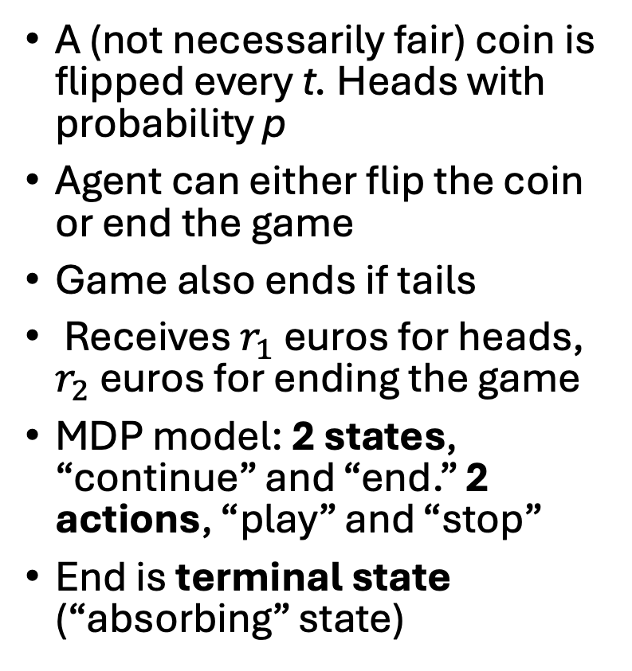
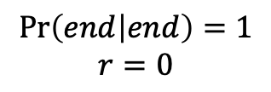
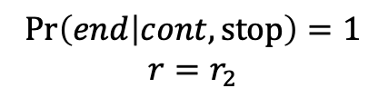
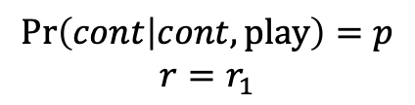
Example 1: a coin flipping game
A (not necessarily fair) coin is flipped every t. Heads with probability p
Agent can either flip the coin or end the game
Game also ends if tails
Receives $r_{1}$ euros for heads, $r_{2}$ euros for ending the game
MDP model: 2 states, “continue” and “end.” 2 actions, “play” and “stop”
End is terminal state (“absorbing” state)
$$\operatorname{Pr}\left(cont | cont,play\right)=p$$
$$r=r_{1}$$
continue
$$\operatorname{Pr}\left(end | cont,stop\right)=1$$
$$r=r_{2}$$
$$\operatorname{Pr}\left(end | cont,play\right)=1−p$$
$$r=0$$
end
$$\operatorname{Pr}\left(end | end\right)=1$$
$$r=0$$

Slide 7
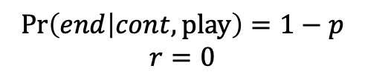
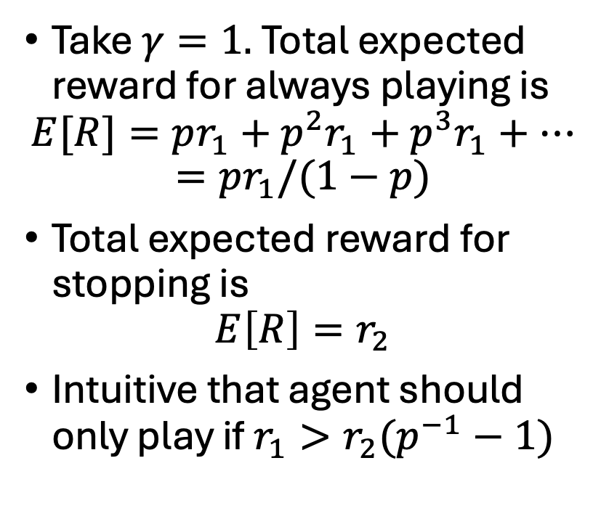
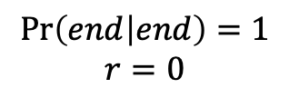
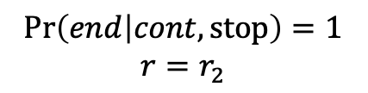
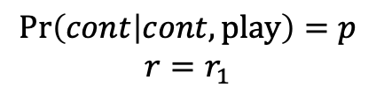
Example 1: a coin flipping game (cont’d)
Take $γ=1.$Total expected reward for always playing is
$$E[R]=pr_{1}+p^{2}r_{1}+p^{3}r_{1}+…$$
$$=pr_{1}/(1−p)$$
Total expected reward for stopping is
$$E\left[R\right]=r_{2}$$
Intuitive that agent should only play if $r_{1}>r_{2}(p^{−1}−1)$
$$\operatorname{Pr}\left(cont | cont,play\right)=p$$
$$r=r_{1}$$
continue
$$\operatorname{Pr}\left(end | cont,stop\right)=1$$
$$r=r_{2}$$
$$\operatorname{Pr}\left(end | cont,play\right)=1−p$$
$$r=0$$
end
$$\operatorname{Pr}\left(end | end\right)=1$$
$$r=0$$

Slide 8
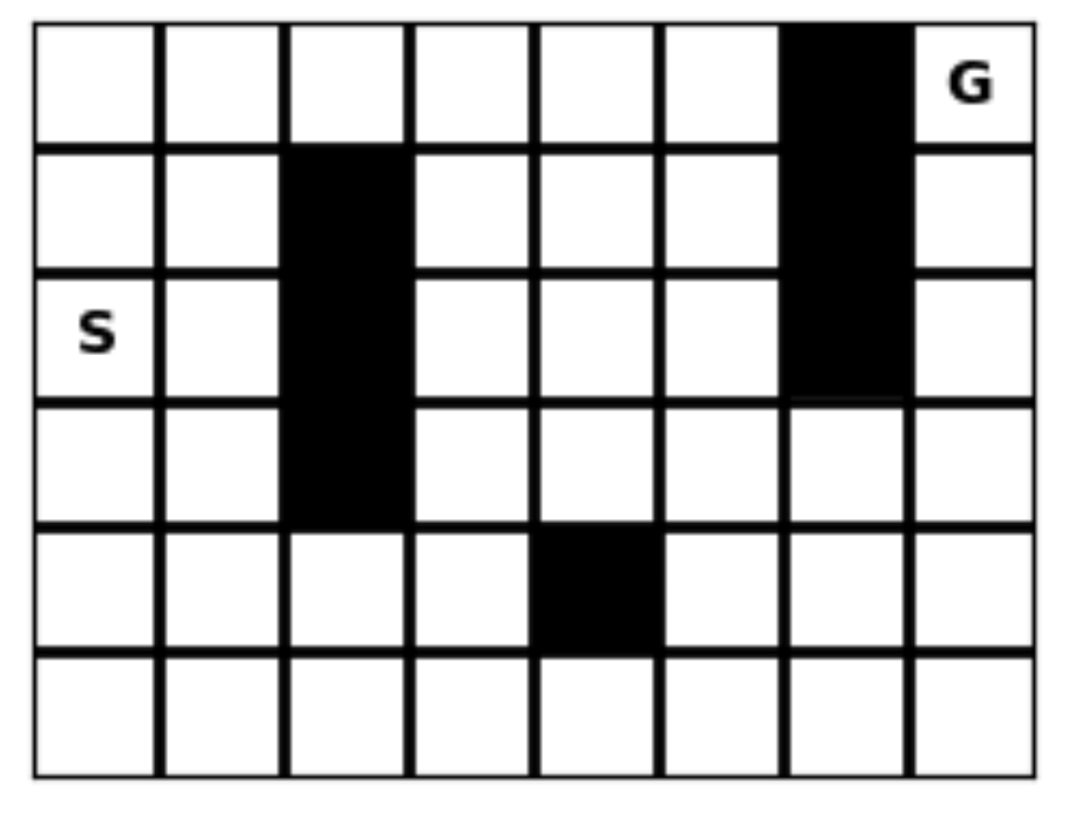
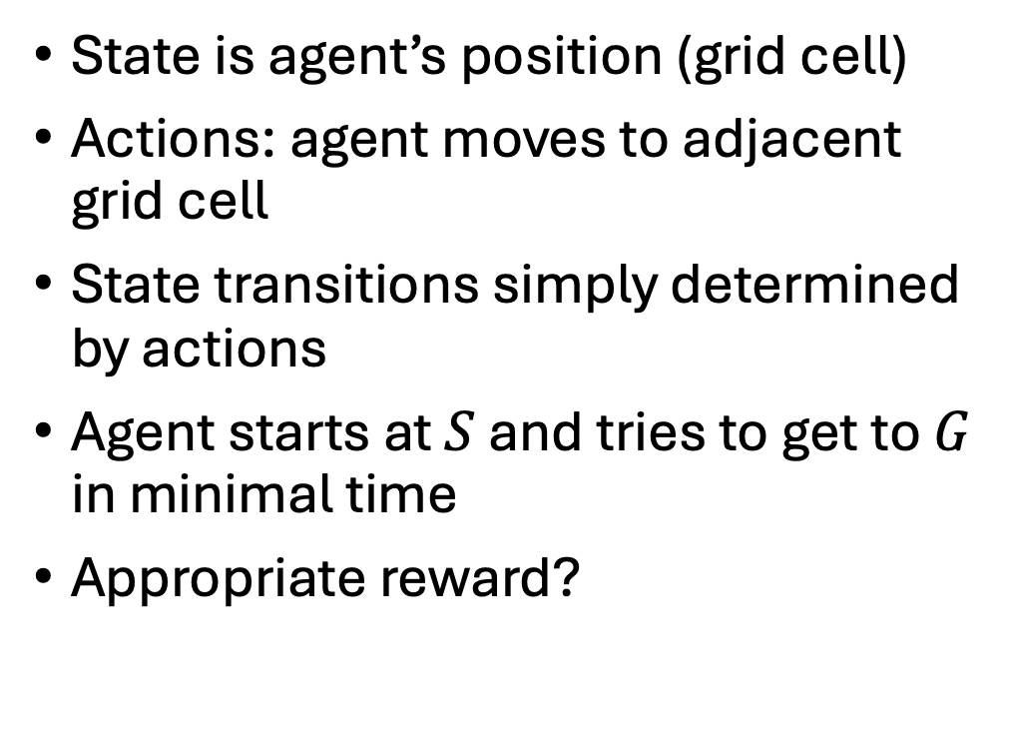
Example 2: a maze
State is agent’s position (grid cell)
Actions: agent moves to adjacent grid cell
State transitions simply determined by actions
Agent starts at $S$ and tries to get to $G$ in minimal time
Appropriate reward?

Slide 9
Example 2: a maze (cont’d)
Notice that problem can be solved by counting backwards from goal
Optimal policy: always move to square shortest distance from goal
This idea of exploiting recursive structure of problem can be generalized to all MDPs!
Leads to solution technique called “dynamic programming”
13
12
11
10
9
8
14
13
9
8
7
1
12
8
7
6
2
12
11
7
6
5
4
3
11
10
9
8
6
5
4
12
10
11
9
8
7
6
5

Slide 10
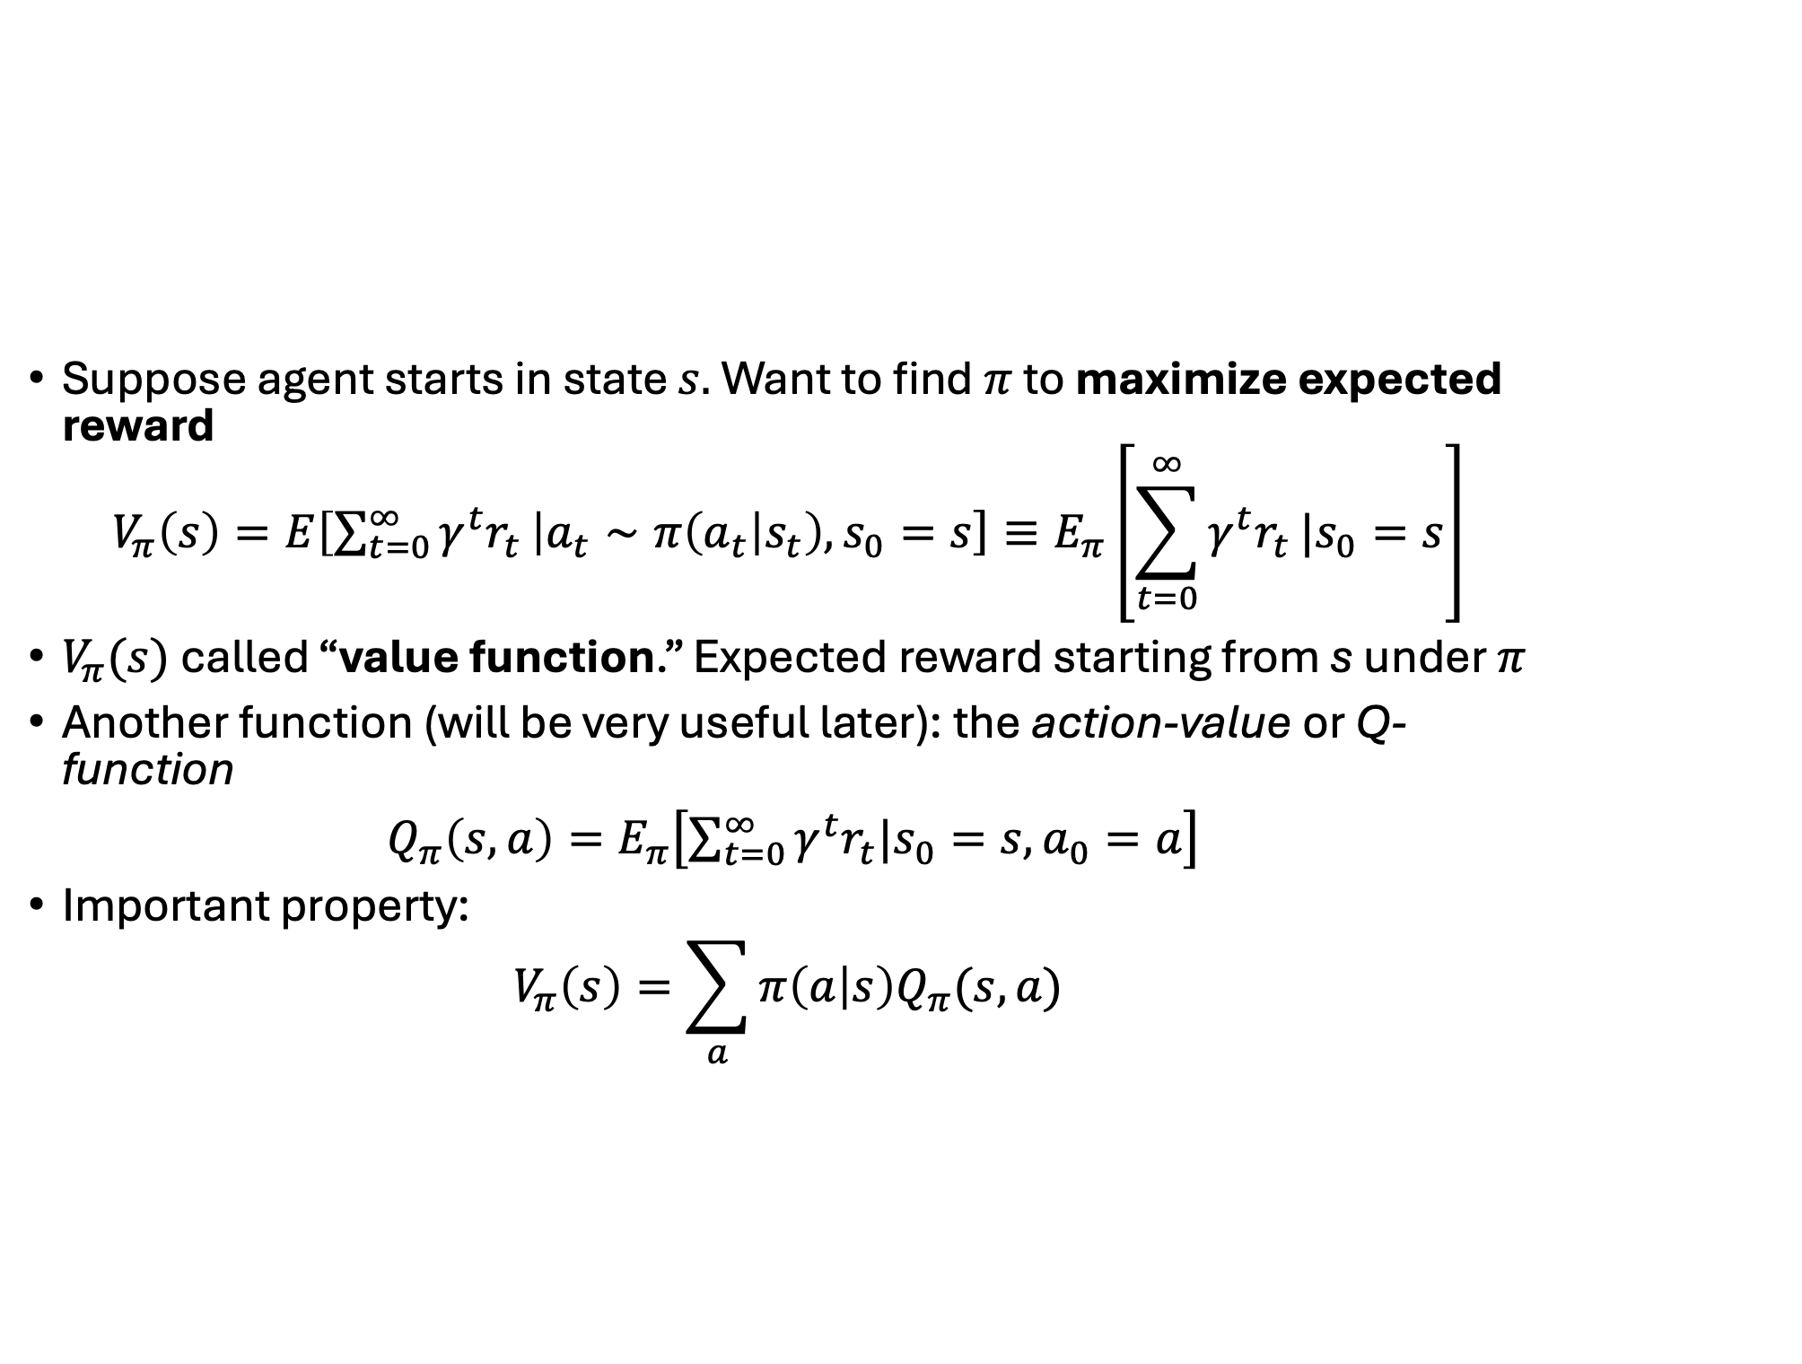

The value function and $Q$
Suppose agent starts in state $s.$ Want to find $π$ to maximize expected reward
$$V_{π}\left(s\right)=E\left.\left[\sum_{t=0}^{∞}{γ^{t}r_{t}} | a_{t}∼π\left(a_{t} | s_{t}\right),s_{0}=s\right.\right]≡E_{π}\left.\left[\sum_{t=0}^{∞}{γ^{t}r_{t}}\right.|s_{0}=s\right]$$
$V_{π}(s)$ called “value function.” Expected reward starting from s under $π$
Another function (will be very useful later): the action-value or Q-function
${Q_{π}\left(s,a\right)=E}_{π}\left.\left[\sum_{t=0}^{∞}{γ^{t}r_{t}}\right.|s_{0}=s,a_{0}=a\right]$
Important property:
$$V_{π}\left(s\right)=\sum_{a}{π\left(a | s\right)Q_{π}(s,a)}$$

Slide 11
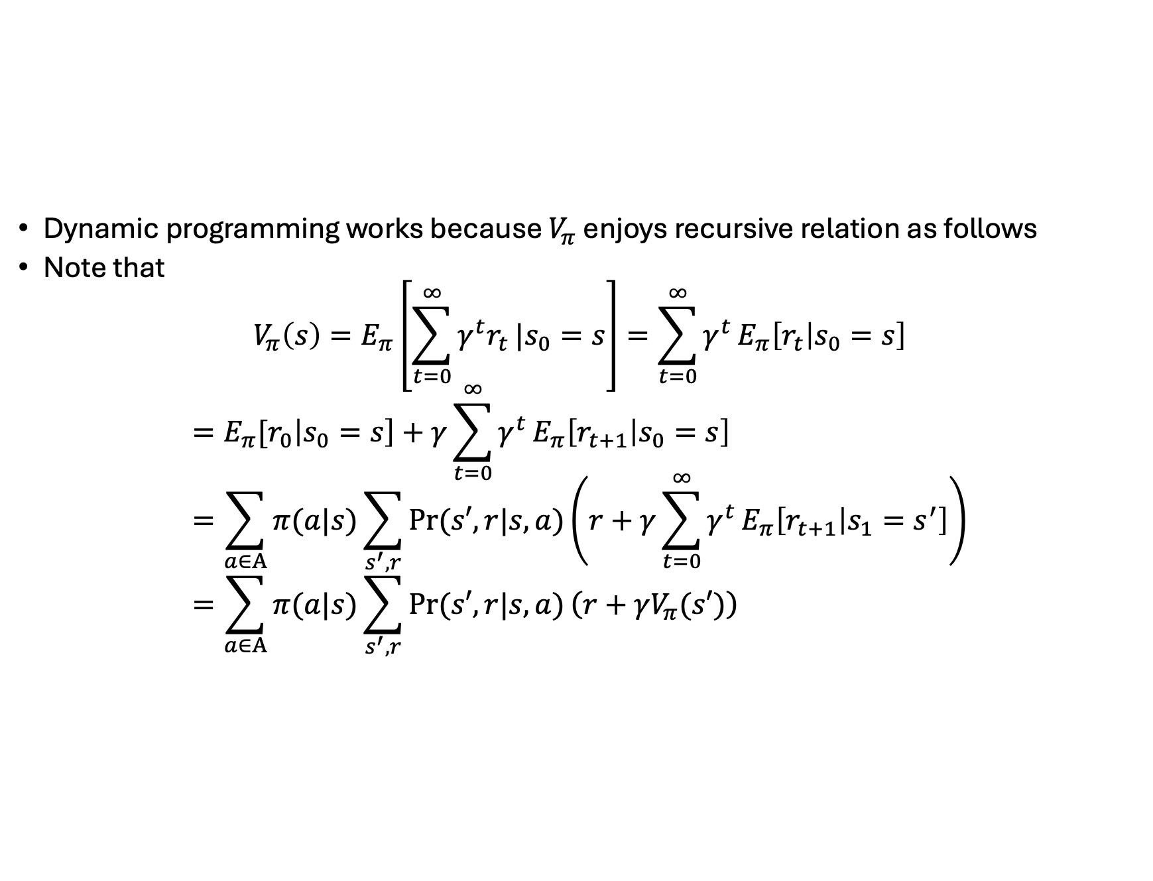
The Bellman equation
Dynamic programming works because $V_{π}$ enjoys recursive relation as follows
Note that
$$V_{π}\left(s\right)=E_{π}\left.\left[\sum_{t=0}^{∞}{γ^{t}r_{t}}\right.|s_{0}=s\right]=\sum_{t=0}^{∞}{γ^{t}}E_{π}\left[r_{t} | s_{0}=s\right]$$
$$={E_{π}[r}_{0}\left|s_{0}=s\right]+γ\sum_{t=0}^{∞}{γ^{t}}E_{π}\left[r_{t+1} | s_{0}=s\right]=\sum_{a∈A}{π(a|s)}\sum_{s^{′},r}{Pr⁡(s′,r|s,a)}\left.\left(r+γ\sum_{t=0}^{∞}{γ^{t}}E_{π}\left[r_{t+1} | s_{1}=s^{′}\right]\right.\right)=\sum_{a∈A}{π(a|s)}\sum_{s^{′},r}{Pr⁡(s′,r|s,a)}\left.\left(r+γV_{π}(s′)\right.\right)$$

Slide 12
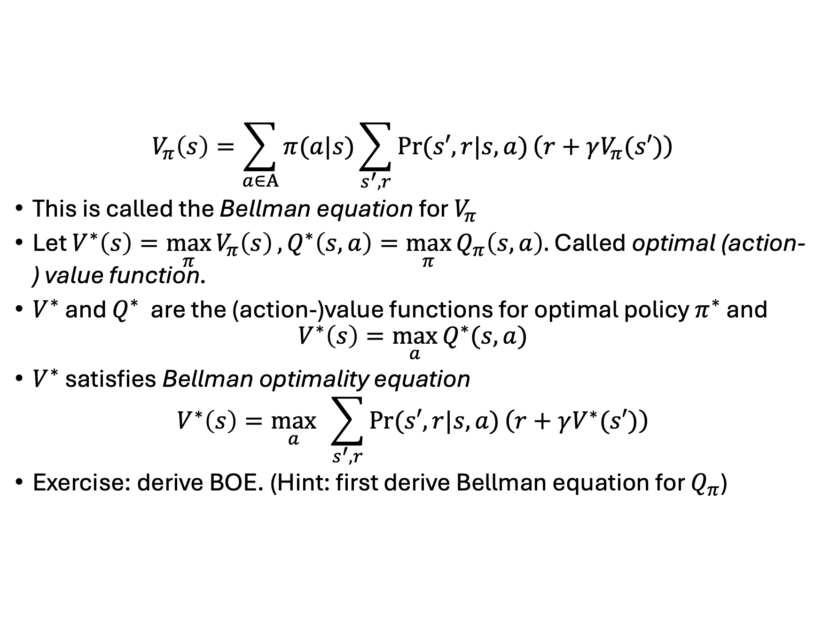
The Bellman equation
$$V_{π}\left(s\right)=\sum_{a∈A}{π(a|s)}\sum_{s^{′},r}{Pr⁡(s′,r|s,a)}\left.\left(r+γV_{π}(s′)\right.\right)$$
This is called the Bellman equation for $V_{π}$
Let $V^{∗}\left(s\right)=\max_{π}{V_{π}\left(s\right)}, Q^{∗}\left(s,a\right)=\max_{π}{Q_{π}\left(s,a\right).}$ Called optimal (action-) value function.
$V^{∗}$ and $Q^{∗}$ are the (action-)value functions for optimal policy $π^{∗}$ and
$$V^{∗}\left(s\right)=\max_{a}{Q^{∗}(s,a)}$$
$V^{∗}$ satisfies Bellman optimality equation
$$V^{∗}\left(s\right)=\max_{a}{ }\sum_{s^{′},r}{Pr⁡(s′,r|s,a)}\left.\left(r+γV^{∗}(s′)\right.\right)$$
Exercise: derive BOE. (Hint: first derive Bellman equation for $Q_{π}$)

Slide 13
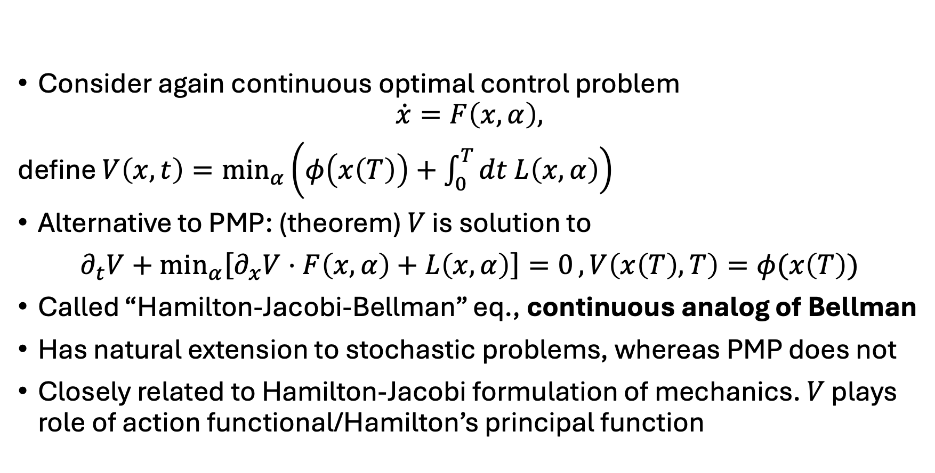
Aside: Hamilton-Jacobi-Bellman equation
Consider again continuous optimal control problem
$$\dot{x}=F\left(x,α\right),$$
define $V\left(x,t\right)=\min_{α}\left.\left(φ\left(x\left(T\right)\right)+\int_{0}^{T}{dt L\left(x,α\right)}\right.\right)$
Alternative to PMP: (theorem) $V$ is solution to
$∂_{t}V+\min_{α}\left.\left[∂_{x}V⋅F\left(x,α\right)+L\left(x,α\right)\right.\right]=0, V\left(x\left(T\right),T\right)=φ(x\left(T\right))$
Called “Hamilton-Jacobi-Bellman” eq., continuous analog of Bellman
Has natural extension to stochastic problems, whereas PMP does not
Closely related to Hamilton-Jacobi formulation of mechanics. $V$ plays role of action functional/Hamilton’s principal function

Slide 14
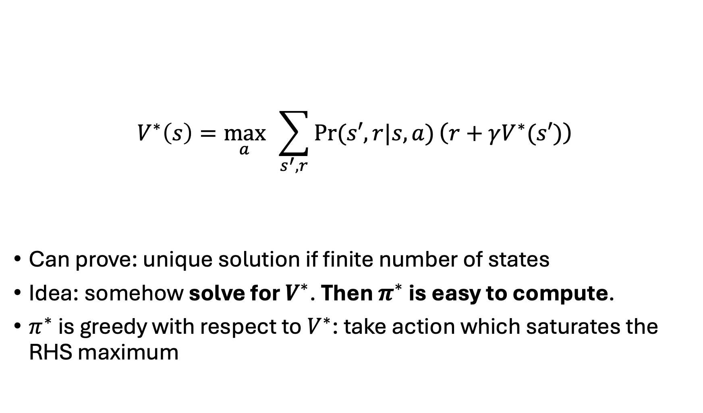
Dynamic programming
$$V^{∗}\left(s\right)=\max_{a}{ }\sum_{s^{′},r}{Pr⁡(s′,r|s,a)}\left.\left(r+γV^{∗}(s′)\right.\right)$$
Can prove: unique solution if finite number of states
Idea: somehow solve for $V^{∗}$. Then $π^{∗}$ is easy to compute.
$π^{∗}$ is greedy with respect to $V^{∗}$: take action which saturates the RHS maximum
max expected
total reward
next
reward
all future
expected rewards
expectation of

Slide 15
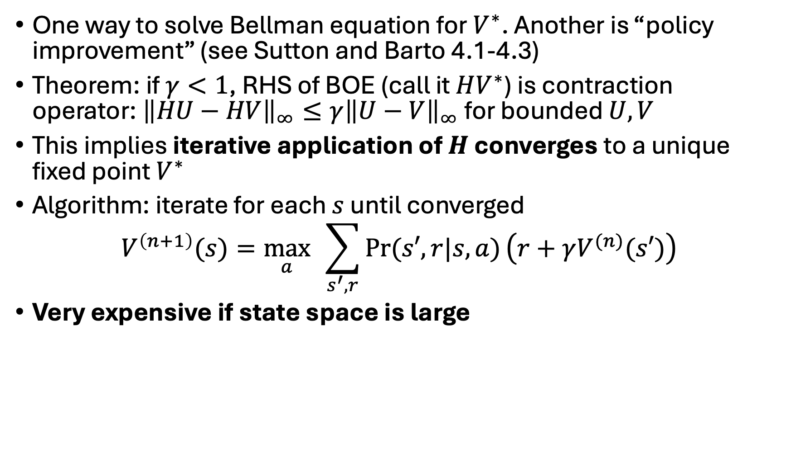
Value iteration
One way to solve Bellman equation for $V^{∗}$. Another is “policy improvement” (see Sutton and Barto 4.1-4.3)
Theorem: if $γ<1$, RHS of BOE (call it $HV^{∗}$) is contraction operator: ${\left\|HU−HV\right\|}_{∞}≤γ{\left\|U−V\right\|}_{∞}$ for bounded $U,V$
This implies iterative application of $H$ converges to a unique fixed point $V^{∗}$
Algorithm: iterate for each $s$ until converged
$$V^{\left(n+1\right)}(s)=\max_{a}{ }\sum_{s^{′},r}{Pr⁡(s′,r|s,a)}\left.\left(r+γV^{(n)}(s′)\right.\right)$$
Very expensive if state space is large

Slide 16
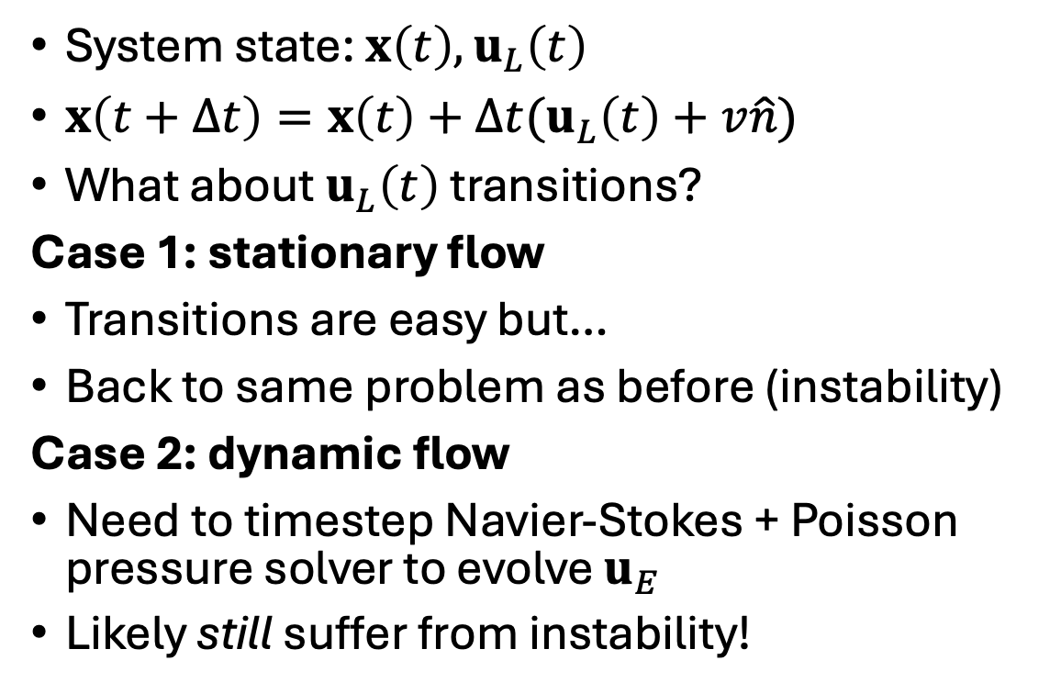
Can we solve Zermelo problem now?
System state: $x\left(t\right), u_{L}\left(t\right)$
$x\left(t+Δt\right)=x\left(t\right)+Δt(u_{L}\left(t\right)+v\hat{n})$
What about $u_{L}\left(t\right)$ transitions?
Case 1: stationary flow
Transitions are easy but…
Back to same problem as before (instability)
Case 2: dynamic flow
Need to timestep Navier-Stokes + Poisson pressure solver to evolve $u_{E}$
Likely still suffer from instability!
And in both cases...
need to know flow at every position
Have to solve the dynamic programming problem (good luck!)
N.B. MDP solution by stochastic HJB could be good approach for control of diffusing particle!

Slide 17
What about olfactory search?
What is the state of the system?
Does the agent have access to state?
Need notion of partial observability

