Slide 1
Lecture 4: Partial observability
Optimal policies for Lagrangian turbulence – Dr. Robin Heinonen
Aqtivate workshop on data-driven and model-based tools for complex flows and complex fluids
June 3-7

Slide 2



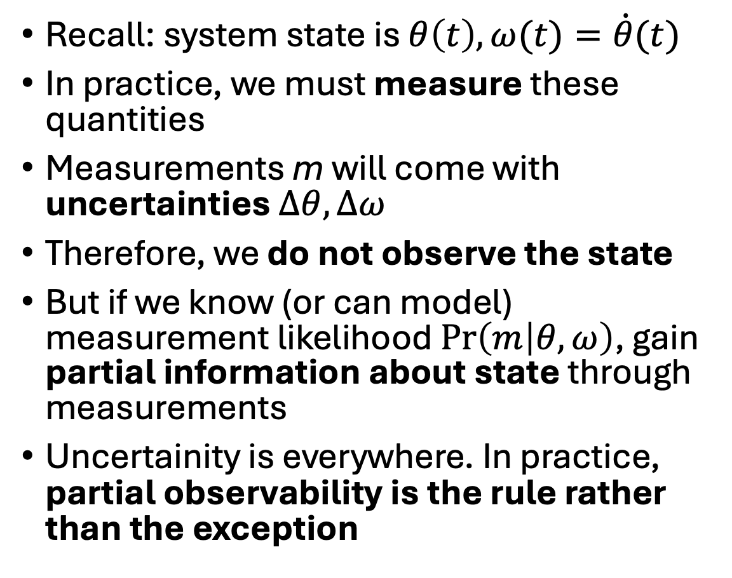



The inverted pendulum revisited
Recall: system state is $θ\left(t\right), ω(t)=\dot{θ}(t)$
In practice, we must measure these quantities
Measurements m will come with uncertainties $Δθ,Δω$
Therefore, we do not observe the state
But if we know (or can model) measurement likelihood $\operatorname{Pr}\left(m | θ,ω\right)$, gain partial information about state through measurements
Uncertainity is everywhere. In practice, partial observability is the rule rather than the exception
$$m$$
$$θ(t)$$
$$ℓ$$
$$x(t)$$
$$M$$
$$F(t)$$

Slide 3
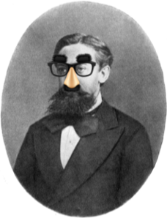
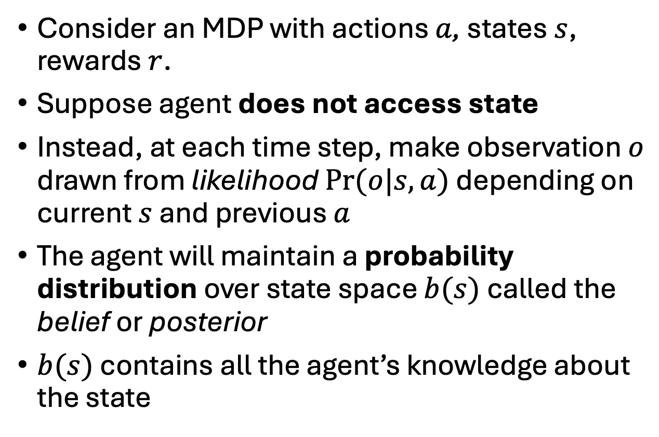
The partial observable Markov decision process
Consider an MDP with actions $a$, states$s$, rewards $r$.
Suppose agent does not access state
Instead, at each time step, make observation $o$ drawn from likelihood $Pr⁡(o|s,a)$ depending on current $s$ and previous $a$
The agent will maintain a probability distribution over state space $b(s)$ called the belief or posterior
$b(s)$ contains all the agent’s knowledge about the state
Partially observable Markov

Slide 4
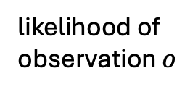
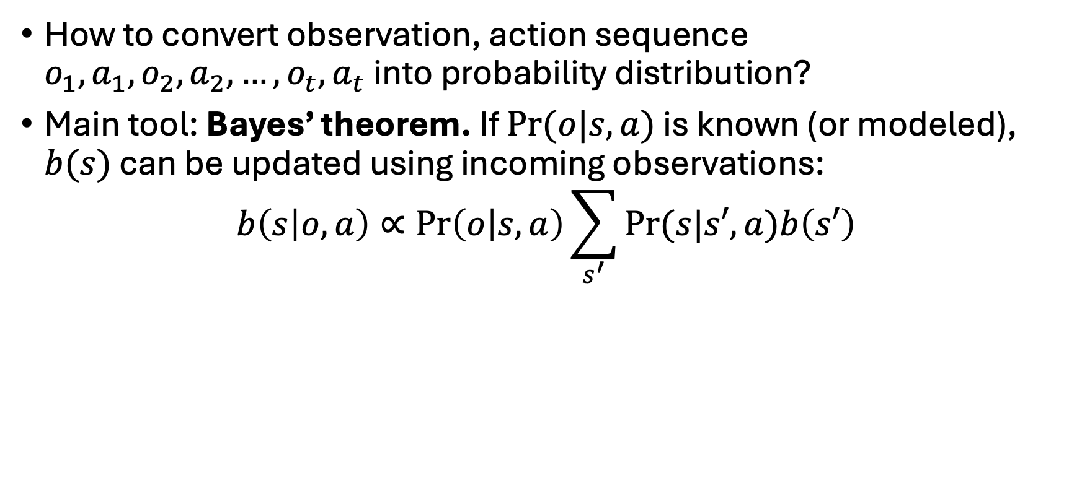
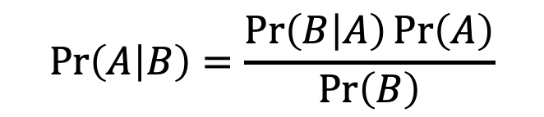
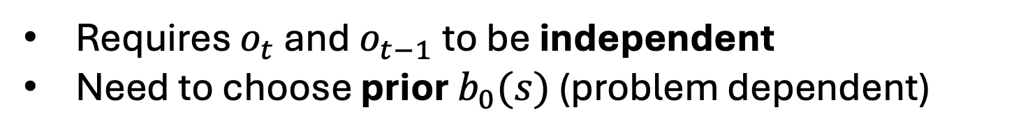

Bayesian inference
$$\operatorname{Pr}\left(A | B\right)=\frac{\operatorname{Pr}\left(B | A\right)\operatorname{Pr}\left(A\right)}{\operatorname{Pr}\left(B\right)}$$
How to convert observation, action sequence $o_{1},a_{1},o_{2},a_{2},…,o_{t},a_{t}$ into probability distribution?
Main tool: Bayes’ theorem. If $Pr⁡(o|s,a)$ is known (or modeled), $b(s)$ can be updated using incoming observations:
$$b\left(s | o,a\right)∝\operatorname{Pr}\left(o | s,a\right)\sum_{s^{′}}{Pr⁡(s|s′,a)b\left(s′\right)}$$
old belief
new belief
likelihood of
observation $o$
prob. of being in state $s$
Requires $o_{t}$ and $o_{t−1}$ to be independent
Need to choose prior $b_{0}(s)$ (problem dependent)

Slide 5
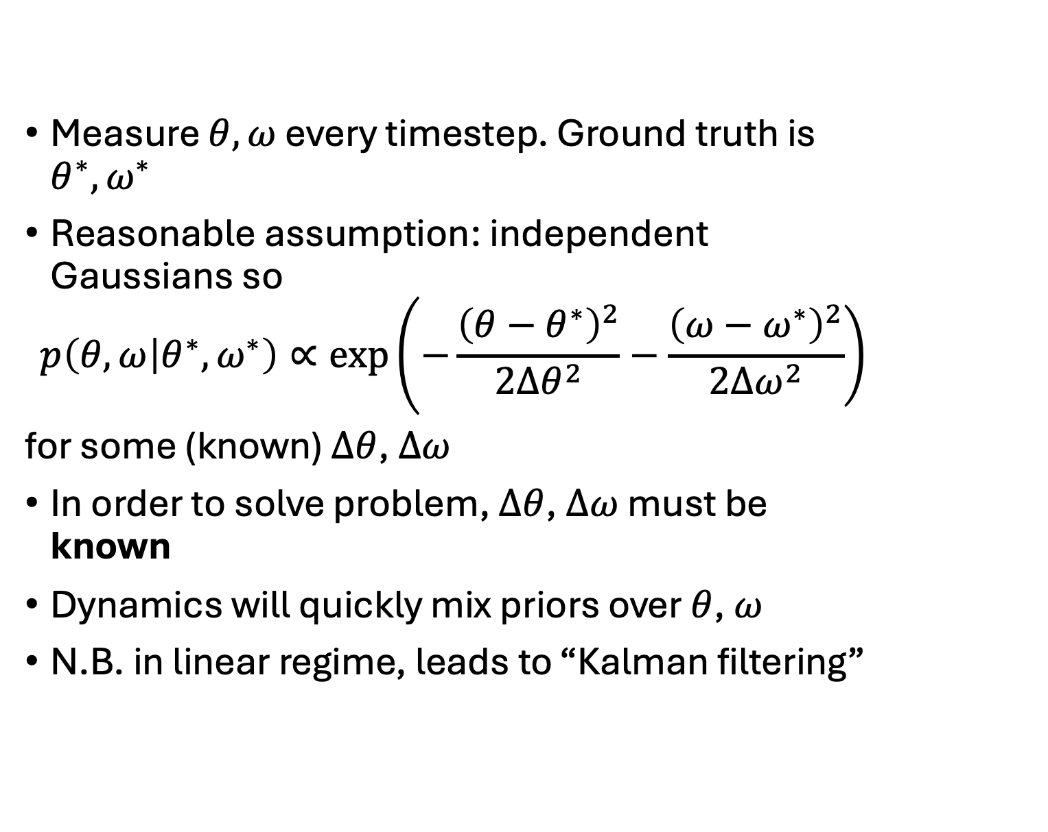
Example 1: inverted pendulum
Measure $θ, ω$ every timestep. Ground truth is $θ^{∗},ω^{∗}$
Reasonable assumption: independent Gaussians so
$$p\left(θ,ω | θ^{∗},ω^{∗}\right)∝\exp\left.\left(−\frac{{\left(θ−θ^{∗}\right)}^{2}}{2Δθ^{2}}−\frac{{\left(ω−ω^{∗}\right)}^{2}}{2Δω^{2}}\right.\right)$$
for some (known) $Δθ$, $Δω$
In order to solve problem, $Δθ$, $Δω$ must be known
Dynamics will quickly mix priors over $θ$, $ω$
N.B. in linear regime, leads to “Kalman filtering”
$$m$$
$$θ(t)$$
$$ℓ$$
$$x(t)$$
$$M$$
$$F(t)$$

Slide 6
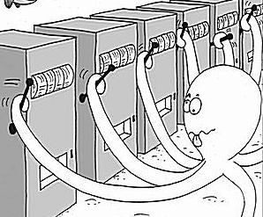
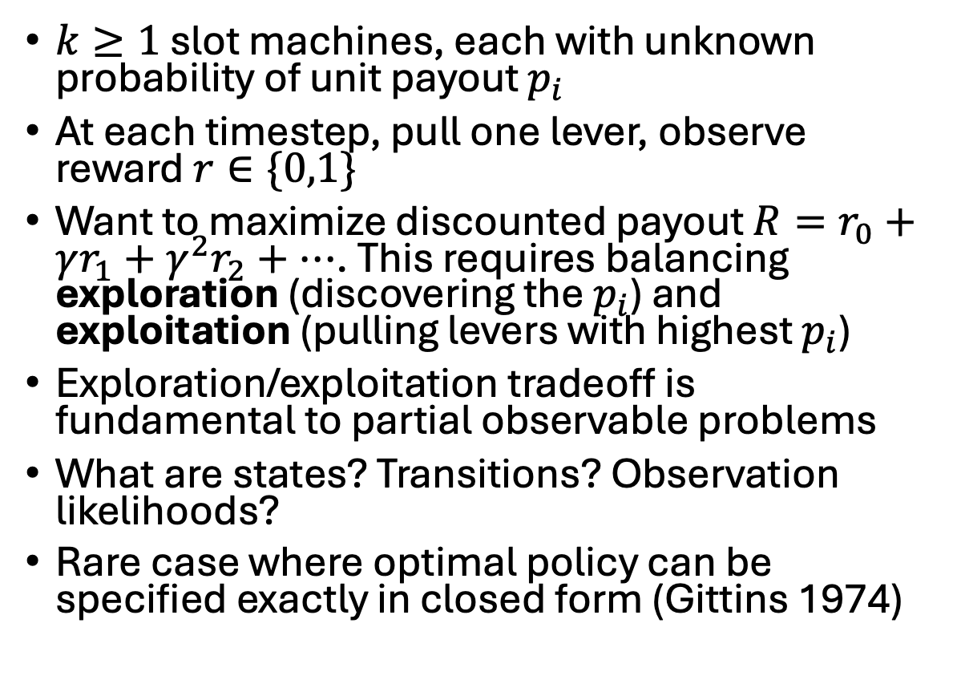
Example 2: multi-armed Bernoulli bandit
$k≥1$ slot machines, each with unknown probability of unit payout $p_{i}$
At each timestep, pull one lever, observe reward $r∈\{0,1\}$
Want to maximize discounted payout $R=r_{0}+γr_{1}+γ^{2}r_{2}+…$. This requires balancing exploration (discovering the $p_{i}$) and exploitation (pulling levers with highest $p_{i}$)
Exploration/exploitation tradeoff is fundamental to partial observable problems
What are states? Transitions? Observation likelihoods?
Rare case where optimal policy can be specified exactly in closed form (Gittins 1974)

Slide 7
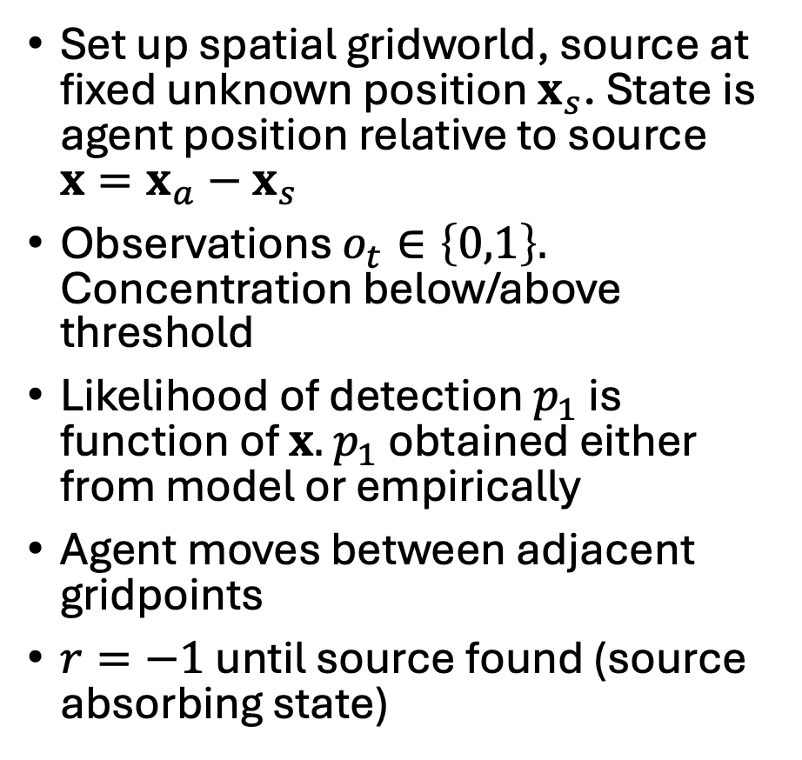
Example 3: olfactory search
Set up spatial gridworld, source at fixed unknown position $x_{s}$. State is agent position relative to source $x=x_{a}−x_{s}$
Observations $o_{t}∈\left\{0,1\right\}.$ Concentration below/above threshold
Likelihood of detection $p_{1}$ is function of $x.$ $p_{1}$ obtained either from model or empirically
Agent moves between adjacent gridpoints
$r=−1$ until source found (source absorbing state)

Slide 8
How to solve a POMDP?
POMDPs can be viewed as special cases of MDPs. States are probability distributions, state transitions are governed by Bayes theorem
Therefore, they obey a Bellman equation and can (in principle) be solved via dynamic programming.
But solution is very hard because state space is huge
Before we dive into POMDP solution, worth noting that there are often powerful heuristics available, vastly simpler to implement than a quasi-optimal policy. This will be subject of hands-on session (Friday)

Slide 9
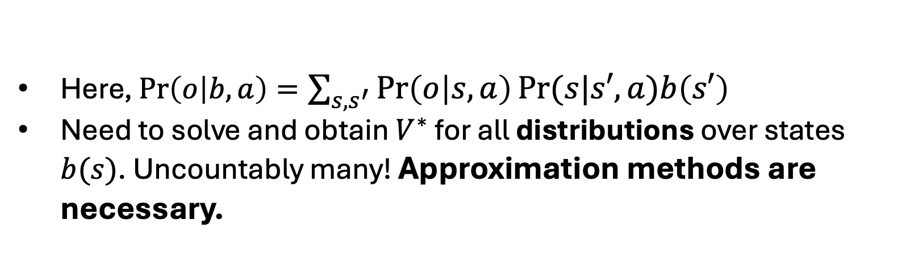
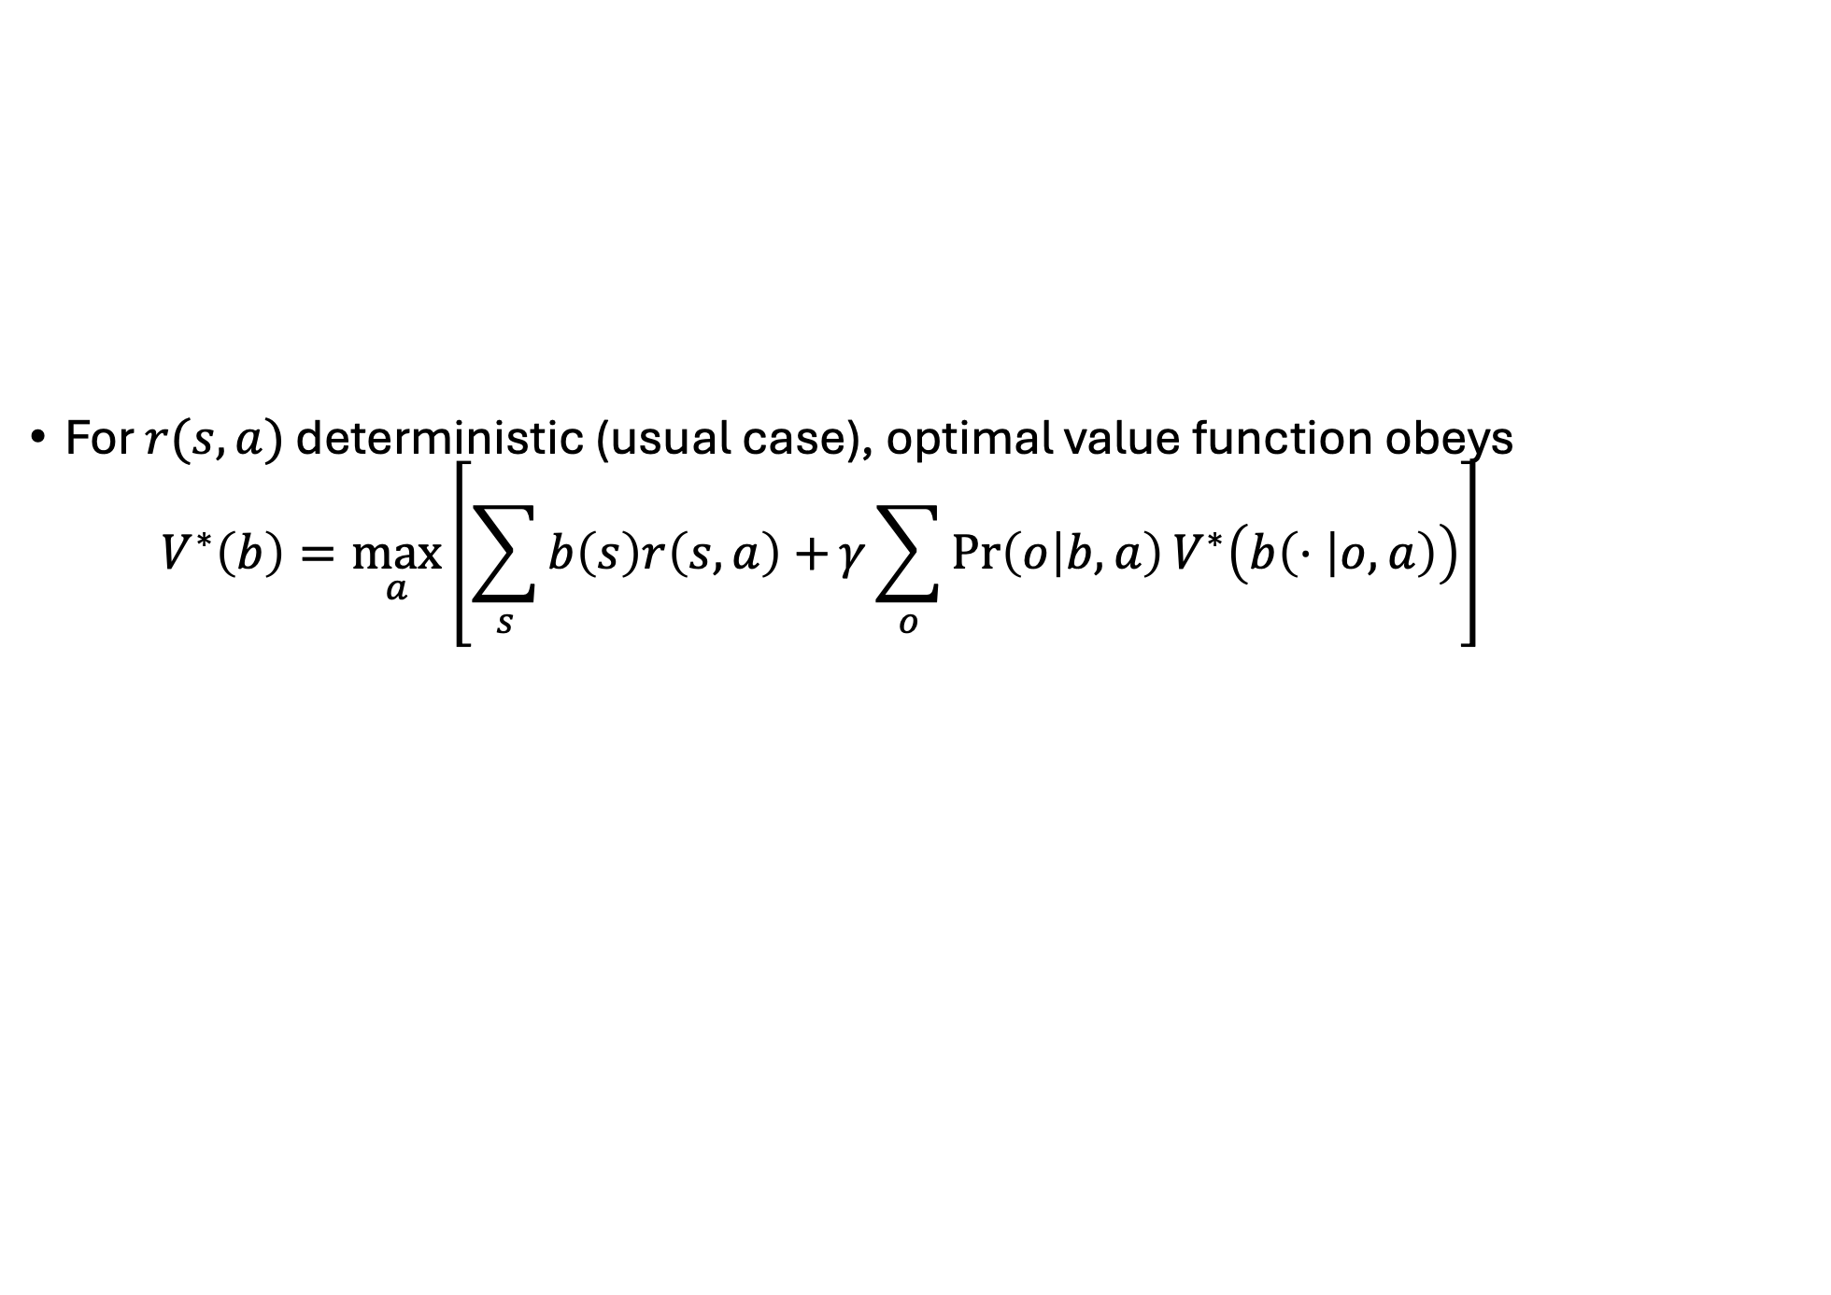
Bellman equation for POMDPs
For $r(s,a)$ deterministic (usual case), optimal value function obeys
$$V^{∗}\left(b\right)=\max_{a}\left.\left[\sum_{s}{b\left(s\right)r\left(s,a\right)+}γ\sum_{o}{\operatorname{Pr}\left(o | b,a\right)V^{∗}\left(b\left(⋅ | o,a\right)\right)}\right.\right]$$
belief after Bayesian update
expected immediate reward
expectation of all future rewards
Here, $\operatorname{Pr}\left(o | b,a\right)=\sum_{{s,s}^{′}}{\operatorname{Pr}\left(o | s,a\right)Pr⁡(s|s′,a)b\left(s′\right)}$
Need to solve and obtain $V^{∗}$ for all distributions over states $b(s)$. Uncountably many! Approximation methods are necessary.

Slide 10
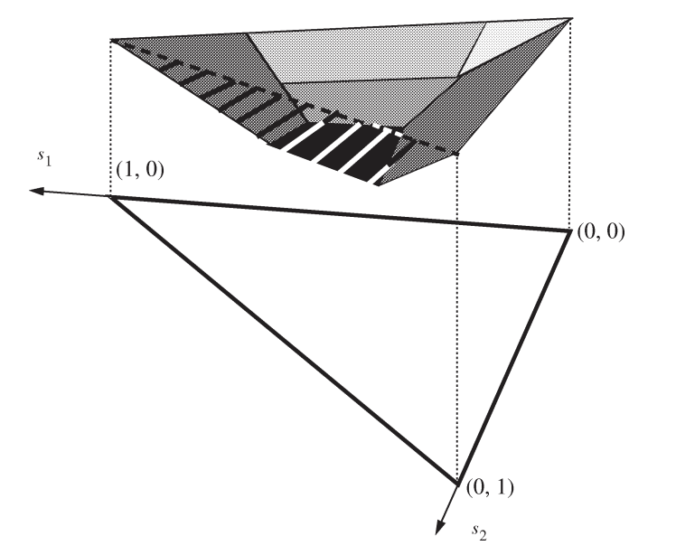
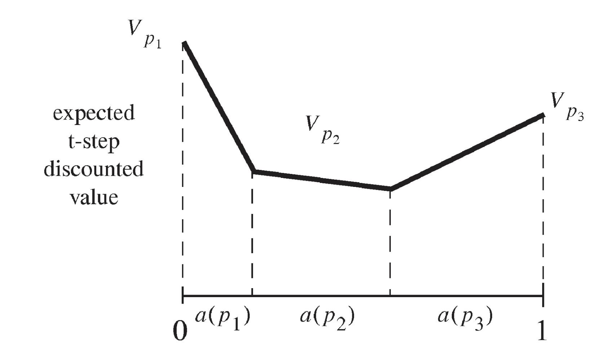
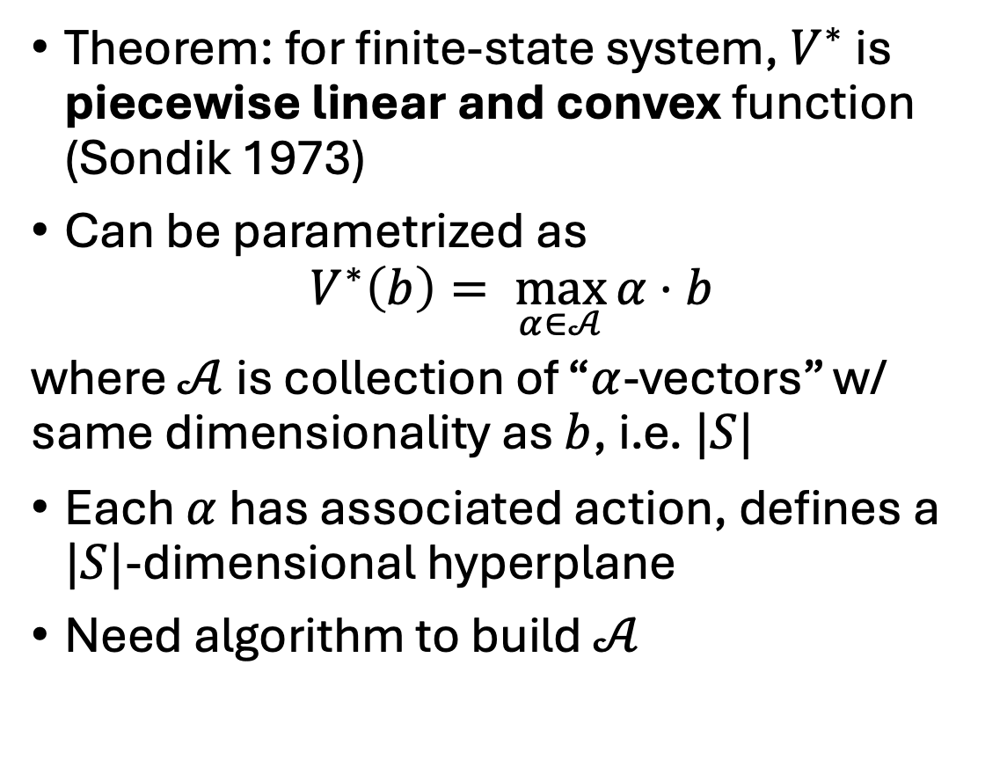
PWLC representation
Theorem: for finite-state system, $V^{∗}$ is piecewise linear and convex function (Sondik 1973)
Can be parametrized as
$$V^{∗}\left(b\right)= \max_{α∈𝒜}{α}⋅b$$
where $𝒜$ is collection of “$α$-vectors” w/ same dimensionality as $b$, i.e. $|S|$
Each $α$ has associated action, defines a $|S|$-dimensional hyperplane
Need algorithm to build $𝒜$
PWLC value function in two-state system.

Slide 11
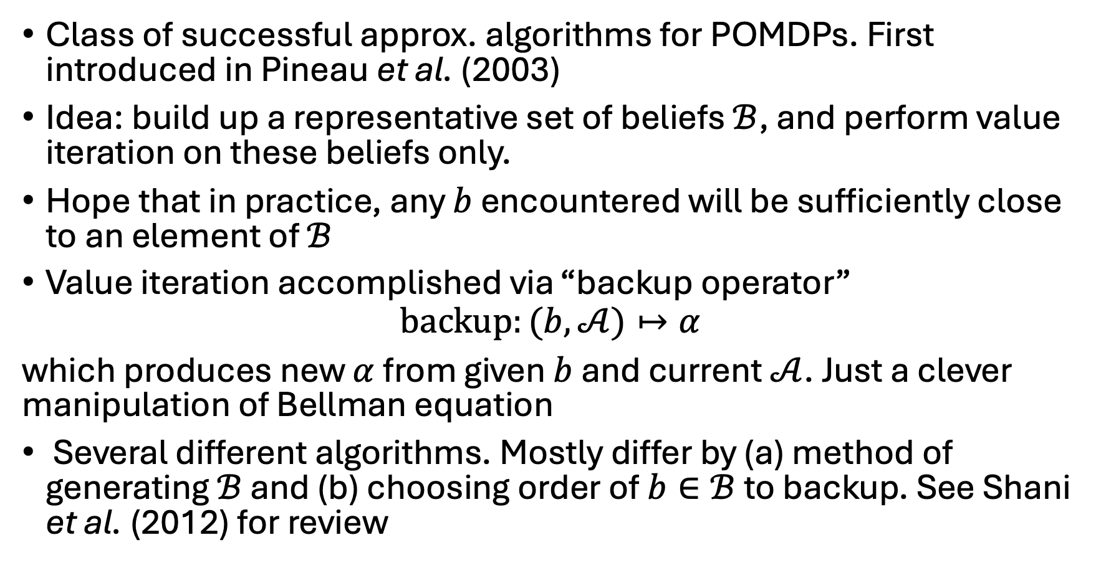
Point-based value iteration
Class of successful approx. algorithms for POMDPs. First introduced in Pineau et al. (2003)
Idea: build up a representative set of beliefs $ℬ$, and perform value iteration on these beliefs only.
Hope that in practice, any $b$ encountered will be sufficiently close to an element of $ℬ$
Value iteration accomplished via “backup operator”
$$backup:(b,𝒜)↦α$$
which produces new $α$ from given $b$ and current $𝒜$. Just a clever manipulation of Bellman equation
Several different algorithms. Mostly differ by (a) method of generating $ℬ$ and (b) choosing order of $b∈ℬ$ to backup. See Shani et al. (2012) for review

Slide 12
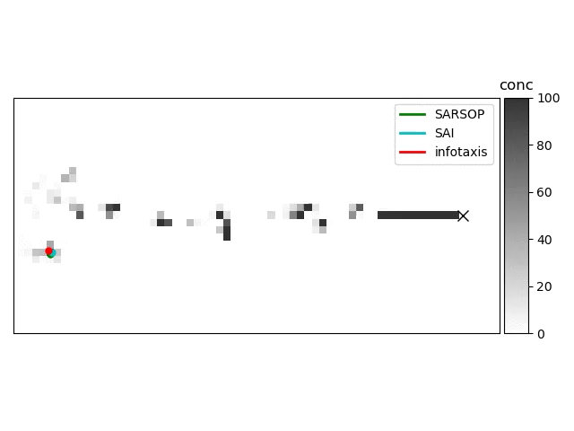
POMDP solution of olfactory search
Example of SARSOP algorithm (Kurniawati et al. 2012) beating heuristics in real flow data
POMDP solution using Perseus algorithm (Spaan and Vlassis 2005) beats every tested heuristic for olfactory search, on both single points and an ensemble of points. From Heinonen et al. (2023)

Slide 13
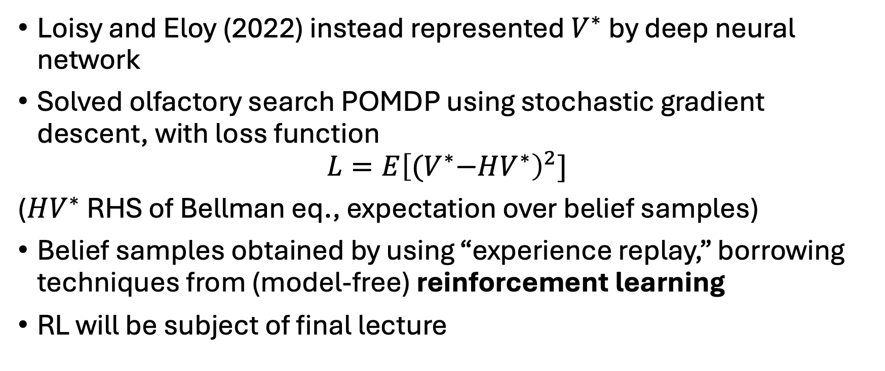
Alternate method of solution
Loisy and Eloy (2022) instead represented $V^{∗}$ by deep neural network
Solved olfactory search POMDP using stochastic gradient descent, with loss function
$$L=E{\left[{(V}^{∗}−HV^{∗}\right)}^{2}]$$
($HV^{∗}$ RHS of Bellman eq., expectation over belief samples)
Belief samples obtained by using “experience replay,” borrowing techniques from (model-free) reinforcement learning
RL will be subject of final lecture

