Slide 1

Accelerating Generative AI with PyTorch
Introduction to the HPC System

Slide 2
Presenters
Boris Velichkov
Lead Presenter (Introduction and Setup) and Instructor (Practical Session)
Researcher for the EuroCC2 Project at Sofia University
boris.velichkov@fmi.uni-sofia.bg
Robert Jan
Lead Presenter (PyTorch Intro and Profiling) and Instructor (Practical Session)
Technical Advisor ML/HPC at SURF BV
robert-jan.schlimbach@surf.nl

Slide 3
Introduction to the HPC Environment
GWDG HPS System
The provided HPC system for this tutorial.
Each attendee must have a profile to access AcademicCloud and GWDG HPC environment.
SSH Access
The primary method of accessing the provided HPC resources is through Secure Shell (SSH).
Python and Jupyter
All tutorials are based on Python and Jupyter, both of which are fully supported by the provided HPC system.

Slide 4




The GWDG at a glance
Gesellschaft für wissenschaftliche Datenverarbeitung mbH Göttingen
The computer center and IT competence center for the Georg-August-University Göttingen and the Max Planck Society.

Slide 5
Central areas of responsibility
Modern and secure IT infrastructure
IT support for excellent research
In-house research for innovative IT services
Various supra-regional tasks:
National High Performance Computing Center
National HPC Center of the DLR
AI service center for sensitive and critical infrastructures
Data center in four NFDI consortia
Host for DARIAH-EU, German National Library, GFBio, NUM CODEX, MWS, WirLernenOnline, etc.
Cloud operator, including Academic Cloud for universities in Lower Saxony

Slide 6

KISSKI: AI Service Center for Sensitive and Critical Infrastructures
Research into AI methods and their provision in a highly available AI service center for critical and sensitive infrastructures. Focus on socially highly relevant fields of medicine and energy
Service offer:
Infrastructure
Hardware
Software
Models & data
Consulting
Initial consultation
Further consultation
Development
Training
Training courses designed specifically for KISSKI
External courses offered by the KISSKI consortium partners

Slide 7
NHR-NORD@GÖTTINGEN
As a high-performance computing center, the GWDG, together with the University of Göttingen, is now one of nine members of the National High Performance Computing Network - NHR. It currently operates the NHR systems Emmy and Grete.
Competencies
Life sciences
Earth system sciences
Fluid mechanics
AI and big data
Digital humanities
Access to the NHR systems
The allocation of computing time for small (test) projects is informal
A short application is required for extensive projects https://docs.hpc.gwdg.de/application_process/index.html
Approved projects can be managed in our convenient portal https://hpcproject.gwdg.de

Slide 8
Become customers at NHR-NORD@GÖTTINGEN & KISSKI
NHR-NORD@GÖTTINGEN (https://gwdg.de/en/community-pages/nhr-intro/)
To be able to use the computing systems, you must join an existing project or apply for a project. The following options are available:
Join an existing project
Apply for test access with limited computing time (requirement: member of a German university)
Apply for a full project (requirement: member of a German university)
KISSKI (https://kisski.gwdg.en/)
To book services of KISSKI an AcademicID is required. The following options are available:
Federated login: log in with your own institution's access data
New registration: create an AcademicID during the booking process

Slide 9




Acknowledgments
Acknowledgment
Funded by the European Union, as part of the EuroCC2 Project, this work has received funding from the European High-Performance Computing Joint Undertaking (JU) under grant agreement No 101101903. The JU receives support from the Digital Europe Programme and Germany, Bulgaria, Austria, Croatia, Cyprus, Czech Republic, Denmark, Estonia, Finland, Greece, Hungary, Ireland, Italy, Lithuania, Latvia, Poland, Portugal, Romania, Slovenia, Spain, Sweden, France, Netherlands, Belgium, Luxembourg, Slovakia, Norway, Türkiye, Republic of North Macedonia, Iceland, Montenegro, Serbia.
We acknowledge the support of the Academic Cloud and the Georg-August-University Göttingen (GWDG) for providing the HPC System.
Disclaimer
Funded by the European Union, as part of the EuroCC2 Project, the views and opinions expressed in this work are solely those of the author(s) and do not necessarily reflect those of the European Union or the European High-Performance Computing Joint Undertaking (JU) and participating countries in the project. Neither the European Union nor the granting authority can be held responsible for them.

Slide 10
Setting Up Your HPC Environment
Login into Academic Cloud
Login into GWDG HPC Project
You need to find the project username (e.g. u12345) and username (e.g. name.surname) provided by GWDG
Connecting via SSH
Install SSH clients (if needed)
Generating SSH keys
Uploading SSH keys
Configuring SSH
Logging in
Set up SSH Тunnel.
Setting Up and Run a Jupyter Project
Create and activate virtual environment
Install Jupyter Notebook and required packages
Run Jupyter Notebook

Slide 11
Setup: Connecting via SSH
Install SSH Clients (If Needed)
Linux
To check if the OpenSSH client is already installed execute the following command in the terminal: ssh -V
To install the OpenSSH client execute the following command in the terminal: sudo apt install openssh-client
Mac
Mac OS X and newer already have a terminal and OpenSSH client installed.
Windows
To check if the OpenSSH client is already installed execute the following command in the terminal: ssh --version
To install the OpenSSH client execute the following command in the terminal: Add-WindowsCapability -Online -Name OpenSSH.Client~~~~0.0.1.0

Slide 12
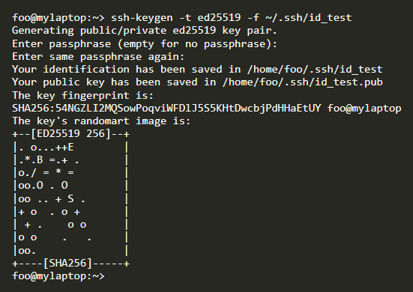
Setup: Connecting via SSH
Generate SSH keys
OpenSSH in terminal (Linux, Mac, Windows PowerShell)
To generate key with OpenSSH execute the following in the terminal (traditionally, the KEYNAME would be ~/.ssh/id_NAME where NAME is a convenient name to help keep track of the key): ssh-keygen -t ed25519 -f KEYNAME
The terminal will ask to enter a passphrase. Choose a secure passphrase that you can remember. The terminal should look like the image on the right.
Note: The private key has no file extension, while the public key is in .pub format.

Slide 13
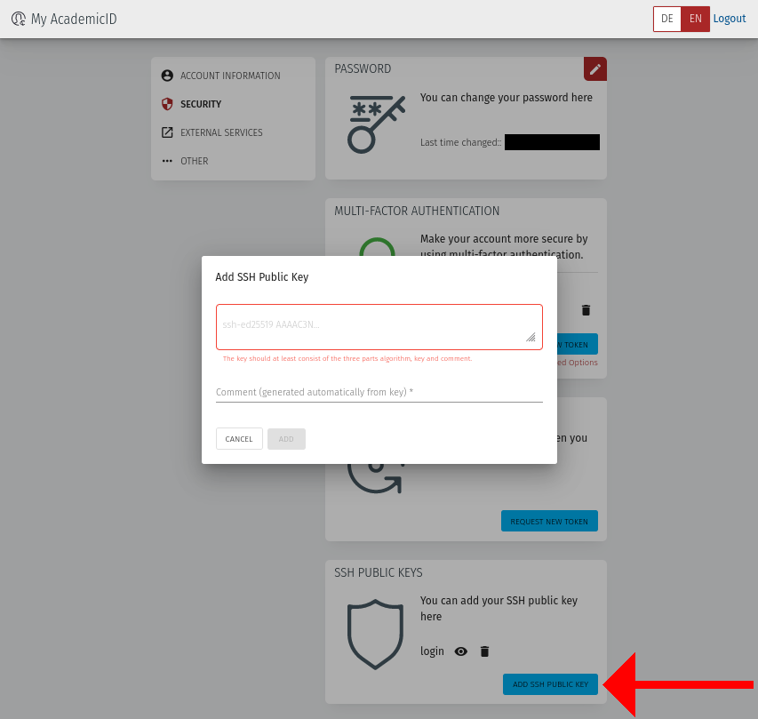
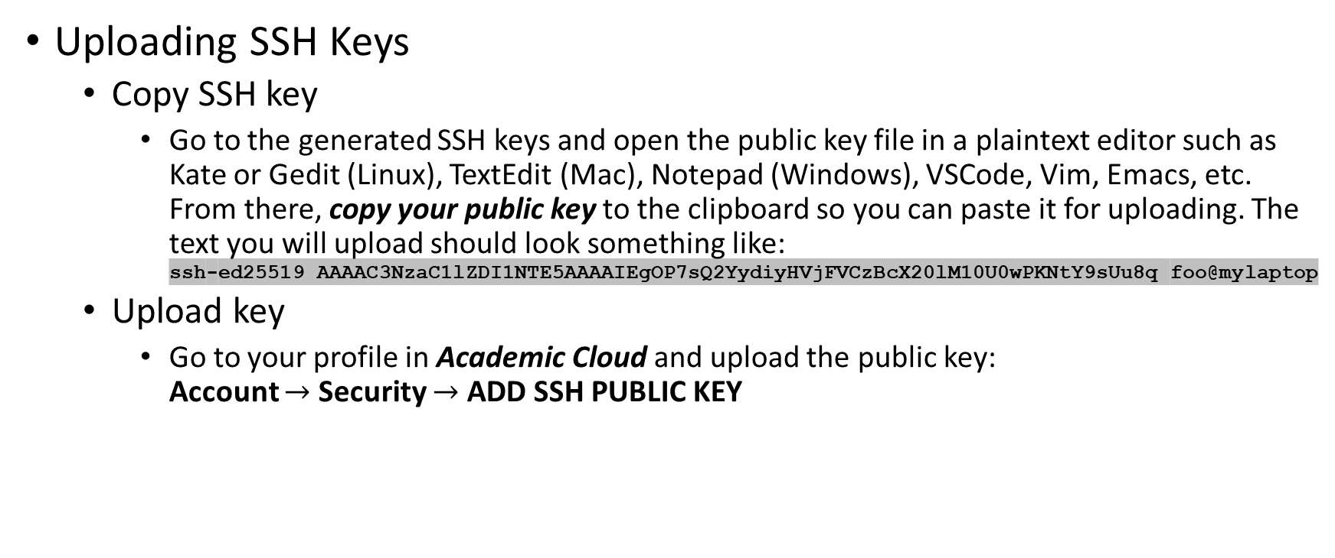
Setup: Connecting via SSH
Uploading SSH Keys
Copy SSH key
Go to the generated SSH keys and open the public key file in a plaintext editor such as Kate or Gedit (Linux), TextEdit (Mac), Notepad (Windows), VSCode, Vim, Emacs, etc. From there, copy your public key to the clipboard so you can paste it for uploading. The text you will upload should look something like: ssh-ed25519 AAAAC3NzaC1lZDI1NTE5AAAAIEgOP7sQ2YydiyHVjFVCzBcX20lM10U0wPKNtY9sUu8q foo@mylaptop
Upload key
Go to your profile in Academic Cloud and upload the public key: Account $→$ Security $→$ ADD SSH PUBLIC KEY

Slide 14
Setup: Connecting via SSH
Configuring SSH
The SSH config file is usually located in your home directory or user profile directory under .ssh/config. If you do not find such a file or directory, create them manually and edit it as shown below using your username.
Linux ~/.ssh/config /home/$USERNAME/.ssh/config
Mac ~/.ssh/config /User/$USERNAME/.ssh/config
Windows %USERPROFILE%\.ssh\config C:\Users\your_username\.ssh\config
Host Emmy-p1
Hostname glogin-p1.hpc.gwdg.de
User u12345
IdentityFile ~/.ssh/id_ed25519
MACs hmac-sha2-512,hmac-sha2-256
Host Emmy-p2
Hostname glogin-p2.hpc.gwdg.de
User u12345
IdentityFile ~/.ssh/id_ed25519
MACs hmac-sha2-512,hmac-sha2-256
Host Emmy-p3
Hostname glogin-p3.hpc.gwdg.de
User u12345
IdentityFile ~/.ssh/id_ed25519
MACs hmac-sha2-512,hmac-sha2-256
Host Grete
Hostname glogin-gpu.hpc.gwdg.de
User u12345
IdentityFile ~/.ssh/id_ed25519
MACs hmac-sha2-512,hmac-sha2-256
Note: The "config" file has no extension!

Slide 15
Setup: Connecting via SSH
Logging In
Logging In using SSH config file
Open the terminal and execute the following command: ssh Grete
Logging In with manual SSH command entry
Open the terminal and execute the following command: ssh u12345@glogin.hlrn.de -i ~/.ssh/id_ed25519
If you get the error Corrupted MAC on input execute the following command: ssh -m hmac-sha2-512,hmac-sha2-256 u12345@glogin.hlrn.de -i ~/.ssh/id_ed25519
Note 1: You’ll be prompted to enter the passphrase.
Note 2: Ensure there is no whitespace between the MACs.
Note 3: Replace "u12345" with your username.
Note 4: Replace "glogin.hlrn.de" with the hostname of the server you want to connect to.
Note 5: Replace "~/.ssh/id_ed25519" with the path to your private SSH key.

Slide 16
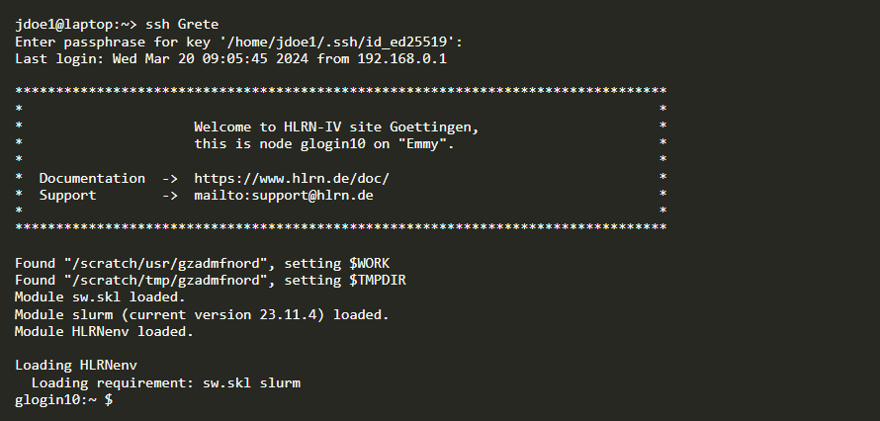
Setup: Connecting via SSH
Logging In Example

Slide 17
Setup: Connecting via SSH
SSH Key Fingerprints
Node(s) | sha256 fingerprint ed25519
login.gwdg.de | pY12krRnUkQ5lHNkRQSD/53wCdLO8gk3Fk82vpLGrp4
transfer.gwdg.de | BLij4wfP5Jh0yCTsPtQN8Vqqt0ULd//IUsuKgZwKC1I
gwdu[101-102,108].gwdg.de | Vylg/10HwDRxPUuOarcngRFH2jmDlnxWOqte7rnR3OI
login-dbn02.hpc.gwdg.de | kZRp6U5PuEXn3nfofp2brld0ZXx+yqIZBrrtmmLi7cE
ngs01.hpc.gwdg.de | yWUzxLXSIfXVuIX164VH8fHix5eNhBwWUr3CMCebQ0Y
glogin[1-10].hpc.gwdg.de | 53WD36v+IjHObgS3DbjIi+zShcQ/MCAIqJNgJOlfR08
glogin[11-13].hpc.gwdg.de | ndaE+nA0BmaAmWXfAai06+uzwSvREcUi06EbdKFEK94

Slide 18
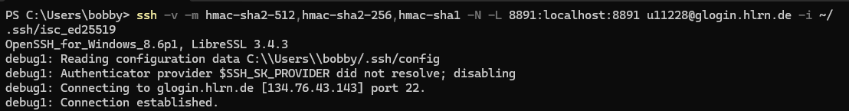
Setup: Connecting via SSH
Set Up SSH Tunnel
OpenSSH in terminal (Linux, Mac, Windows PowerShell)
To create an SSH tunnel, execute the following command in the terminal: ssh -v -N -L 8891:localhost:8891 u11228@glogin.hlrn.de -i ~/.ssh/isc_ed25519
If you get the error Corrupted MAC on input execute the following command: ssh -v -m hmac-sha2-512,hmac-sha2-256 -N -L 8891:localhost:8891 u11228@glogin.hlrn.de -i ~/.ssh/isc_ed25519

Slide 19
Setup: Setting Up and Run a Jupyter Project
Create and Activate Virtual Environment
Navigate to your project directory (or create one) using the terminal
Create a virtual environment
Execute the following command to create a virtual environment named myenv: python3 -m venv myenv
Activate the virtual environment
Linux/Mac: source myenv/bin/activate
Windows: myenv\Scripts\activate

Slide 20
Setup: Setting Up and Run a Jupyter Project
Install Jupyter Notebook and Required Packages
Ensure your virtual environment is activated
Use pip to install Jupyter Notebook and any required packages
Execute the following command to install Jupyter Notebook: pip install jupyter
Run Jupyter Notebook
Run Jupyter Notebook on the server
To run the Jupyter Notebook execute the following command: jupyter notebook
Open Jupyter Notebook on the local browser:
If a new tab does not open automatically in your default web browser, you can manually do so by copying the address provided in the server terminal and pasting it into your web browser's address bar.

Slide 21
Next Steps
Introduction to PyTorch and Profiling (Robert)
Learn how to train machine learning models using PyTorch and optimize their performance with profiling on the provided HPC system
Practical Session (Boris and Robert)
Gain hands-on experience with PyTorch and profiling on the HPC system as you work through guided exercises with expert support

