Slide 1






2025.03
25-1
AI Tutorial
CATS
-03 Error Back Propagation Algorithm
Presenter. Kim Chanu

Slide 2


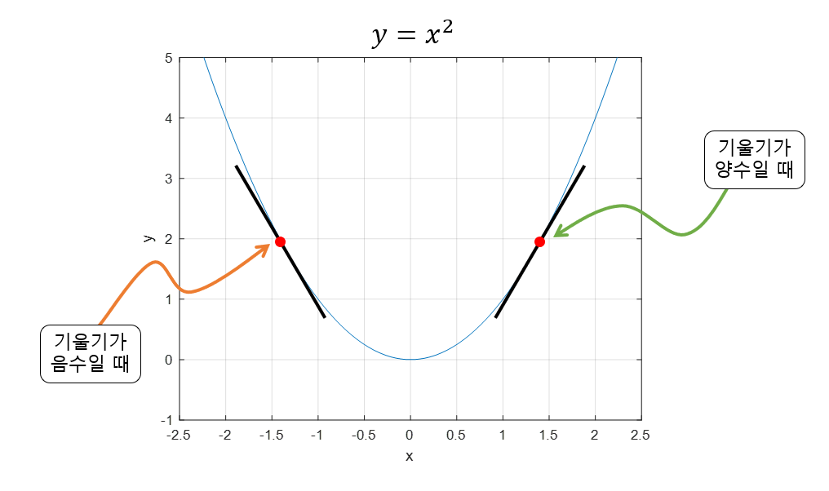
Chapter 03
2025.03
Valid Parameter
Gradient Descent
CATS

Slide 3
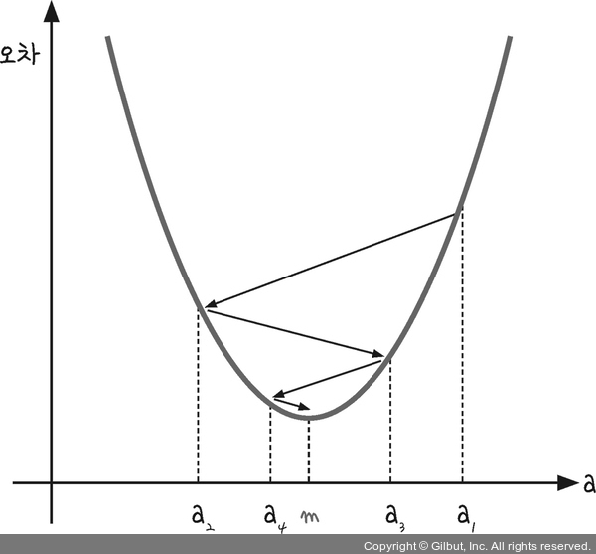
Chapter 03
2025.03
Valid Parameter
Gradient Descent
CATS

Slide 4
Chapter 03
2025.03
Valid Parameter
Gradient Descent
CATS

Slide 5
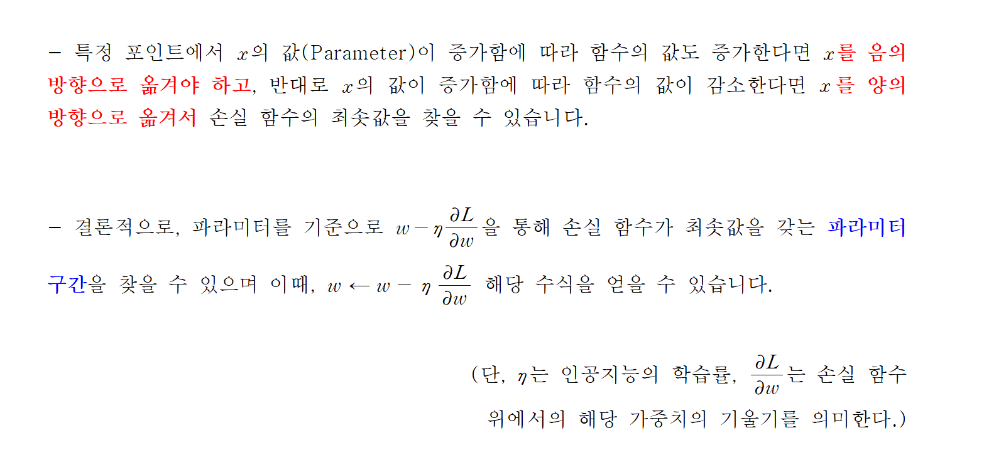
Chapter 03
2025.03
Valid Parameter
Gradient Descent
CATS

Slide 6
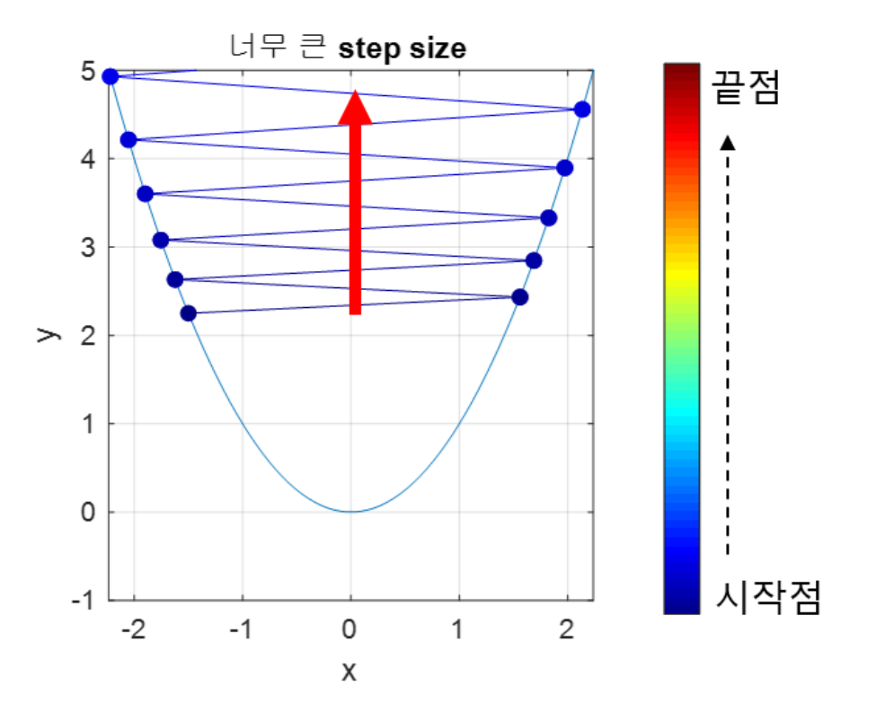
Chapter 03
2025.03
Valid Parameter
Gradient Descent
CATS

Slide 7
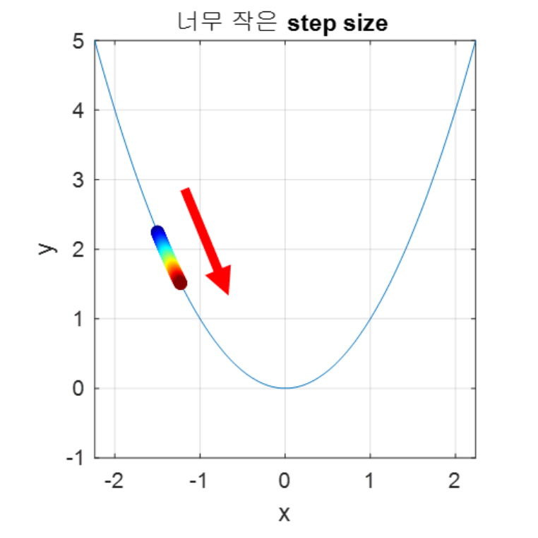
Chapter 03
2025.03
Valid Parameter
Gradient Descent
CATS

Slide 8
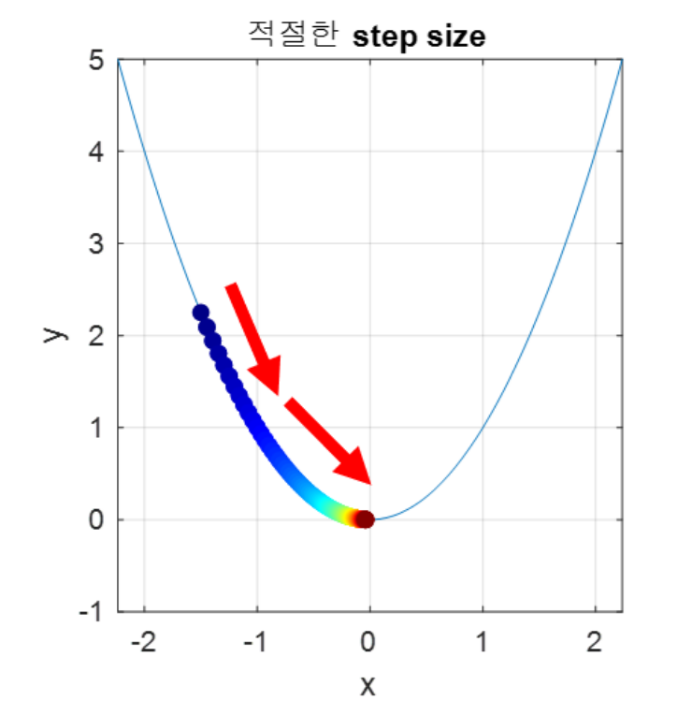
Chapter 03
2025.03
Valid Parameter
Gradient Descent
CATS

Slide 9
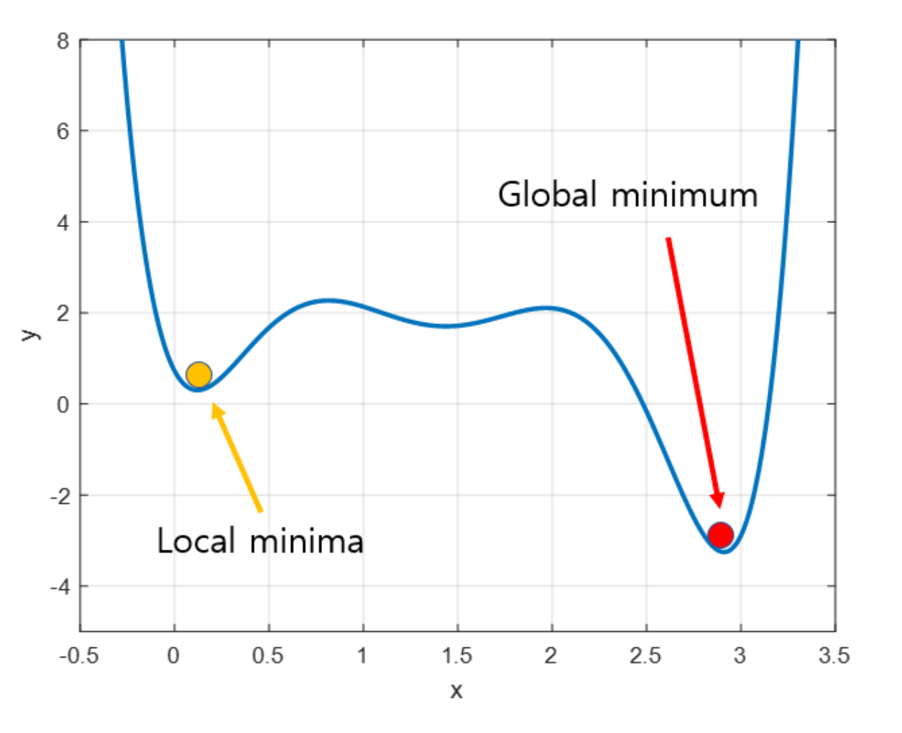
Chapter 03
2025.03
Valid Parameter
Gradient Descent
CATS

Slide 10
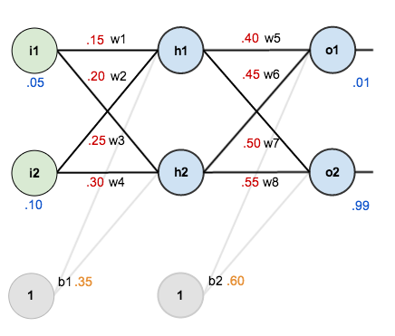
Chapter 03
2025.03
Weights Optimization
Error Back Propagation
CATS

Slide 11

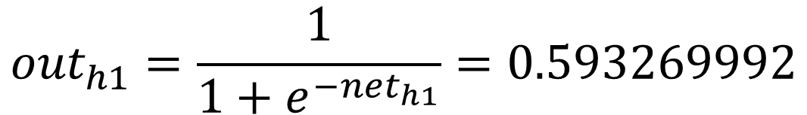
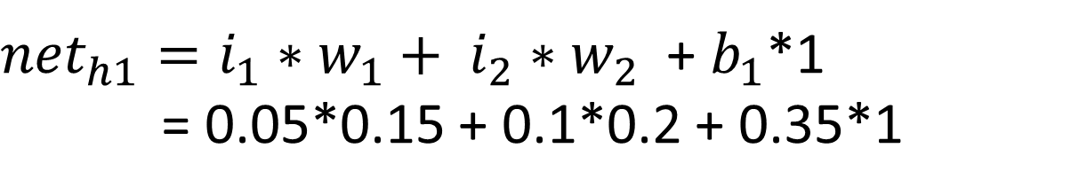
Chapter 03
2025.03
Error Back Propagation
Feed Forward
${net}_{h1}=i_{1}∗w_{1}+ i_{2}∗w_{2}$ + $b_{1}$*1
= 0.05*0.15 + 0.1*0.2 + 0.35*1
CATS
$${out}_{h1}=\frac{1}{1+e^{−{net}_{h1}}}=0.593269992$$
$${out}_{h2}=0.596884378$$
$${out}_{o1}=0.751365070$$
$${out}_{o2}=0.772928465$$

Slide 12
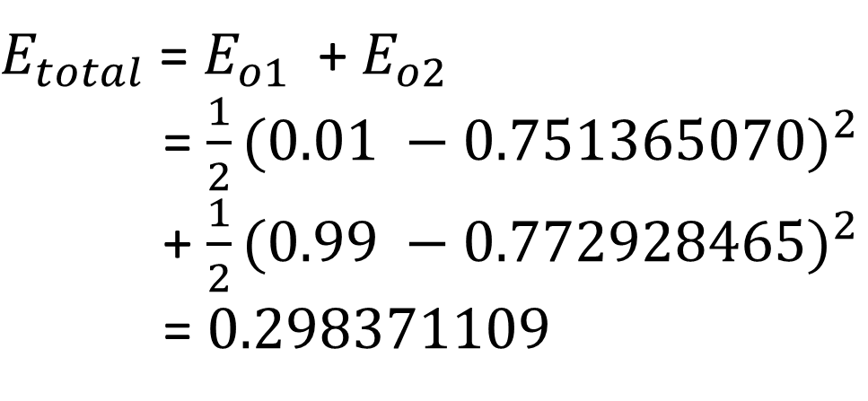
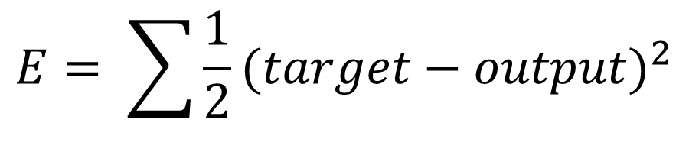
Chapter 03
2025.03
Error Back Propagation
Error
$$E= \sum{\frac{1}{2}{(target−output)}^{2}}$$
CATS
$E_{total}$ = $E_{o1}$ + $E_{o2}$
= $\frac{1}{2}{(0.01 −0.751365070)}^{2}$
+ $\frac{1}{2}{(0.99 −0.772928465)}^{2}$
= $0.298371109$

Slide 13
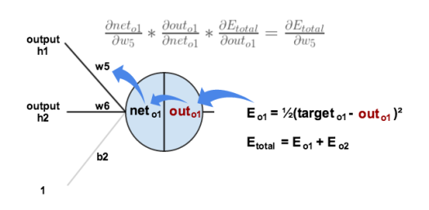
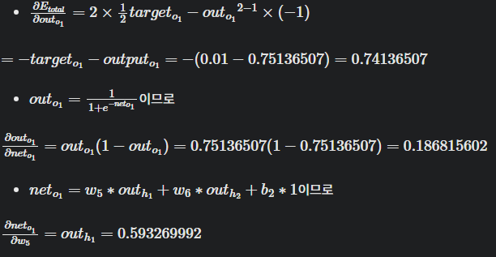
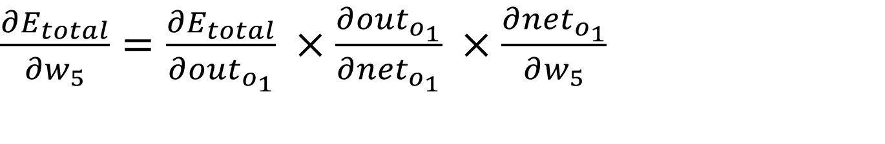
Chapter 03
2025.03
Error Back Propagation
Back-Propagation
$\frac{∂E_{total}}{∂w_{5}}=\frac{∂E_{total}}{∂{out}_{o_{1}}} ×\frac{∂{out}_{o_{1}}}{∂{net}_{o_{1}}} ×\frac{∂{net}_{o_{1}}}{∂w_{5}}$
CATS

Slide 14


Chapter 03
2025.03
Error Back Propagation
Back-Propagation
$\frac{∂E_{total}}{∂w_{5}}=\frac{∂E_{total}}{∂{out}_{o_{1}}} ×\frac{∂{out}_{o_{1}}}{∂{net}_{o_{1}}} ×\frac{∂{net}_{o_{1}}}{∂w_{5}}$
CATS

Slide 15
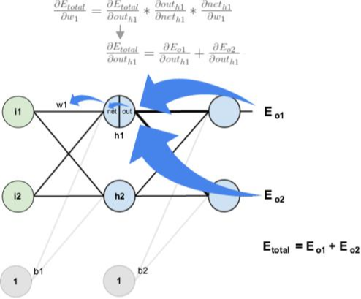



Chapter 03
2025.03
Error Back Propagation
Back-Propagation
CATS

Slide 16
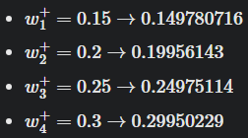
Chapter 03
2025.03
Error Back Propagation
Back-Propagation
CATS

Slide 17
Chapter 03
2025.03
Error Back Propagation
Back-Propagation
CATS
Epoch 1) E : 0.298371109 -> 0.291027924
.
.
.
Epoch 10000) E : 0.0000351084

Slide 18
2025.03
Thank You!
CATS
Presenter
Kim Chanu

