Slide 1






2025.03
25-1
AI Tutorial
CATS
-02 Multi Layer Perceptron-
Presenter. Kim Chanu

Slide 2



















Chapter 02
2025.03
What a Perceptron does
Multi Layer Perceptron
$$x_{1}$$
$$w_{1}$$
$$x_{2}$$
$$(a, b)$$
CATS
$$w_{2}$$
$$(c, d)$$
$$x_{2}$$
$$Σ$$
$$f$$
$$y$$
$$(e, f)$$
$$x_{1}w_{1}+x_{2}w_{2}+w_{3}=0$$
$$w_{3}$$
Perceptron
$$0$$
$$x_{1}$$
$$1$$
Linear Separable

Slide 3





Chapter 02
2025.03
AND Operation
$$x_{2}$$
Multi Layer Perceptron
$$1$$
$$x_{1}$$
$$w_{1}$$
$$0$$
$$x_{1}$$
CATS
$$w_{2}$$
$w_{1}=1.0$, $w_{2}=1.0$, $w_{3}=−1.5$
$$x_{1}$$ | $$x_{2}$$ | $$Σ$$ | $$y$$
0 | 0 | -1.5 | 0
0 | 1 | -0.5 | 0
1 | 0 | -0.5 | 0
1 | 1 | 0.5 | 1
$$x_{2}$$
$$Σ$$
$$f$$
$$y$$
$$w_{3}$$
Perceptron
$$1$$

Slide 4


Chapter 02
2025.03
OR Operation
$$x_{2}$$
Multi Layer Perceptron
$$1$$
$$x_{1}$$
$$w_{1}$$
$$0$$
$$x_{1}$$
CATS
$$w_{2}$$
$w_{1}=1.0$, $w_{2}=1.0$, $w_{3}=−0.5$
$$x_{1}$$ | $$x_{2}$$ | $$Σ$$ | $$y$$
0 | 0 | -0.5 | 0
0 | 1 | 0.5 | 1
1 | 0 | 0.5 | 1
1 | 1 | 1.5 | 1
$$x_{2}$$
$$Σ$$
$$f$$
$$y$$
$$w_{3}$$
Perceptron
$$1$$

Slide 5



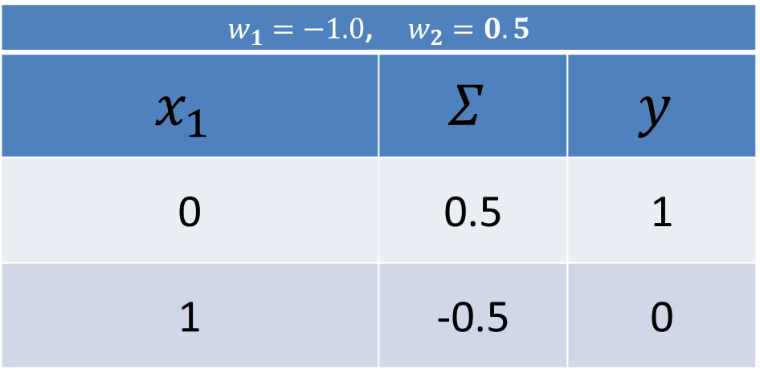
Chapter 02
2025.03
NOT Operation
Multi Layer Perceptron
$$x_{1}$$
$$w_{1}$$
$$x_{1}$$
CATS
$$0$$
$$1$$
$$Σ$$
$$f$$
$$y$$
$w_{1}=−1.0$, $w_{2}=0.5$
$$x_{1}$$ | $$Σ$$ | $$y$$
0 | 0.5 | 1
1 | -0.5 | 0
$$w_{2}$$
Perceptron
$$1$$

Slide 6






















Chapter 02
2025.03
Non-Linery Separable
Multi Layer Perceptron
$$x_{1}$$
$$y_{1}$$
$$w_{11}$$
$$Σ$$
$$f$$
$$w_{12}$$
$$w_{31}$$
CATS
$$w_{13}$$
$$x_{2}$$
$$Σ$$
$$f$$
$$y$$
$$w_{21}$$
$$w_{32}$$
$$y_{2}$$
$$w_{22}$$
$$Σ$$
$$f$$
$$w_{33}$$
$$w_{23}$$
$$1$$
$$1$$

Slide 7


































$$x_{1}$$
$$y_{1}$$
$$w_{11}$$
Chapter 02
$$w_{12}$$
$$Σ$$
$$f$$
$$w_{31}$$
2025.03
$$w_{13}$$
Non-Linery Separable
$$x_{2}$$
$$w_{32}$$
$$Σ$$
$$f$$
$$y$$
$$w_{21}$$
$$y_{2}$$
Multi Layer Perceptron
$$w_{22}$$
$$Σ$$
$$f$$
$$w_{33}$$
$$w_{23}$$
$$1$$
$$x_{2}$$
$$x_{2}$$
$$1$$
$$y_{2}$$
$$1$$
$$1$$
$$1$$
CATS
$$x_{1}$$
$$x_{1}$$
$$y_{1}$$
$w_{11}=1.0$, $w_{12}=1.0$, $w_{13}=−1.5$
$$x_{1}$$ | $$x_{2}$$ | $$Σ$$ | $$y_{1}$$
0 | 0 | -1.5 | 0
0 | 1 | -0.5 | 0
1 | 0 | -0.5 | 0
1 | 1 | 0.5 | 1
$w_{21}=1.0$, $w_{22}=1.0$, $w_{23}=−0.5$
$$x_{1}$$ | $$x_{2}$$ | $$Σ$$ | $$y_{2}$$
0 | 0 | -0.5 | 0
0 | 1 | 0.5 | 1
1 | 0 | 0.5 | 1
1 | 1 | 1.5 | 1
$w_{31}=1.0$, $w_{32}=−1.0$, $w_{33}=−0.5$
$$y_{1}$$ | $$y_{2}$$ | $$Σ$$ | $$y$$
0 | 0 | -0.5 | 0
0 | 1 | 0.5 | 1
0 | 1 | 0.5 | 1
1 | 1 | -0.5 | 0

Slide 8














Chapter 02
2025.03
Structure of Multi-layer Perception
Multi Layer Perceptron
Neural Network -> can compute all kinds of functions
Feed-Forward Network, Layered Structure
Boolean Function : 2-layer
Continuous Function : 2-layer
Arbitary Function : 3-layer
Why Do We Need DN(over 5-layer)?
$$w_{ij}$$
$$w_{jk}$$
$$x_{1}$$
$$y_{1}$$
CATS
$$x_{1}$$
$$y_{2}$$
$$…$$
$$…$$
$$…$$
$$x_{m}$$
$$y_{n}$$
$$input layer$$
$$hidden layer$$
$$output layer$$

Slide 9
2025.03
Thank You!
CATS
Presenter
Kim Chanu

