Slide 1

Predicting suitable locations to open new cuisine restaurants.

Slide 2
Business Problem
In order to open a new restaurant, the owner need to assess the localities in a city to get insights about the different kind of possibilities, like a suitable
location along with the type of cuisine that will be served in the restaurant.
So the problem is to find out a suitable locality to start new restaurants alongwith the proper choice of cuisine to be served at each restaurant.

Slide 3
Things to keep in mind.
u Generally restaurants are opened with keeping the locality in mind.
u Restaurant should not be opened in an area where too many restaurants are already present.
u What kind of cuisine will be served also need to be picked wisely.
u Predicting suitable location helps the owner to target location to acquire.
u What restaurants in your area are successful and which are failures.
u Foodies have interest as well.

Slide 4
Data Acquisition
u The dataset `zomato.csv` is downloaded from Kaggle dataset.
u Restaurant, City, Locality, Type of Cuisine served alongwith Price Range and Rating are the major columns for consideration.
u Latitude & Longitude for each restaurant are also available in the dataset.
u In total, 9551 rows and 21 columns.

Slide 5
Data Cleaning
u For sake of simplicity only data for city=‘Gurgaon’ is considered and rest of the data is dropped.
u Duplicate, highly similar or highly correlated features were dropped.
u For example- Rating, Rating Color and Rating text all conveys the same
information therefore any two of these columns can be dropped without any loss of information.

Slide 6


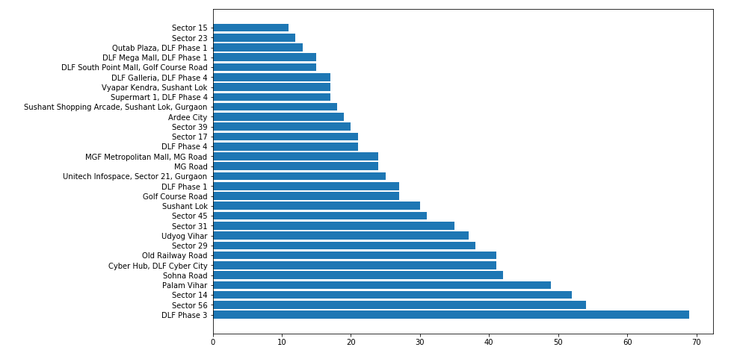


Different localities in Gurgaon

Slide 7
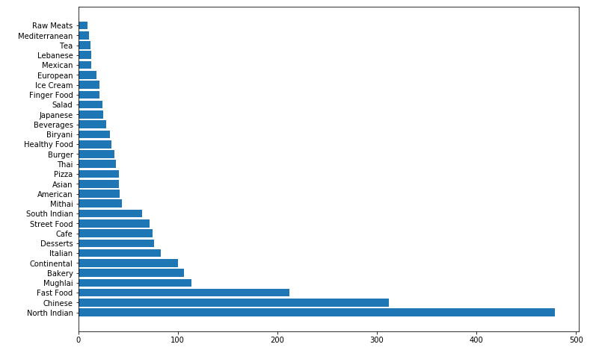
Most famous kind of cuisines

Slide 8
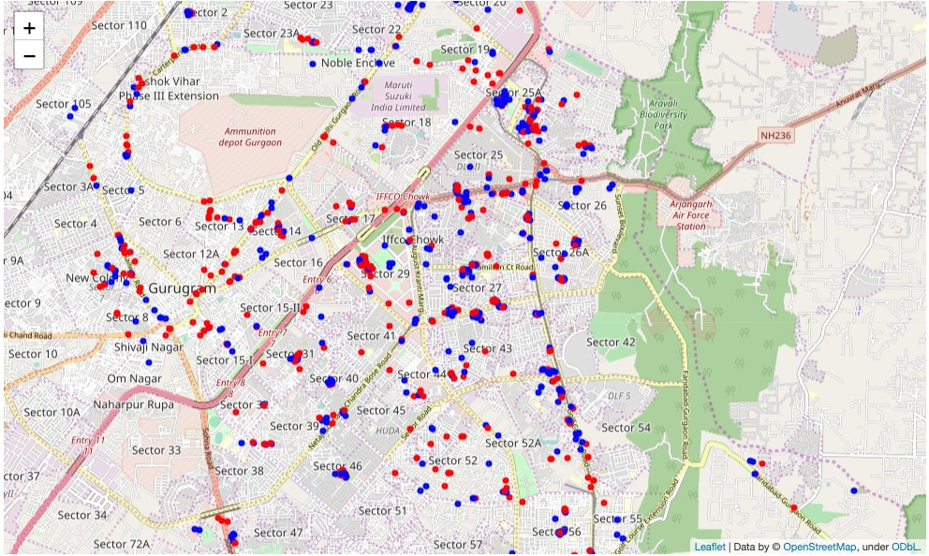
North Indian restaurants (in red)

Slide 9
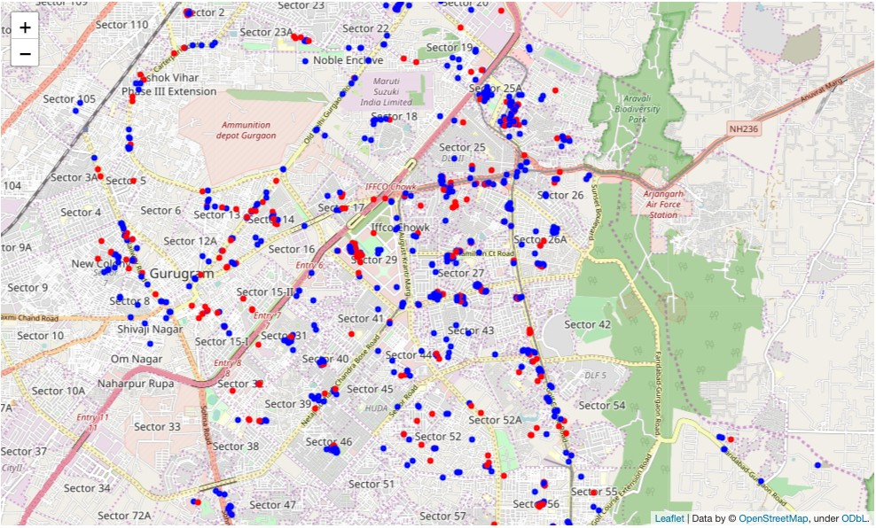
Chinese restaurants (in red)

Slide 10
Final Observations
As per the observations from the notebook. Following predictions can be made:
u Cafe can be opened in 'Palam Vihar'
u Chinese Restaurant in 'Cyber Hub'
u Pizza Store on 'Sohna Road'
u Street Food at 'Old Railway Road'
u Fast Food Centre in 'Sector 29'

