Slide 1
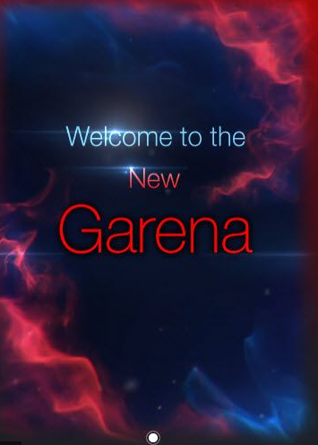

Garena
sydrem
>
Remember Password
LOGIN
CREATE ACCOUNT
Forgot Password?
English
>

Slide 2


