Slide 1
Version Control: git
A complete history of your work

Slide 2
What is version control?
A tool to:
Back-up files
Save history of changes
Collaborate and combine changes
But it isn’t magic...
You have to know how to use it
You have to make it part of your work flow

Slide 3
Why version control?
Case Studies:
Know what changes you made when
Avoid files named ..._final_final2
Your code used to work and now it doesn‘t
Make your process transparent to others
Make your code easy

Slide 4
How? The Structure of Git
Local repository - track your own changes
Working Directory
Staging Area
Local Repository
Create or modify a file
start tracking changes in a file
with ‘git add’
save snapshot of mini file system with ‘git commit’
Parse.py
Really_big_data_file.fasta
Manuscript.doc
Intermediate_file.bwt
Parse.py
Manuscript.doc
Parse.py
Manuscript.doc
Notes:
Lots of different types of version control, we are using git. Git has become very common in recent years
Staging area: items to go in your next commit. Only changes to files in your staging area will be added to your local repository
Repository: permanant storage

Slide 5
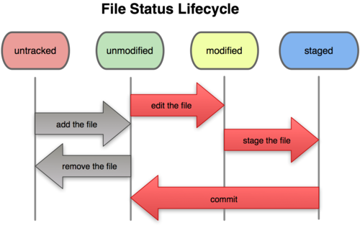
Local Workflow

Slide 6
Basic git workflow
git init - create a repository in a given directory

Slide 7
Basic git workflow
git status - find the state of every file

Slide 8
Basic git workflow
git add filename or directory - add file to list of files to be committed to local repository. This is also referred to as staging the files

Slide 9
Basic git workflow
git commit commit all stage changes to the local repository

Slide 10
Step 0: Configuring Git
git config --global user.name "User Name“
git config --global user.email "user@email.com"
Selecting the default editor
Windows
git config --global core.editor "'C:/Program Files (x86)/Notepad++/notepad++.exe' -multiInst -notabbar -nosession -noPlugin"
Mac
git config --global core.editor "edit -w"
Linux
git config --global core.editor <your favorite editor here (nano, emacs, etc etc)>

Slide 11
Exercise 1: Our first Repo
Create a new repository (don’t forget to make a new directory!)
Create a file named README containing the text:
My first git repository!
Commit README to your local repository
Working Directory
Staging Area
Local Repository
start tracking changes in a file
save snapshot of mini file system

Slide 12
More git commands
git checkout <object>
Can be a
Branch
Tag
Can also be used to revert changes to a file
git mv
Tell git you’re moving a file
git rm <file>
Remove a file
Use with –cached to untrack a file

Slide 13
Exercise 2: Dealing with accidents
Copy 01-shell/data/Bert/audioresult-00215 to your repository and “accidently” add it
Unstage it from the commit
“Accidently” overwrite/delete README
Restore it from the latest version

Slide 14
(Even) more git commands
git log
View the commit history
git diff
View differences
Between files
Between revisions
Between branches

Slide 15
Exercise 3: Seeing the history
Add some text to README
Look at the difference between your current README and the latest version in your repo
Copy the hello.py script from 02-python-variables to your repository
Commit both files
View the history for your repository
Move hello.py to 02_python_solution.py and commit
Look at the log again
Delete hello.py from the repository and commit the changes
Look at the log again to see what’s changed

Slide 16
Branching
Why: try new code without messing up working version
branch: version of file that can be modified without affecting the working version of the code
HEAD: points to current branch
master: default branch name

Slide 17
Branching
testing:
test_file
testing:
test_file
modify test_file
branch
master:
test_file
master:
test_file
http://pcottle.github.io/learnGitBranching/?NODEMO

Slide 18
Git (branching) commands
git branch <name>
create a branch called <name>
git branch
tells you which branch you are on using *
git checkout <name>
switch to <name> branch

Slide 19
Exercise 6: Branching
Create a branch and switch to it
Make a change to an EXISTING LINE in README
Commit the change
Compare the two version of README
Via checking out master
Extra credit: Via git diff

Slide 20
Merging
Checkout the branch you want to merge into
git merge <other branch>
No conflicts? awesome
Conflicts?
Edit files to resolve conflicts
Add
Commit
git branch –d <branch name>
Deletes the branch
git branch -d branch_name - deletes branch

Slide 21
Merging
testing:
test_file
testing:
test_file
testing:
test_file
modify test_file
merge
branch
master:
test_file
master:
test_file
master:
test_file
master:
test_file
http://pcottle.github.io/learnGitBranching/?NODEMO

Slide 22
Exercise 7
Merge the branch you created in exercise 6 in to the master branch
Resolve the conflict

