Slide 1
ROCK PAPER SCISSORS GAME
MEMBERS LIST:
CABALLERO
HECHANOVA
LEONO
PEREGRINO
TORRICO
A Mini Project Presentation for ITE 260 (Computer Programming 1)

Slide 2
DESCRIPTION:
Digital console adaptation of the traditional Rock Paper Scissors game.
Single-player terminal workspace against an automated computer opponent.
Built entirely on basic user controls, string arrays, and logic branches.
Features text normalization methods to process inputs cleanly.
Highlights fundamental programming building blocks for ITE 260.

Slide 3
OBJECTIVES:
General Objective
  To develop a fully functional Rock Paper Scissors terminal game application.
Specific Objectives
  Input Array Mapping: Establish a validation system to check string entries against the choices list variable.
  Unpredictable AI Opponent: Program an automated computer choice using the random.choice library module.
  Conditional Evaluation Matrix: Design a structured if/elif/else decision tree to resolve game rules.
  Continuous Replay Management: Implement a dynamic control loop (while player == "y") to maintain ongoing game rounds.

Slide 4
Scope and Limitations
The scope of our project focuses on the core mechanics of a standard Rock Paper Scissors match between a player and a computer. The application runs locally on a computer terminal and processes one round after another until the player decides to exit.
LIMITATIONS:
the program uses local memory, meaning all high scores and match histories are completely reset every time you close the application. It also does not support online multiplayer or advanced graphics since it is built purely to test our core programming fundamentals. Lastly, the AI opponent does not learn from the player's habits and relies purely on random selection.

Slide 5
SOURCE CODE:
import random
choices=["rock","paper","scissors"]
print("WELCOME TO ROCK PAPER SCISSORS!")
player=input("Do you want to play?y/n: ")
while player=="y":
player=input("choose rock,paper,scissors: ").lower()
if player not in choices:
print("invalid choice!please choose rock,paper,or scissors.")
else:
computer = random.choice (choices)
print ("computer choose:",computer)
if player == computer:
print("It's a draw!")
elif player == "rock" and computer == "scissors":
print("You win!")
elif player == "paper" and computer == "rock":
print("You win!")
elif player == "scissors" and computer == "paper":
print("You win!")
else:
print("Computers win!")
player = input ("Do you want to play again? y/n: ").lower()
print("Thanks for playing?")

Slide 6
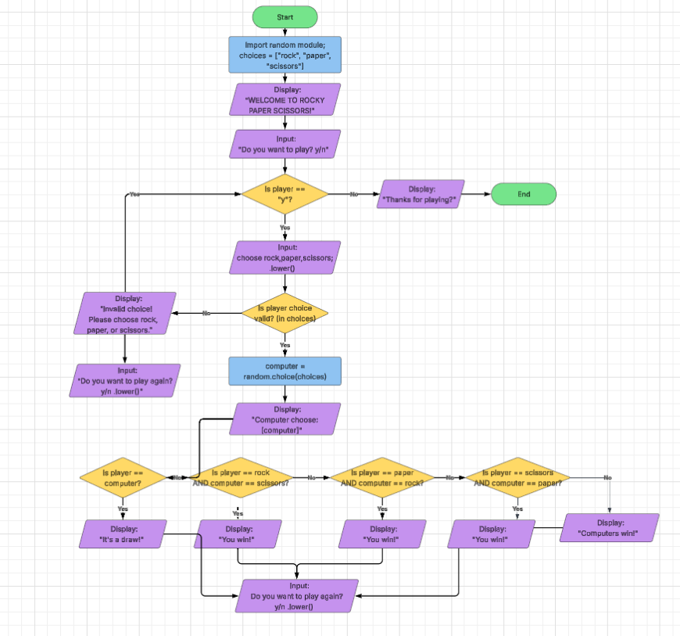
FLOW CHART

