Slide 1
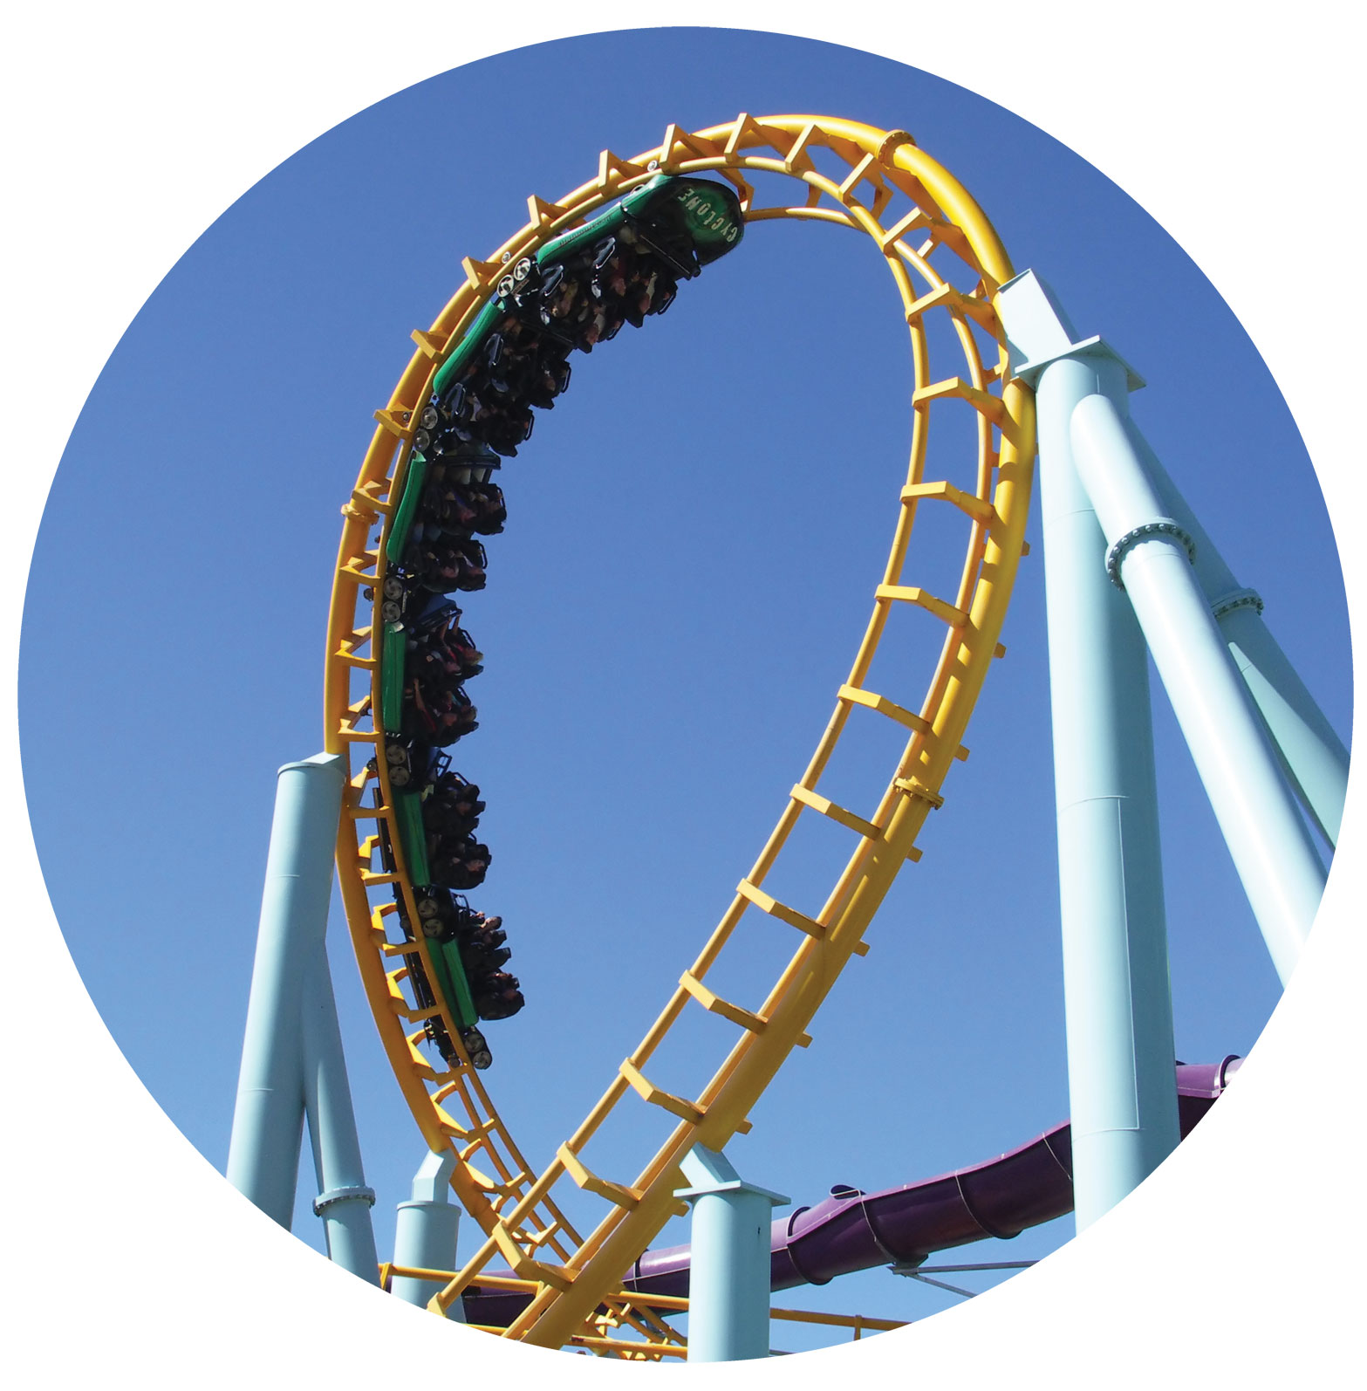
Up Around the Circular Flow
GDP

Slide 2
Nominal GDP value at current prices of all final products and services produced annually in a country
Nominal GDP₁₉₃₅
Nominal GDP₂₀₁₃
P^{A}₁₉₃₅ Q^{A}₁₉₃₅ + P^{B}₁₉₃₅ Q^{B} ₁₉₃₅
+ P^{C}₁₉₃₅ Q^{C} ₁₉₃₅ +… P^{Z}₁₉₃₅ Q^{Z} ₁₉₃₅
=
P^{A}₂₀₁₃ Q^{A} ₂₀₁₃ + P^{B}₂₀₁₃ Q^{B} ₂₀₁₃
+ P^{C}₂₀₁₃ Q^{C} ₂₀₁₃ +… P^{Z}₂₀₁₃ Q^{Z} ₂₀₁₃
=

Slide 3
Differences in nominal GDP between years due to price changes or quantity changes
GDP includes products and services produced within a country’s borders, no matter what the nationality of the business doing the producing
GDP is a flow amount per unit of time
Stock fixed amount at a moment in time

Slide 4
Real GDP value at constant prices of all final products and services produced annually in a country.
Real GDP₁₉₃₅
Real GDP₂₀₁₃
P^{A}₂₀₀₂ Q^{A} ₁₉₃₅ + P^{B}₂₀₀₂ Q^{B} ₁₉₃₅
+ P^{C}₂₀₀₂ Q^{C} ₁₉₃₅ +… P^{Z}₂₀₀₂ Q^{Z} ₁₉₃₅
=
P^{A}₂₀₀₂ Q^{A} ₂₀₁₃ + P^{B}₂₀₀₂ Q^{B} ₂₀₁₃
+ P^{C}₂₀₀₂ Q^{C} ₂₀₁₃ +… P^{Z}₂₀₀₂ Q^{Z} ₂₀₁₃
=
Differences in real GDP between years show only changes in quantities

Slide 5
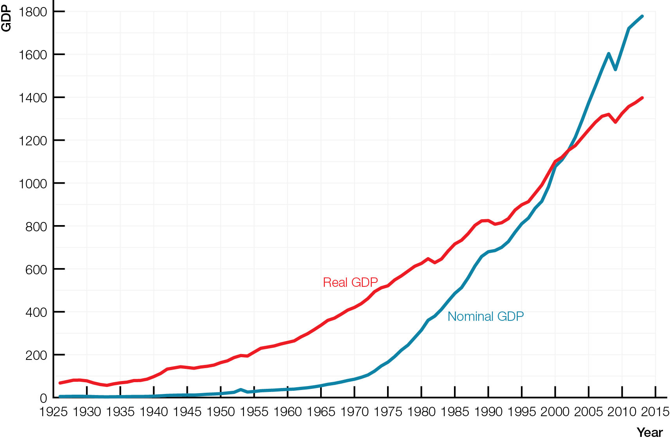
Nominal GDP and Real GDP, 1926 - 2013

Slide 6
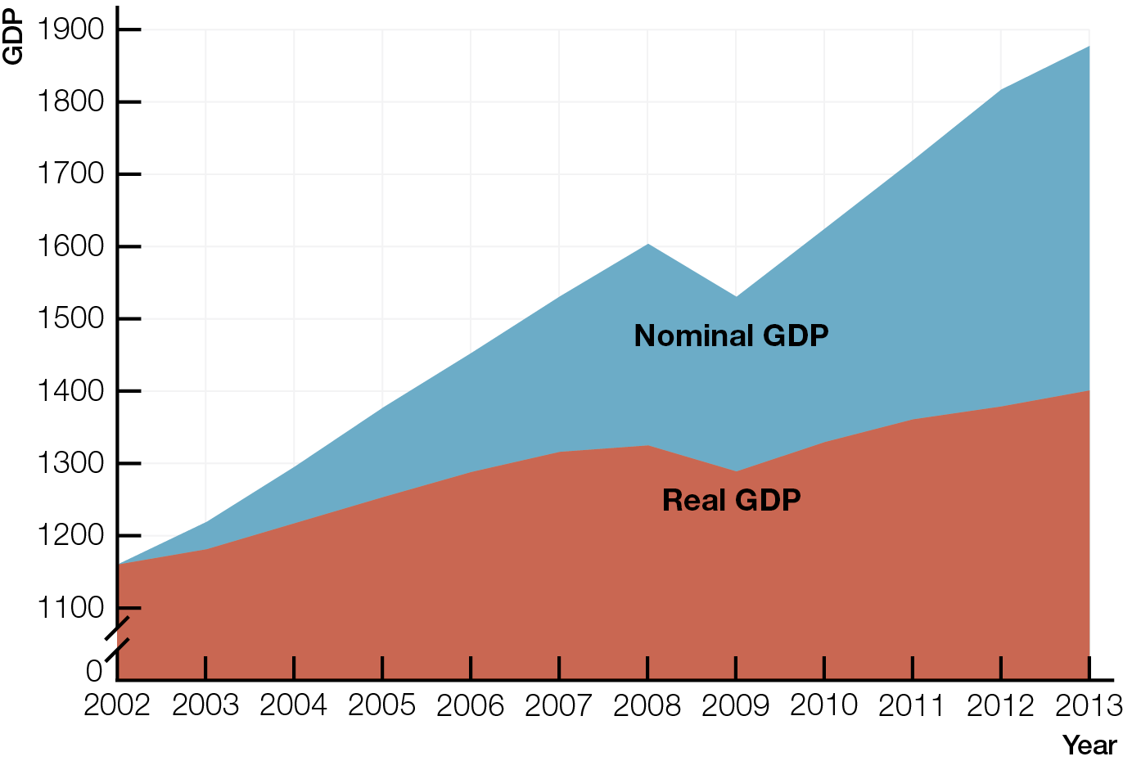
Nominal GDP and Real GDP, 2002-2013

Slide 7
Real GDP per person real GDP divided by population
Real GDP per person is the best measure of material standard of living

Slide 8
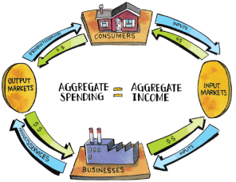
VALUE ADDED AND THE ENLARGED CIRCULAR FLOW
Value added solves the problems of double counting and distinguishing final and intermediate products and services, and shows how aggregate spending equals aggregate income in circular flow diagrams.

Slide 9
Final product or service consumed directly by consumers
Intermediate product or service input bought from other businesses
Value added value of output minus the value of intermediate products and services bought from other businesses

Slide 10
Value added solves the problems of double counting and of distinguishing between final and intermediate products and services
Value of final products and services = value added
Value of final products and services (GDP) = input’s income

Slide 11
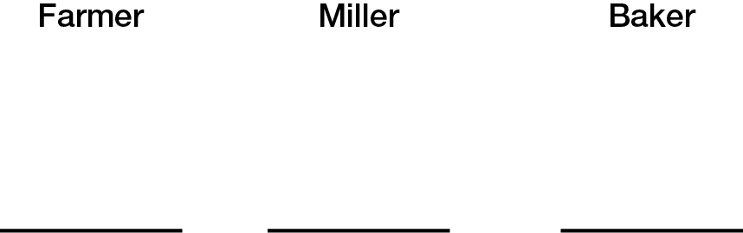
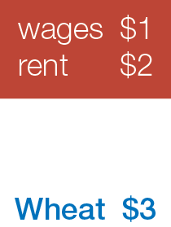
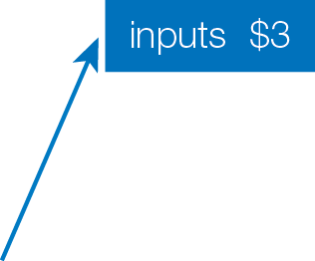
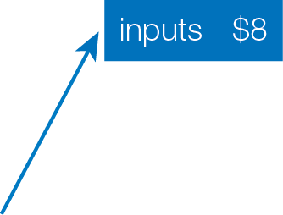
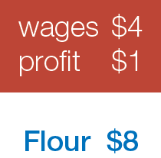
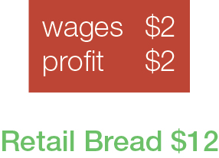



Value Added Equals Value of Final Products and Services

Slide 12
Value of final products & services = value added
Value of final products & services = input’s income
GDP can be calculated using either half of the circular flow
aggregate spending (GDP) = aggregate income (Y)
spending on final = payments to input owners products and services

Slide 13
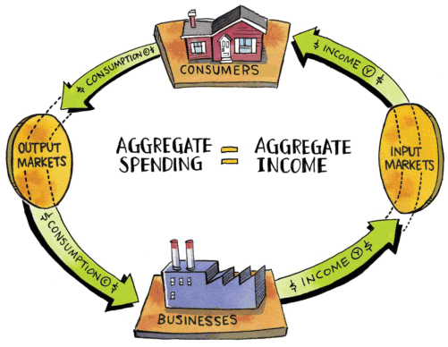
Simple GDP Circular Flow of Income and Spending

Slide 14
Flows of spending on the enlarged circular flow
C — consumption spending by consumers
I — business investment spending on factories and machines made by businesses
G — government spending on products and services
X — spending by the rest of the world (R.O.W.) on Canadian exports of products and services.
IM — Canadian spending on imports of products and services produced by the rest of the world

Slide 15
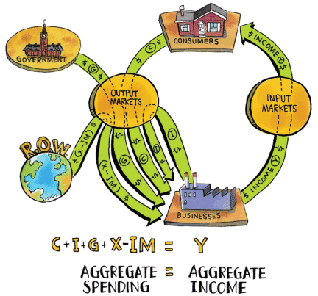
Enlarged GDP Circular Flow of Income and Spending

Slide 16
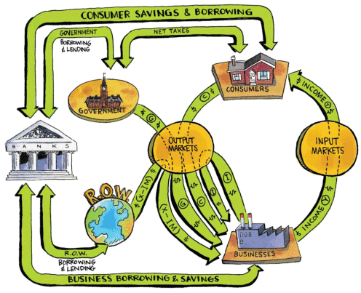
Enlarged GDP Circular Flow of Income and Spending with Banking System

Slide 17
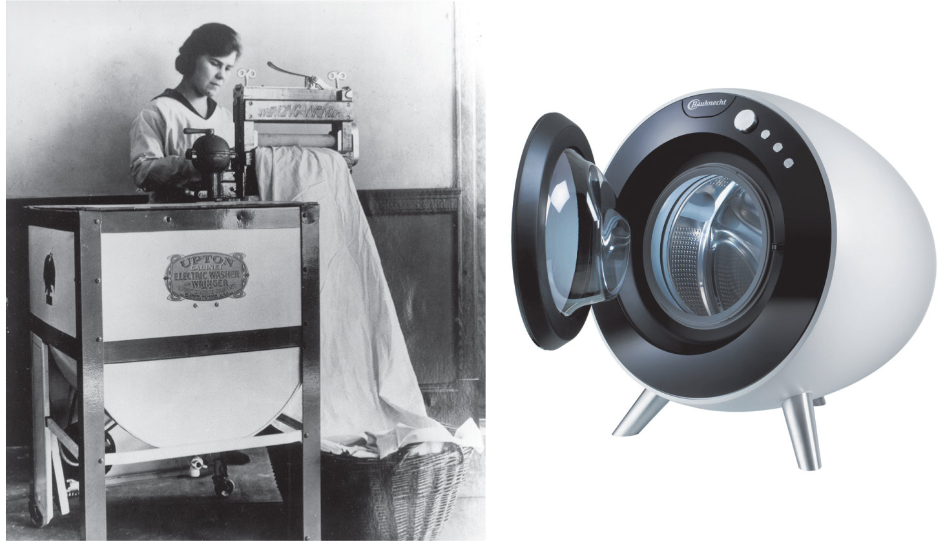
POTENTIAL GDP AND ECONOMIC GROWTH
By increasing the quantity and quality of inputs, economic growth increases productivity and potential GDP per person, raising maximum possible living standards.

Slide 18
Potential GDP real GDP when all inputs fully employed — labour, capital, land/resources, entrepreneurship
Short-run goal for economic performance
Outcome if invisible hand works perfectly
Potential GDP per person potential GDP divided by the population
Short-run maximum possible living standards for an economy

Slide 19
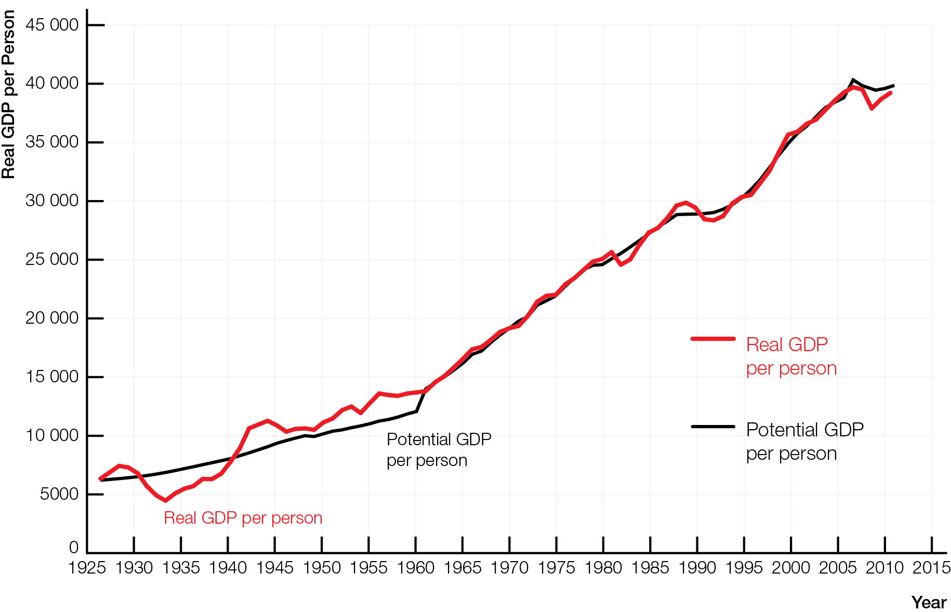
Potential GDP per Person and Real GDP per Person, 1926 - 2011

Slide 20
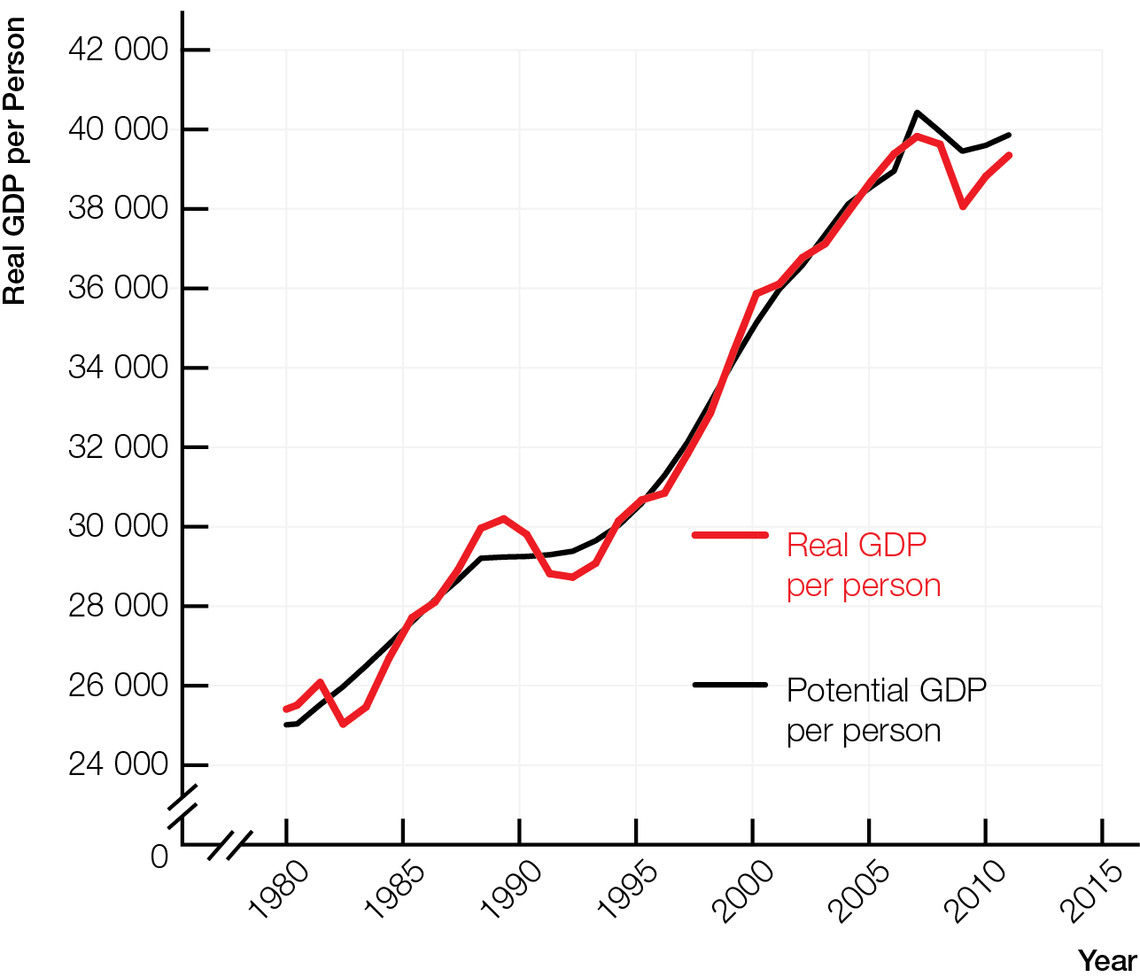
Potential GDP per Person and Real GDP per Person, 1980 - 2011

Slide 21
Economic growth expansion of economy’s capacity to produce products and services; increase in potential GDP (per person)
Macro production possibilities frontier (PPF) shows maximum combinations of products and services a country can produce when all inputs fully employed
On macro PPF, all inputs fully employed; economy producing at potential GDP
Inside macro PPF, some inputs unemployed; economy producing below potential GDP

Slide 22
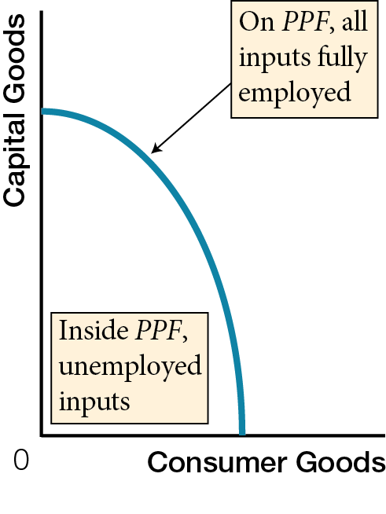
Macro Production Possibilities Frontier

Slide 23
Economic growth increases potential GDP (per person)
Shifts macro PPF outward
Caused by increases in the quantity or quality of a country’s inputs, including technological change

Slide 24
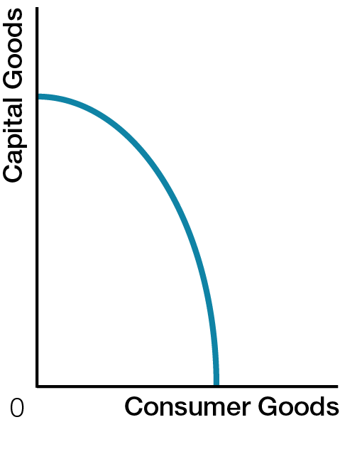
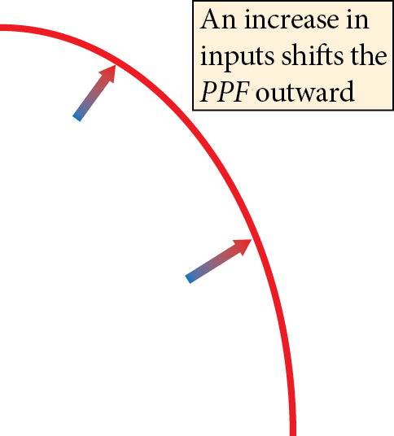
Economic Growth

Slide 25
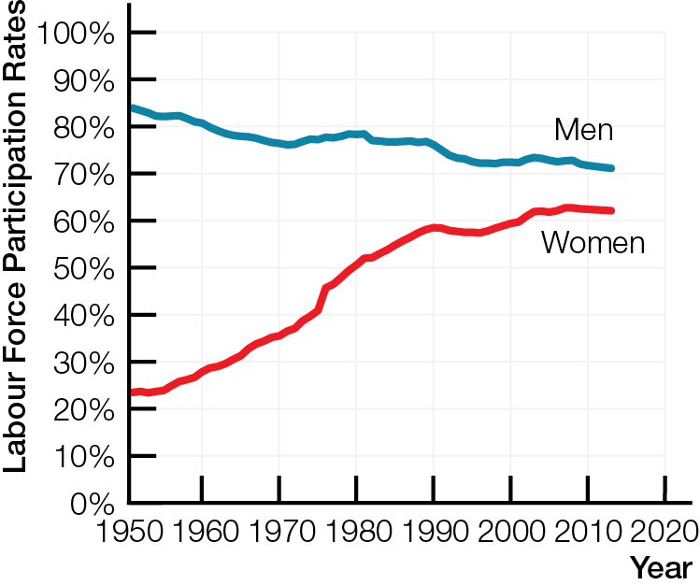
Increases in labour
Quantity — population growth, immigration, labour force participation rate
Quality — increases in human capital — increased earning potential from work experience, on-the-job training, education

Slide 26
Increases in capital
Quantity — more factories and equipment
Quality — technological change — improvements in quality of capital through innovation, research, development
Increases in land and resources
Quantity — bringing land and resources not connected to markets into the circular flow
Quality — due to increases in capital used with land
Increases in entrepreneurship
Quantity and quality interrelated
Better management techniques, organization, worker/management relations

Slide 27
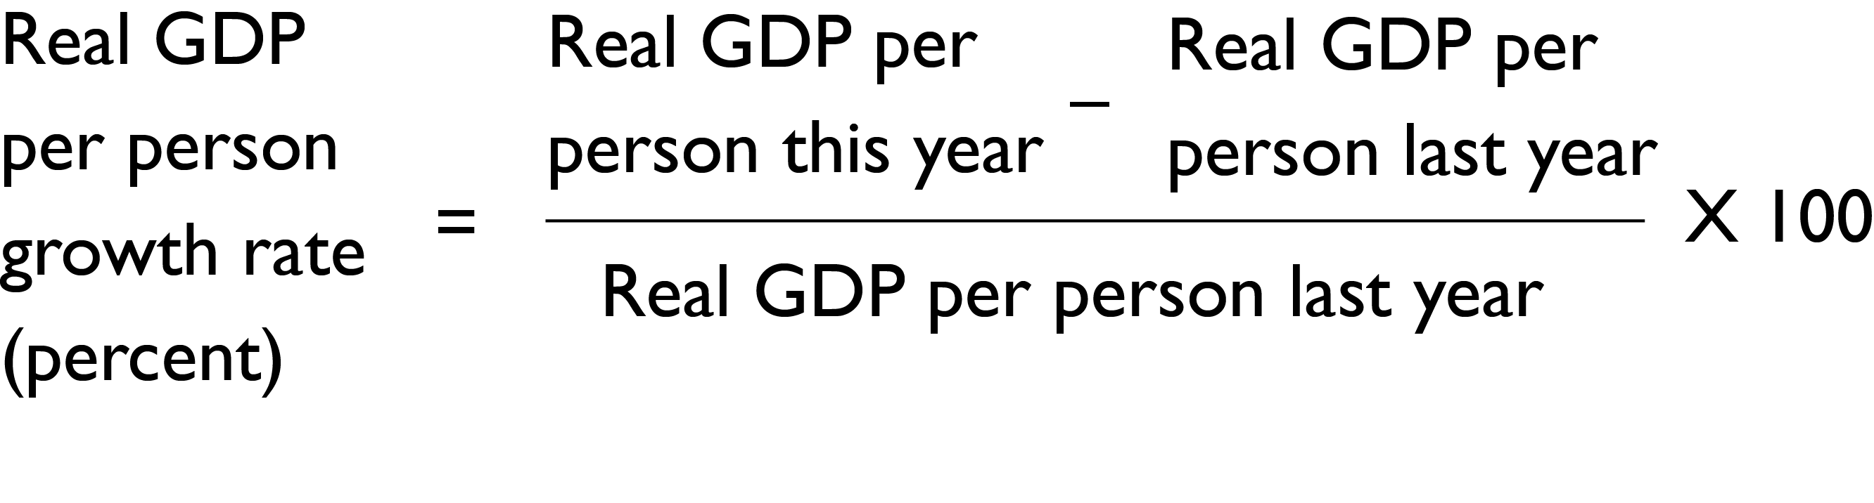
Economic growth rate annual percentage change in real GDP per person
Canada’s average annual economic growth rate, 1926-2008, was 2.1%
Canada’s economic growth rate was
2.6% in 2014
0.9% in 2015

Slide 28
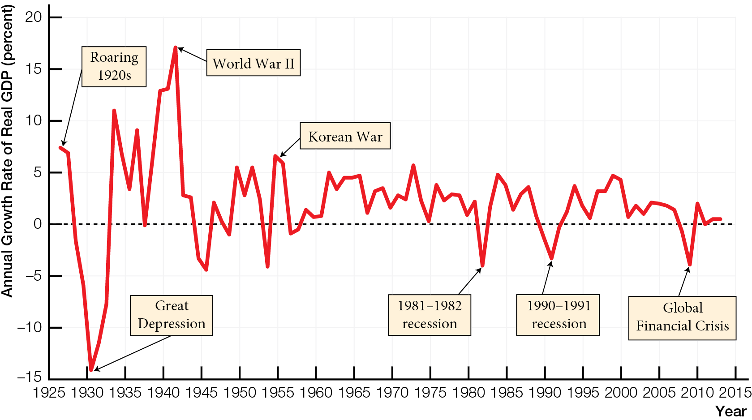
Annual Growth Rates of Canadian Real GDP per Person, 1926 - 2013

Slide 29
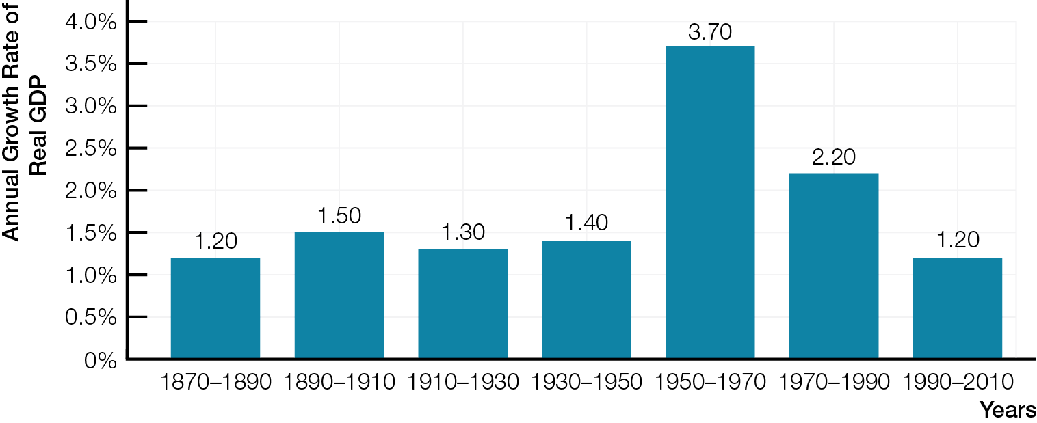
Growth in Real GDP per Person, Industrialized Countries, 1870 - 2010

Slide 30
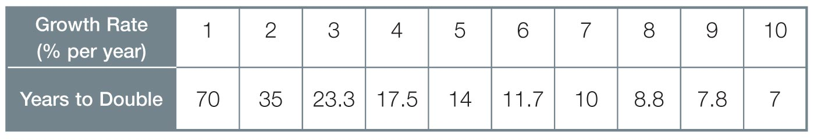
Rule of 70 number of years it takes for initial amount to double is roughly 70 divided by annual percentage growth rate
Because of compounding, small differences in annual growth rates have large consequences over time

Slide 31

Productivity quantity of real GDP produced by an hour of labour
Increases in productivity increase living standards
More can be produced
Reduced amount of work time required to buy products and services
Creative destruction competitive business innovations generate profits for winners, improving living standards for all, but destroy less productive or less desirable products and production methods

Slide 32
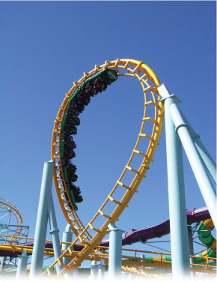
BUSINESS CYCLES
Business cycles — fluctuations of real GDP around potential GDP — are periods of real GDP expansion and contraction. Output gaps measure the difference between real GDP and potential GDP, and “closing the gap” is an important target for policymakers.

Slide 33
Language of business cycles up and down fluctuations of real GDP around potential GDP
Expansion period during which real GDP increases
Peak — highest point of an expansion
Contraction period during which real GDP decreases
Trough lowest point of a contraction
Recession 2+ successive quarters contraction of real GDP

Slide 34
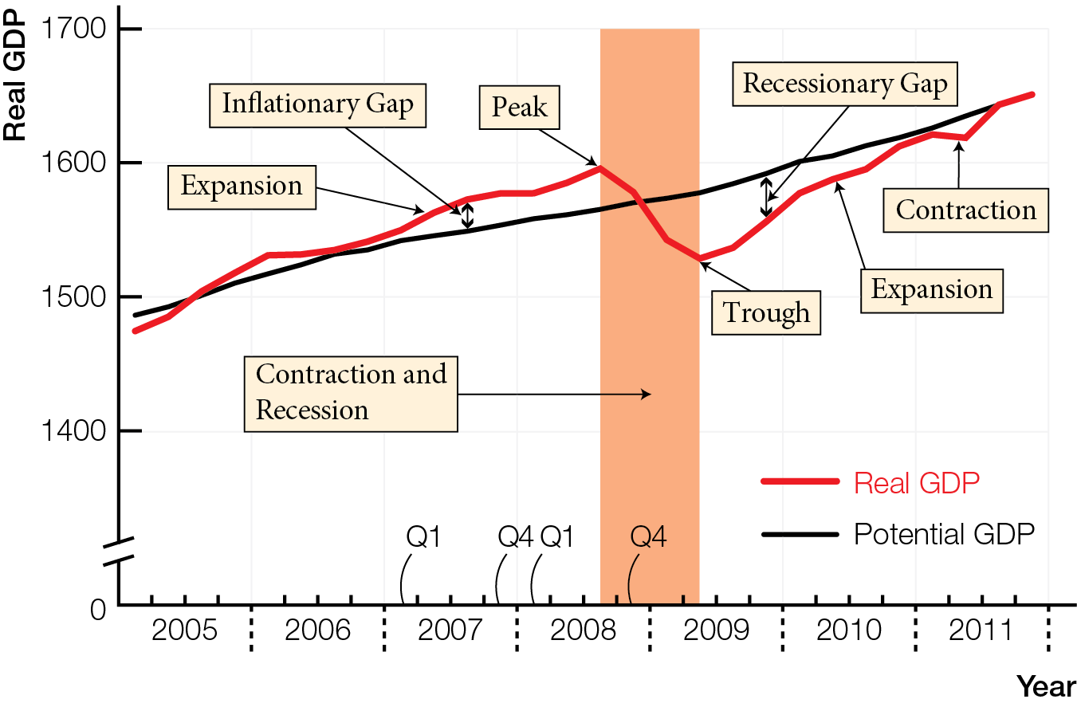
Most Recent Complete Canadian Business Cycle

Slide 35
Output gap real GDP minus potential GDP
Recessionary gap real GDP below potential GDP; gap is a negative number
Inflationary gap real GDP above potential GDP; gap is a positive number

Slide 36
Most Recent Complete Canadian Business Cycle

Slide 37
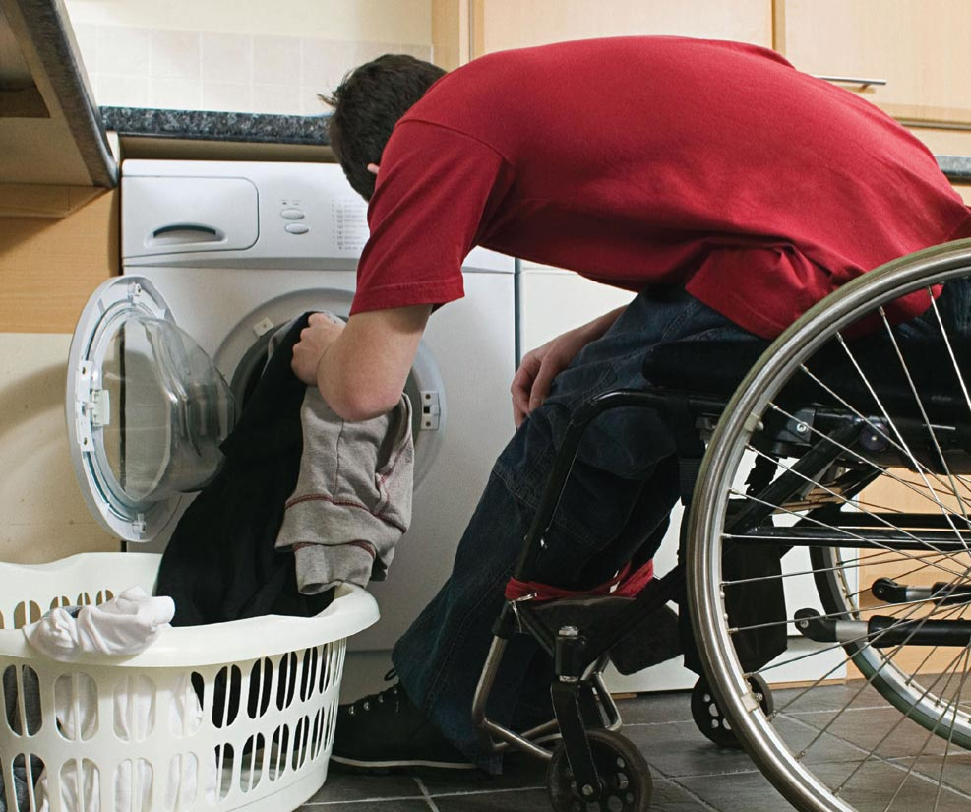
WHAT’S WRONG WITH GDP AS A MEASURE OF WELL-BEING
Real GDP per person is a limited measure of well-being because it excludes non-market production, underground economy, environmental damage, leisure, and political freedoms and social justice.

Slide 38
Real GDP per person is a limited measure of well being; does not include
Non-market production — household production is not counted but improves the quality of life
Underground economy — hides activities that are illegal, or legal but avoiding taxes (cash payments for services, unreported tips)
Environmental damage — does not subtract costs of environmental damage and resource depletion
Leisure — lowers real GDP, but may be desirable

Slide 39
Political freedoms and social justice — countries with high real GDP per person can have limited political freedoms, unequal distributions of income
Growth rates of real GDP per person useful for judging economic progress if no major changes in the limitations
United Nations Human Development Index (HDI) measures quality of life by combining life expectancy, educational achievement, and income

