Slide 1

Unemployment
and
Inflation

Slide 2

HEALTY & UNHEALTHY UNEMPLOYMENT
The unemployment rate measures the percentage of the labour force who are out of work and actively searching for jobs, but misses involuntary part-time workers and discouraged workers.
There are four types of unemployment — frictional, structural, seasonal, and cyclical — but only cyclical unemployment is both unhealthy and a problem.

Slide 3
Statistics Canada sorts working-age population (age 15 and over) into three categories
Employed working full-time or part-time at paid job
Unemployed not doing paid work and actively searching for job; on temporary layoff; about to start new job
Not in the labour force not employed or unemployed (full-time student, homemaker, retiree)

Slide 4

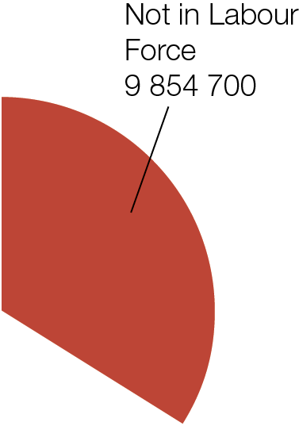
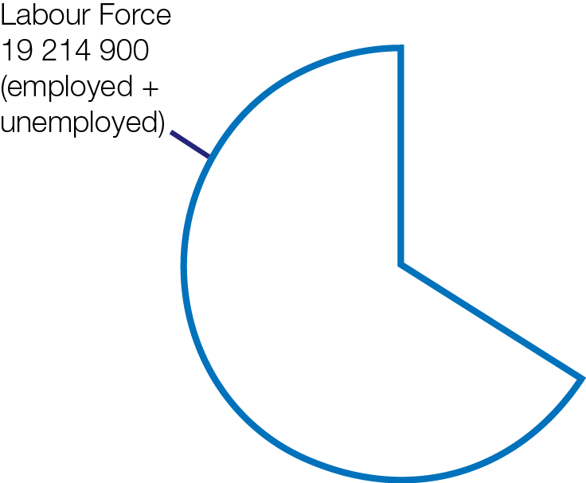
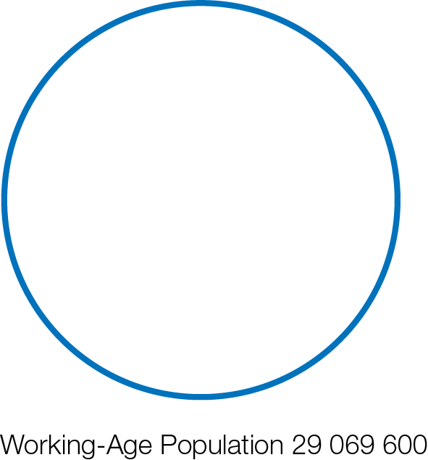
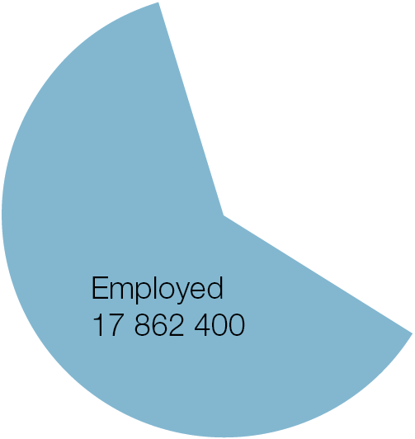
Labour Force Categories for Working-Age Population (July 2014)

Slide 5

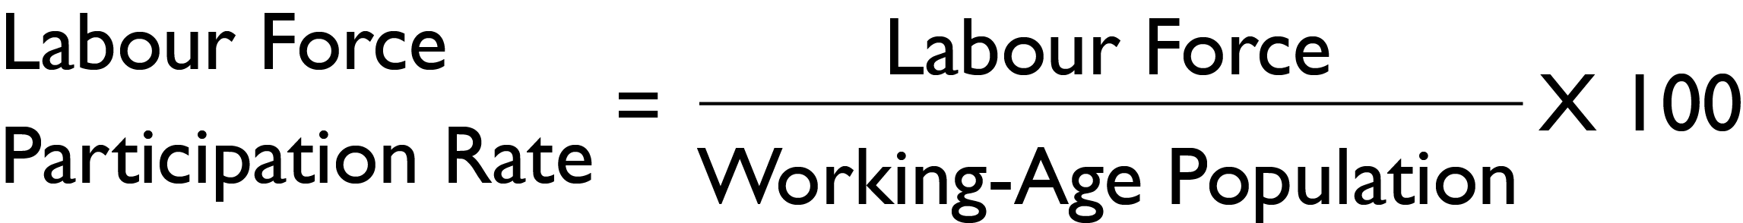
Labour Force = employed + unemployed
Unemployment Rate
Percentage of people in labour force who are unemployed
Labour Force Participation Rate
Percentage of working-age population in the labour force (employed or unemployed)

Slide 6
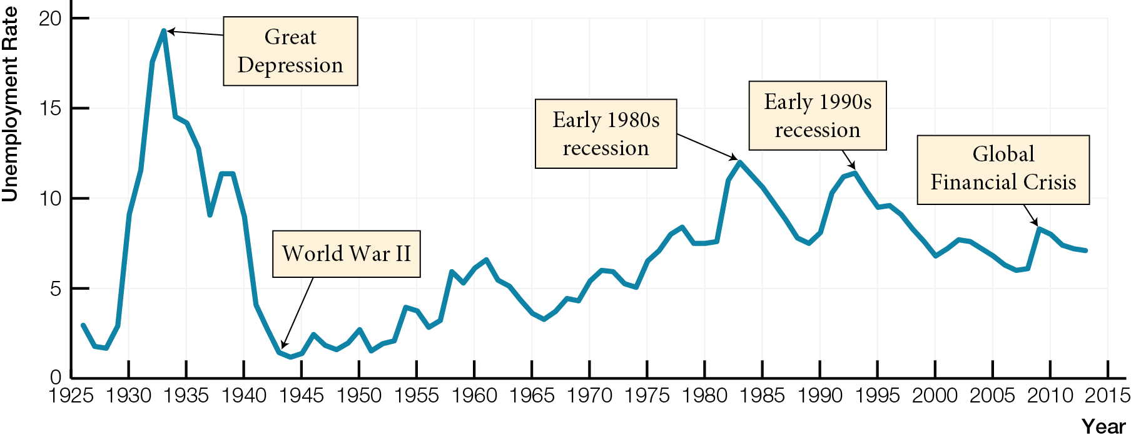
Unemployment Rates in Canada, 1926 - 2013

Slide 7
Canadian Unemployment Rates, November 2016
Province | Unemployment Rate
CANADA | 6.8
Newfoundland/Labrador | 14.3
Prince Edward Island | 8.7
Nova Scotia | 8.0
New Brunswick | 8.7
Quebec | 6.2
Ontario | 6.3
Manitoba | 6.2
Saskatchewan | 6.8
Alberta | 9.0
British Columbia | 6.1

Slide 8
Unemployment rate misses
Involuntary part-time workers employed part time, would rather have full-time job, but can’t find one
Discouraged workers want to work but have given up actively searching for jobs
Labour Underutilization Rate unemployment rate including unemployed, involuntary part-time workers, discouraged workers

Slide 9
Example of Discouraged Worker Impact on Unemployment Rate
Unemployed Employed Labour Unemployment Force Rate
20 80 100 20 %
10 80 90 11 %

Slide 10
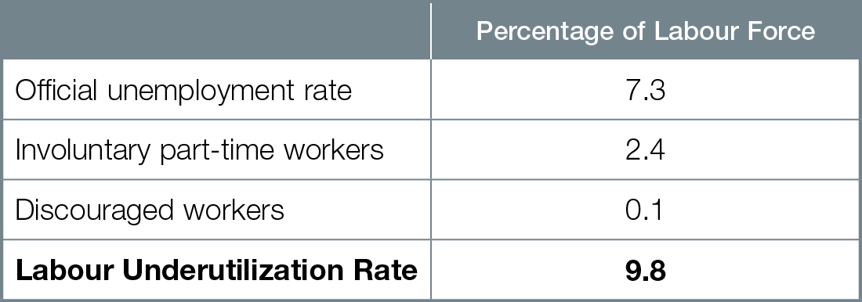
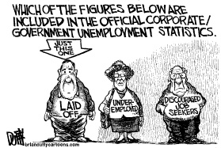
Unemployment and Underutilization of Labour, July 2014

Slide 11
Unemployment Rate and Labour Underutilization Rate (R8)

Slide 12
Healthy and unhealthy types of unemployment
Frictional unemployment due to normal labour turnover and job search; healthy part of a changing economy; not a problem
Structural unemployment due to technological change or international competition making workers’ skills obsolete; mismatch between skills workers have and skills new jobs require; healthy part of changing economy; problem requiring retraining

Slide 13
Seasonal unemployment due to seasonal changes in weather; healthy; not a problem
Cyclical unemployment due to business cycle fluctuations in economic activity; unhealthy part of changing economy; problem needs fixing

Slide 14
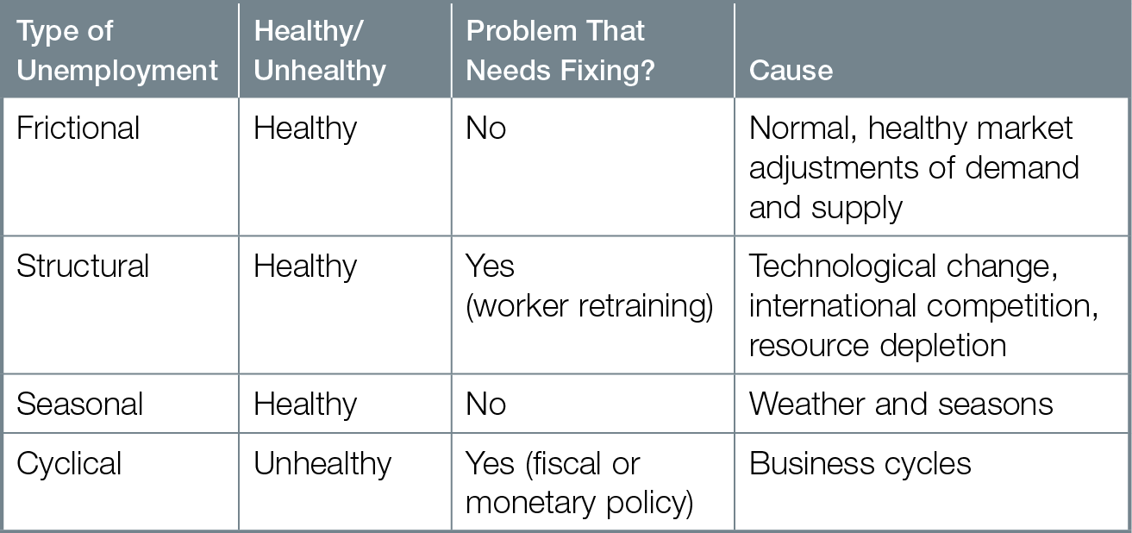
Types of Unemployment

Slide 15
NATURAL RATE OF UNEMPLOYMENT
The natural rate of unemployment occurs at full employment, when there is only healthy frictional, structural, and seasonal unemployment. Relative to the natural rate, the unemployment rate is higher in a recessionary gap and lower in an inflationary gap.

Slide 16
Natural Rate of Unemployment unemployment rate at full employment; includes frictional, structural, seasonal unemployment
Full employment not zero percent unemployment, but zero percent cyclical unemployment

Slide 17
Relation between natural rate of unemployment and potential GDP
When unemployment = natural rate; real GDP = potential GDP; full employment
When unemployment > natural rate; real GDP < potential GDP; recessionary output gap; cyclical unemployment
When unemployment < natural rate; real GDP > potential GDP; inflationary output gap

Slide 18
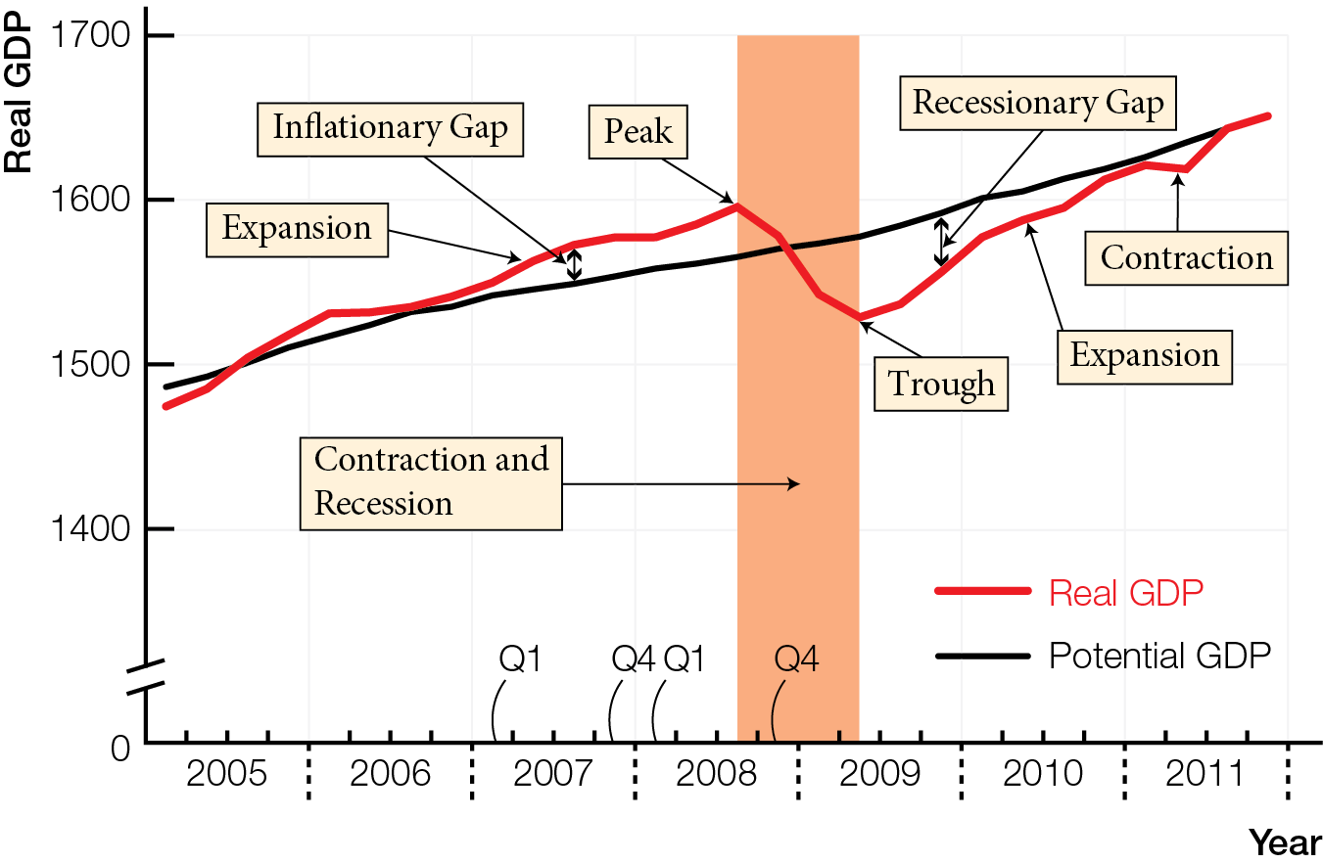
Most Recent Complete Canadian Business Cycle

Slide 19
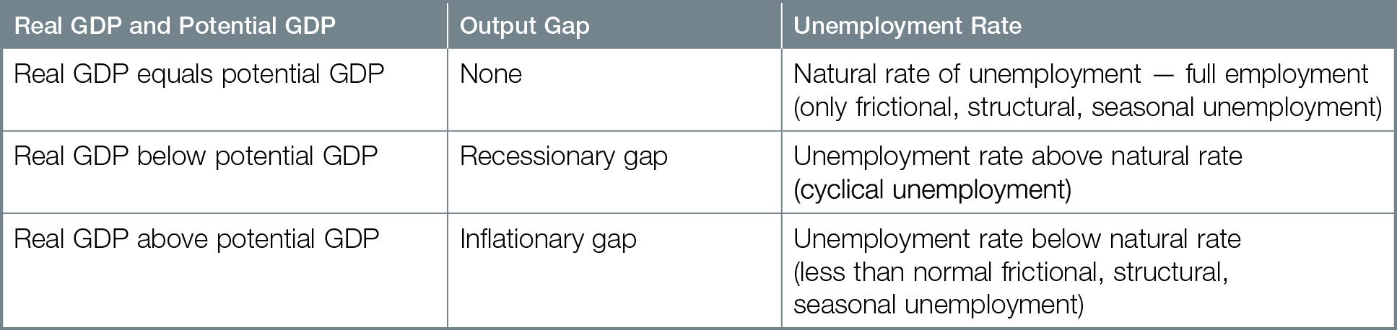
Output Gaps and Unemployment

Slide 20
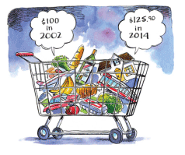
WHAT IS INFLATION?
Inflation is measured by changes in the Consumer Price Index, hurts those on fixed incomes, creates risk for business investment, and, through expectations, can create a vicious cycle of more inflation. The inflation rate overstates increases in the cost of living by missing switches to cheaper substitutes and new/improved products/services.

Slide 21
Inflation persistent rise in average prices and fall in value of money
You must spend more to get same products and services as before
Your money is worth less
Consumer Price Index (CPI) measure of average prices of fixed shopping basket of products and services
CPI = 100 for the base year, currently 2002

Slide 22
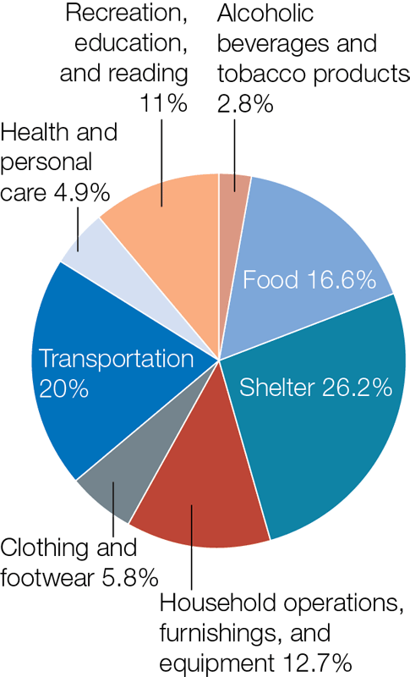
Consumer Price Index Basket

Slide 23
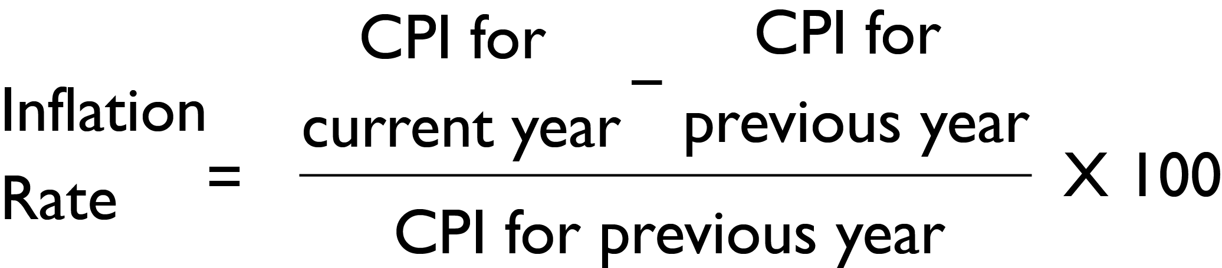
Inflation rate annual percentage change in Consumer Price Index
Core inflation rate inflation rate excluding volatile categories
Year Inflation Rate Core Inflation Rate 2014 1.5% 2.2% 2015 1.6% 1.9% 2016* 1.5% 1.7%

Slide 24
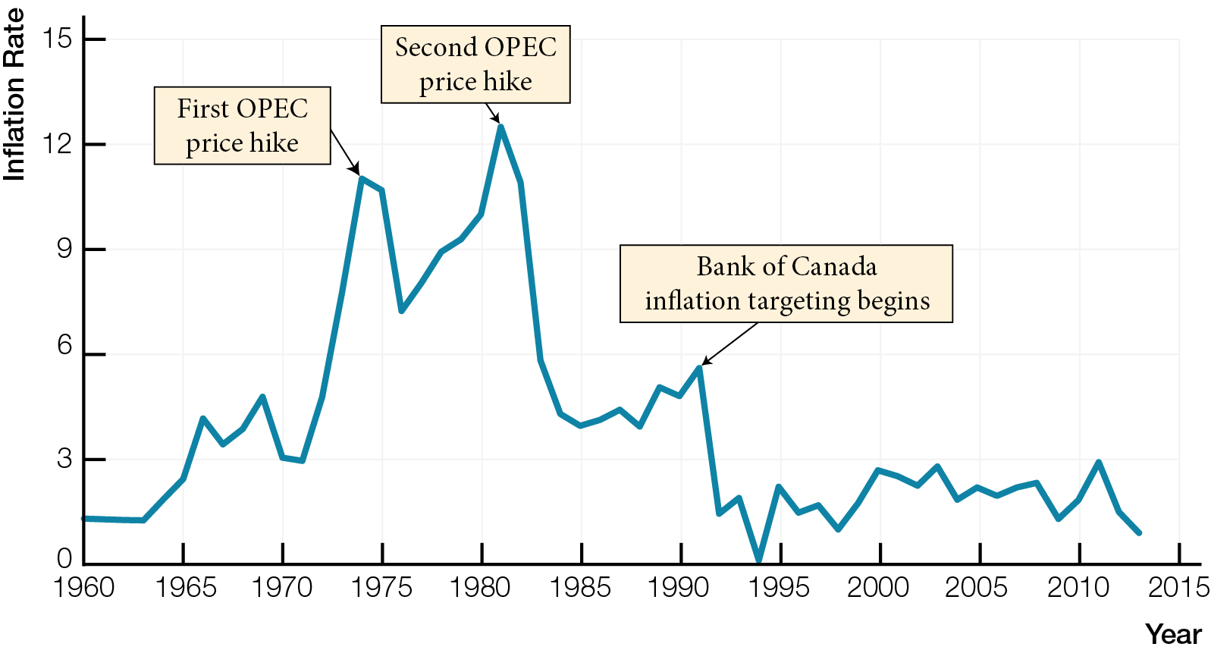
Inflation Rates in Canada, 1960 - 2013

Slide 25
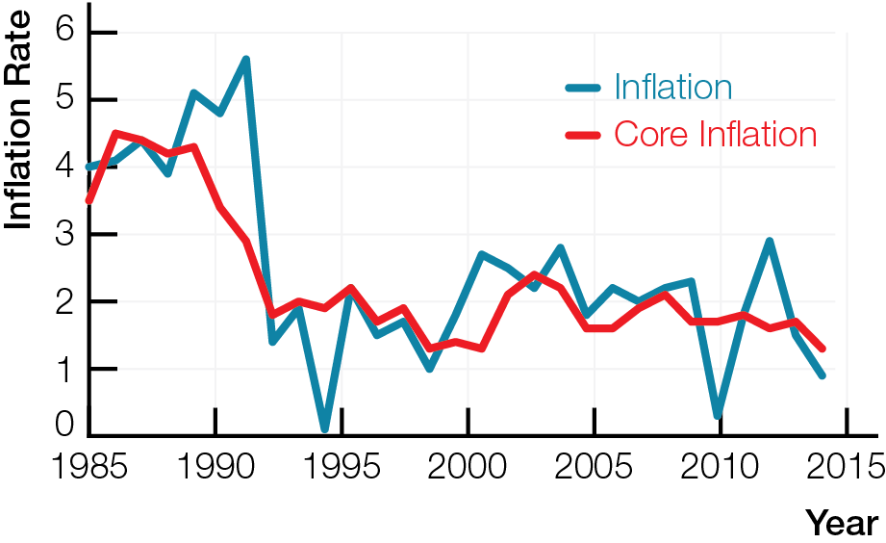
Inflation Rates and Core Inflation Rates in Canada, 1985 - 2013

Slide 26
Inflation is a worry because of falling value of money
Inflation reduces purchasing power of people with fixed (unchanged dollar) income or savings
Inflation affects interest rates
Nominal interest rate observed interest rate; dollars received per year in interest as percentage of dollars saved
Realized real interest rate = nominal interest rate adjusted for inflation = nominal interest rate – inflation rate

Slide 27
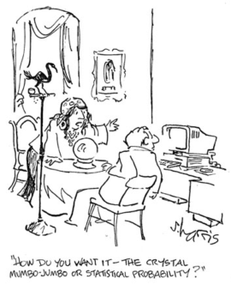
Inflation is a worry because
Unpredictable prices create risk and discourage business investment
Expectations of inflation can cause inflation
Predictable inflation rates between 1 and 3 percent are Bank of Canada’s aim

Slide 28
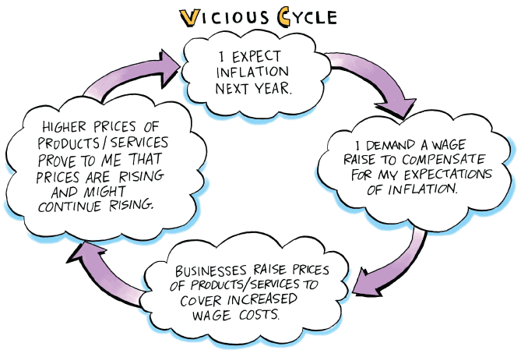

Slide 29
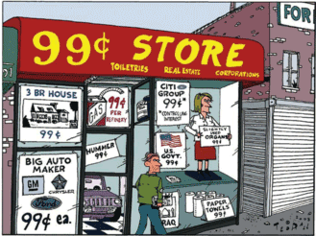
Deflation persistent fall in average prices and a rise in value of money
Consumers postpone spending, causing economic contraction and increasing unemployment
Deflation benefits savers but hurts borrowers
Deflation is worse than low inflation

Slide 30
CPI fixes quantities in the shopping basket to isolate impact of changing prices only on cost of living
When prices rise, CPI misses quantity switches to cheaper substitutes and new/improved products
Inflation rate based on the CPI overstates increases in cost of living.

Slide 31
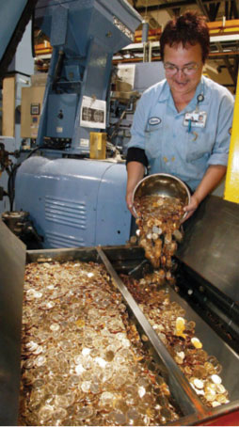
QUANTITY THEORY OF MONEY
The quantity theory of money explains inflation from an increase in the quantity of money in an economy, holding constant the velocity of money and the quantity of real output.

Slide 32
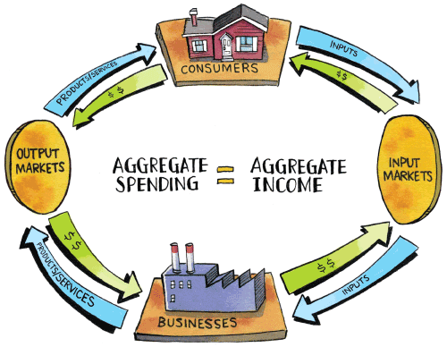
Simple Circular Flow

Slide 33
For any economy with money, M x V = P x Q, where
M quantity of money
V velocity of money number of times a unit of money changes hands during a year
P average prices — Consumer Price Index
Q aggregate quantity of real output
P x Q nominal GDP
There must be enough money, multiplied by velocity, to allow sales of all output produced (nominal GDP)

Slide 34
Quantity theory of money increase in quantity of money causes an equal percentage increase in inflation rate
Takes equation M x V = P x Q, fixes V and fixes Q at potential GDP
“Printing money causes inflation”
Video from October 2010 “Inflation on the Way Despite Deflation Fears”

Slide 35
Inflation is always accompanied by increases in quantity of money
But increase in quantity of money does not always cause inflation, especially when Q (real GDP) is below potential GDP
Not all inflation is caused by increases in quantity of money

Slide 36
UNEMPLOYMENT-INFLATION TRADE-OFFS
The Phillips Curve shows an immediate trade-off between unemployment and inflation consistent with demand-pull stories of inflation.
Cost-push inflation (simultaneous unemployment and inflation) changes in expectations and changes in the natural rate of unemployment complicate the original Phillips Curve.

Slide 37
Phillips Curve graph showing inverse relation between unemployment and inflation
Demand-pull inflation rising average prices caused by increases in demand — explains Phillips Curve’s trade-off between unemployment and inflation
During expansions, demand is key force causing shortages and pulling up prices for inputs (wages) and outputs

Slide 38
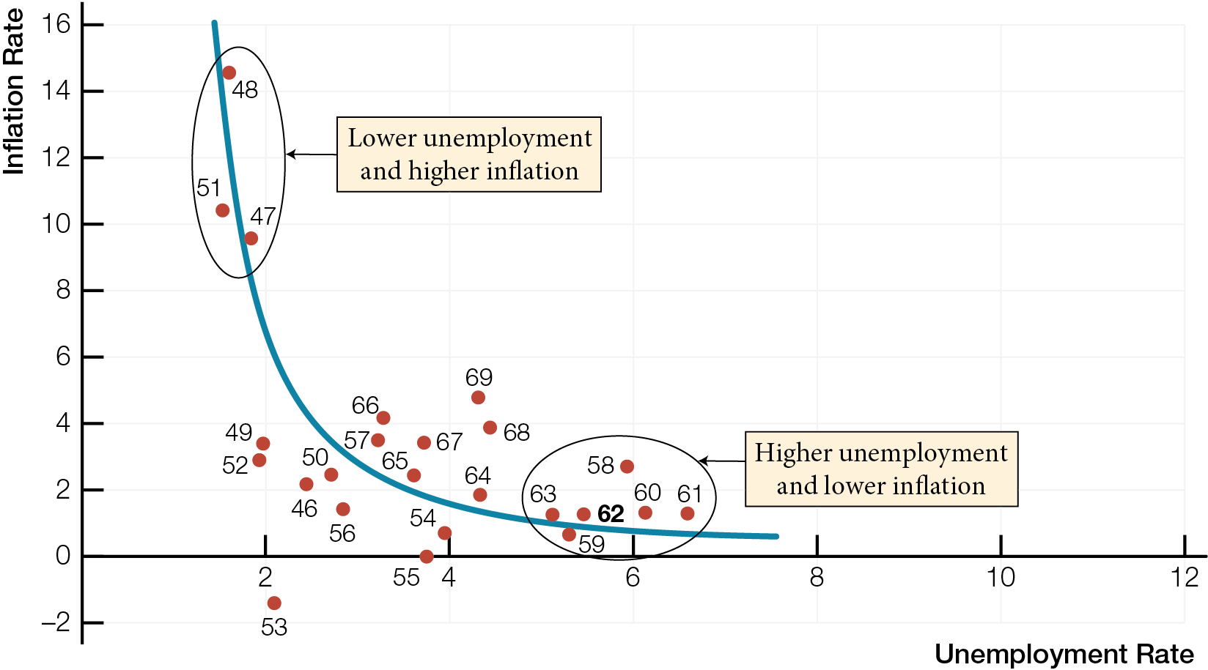
Phillips Curve in Canada, 1946 - 1969

Slide 39
Cost-push inflation rising average prices caused by decreases in supply
Does not fit Phillips Curve
Caused by supply shocks events directly affecting businesses’ costs, prices, and supply
Decrease in supply pushes up output prices, while pushing economy into contraction, increasing unemployment
Can cause stagflation combination of recession (unemployment) and inflation

Slide 40
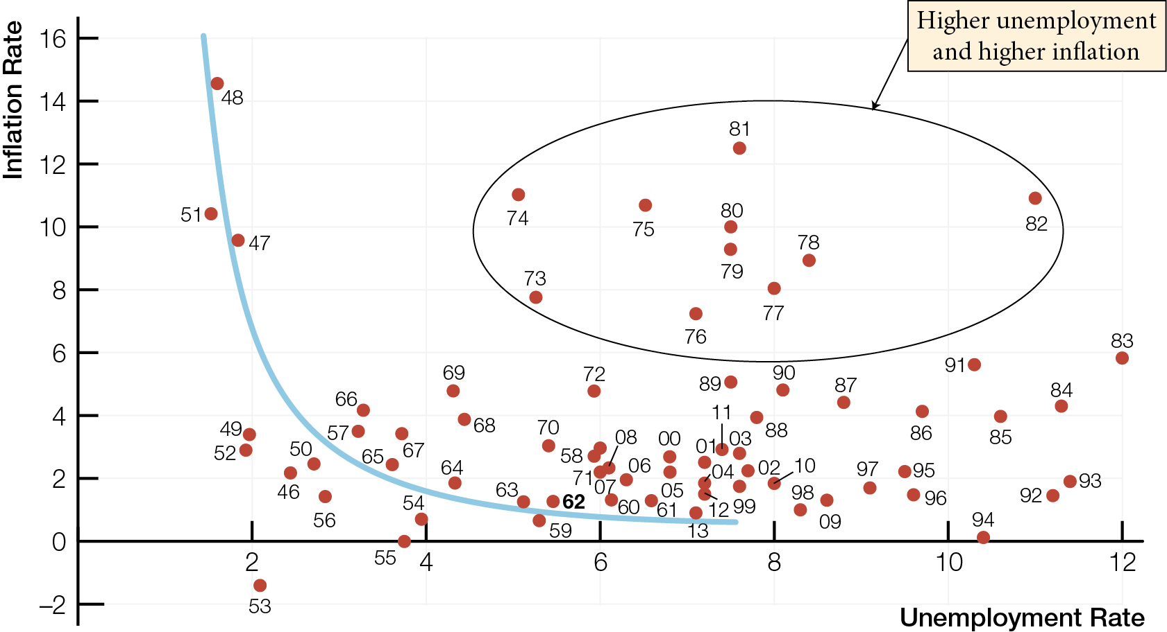
Phillips Curve in Canada, 1946 - 2013

Slide 41
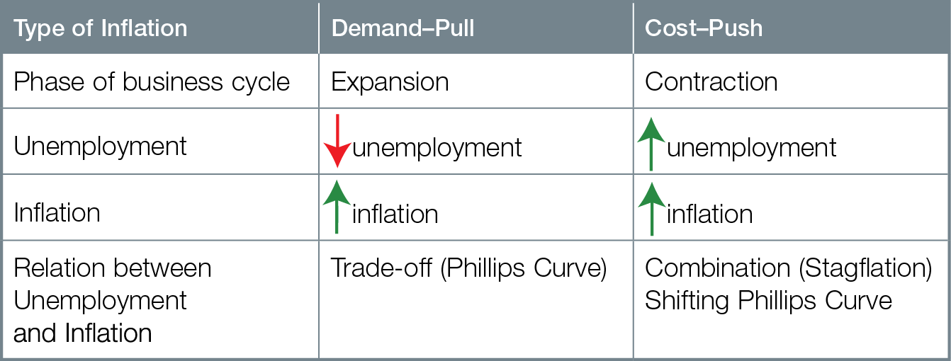
Types of Inflation

Slide 42

Both demand-pull and cost-push inflation require an accompanying increase in the quantity of money
Over time, trade-offs between unemployment and inflation of the original Phillips Curve become complicated due to changes in
Expectations of inflation
Natural rate of unemployment

