Slide 1

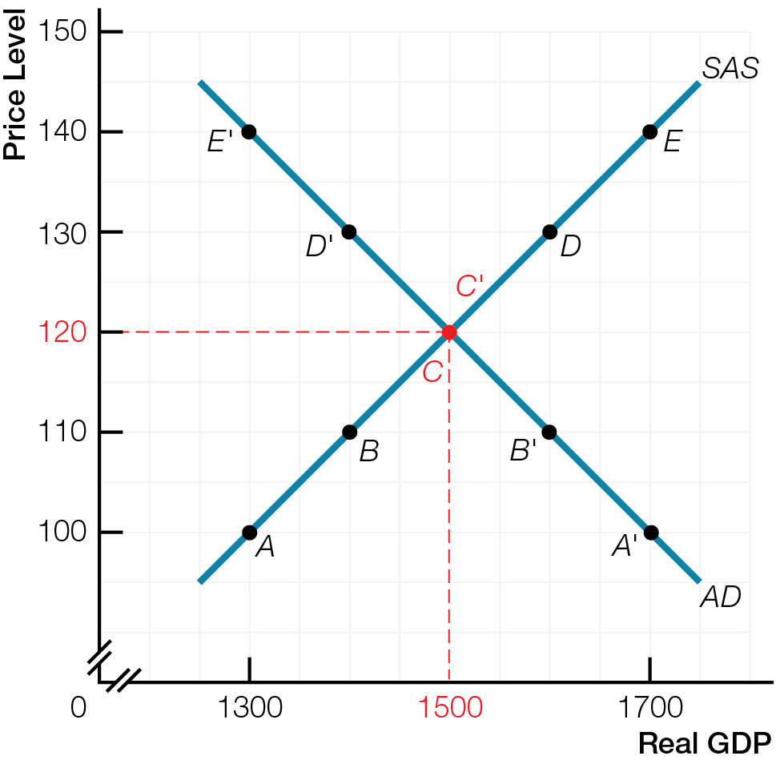
Aggregate Supply & Aggregate Demand Model

Slide 2
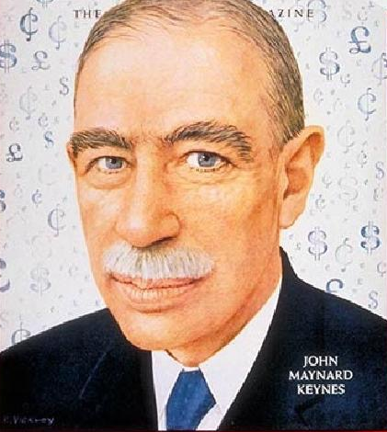
“Economics is a science of thinking in terms of models joined to the art of choosing models which are relevant to the contemporary world.
It is compelled to be this, because, unlike the typical natural science, the material to which it is applied is, in too many respects, not homogeneous through time. The object of a model is to segregate the semi-permanent or relatively constant factors from those which are transitory or fluctuating so as to develop a logical way of thinking about the latter ….
Good economists are scarce because the gift for using ‘vigilant observation’ to choose good models, although it does not require a highly specialised intellectual technique, appears to be a very rare one.”
– John Maynard Keynes

Slide 3
An economic model is a simplified representation of the real world, focusing attention on what’s important for understanding
Economic models assume all other things not in the model do not change
Mental equivalent of controlled experiments in laboratory

Slide 4
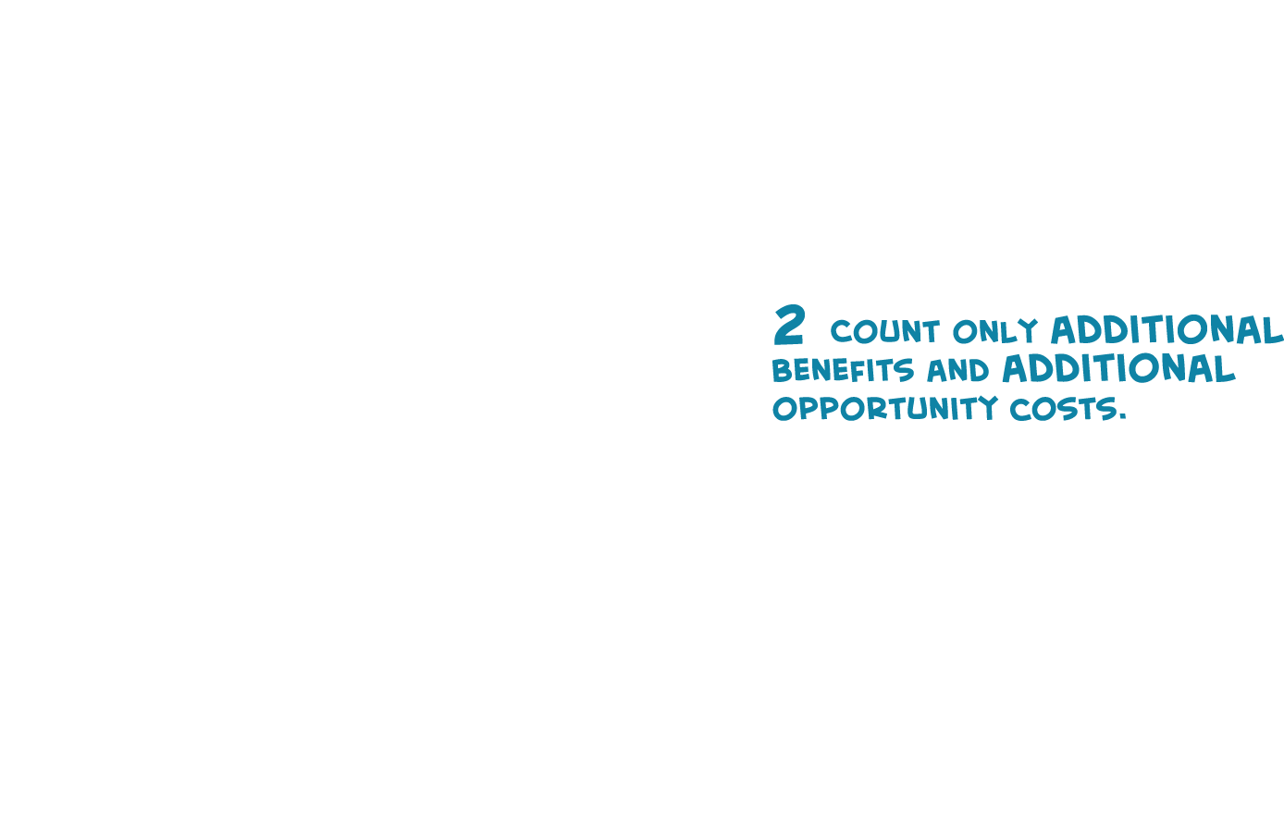

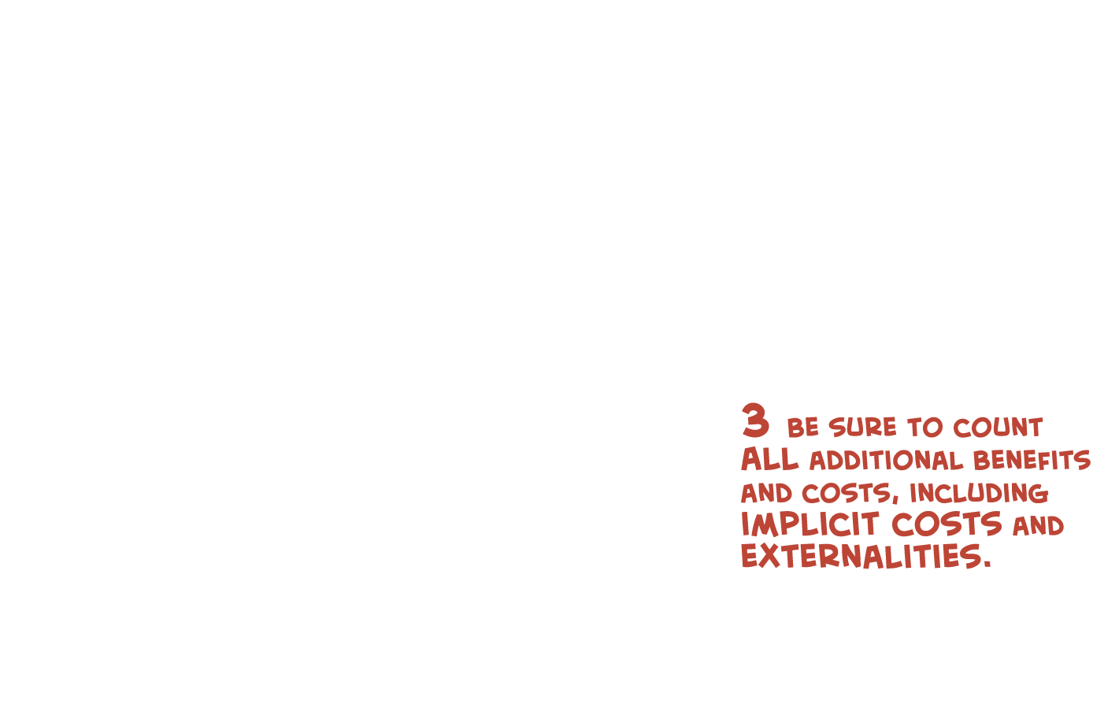

3 Keys modeL for Micro

Slide 5
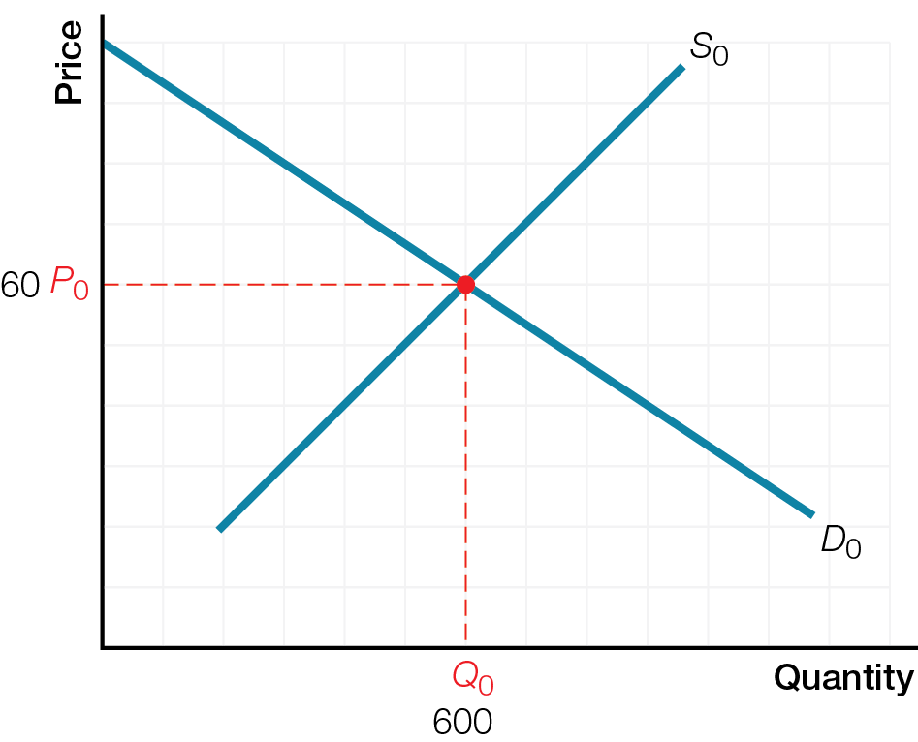
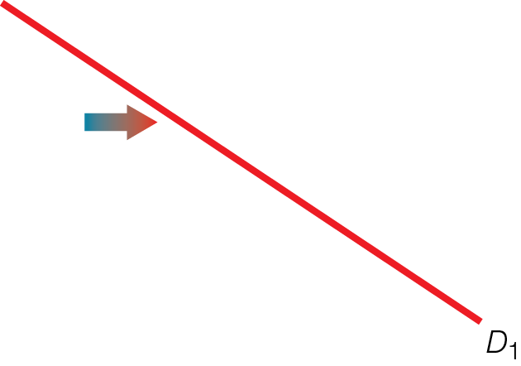
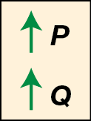
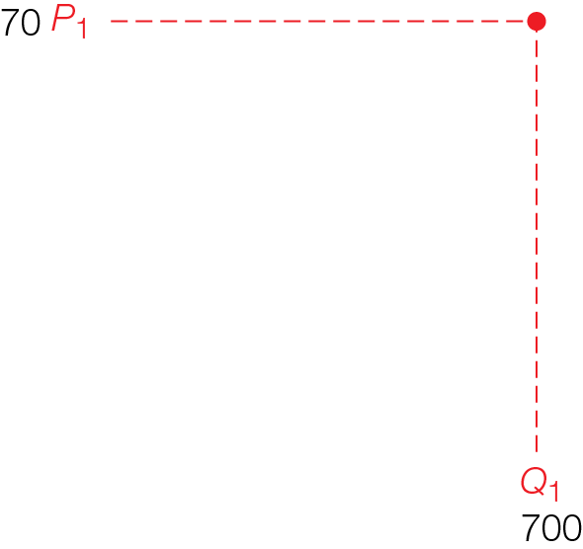

Microeconomic Supply and Demand Model

Slide 6
Review of Comparative Statics for Microeconomics
Price and Quantity changes are the result, not the cause, of economic events
Thinking like an economists means analyzing a situation using comparative statics
Start with one equilibrium situation (intersection of supply and demand, other things the same)
Change one other thing/variable
Compare resulting equilibrium situation (intersection of supply and demand after the change) in terms of price and quantity

Slide 7
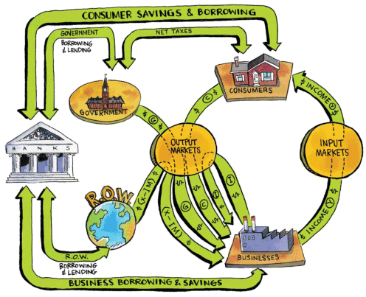
Circular Flow Model for Macro

Slide 8
Introduction to the Aggregate Supply & Aggregate Demand Model
Model of aggregate supply & aggregate demand explains
When the economy hits targets of potential GDP, full employment, stable prices
When the economy misses targets, resulting in business cycles, unemployment, inflation
Caused by shifts of aggregate supply & aggregate demand
Supply shocks and demand shocks
Differences between Yes and No camps on origins of shocks, and how economy responds after a shock

Slide 9
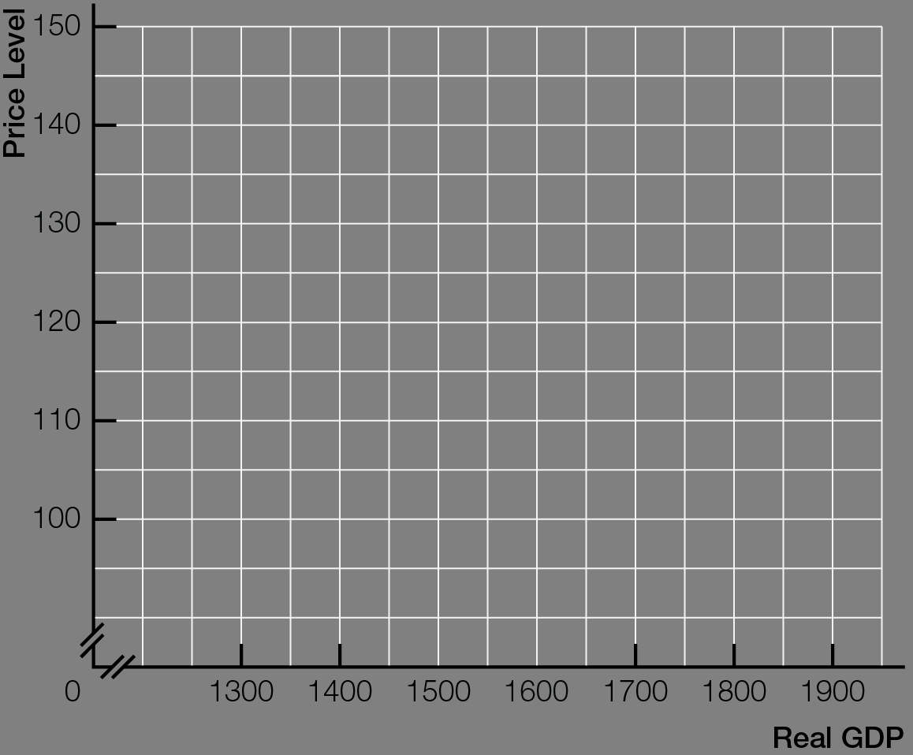
Outcomes of Aggregate Supply & Aggregate Demand Model

Slide 10
Comparative Statics for Macroeconomics
Changes in real GDP, unemployment, and inflation are the result, not the cause, of economic events
Thinking like an economist means analyzing a situation using comparative statics
Start with one equilibrium situation (intersection of aggregate supply and aggregate demand, other things the same)
Change one other thing/variable
Compare resulting equilibrium situation (intersection of aggregate supply and aggregate demand after change) in terms of real GDP, unemployment, and inflation

Slide 11
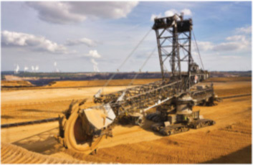
LONG-RUN AGGREGATE SUPPLY
Long-run aggregate supply models the macroeconomic target outcomes of potential GDP and full employment with existing inputs.

Slide 12
Potential GDP (full-employment output) is modeled as
Points on production possibilities frontier (PPF)
Long-run aggregate supply quantity real GDP supplied when all inputs fully employed
Long-run aggregate supply curve (LAS) — vertical line at potential GDP; potential GDP does not change when price level changes
Existing inputs are unused or unemployed at
Points inside PPF
Any quantity of real GDP less than potential GDP

Slide 13
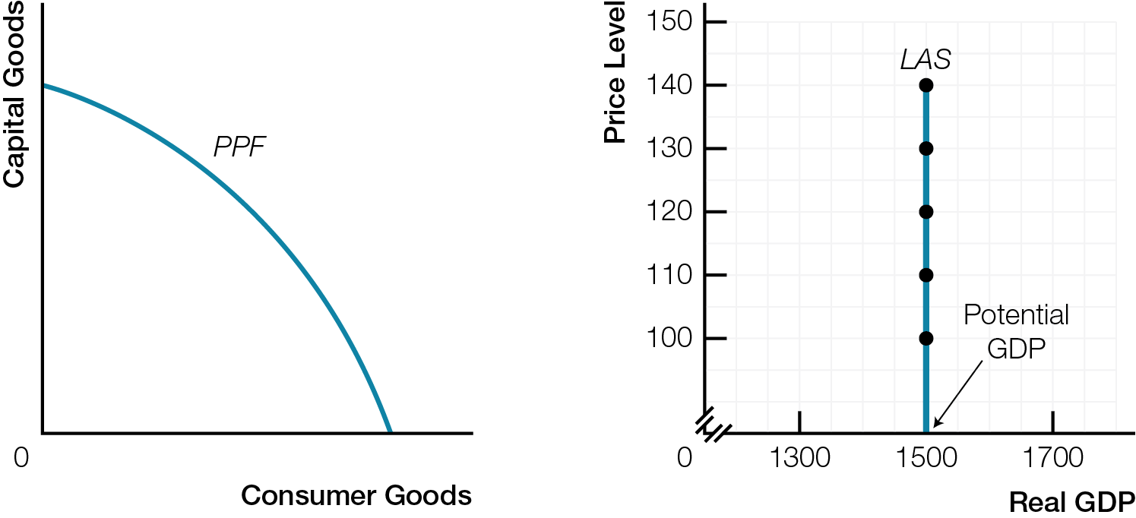
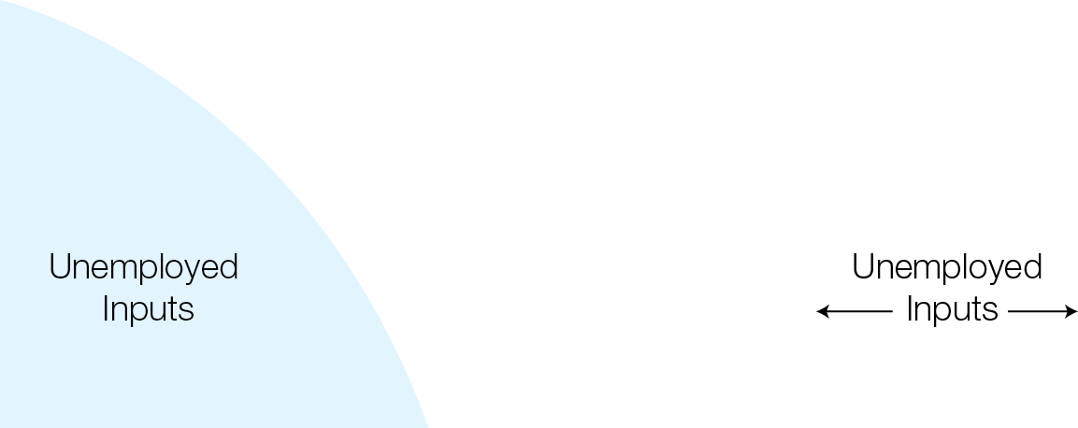
Production Possibilities Frontier and Long-Run Aggregate Supply

Slide 14
Time periods for macroeconomic analysis are
Long run — a period of time long enough for all prices and wages to adjust to equilibrium; economy at potential GDP, the full employment outcome of coordinated smart choices
Short run — a period of time when some input prices do not change; not all prices have adjusted to clear all markets
Difference based on real world observations that prices adjust more slowly in input (labour) markets than in output markets

Slide 15
Difference between macroeconomic long run and short run involves a disconnect between input markets and output markets
In short run, prices fixed in input markets, but flexible in output markets
In long run, prices flexible in both input and output markets
Long run and short run not defined in calendar time, but defined if all prices have adjusted to equilibrium (long-run) or not (short-run)

Slide 16

SHORT-RUN AGGREGATE SUPPLY
Supply plans for existing inputs determine aggregate quantity supplied. Supply plans to increase the quantity and quality of inputs, together with supply shocks, change aggregate supply.

Slide 17



Macroeconomic players consumers, businesses, government, make two kinds of plans for supplying real GDP
Supply plans for existing inputs
Supply plans to increase inputs
Focus on business supply plans as most important
Production takes time, so business supply plans are based on expectation of what demand will be when products come to market

Slide 18
Business supply plans for existing inputs with fixed input prices are like microeconomic choices about quantity supplied
Short-run aggregate supply quantity of real GDP macroeconomic players plan to supply at different price levels
Law of short-run aggregate supply as price level rises, aggregate quantity supplied of real GDP increases
Changes in price level cause movement along an unchanged short-run aggregate supply curve (SAS)

Slide 19
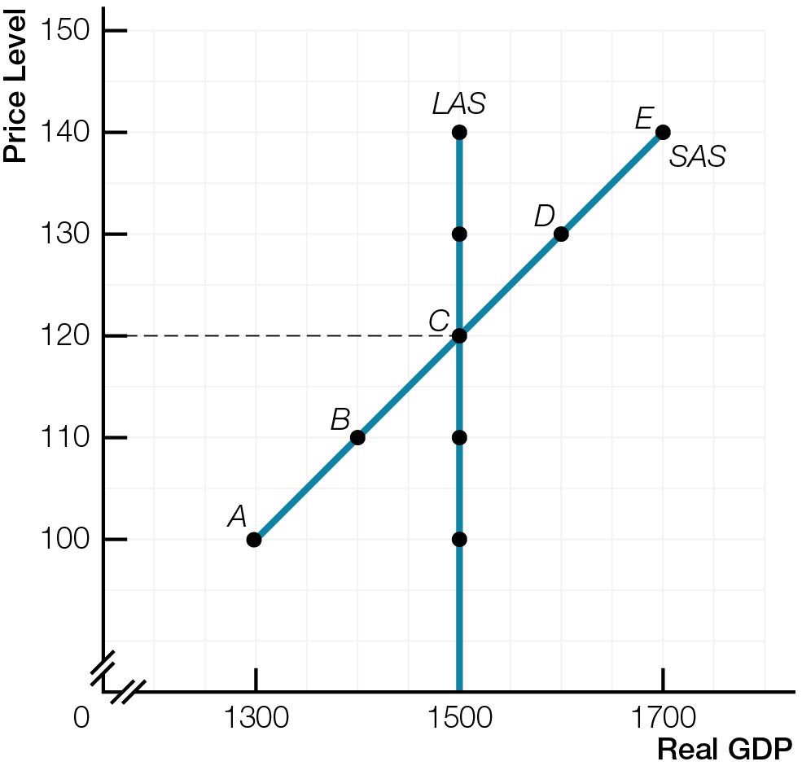
Short-Run and Long-Run Aggregate Supply

Slide 20
Supply plans to increase quantity or quality of inputs cause increase in aggregate supply — increase in economy’s capacity to produce real GDP
Changes in quantity or quality of inputs shift both long-run aggregate supply curve (LAS) and short-run aggregate supply curve (SAS) in same direction
Both aggregate supply curves shift rightward for increase in inputs; leftward for decrease in inputs

Slide 21
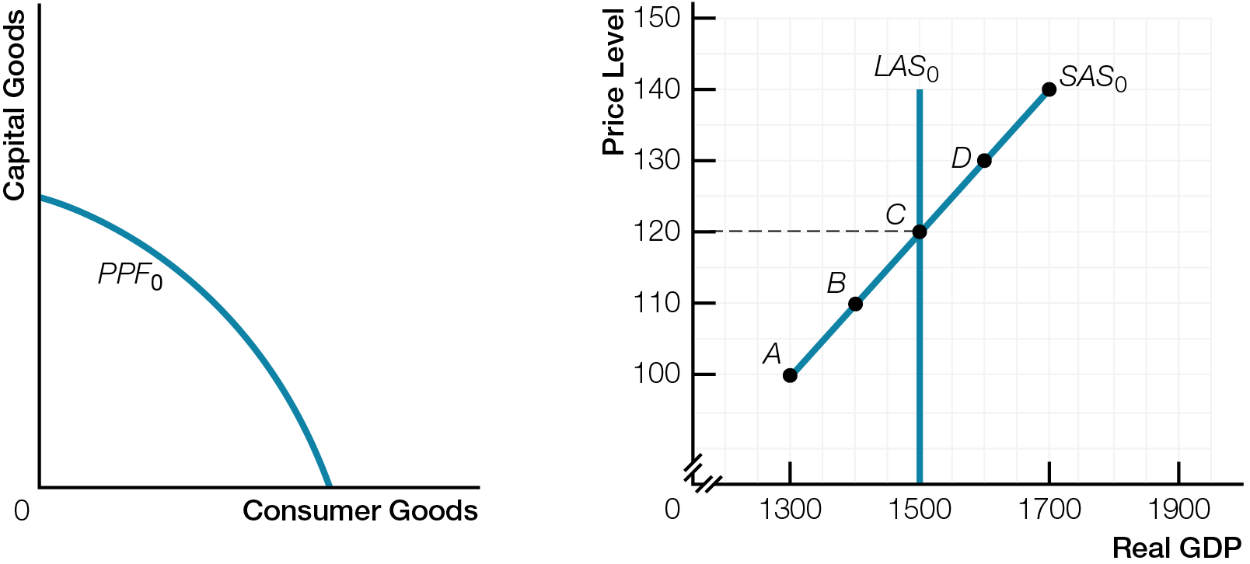
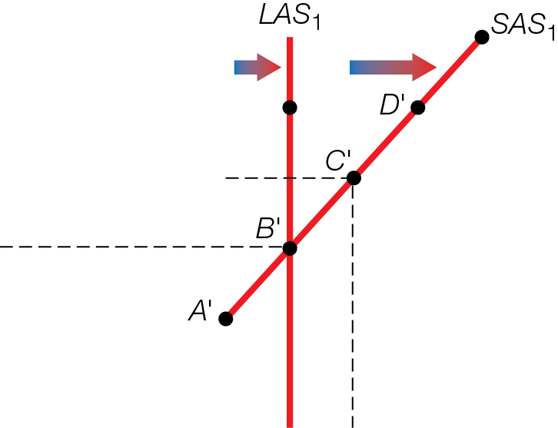
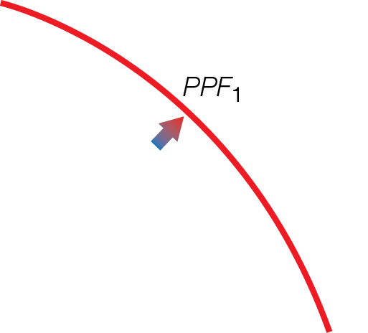
Increase in Potential GDP
Outward Shift PPF
b) Rightward Shift LAS and SAS

Slide 22
Changes in input prices shift short-run aggregate supply curve (SAS) but not long-run aggregate supply curve (LAS)
Rising input prices shift SAS leftward
Falling input prices shift SAS rightward

Slide 23
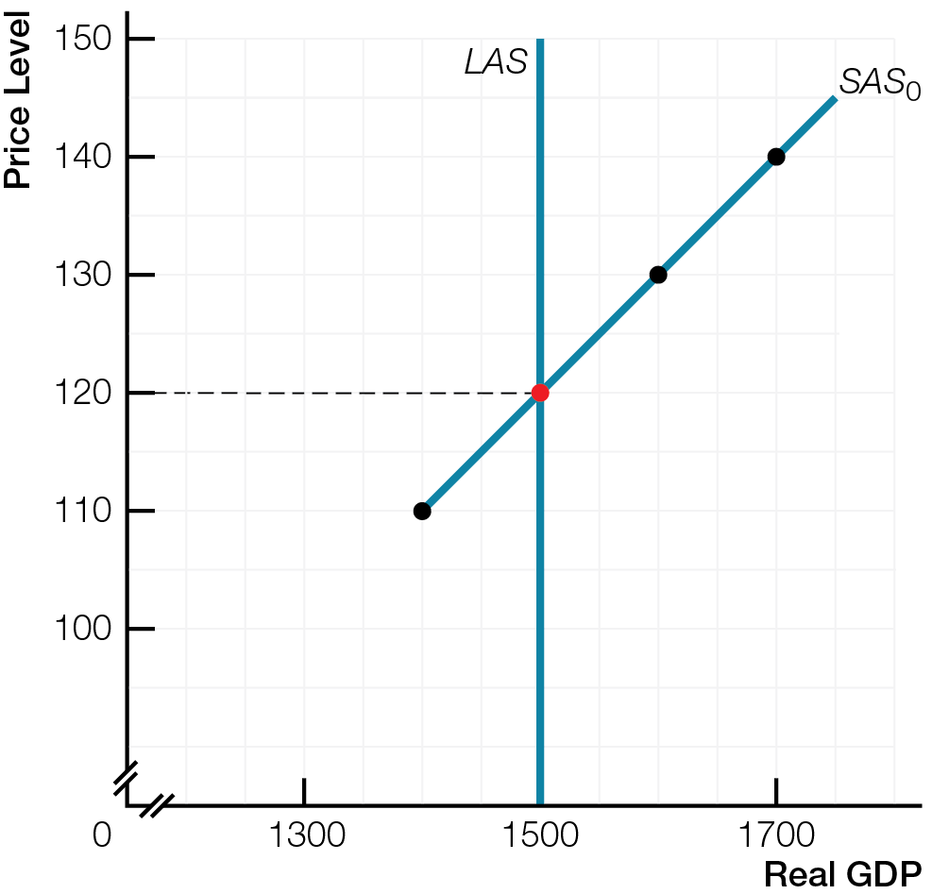
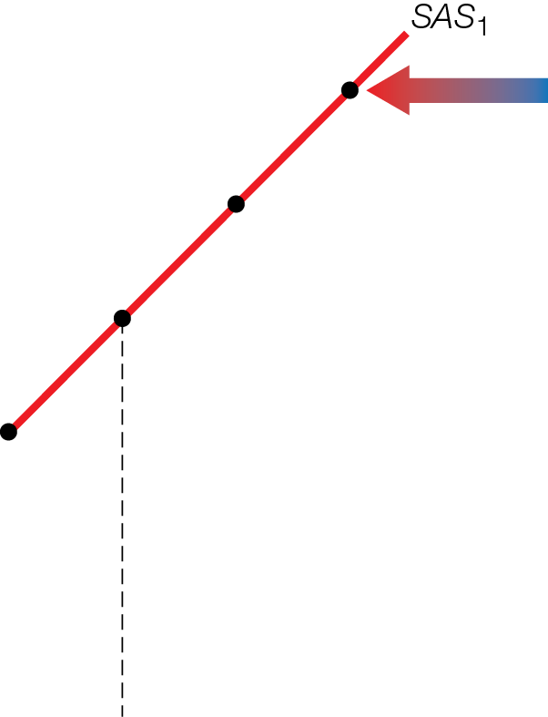
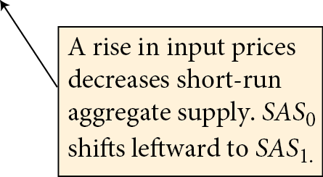
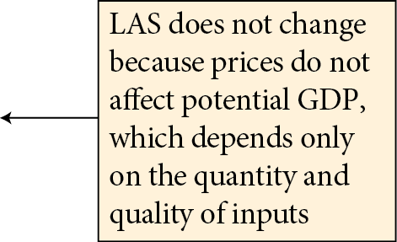
Input Prices and Aggregate Supply
Fig. 8.4

Slide 24
Changes in input prices shift short-run aggregate supply curve (SAS) but not long-run aggregate supply curve (LAS)
Rising input prices shift SAS leftward
Falling input prices shift SAS rightward
Negative supply shocks directly increase costs or reduce inputs, decreasing short-run aggregate supply
SAS shifts leftward
Positive supply shocks directly decrease costs, increase inputs, or improve productivity, increasing short-run aggregate supply
SAS shifts rightward

Slide 25
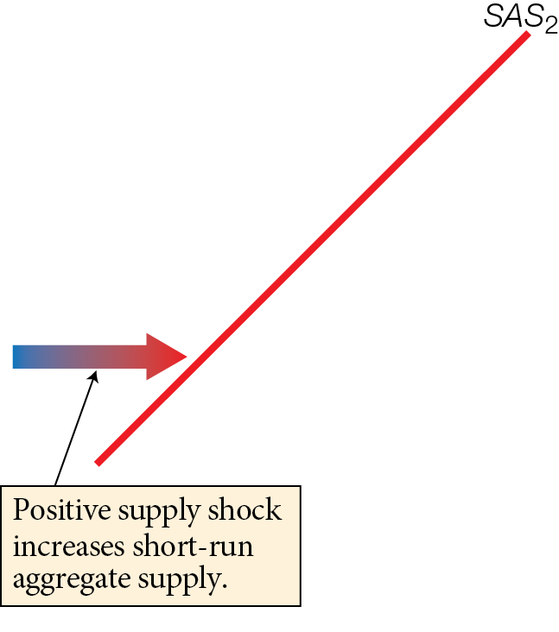
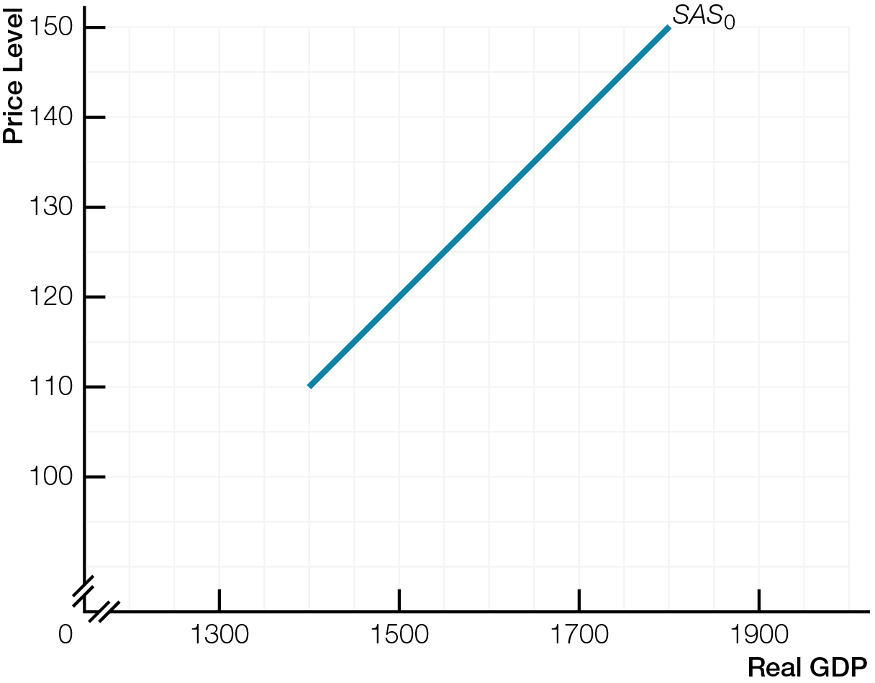
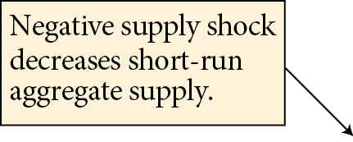
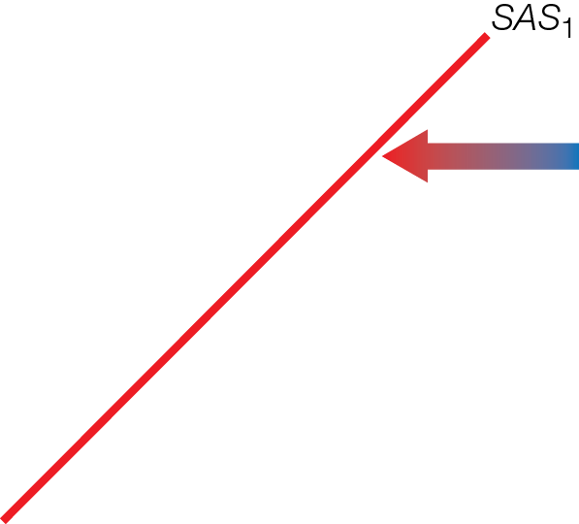
Supply Shocks & Short-Run Aggregate Supply
Fig. 8.5

Slide 26
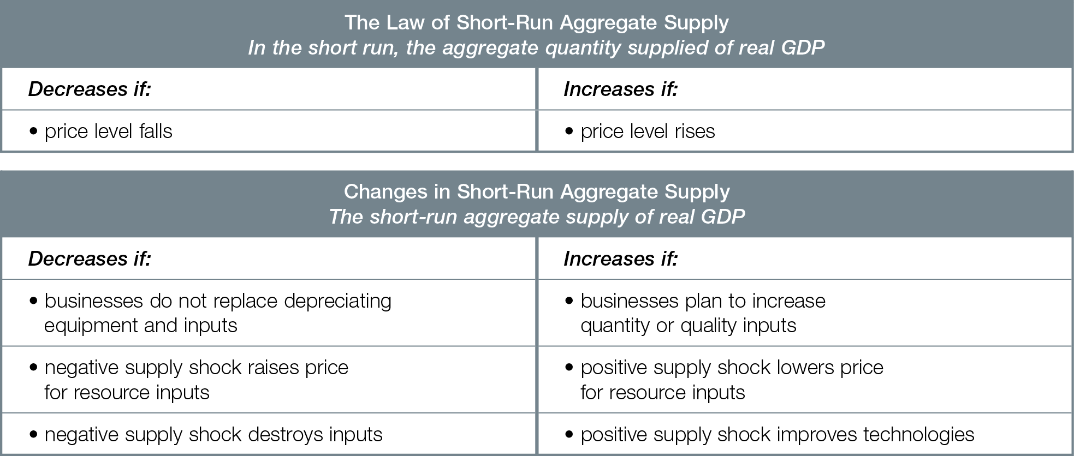
Law of Short-Run Aggregate Supply and Changes in Short-Run Aggregate Supply

Slide 27

AGGREGATE DEMAND
Demand plans by macroeconomic players determine aggregate quantity demanded. Demand shocks — from changes in expectations, interest rates, government policy, GDP in R.O.W., exchange rates — change aggregate demand.

Slide 28
All macroeconomic players — consumers, businesses, government, R.O.W. — make demand plans for spending, similar to microeconomic choices about quantity demanded
All aggregate demand plans are in the short run
Aggregate demand quantity of real GDP macroeconomic players plan to demand at different price levels
Law of aggregate demand as price level rises, aggregate quantity demanded of real GDP decreases

Slide 29
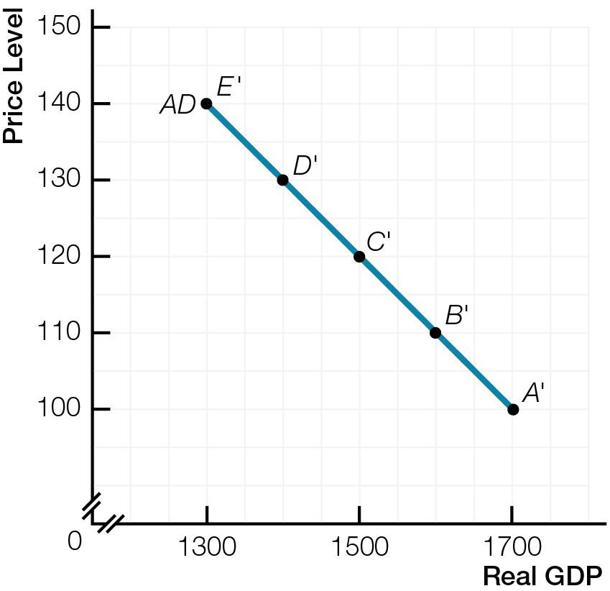
Aggregate Demand

Slide 30
Fallacy of composition makes macroeconomic law of aggregate demand different from microeconomic law of demand
When prices rise for all Canadian products and services, only substitutes are imports from R.O.W.
Canadians buy more imports, and R.O.W. buys fewer Canadian exports
Planned spending on aggregate demand = planned C + planned I + planned G + planned (X – IM )

Slide 31
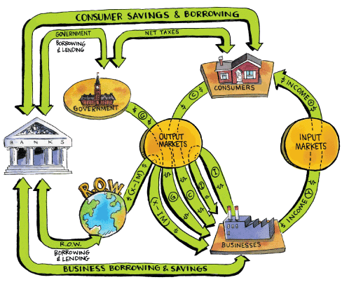
Enlarged GDP Circular Flow of Income and Spending ($) with Banking System

Slide 32
Consumers plan to spend (C) a fraction of disposable income and save the rest
Consumer spending is largest, most stable component of aggregate demand
Businesses plan investment spending (I) for new factories and equipment
Investment spending plans change quickly because easily postponed
Investment spending is most volatile component of aggregate demand

Slide 33

Government spending plan (G) for products and services set by budget
Transfer payments are not part of G
G as percentage of real GDP stable since early 1990s
R.O.W. spending plans (X) for Canadian exports
Must subtract imports (IM) from all other planned spending to get net exports (X – IM)

Slide 34
Demand shocks changes in factors other than the price level that change aggregate demand and shift aggregate demand curve (AD)
Expectations
Interest rates
Government policy
GDP in R.O.W.
Exchange rates
Negative demand shocks decrease aggregate demand, AD shifts leftward
Positive demand shocks increase aggregate demand, AD shifts rightward

Slide 35
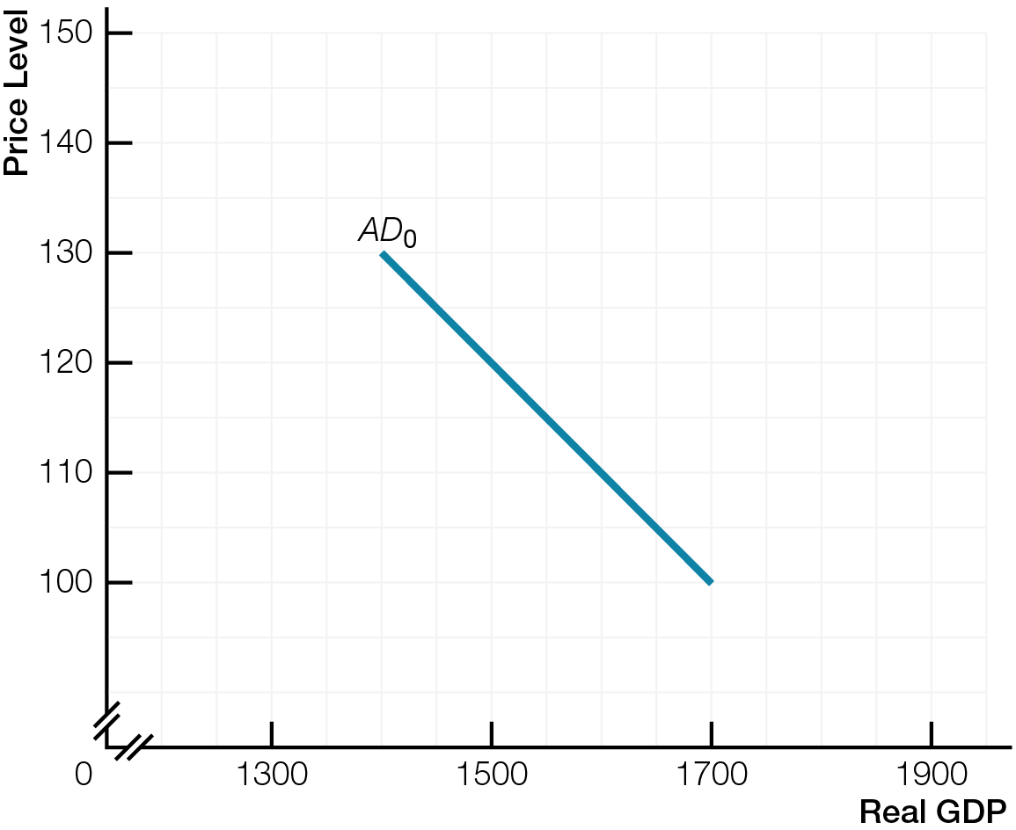
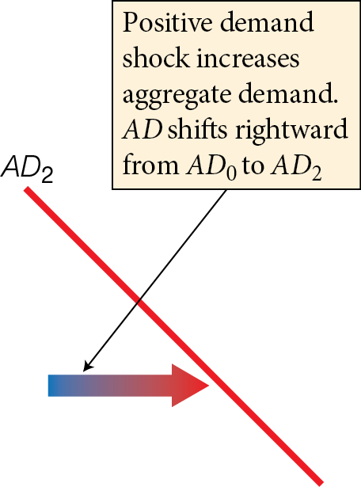
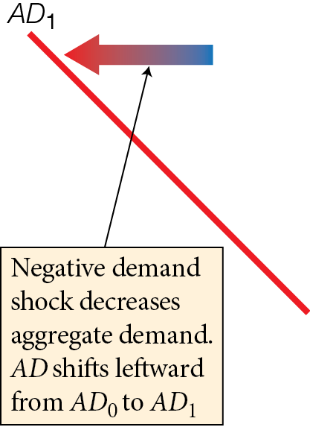
Demand Shocks and Aggregate Demand
Fig. 8.9

Slide 36

Negative demand shocks decrease aggregate demand, AD shifts leftward
More pessimistic expectations (I)
Higher interest rates (I or C)
Lower government spending or higher taxes (G or C)
Decreased GDP in R.O.W. (X)
Higher value of Canadian dollar (X and IM)

Slide 37

“The outstanding fact is the extreme precariousness of the basis of knowledge on which our estimates of the prospective yield [of any investment] have to be made…. If we speak frankly, we have to admit that the basis of knowledge for estimating the yield ten years hence of a railway, a copper mine, a textile factory … a building in the City of London amounts to little and sometimes nothing”
-John Maynard Keynes, 1937

Slide 38
Positive demand shocks increase aggregate demand, AD shifts rightward
More optimistic expectations (I)
Lower interest rates (I or C)
Higher government spending or lower taxes (G or C)
Increased GDP in R.O.W. (X)
Lower value of Canadian dollar (X and IM)

Slide 39
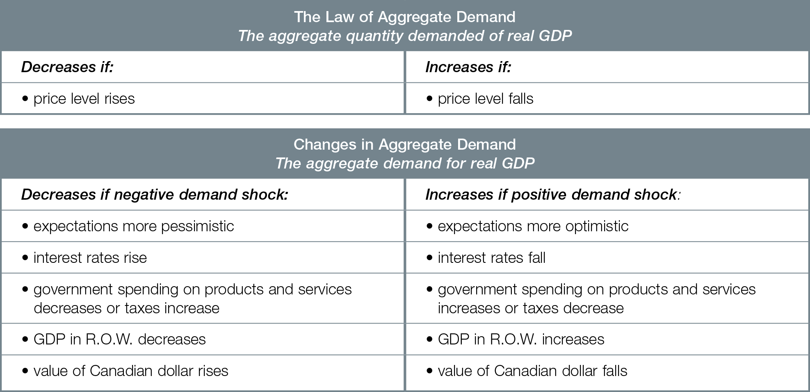
Law of Aggregate Demand and Changes in Aggregate Demand

Slide 40

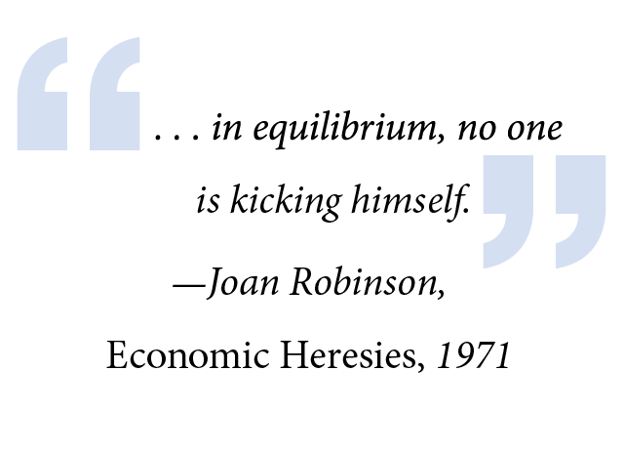
AGGREGATE SUPPLY & AGGREGATE DEMAND MODEL
The loanable funds market allows the economy to hit long-run equilibrium performance targets over time. Aggregate demand and aggregate supply shocks move the economy away from long-run equilibrium targets.

Slide 41
AS/AD Model Puts Together ….
SAS (Song-Run Aggregate Supply)
Short-Run supply plans by all macro players with fixed input prices
AD (Aggregate Demand)
Short-run demand plans by all macro players
LAS (Long-Run Aggregate Supply)
Different from SAS and AD. LAS is a performance target, where all economists want the economy to end up.

Slide 42
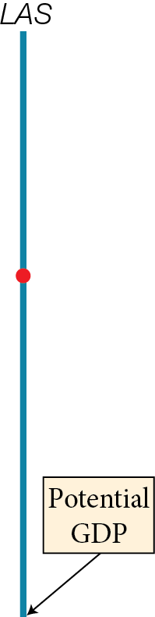
Short-Run and Long-Run Macroeconomic Equilibrium

Slide 43
Short-run macro equilibrium at intersection SAS and AD
Long-run macro equilibrium at intersection SAS and AD and LAS
Aggregate quantity supplied = Aggregate quantity demanded of real GDP = Potential GDP

Slide 44
How To Use AS/AD Models to Think Like an Economist
Remember LAS is different from SAS and AD. LAS is a performance target. SAS and AD are plans.
Always start the story in long-run macroeconomic equilibrium, where LAS, SAS, AD all intersect
Model a macroeconomic event as 1 of the 4 possible shocks – positive/negative aggregate supply/demand shock. Examine results of shock on GDP, unemployment, inflation
Analyze the return to long-run equilibrium after the shock
Yes and No camps disagree about how markets adjust after shocks – no simple stories

Slide 45
SCENARIO ONE
SAS and AD Plans Match and Economy Hits Target of LAS

Slide 46
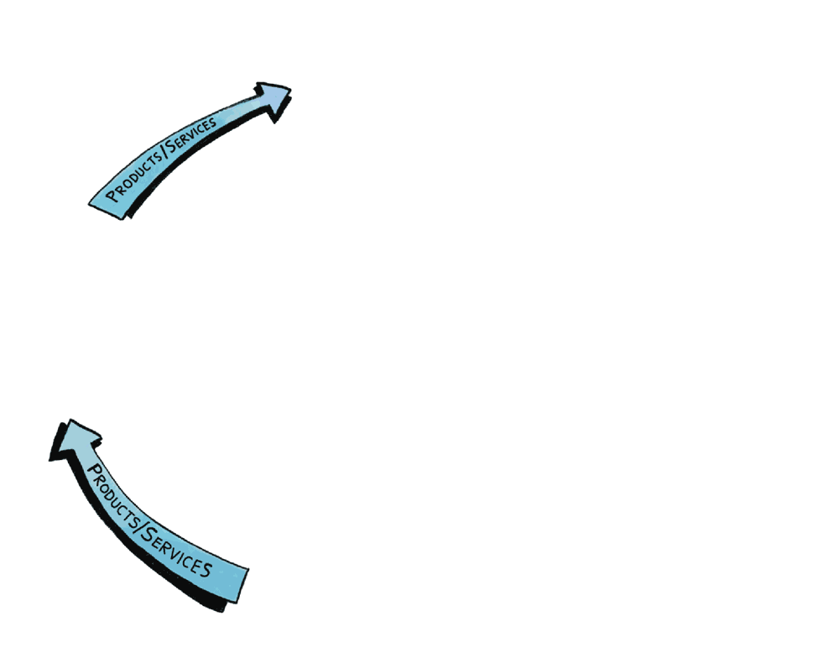
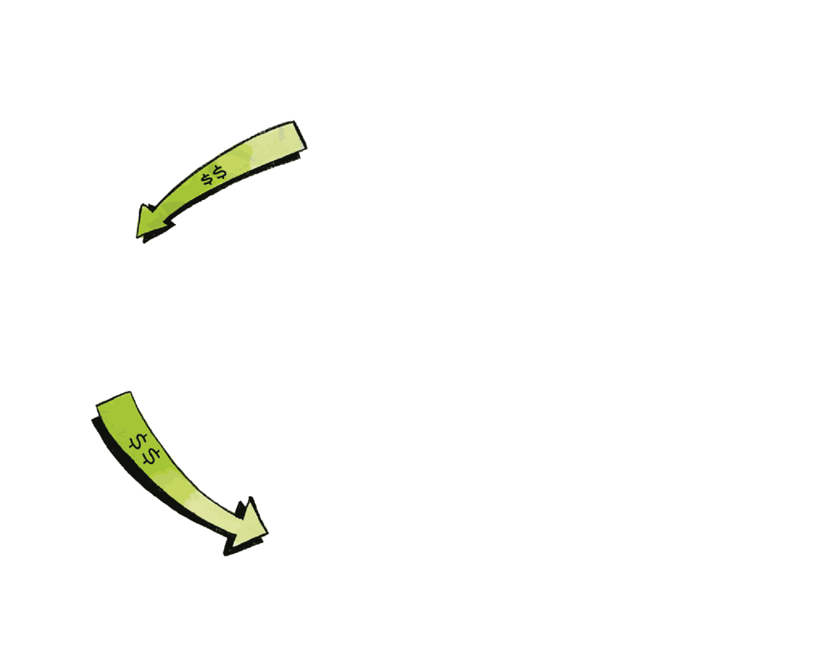
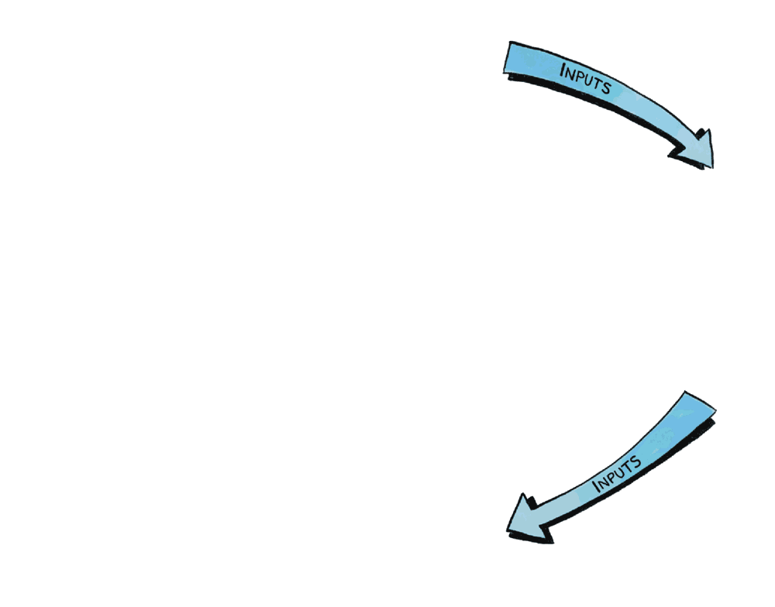
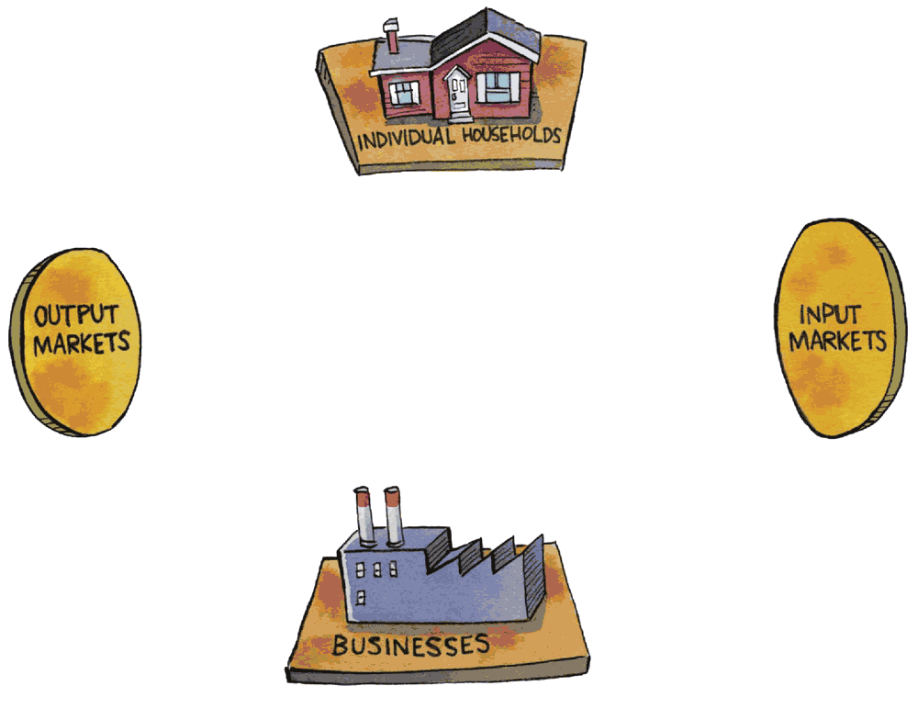
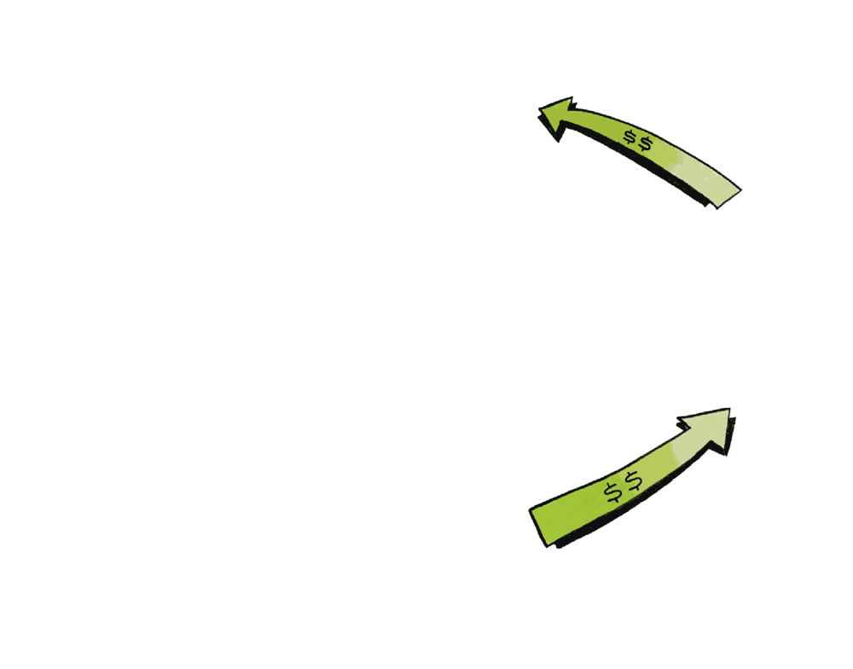
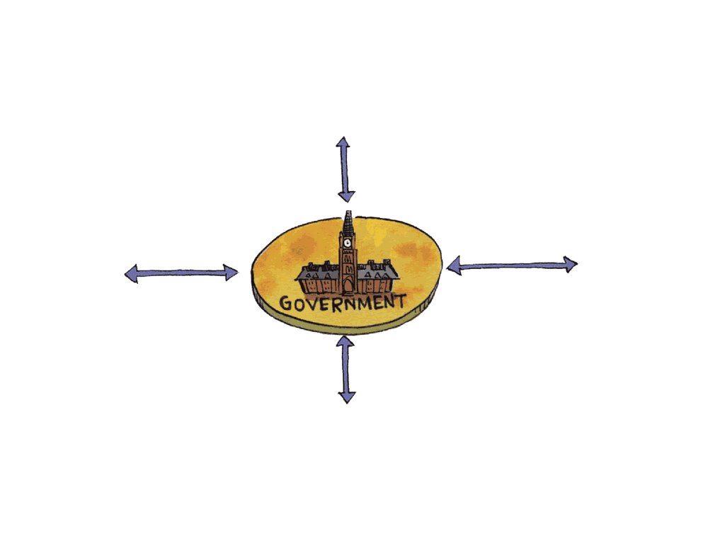
Circular Flow of Economic Life

Slide 47
Short-Run and Long-Run Macroeconomic Equilibrium

Slide 48
SCENARIO TWO
SAS and AD Plans Match Even with Saving, But Investment Offsets Saving so Economy Hits Growing LAS Target Over Time

Slide 49

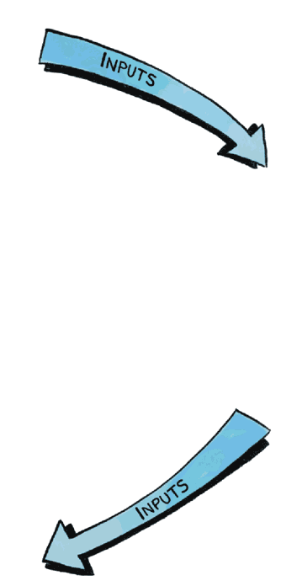

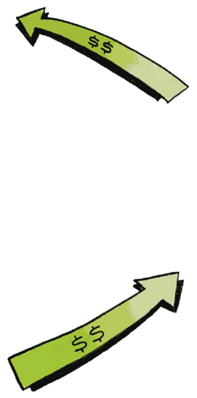
What Does Savings Do To the Circular Flow ?
?

Slide 50
Enlarged GDP Circular Flow of Income and Spending ($) with Banking System

Slide 51

To explain macroeconomic equilibrium with savings, add the banking system
Market for loanable funds banks coordinate supply of loanable funds (saving) with demand for loanable funds (borrowing for investment spending)
Interest rate is the price of loanable funds
If banks loan out savings to business borrowers who spend on new factories and equipment, that spending replaces consumer saving
Short-run aggregate supply still = aggregate demand

Slide 52
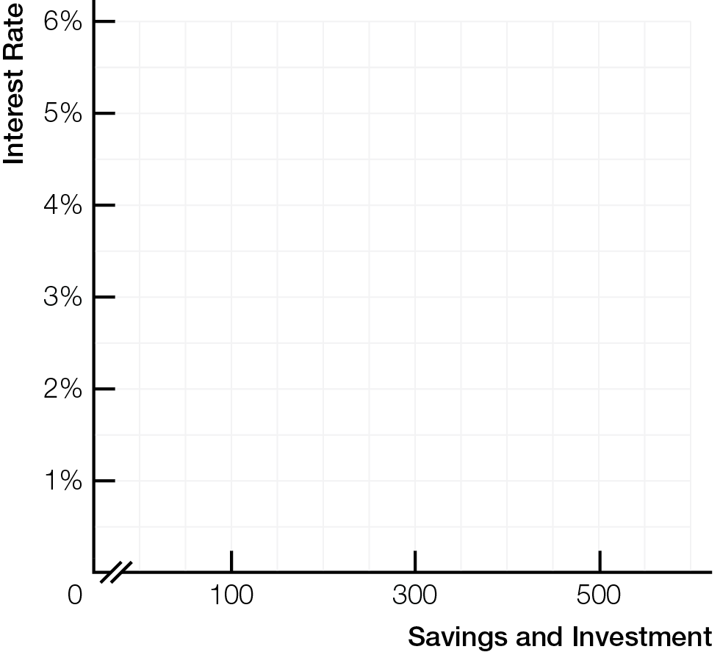
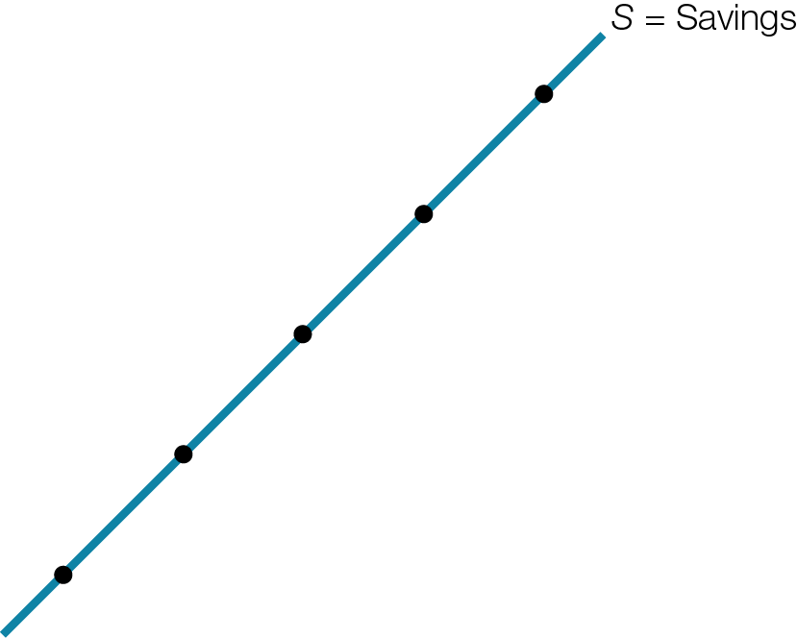
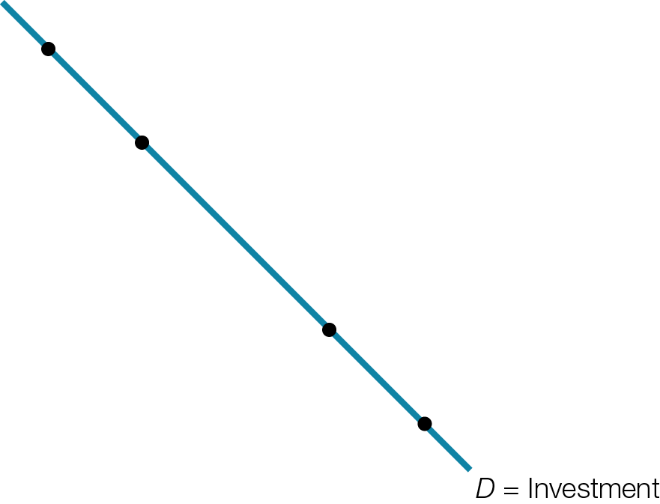
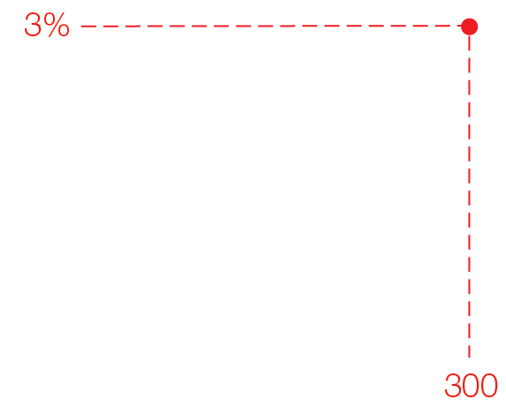
The Loanable Funds Market

Slide 53
Enlarged GDP Circular Flow of Income and Spending ($) with Banking System

Slide 54
Savings, Investment, and Growth
Business investment spending also increases quantity and quality of inputs, so potential GDP and living standards increase over time
Full employment continues
Average prices stay stable
Say’s Law works even with savings, yielding ideal Invisible Hand outcomes with economic growth

Slide 55
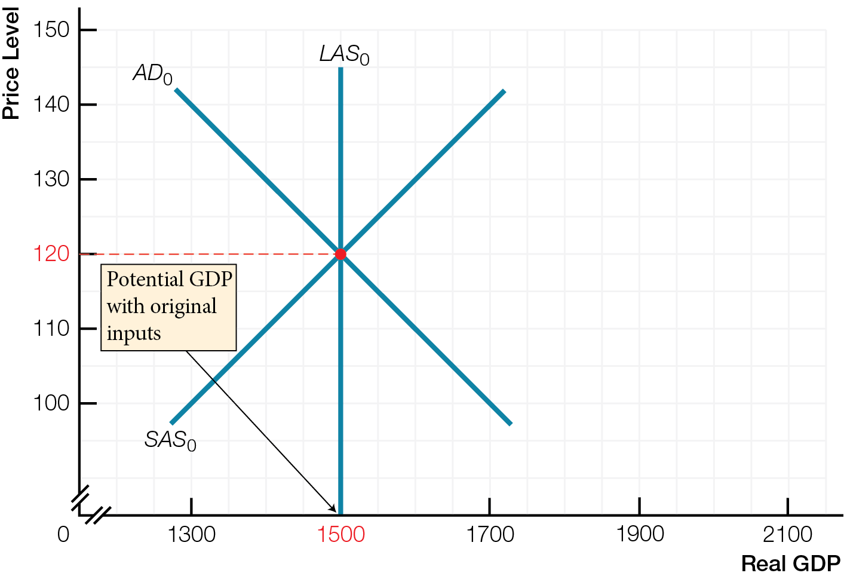
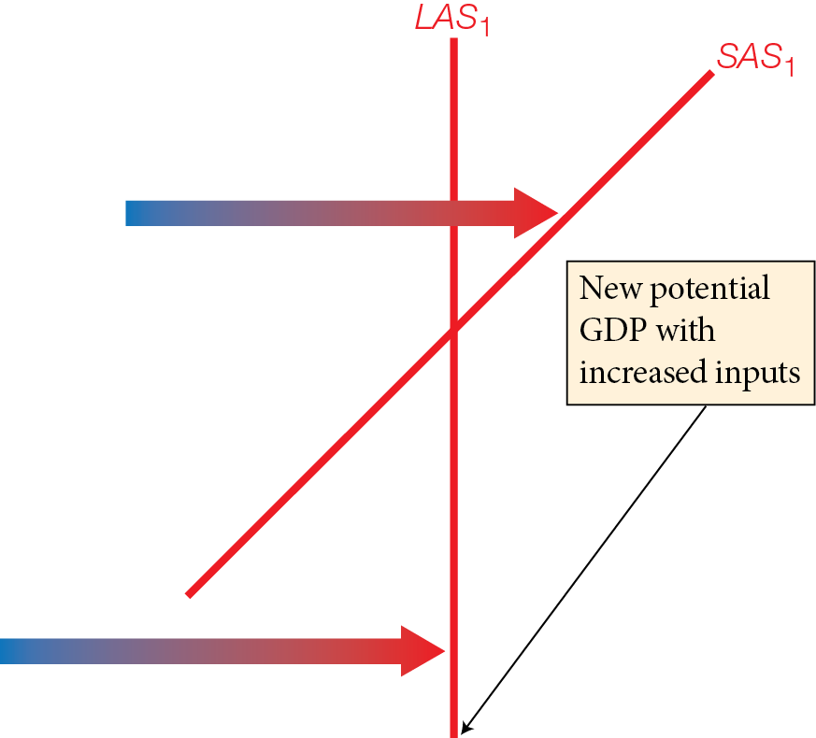
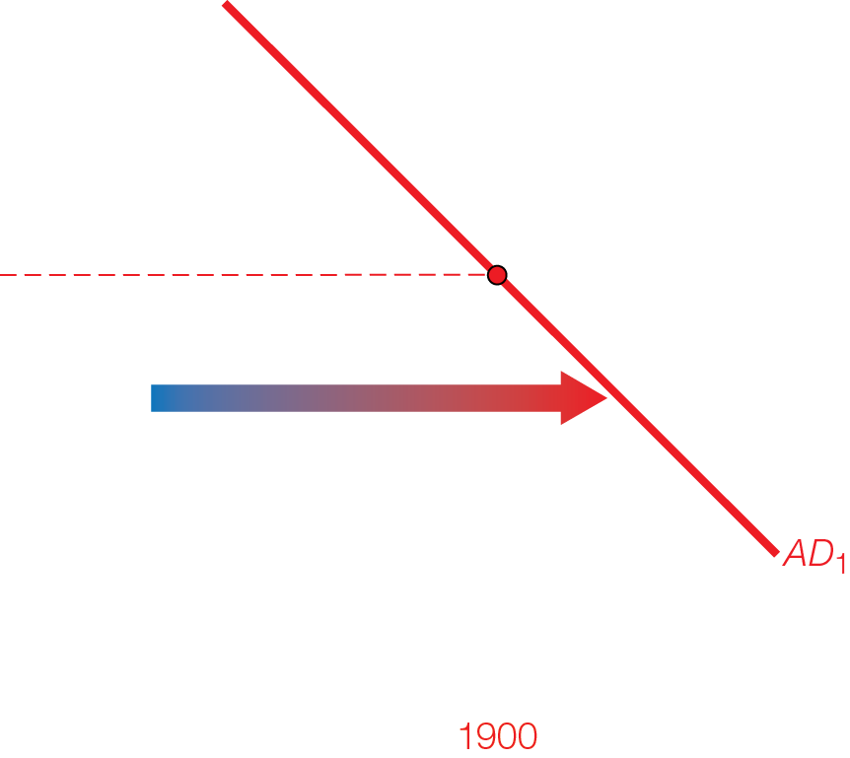
Economic Growth, Rising Living Standards, and Stable Prices

Slide 56
SCENARIO THREE
Mismatches between SAS and AD Plans

Slide 57
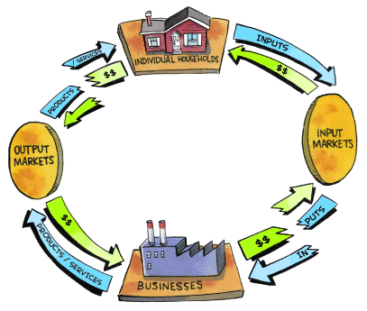
Four mismatches between aggregate demand and aggregate supply move economy away from long-run equilibrium targets

Slide 58
Negative demand shocks cause a recessionary gap — falling average prices, decreased real GDP, increased unemployment

Slide 59






Negative Demand Shocks
Fig. 8.14

Slide 60
Positive demand shocks cause an inflationary gap — rising average prices, increased real GDP, decreased unemployment

Slide 61





Positive Demand Shocks
Fig. 8.15

Slide 62
Negative demand shocks cause a recessionary gap — falling average prices, decreased real GDP, increased unemployment
Positive demand shocks cause an inflationary gap — rising average prices, increased real GDP, decreased unemployment
Demand shocks
Y and P move in same direction
Unemployment and inflation move in opposite directions; like Phillips Curve

Slide 63
Negative supply shocks cause stagflation — rising average prices, decreased real GDP, increased unemployment

Slide 64






Negative Supply Shock - Stagflation
Fig. 8.16

Slide 65
Positive supply shocks cause — falling average prices, increased real GDP, continued full unemployment

Slide 66






Positive Supply Shock – Increase in Potential GDP
Fig. 8.17

Slide 67
Negative supply shocks cause stagflation — rising average prices, decreased real GDP, increased unemployment
Positive supply shocks cause — falling average prices, increased real GDP, continued full unemployment
Supply shocks
Y and P move in opposite directions
Unemployment and inflation move in same direction: inconsistent with original Phillips Curve

Slide 68
How To Use AS/AD Models to Think Like an Economist
Remember LAS is different from SAS and AD. LAS is a performance target. SAS and AD are plans.
Always start the story in long-run macroeconomic equilibrium, where LAS, SAS, AD all intersect
Model a macroeconomic event as 1 of the 4 possible shocks – positive/negative aggregate supply/demand shock. Examine results of shock on GDP, unemployment, inflation
Analyze the return to long-run equilibrium after the shock
Yes and No camps disagree about how markets adjust after shocks – no simple stories

Slide 69


ORIGINS AND RESPONSES TO BUSINESS CYCLES
The “Yes — Markets Self-Adjust” and “No — Markets Fail Often” camps disagree about the external/internal origins of shocks, about rational/volatile expectations, and about how quickly price adjustments restore the match between aggregate supply and aggregate demand.

Slide 70
Negative Demand Shocks

Slide 71


“Yes — Markets Self-Adjust” so government hands-off
Long-run focus
Origins of shocks are external to economy — in nature, science, and mistaken government policies
Emphasizes rational expectations of investors and logical choices

Slide 72

When shocks occur, price adjustments in markets quickly restore match between aggregate supply and aggregate demand
In loanable funds market, falling interest rates increase investment spending (I) to restore aggregate demand [AD shifts rightward]
In labour market, unemployment causes wages to fall, increasing hiring of labour until full employment restored [SAS shifts rightward]

Slide 73
Negative Demand Shocks

Slide 74


“No — Markets Fail Often” so government hands-on
Short-run focus
Origins of shocks are internal to economy — from changing expectations, role of money, and connections with R.O.W.
Emphasizes volatile expectations: fundamental uncertainty; changeable “herd mentality” of investors; postponable nature of investments; investment based on animal spirits — gut-level instinct to act

Slide 75
When shocks occur, price adjustments are difficult and slow, so role for government to bring short-run aggregate supply and aggregate demand back into balance
In loanable funds market, even if interest rates fall, pessimistic expectation may decrease investment spending (I) [AD does not shift rightward]
In labour market, wages are sticky (don’t fall easily) even with unemployment — workers and employers accept layoffs instead of lower wages [SAS does not shift rightward]

Slide 76

Origins of Shocks and Business Cycles

Slide 77
Law of Short-Run Aggregate Supply and Changes in Short-Run Aggregate Supply

Slide 78
Law of Aggregate Demand and Changes in Aggregate Demand

