Slide 1

Steering Blindly?
Monetary Policy and the Bank of Canada

Slide 2

BANK OF CANADA’S JOB
The Bank of Canada changes the money supply and interest rates, aiming for an inflation control target that achieves steady growth, full employment, and stable prices.

Slide 3
Bank of Canada is responsible for monetary policy — adjusting the supply of money and interest rates to achieve steady growth, full employment, and price stability
Price stability means inflation rate is low enough to not significantly affects peoples’ decisions

Slide 4
Inflation-control target range of inflation rates set by a central bank as a monetary policy objective
Bank of Canada’s target is an annual inflation rate of 1 to 3 percent as measured by the CPI
Monetary policy aims for 2 percent
Bank of Canada uses core CPI as an operational guide about underlying inflation trends

Slide 5

OPEN MARKET OPERATIONS
The Bank of Canada uses open market operations to change interest rates. Buying bonds increases the money supply and raises bond prices, lowering interest rates. Selling bonds decreases the money supply and lowers bond prices, raising interest rates.

Slide 6
Interest rates are determined in money and loanable funds (bond) markets
Central banks influence short-run interest rates, but not long-run interest rates
Bank of Canada’s main policy tool is the overnight rate — interest rate banks charge each other for one-day loans
Overnight rate determines all other short-run interest rates

Slide 7
Lower interest rates ➔ ⬆ borrowing and spending, ⬇ saving
In a recessionary gap, Bank of Canada lowers interest rates to increase aggregate demand and accelerate the economy
Higher interest rates ➔ ⬇ borrowing and spending, ⬆ saving
In an inflationary gap, Bank of Canada raises interest rates to decrease aggregate demand and slow down the economy

Slide 8
Bank of Canada changes the target interest rate through open market operations — buying or selling government bonds on bond market
Money and bond markets are interconnected

Slide 9
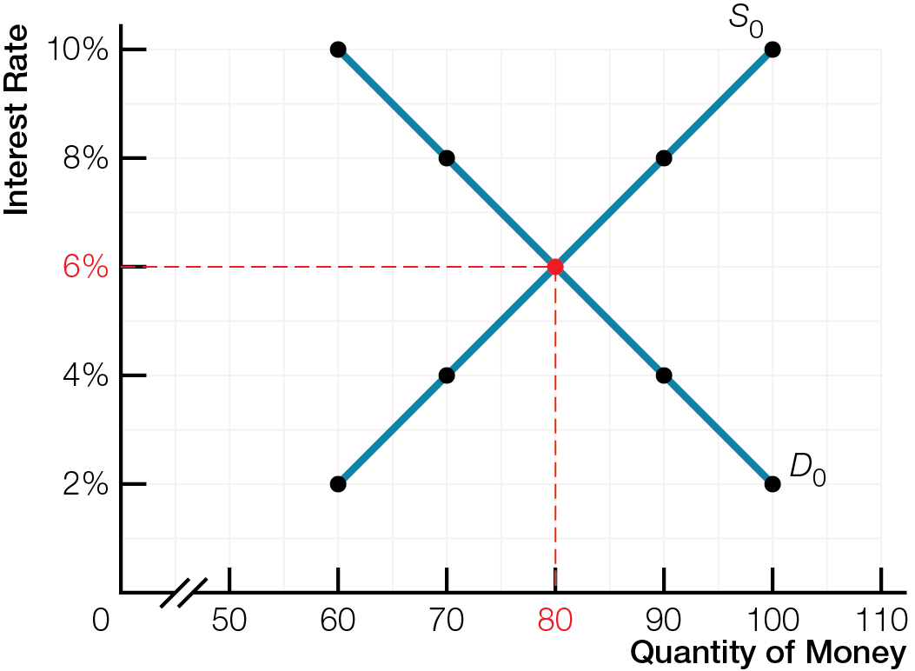
Initial Demand and Supply in the Money Market

Slide 10
To lower interest rates and accelerate economy
Money market story BoC changes money supply using open market operations to influence quantity of demand deposits (part of M1+)
Bank of Canada buys bonds, increasing bank reserves, loans, demand deposits, money supply
Bond market story BoC changes money supply using open market operations to influence bond prices and interest rates
Bank of Canada buys bonds, demand for bonds increases, raising bond prices, lowering interest rates

Slide 11
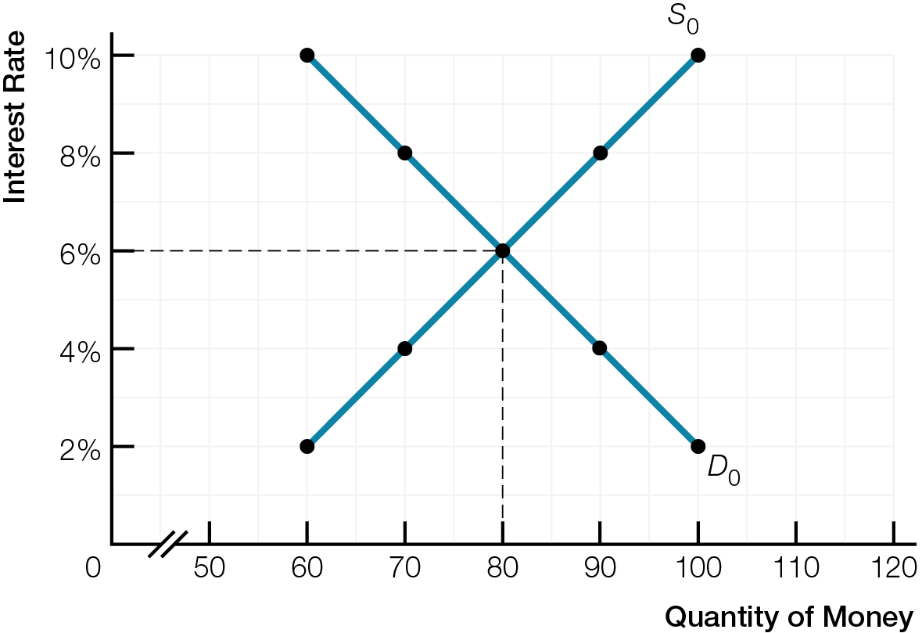
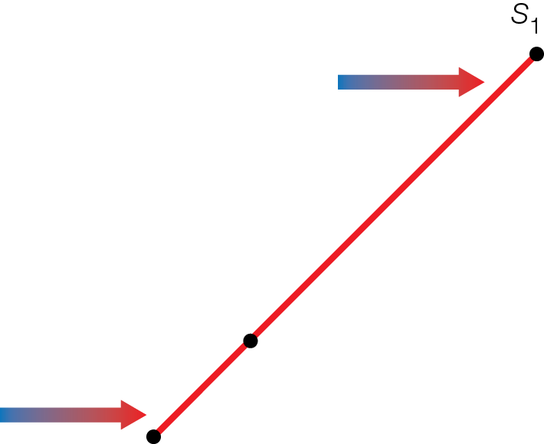
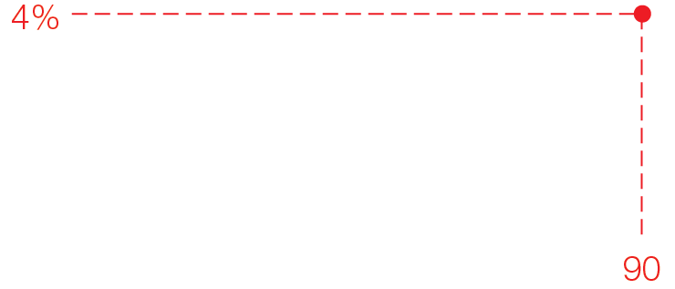
Demand and Supply in the Money Market after Bank of Canada Buys Bonds
Fig. 11.3

Slide 12
To raise interest rates and slow down economy
Money market story BoC changes money supply using open market operations to influence quantity of demand deposits (part of M1+)
Bank of Canada sells bonds, decreasing bank reserves, loans, demand deposits, money supply
Bond market story BoC changes money supply using open market operations to influence bond prices and interest rates
Bank of Canada sells bonds, supply of bonds increases, lowering bond prices, raising interest rates

Slide 13
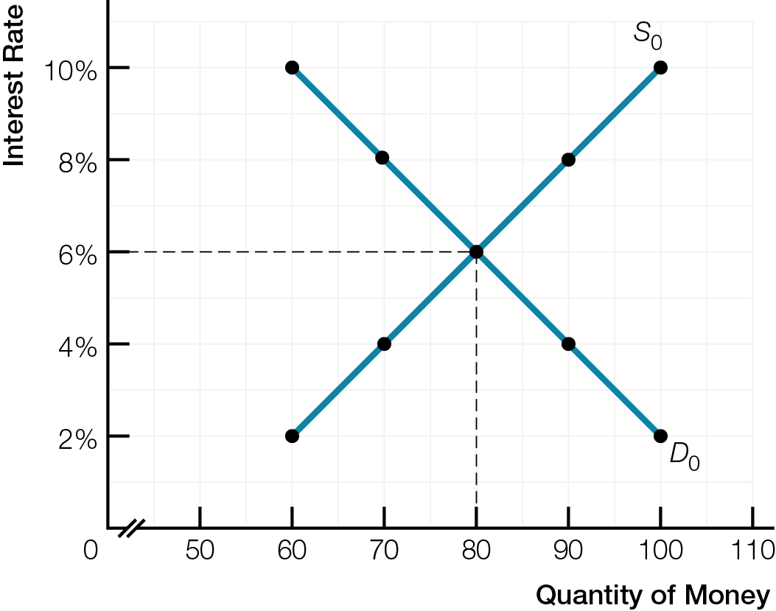
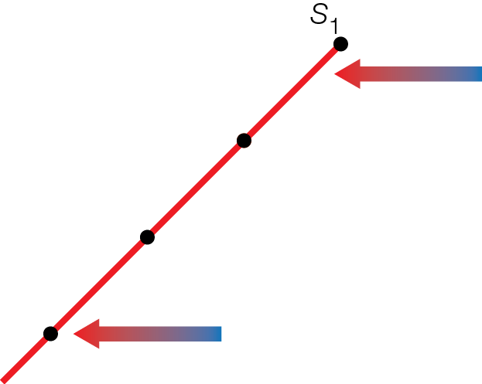
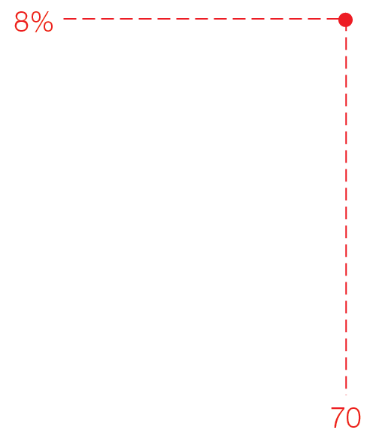
Demand and Supply in the Money Market after Bank of Canada Sells Bonds
Fig. 11.4

Slide 14
When Bank of Canada changes overnight rate, most short-run interest rates change in same direction
Prime rate interest rate on loans to lowest-risk borrowers
Long-run interest rates determined in the loanable funds (bond) market

Slide 15
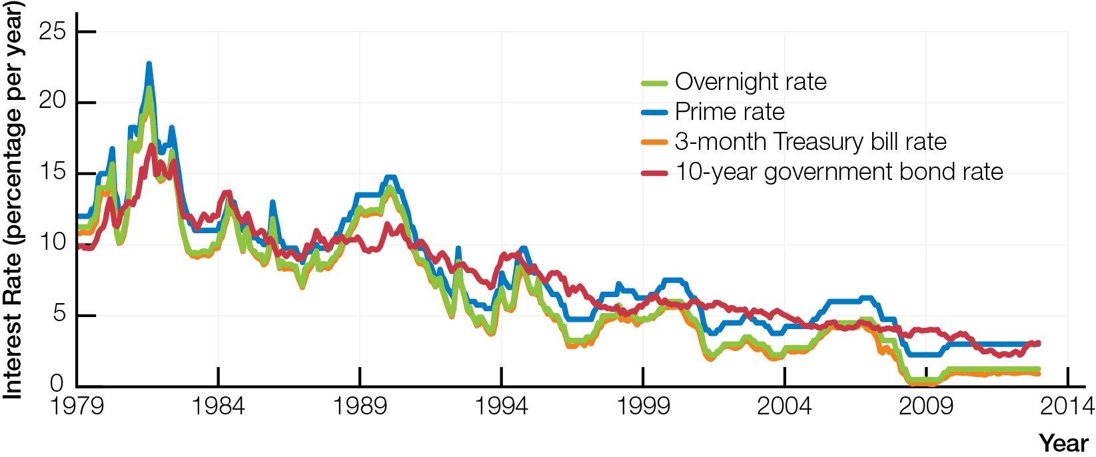
Short-Run and Long-Run Interest Rates in Canada, 1979 - 2013

Slide 16

TRANSMISSION MECHANISMS
Monetary policy affects aggregate demand by reinforcing domestic and international transmission mechanisms connecting interest rates, exchange rates, and spending.

Slide 17
Open market operations and interest rates affect aggregate demand (C + I + G + X – IM) through
Domestic monetary transmission mechanism (red paths on next slide)
International transmission mechanisms (blue paths on next slide)

Slide 18
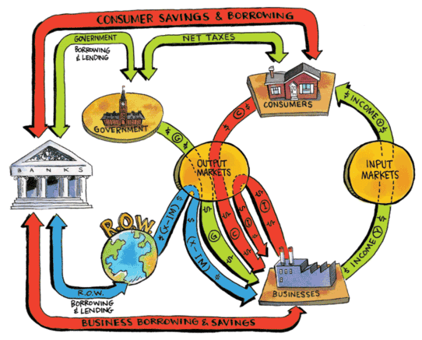
Enlarged GDP Circular Flow of Income and Spending ($) with Banking System

Slide 19
Domestic monetary transmission mechanism
Lower interest rates a positive aggregate demand shock, increasing consumption (C) and business investment spending (I)
Higher interest rates a negative aggregate demand shock, decreasing consumption (C) and business investment spending (I)

Slide 20
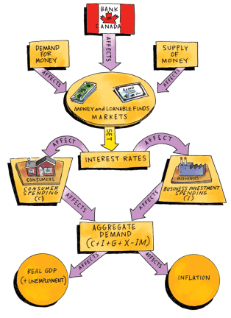
Bank of Canada and Domestic Monetary Transmission Mechanism

Slide 21

International transmission mechanisms work through impact of interest rates on exchange rate
Lower interest rate ➔ depreciating C$; positive demand shock increasing net exports (X − IM), increasing inflation
Higher interest rate ➔ appreciating C$; negative demand shock decreasing net exports (X − IM), decreasing inflation

Slide 22
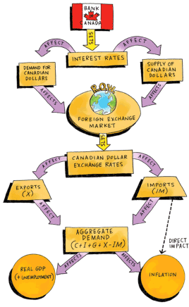
Bank of Canada and International Monetary Transmission Mechanism

Slide 23
Domestic and international transmission mechanisms reinforce each other
Use monetary policy to correct recessionary gap by lowering interest rates — ➔ aggregate demand increases, unemployment decreases, inflation increases

Slide 24
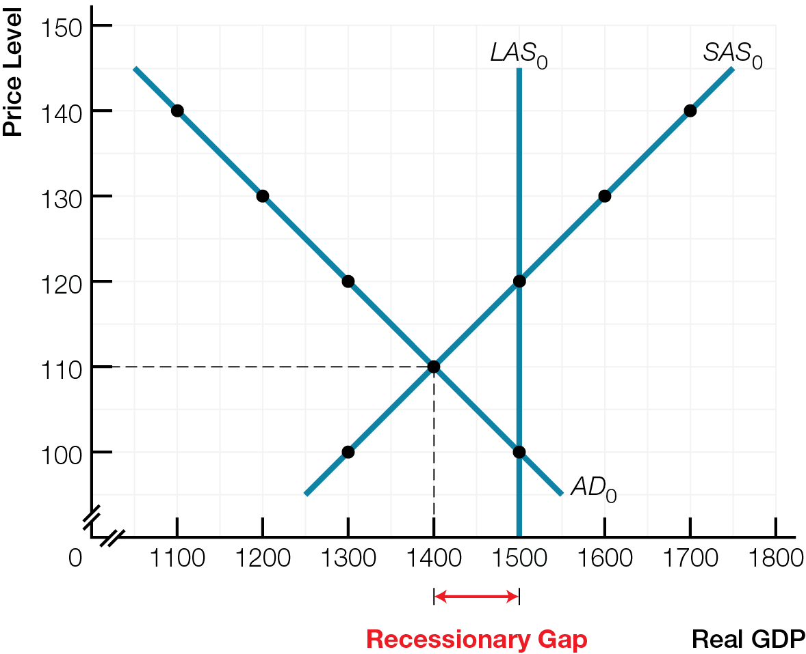
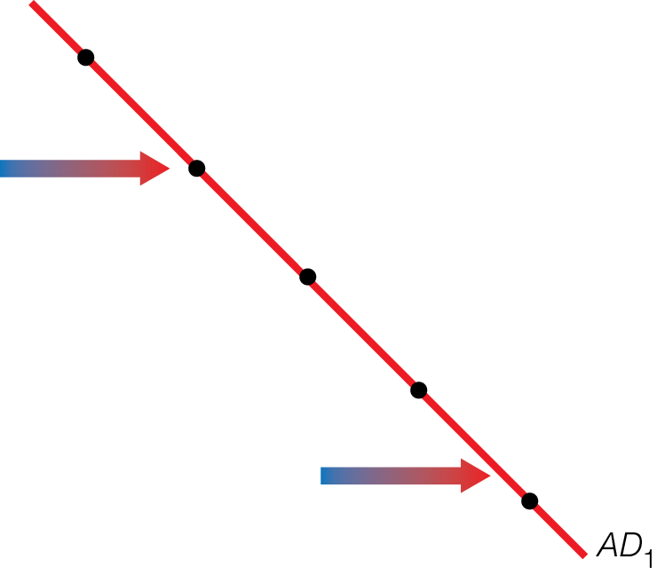
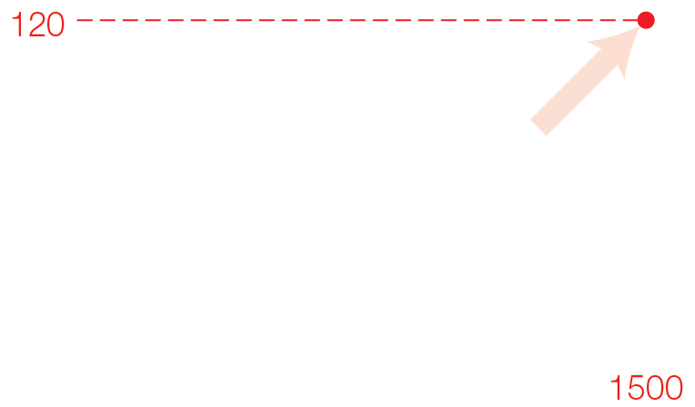
Lowering Interest Rates Causes a Positive Demand Shock
Fig. 11.9

Slide 25
Use monetary policy to correct inflationary gap by raising interest rates — ➔ aggregate demand decreases, unemployment increases to natural rate, inflation decreases

Slide 26
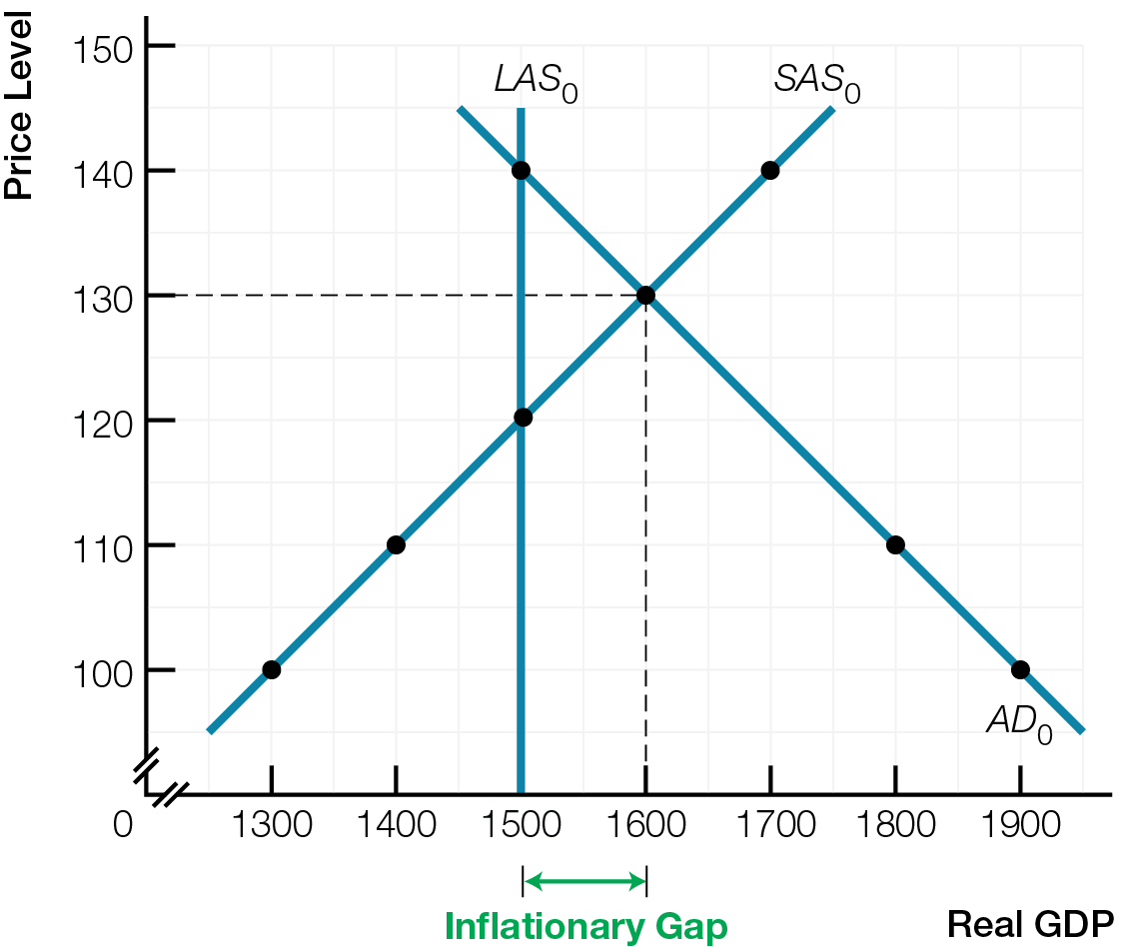
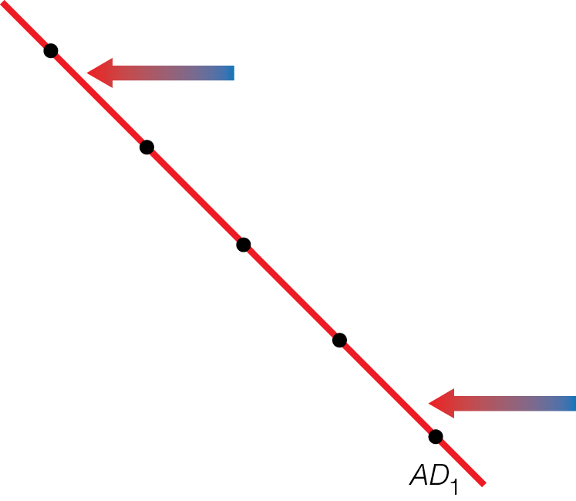
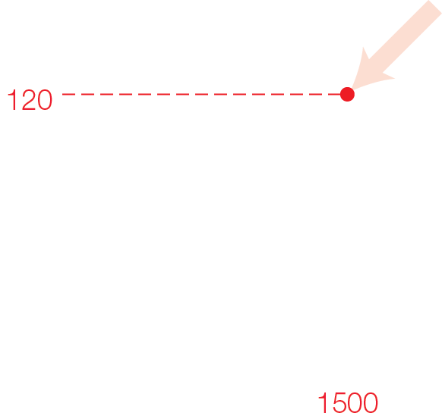
Raising Interest Rates Causes a Negative Demand Shock
Fig. 11.10

Slide 27
Monetary policy is about moderation — accelerating when economy is slowing, braking when economy is speeding up
Monetary policy to brake the economy is politically unpopular
“Taking away the punch bowl just when the party is getting started!”

Slide 28
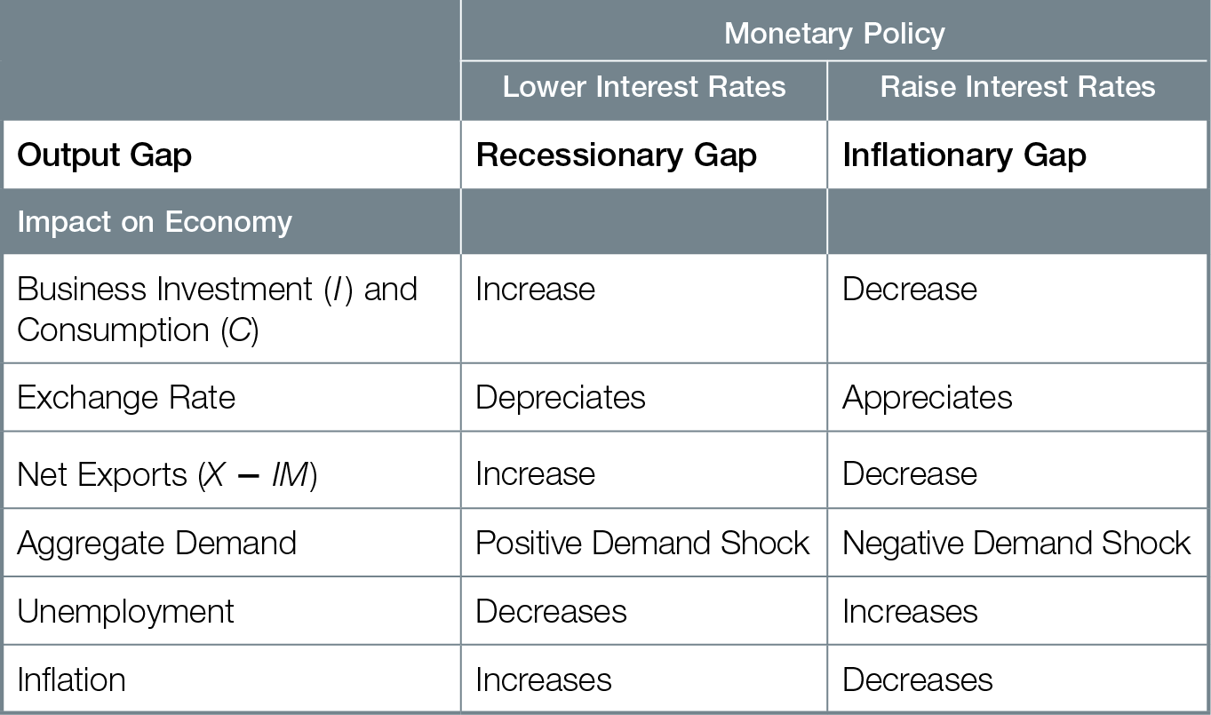
Transmission Effects of Monetary Policy

Slide 29

TRANSMISSION BREAKDOWNS
In a balance sheet recession, individuals and businesses focus on paying down debt and do not want to borrow or spend. Even when monetary policy lowers interest rates, the economy remains in recession.

Slide 30
Recessions often start with decreasing business investment spending, falling net exports, or rising interest rates
2008 Global Financial Crisis instead started with falling asset prices ➔ a balance sheet recession
Balance sheet shows assets (what you own or earn) and debts or liabilities (what you owe or spend)
Falling asset prices led individuals and businesses to cut spending, save, and pay down debt
Transmission breakdowns for monetary policy: ⬇ interest rates did not ⬆ spending or aggregate demand
Notes:
Listen to video to write lead in and out

Slide 31



Transmission breakdowns are caused by
Consumers — saving more, paying off debts, spending less
Businesses — pessimistic expectations decrease business investment spending even with lower interest rates
Money as a store of value — giving players a way not to spend
Banks — holding cash reserves and not making new loans and not increasing demand deposits and money supply

Slide 32

To counteract transmission breakdowns, central banks used quantitative easing — flooding the financial system with money by buying high-risk bonds, mortgages, and assets from banks
Liabilities on bank balance sheets replaced with cash, enabling banks to make new loans, new demand deposits, and increase quantity of money

Slide 33
Risk of inflation from flooding financial system with money
Quantity theory of money predicts increasing money supply causes inflation
Central banks have a difficult timing problem of applying monetary “brake” of higher interest rates before inflation starts, but not too soon to stop economic recovery
Balance sheet recessions cause transmission problems for monetary policy, making it harder to steer economy toward recovery

Slide 34
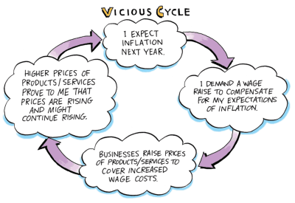
ANCHORING INFLATION EXPECTATIONS
Inflation rate targeting by an independent central bank anchors inflation expectations, helps price signals work, and combines a hands-off emphasis on rules and hands-on emphasis on government discretion.

Slide 35
Inflation-control target set jointly by Government of Canada and Bank of Canada
Bank of Canada alone responsible for monetary policy to achieve the target
Bank of Canada has considerable independence, but ultimately responsible to Parliament
Bank of Canada focused only on inflation rate since 1991
Inflation stayed within the target range
Steered economy toward rising living standards, full employment

Slide 36
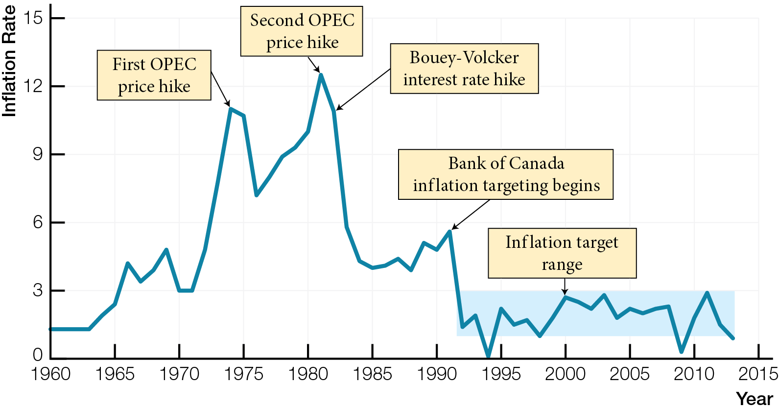
Inflation Rates and Targets in Canada, 1960 - 2013

Slide 37
Advantages of inflation rate targeting
Anchoring expectations about inflation
Improving predictability of prices
Phillips Curve trade-off between inflation & unemployment works when expectations of inflation do not change
Once inflation starts, changing expectations self-fulfilling — reacting to expectation of inflation may cause it
Changing inflation expectations, with increases in money supply, eliminated original Phillips Curve’s trade-off between inflation and unemployment
Inflation expectations go up quickly and easily, but come down slowly and painfully

Slide 38

Unpredictable prices — due to inflation — create risk, discourage business investment, interfere with price signals for smart choices
Yes — Markets Self-Adjust — Hands-Off and No — Markets Fail Often — Hands-On camps agree markets need a central bank
Banks regulated because of trade-off between profits and prudence
Disagreements between camps on monetary policy

Slide 39

Yes — Markets Self-Adjust camp favours hands-off rules for monetary policy, likes targets, no discretion for central bankers, no opportunity for politicians to influence monetary policy
Believes government failure is more likely than market failure

Slide 40

No — Markets Fail Often camp favours hands-on government discretion for monetary policy to correct transmission breakdown, allow elected politicians to set policy
Believes market failure is more likely than government failure

Slide 41

Both camps agree that inflation control targets are an effective compromise between hands-off emphasis on rules and hands-on emphasis on government discretion

