Slide 1

Spending Others’ Money
Fiscal Policy, Deficits and the National Debt

Slide 2
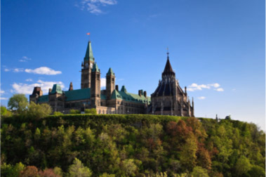
DEMAND POLICIES FOR STABILIZATION
Fiscal policies — changes in government spending, taxes, and transfers — act as aggregate demand shocks, have multiplied impact on aggregate demand, and can counter output gaps.

Slide 3
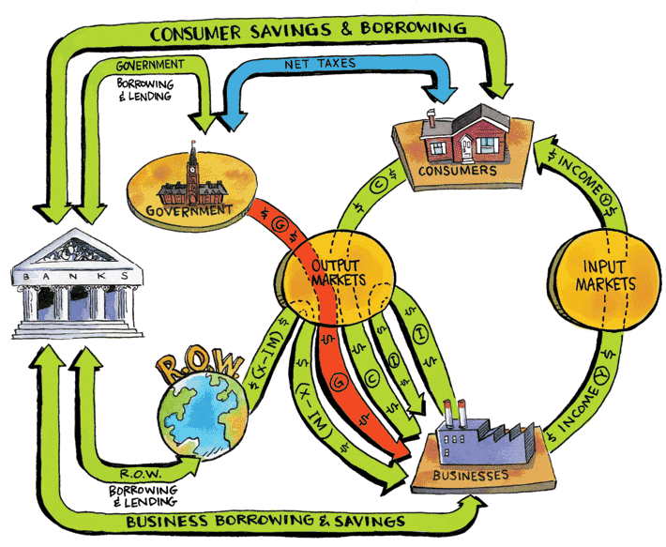
Enlarged GDP Circular Flow of Income and Spending with Banking System

Slide 4
Fiscal policy changes in government purchases, taxes, transfers to achieve macroeconomic outcomes of steady growth, full employment, and stable prices
Circular flow transmits the effects of fiscal policy
Injection spending in the circular flow not starting with consumers: G (government spending), I (business investment spending), X (exports)
Leakage spending leaking out of the circular flow through taxes, saving, imports

Slide 5
Multiplier effect spending injection has multiplied effect on aggregate demand
Multiplied increase in aggregate demand from
Increased government spending
Tax cuts
Increased transfers
Multiplied decrease in aggregate demand from
Decreased government spending
Tax increases
Decreased transfers

Slide 6
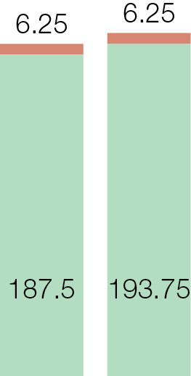
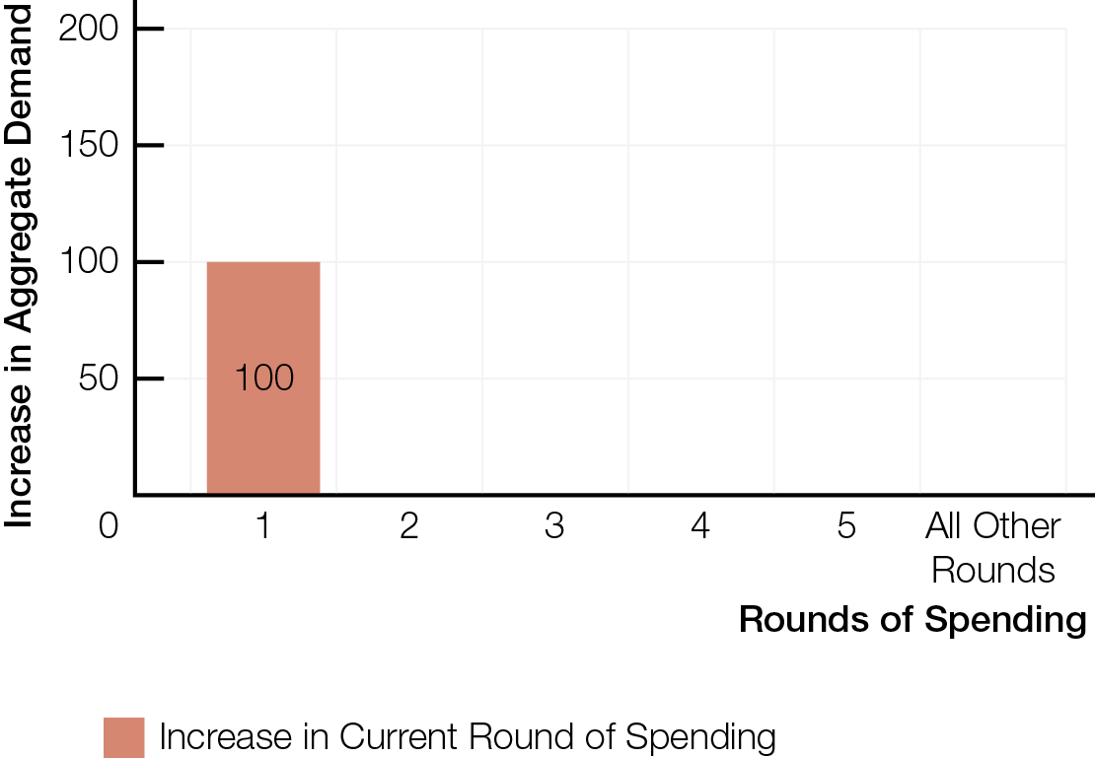
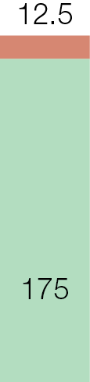
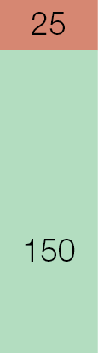
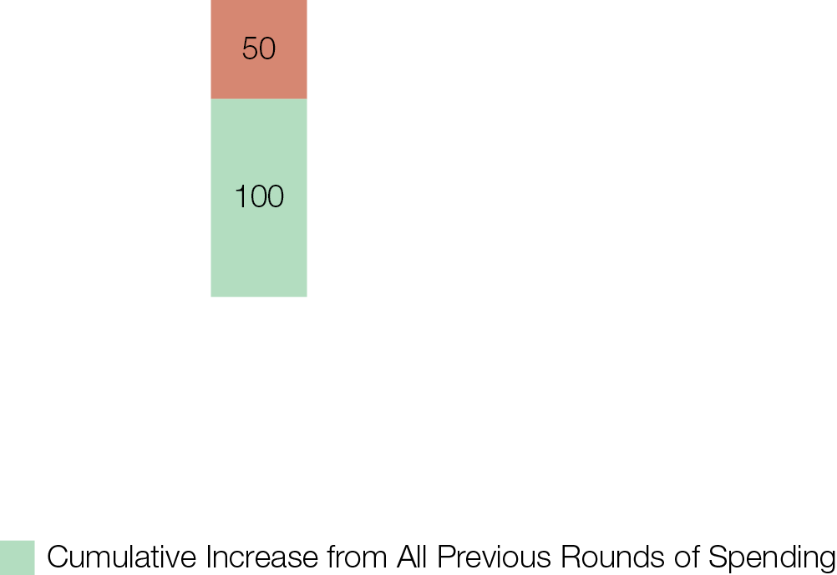
The Multiplier Effect
Fig. 12.2

Slide 7
Size of multiplier effects depends on leakages out of circular flow
More leakages = smaller multiplier
Fewer leakages = larger multiplier
Multiplier effect for tax and transfer changes smaller than for government spending
Change in injections — G , I , X — is aggregate demand shock, shifting AD rightward (⬆ injections) or leftward (⬇ injections) by multiplied effect of initial injection
1
% of leakages from additional income
Size of Multiplier
Effect
=

Slide 8
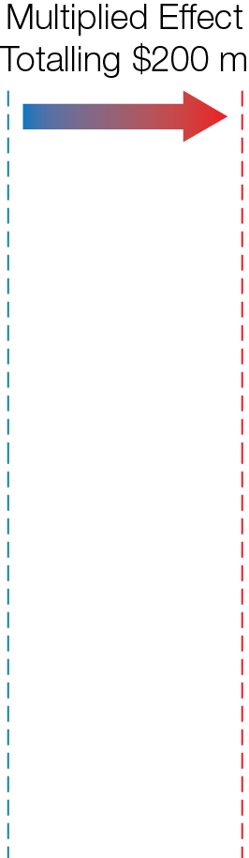
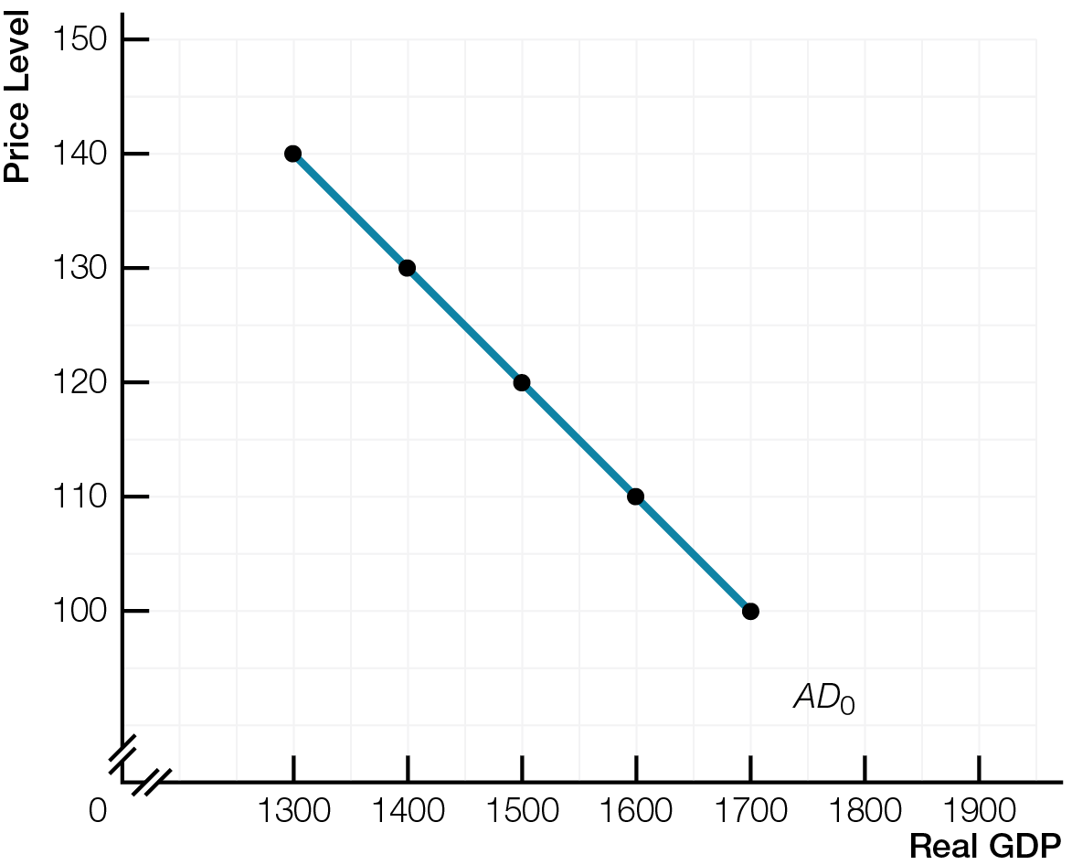
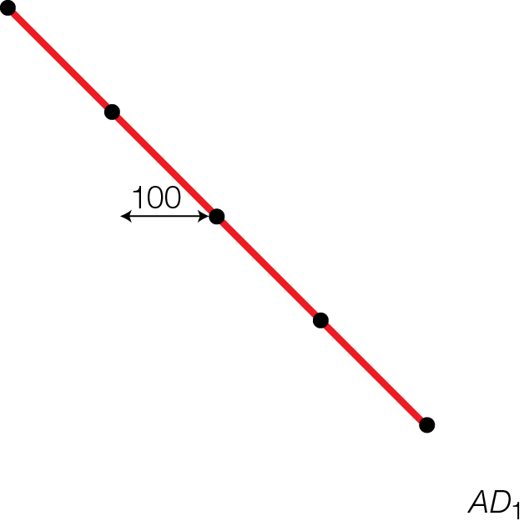
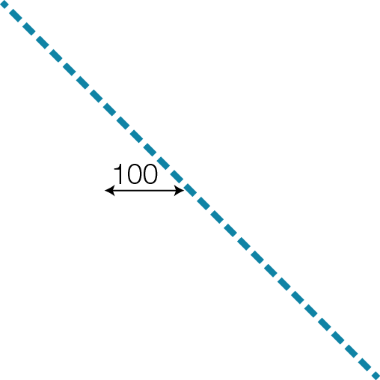
The Multiplied Effect of Government Spending on Aggregate Demand
Fig. 12.3

Slide 9
Expansionary fiscal policy increases aggregate demand by increasing government spending, decreasing taxes, or increasing transfers
Shifts the aggregate demand curve rightward — positive aggregate demand shock
Counters a recessionary gap

Slide 10
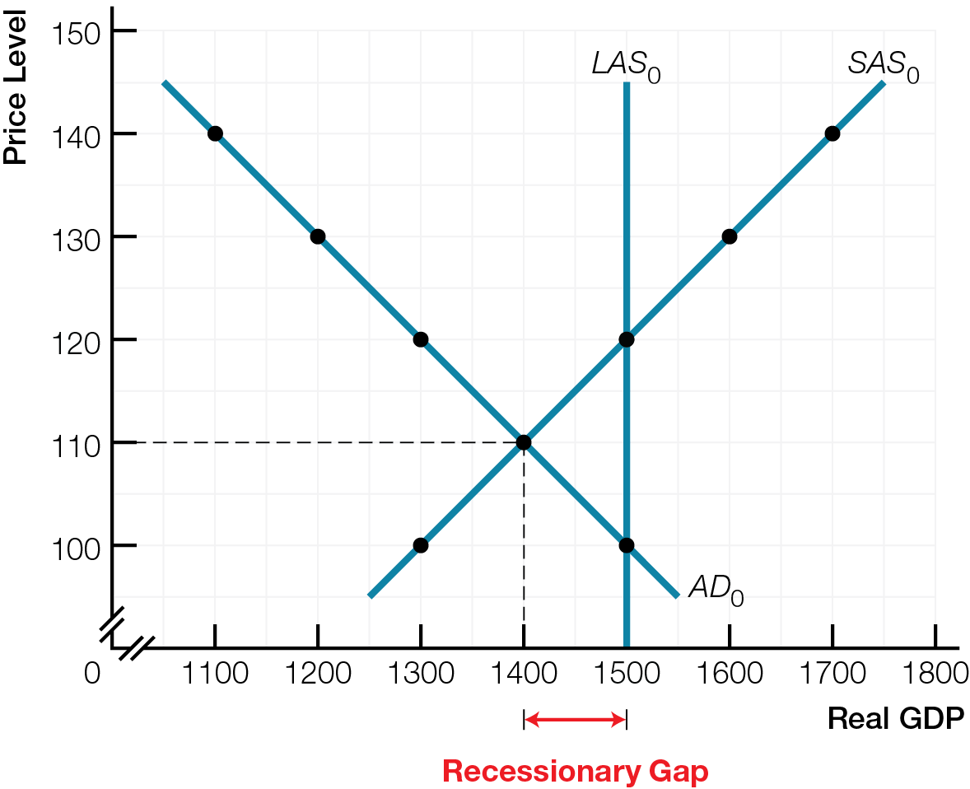
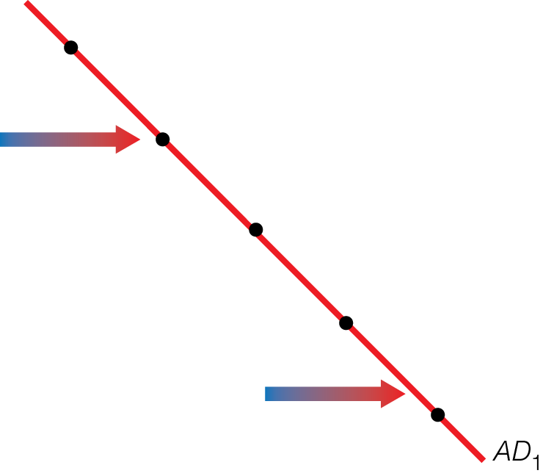
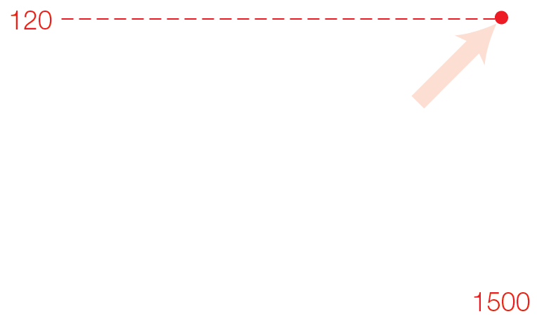
Expansionary Fiscal Policy to Fill a Recessionary Gap
Fig. 12.4

Slide 11
Contractionary fiscal policy decreases aggregate demand by decreasing government spending, increasing taxes, or decreasing transfers
Shifts the aggregate demand curve leftward — negative aggregate demand shock
Counters an inflationary gap

Slide 12
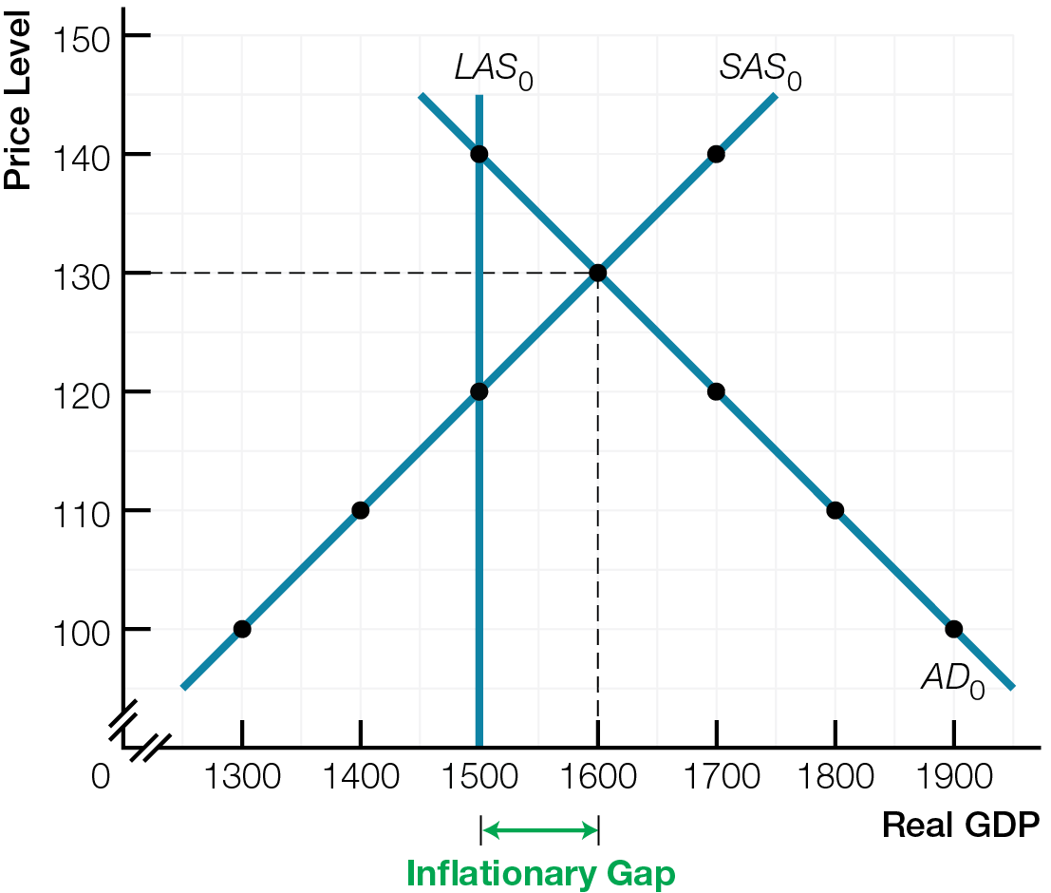
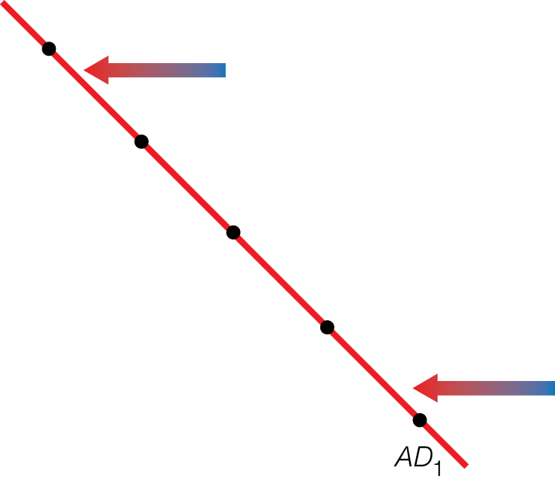
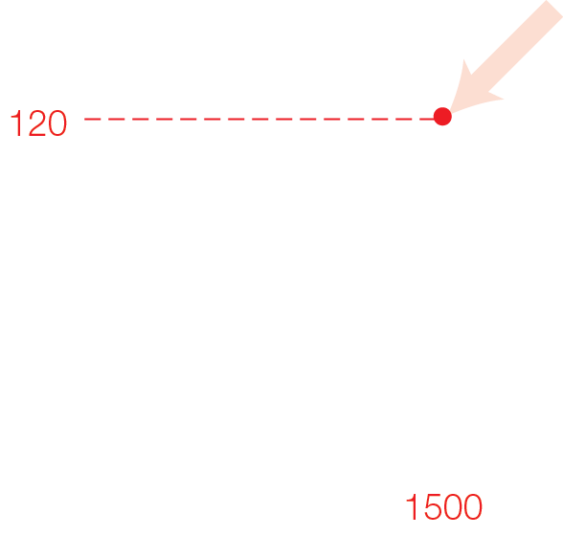
Contractionary Fiscal Policy to Fill an Inflationary Gap
Fig. 12.5

Slide 13
Injection’s multiplier effects on equilibrium real GDP depend on how close economy is to potential GDP
When economy below potential GDP, more of increase in aggregate demand increases real GDP
When economy at or above potential GDP, more of increase in aggregate demand drives up prices

Slide 14
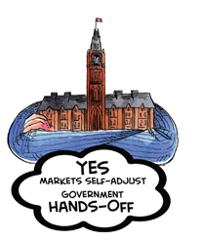
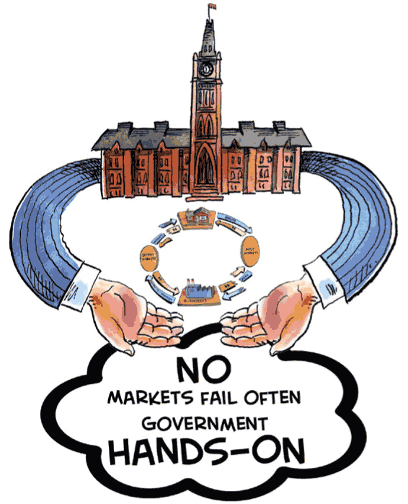
Hands-off camp favours tax cuts to accelerate economy; spending reductions to slow economy
Hands-on camp favours government spending to accelerate economy; tax increases to slow economy

Slide 15
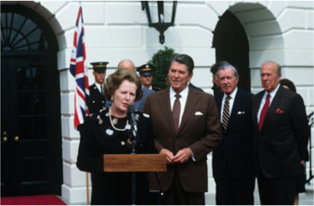
SUPPLY POLICIES FOR GROWTH
Fiscal policies targeting aggregate supply — tax incentives, support for R&D, education, training — promote economic growth, but hands-off and hands-on camps differ in emphasizing long-run or short-run effects.

Slide 16
Government policies to promote economic growth include spending and tax incentives
To stimulate saving and increase quantity of capital
For research and development
For education and training increasing human capital
Fiscal spending and tax policies can increase quantity and quality of inputs, increasing (long-run and short-run) aggregate supply and potential GDP per person

Slide 17
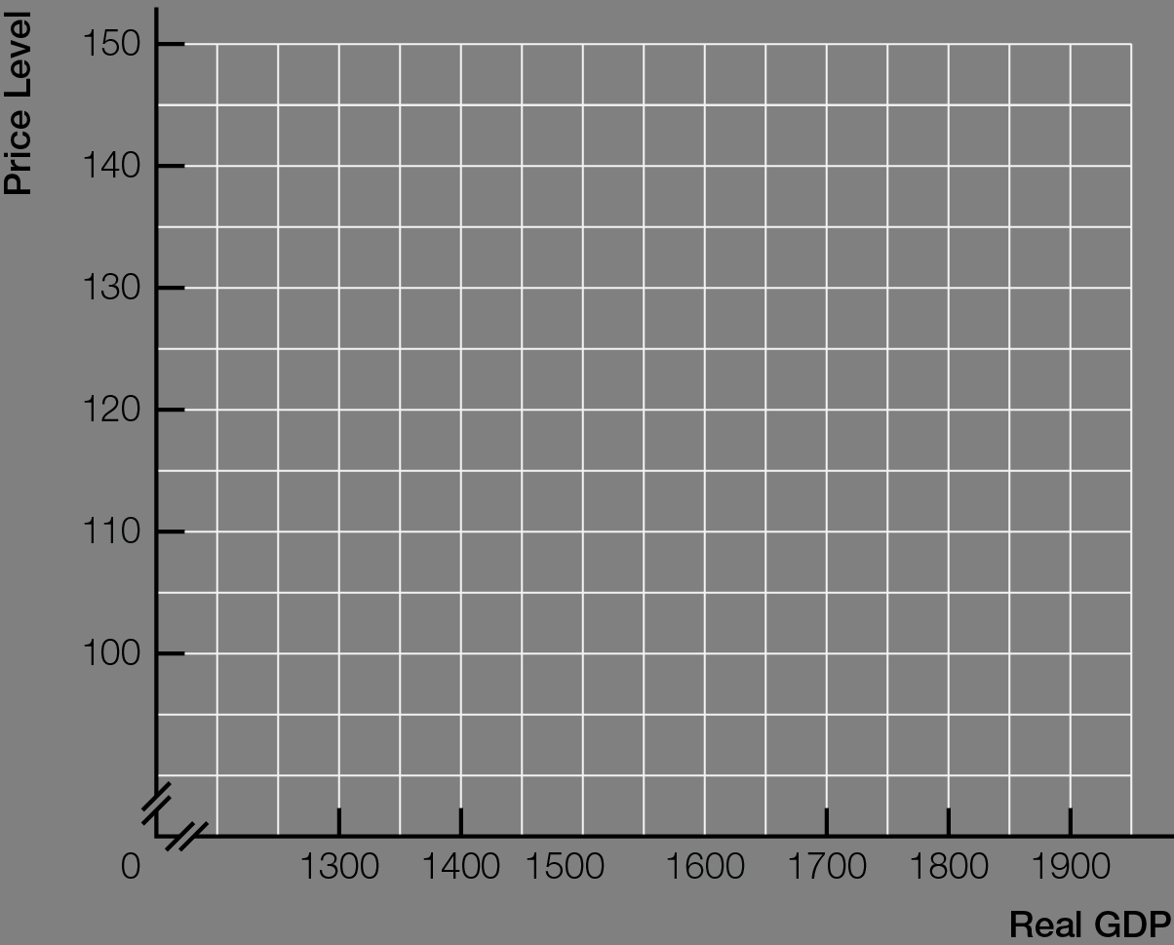
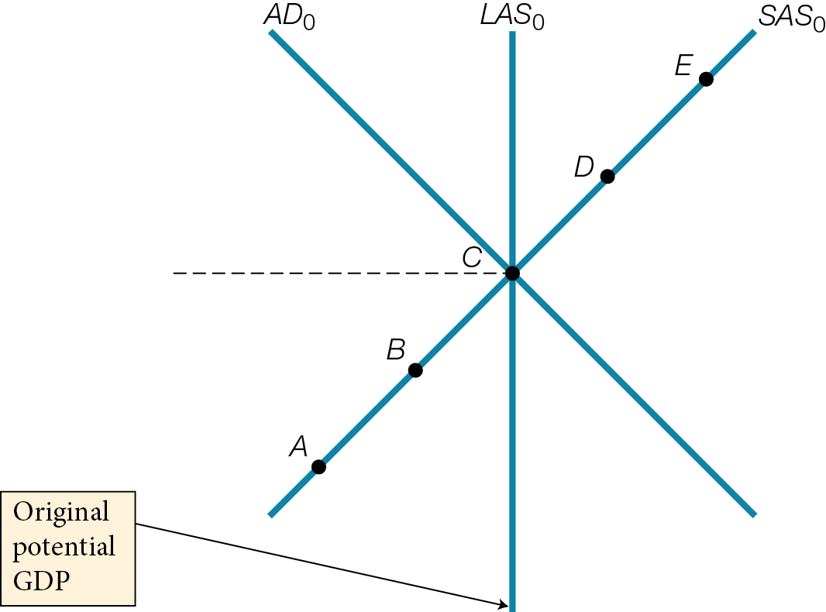
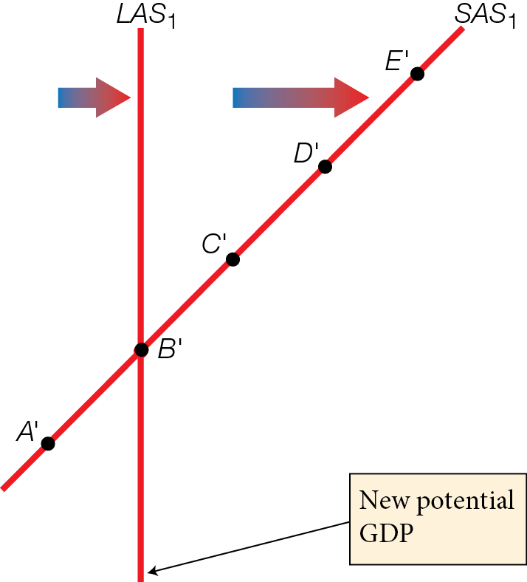

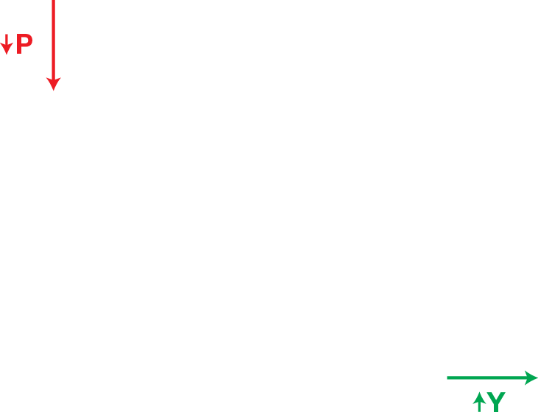
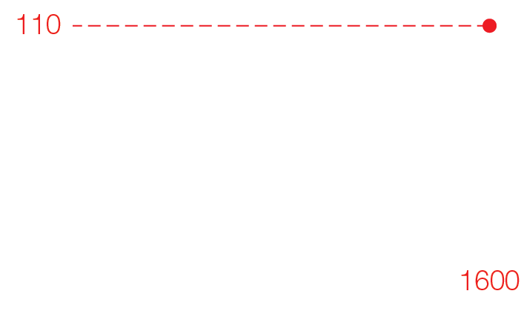
Positive Supply Shock and Economic Growth
Fig. 12.6

Slide 18
Supply-side effects incentive effects of taxes on aggregate supply
Supply-siders believe tax cuts have powerful incentive effects and will increase, not decrease, government tax revenues
Laffer Curve — graph showing that as tax rate increases, tax revenues increase, reach a maximum, then decrease

Slide 19
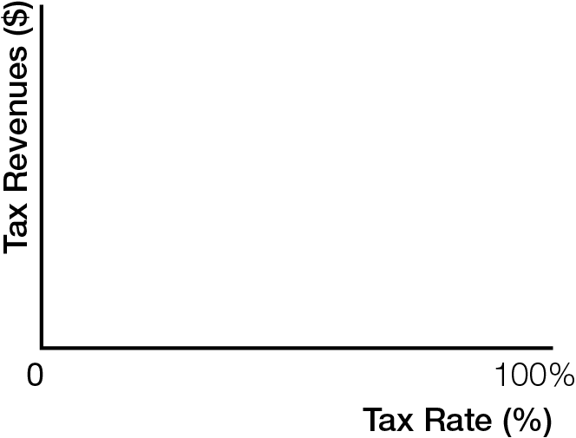
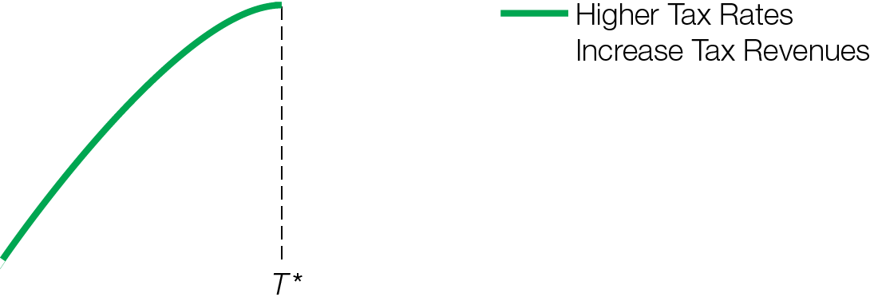
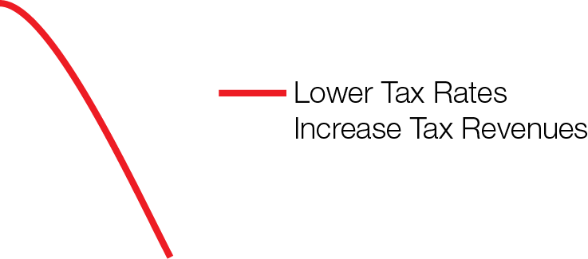
The Laffer Curve
Fig. 12.7

Slide 20
Supply-side effects incentive effects of taxes on aggregate supply
Supply-siders believe tax cuts have powerful incentive effects and will increase, not decrease, government tax revenues
Laffer Curve — graph showing that as tax rate increases, tax revenues increase, reach a maximum, then decrease
Evidence shows that tax cuts reduce revenue
Supply-sider arguments appeal to politicians who promise tax cuts — which voters like — without reducing government services or going into debt

Slide 21
Fiscal policies that encourage saving can decrease aggregate demand in the present
Hands-off camp believes long-run benefits of increased aggregate supply outweigh short-run mismatches between reduced aggregate demand and aggregate supply
Hands-on camp worries that short-run costs of decreased aggregate demand and recession outweigh long-run benefits of economic growth

Slide 22

BUDGET SURPLUSES AND DEFICITS
Automatic stabilizers create cyclical budget deficits and surpluses while keeping the economy close to potential GDP. Structural deficits and surpluses at potential GDP are more problematic.

Slide 23
Government budget scenarios
Balanced budget revenues = spending
Budget deficit revenues < spending
Budget surplus revenues > spending

Slide 24
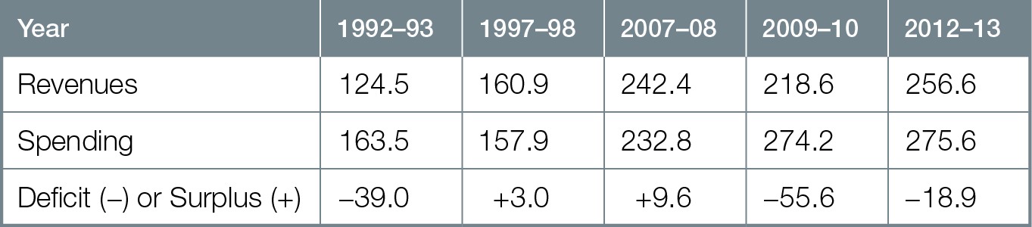
Government of Canada Budgets, Selected Years, 1992 - 2014

Slide 25
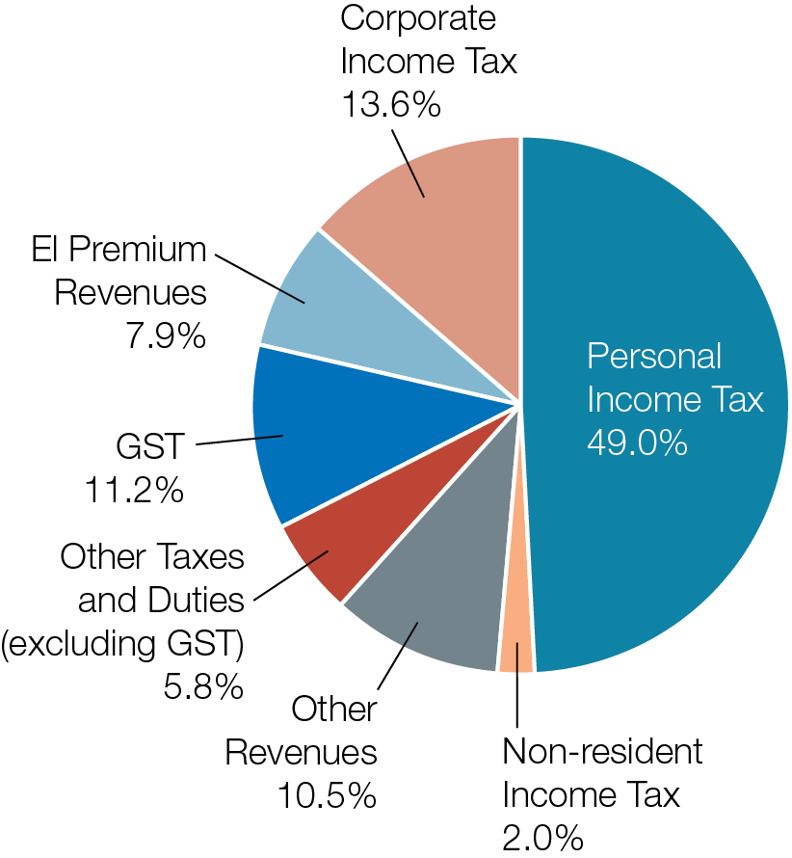
Government Revenues for 2012 - 2013

Slide 26
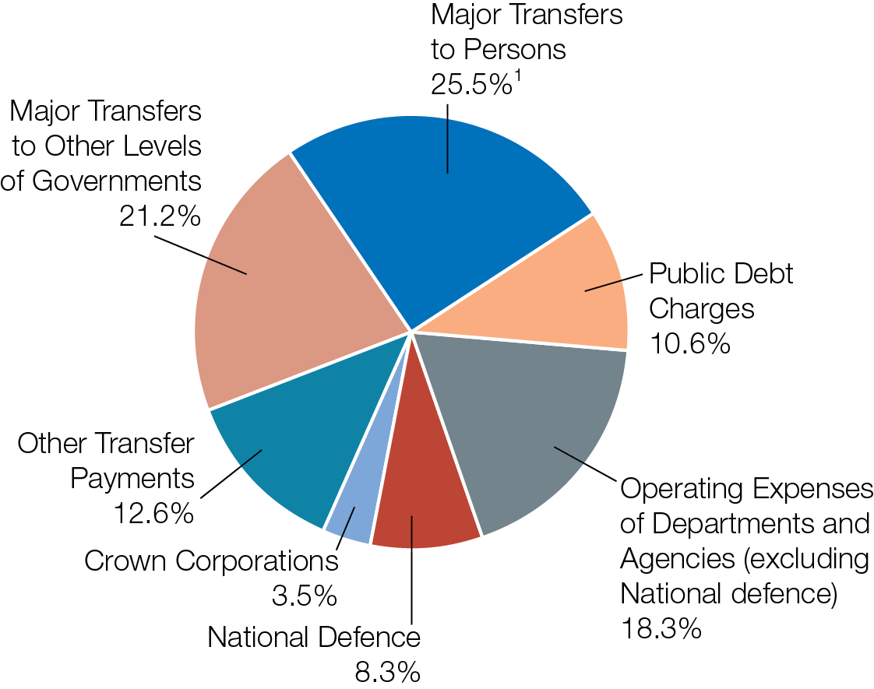
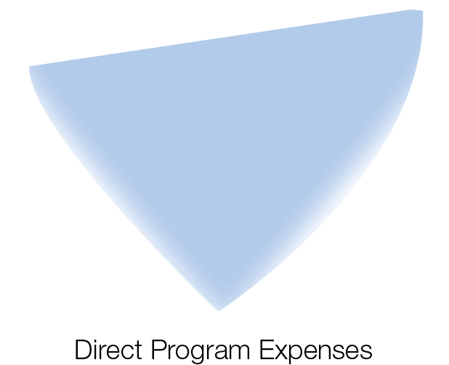
Government Spending for 2012 - 2013

Slide 27
Automatic stabilizers tax and transfer adjustments counteracting changes to real GDP, without explicit government decisions
During contractions, tax revenues fall, transfer payments increase, supporting spending and aggregate demand, but causing automatic budget deficit
During expansions, tax revenues rise, transfer payments decrease, reducing spending and aggregate demand, but causing automatic budget surplus

Slide 28
Automatic stabilizers work like a thermostat, keeping economy close to potential GDP
Since automatic stabilizers introduced after Great Depression, business cycles are less frequent, contractions less severe
Cyclical deficits and surpluses created only as a result of automatic stabilizers counteracting business cycles
With automatic stabilizers, government attempts to balance the budget during
Recessions — decrease aggregate demand, make recessions worse
Expansions — increase aggregate demand, increase risk of inflation

Slide 29
With a balanced budget over the business cycle, cyclical surpluses during expansions offset cyclical deficits during contractions
Economists are most concerned with structural deficits and surpluses — budget deficits and surpluses at potential GDP

Slide 30

NATIONAL DEBT
Deficits are a flow while debt is a stock. Of five common arguments about national debt, some are myths, some are potential problems.

Slide 31
Deficits and debt have different time dimensions
Deficits and surpluses are flows
Debt is a stock
National debt (public debt) total amount owed by government = (sum of past deficits) – (sum of past surpluses)

Slide 32
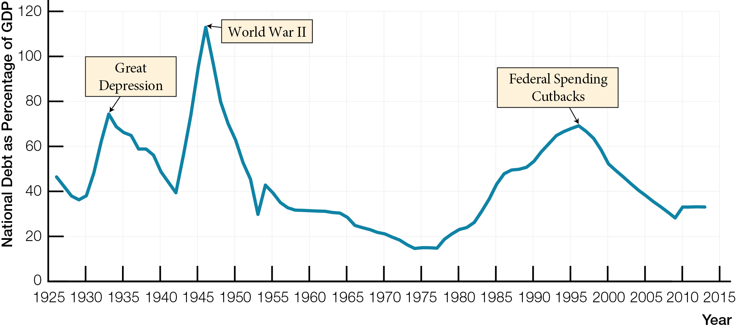
Canada’s National Debt as a Percentage of GDP, 1916 - 2013

Slide 33
Five arguments about national debt
Will Canada go bankrupt ?
Largely a myth
Government of Canada never has to pay back national debt — can simply refinance it
Governments that do not pay debts find it difficult/expensive to borrow on bond market
Burden for future generations ?
Depends on who receives interest payments on national debt — Canadians or non-Canadians

Slide 34
Debt is always bad
Myth — consumers and businesses make smart choices to go into debt
Government debt can be smart choice if positive impact on economy of spending financed by debt is greater than interest cost
Government debt can be not-smart choice if spending financed by debt for consumption only
Yes — Hands-Off camp opposes, No — Hands-On camp supports, debt-financed government spending to prevent recession

Slide 35
Interest payments create self-perpetuating debt
Potential problem of the national debt
Canada’s yearly deficits between mid-1970s and mid-1990s increased national debt and interest payments ➔ increasing yearly deficits
Vicious cycle broke in 1996

Slide 36
Crowding out and crowding in
Potential problem and benefit of the national debt
Crowding out when government debt-financed fiscal policy decreases private investment by raising interest rates
Crowding in when government debt-financed fiscal policy increases private investment by improving expectations

Slide 37

GOVERNMENT HANDS-OFF OR HANDS-ON ROLE?
Sort out economic arguments from political arguments so that you can make informed choices as a citizen about hands-off and hands-on roles for government fiscal policy and your own future.

Slide 38
Political philosophies differ among countries
United States — created through a revolution against British government interference — has hands-off origins
Canada — created by an act of government — has hands-on origins

Slide 39
Words about proper role for government often reveal speaker’s point of view
Hands-off words used with government: intervene, interfere, mistake
Hands-on words used with government: act, participate, responsibility

Slide 40
Arguments about fiscal policy, deficits, and debt often mix up politics and economics
Policies that make economic sense (balance budget over business cycle) might not make political sense; when recession over, hard to stop spending, to raise taxes
Political hands-off arguments against government are often disguised as arguments against national debt
Sort out economic from political arguments to make informed choices about hands-off and hands-on roles for government

