Slide 1
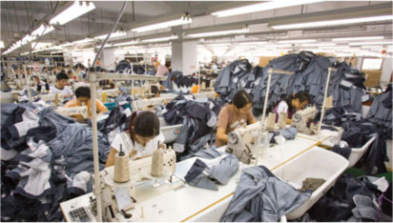
Are Sweatshops All Bad?
Globalization and Trade Policy

Slide 2
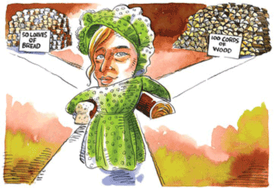
GAINS FROM TRADE
Opportunity cost and comparative advantage are key to understanding why specializing and trading makes us all better off.

Slide 3
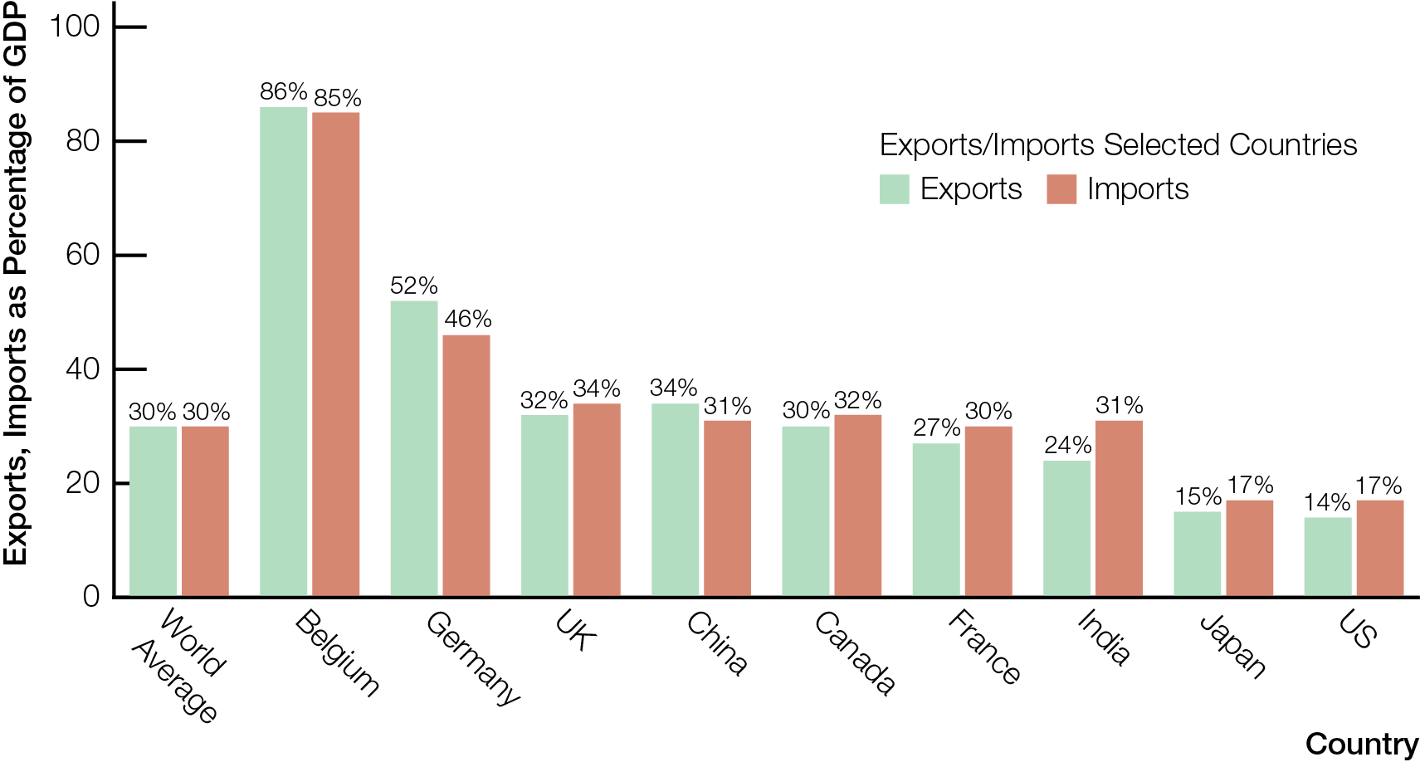
The Importance of International Trade: Exports & Imports as Percentage of GDP, Selected Countries, 2012
2015
22% 19% 20% 23%

Slide 4
Canada is a trading nation — 30+ percent of Canadian GDP is from selling exports to the rest of the world
With voluntary trade, each person (or country) feels that what they get is of greater value than what they give up
Absolute advantage ability to produce at a lower absolute cost
Comparative advantage ability to produce at a lower opportunity cost

Slide 5
Give Up
Get
Opportunity Cost =
Comparative advantage key to mutually beneficial gains from trade
Trade makes individuals (or countries) better off when each
Specializes in products and services with comparative advantage (lower opportunity cost)
Trades for other products and services

Slide 6
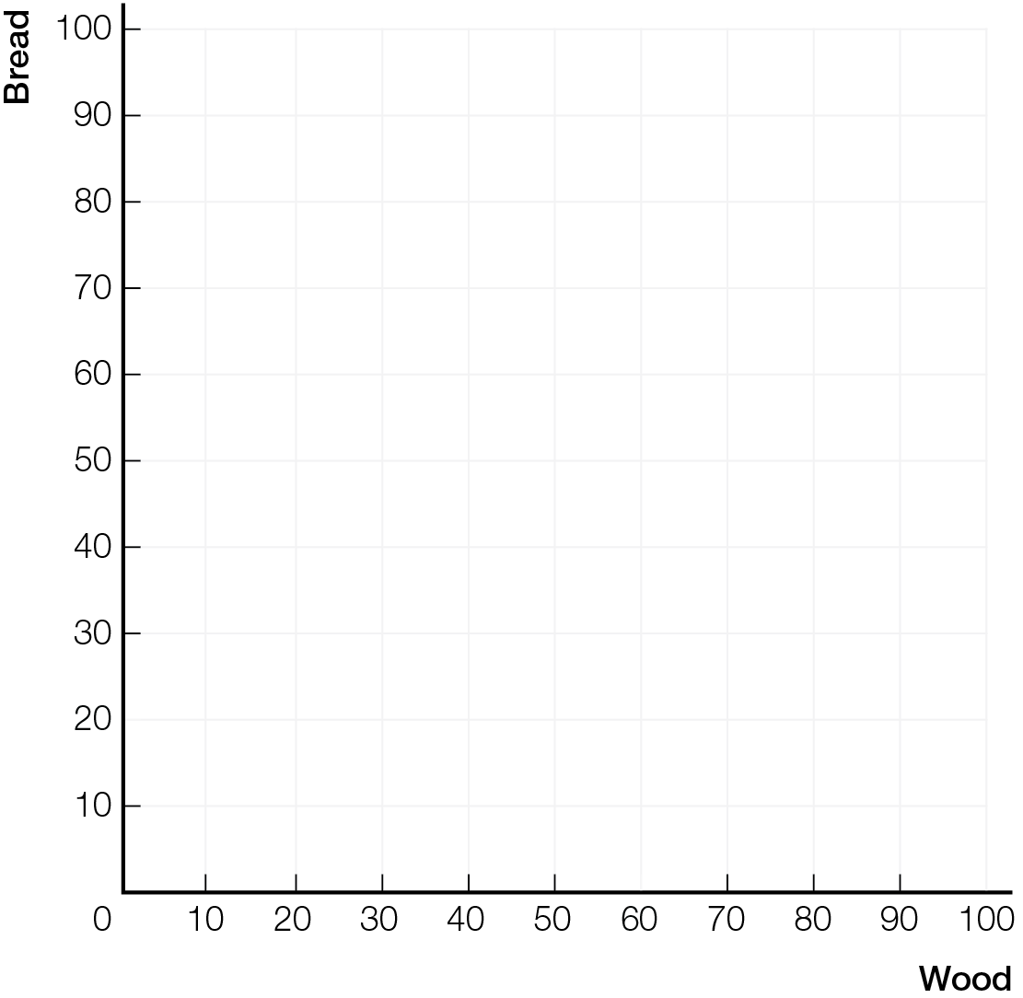
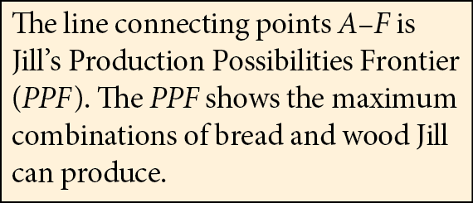

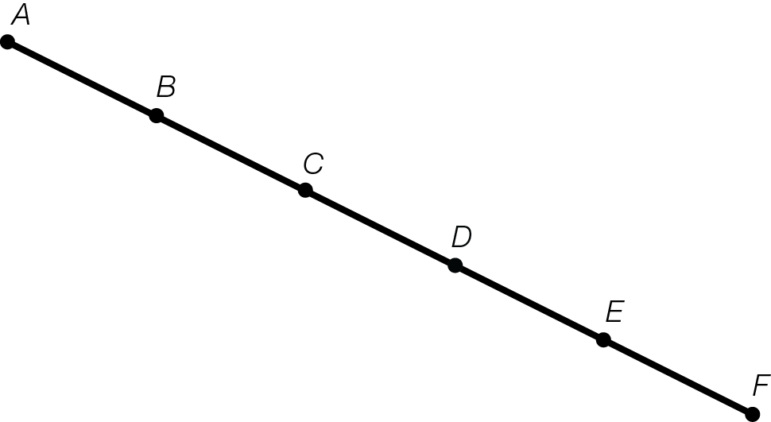

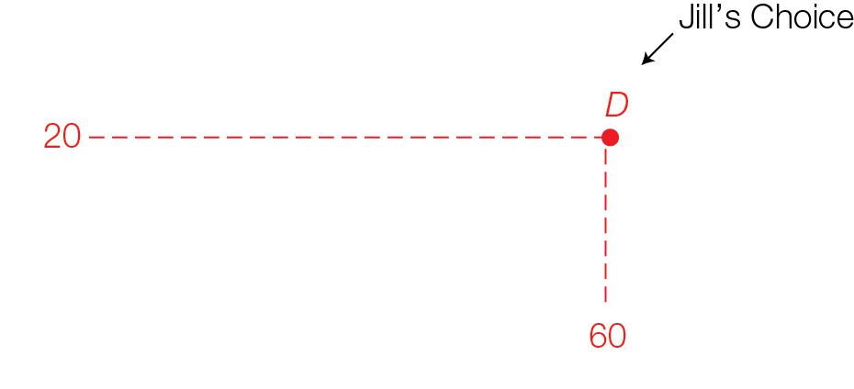
Jill’s Production Possibilities

Slide 7

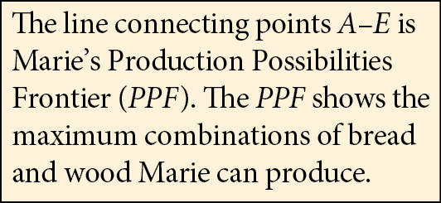

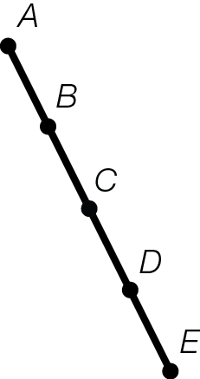
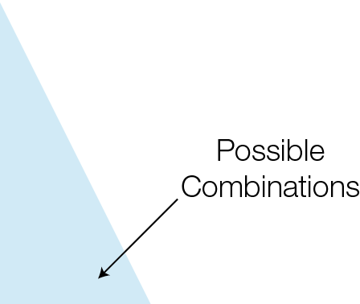
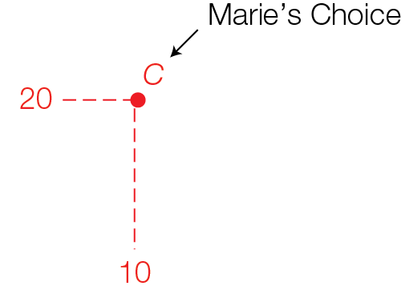
Marie’s Production Possibilities
Fig. 13.3

Slide 8
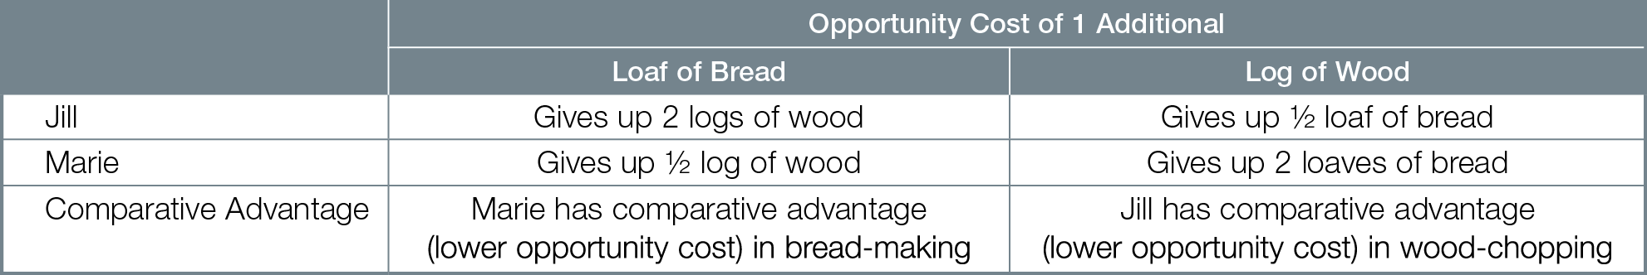
Opportunity Costs for Jill and Marie

Slide 9
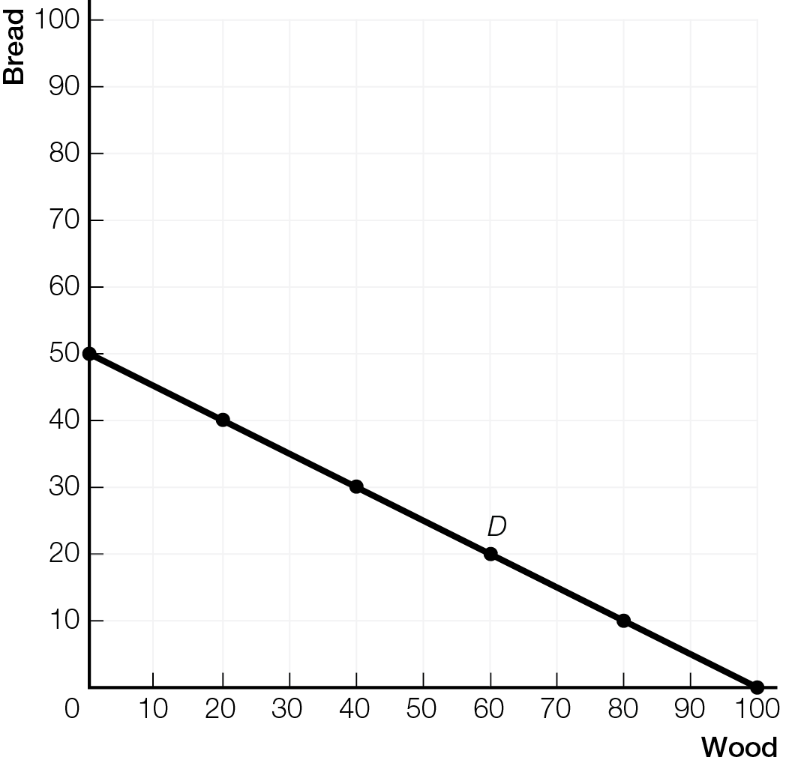
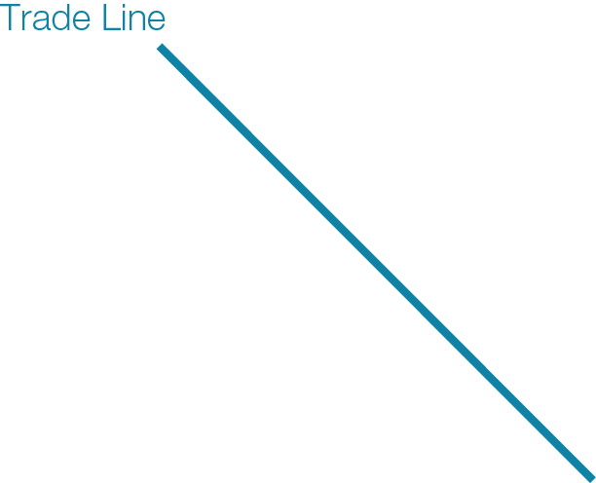
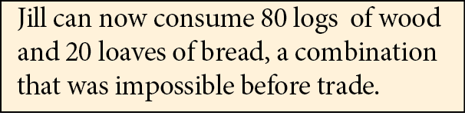
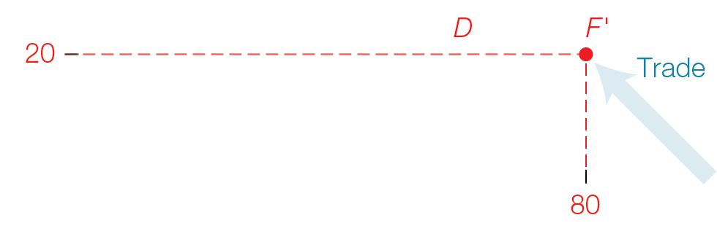

Mutually Beneficial Gains from Trade: Jill’s Gains from Trade

Slide 10
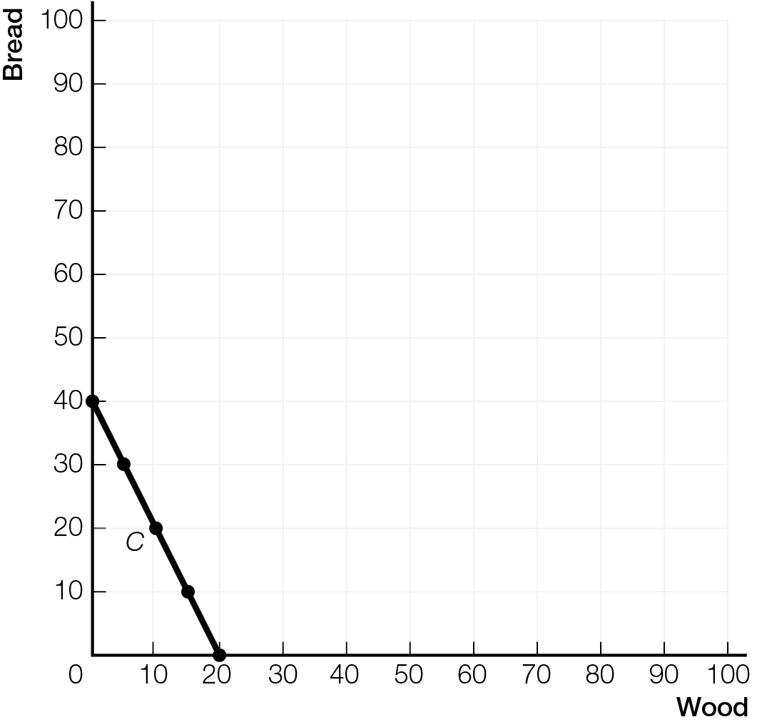
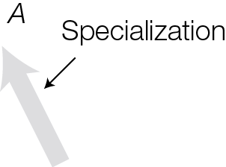

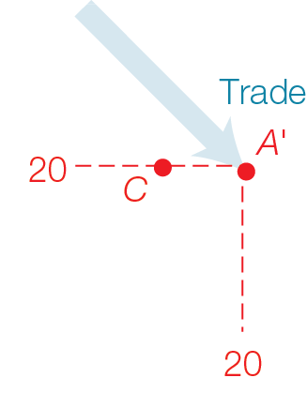
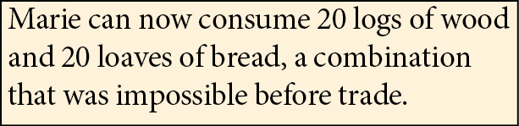
Mutually Beneficial Gains from Trade: Marie’s Gains from Trade

Slide 11
Even if one individual has absolute advantage in producing everything, differences in comparative advantage allow mutually beneficial gains from specializing and trading
Terms of trade quantity of exports required to pay for one unit of imports
Must be between each trader’s local opportunity costs
Different terms of trade will split gains differently

Slide 12
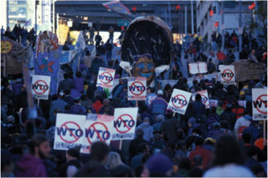
PROTECTIONISM AND TRADE
Freer trade creates winners and losers from the competitive process of creative destruction. Concentrated losses in import-competing industries create political pressure for protectionism despite overall gains.

Slide 13
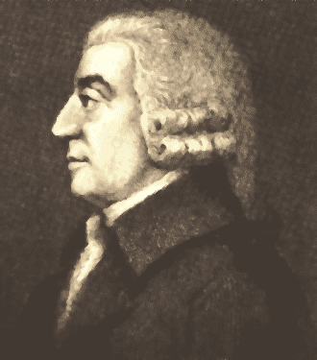
Adam Smith on Trade
“What is prudence in the conduct of every family can scarce be folly in that of a great kingdom. If a foreign country can supply us with a commodity cheaper than we ourselves can make it, better buy it of them with some part of the produce of our own industry, employed in a way in which we have some advatage.” Adam Smith, The Wealth of Nations, 1776

Slide 14
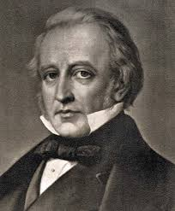
“Free trade, one of the greatest blessings which a government can confer on a people, is in almost every country unpopular.” Thomas Macaulay, British MP, 1824

Slide 15
Freer trade increases competition, creating opponents to freer trade
Connections to new markets bring new competitors
With creative destruction, gains from specialization, trade, competition, and innovation destroy higher-cost, and less popular products and businesses
Gains are increased productivity and higher living standards
Losses are structural unemployment — technological change or international competition make some workers’ skills obsolete

Slide 16
Trade opening new international markets creates winners and losers in Canada
Winners Canadian consumers, Canadian exporters and workers in exporting industries
Losers Canadian businesses and workers in import-competing industries

Slide 17
Government responses to protect losers from freer trade include
Tariffs tax on imports, raising price of products to consumers
Import quotas limit on the quantity that can be imported
Subsidies to domestic producers government payment to domestic producers of products or services

Slide 18
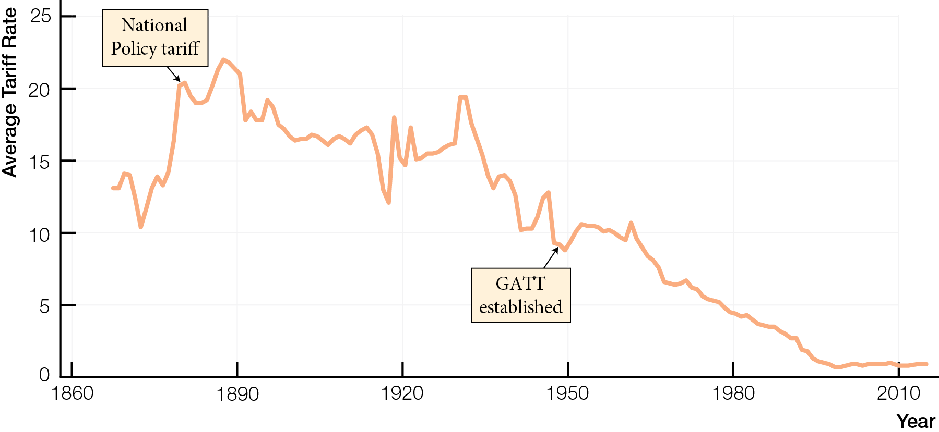
Canadian Tariffs, 1867 - 2014

Slide 19
Unequal distribution of gains and losses produces political pressure for protectionism to help the losers
Many consumers gain from free trade, but gain for each is small
Few businesses and workers in import-competing industries lose from free trade, but loss for each is large
Protectionism leaves Canadians as a whole worse off
Freer trade could benefit more people than it harms, but political pressure from import-competing industries slows international trade negotiations

Slide 20
Protecting national security and cultural identity are valid, limited arguments for protectionism
Protectionism creates risk of retaliation, triggering trade wars that make all countries worse off

Slide 21
“Economists Love Free Trade – Except That They Don’t” Noah Smith, Bloomberg News, January 2016
Cites research by economists (Dani Rodrik and others) showing
Industries more exposed to Chinese import competition since 2000 — the year China joined the World Trade Organization — were hit hard and have not recovered. Workers in these industries don’t go to better jobs, or even similar jobs in different industries. They shuffle between low-paid jobs, never recovering the prosperity they had before Chinese competition.
Real-world economies may be much worse at adjusting to big changes than most economic models assume. These adjustment costs might overwhelm the gains from trade.

Slide 22
Gains from Trade? What If Adjustment Costs Outweigh Gains?
Adjustment costs to trade may put a country inside its PPF, so even with gains from trade, there are significant losses for some groups.
•
•

Slide 23
GLOBALIZATION AND SWEATSHOPS
While anti-globalization critics view sweatshops as the outcome of globalization and free-market policies, economists ask whether workers are better off or worse off with international trade.

Slide 24
Economic globalization integration of economic activities, across borders, through markets
Speeding up due to falling transportation and communication costs, elimination of government barriers to trade
Anti-globalization groups view international trade as causing problems in developing countries and target World Bank and International Monetary Fund (IMF)
World Bank and IMF, during 1990s, attached “free market” hands-off conditions to assistance to developing countries

Slide 25
Sweatshops — a historical consequence of globalization going back 200 years — provide low-wage jobs, often under poor working conditions
Anti-globalization critics view sweatshops as exploitation for corporate profits
Economists ask the opportunity cost question — are workers lives better off, or worse off, compared to a situation without globalization, trade, and factory jobs?
In each sweatshop country, history of rising wages over time and movement of production elsewhere

Slide 26

GOVERNMENTS AND GLOBAL MARKETS
On the role of government in global markets, the hands-off position views government failure as worse than market failure; the hands-on position views market failure as worse than government failure.

Slide 27
Joseph Stiglitz and hands-on economists support a limited role for government
Want social safety net to support those left behind by trade and markets
The Economist magazine and hands-off economists worry that allowing governments in will result in protectionist policies
Argue that the harm poor countries suffer from globalization is caused by government protectionist policies, not by market forces

Slide 28
In trade negotiations at the World Trade Organization (WTO), power struggles over tariffs and subsidies between rich and poor countries affect terms of trade — how gains are divided

Slide 29
Hands-Off position —
Leave markets alone to produce economic growth that eventually benefits all
Risk is losers in import-competing industries get no assistance in adjusting
Believe government failure worse than market failure
Hands-On position —
Government should help losers from expanded trade in import-competing industries
Risk is government gives into political pressure for protectionism
Believe market failure worse than government failure

