Slide 1

Coordinating Demand and Supply

Slide 2

WHAT’S A MARKET?
Markets connect competition between buyers, competition between sellers, and cooperation between buyers and sellers. Government guarantees of property rights allow markets to function.

Slide 3
Market — interactions between buyers and sellers
Markets mix
Competition — between buyers, between sellers
Cooperation — between buyers and sellers
Voluntary exchanges between buyers and sellers happen only when both sides end up better off
Property rights legally enforceable guarantees of ownership of physical, financial, and intellectual property
Government sets rules of the game, defining and enforcing property rights necessary for free and voluntary exchange

Slide 4

PRICE SIGNALS FROM COMBINING DEMAND & SUPPLY
When there are shortages, competition between buyers drives prices up. When there are surpluses, competition between sellers drives prices down.

Slide 5
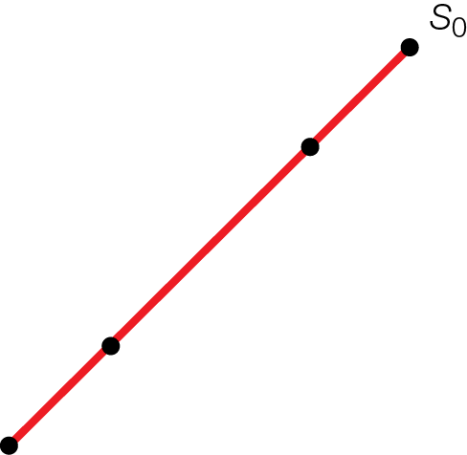
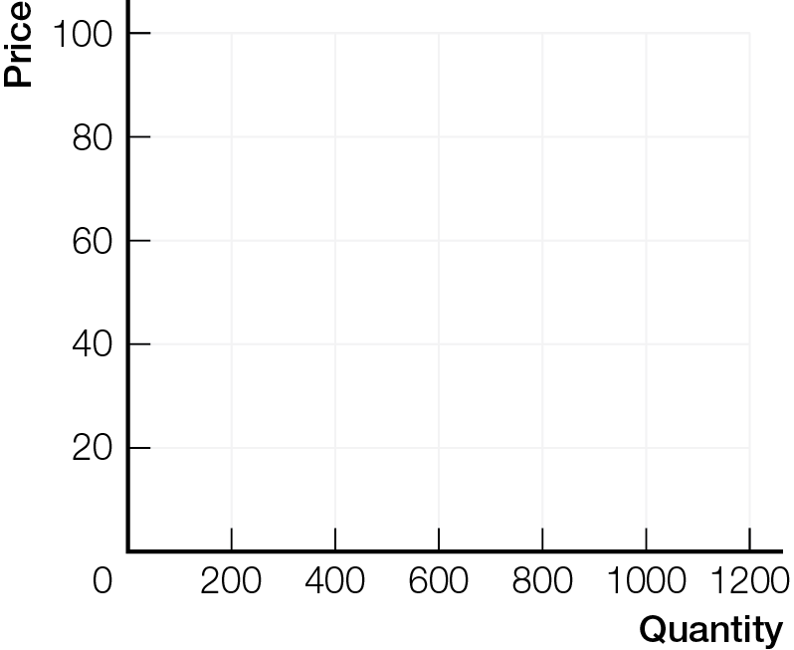
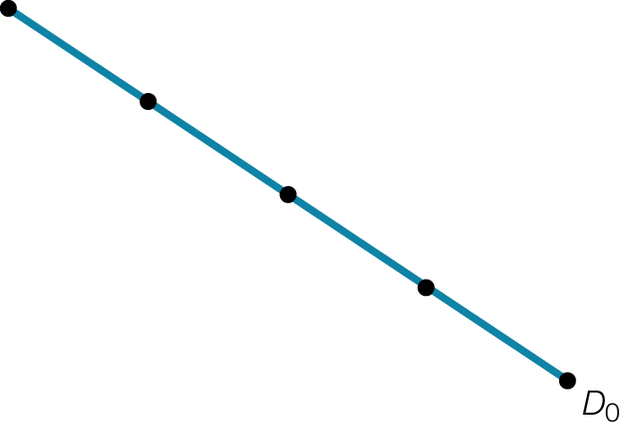
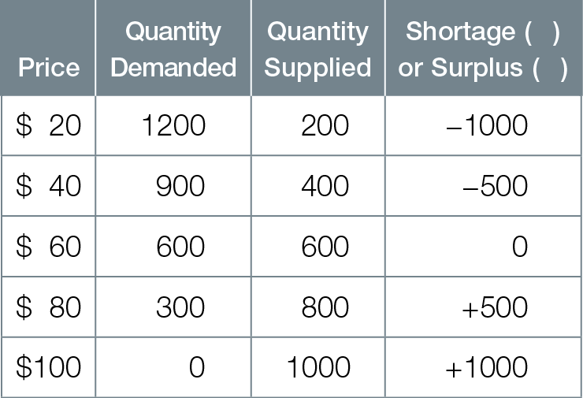
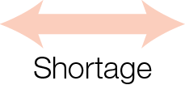
Market Demand and Supply for Piercings
Fig. 4.1
-
+

Slide 6
Prices are the outcome of a market process of competing bids (from buyers) and offers (from sellers)
Frustrated Buyers — market price too low
Shortage, or excess demand quantity demanded exceeds quantity supplied
Shortages create pressure for prices to rise
Rising prices provide signals and incentives for businesses to increase quantity supplied and for consumers to decrease quantity demanded, eliminating the shortage

Slide 7
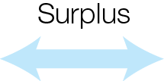
Market Demand and Supply for Piercings
Fig. 4.1
-
+

Slide 8
Frustrated Sellers — market price too high
Surplus, or excess supply quantity supplied exceeds quantity demanded
Surpluses create pressure for prices to fall
Falling prices provide signals and incentives for businesses to decrease quantity supplied and for consumers to increase quantity demanded, eliminating the surplus

Slide 9

Market Demand and Supply for Piercings
Fig. 4.1
-
+

Slide 10
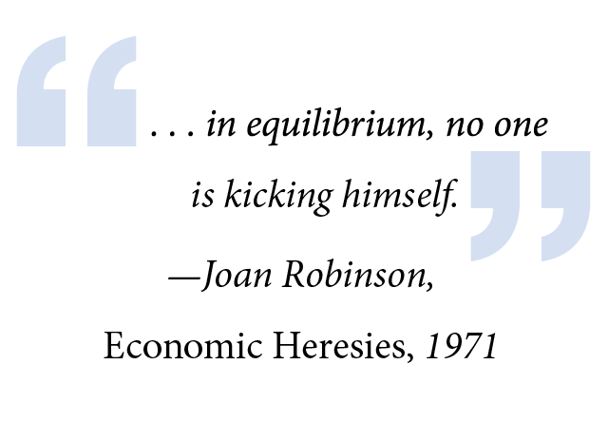
MARKET-CLEARING OR EQUILIBRIUM PRICES
Market-clearing or equilibrium prices balance quantity demanded and quantity supplied, coordinating smart choices of consumers and businesses.

Slide 11
The price that coordinates the smart choices of consumers and businesses has two names
Market-clearing price the price that equalizes quantity demanded and quantity supplied
Equilibrium price the price that balances forces of competition and cooperation, so that there is no tendency for change

Slide 12
Price signals in markets create incentives, so that while each person acts only in own self-interest
Interaction coordinated through Adam Smith’s invisible hand of competition
Result is the miracle of markets — continuous, ever-changing production of products and services we want

Slide 13
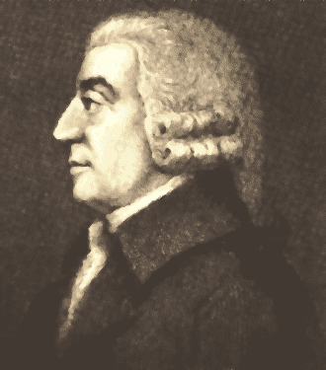
Adam Smith’s Invisible Hand
When an individual makes choices
“…he intends only his own gain, and he is in this... led by an invisible hand to promote an end which was no part of his intention.... By pursuing his own interest he frequently promotes that of the society more effectually than when he really intends to promote it.” Adam Smith, The Wealth of Nations, 1776

Slide 14
WHAT HAPPENS WHEN DEMAND AND SUPPLY CHANGE?
When demand or supply change, equilibrium prices and quantities change. The price changes cause businesses and consumers to adjust their smart choices. Well functioning markets supply the changed products and services demanded.

Slide 15
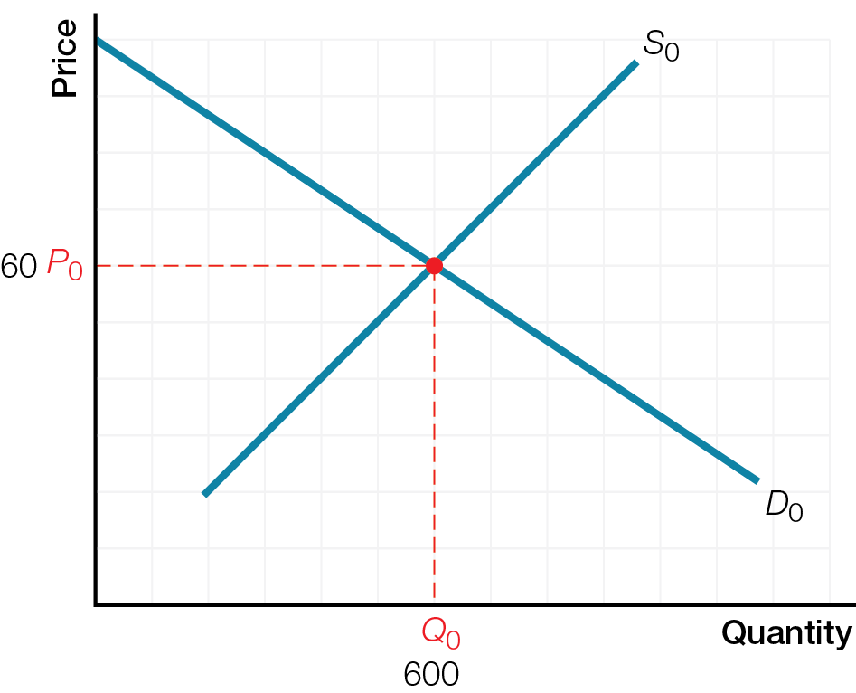
Original Equilibrium Price and Quantity in Bacon Market

Slide 16
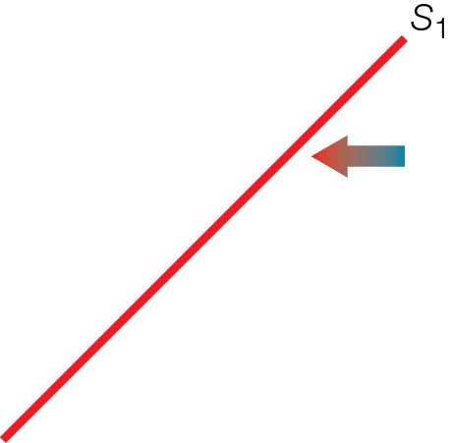
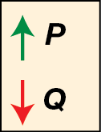
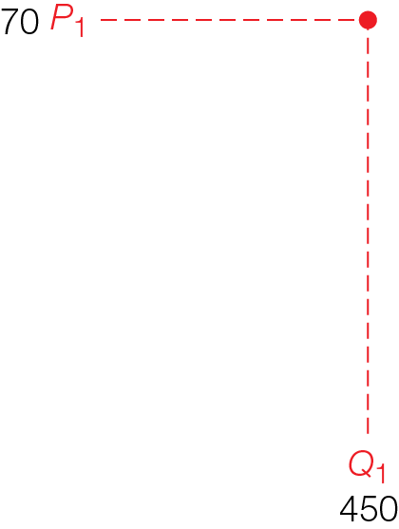

Rise in Price of Input (Pig Feed) on Bacon Market

Slide 17
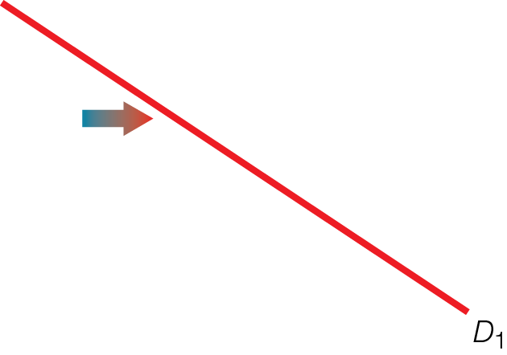
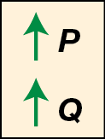
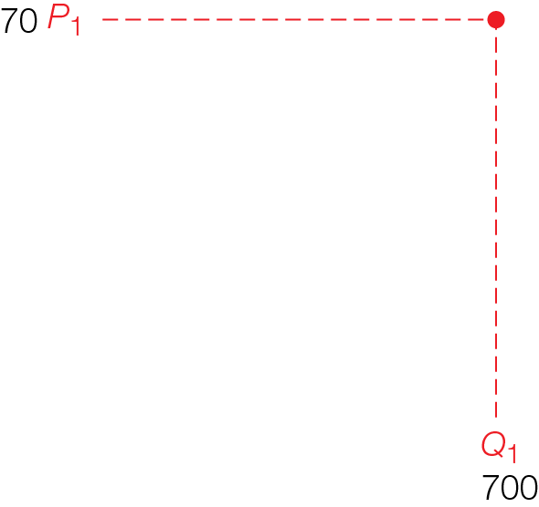

Increase in Preferences (from Epic-Meal-Time) in Bacon Market

Slide 18
Economists Do It With Models
Price and Quantity changes are the result, not the cause, of economic events
Thinking like an economist means analyzing a situation using comparative statics
Start with one equilibrium situation (intersection of demand and supply, other things the same)
Change one other thing/variable
Compare resulting equilibrium situation (intersection of demand and supply after the change) in terms of price and quantity

Slide 19
Demand changes due to a change in
Preferences
Prices of related products
Income
Expected future prices
Number of consumers

Slide 20
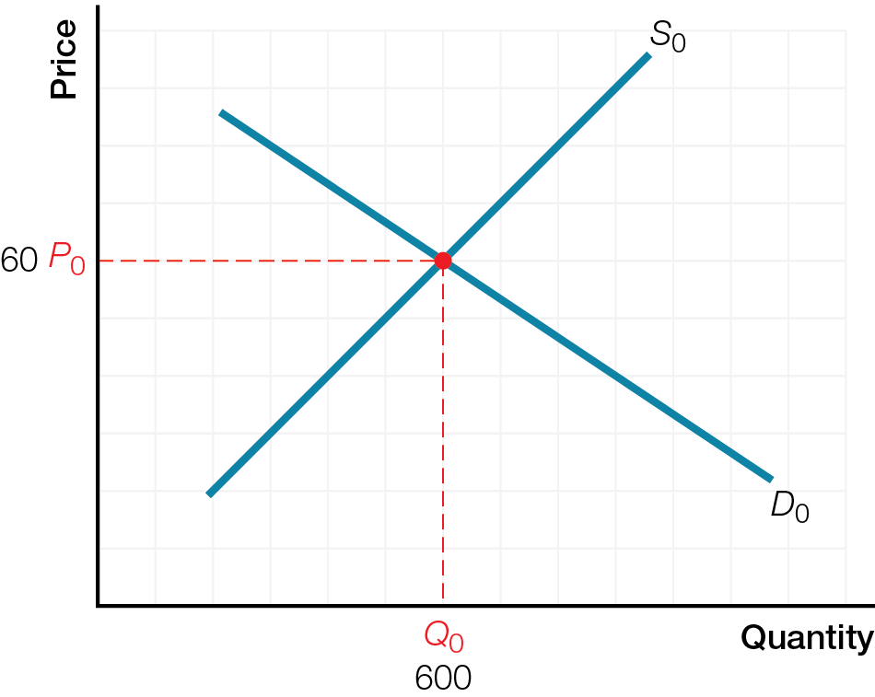
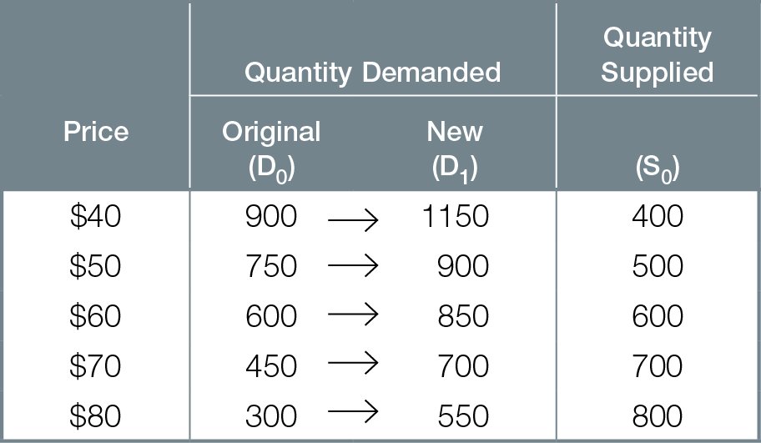
Increase in Demand
Fig. 4.2

Slide 21
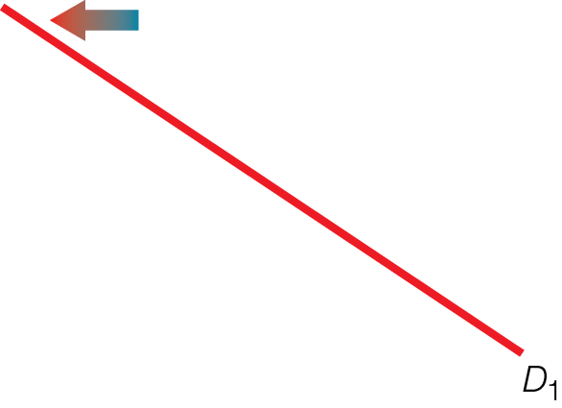
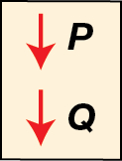
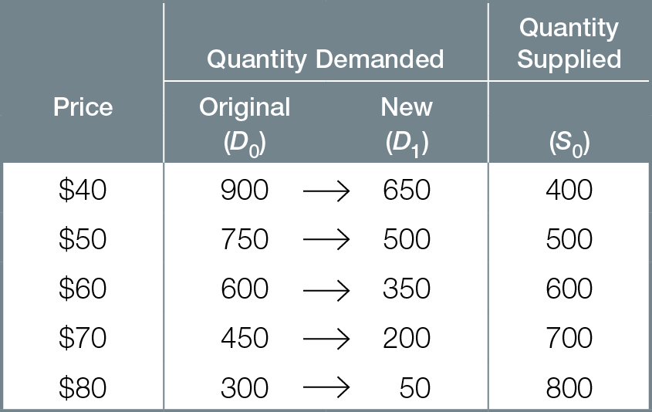

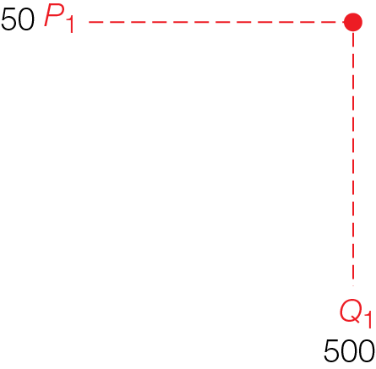
Decrease in Demand
Fig. 4.3

Slide 22
Increase in demand causes
Rise in equilibrium price
Increase in quantity supplied
Decrease in demand causes
Fall in equilibrium price
Decrease in quantity supplied

Slide 23
Supply changes due to a change in
Technology
Environment
Prices of inputs
Prices of related products produced
Expected future prices
Number of businesses

Slide 24
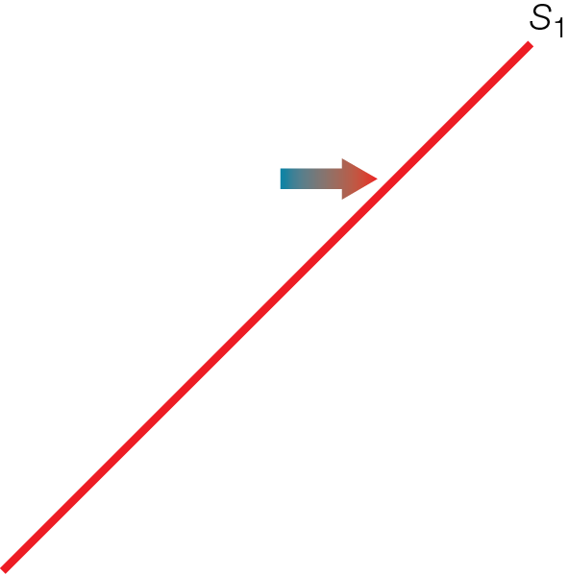
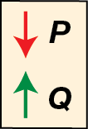

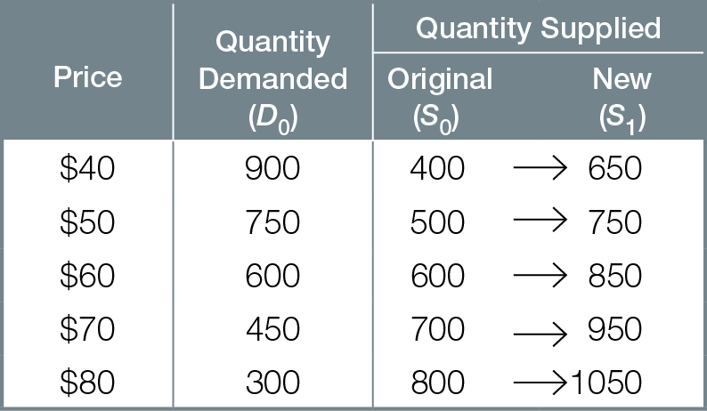
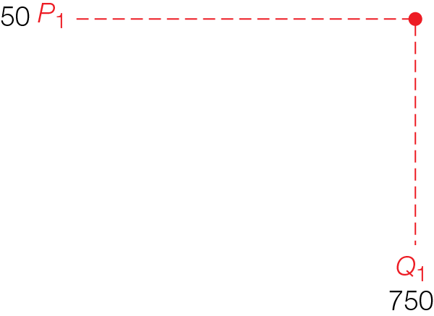
Increase in Supply
Fig. 4.4

Slide 25

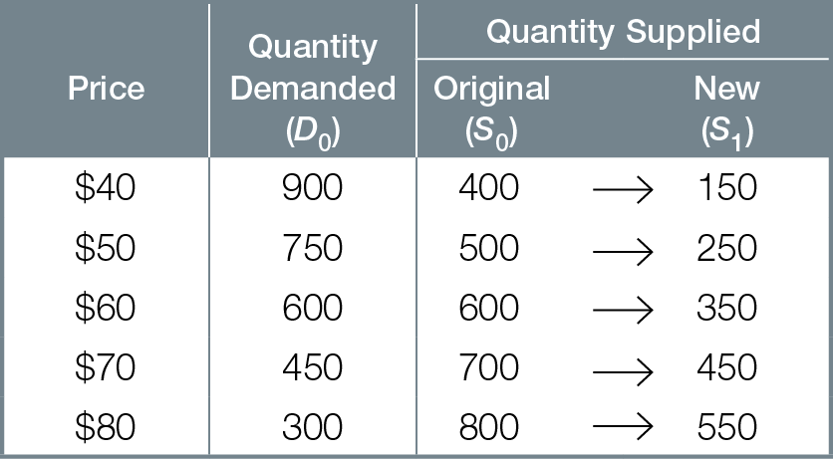
Decrease in Supply
Fig. 4.5

Slide 26
Increase in supply causes
Fall in equilibrium price
Increase in quantity demanded
Decrease in supply causes
Rise in equilibrium price
Decrease in quantity demanded

Slide 27
Review of Comparative Statics
Price and Quantity changes are the result, not the cause, of economic events
Thinking like an economists means analyzing a situation using comparative statics
Start with one equilibrium situation (intersection of demand and supply, other things the same)
Change one other thing/variable
Compare resulting equilibrium situation (intersection of demand and supply after the change) in terms of price and quantity

Slide 28
When both demand and supply change at the same time
Can predict change in equilibrium price or equilibrium quantity
But without information about relative size of shifts of demand and supply curves, cannot predict the other equilibrium outcome

Slide 29
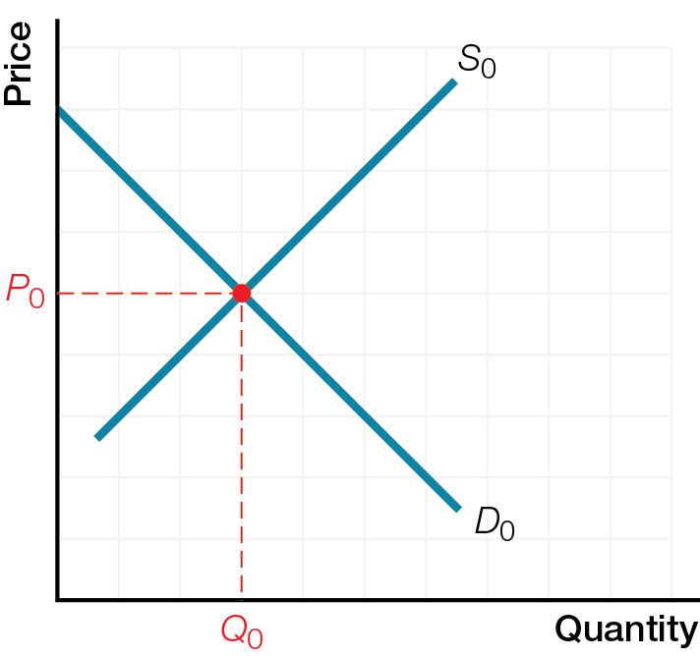
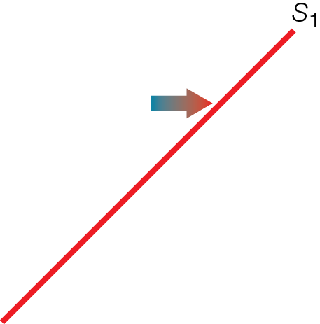
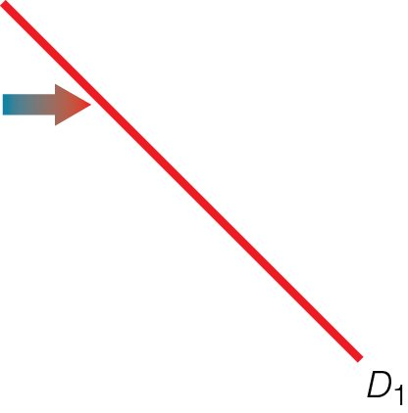
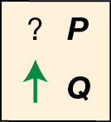
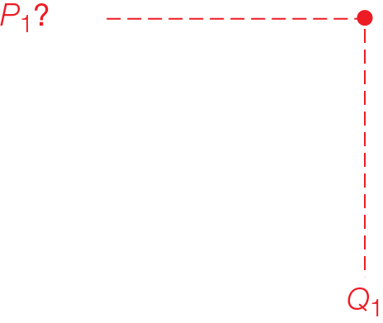
Increase in Both Demand and Supply
Fig. 4.6a

Slide 30
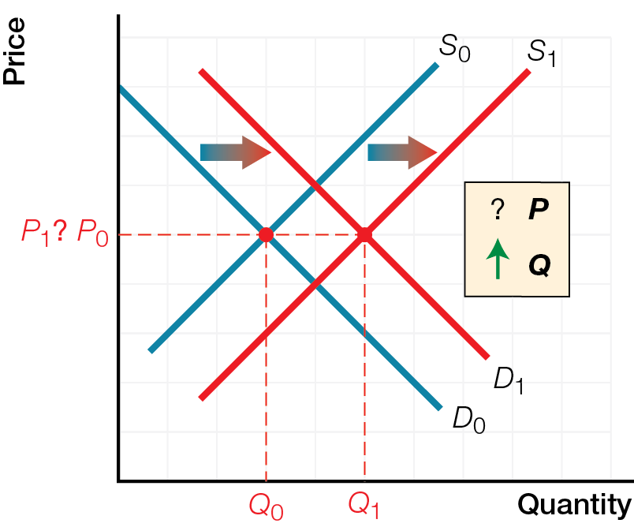
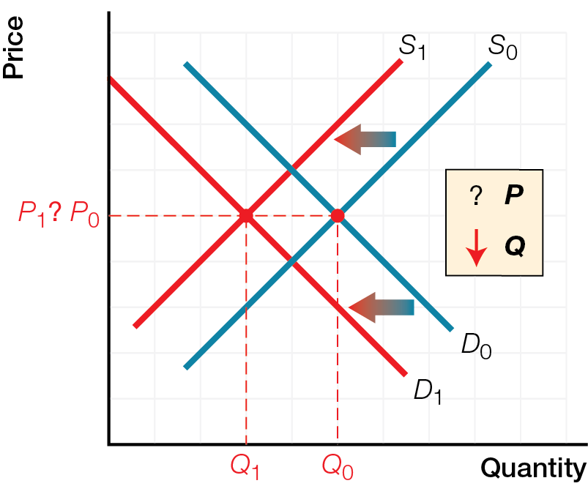
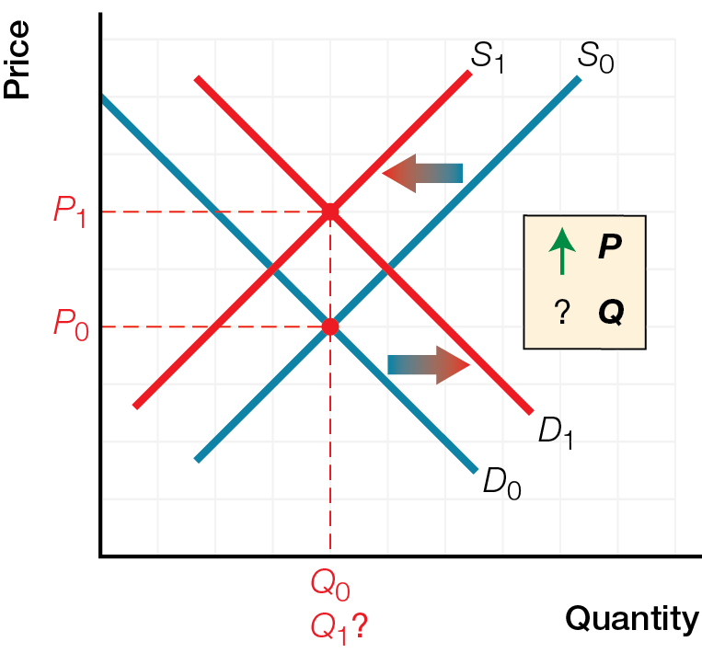
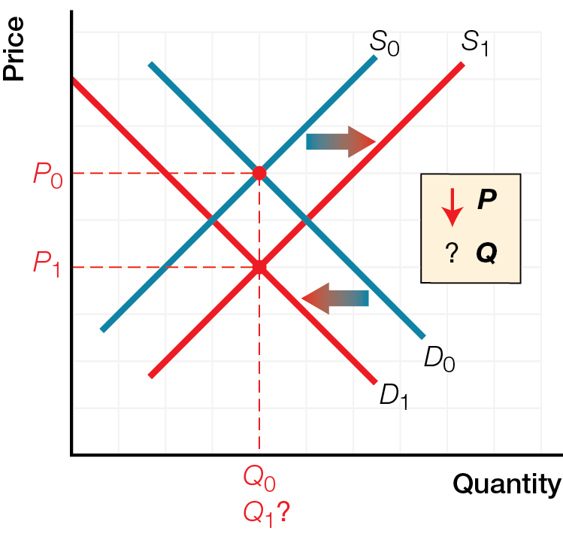
The Effects of Combined Changes in Demand and Supply
Fig. 4.6
a) Increase in Both Demand and Supply
b) Decrease in Both Demand and Supply
c) Increase in Demand and Decrease in Supply
d) Decrease in Demand and Increase in Supply

Slide 31
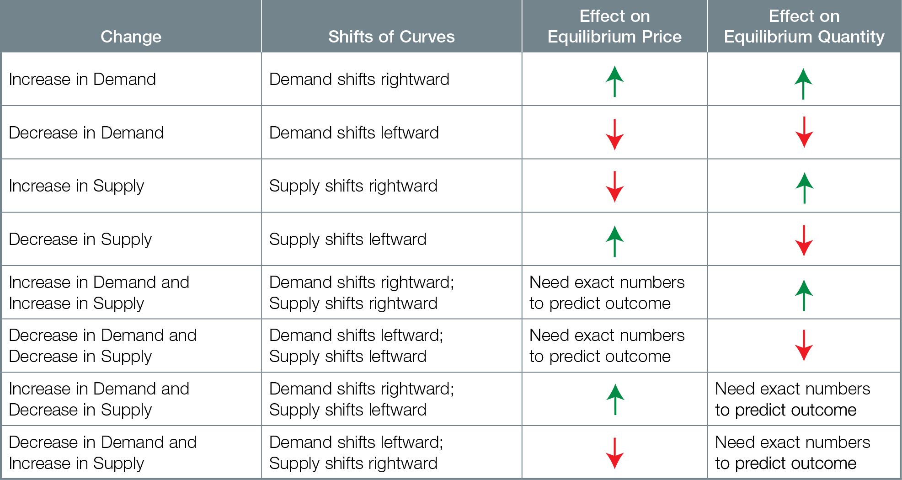
Effects in Changes in Demand or Supply

Slide 32


CONSUMER SURPLUS, PRODUCER SURPLUS, AND EFFICIENCY
An efficient market outcome has the largest total surplus, prices just cover all opportunity costs of production and consumers’ marginal benefit equals businesses’ marginal cost.

Slide 33
Reading demand and supply curves as marginal benefit and marginal cost curves reveals concepts of
Consumer surplus difference between amount a consumer is willing and able to pay, and the price actually paid;
area under marginal benefit curve but above market price

Slide 34
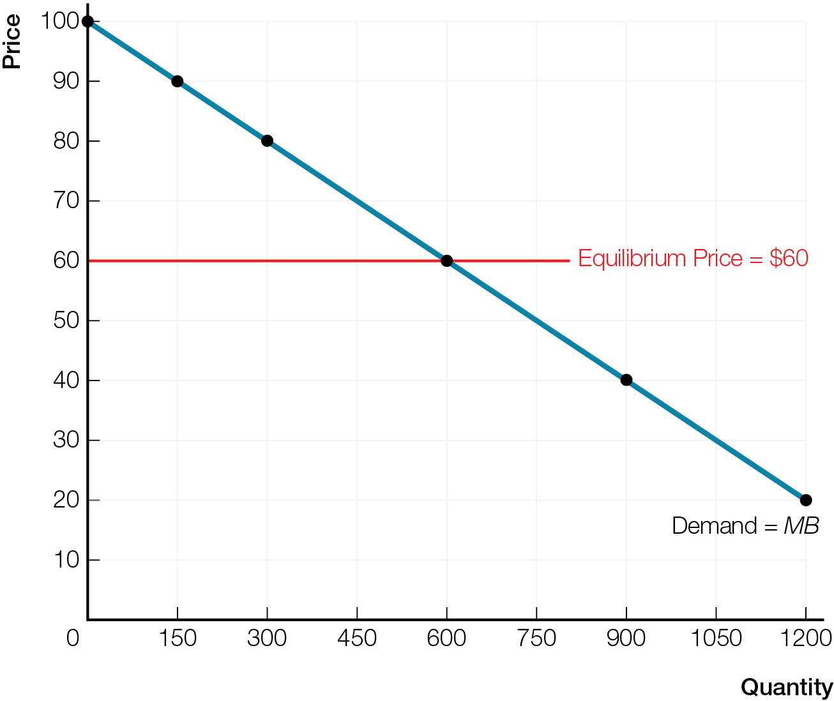
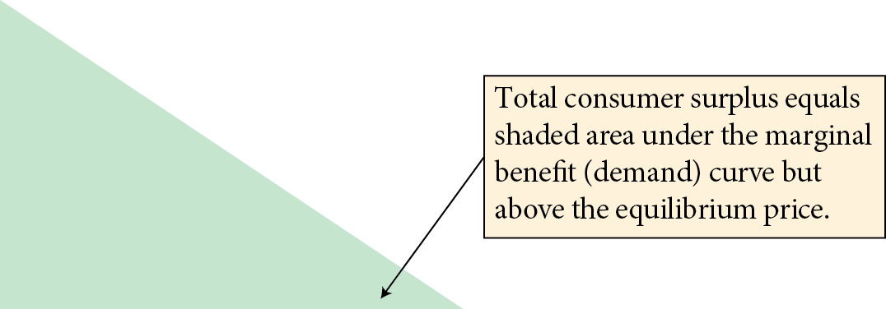
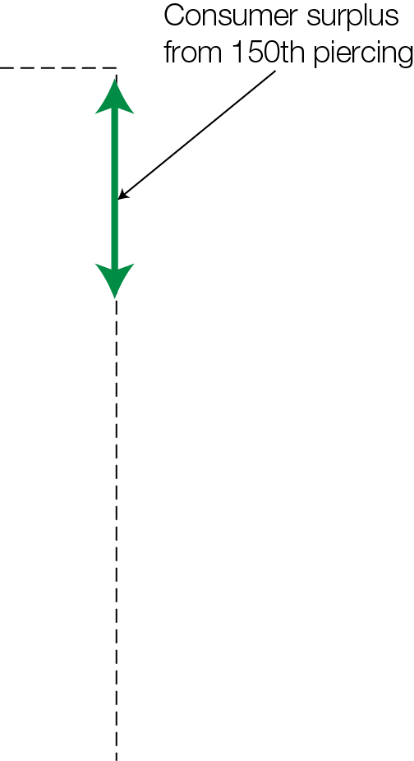
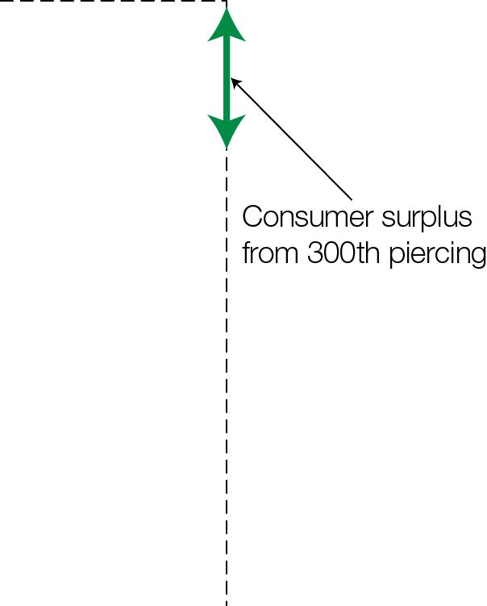
Marginal Benefit and Consumer Surplus
Fig. 4.8

Slide 35
Producer surplus difference between amount a producer is willing to accept, and the price actually received;
area below market price but above marginal cost curve

Slide 36
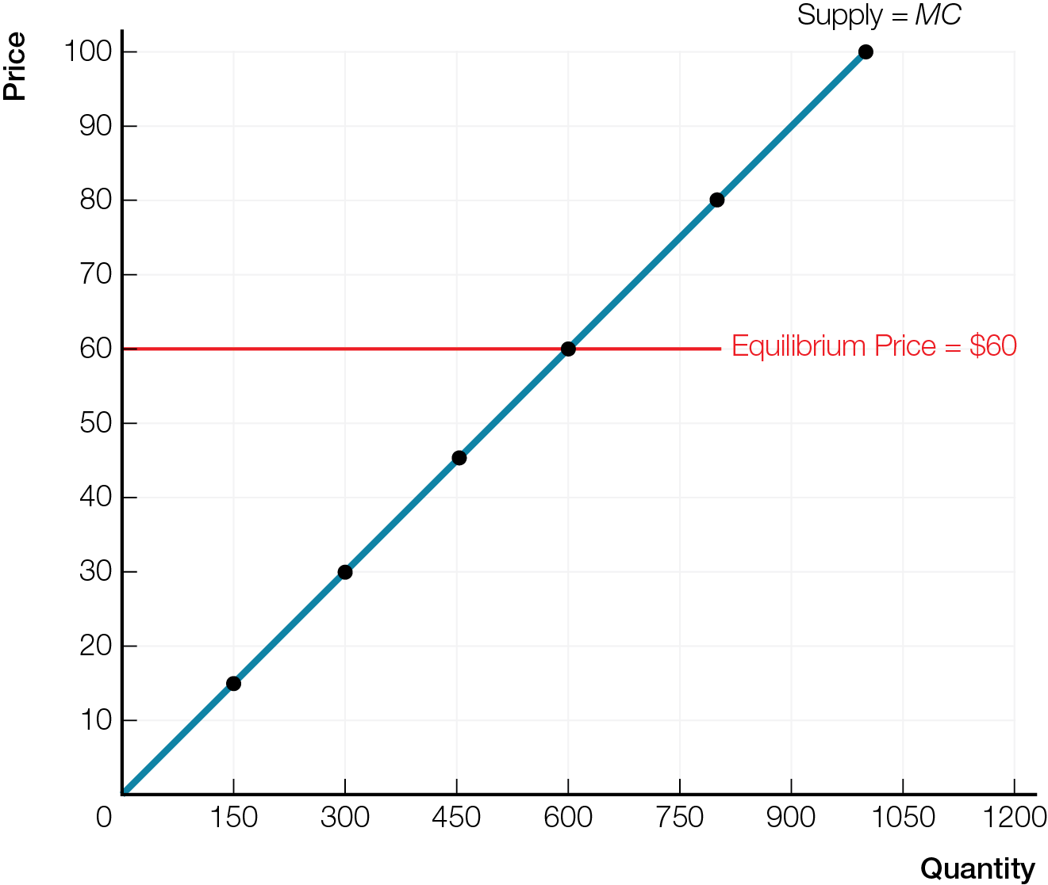
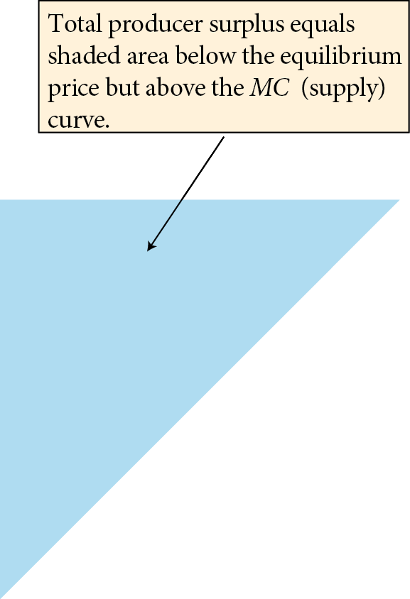
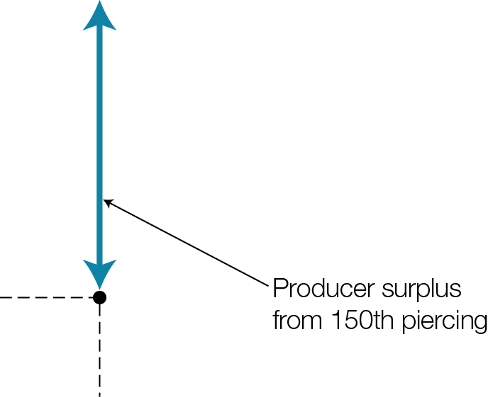
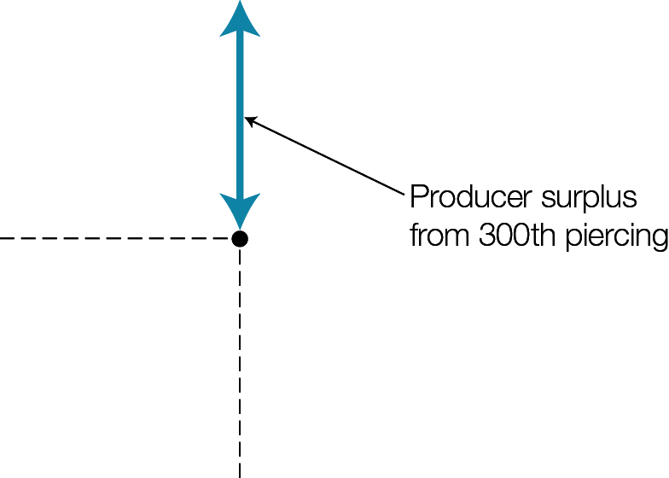
Marginal Cost and Producer Surplus
Fig. 4.9

Slide 37
Efficient market outcome coordinates smart choices of businesses and consumers so
Consumers buy only products and services where marginal benefit is greater than price
Product and services produced at lowest cost; prices just cover all opportunity costs of production
Products and services go to consumers most willing and able to pay
Total surplus (consumer surplus plus producer surplus) is at a maximum

Slide 38
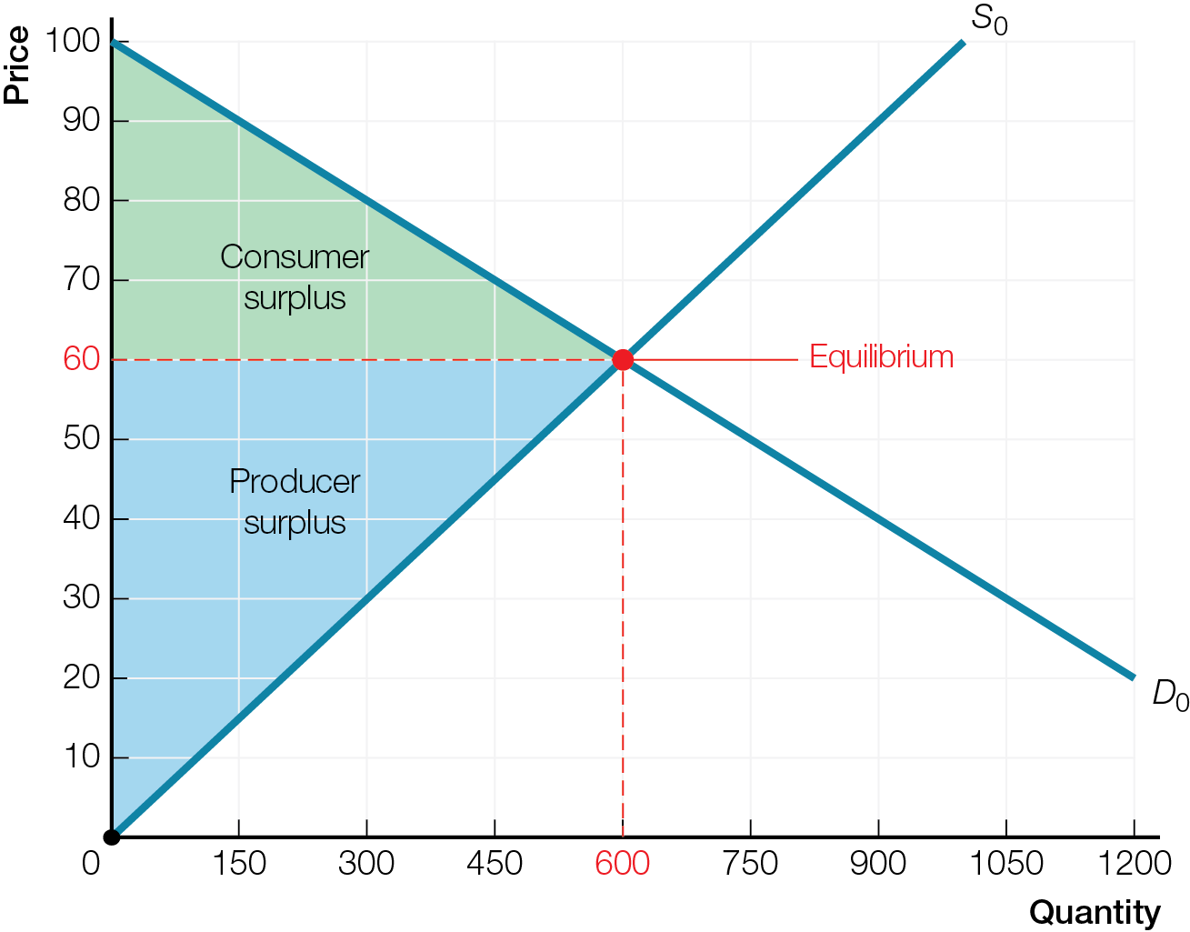
Maximum Total Surplus for Efficient Market
Fig. 4.10a

Slide 39
Inefficient Outcomes
Deadweight loss decrease in total surplus compared to an economically efficient outcome
For an inefficient outcome, subtract deadweight loss, so total surplus is less than for an economically efficient outcome

Slide 40
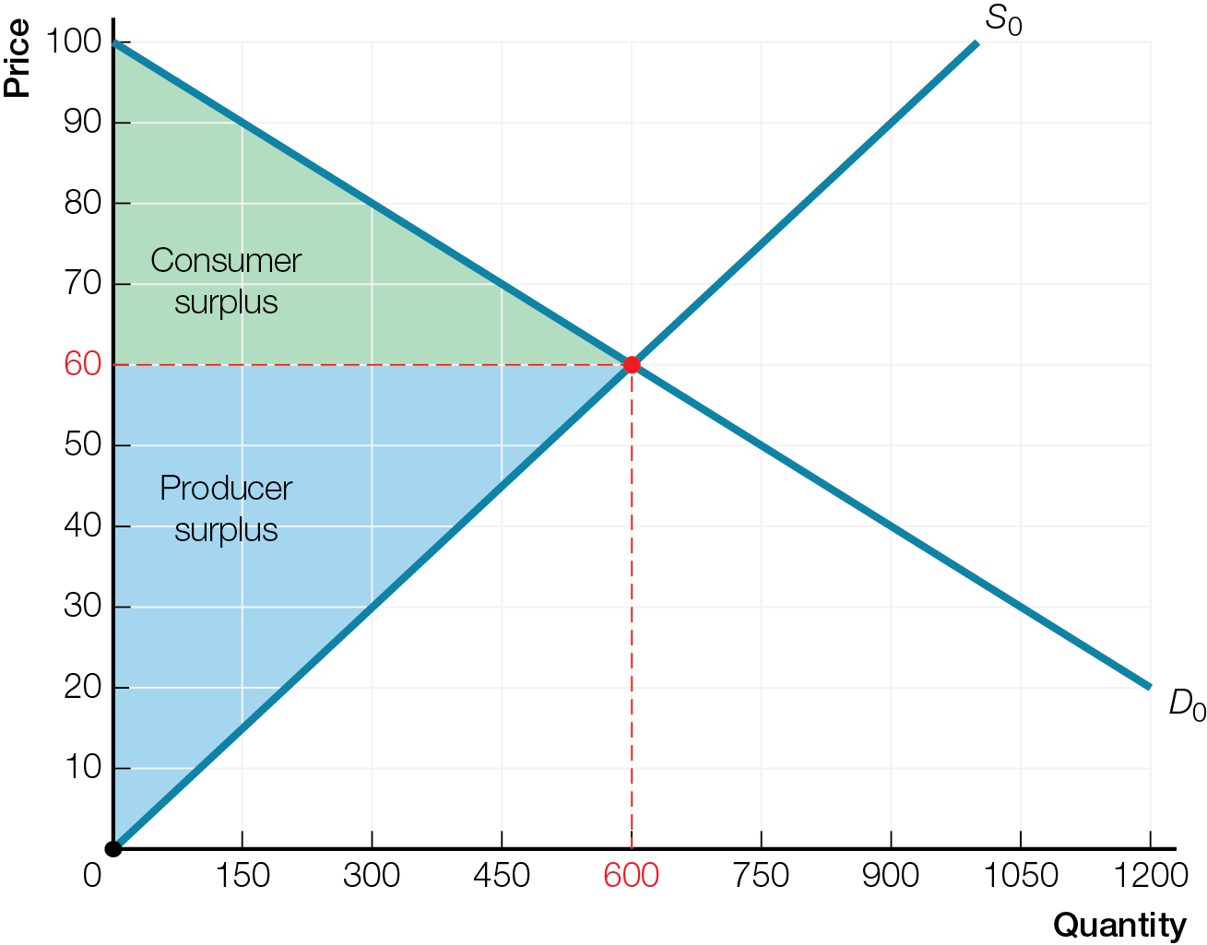
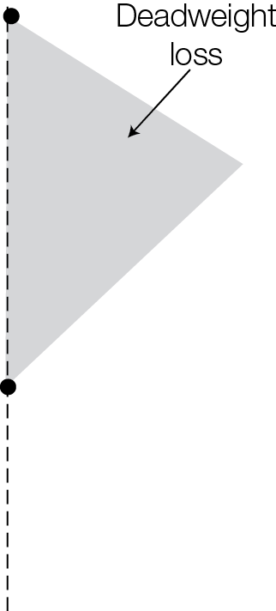
Inefficiency of Producing Too Little
Fig. 4.11a

Slide 41
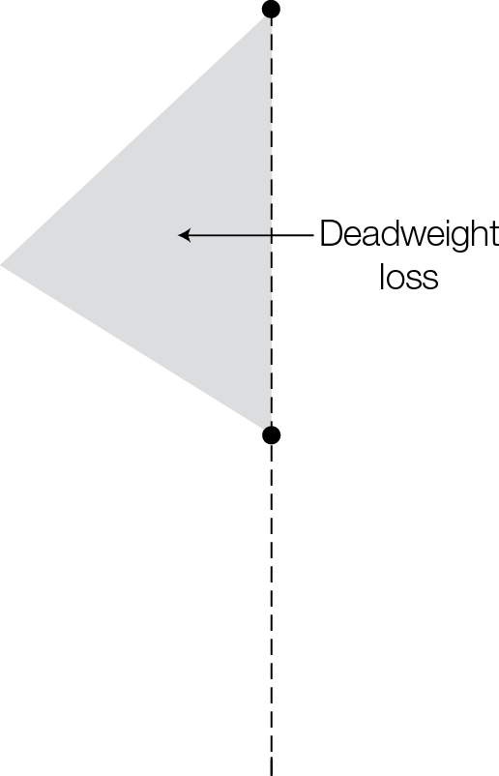
Inefficiency of Producing Too Much
Fig. 4.11b

