Slide 1
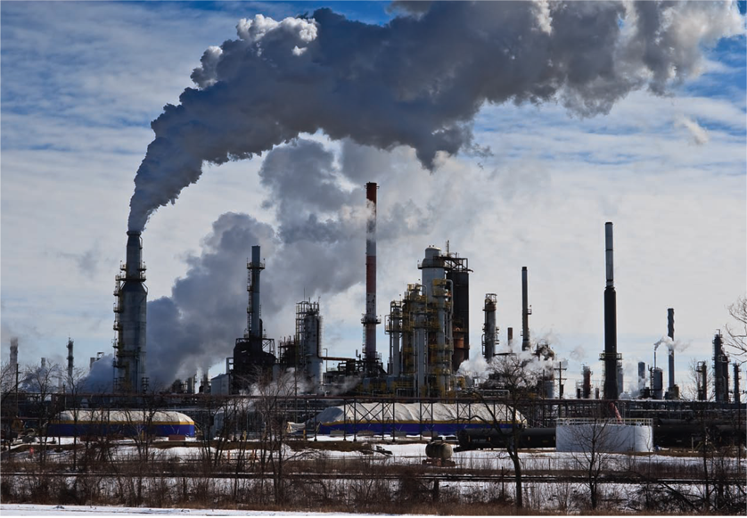
Acid Rain on Others’ Parades

Slide 2
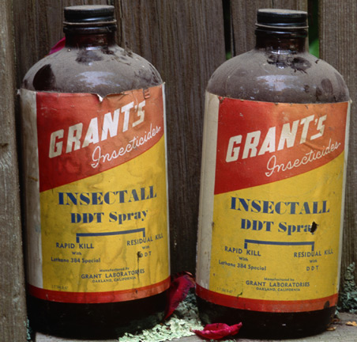
MARKET FAILURE WITH EXTERNALITIES
When externalities exist, prices don’t reflect all social costs and benefits; markets fail to coordinate private smart choices with social smart choices.

Slide 3
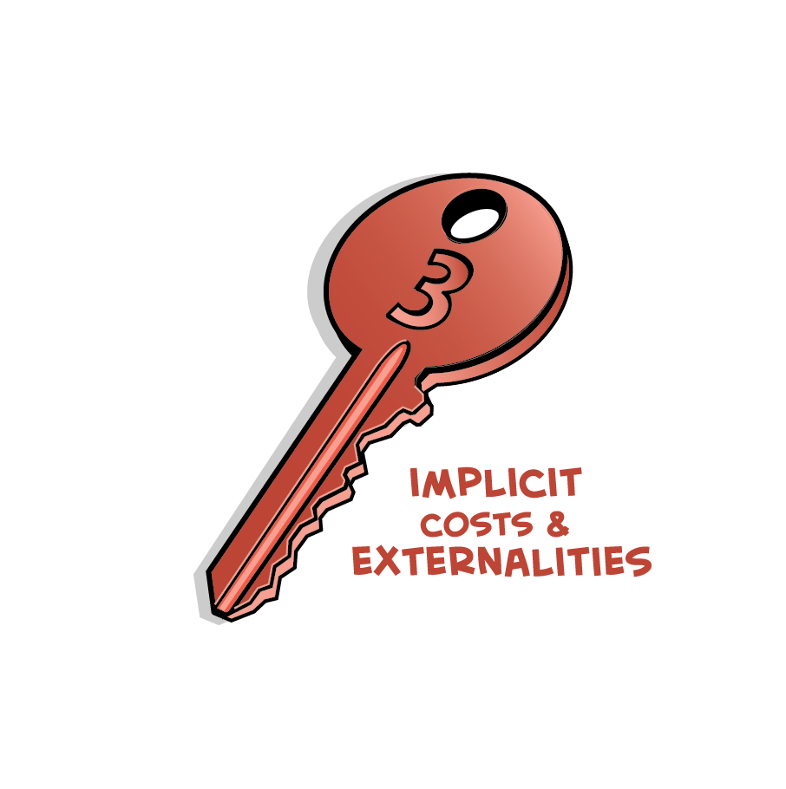
Negative externalities (external costs) costs to society from your private choice that affect others, but that you do not pay
Positive externalities (external benefits) benefits to society from your private choice that affect others, but that others do not pay you for

Slide 4
Externalities occur when clear property rights are missing
Tragedy of the commons the overuse and depletion of a resource that no one can be excluded from because of missing property rights
Free riders those who consume products or services without paying

Slide 5
When externalities exist, prices don’t reflect all social costs and benefits, and markets fail to produce efficient outcomes. Instead markets produce
Too many products and services with negative externalities (second-hand smoke, pollution, traffic jams)
Too few products and services with positive externalities (vaccinations, education)

Slide 6
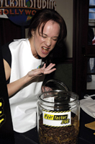
NEGATIVE EXTERNALITIES AND EFFICIENT POLLUTION
For an efficient market outcome when there are negative externalities, choose the quantity of output where marginal social cost equals marginal social benefit.

Slide 7
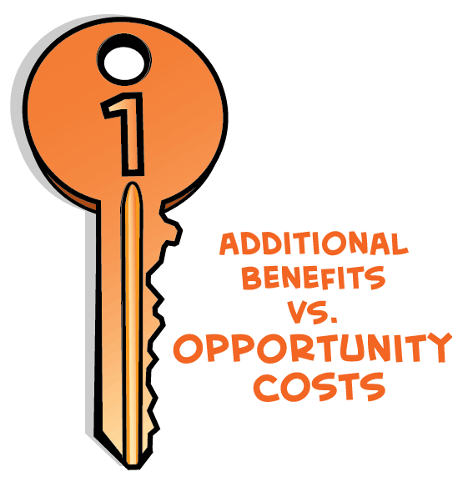
“Efficient pollution” balances the additional environmental benefits of lower pollution with additional opportunity costs of reduced living standards
Socially desirable amount of pollution is not zero
At some point, additional opportunity costs of reducing pollution are greater than additional benefits of lower pollution

Slide 8
When there are externalities, smart choice rule is: Choose the quantity of output where marginal social cost = marginal social benefit
Marginal social cost (MSC) = marginal private cost (MC) plus marginal external cost
Marginal external cost = price of preventing or cleaning up damage to others external to the original activity
Marginal social benefit (MSB) = marginal private benefit (MB) plus marginal external benefit
Marginal external benefit = price of the value or savings to others external to the original activity

Slide 9
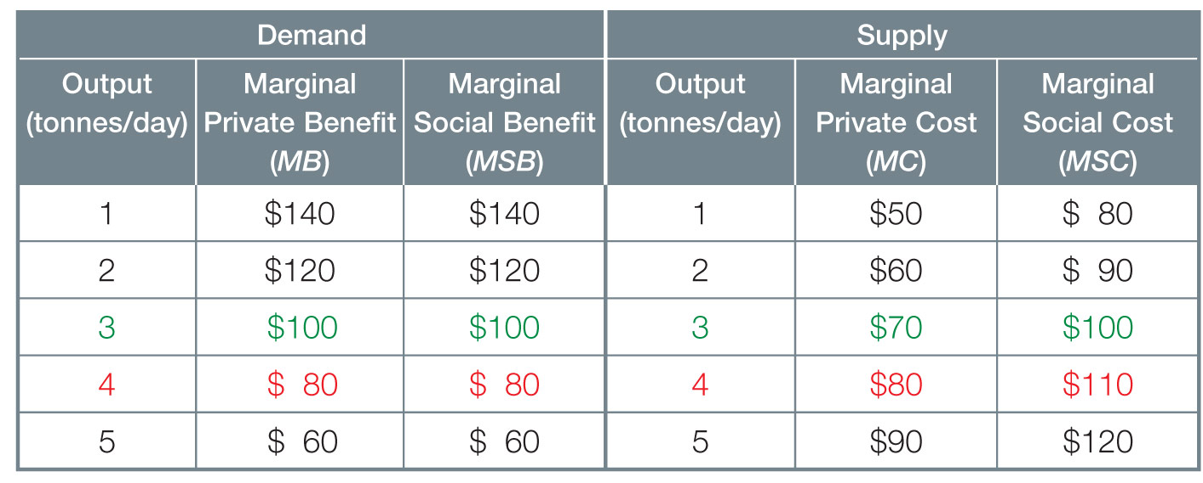
Demand, Supply & Negative Externalities in the Pulp Market

Slide 10
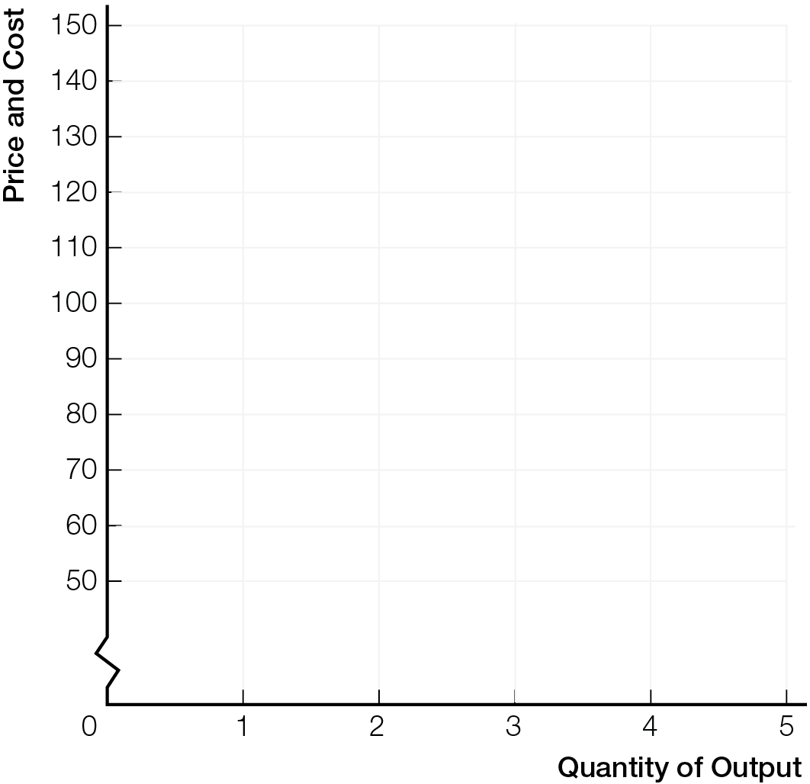
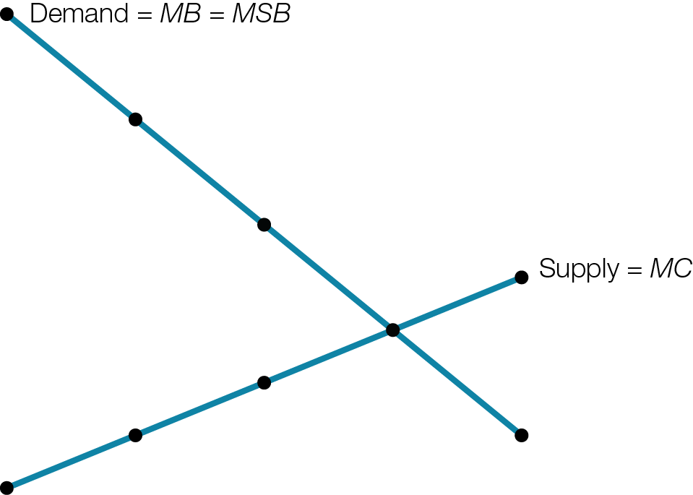
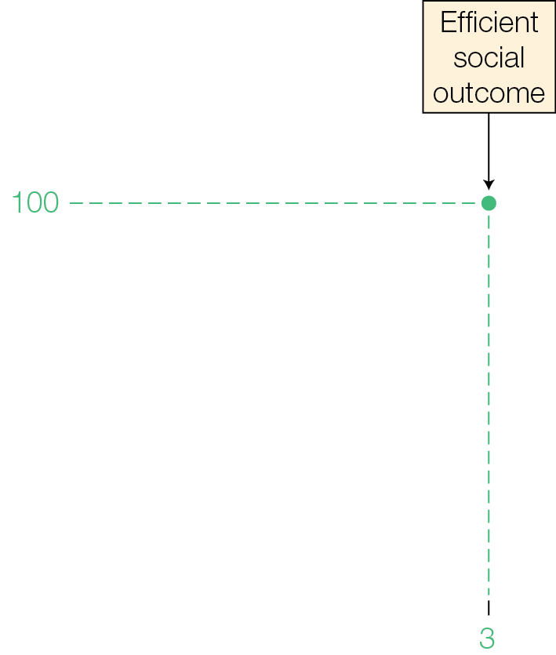
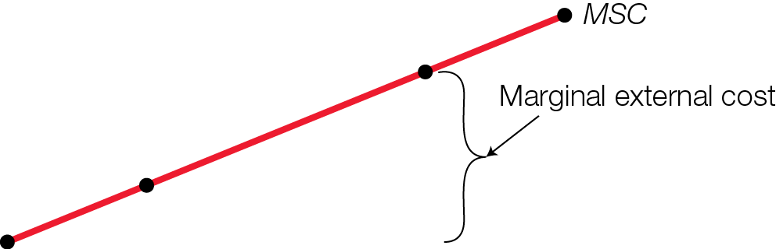
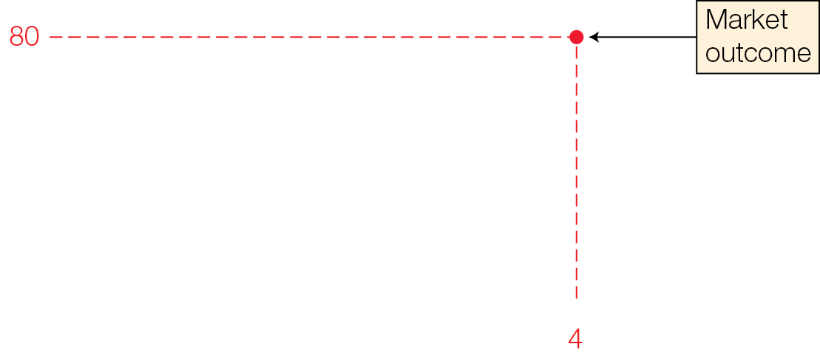
Demand, Supply & Negative Externalities in the Pulp Market
Fig. 11.1

Slide 11
Markets overproduce products and services with negative externalities
Price is too low because it does not incorporate external costs

Slide 12
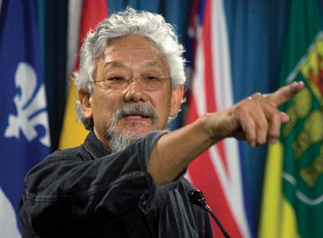
POLICIES TO INTERNALIZE NEGATIVE EXTERNALITIES
If polluters are forced by government to pay the marginal external costs of their pollution, this internalizes the externalities/costs into private choices, creating smart social choices.

Slide 13
Without property rights to the environment, businesses have incentives to save money and improve profits by ignoring external costs like pollution and global warming
Governments can remedy market failures from externalities by creating social property rights to the environment, making polluting illegal, and penalizing polluters

Slide 14
Emissions tax tax to pay for external costs of emissions
Carbon tax emissions tax on carbon-based fossil fuels
Smart carbon tax = marginal external cost of damage from emissions
Internalize the externality transform external costs into costs the producer must pay to the government

Slide 15
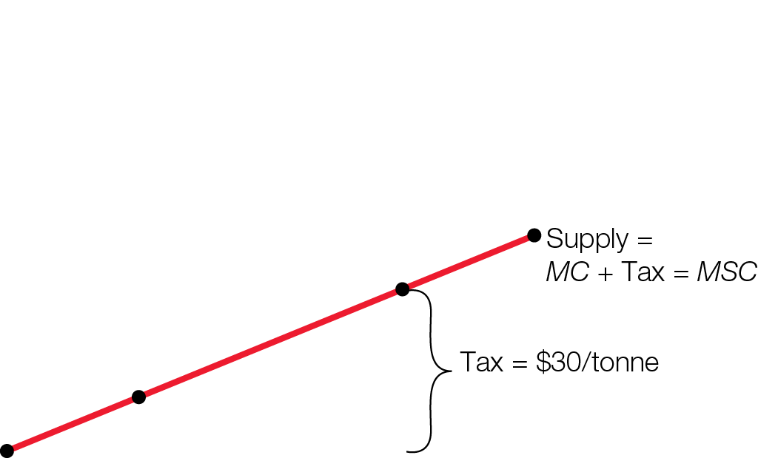
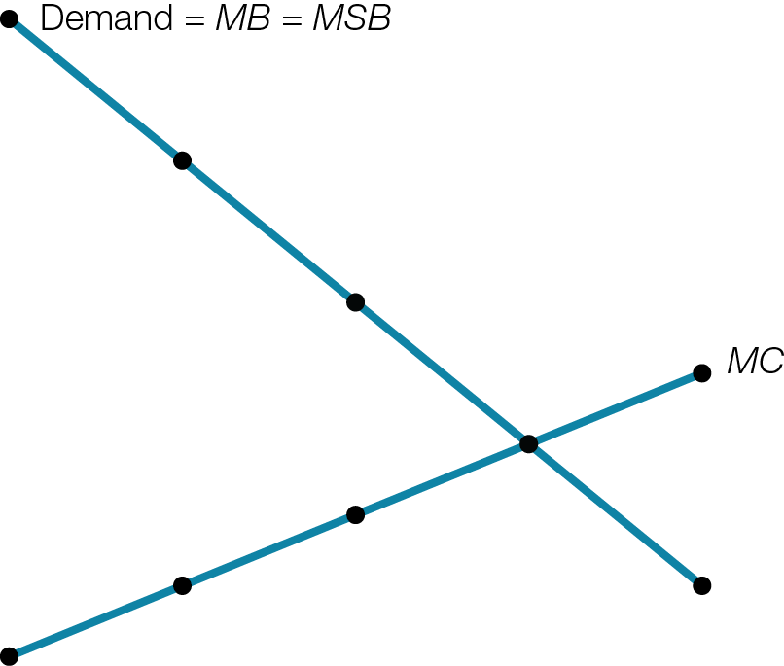
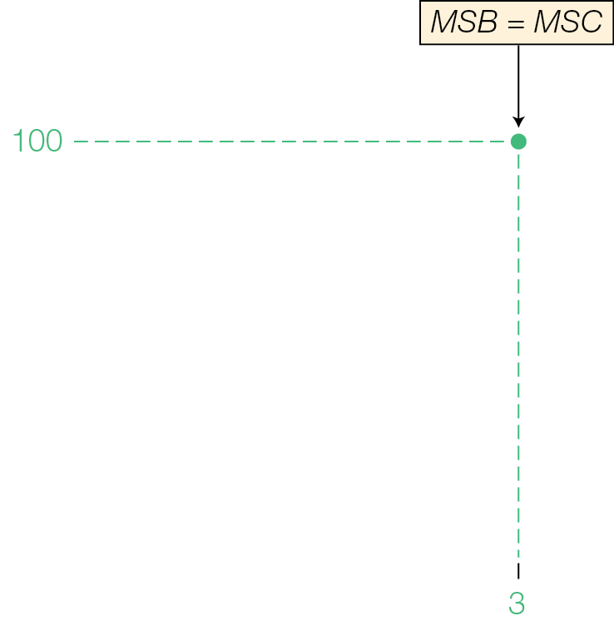
Pulp Market with $30/Tonne Emissions Tax
Fig. 11.2

Slide 16
Cap-and-trade system limits quantities of emissions businesses can release into environment
Government auctions off pollution permits to highest bidders
Total quantity of emissions allowed by permits = emissions target
Businesses buy and sell emissions permits; Permit price becomes private cost to business reflecting marginal external cost of pollution

Slide 17
Carbon taxes and emissions permits give pollution a price reflecting marginal external cost of damage, so smart private choices become smart social choices
Carbon taxes and cap-and-trade systems may be inequitable, hurting lower-income consumers most
Differences
Carbon taxes set price of emissions and the market adjusts quantities
Cap-and-trade systems set quantities and the market adjusts prices

Slide 18
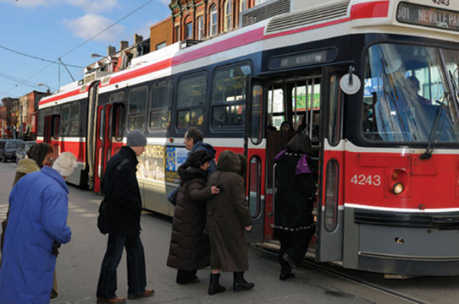
FREE RIDERS AND PUBLIC GOODS
With positive externalities, buyers and sellers are not paid for the external benefits their exchange creates. The market-clearing price is too high for buyers to be willing to buy the socially best quantity of output, and too low for sellers to be willing to supply.

Slide 19
Positive externalities (external benefits) benefits to society from your private choice that affect others, but that others do not pay you for
Public goods provide external benefits consumed simultaneously by everyone; no one can be excluded
Public goods like lighthouses and national defence are extreme examples of positive externalities
Free rider someone who does not have to pay for external benefits

Slide 20
With positive externalities, smart social quantity of output is at intersection of marginal social benefit and marginal social cost curves
Because of Free-rider problem
Markets underproduce products and services with positive externalities
No single price can coordinate smart individual choices and smart social choices
Market-clearing price is too high for buyers to be willing to buy and too low for sellers to be willing to supply

Slide 21
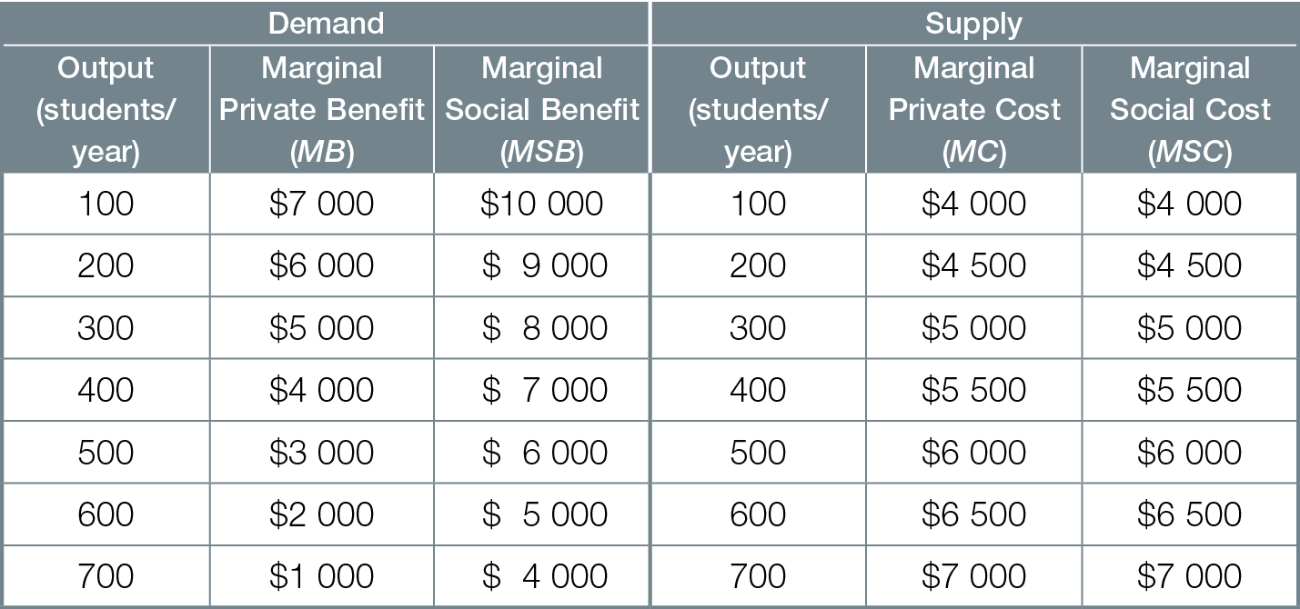
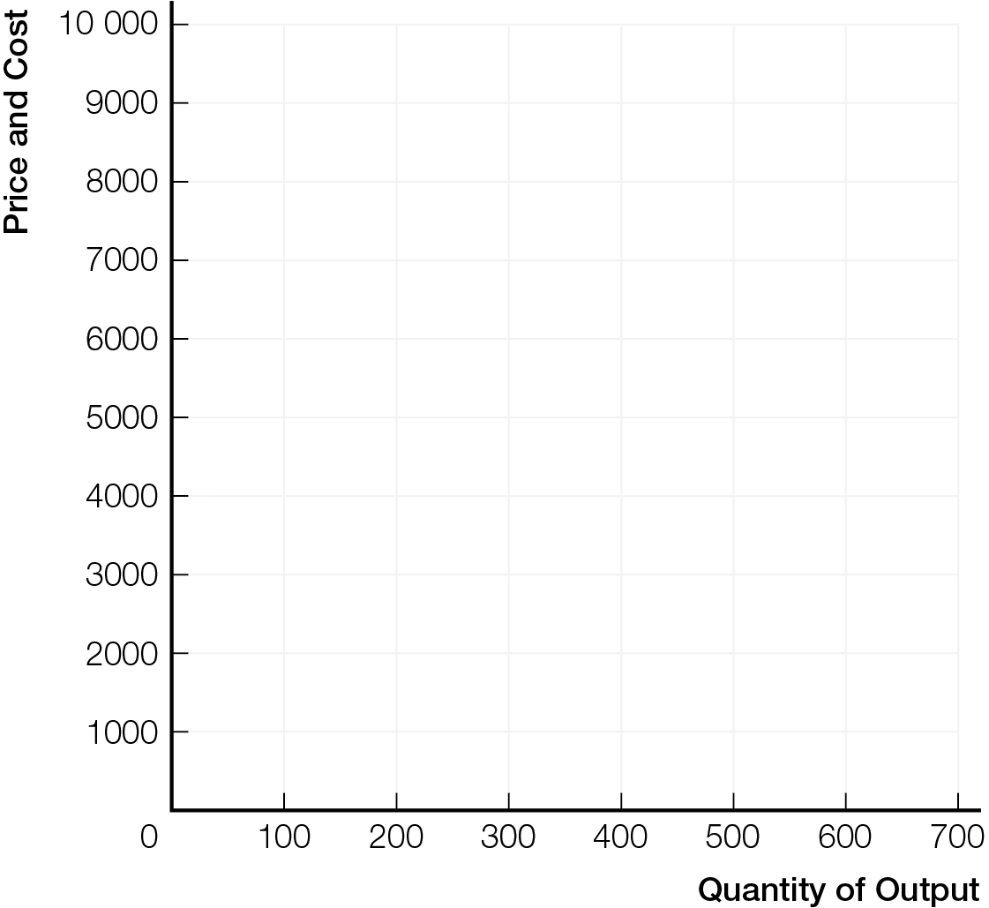
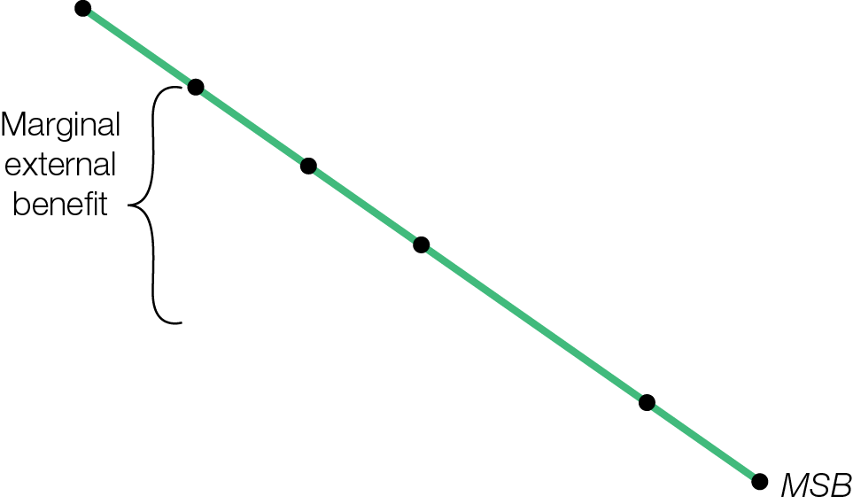
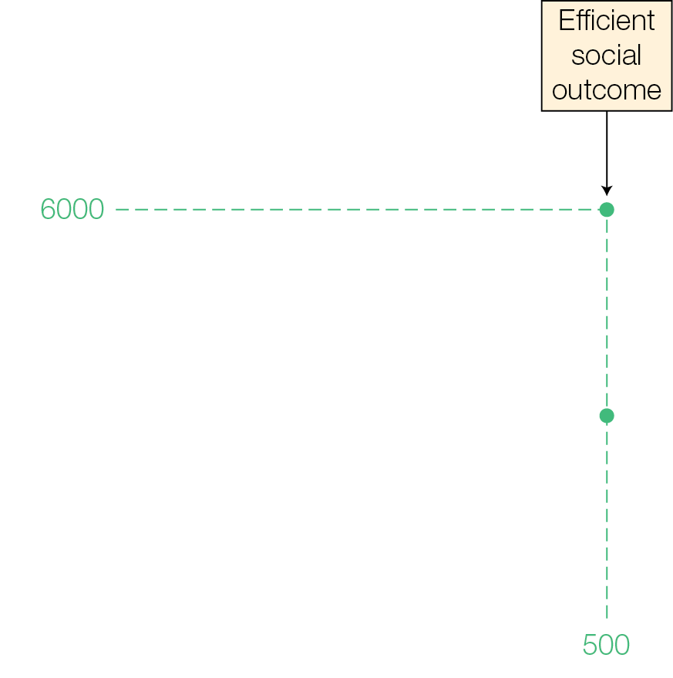
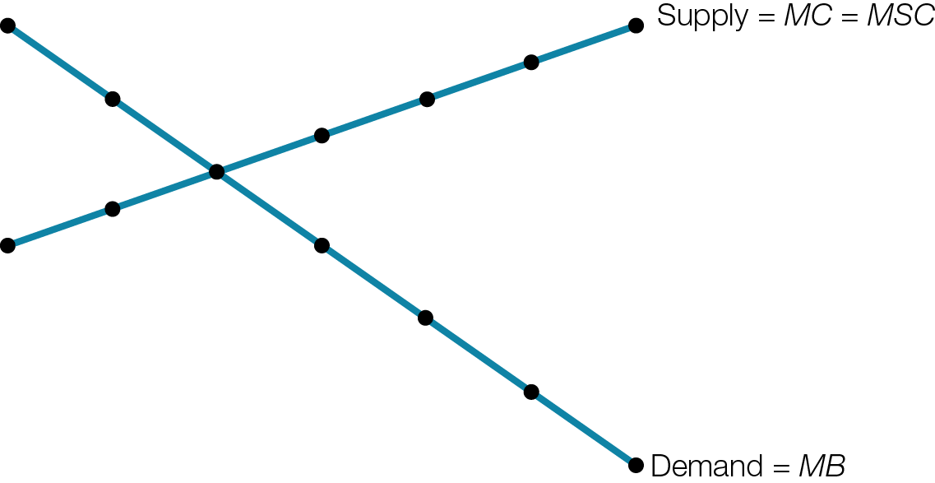
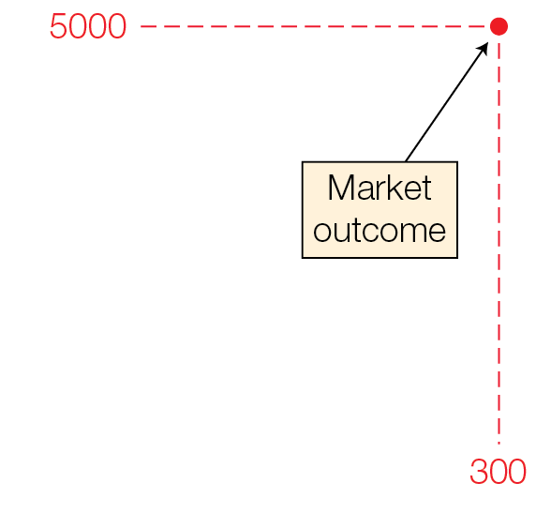
Demand, Supply & Positive Externalities in a Private Post-Secondary Education Market
Fig. 11.3

Slide 22
SUBSIDIES FOR THE PUBLIC GOOD
When there are positive externalities, government subsidies can get everyone to voluntarily choose the socially best quantity of output where marginal social benefit equals marginal social cost.

Slide 23
Government policy tools to get all to voluntarily choose output where marginal social benefit = marginal social cost
Public provision government provision of products or services with positive externalities, financed by tax revenue
Subsidy payment to those creating positive externalities
Smart subsidies (= value marginal external benefit) and public provision remove the disconnect between prices for buyers and sellers, leading to voluntary choice of output best for society

Slide 24
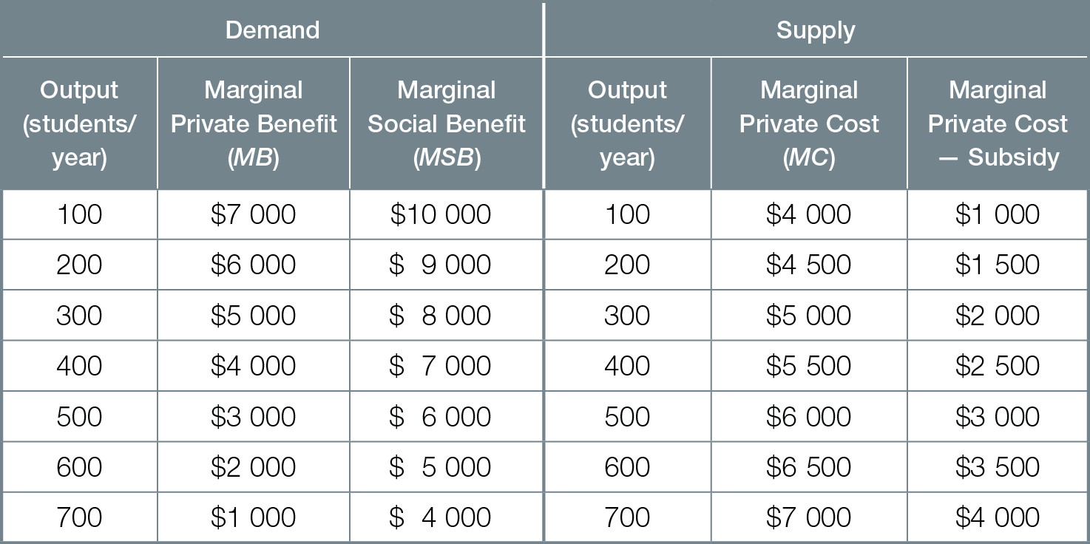
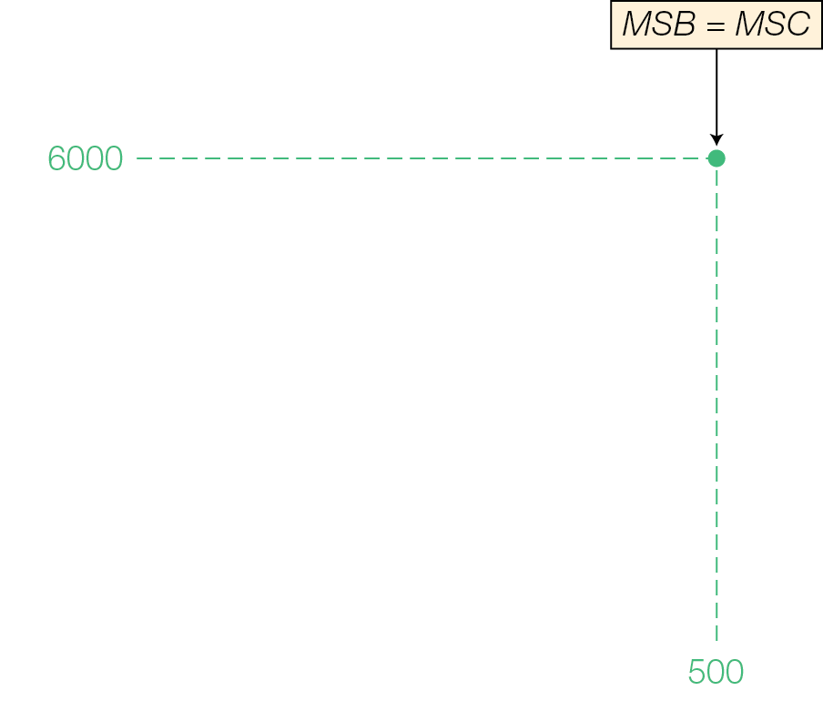
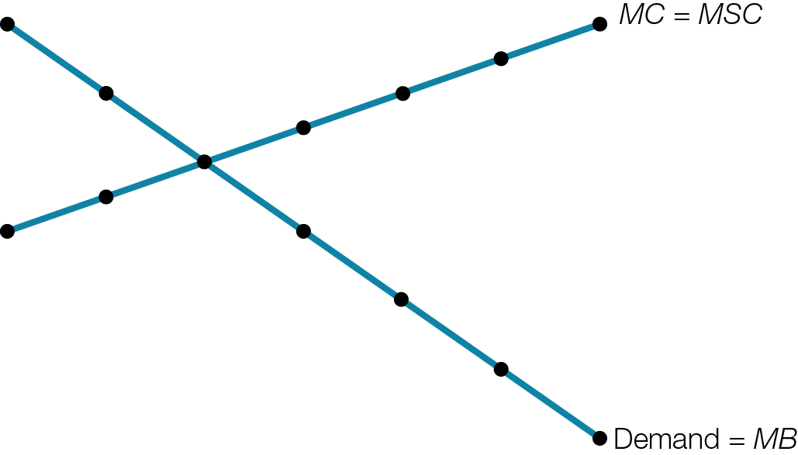
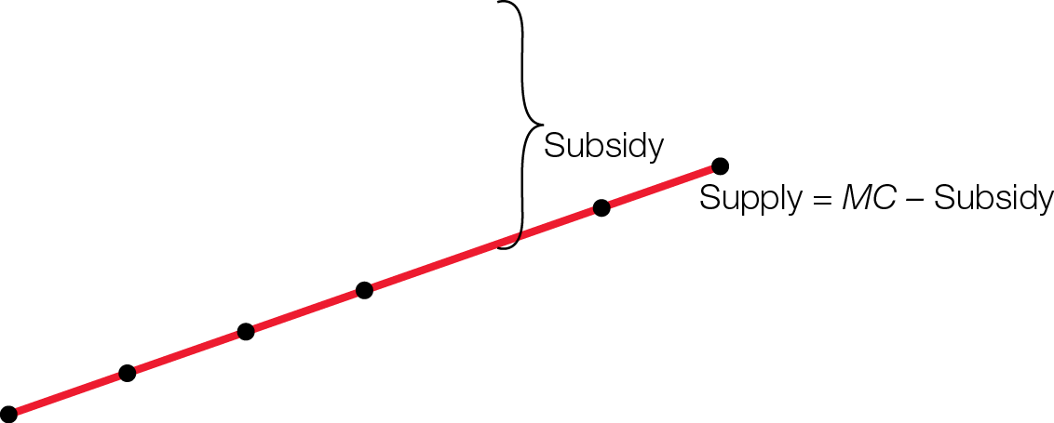
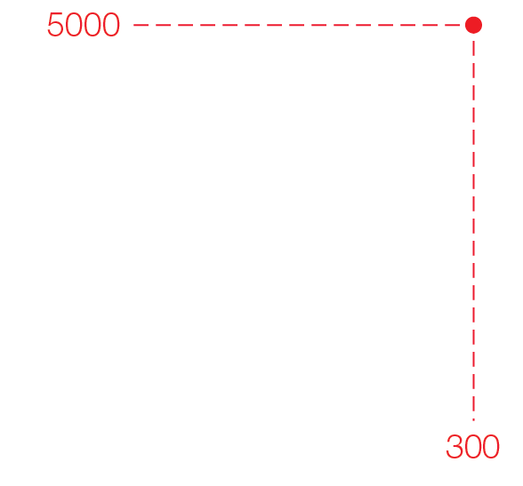

Post-Secondary Education Market with $3000 Subsidy to Schools
Fig. 11.4

