Slide 1
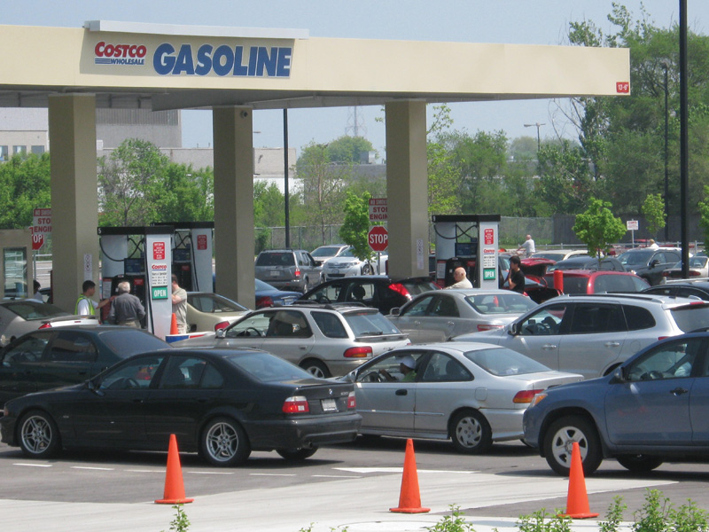
What Gives When Prices Don’t?

Slide 2
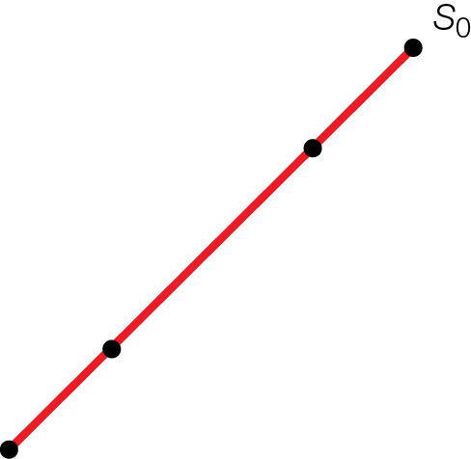
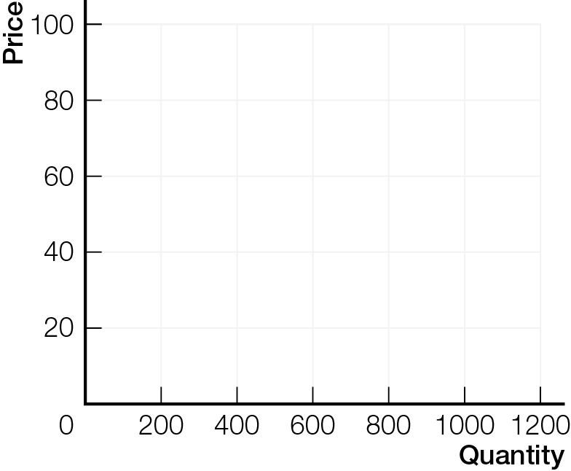
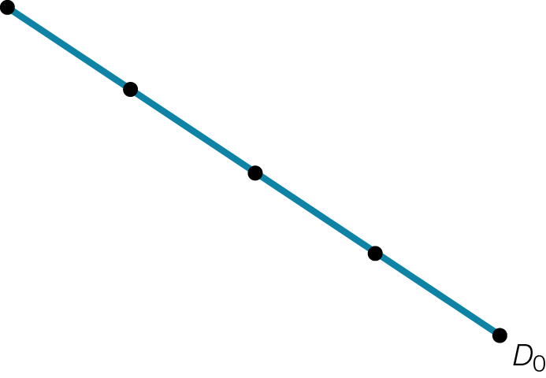



Market Demand and Supply for Piercings
Fig. 4.1

Slide 3

DO PRICES OR QUANTITIES ADJUST?
When government fixes prices, the smart choices of consumers and businesses are not coordinated. Quantities adjust to whichever is less — quantity supplied or quantity demanded.

Slide 4
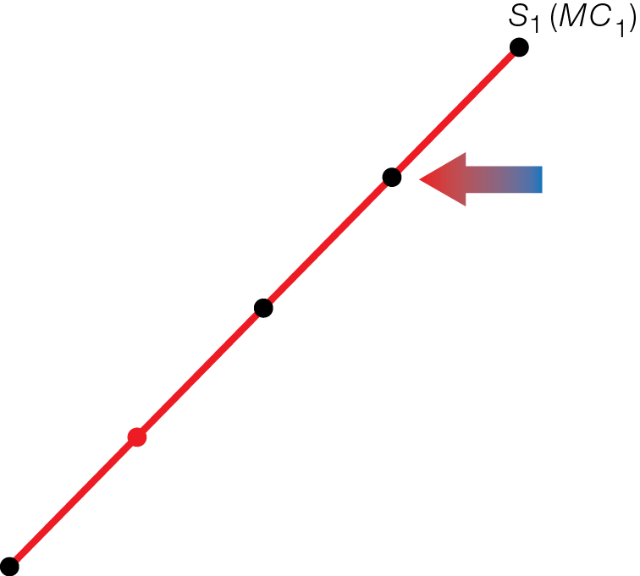
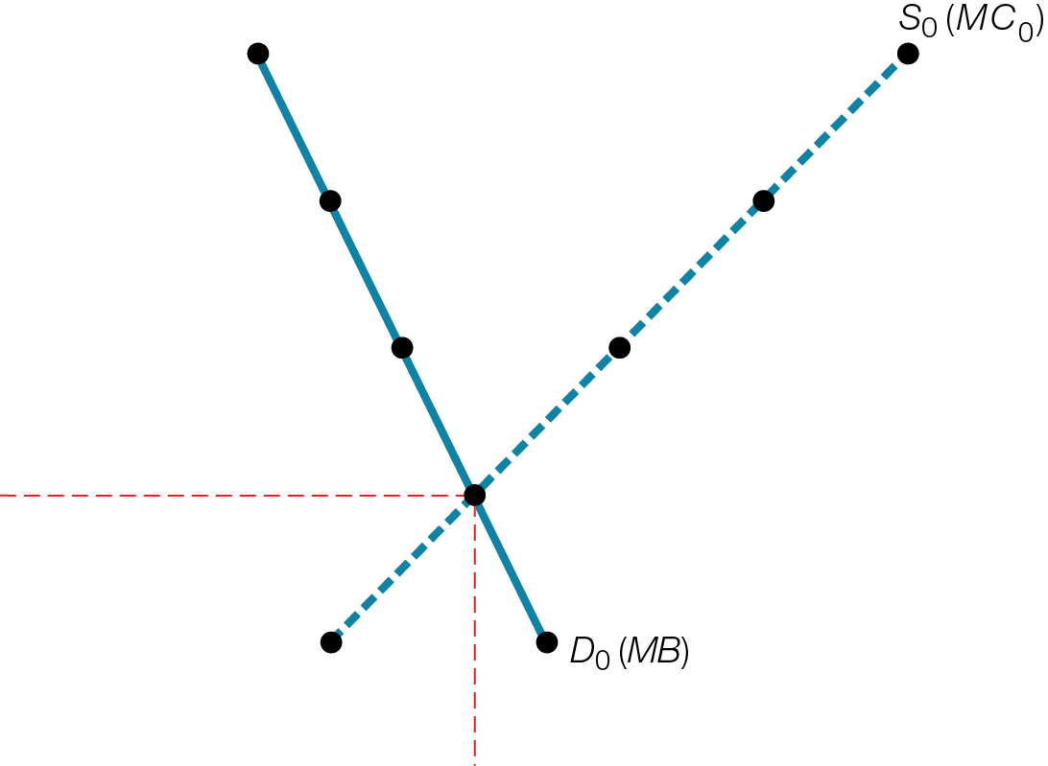
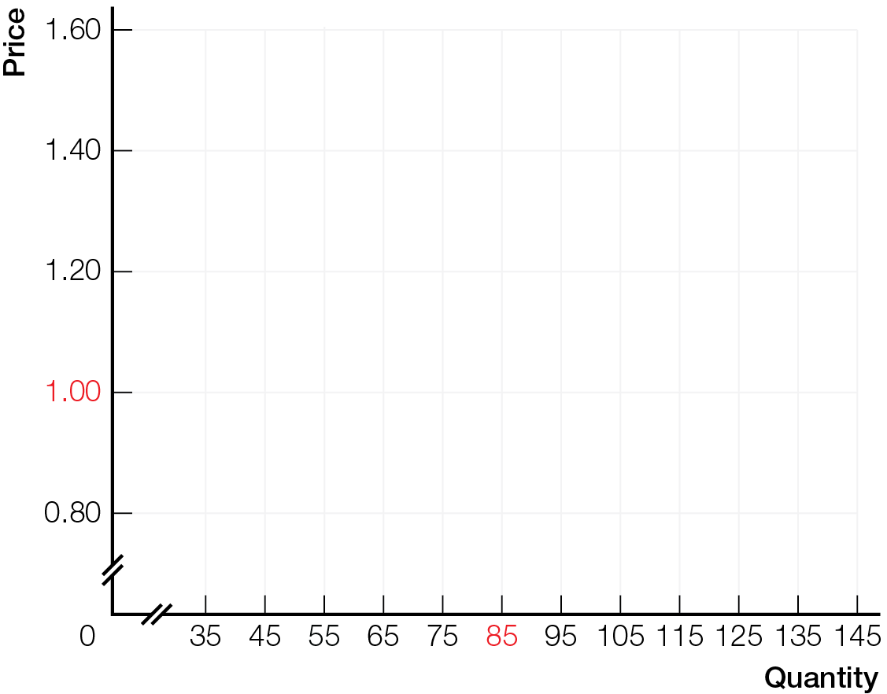
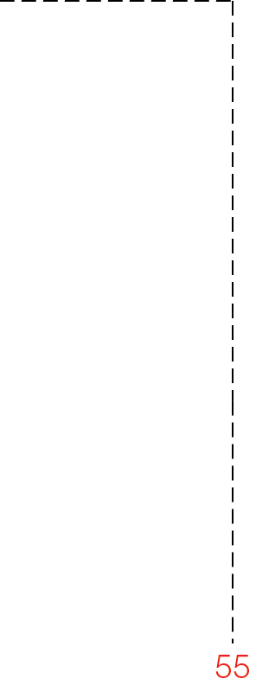

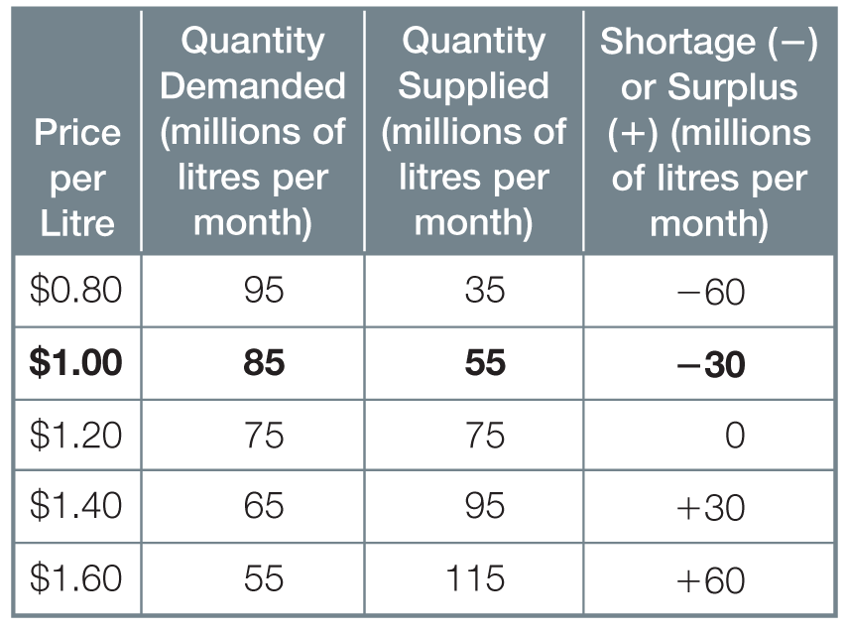

Market Gasoline with Shortage
Fig. 6.1

Slide 5
When price is fixed below market-clearing
Shortages develop — quantity demanded > quantity supplied
Consumers are frustrated
Quantity sold = quantity supplied only
When price is fixed above market-clearing
Surpluses develop — quantity supplied > quantity demanded
Businesses are frustrated
Quantity sold = quantity demanded only

Slide 6
When prices are fixed, quantities adjust to whichever is less — quantity supplied or quantity demanded
Governments can fix prices, but can’t force businesses (or consumers) to produce (or buy) at the fixed price
Businesses can reduce output or move resources elsewhere
Consumers can reduce purchases or buy something else

Slide 7

PRICE CEILINGS
Rent controls fix rents below market-clearing levels, and quantity adjustment takes the unintended form of apartment shortages.

Slide 8
Rent controls example of price ceiling maximum price set by government, making it illegal to charge higher price
Rent controls sometimes justified by Robin Hood principle — take from the rich (landlords) and give to the poor (tenants)

Slide 9
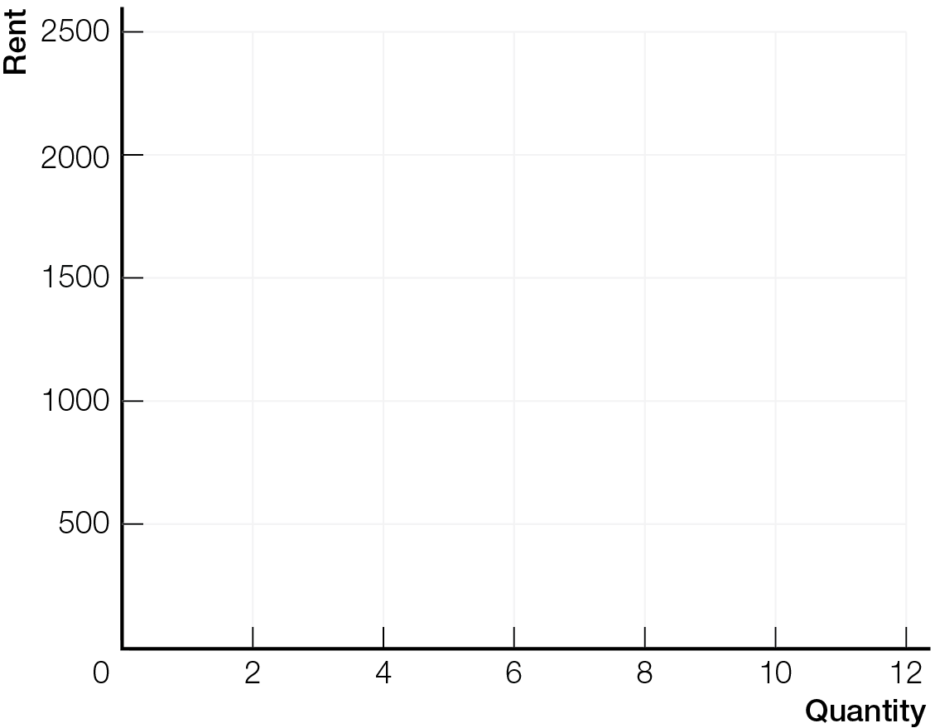
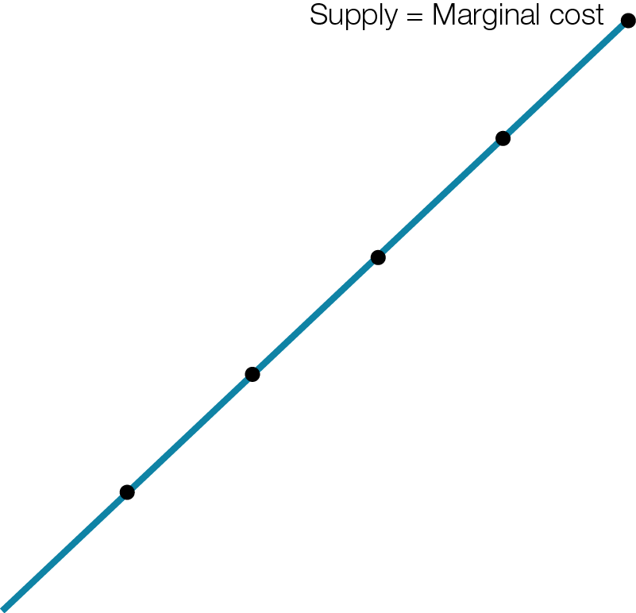
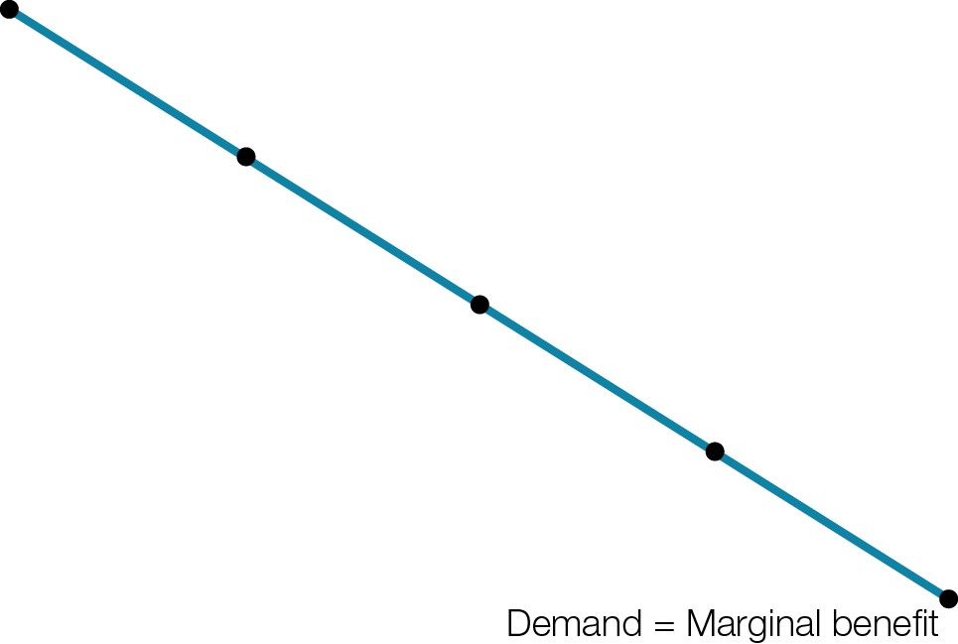
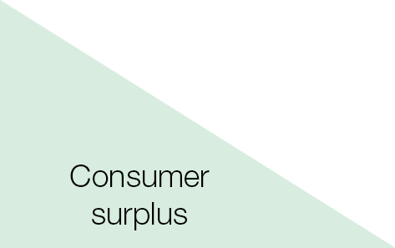
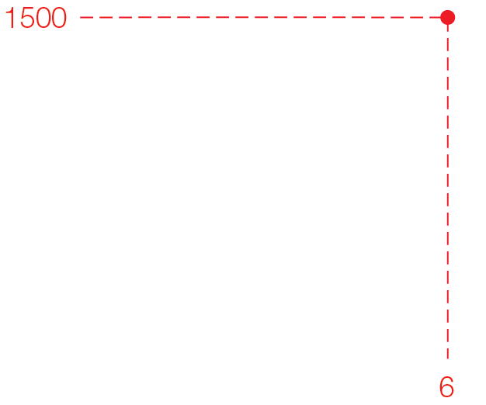
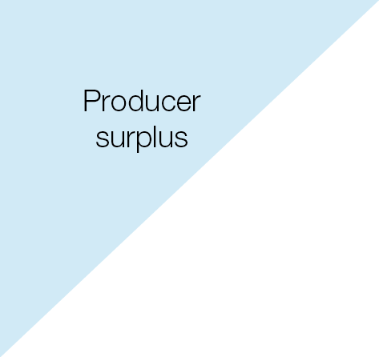
Market for Two-Bedroom Apartments
Fig. 6.3a

Slide 10

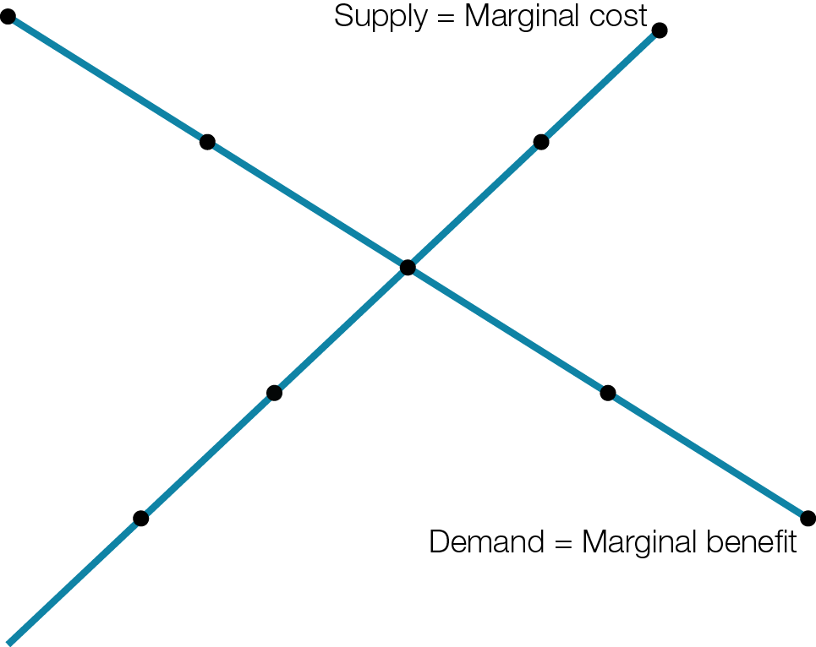

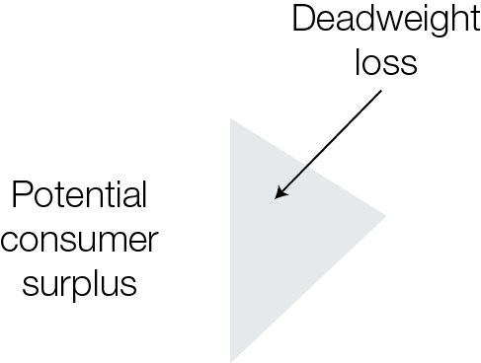
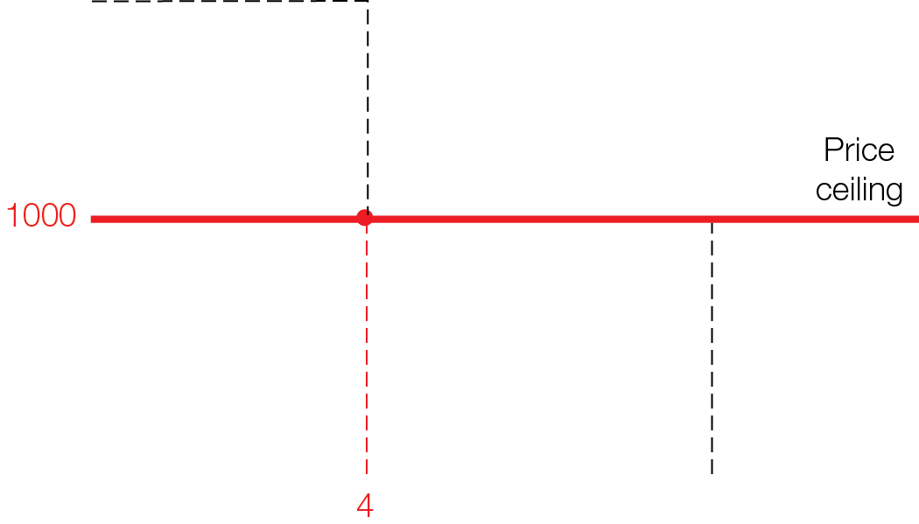
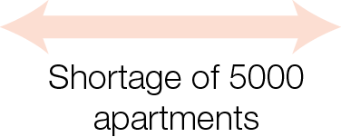

Market for Two-Bedroom Apartments with Rent Controls
Fig. 6.3b

Slide 11
Rent controls have unintended consequences
Create housing shortages, giving landlords the upper hand over tenants
Subsidize well-off tenants willing and able to pay market-clearing rents
Inefficiency, reducing total surplus below market-clearing amounts

Slide 12
Alternative policies to help the homeless that do not sacrifice market flexibility
Government income subsidies
Government-supplied housing
All policies have opportunity costs
Be sure to look for unintended consequences of policies that have good intentions

Slide 13
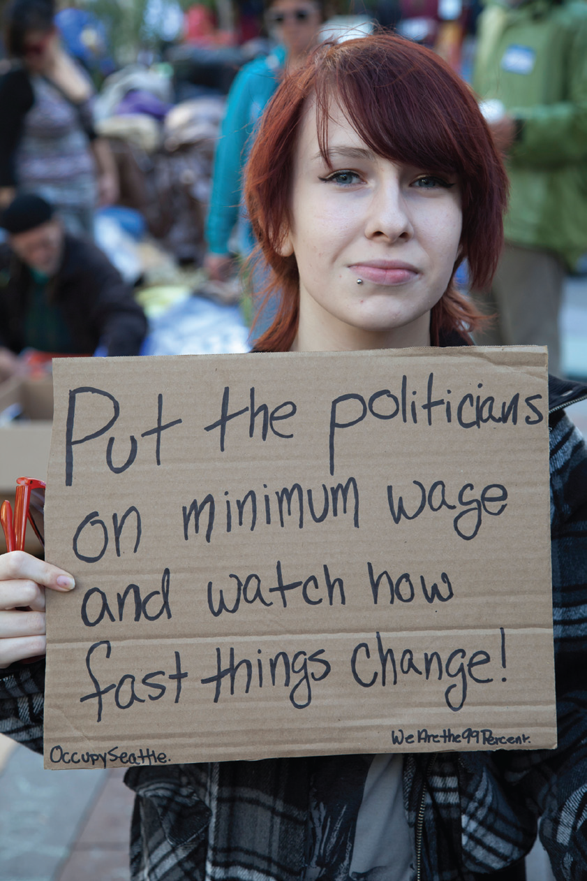
PRICE FLOORS
Minimum wage laws fix wages above market-clearing levels, and quantity adjustment takes the unintended form of unemployment.

Slide 14
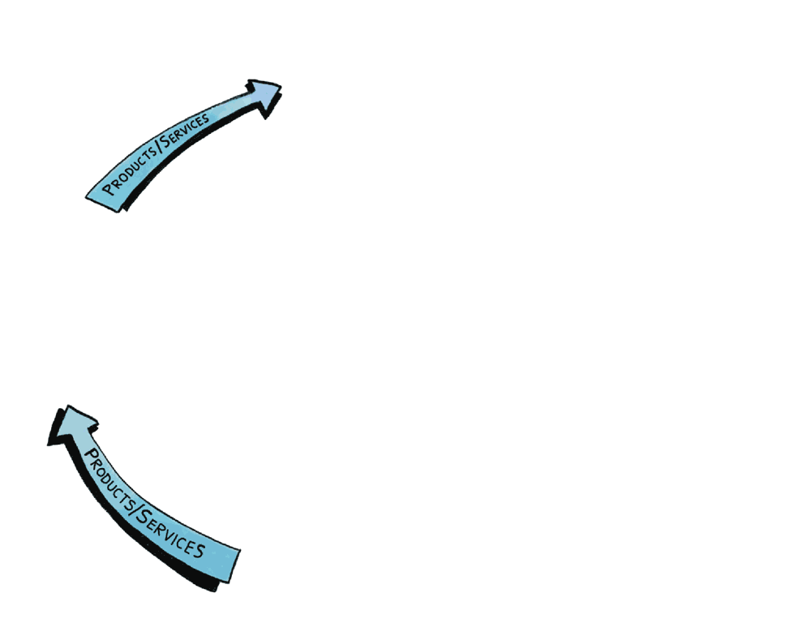
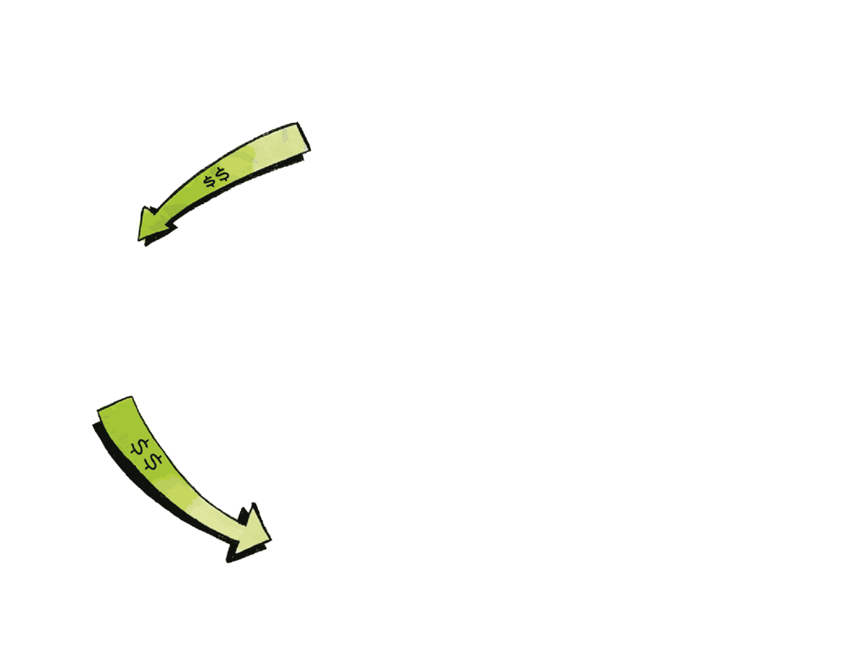
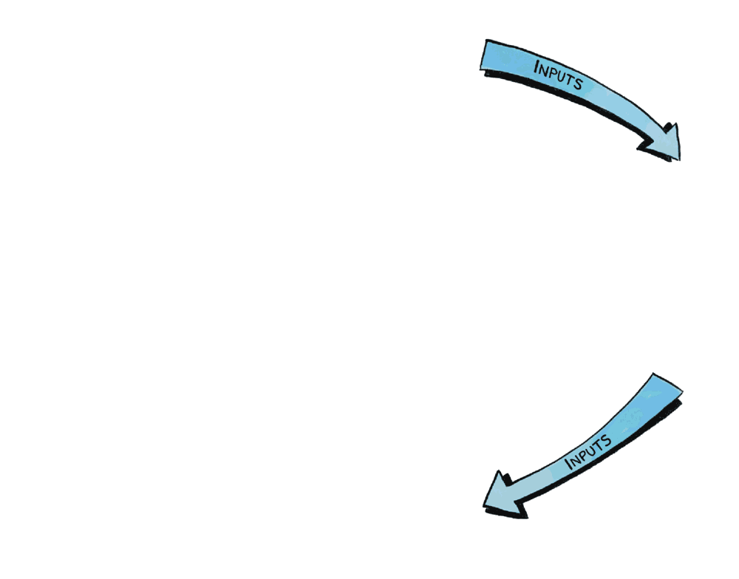
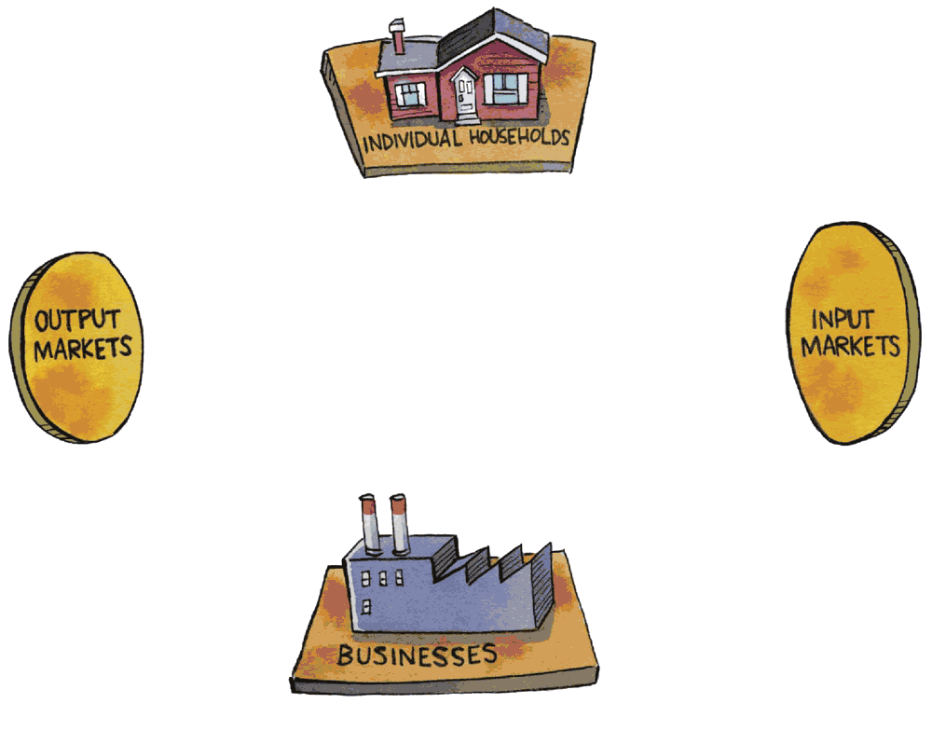

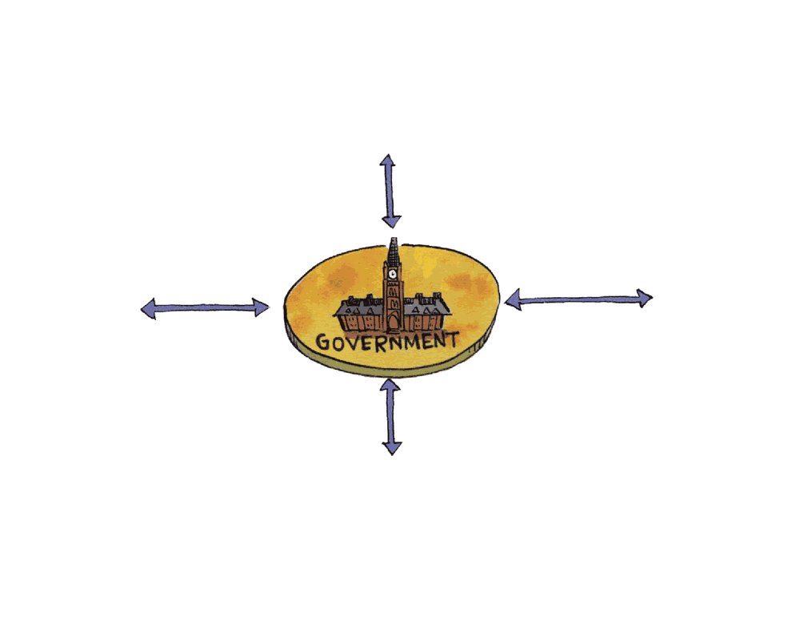
Circular Flow of Economic Life: Labour Markets are Input Markets

Slide 15
Minimum wage laws example of price floor minimum price set by government, makes it illegal to pay a lower wage – the price of labour
Living wage estimated at $20 per hour, to allow individual in a large Canadian city to live above poverty line
Unintended consequences of minimum wage above market-clearing wage
Quantity of labour supplied by households is greater than quantity of labour demanded by businesses
Creates unemployment

Slide 16
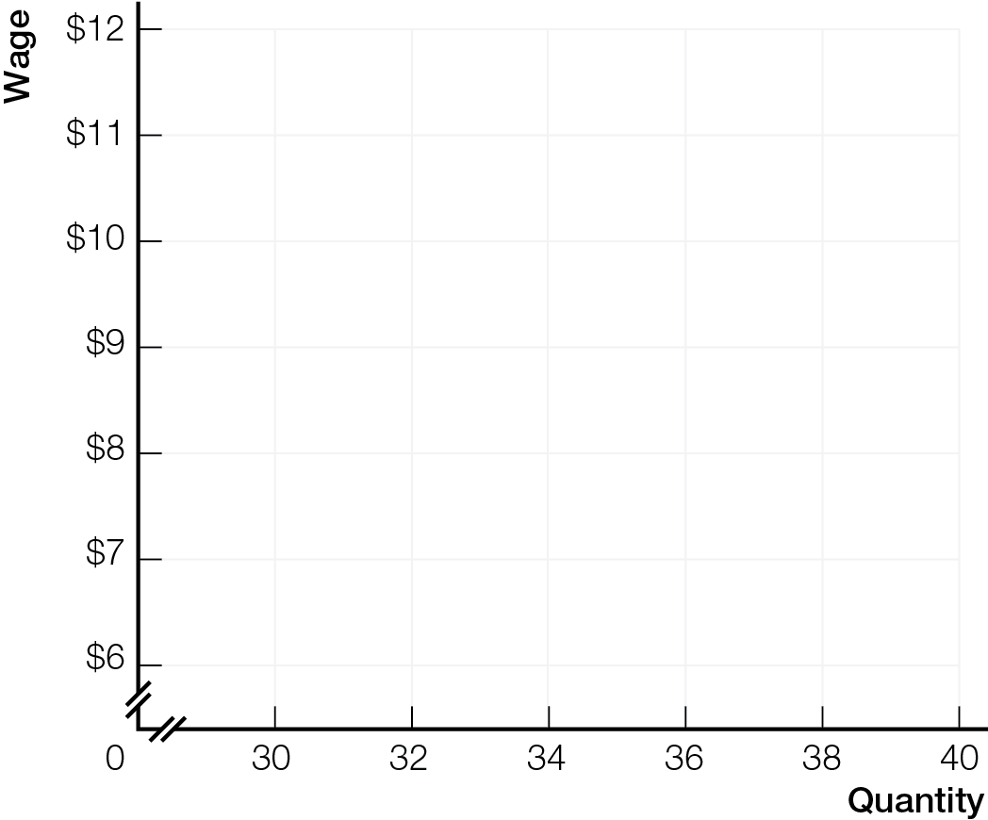
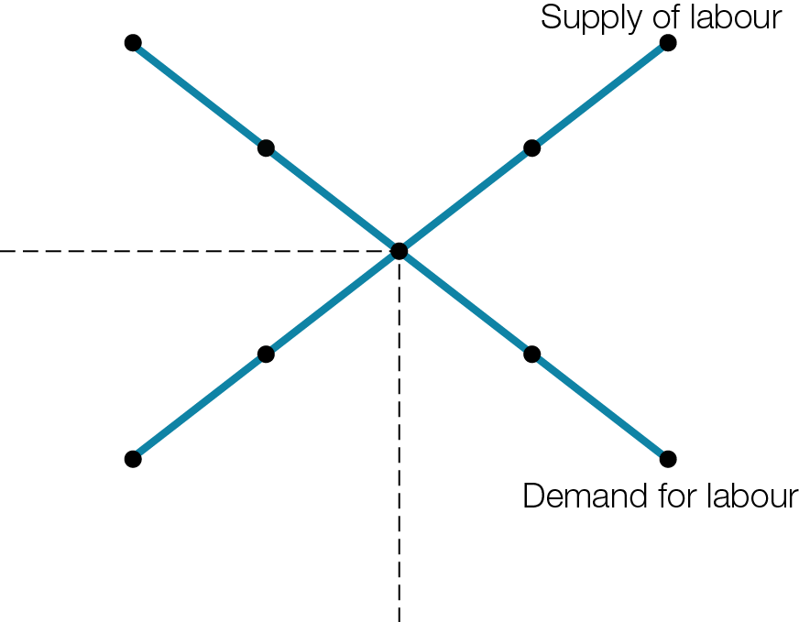
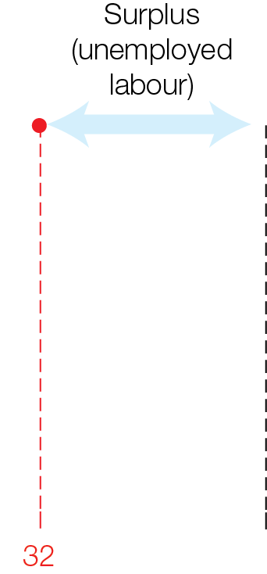

Market for Unskilled Labour with a Minimum Wage

Slide 17
How much unemployment is created by raising minimum wage depends on elasticity of business demand for unskilled labour
When demand inelastic and businesses have few substitutes for labour, small response in decreased quantity demanded
When demand elastic and businesses can easily substitute machines for people, large response in decreased quantity demanded
Minimum wages help the working poor if gains of workers who keep their jobs with higher incomes, are greater than losses of workers who lose jobs and income

Slide 18
In output markets, Q X P = total revenue for business
In input markets, Q X P = income for workers (Q = hours worked; P = wage rate)
Increased wage (P) ➔ increased income (Q X P) if labour demand inelastic
Increased wage (P) ➔ decreased income (Q X P) if labour demand elastic

Slide 19
Alternative policies to help the working poor that do not sacrifice market flexibility
Training programs to help unskilled workers get higher-paying jobs
Wage supplements
All policies have opportunity costs
Be sure to look for unintended consequences before making up your mind about policy choices

Slide 20
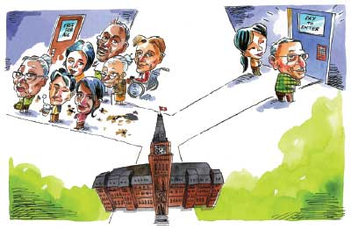
TRADE-OFFS BETWEEN EFFICIENCY & EQUITY
Well-functioning markets are efficient, but not always equitable. Government may smartly choose policies that create more equitable outcomes, even though the trade-off is less efficiency.

Slide 21
Efficient, well-functioning markets produce the products and services we value most, which means outputs go to those most willing and able to pay
But efficient market outcomes may not be fair or equitable

Slide 22
Efficient market outcome
Coordinates smart choices of businesses and consumers
Outputs are produced at lowest cost (prices just cover all opportunity costs of production)
Consumers buy products and services providing the most bang per buck (marginal benefit greater than price)

Slide 23
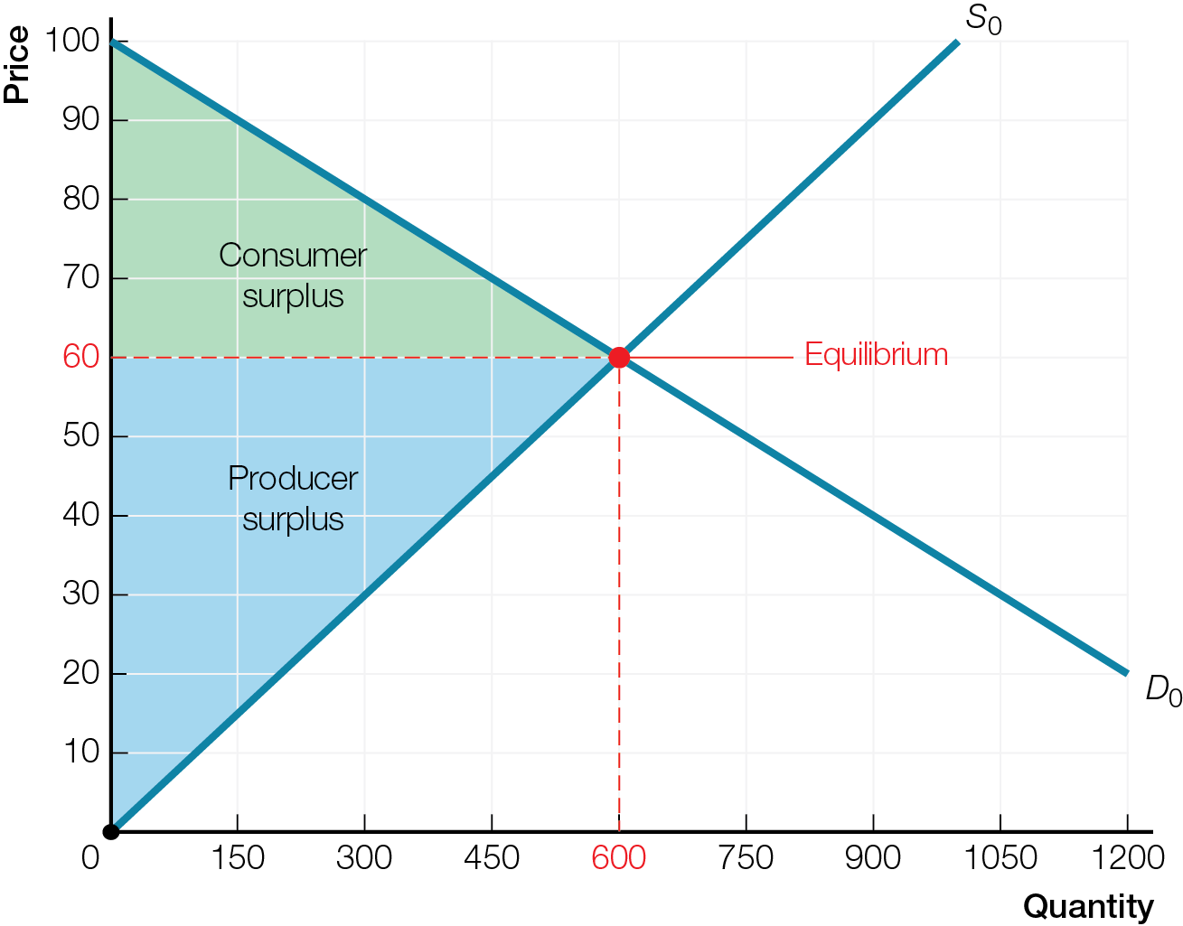
Maximum Total Surplus for Efficient Market
All these consumers do not get the product

Slide 24
Consumers who do not buy at equilibrium, market-clearing prices are either
Unwilling — because marginal benefit is less than price (even though could afford to buy), or
Unable to afford to buy — even though willing (marginal benefit is greater than price)

Slide 25
Allowing markets to operate without government interaction is a choice with an opportunity cost — unfairness or inequality
Trade-off between efficiency and equity. Compare U.S. market-driven health care with Canadian universal, government-run health care
Canadian-style government healthcare more equitable, but less efficient
U.S.-style private market outcome more efficient, but less equitable
Health-care waiting lists are a quantity adjustment when prices are fixed too low

Slide 26
Government may make smart policy choices that
Create more equitable outcomes, even though the trade-off is less efficiency
Create more efficient outcomes, even though the trade-off is less equity

Slide 27
WHAT ECONOMICS CAN AND CANNOT DO FOR YOU
Once you choose to support a political position or social goal based on your values, positive economic thinking helps identify the smartest choices to efficiently achieve that goal.

Slide 28
Positive (or empirical) statements about what is
Can be evaluated as true or false by checking facts
Normative statements about what you believe should be; involve value judgments
Efficiency versus Equity choices are normative

Slide 29
Two definitions of equity
Equal outcomes — at the end, everyone gets the same amount
Equal opportunities — at the start, everyone has the same opportunities, but the outcomes can be different

Slide 30
THE POLITICS OF EQUITY
Equal OUTCOMES
Politicians on political left
Redistribution of incomes towards equality: skeptical about equal opportunities
Equity priority over efficiency
Equal OPPORTUNITIES
Politicians on political right
Unequal outcomes are fair result of personal differences
Efficiency priority over equal outcomes
For any policy choice, weigh benefits against opportunity costs, including unintended consequences

