Slide 1
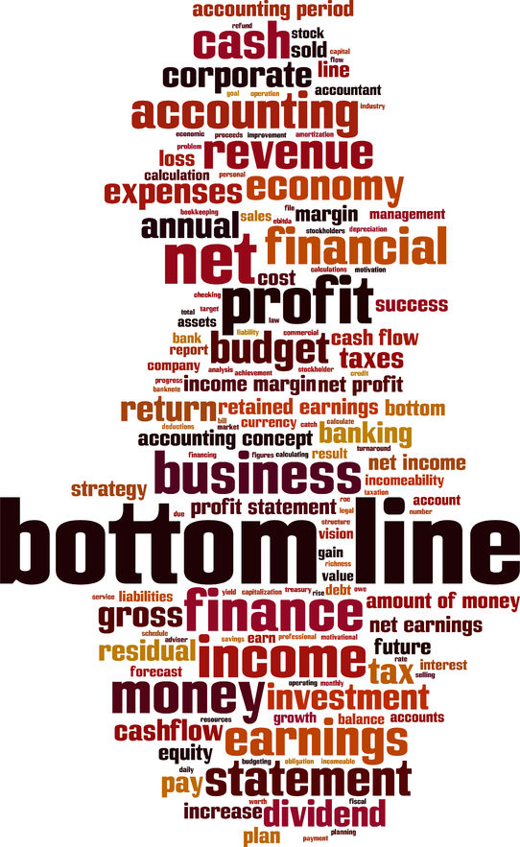
Finding the Bottom Line

Slide 2
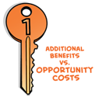


The Three Keys Model to Smart Choices
Choose only when additional benefits are greater than additional opportunity costs
Count only additional benefits and additional opportunity costs
Be sure to count all additional benefits and costs, including implicit costs and externalities

Slide 3
The Three Keys Model to Smart Choices
Choose only when additional benefits are greater than additional opportunity costs
Count only additional benefits and additional opportunity costs
Be sure to count all additional benefits and costs, including implicit costs and externalities
Notes:
)

Slide 4
The Three Keys Model to Smart Choices
Choose only when additional benefits are greater than additional opportunity costs
Count only additional benefits and additional opportunity costs
Be sure to count all additional benefits and costs, including implicit costs and externalities

Slide 5
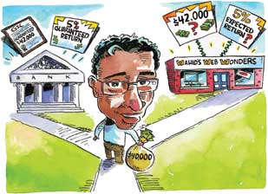
ACCOUNTING PROFITS AND HIDDEN OPPORTUNITY COSTS
Accounting profits equal revenues minus all obvious costs, including depreciation. But accounting profits miss the hidden, implicit opportunity costs of a business owner’s time and money.
Notes:
.

Slide 6
Obvious costs (explicit costs) costs a business pays directly
Accountants count all obvious business costs and include depreciation
Decrease in the value of equipment over time because of wear and tear and because it becomes obsolete
Yearly depreciation cost is the price of equipment divided by number of years it lasts
Accounting profits Revenues – Obvious Costs (including depreciation)

Slide 7
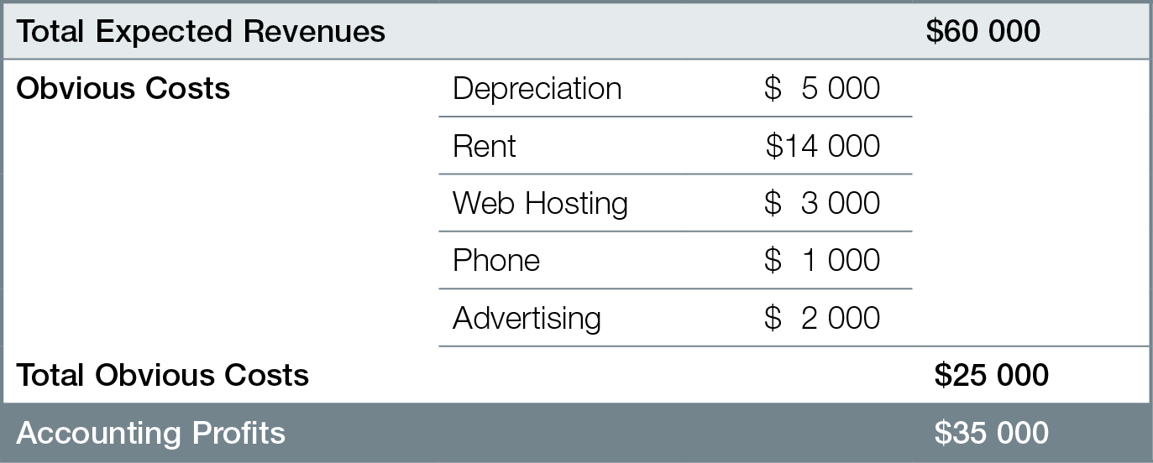
Accountant’s One-Year Business Plan for Wahid’s Web Wonders

Slide 8
Implicit costs hidden opportunity costs of what business owner could earn elsewhere with time and money invested
Opportunity cost of time — best alternative use of business owner’s time
Opportunity cost of money — best alternative use of business owner’s money invested in the business
Must include compensation for risk

Slide 9
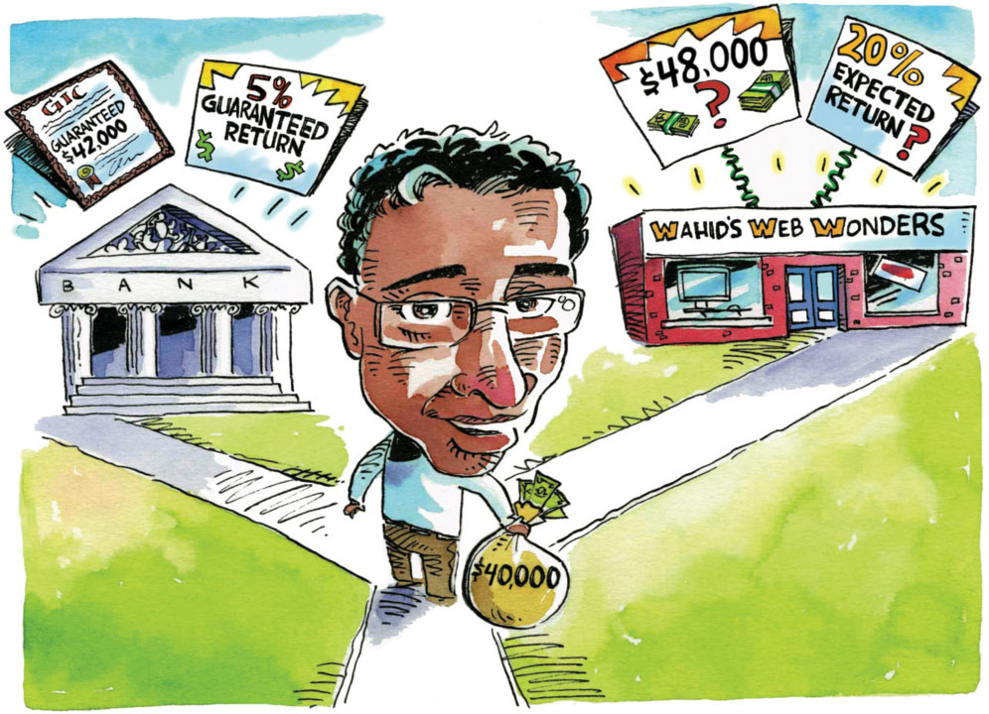

Slide 10

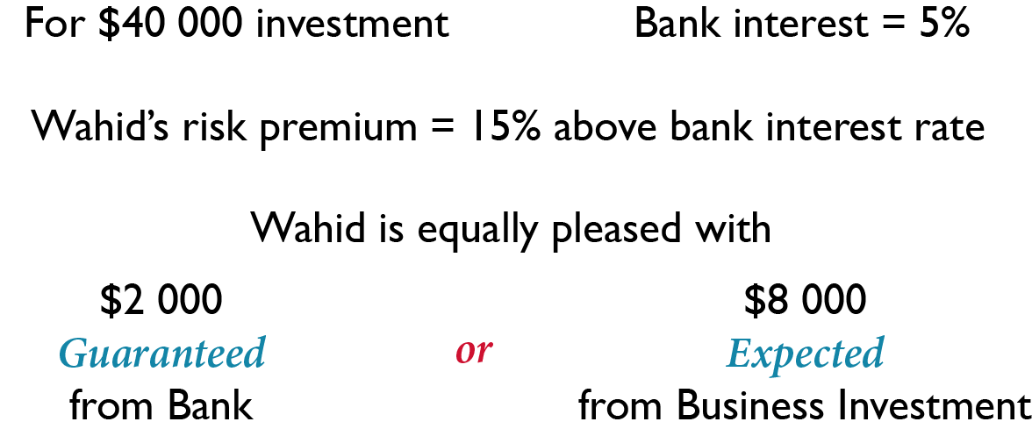

Slide 11
Risk compensation depends on attitudes toward risk
Risk-loving investor does not require much compensation for taking risks
Risk-averse (risk-avoiding) investor requires high compensation for taking risks

Slide 12
NORMAL PROFITS AND ECONOMIC PROFITS
Smart business decisions return at least normal profits — what a business owner could earn from the best alternative uses of her time and money. There are economic profits over and above normal profits when revenues are greater than all opportunity costs of production, including hidden opportunity costs.

Slide 13
Normal profits
Compensation for business owner’s time and money, or
Sum of hidden opportunity costs (implicit costs), or
What business owner must earn to do as well as best alternative use of time and money, or
Average profits in other industries

Slide 14
Economic profits =
Revenues minus all Opportunity Costs
Revenues − (Obvious Costs + Hidden Opportunity Costs)
Revenues − (Obvious Costs + Implicit Costs)
Revenues − (Obvious Costs + Normal Profits)
Economists subtract hidden opportunity costs when calculating profits — accountants do NOT
Economic profits are less than accounting profits

Slide 15
Economic losses negative economic profits
If revenues are less than all opportunity costs, not a smart decision, business owner would be better off in alternative uses of time and money
With economic losses, business owner earning less than normal profits, or less than average profits in other industries

Slide 16
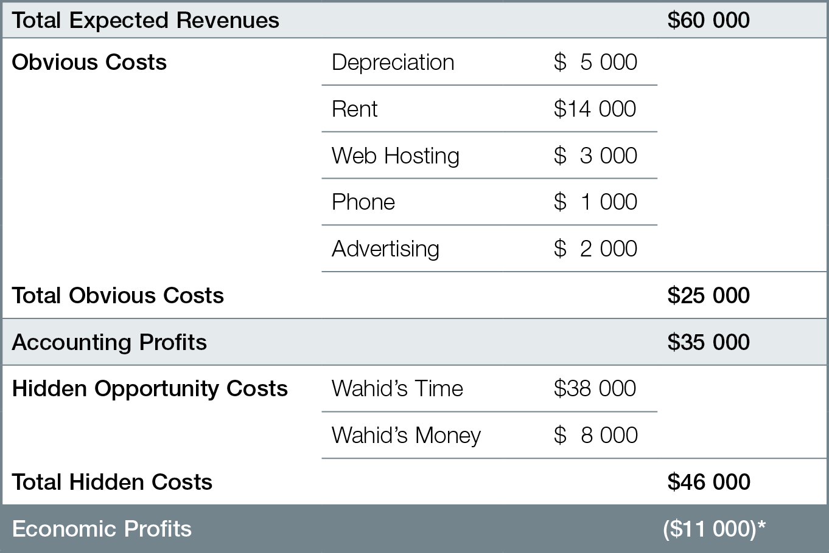
Economist’s One-Year Business Plan for Wahid

Slide 17
The Three Keys Model to Smart Choices
Choose only when additional benefits are greater than additional opportunity costs
Count only additional benefits and additional opportunity costs
Be sure to count all additional benefits and costs, including implicit costs and externalities

Slide 18
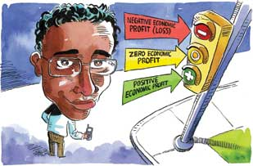
HOW ECONOMIC PROFITS DIRECT THE INVISIBLE HAND
The simplest rule for smart business decisions is “Choose only when economic profits are positive.” When businesses pursue economic profits, markets produce the products and services consumers want.

Slide 19
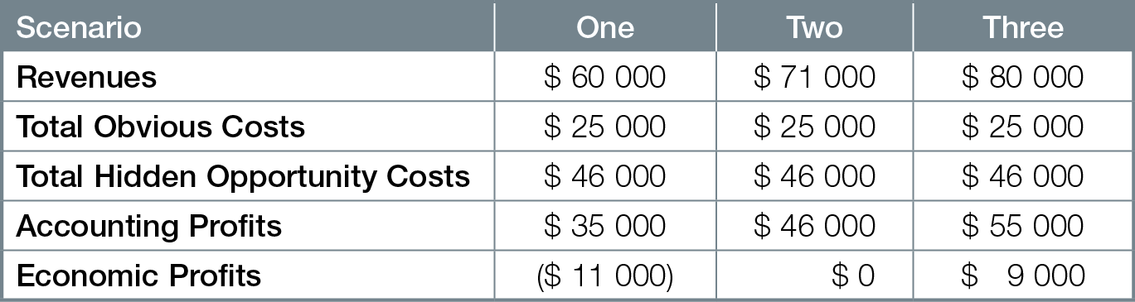
Alternative Profit Scenario’s for Wahid’s Web Wonders

Slide 20
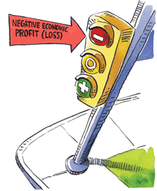
Economic profits (losses) signal smart business decisions
Economic losses ➔ businesses contract & leave industry, supply decreases, pushing prices up, until prices just cover opportunity costs of production, economic profits = zero
Economic losses are Red Light

Slide 21
Alternative Profit Scenario’s for Wahid’s Web Wonders

Slide 22
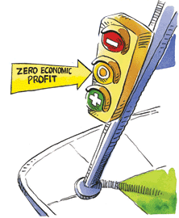
Breakeven point businesses just earning normal profits. Market equilibrium with zero economic profits/losses. No tendency for change.
Breakeven point is Yellow Light

Slide 23
Alternative Profit Scenario’s for Wahid’s Web Wonders

Slide 24
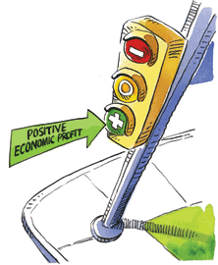
Economic profits ➔ businesses expand and enter industry, supply increases, pushing prices down, until prices just cover all opportunity costs of production, economic profits = zero
Economic profits are Green Light

Slide 25
Alternative Profit Scenario’s for Wahid’s Web Wonders

Slide 26
Short-run market equilibrium quantity demanded equals quantity supplied, but economic losses or profits lead to changes in supply
Long-run market equilibrium quantity demanded equals quantity supplied, economic profits = zero, no tendency for change
Price consumers willing and able to pay just covers businesses’ opportunity costs of production, including normal profits

Slide 27
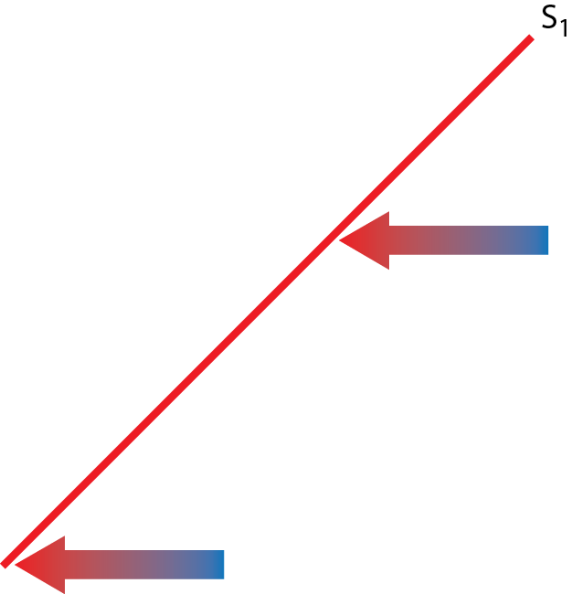
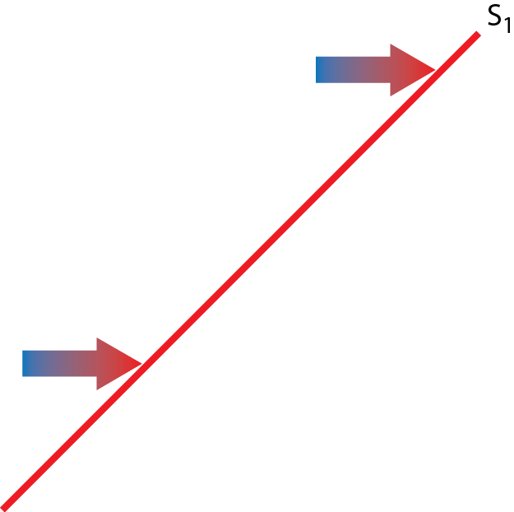
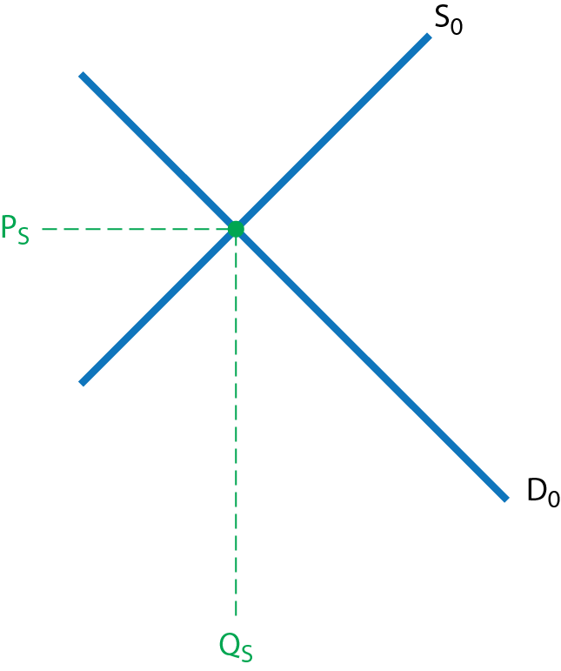
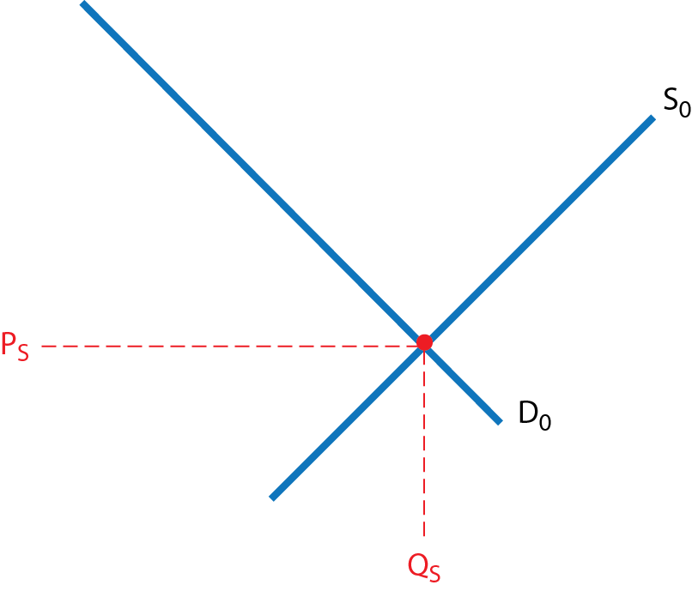

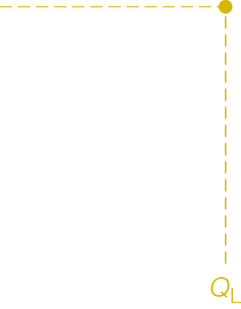

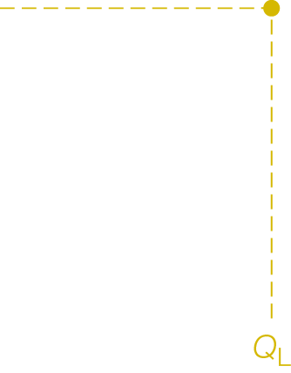
Short-Run and Long-Run Market Equilibrium
a) Economic Losses and Decreased Supply Lead to
Long-Run Market Equlibrium (Scenario One)
b) Economic Profits and Increased Supply Lead to Long-Run Market Equlibrium (Scenario Three)

Slide 28
Difference between short-run and long-run market equilibrium is additional time it takes for supply changes to adjust economic profits to zero
Economic profits/losses are key signal directing businesses to product products and services consumers want. Changes in economic profits trigger
Changes in supply,
Changing prices,
Moving industry from short-run market equilibrium to long-run market equilibrium

Slide 29
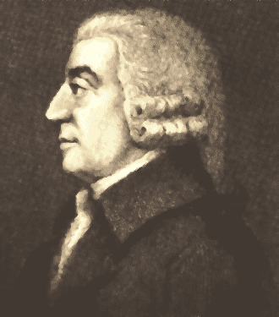
Adam Smith on Economic and Normal Profits
“If in the same neighbourhood, there was
any employment evidently either more or less
advantageous than the rest, so many people
would crowd into it in the one case, and so many would desert it in the other, that its advantages would soon return to the level of other employments.” Adam Smith, The Wealth of Nations, 1776

