Slide 1

Pricing Power
Monopoly to Competition and In Between

Slide 2
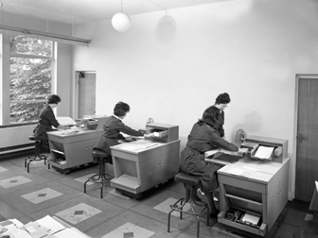
PRICE MAKERS AND PRICE TAKERS
Businesses aim for monopoly’s economic profits and price-making power. Competitors usually push businesses toward the normal profits and price taking of perfect competition.

Slide 3
Monopoly only seller of product or service; no close substitutes available
Demand curve is steep and inelastic
Market power business’s ability to set prices
Price maker monopoly with maximum power to set prices

Slide 4
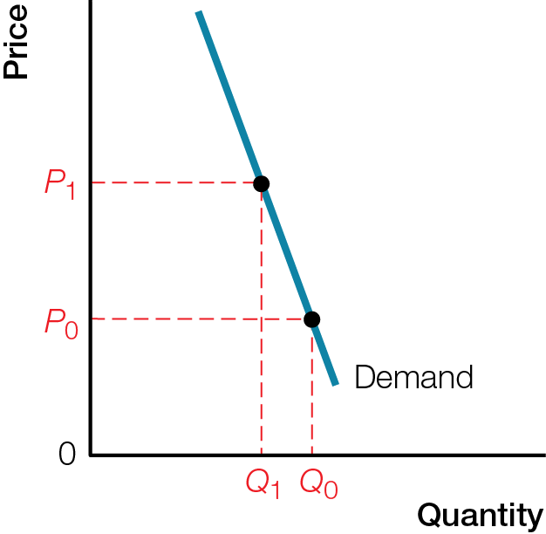

Monopoly’s Inelastic Demand

Slide 5
Businesses can set any price, but cannot force consumers to buy
Even monopoly price makers must live by law of demand
Perfect competition many sellers producing identical products or services
Demand curve is horizontal and perfectly elastic at the market price
Price taker business with zero power to set prices

Slide 6
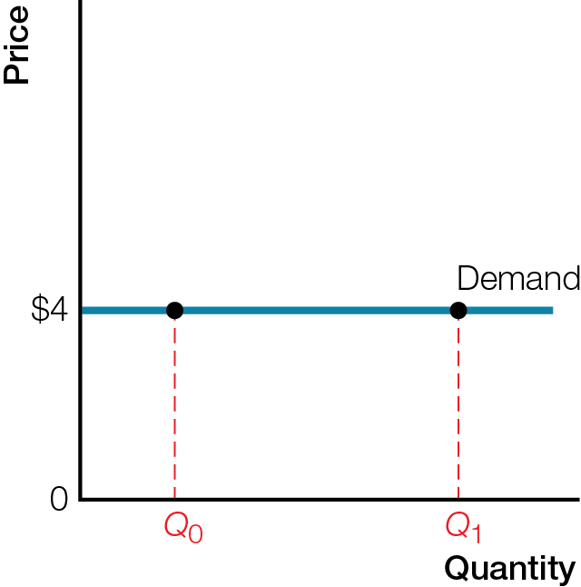
Perfectly Elastic Demand for an Individual Business in Perfect Competition

Slide 7
MARKET STRUCTURE
Pricing power depends on the competitiveness of a business’s market structure — available substitutes, number of competitors, barriers to the entry of new competitors — and on elasticity of demand.

Slide 8
Market structure characteristics affecting competition and pricing power
Available substitutes
Number of competitors
Barriers to entry of new competitors
Broader definition of market = more substitutes and competitors, more elastic demand, less pricing power
Narrower definition of market = fewer substitutes and competitors, more inelastic demand, more pricing power

Slide 9
Product differentiation attempt to distinguish product or service from those of competitors
Reduces competition and substitutes, increase pricing power
Can be actual differences or perceived differences
Pricing power and number of competitors
Fewer competitors = more price power
More competitors = less price power

Slide 10
Barriers to entry legal or economic barriers preventing new competitors from entering a market
Legal barriers — Patents and copyrights are exclusive property rights to sell or license creations
Economic barriers — Economies of scale average total cost of producing decreases as quantity (scale) of production increases
Average Total Cost = total cost per unit of output

Slide 11
Higher pricing power = more inelastic demand
Consumers have few substitutes or strong brand loyalty
Lower pricing power = more elastic demand
Consumers have many substitutes or no brand loyalty

Slide 12
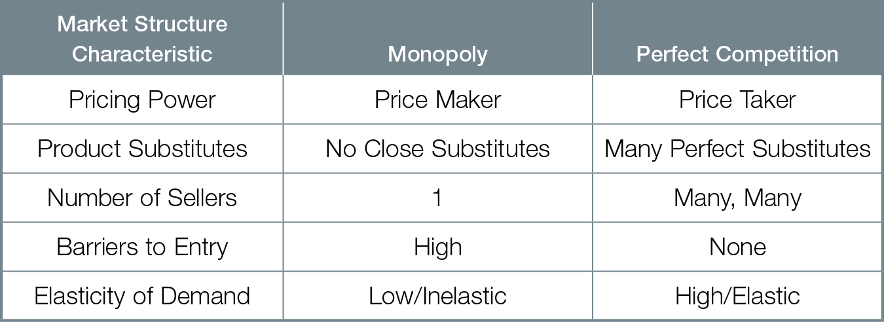
Market Structure and Pricing Power: Monopoly and Perfect Competition

Slide 13
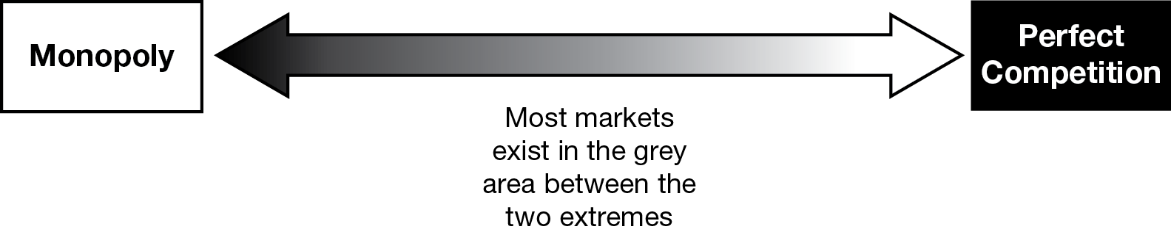
OLIGOPOLY AND MONOPOLISTIC COMPETITION
The four main market structures are monopoly, oligopoly, monopolistic competition, and perfect competition.

Slide 14
Oligopoly few big sellers control most of the market
Monopolistic competition many small businesses make similar but slightly differentiated products or services

Slide 15
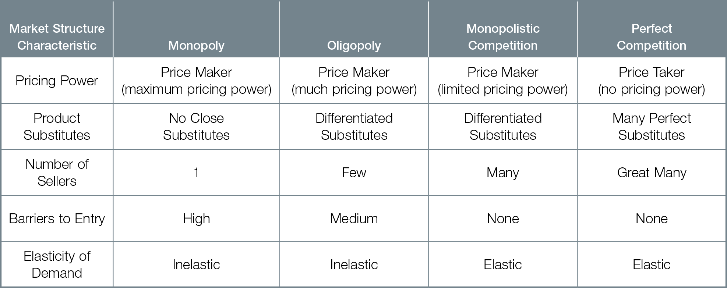
Market Structure and Pricing Power

Slide 16
In moving across range of market structures from monopoly to perfect competition
Pricing power moves from price maker to price taker
Available substitutes go from none to many
Number of sellers goes from one to great many
Entry barriers go from high to low
Elasticity of demand goes from low to high

Slide 17
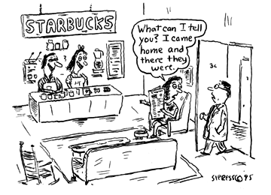
HOW DO BUSINESSES COMPETE?
Businesses actively compete for monopoly’s economic profits and pricing power. This process of creative destruction drives competitors who do not adequately respond out of business, while unintentionally improving productivity and living standards for all.

Slide 18
Competition active attempt to increase profits, gain market power of monopoly
Cutting costs
Improving quality and product innovation
Advertising and brand loyalty
Eliminating competition
Building barriers to entry

Slide 19
A market economy provides extraordinary economic freedom to make business decisions, to invest and spend as we please, to choose our occupations
But as sellers who depend on markets to earn a living, we must play by the market’s competitive rules
Creative destruction competitive business innovations generate economic profits for winners, improve living standards for all, but destroy less productive or less desirable products and production methods

Slide 20
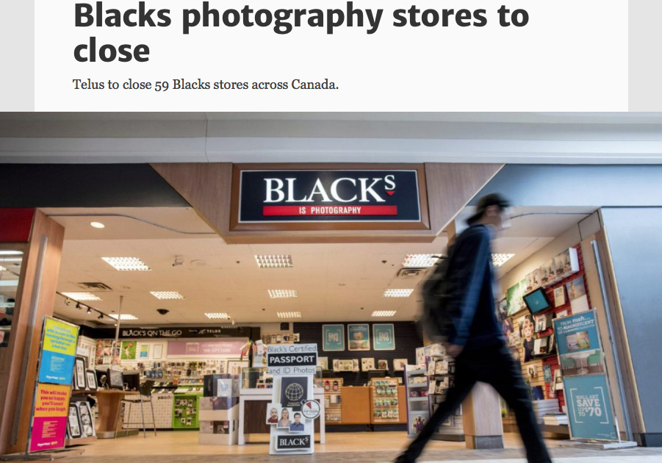
Creative Destruction
“Photography retailer Blacks is closing all of its 59 stores, victim of a fast-changing digital industry and high-quality smartphone cameras and Instagram posts.”
“With smartphones, Canadians are taking more photos than ever before but having fewer of them printed commercially, hurting businesses such as Blacks.”
“The shutdown of the stores … will leave 485 employees without jobs.”

Slide 21
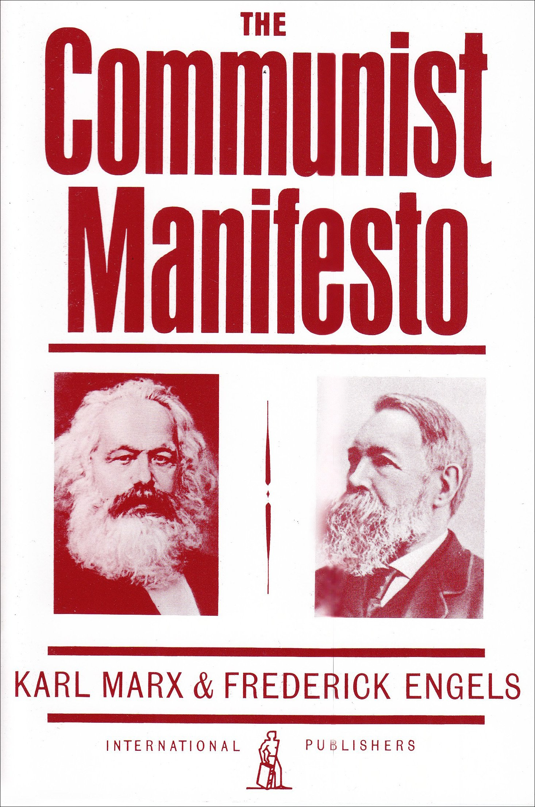
Capitalism, “during it’s rule of scarce 100 years, has created more massive and more colossal productive forces than have all preceding generations together.”
Karl Marx and Frederick Engels (1848)

