Slide 1
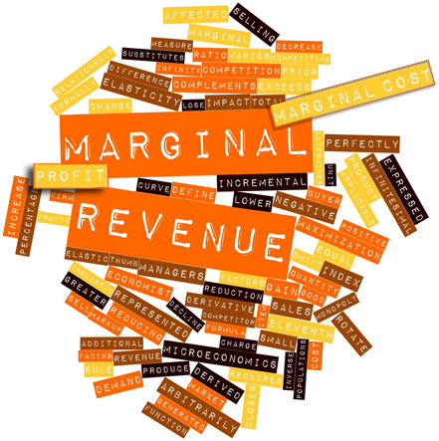
Pricing for Profits

Slide 2
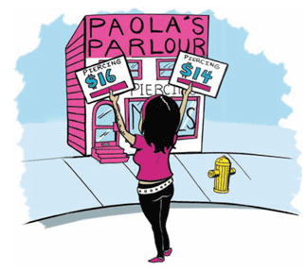

MARGINAL REVENUE
Marginal revenue equals price for price takers and is less than price for price makers. Smart businesses choose actions when marginal revenue is greater than marginal cost.

Slide 3
Marginal revenue additional revenue from selling one more unit (or from more sales)
Marginal revenue depends on market structure (how competitive an industry is) and whether business is price taker or price maker
Marginal revenue = price for price-taking businesses in perfect competition
Marginal revenue < price for price-making businesses in other market structures

Slide 4
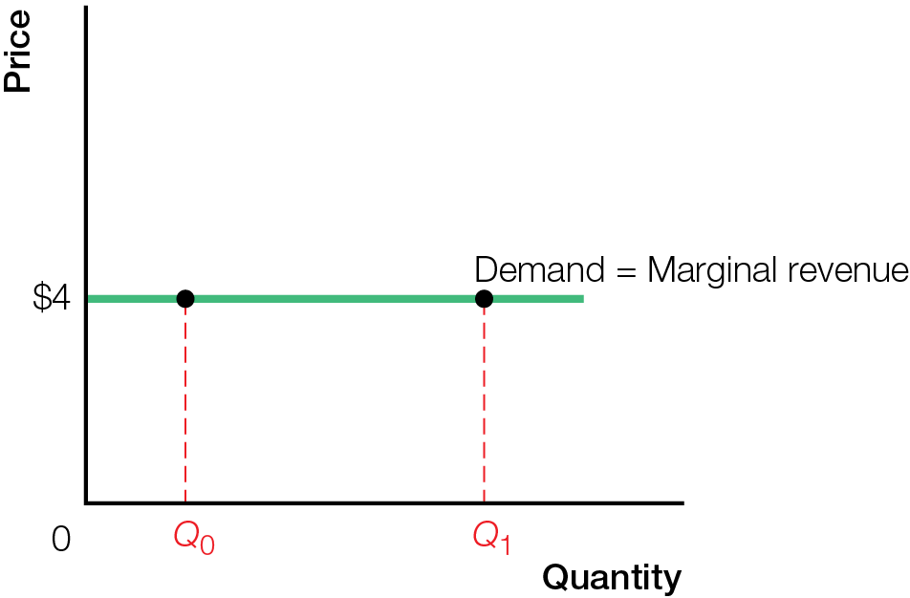
Demand Equals Marginal Revenue for Price Takers

Slide 5
One-price rule — products easily resold have a single price in the market
When a price-making business lowers price, must lower price on all units sold, not just new sales
Reason why marginal revenue < price for price makers

Slide 6
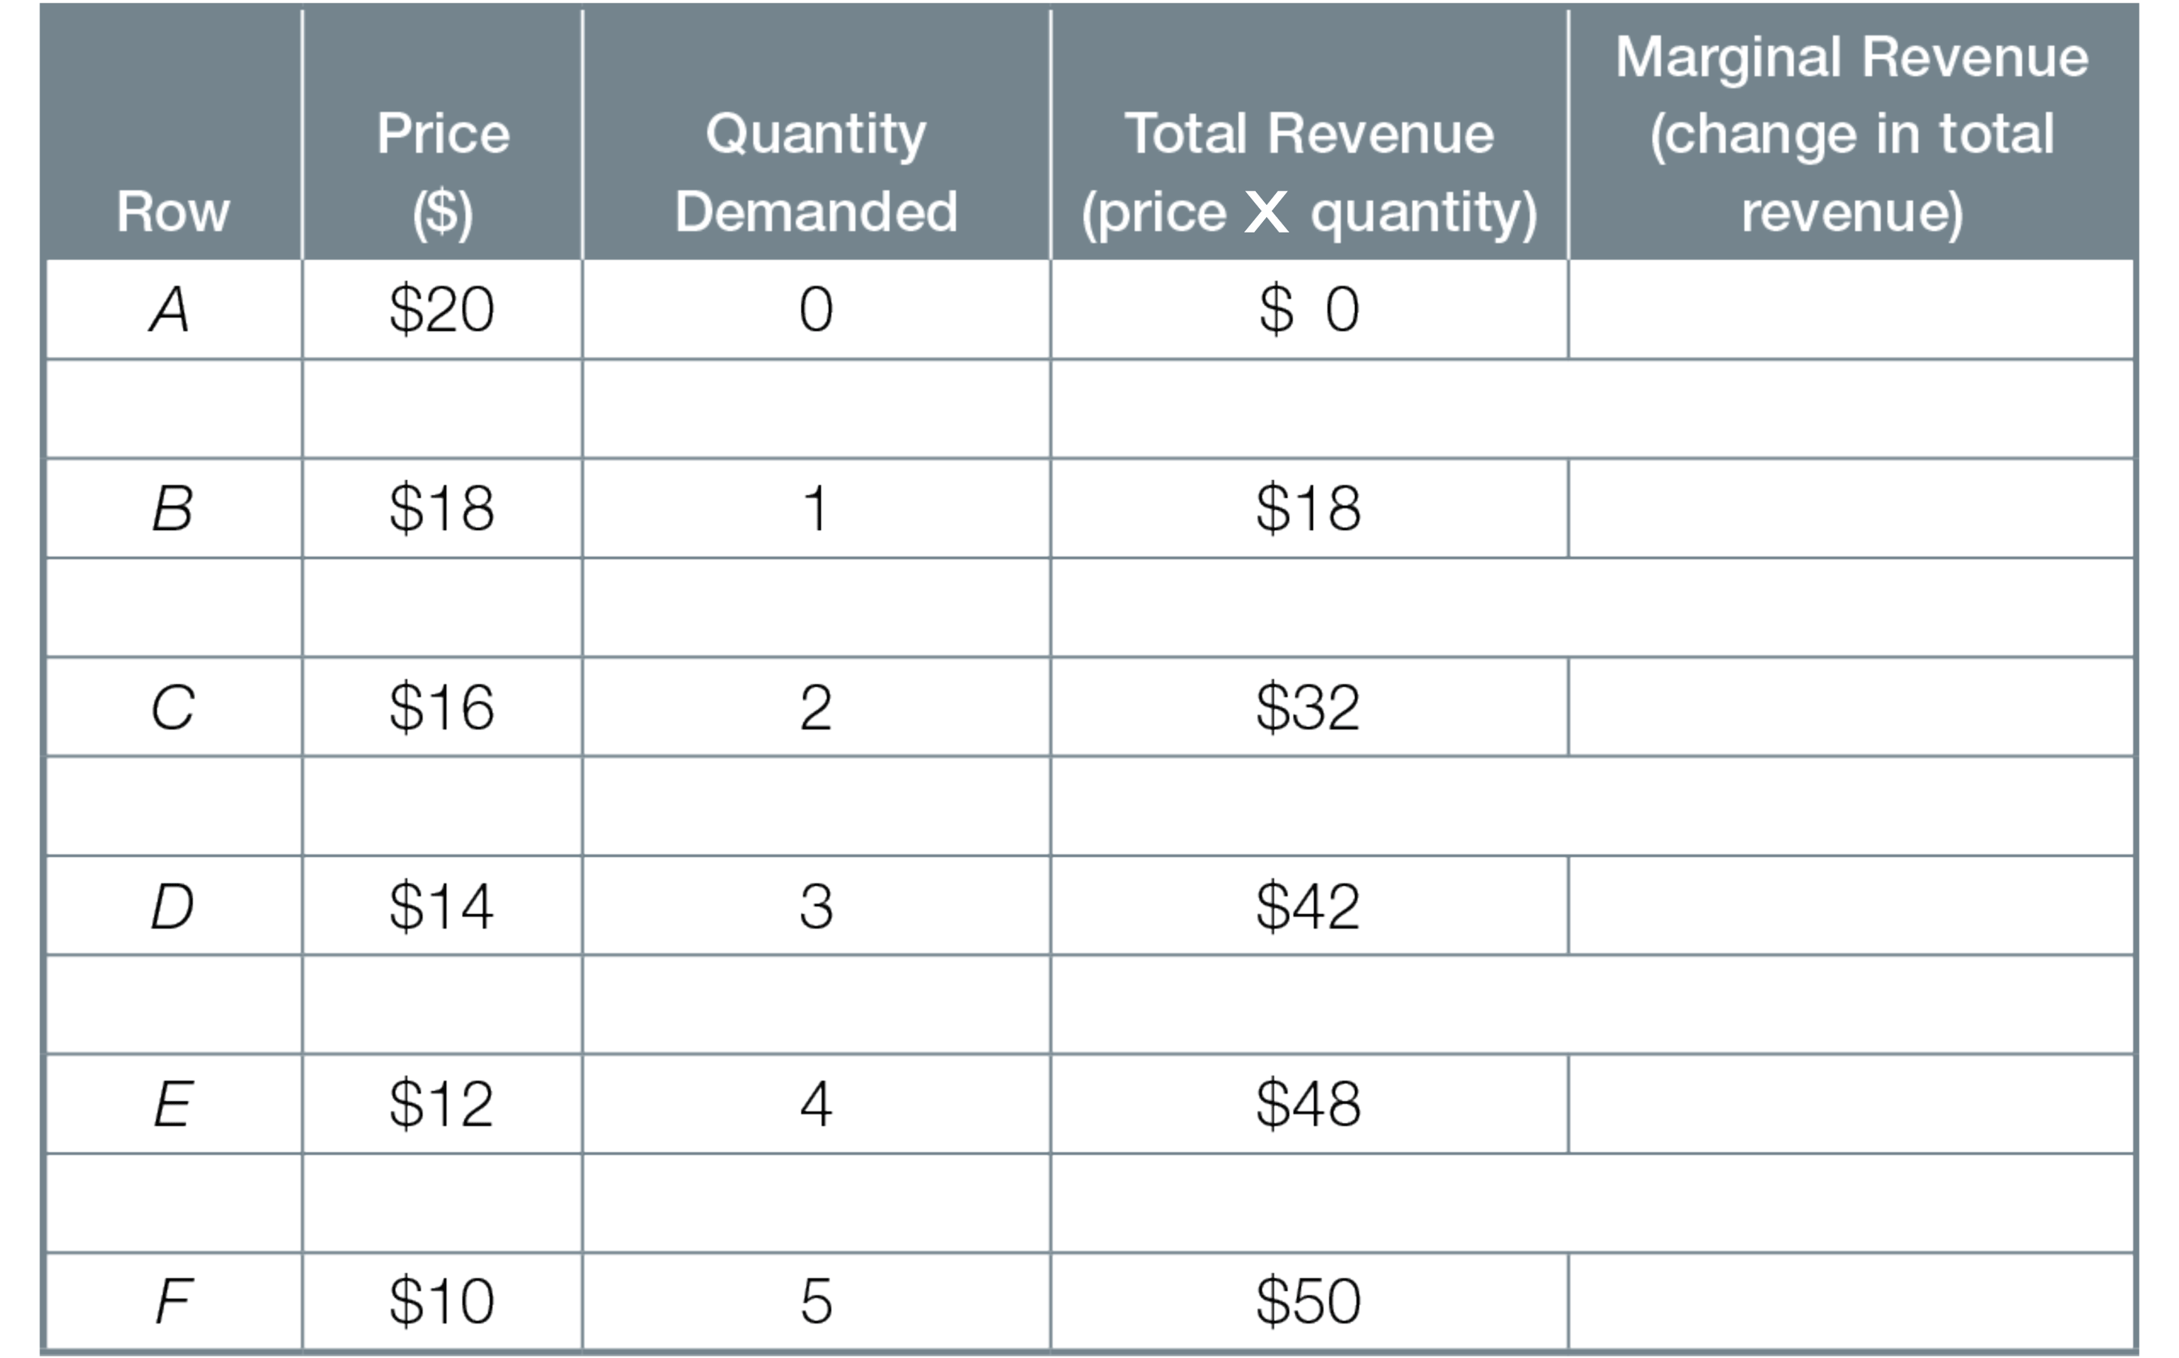
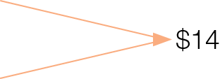
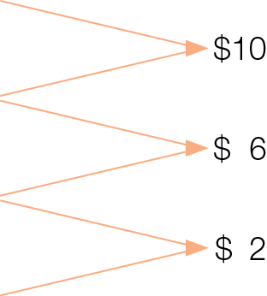
Demand and Marginal Revenue for Price Makers with One-Price Rule
X

Slide 7
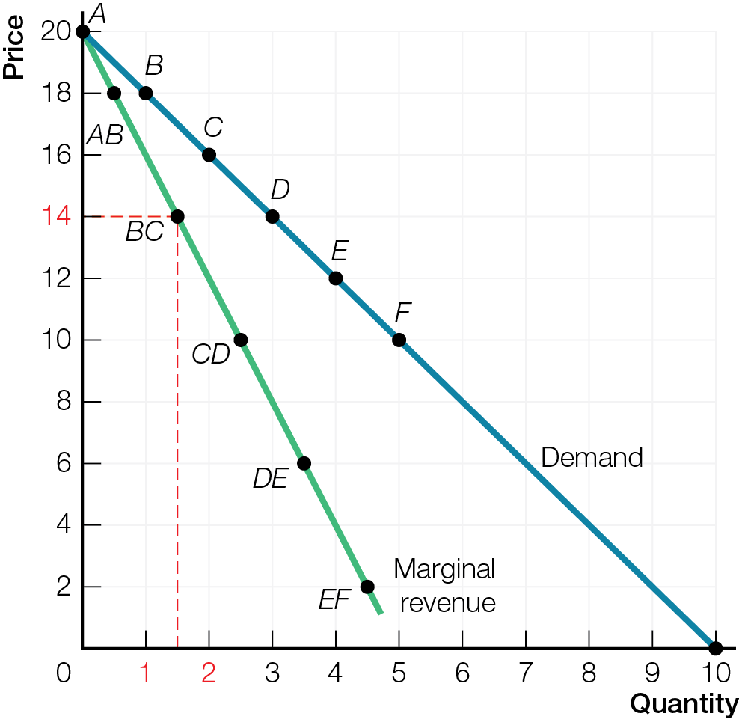
Demand and Marginal Revenue for Price Makers

Slide 8

MARGINAL COST
As output increases, marginal cost increases for businesses operating near capacity or when businesses’ additional inputs cost more. Marginal cost is usually constant for businesses not near capacity.

Slide 9
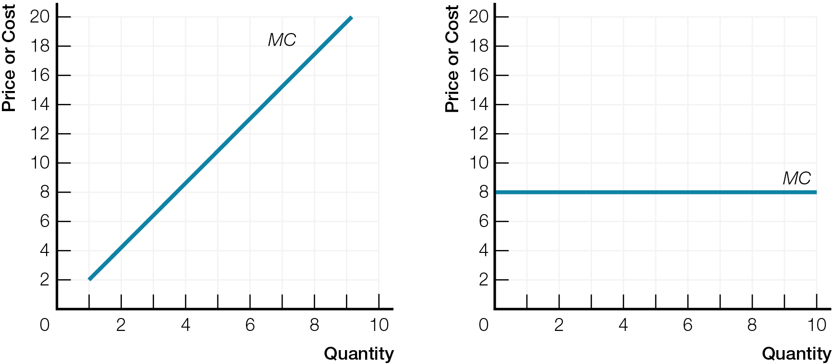
Increasing and Constant Marginal Costs
a) Increasing Marginal Cost
b) Constant Marginal Cost

Slide 10
Diminishing returns as output increases, decreasing productivity increases marginal costs
Businesses operating near capacity, or shifting to more expensive inputs, have increasing marginal costs to increase output
Businesses not operating near capacity have constant marginal costs to increase output

Slide 11
MARGINAL REVENUE GREATER THAN MARGINAL COST
A smart business decision for maximum economic profits involves both quantity and price decisions. The quantity decision is: Produce all quantities for which marginal revenue is greater than marginal cost. The price decision is: Set the highest possible price that allows you to sell that quantity. Key to maximum profits is to focus on marginal revenues, not on total revenues and total costs.

Slide 12
You are working too many hours at your part-time job (which pays $10/hour), and your Economics marks are suffering. Your father wants you to do better in school, but recognizes your need for cash. He offers you this deal: for every 1% increase in your mark on the next test, he will pay you $6.
You estimate:
one additional hour of studying will raise your mark 5%;
a second hour of studying will raise your mark 4%;
a third hour, 3%;
a fourth hour, 2%; and,
a fifth hour, 1%.
If all you are trying to do is make the most money, how many hours should you study?

Slide 13
Additional Hours of Studying | Marginal Revenue = % increase in marks X $6 | Margnal (Opportunity) Cost of Not Working | Smart Choice
1st | 5 X $6 = $30 | $10 | Study
2nd | 4 X $6 = $24 | $10 | Study
3rd | 3 X $6 = $18 | $10 | Study
4th | 2 X $6 = $12 | $10 | Study
5th | 1 X $6 = $ 6 | $10 | Work

Slide 14
Recipe for maximum profits: First, look at the quantity decision
Increase in quantity yields increase in profits if marginal revenue is greater than marginal cost
Stop increasing quantity when marginal revenue is less than marginal cost
Once you choose target quantity (maximum economic profits), look at the price decision
Set highest price that allows sale of target quantity

Slide 15
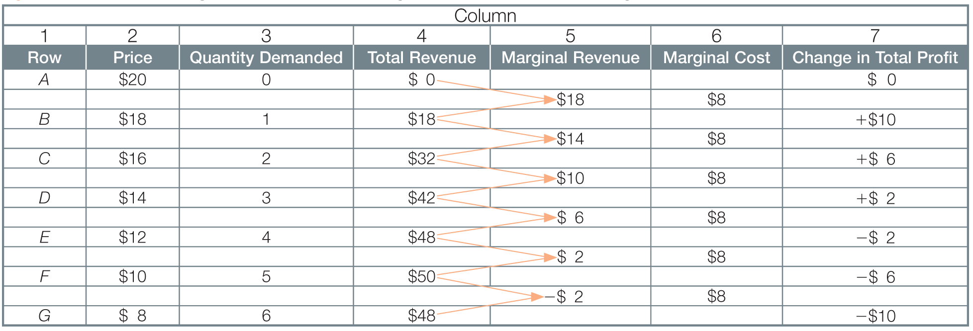
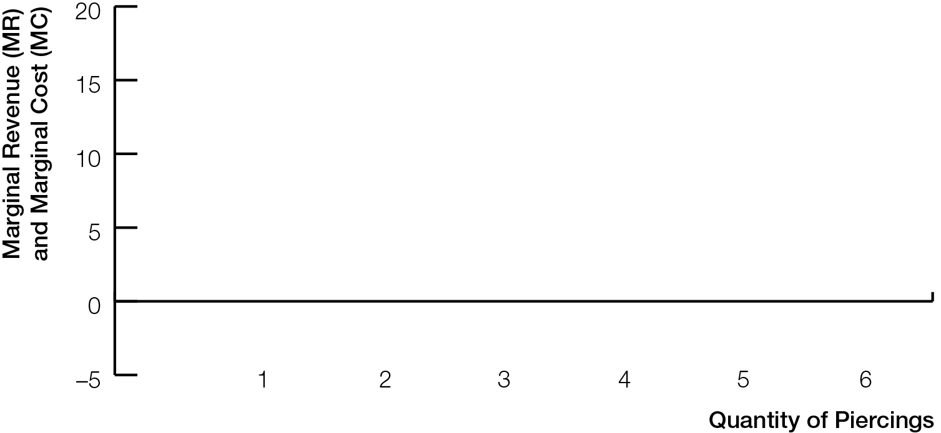
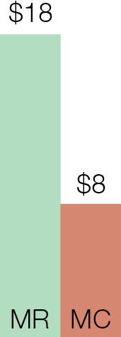
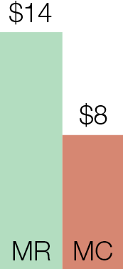
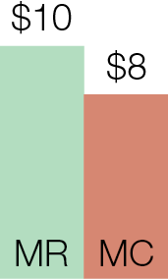
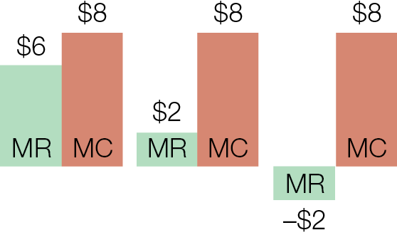
Paola’s Marginal Revenues and Marginal Costs for Nose Piercings
Fig. 9.5

Slide 16
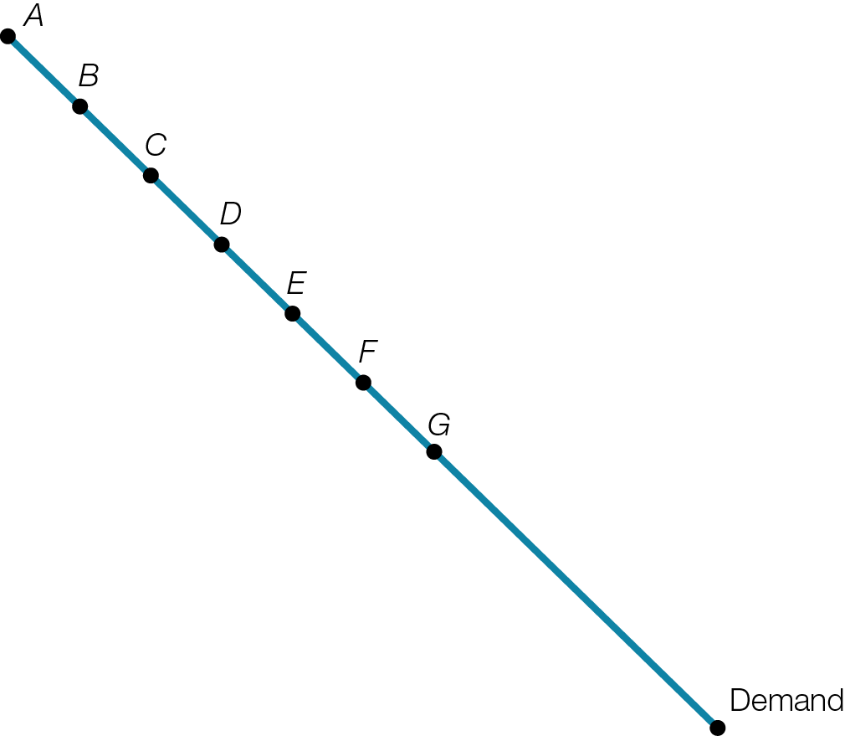
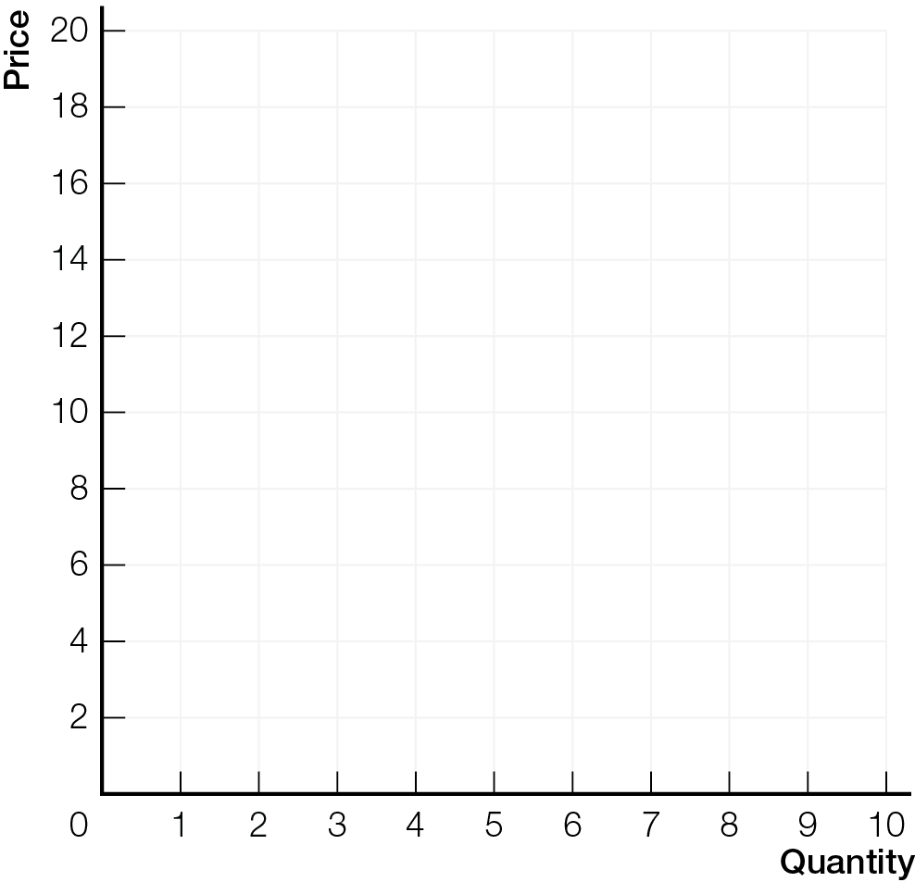
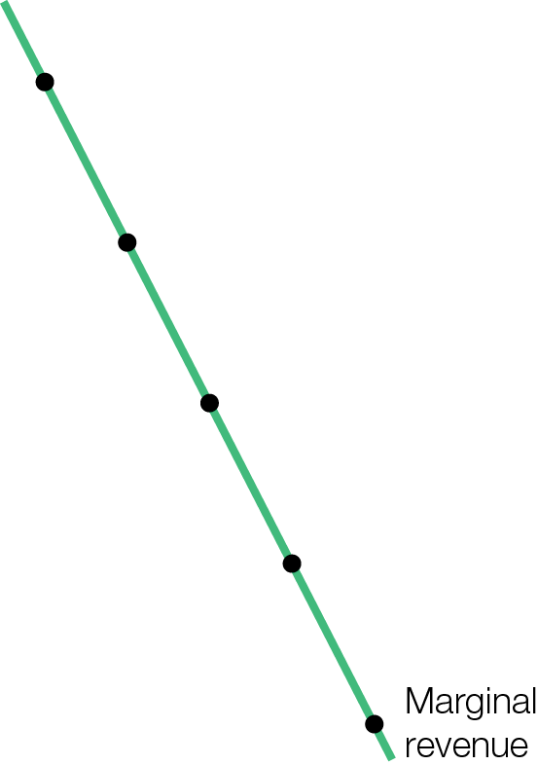
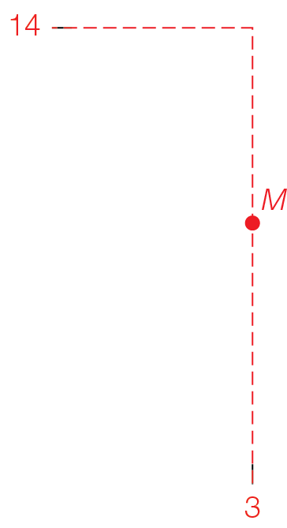

Marginal Revenue and Marginal Cost
Fig. 9.6

Slide 17
Intersection of the MR curve and MC curve is the key to the recipe for maximum profits
Fixed costs do not change with the quantity of output produced
Rent and insurance are examples of fixed costs
For simplicity in this example, fixed costs include normal profits
Economic profits = Total Revenue – Total Costs
= Total Revenue – (obvious costs + normal profits)

Slide 18
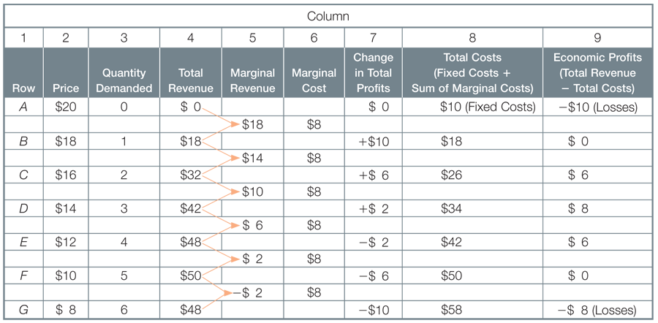
Paola’s Calculation of Economic Profits for Piercings

Slide 19
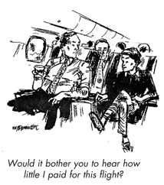
PRICE DISCRIMINATION RECIPES FOR HIGHER PROFITS
Price discrimination is a business strategy that divides customers into groups. Businesses increase profits by lowering the price to attract additional price-sensitive customers (elastic demanders), without lowering the price to others (inelastic demanders).

Slide 20
Price discrimination (Dynamic pricing) charging different customers different prices for the same product or service
Price discrimination breaks the one-price rule. Possible only when business can
Prevent low-price buyers reselling to high-price buyers
Control resentment among high-price buyers

Slide 21
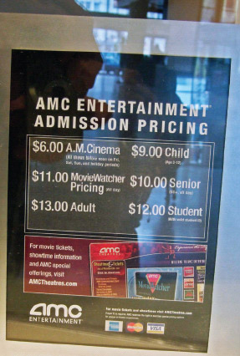

Most examples of price discrimination involve services, which cannot easily be resold

Slide 22

Price discrimination increases profits by separating market into groups
For elastic demand group (lower willingness to pay), charge lower price
For inelastic demand group (higher willingness to pay), charge higher price
Set price for each group allowing sale of all quantities with marginal revenue greater than marginal cost

Slide 23
Dynamic pricing is price discrimination that continuously adjusts for many variables affecting willingness to pay
Made possible by technology advancements including software algorithms that analyze past data, predict future demand, and adjust prices to match
Has become socially acceptable to consumers
Used for event tickets, restaurant reservations, Uber surge pricing, Airbnb pricing, …..

Slide 24


“Disney Theatricals is the undisputed king of dynamic pricing…
Disney boasts a proprietary data-modeling system that allows them to analyze historical sales, project future demand, and adjust ticket prices accordingly.
As a result, The Lion King frequently beats Wicked on weekly revenue, despite the fact that The Lion King has been running 5 years longer than Wicked, and has a significantly lower top ticket price ($195.50 for The Lion King, $300 for Wicked).”

Slide 25
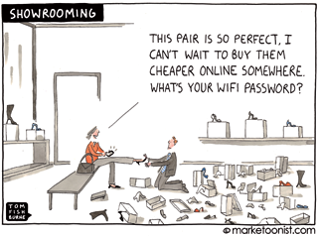
MARKET STRUCTURE AND EFFICIENCY
Maximum profits bring efficiency for perfect competition, but inefficiency for market structures with price-making power.

Slide 26
Perfect competition, with price-taking businesses, is an efficient market structure
Businesses just earn normal profits — economic profits are zero
Maximum total surplus (consumer surplus plus producer surplus)

Slide 27
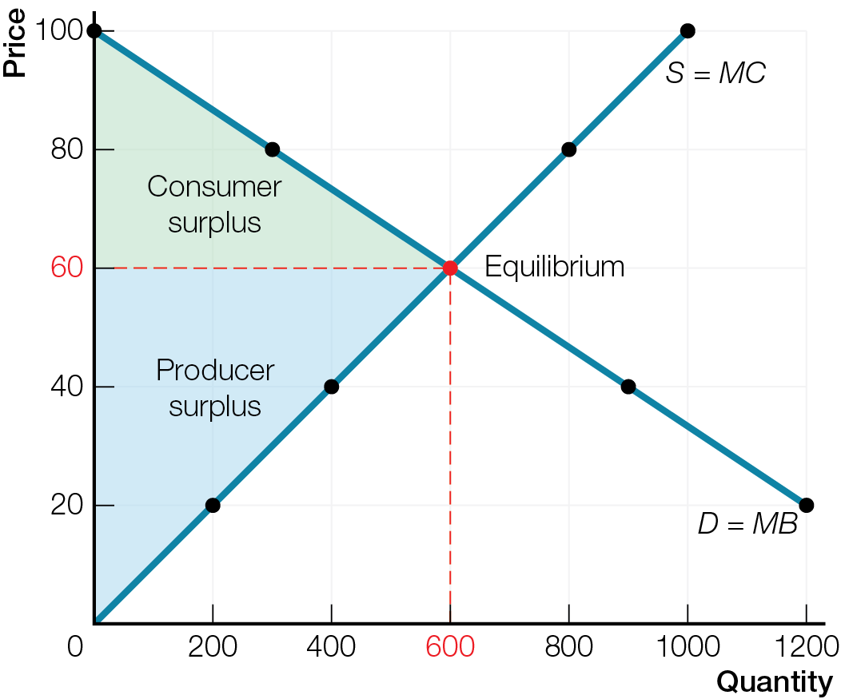
Efficiency of Price Takers and Price Makers
a) Efficiency of Perfect Competition
b) Inefficiency of Market Structure with Price Makers

Slide 28
All other market structures, with price-making businesses, are inefficient
With same inputs, businesses reduce output and raise prices
Businesses earn economic profits
Total surplus is less than perfect competition because of deadweight loss from reduced output

Slide 29
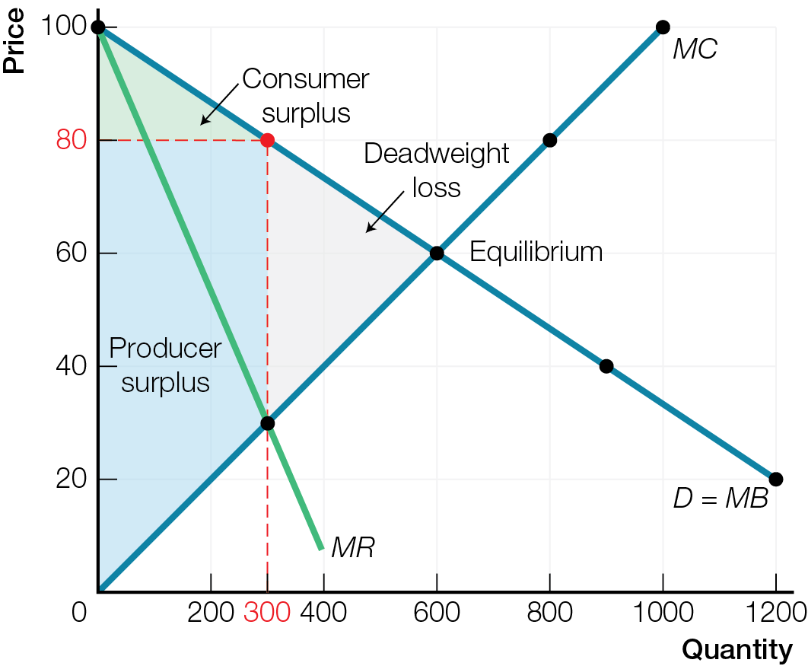
Efficiency of Price Takers and Price Makers
a) Efficiency of Perfect Competition
b) Inefficiency of Market Structure with Price Makers

Slide 30
There are benefits to market structures with price-making power and economic profits
Product variety
Economic profits finance innovations and creative destruction, improving living standards for all
Differential pricing creates some more affordable options
Compare additional costs and additional benefits. There is always a tradeoff.

