Slide 1

When Markets Fail
Natural Monopoly,
Gaming,
Competition,
and Government

Slide 2

MARKET FAILURE AND NATURAL MONOPOLY
Natural monopolies are a market-failure challenge for policymakers — gain the low-cost efficiencies of economies of scale, but avoid the inefficiencies of monopoly’s restricted output and higher price.

Slide 3
Market failure when markets produce outcomes that are inefficient or inequitable
Economies of scale average total costs decrease as quantity of output increases
Natural monopoly economies of scale allows only a single seller to achieve lowest average total cost
Natural monopoly is one cause of market failure

Slide 4
Government policies for natural monopoly
Public ownership
Regulation
Crown corporations
Publicly owned businesses in Canada
Achieve economies of scale, but lack of competition weakens incentives to reduce costs or innovate
Rate of return regulation
Set price allowing regulated monopoly to just cover average total costs and normal profits
But incentive to exaggerate reported costs

Slide 5
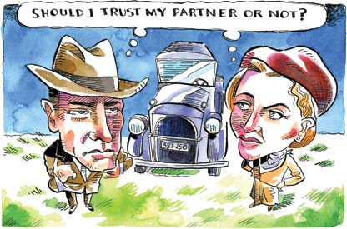
PRISONERS’ DILEMMA AND CARTELS
Strategic interaction among competitors complicates business decisions, creating two smart choices — one based on trust and the other based on lack of trust.

Slide 6
Game theory mathematical tool for understanding how players make decisions, taking into account what they expect rivals to do
Prisoners’ dilemma game with two players who must each make a strategic choice, where results depend on the other player’s choice

Slide 7

Two smart choices exist in a prisoners’ dilemma game: one based on lack of trust and one based on trust

Slide 8
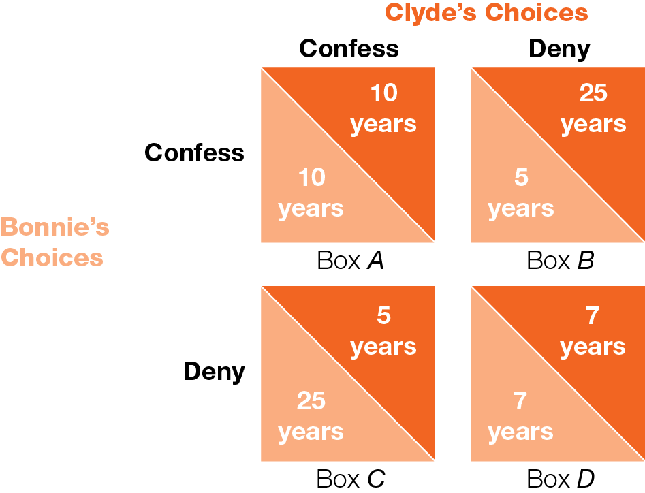
The Prisoners’ Dilemma of Bonnie & Clyde
Fig. 10.1

Slide 9
If other player cannot be trusted, smart choice is to cheat/confess
If other player can be trusted, smart choice is to cooperate/deny
Nash equilibrium outcome of a game in which each player makes best choice, given the choice of the other
All players in Prisoner’s Dilemma driven to Nash equilibrium outcome where everyone cheats/confesses

Slide 10
Summary of the prisoners’ “dilemma”
Each player (prisoner) is motivated to cheat (confess)
Yet both would be better off if they could trust each other to cooperate (deny)
Tension between Nash equilibrium outcome (no trust) and better joint outcome (trust)
With complication of trust/no trust, there are two smart choices
Explains gas station cycle of high prices (cooperate) and price wars (cheat)

Slide 11
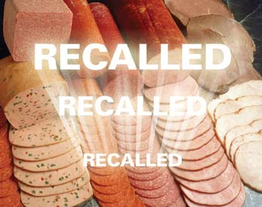
CARTELS, COLLUSION, CHEATING, COMPETITION LAW, CAVEAT EMPTOR
Governments use laws and regulations to try to promote competition, discourage cartels, and protect the public from dangerous business practices.

Slide 12

Collusion conspiracy to cheat or deceive others
Cartel association of suppliers formed to maintain high prices and restrict competition
OPEC (Organization of Petroleum Exporting Countries)
Chocolate cartel (Hershey, Nestlé, Mars)
Quebec Maple Syrup cartel

Slide 13
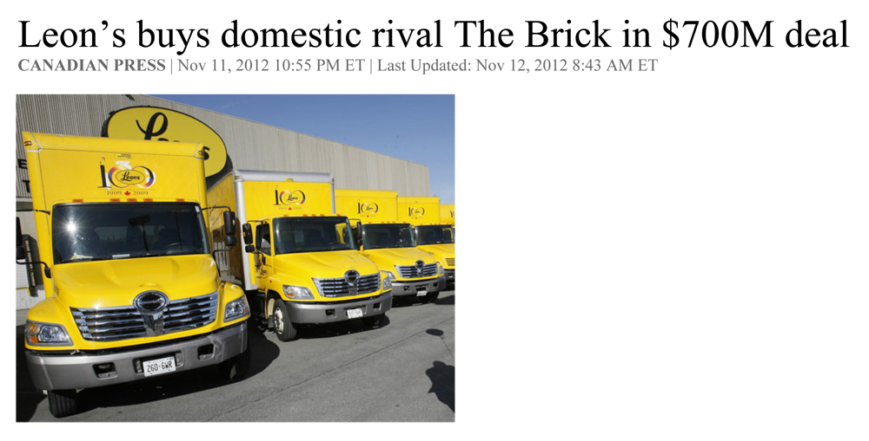
Desirable competitive behaviour — always an active attempt to increase profits and gain the market power of monopoly — is hard to distinguish from undesirable collusive behaviour
“$700 million friendly deal aimed at fending off U.S. competitors making inroads in Canada.”
“Our combined team will have access to national buying opportunities in merchandising and marketing, and a national distribution network that will enable us to greatly enhance our online shopping capabilities.”

Slide 14
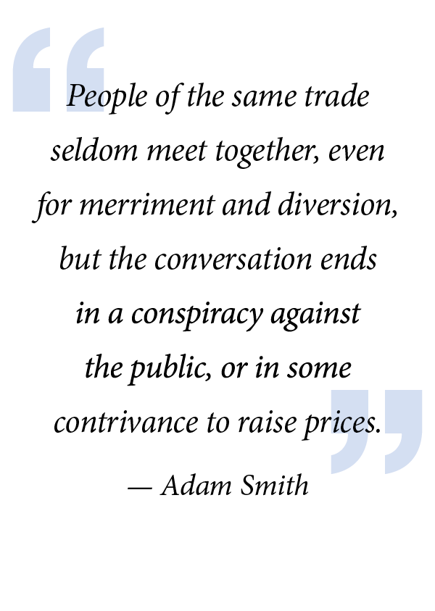
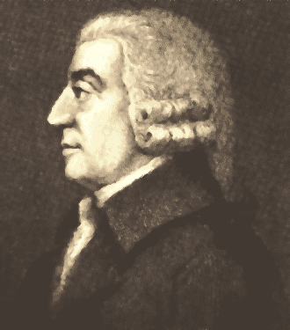

Slide 15
Competition laws originated in late 1800s following steel, coal, railroad cartels
First anti-combines law in 1889
Modern Competition Act 1986
The Competition Act
“To maintain and encourage competition in Canada in order to promote the efficiency and adaptability of the Canadian economy”
To prevent anti-competitive business behaviour

Slide 16
Current concerns with multinational tech companies (Google, Amazon, Facebook, Apple) based on network effects (demand side) instead of economies of scale (supply side)

Slide 17
Competition Act raises expected costs to business of price fixing (prison time, fines, legal prohibition) relative to expected benefits (profits)
Criminal offences
Price fixing, bid rigging, false/misleading advertising
Punished by prison time, fines
Civil offences
Mergers, abusing dominant market position, lessening competition
Punished by fines, legal prohibitions

Slide 18
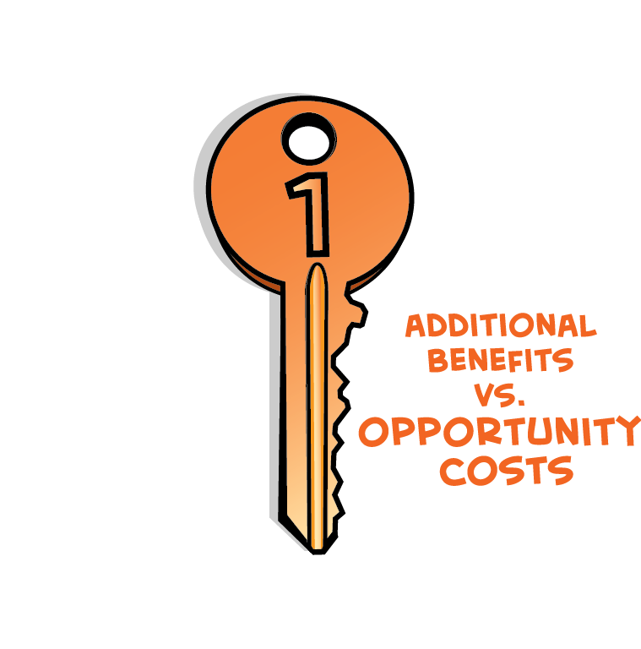
Competition Tribunal for civil offenses weighs costs of lessening competition against benefits of increased efficiencies
If mergers that reduce competition also provide economies of scale, may be approved for promoting “efficiency and adaptability”

Slide 19
Caveat emptor (“let the buyer beware”) buyer alone is responsible for checking quality of products before buying
Certain products — nuclear power, medicines, poisonous insecticides — are regulated by government because average consumer cannot know product’s quality
Major forms of government regulation in Canada
Government departments
Agencies and boards
Professional associations

Slide 20

MARKET FAILURE OR GOVERNMENT FAILURE?
The public-interest view of government regulation suggests government actions improve market-failure outcomes, while the capture view suggests government actions produce government failure.

Slide 21
Public-interest view government regulation eliminates waste, achieves efficiency, promotes the public interest
Capture view government regulation benefits regulated businesses, not the public interest
Evidence is mixed on government regulation — some supports public-interest view, some supports capture view
Most economists agree the Competition Act serves the public interest well

Slide 22
Market failure when markets produce inefficient or inequitable outcomes
Government failure when regulations fail to serve public interest
Market outcome, even with monopoly power, better than government regulation outcome if significant government failure
Government outcome, with public interest regulations, better than market outcome if significant market failure
Economic thinking can’t make normative policy choices, but can answer the positive question, “Will government action improve market failure outcomes, or will government action fail with worse outcomes than market failure?”

