Slide 1
Inputs, Incomes and Inequality
Inputs, Incomes and Inequality

Slide 2

INCOMES ARE PRICES AND QUANTITIES IN INPUT MARKETS
Incomes are determined by prices and quantities in input markets, where households supply to businesses labour, capital, land, and entrepreneurship in exchange for wages, interest, rent, and profits.

Slide 3
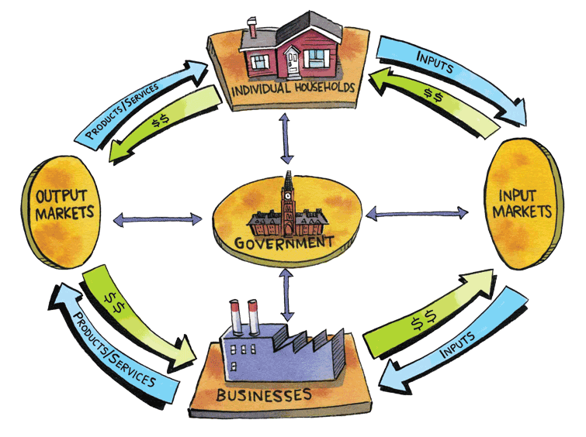
In input markets, households are sellers and businesses are buyers

Slide 4
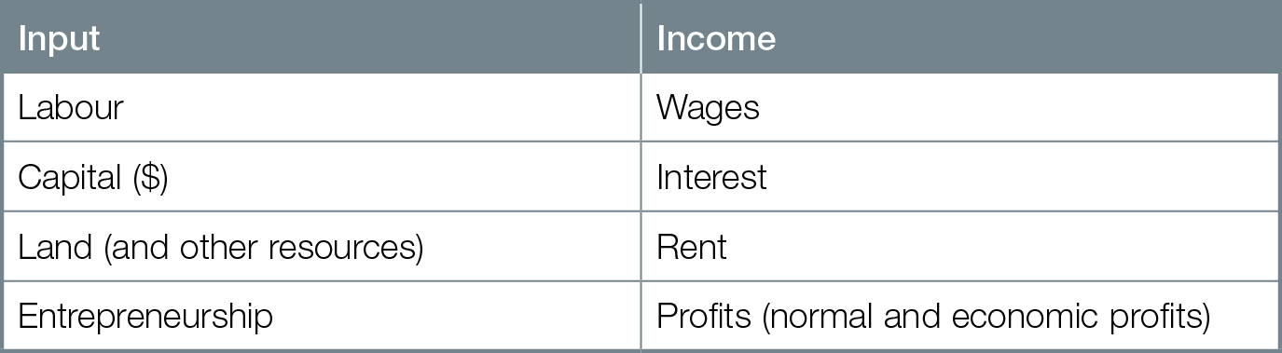
Inputs and Income

Slide 5
Income — what you earn — is a flow
Flow amount per unit of time
Income for labour, capital, and land = price of input x quantity of input
Wealth — total value of assets you own — is a stock
Stock fixed amount at a moment in time

Slide 6
Key concepts for explaining input incomes are
marginal revenue product for labour
present value for capital
economic rent for land
Entrepreneurs earn profits
Entrepreneurs’ incomes not determined by price x quantity
Economic profits are a residual — what is left over from revenues after all opportunity costs of production (including normal profits) have been paid

Slide 7
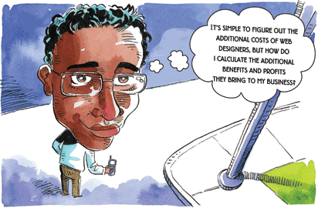
LABOUR AND MARGINAL REVENUE PRODUCT
For maximum profits, businesses should hire additional labour when marginal revenue product is greater than marginal cost.

Slide 8
To hire labour, business must pay the market wage reflecting the best opportunity cost of input owner
Business demand for labour is a derived demand — demand for output and profits businesses can derive from hiring labour
Marginal product additional output from hiring one more unit of labour

Slide 9
When businesses hire additional labourers there is diminishing marginal productivity — as you add more of a variable input to fixed inputs, marginal product of variable input eventually diminishes
Marginal revenue product additional revenue from selling output produced by an additional labourer
Marginal revenue product = marginal product x price of output
Marginal revenue product diminishes for additional labourers

Slide 10
Recipe for maximum profits for business
hire additional inputs when marginal revenue product is greater than marginal cost

Slide 11
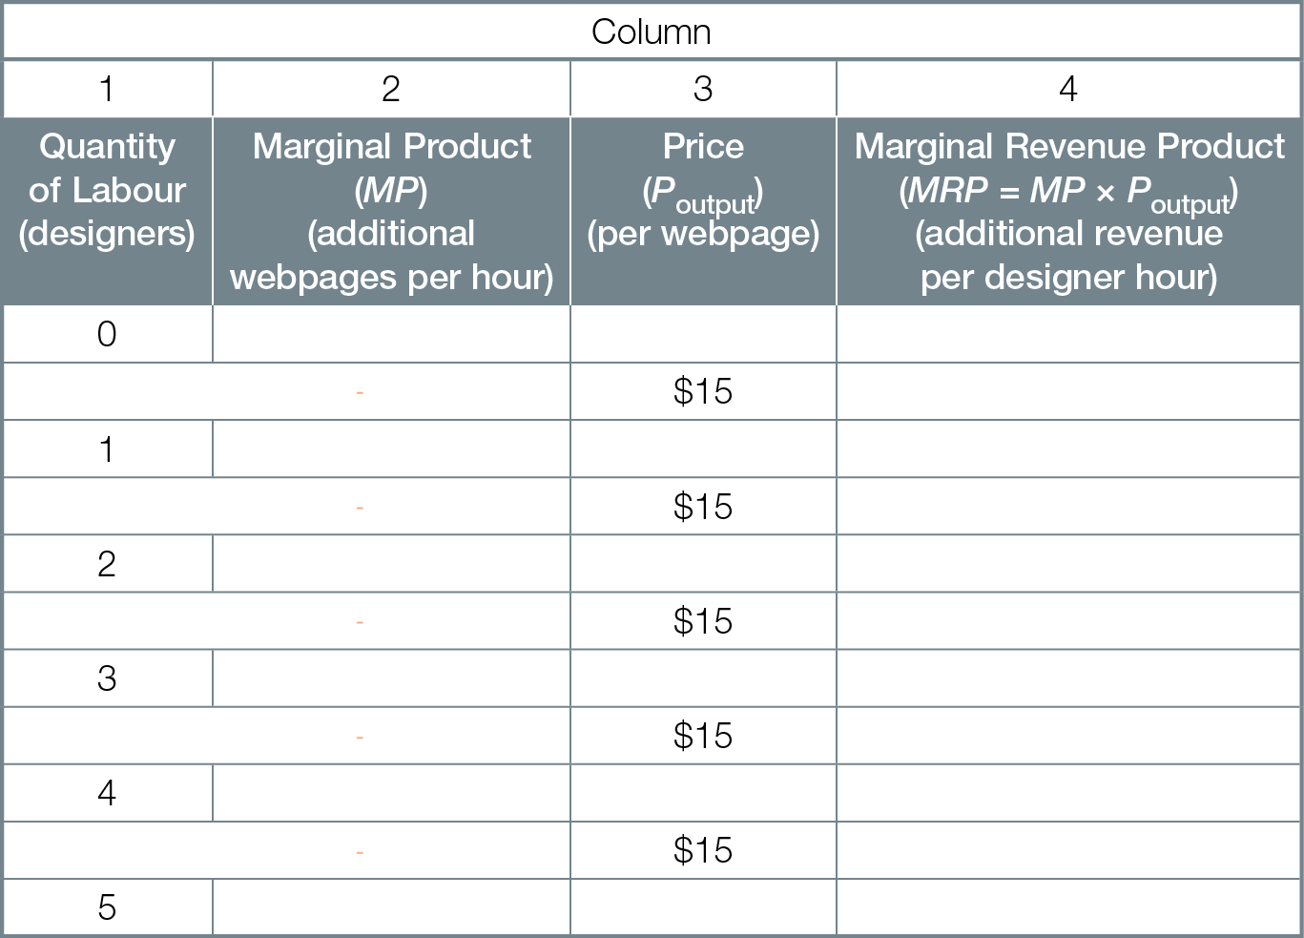



Labour Hiring Decision for Wahid’s Web Wonders Business

Slide 12
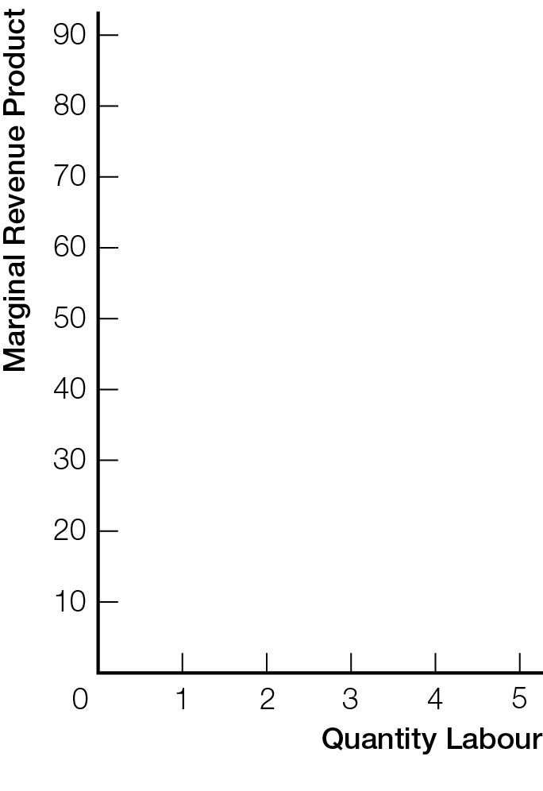
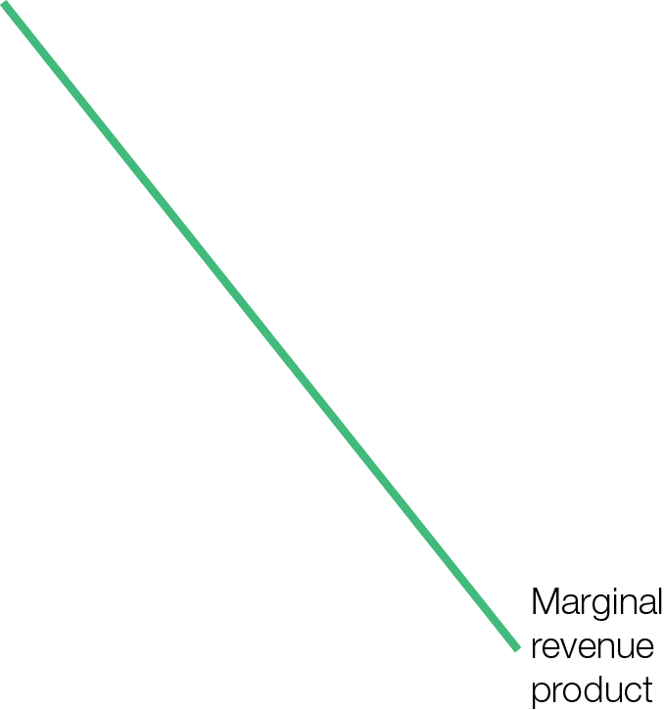


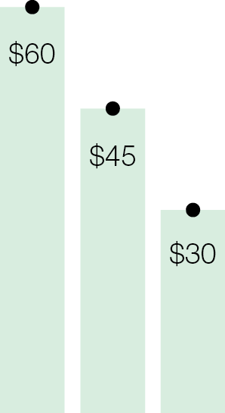

Marginal Revenue Product and the Wage Rate
Fig. 12.4a

Slide 13
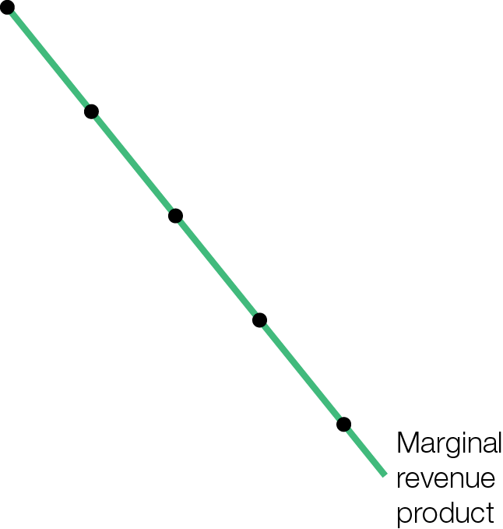

Marginal Revenue Product Curve and Marginal Cost Curve
Fig. 12.4b

Slide 14
Recipe for maximum profits for business — hire additional inputs when marginal revenue product is greater than marginal cost

Slide 15
INTEREST ON CAPITAL AND PRESENT VALUE
Present value tells you what money earned in the future is worth today. Present value compares the price you pay for today’s investment against the investment’s future earnings.
For a smart choice, the present value of the investment’s future earnings is greater than the investment’s price today.

Slide 16

The present value of a future amount of money is the amount that, if invested today, will grow as large as the future amount, taking account of earned interest

Slide 17
Easier to start with future value of present money
If you have $1000 today, interest rate = 12%, how much will that be worth in the future (1 year)?
Add $120 in interest ($1000 X 0.12) to $1000 = $1120
What is the present value of that future $1120 if interest rate = 12% ?
PV = $1120_ = $1000 [n = 1] 1.12

Slide 18
Should your business invest in a new machine ?
costs $1000 and lasts 1 year
generates $1100 in new revenues
interest rate = 12%
Recipe for a smart investment choice — invest when present value of stream of future earnings is greater than the price of the investment
PV = $1100_ = $982 [n = 1] 1.12
Present value ($982) less than price of investment ($1000), so not a smart investment choice

Slide 19
Important ideas about present value
Future revenues are not worth as much as revenues today because today’s revenues earn interest
Discount reduction of future revenues for forgone interest
Present value simplifies the future stream of revenues from an investment to a single number today
Recipe for a smart investment choice — invest when present value of stream of future earnings is greater than the price of the investment

Slide 20

LAND, ECONOMIC RENT, AND SUPERSTARS
Income for any input in inelastic supply, for example land or superstar talent, is economic rent, which is determined by demand alone.

Slide 21
Economic rent income paid to any input in relatively inelastic supply
Land is a classic example of an input in inelastic supply
For inputs like land in inelastic supply, prices are effectively determined by demand alone
For most products and services, high input prices cause high output prices
For inputs in inelastic supply, high output prices cause high input prices
High economic rents

Slide 22

INEQUALITY AND POVERTY
Government policies to address the market’s unequal distributions of income and wealth involve trade-offs between efficiency and equality.

Slide 23
“What are you worth?” is a positive question; depends on quantities of inputs you own and prices markets place on those inputs
“What should you, or any person, be worth?” is a normative question you must answer as a citizen
Poverty results from not owning labour skills or assets that the market values, or from not getting a high enough price for what you do own

Slide 24
Policy options to reduce inequality and poverty
Education, training
Progressive tax and transfer system
Improving human capital through education and training addresses underlying cause of poverty — lack of inputs the market values
Human capital increased earning potential from work experience, on-the-job training, education

Slide 25
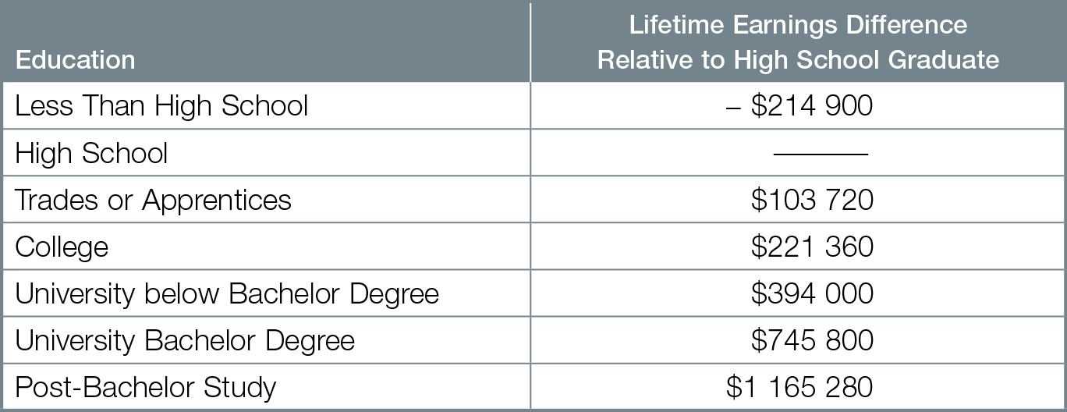
Lifetime Earnings Premiums Relative to High School Education

Slide 26
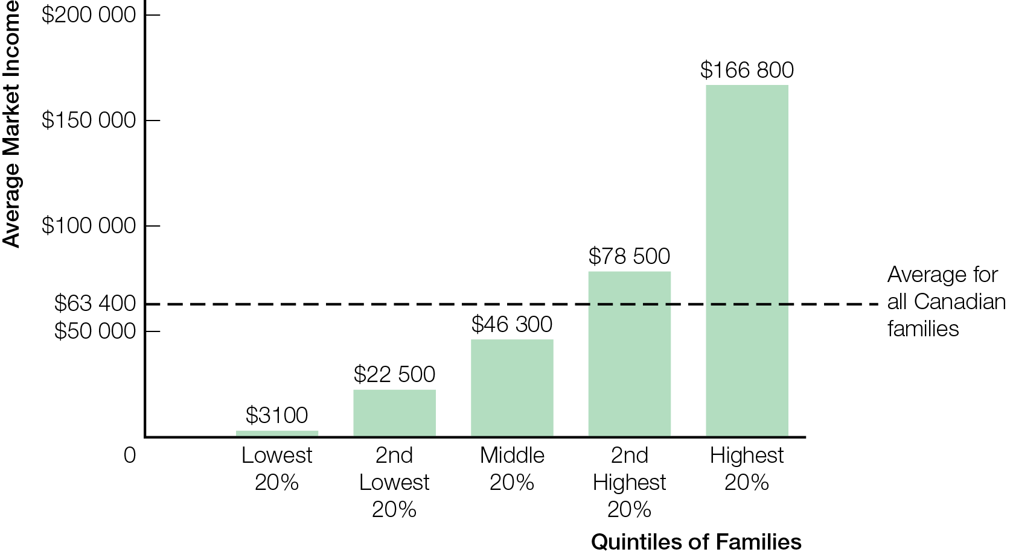
Average 2010 Market Income for Canadian Families, by Family Quintiles

Slide 27
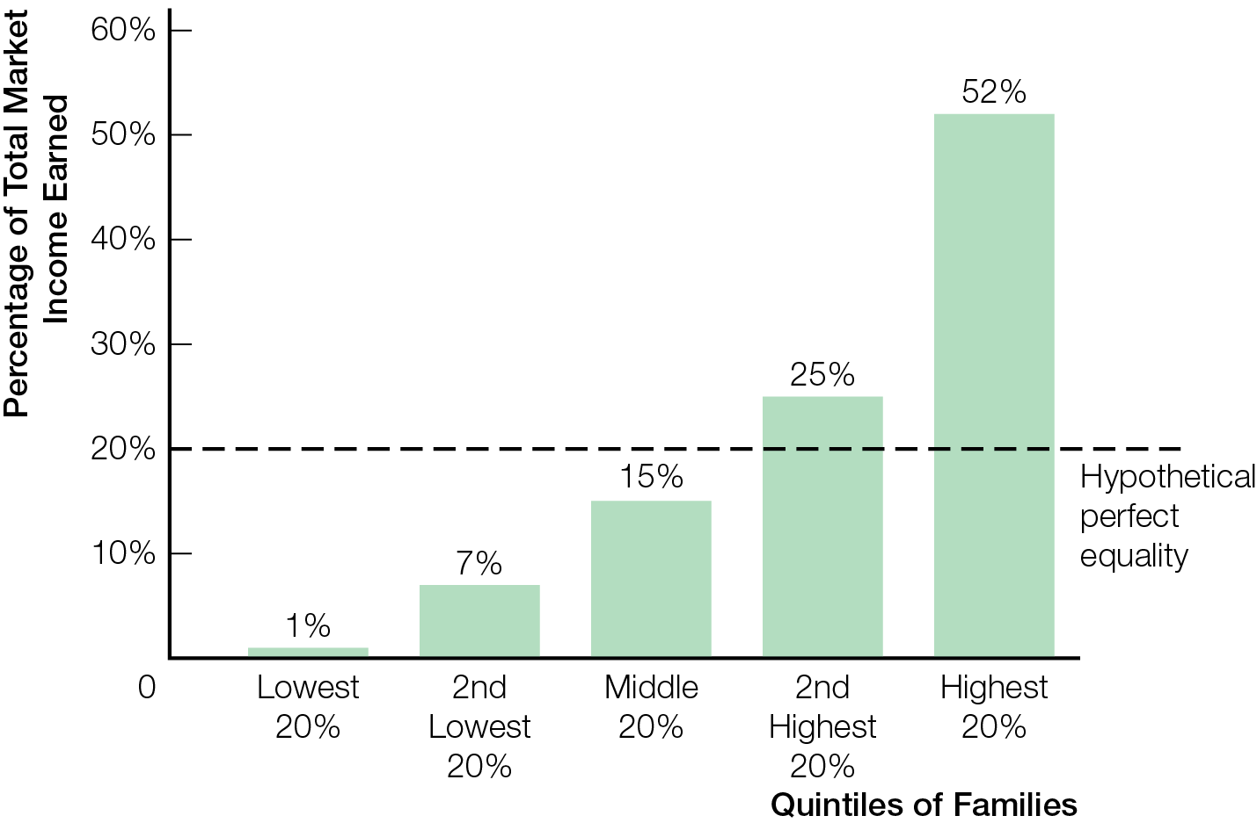
Percentage of 2010 Total Canadian Market Income, by Family Quintiles

Slide 28
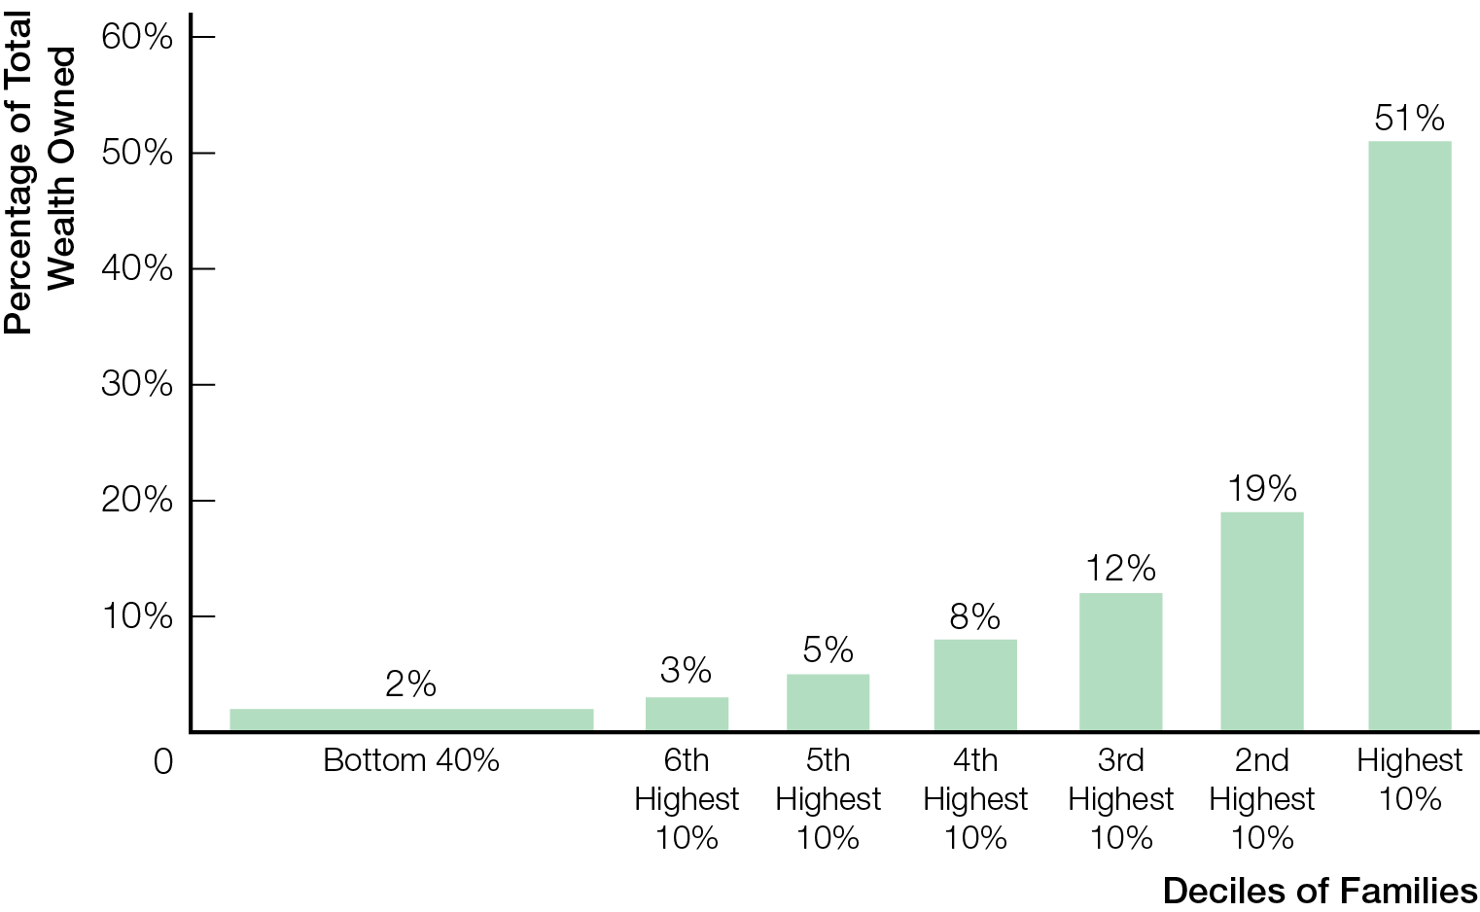
Percentage of 2006 Canadian Wealth Owned, by Family Deciles

Slide 29
Types of taxes
Progressive taxes tax rate increases as income increases; used by Federal and provincial tax systems
Regressive taxes tax rate decreases as income increases
Proportional (flat-rate) taxes tax rate the same regardless of income
Marginal tax rate rate on additional dollar of income
Transfer payments payments by government to households

Slide 30
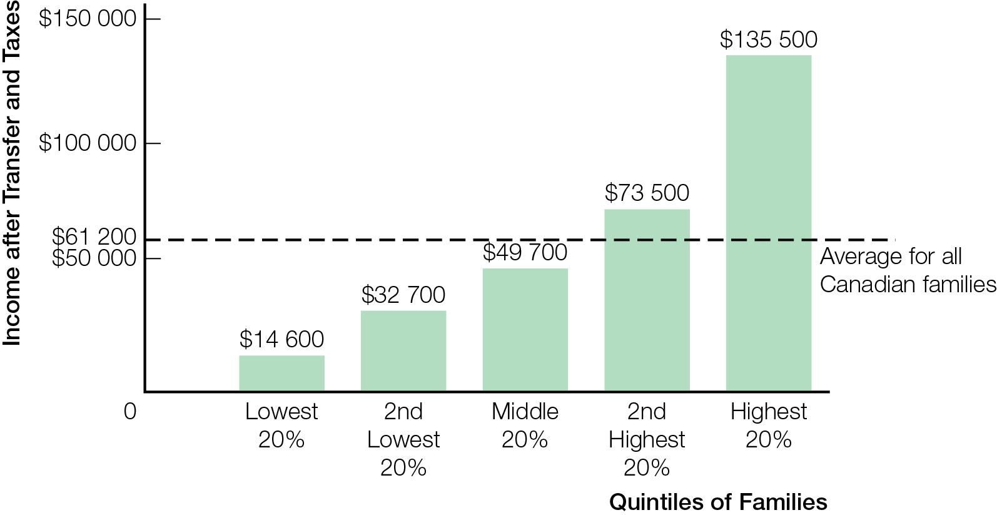
Average 2010 Canadian Income after Transfers and Taxes, by Family Quintiles

Slide 31
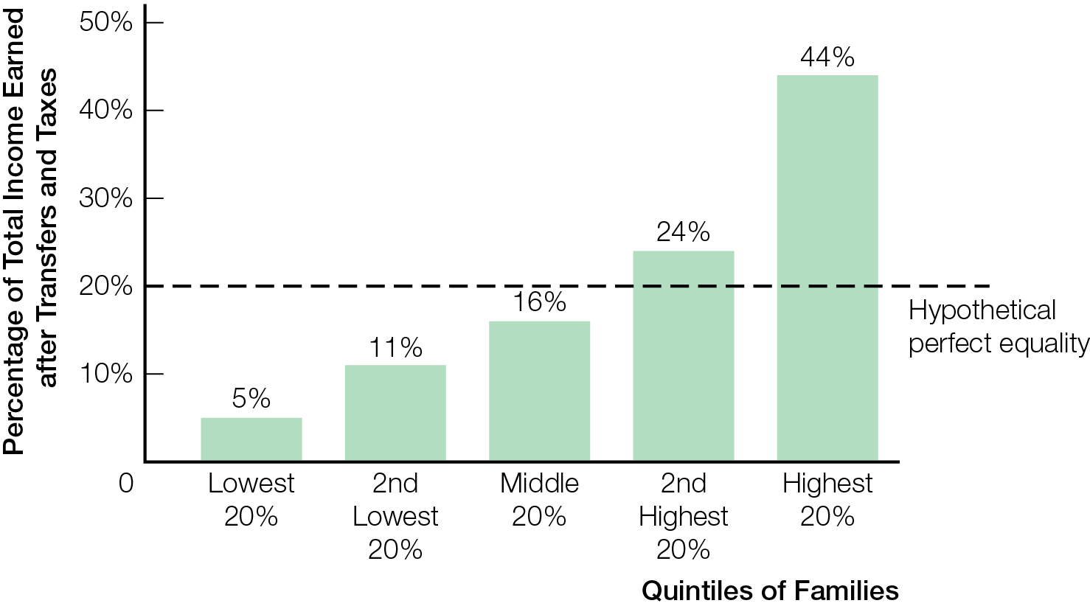
Percentage of 2010 Total Canadian Income after Transfers & Taxes, by Family Quintiles

Slide 32
Due to incentive effects, “A more equally shared pie may be a smaller pie”
An efficient market outcome is not necessarily fair or equitable
May include poor people unable to pay for basic necessities like shelter, food, medical care
Governments can reduce poverty and inequality using tax–and-transfer systems to take from rich and give to poor (like Robin Hood)
Costs and benefits of policies to help the poor apply to different people
How you feel about Robin Hood’s motto depends on whether you are being taken from or given to

Slide 33
Economics of Inequality: Early Childhood Education
James Heckman (Nobel Prize Economics, University of Chicago), argues most important step to reduce (U.S.) inequality is more early childhood education (ECE).

Slide 34
Equity and efficiency usually viewed as tradeoff
Heckman’s research shows that investing in ECE is a policy that promotes both equity and efficiency
Inequality in early childhood produces inequality in ability, achievement, health, adult success
Combination of educational and social skills (attentiveness, perseverance, impulse control, sociability) determine success in white collar jobs
Students with GED certificate (test equivalent of high school degree) don’t succeed as well as high school graduates due to lesser social skills

Slide 35
Adverse impacts of genetic, parental, environmental resources can be overturned through human capital investments in ECE
Investment in ECE for disadvantaged children from birth to 5 years reduces achievement gap, reduces need for special education, increases likelihood of healthier lifestyles, lowers crime rate, reduces overall social costs
Investment in ECE yields 7-10 % per year return
“the question isn’t whether we can afford ECE, but whether we can afford not to provide it. We can pay for prisons or we can pay, less, for ECE to help build a fairer and more equitable nation.”

Slide 36
THE POLITICS OF EQUITY
Politicians on left (Canada’s NDP)
Equity (of outcomes) priority over efficiency
Poverty & inequality as market failures
Unequal opportunities due to birth, family, income, wealth
Redistribution of incomes towards equality by progressive taxation
Politicians on right (Canada’s Conservatives)
Efficiency priority over equal outcomes
Efficiency creates prosperity that helps all
Unequal outcomes a fair result of personal differences
Poverty & inequality not systemic market failure; personal charity response for personal misfortune

Slide 37

SUMMING UP — MICROECONOMICS
Three Keys help focus on information most useful for making a smart choice
Three Keys do not set your personal values and political views
But once you decide on a political position or social goal based on your values, economic thinking helps identify smart policy or personal choices for most efficiently achieving your goals

