Slide 1
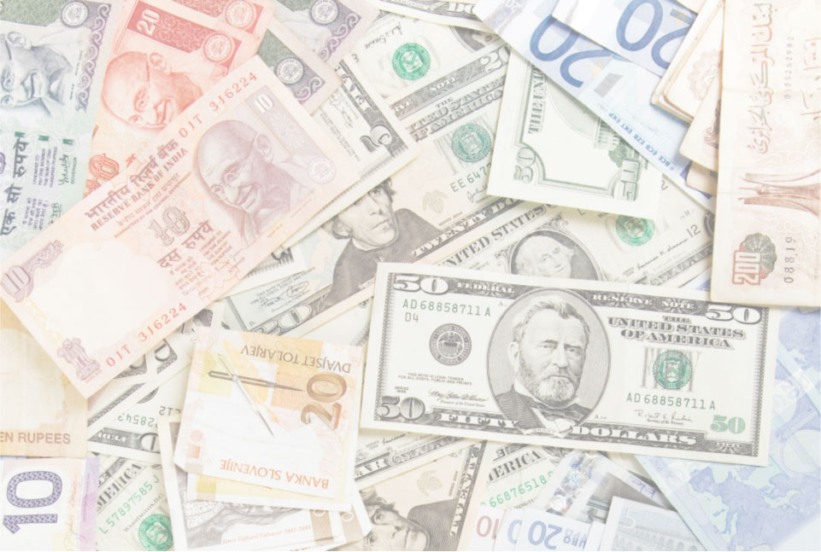
What’s in Economics
for You ?

Slide 2

SCARCITY AND CHOICE
Because you can never satisfy all of your wants, making the most out of your life requires smart choices about what to go after, and what to give up.

Slide 3
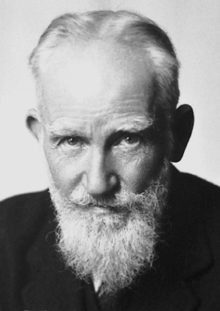
The problem of scarcity arises because of limited money, time, and energy
Economics is how individuals, businesses, and governments make the best possible choices to get what they want, and how those choices interact in markets
“Economy is the art of making the most out of life.”
George Bernard Shaw

Slide 4
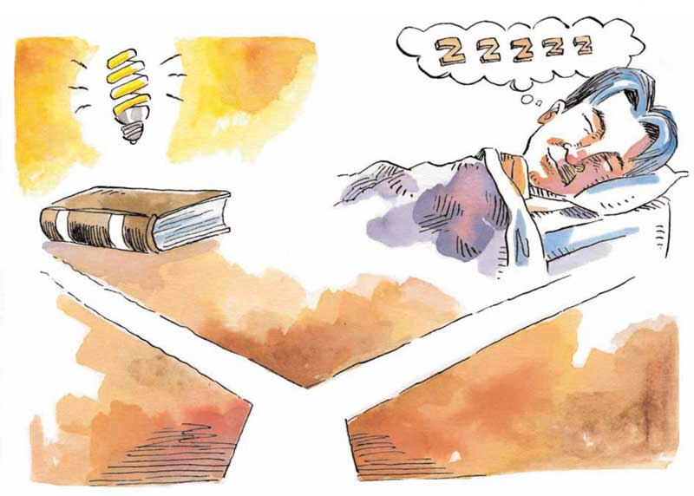
OPPORTUNITY COST
Opportunity cost is the single most important concept both in economics and for making smart choices in life.

Slide 5
Because of scarcity, every choice involves a trade-off — you have to give up something to get something else
The true cost of any choice is the opportunity cost — the cost of the best alternative given up
Opportunity cost is more important than money cost
For a smart choice, the value of what you get must be greater than value of what you give up

Slide 6
Smart choices change as costs and benefits change
Incentives rewards and penalties for choices
You are more likely to choose actions with rewards (positive incentives), and avoid actions with penalties (negative incentives)

Slide 7
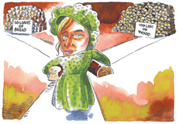
GAINS FROM TRADE
Opportunity cost and comparative advantage are key to understanding why specializing and trading make us all better off.

Slide 8
With voluntary trade, each person feels that what they get is of greater value than what they give up
Absolute advantage the ability to produce a product or service at a lower absolute cost than another producer
Comparative advantage the ability to produce a product or service at a lower opportunity cost than another producer

Slide 9
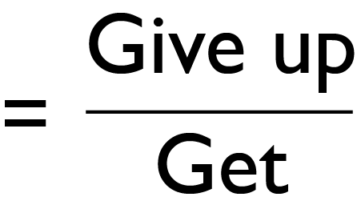
Opportunity cost
Comparative advantage key to mutually beneficial gains from trade
Trade makes individuals better off when each
Specializes in producing a product or service with comparative advantage (lower opportunity cost)
Trades for the other product or service
Production possibilities frontier (PPF) graph showing maximum combinations of products or services that can be produced with existing inputs

Slide 10
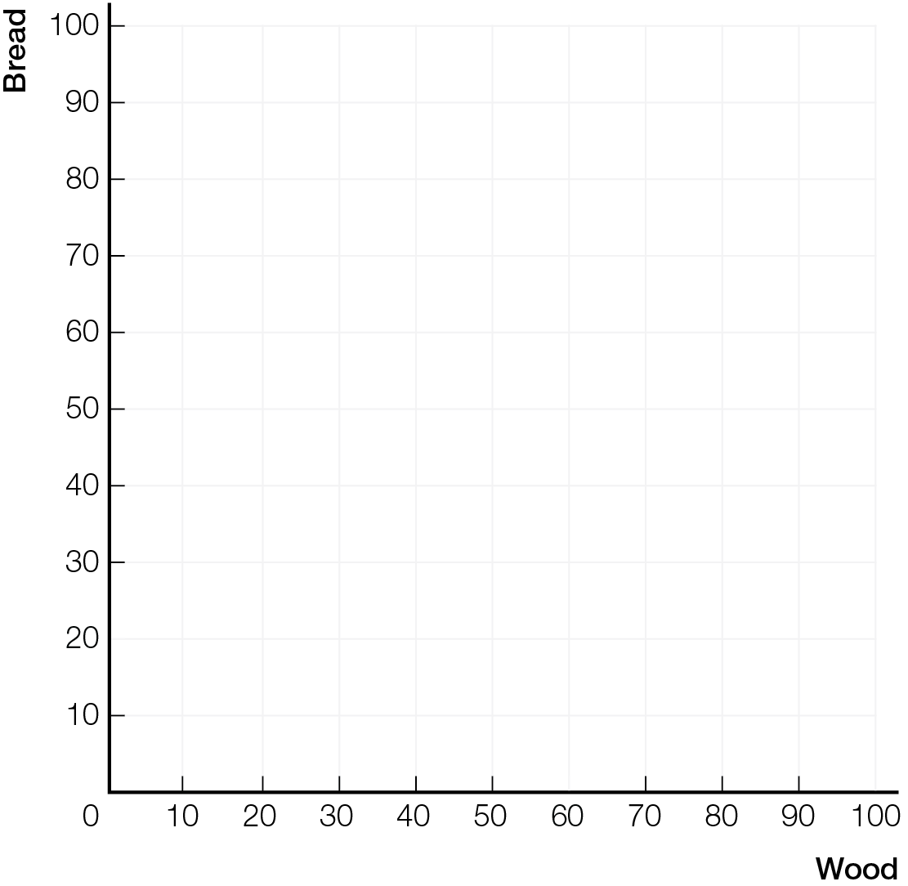
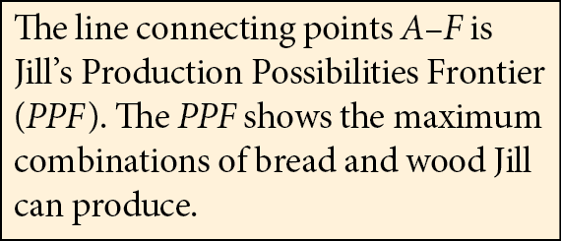

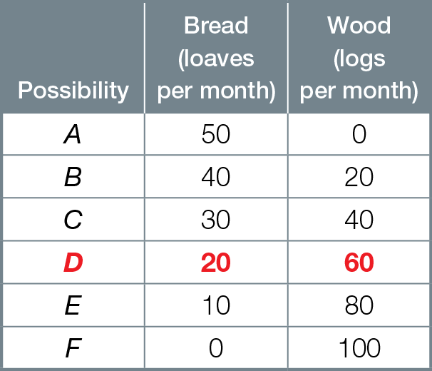
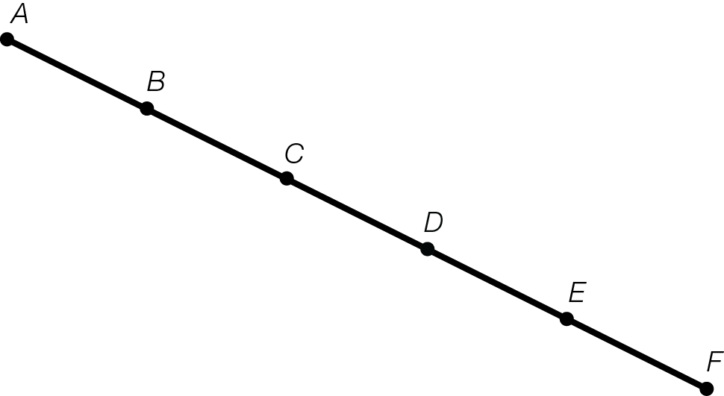
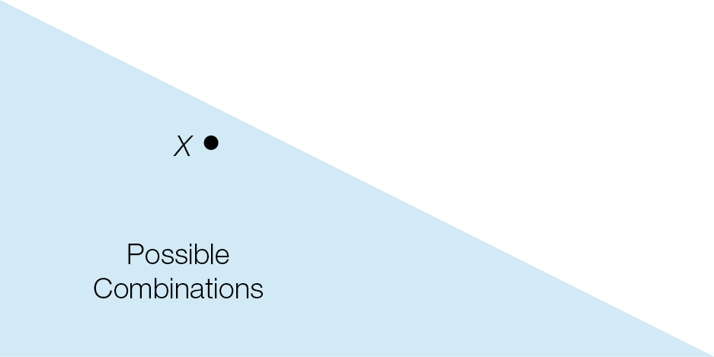
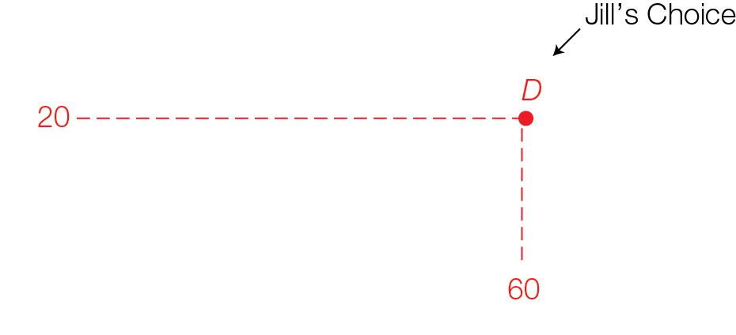
Jill’s Production Possibilities
Fig. 1.1

Slide 11

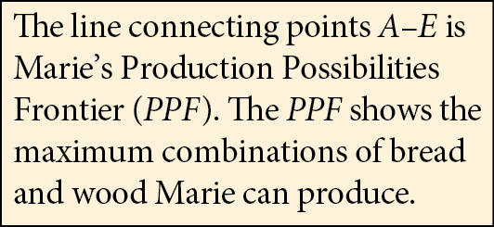

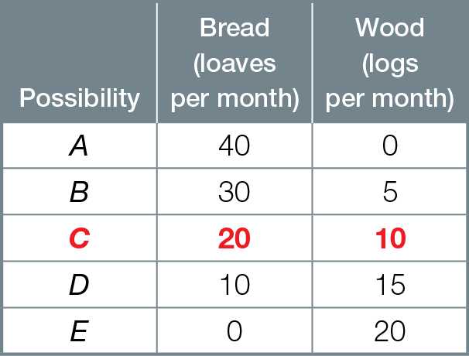
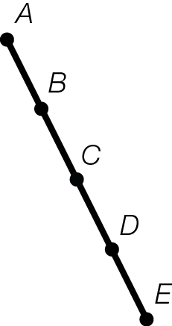
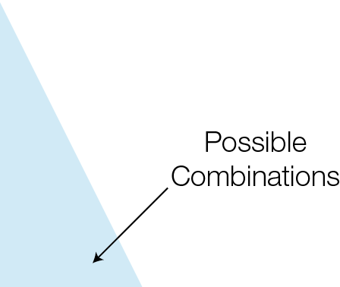
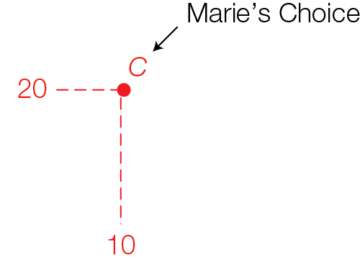
Marie’s Production Possibilities
Fig. 1.2

Slide 12
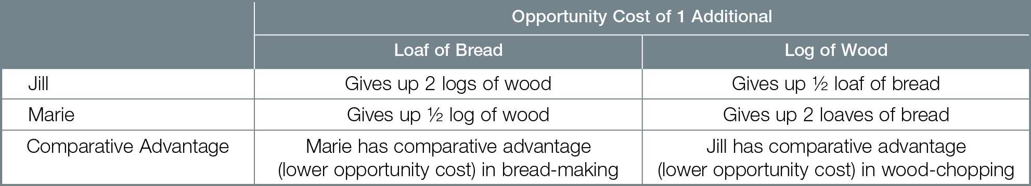
Opportunity Costs for Jill and Marie

Slide 13
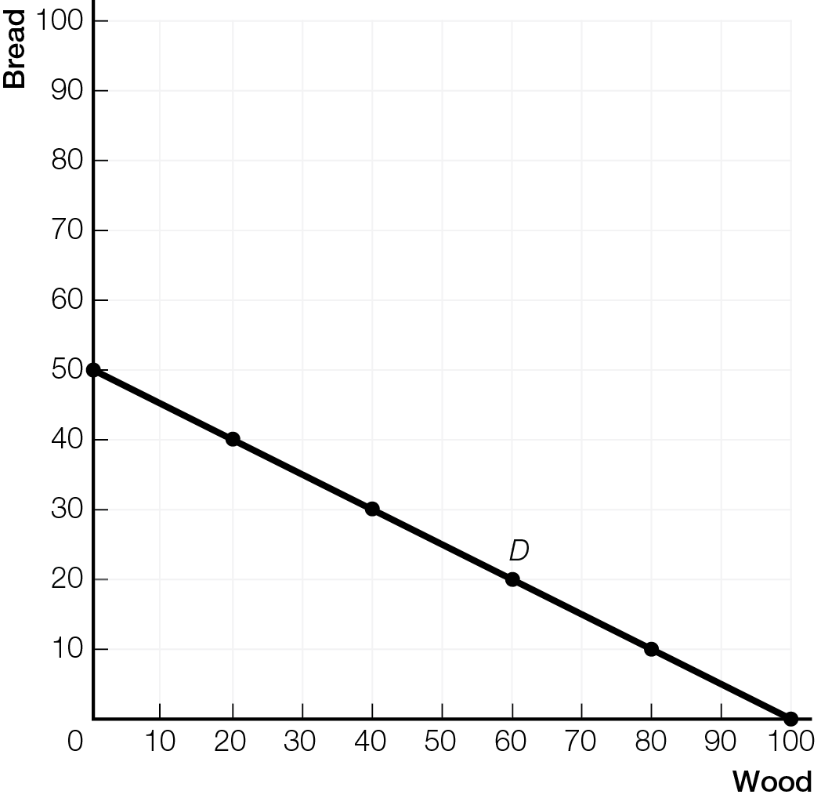
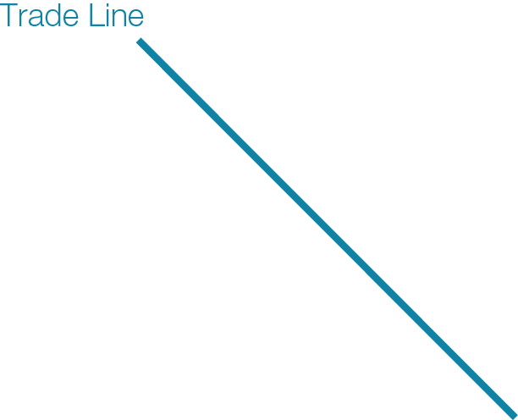
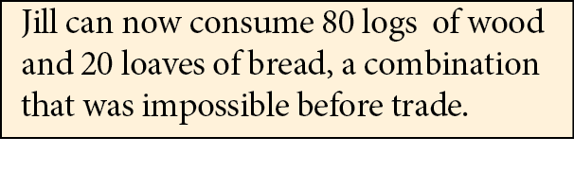
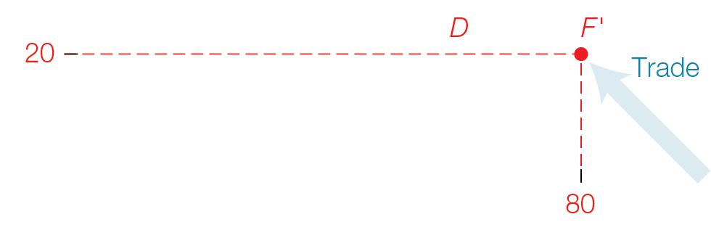

Mutually Beneficial Gains from Trade: Jill’s Gains from Trade
Fig. 1.4a

Slide 14
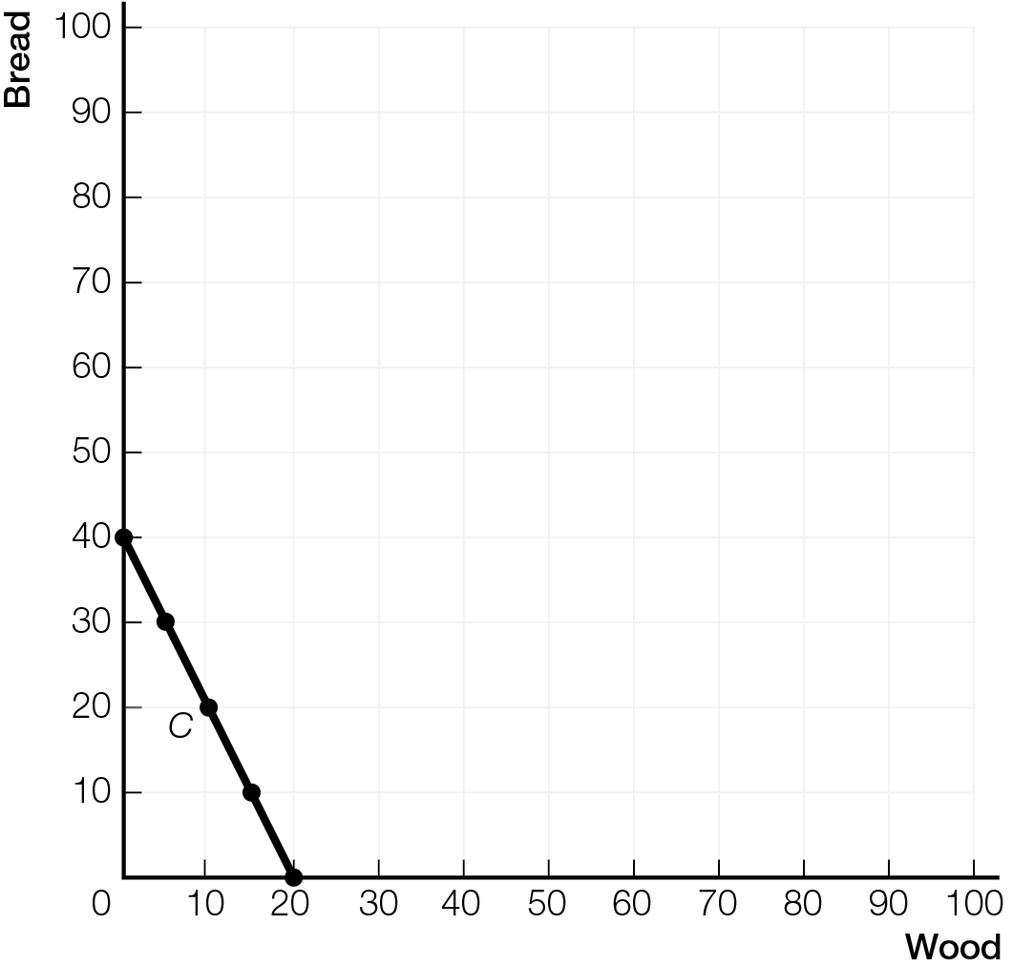
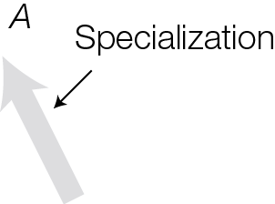

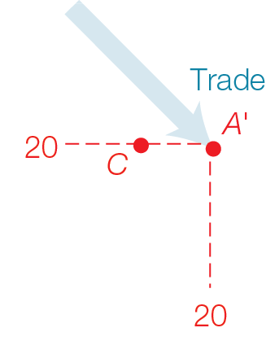
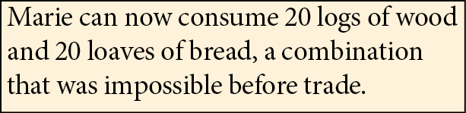
Mutually Beneficial Gains from Trade: Marie’s Gains from Trade
Fig. 1.4b

Slide 15
Specialization according to comparative advantage and trade allows each trader to consume outside her PPF, an impossible combination without trade
All arguments you will ever hear for freer trade are based on comparative advantage
Even if one individual has absolute advantage in producing everything at lower cost, differences in comparative advantage allow mutually beneficial gains from specializing and trading

Slide 16
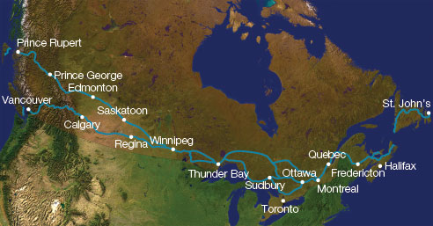
THINKING LIKE AN ECONOMIST
The circular-flow model, like all economic models, focuses attention on what’s important for understanding and shows how smart choices by households, businesses, and governments interact in markets.

Slide 17
An economic model is a simplified representation of the real world, focusing attention on what’s important for understanding
Circular flow model of economic life reduces complexity of the Canadian economy to three sets of players who interact in markets — households, businesses, and governments
In input markets, households are sellers, businesses are buyers
In output markets, households are buyers, businesses are sellers

Slide 18
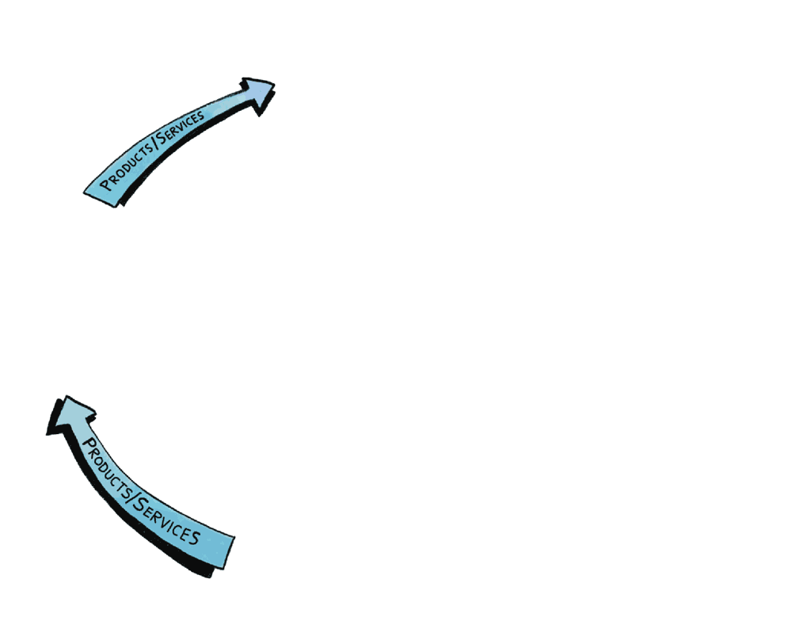
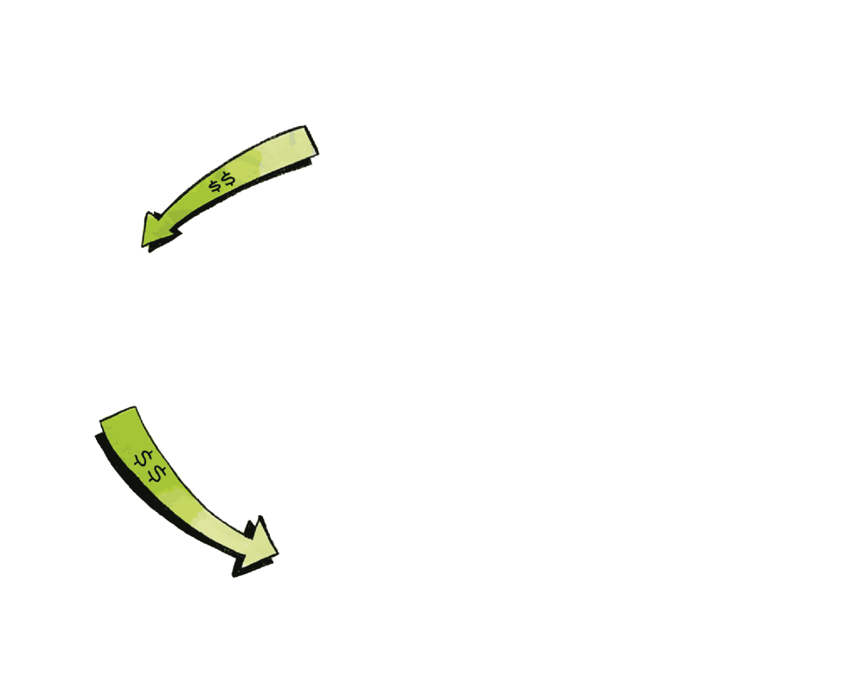
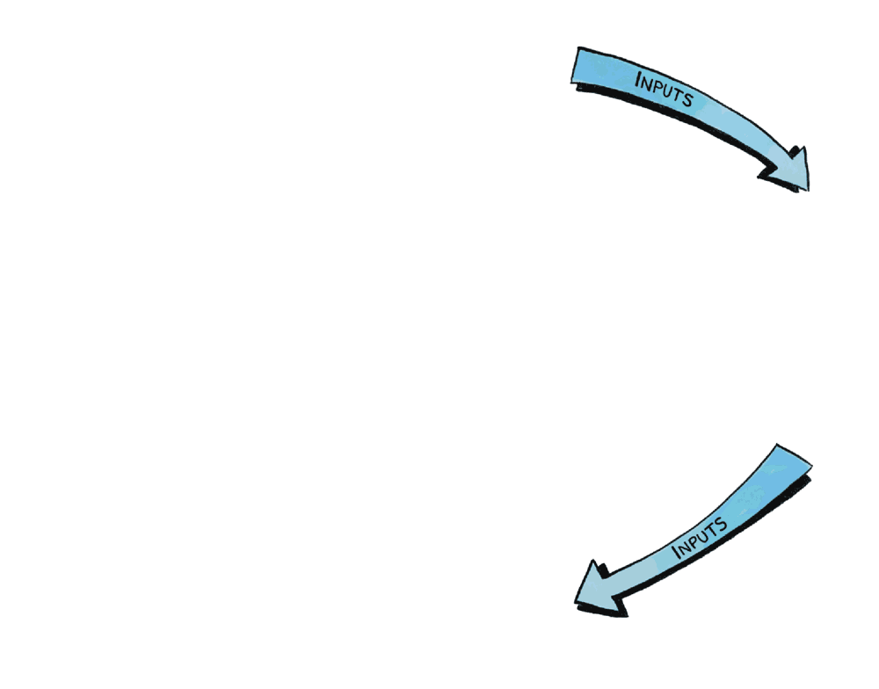
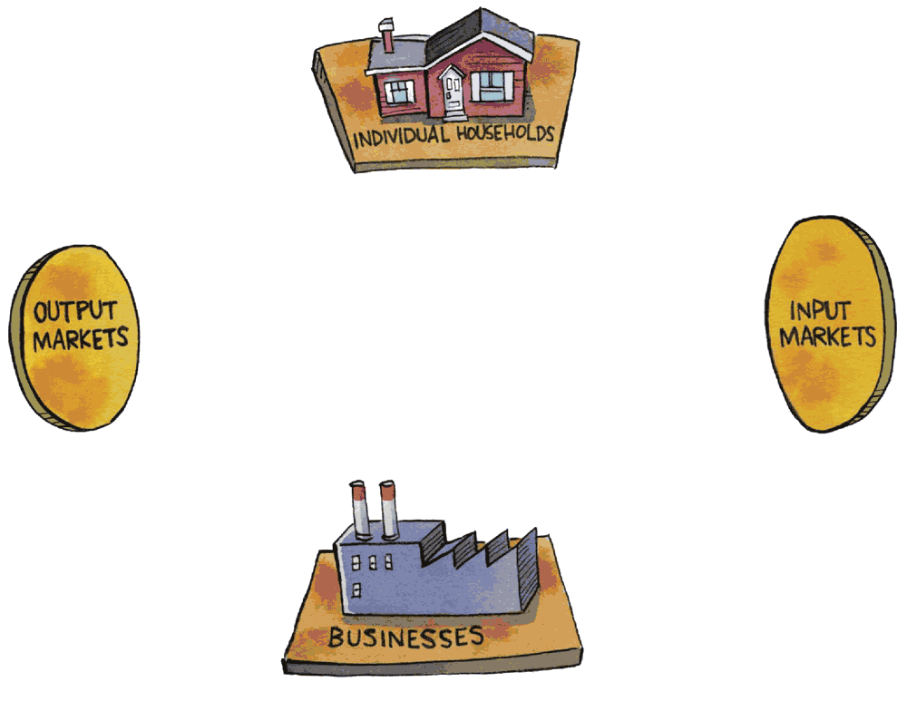
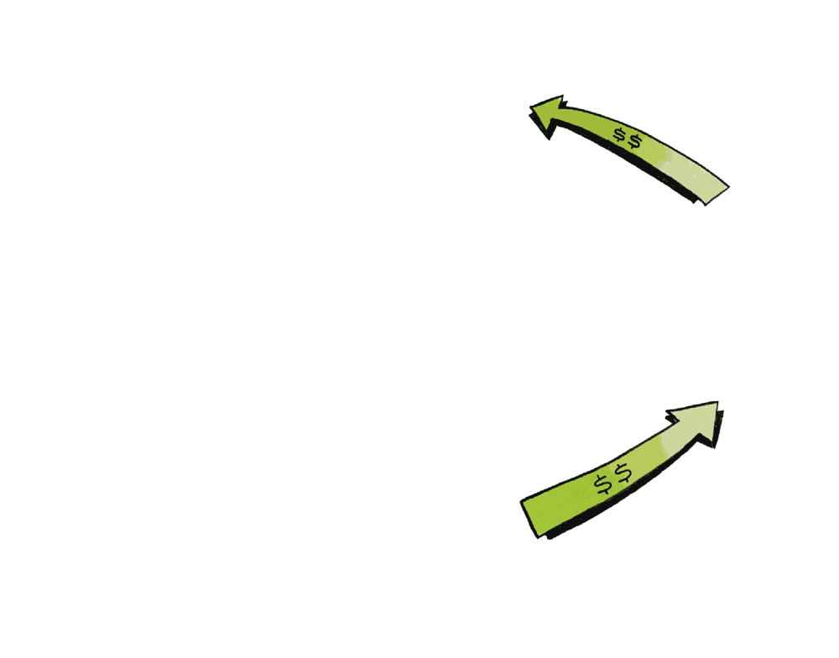
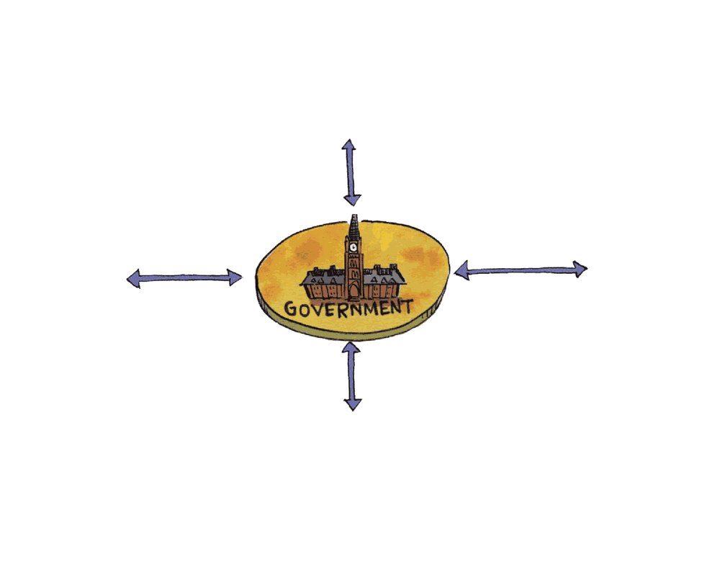
Circular Flow of Economic Life
Fig. 1.5

Slide 19
Inputs are productive resources — labour, natural resources, capital equipment, and entrepreneurial ability — used to produce products and services
Governments set rules of the game and can choose to interact in any aspect of the economy

Slide 20
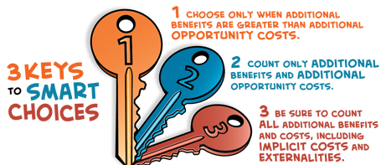
MODELS FOR MICROCONOMICS AND MACROECONOMICS
The Three Keys Model summarizes the core of microeconomics, providing the basis for smart choices in all areas of your life.

Slide 21
Microeconomics analyzes choices that individuals in households, individual businesses, and governments make, and how those choices interact in markets
Macroeconomics analyzes performance of the whole Canadian economy and global economy, the combined outcomes of all individual microeconomic choices
Differences
Trees (micro) versus forest (macro)
Smart choices for you (micro) versus all (macro) ?

Slide 22
Father Guido Sarducci's Five Minute University

Slide 23
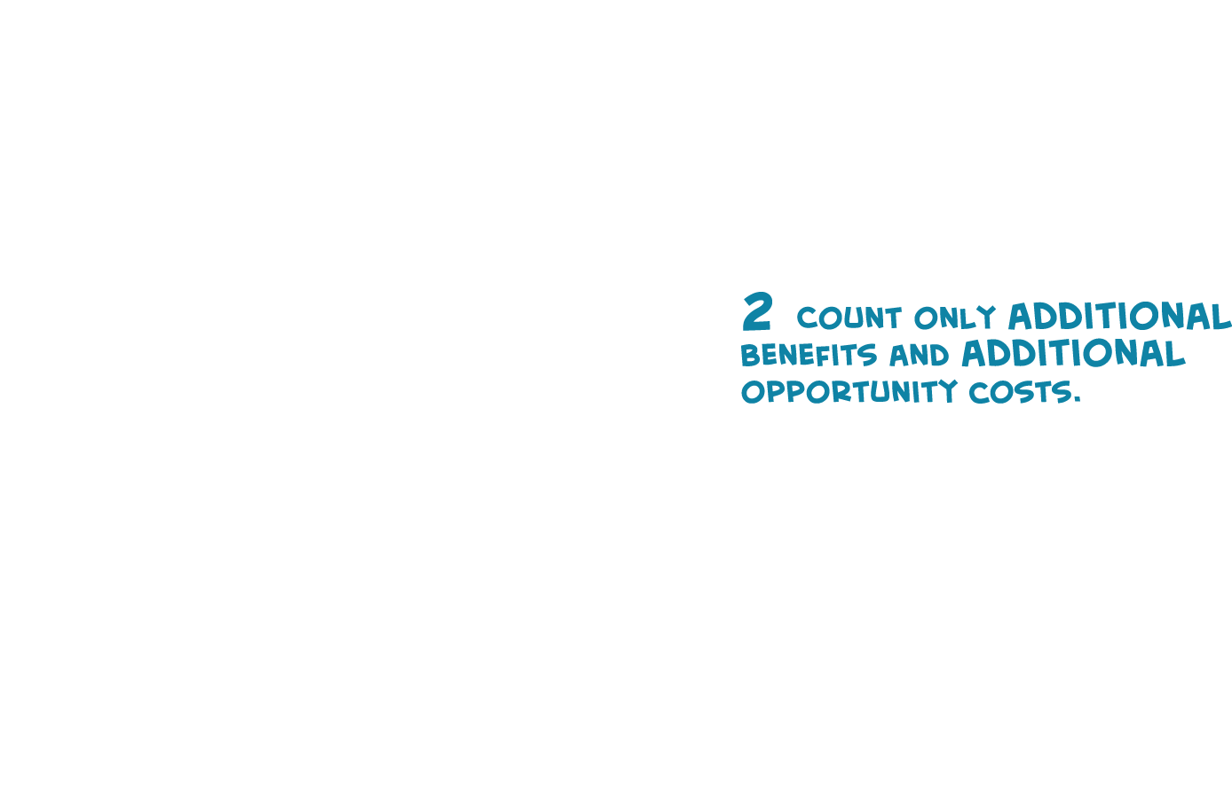
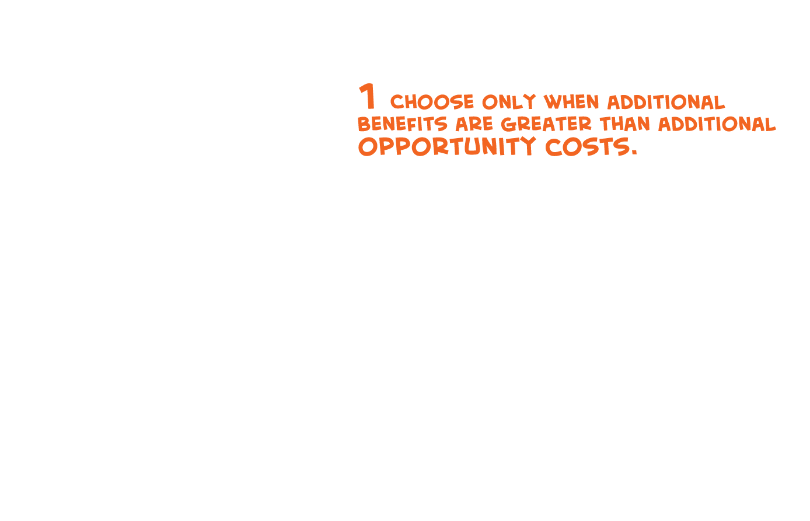
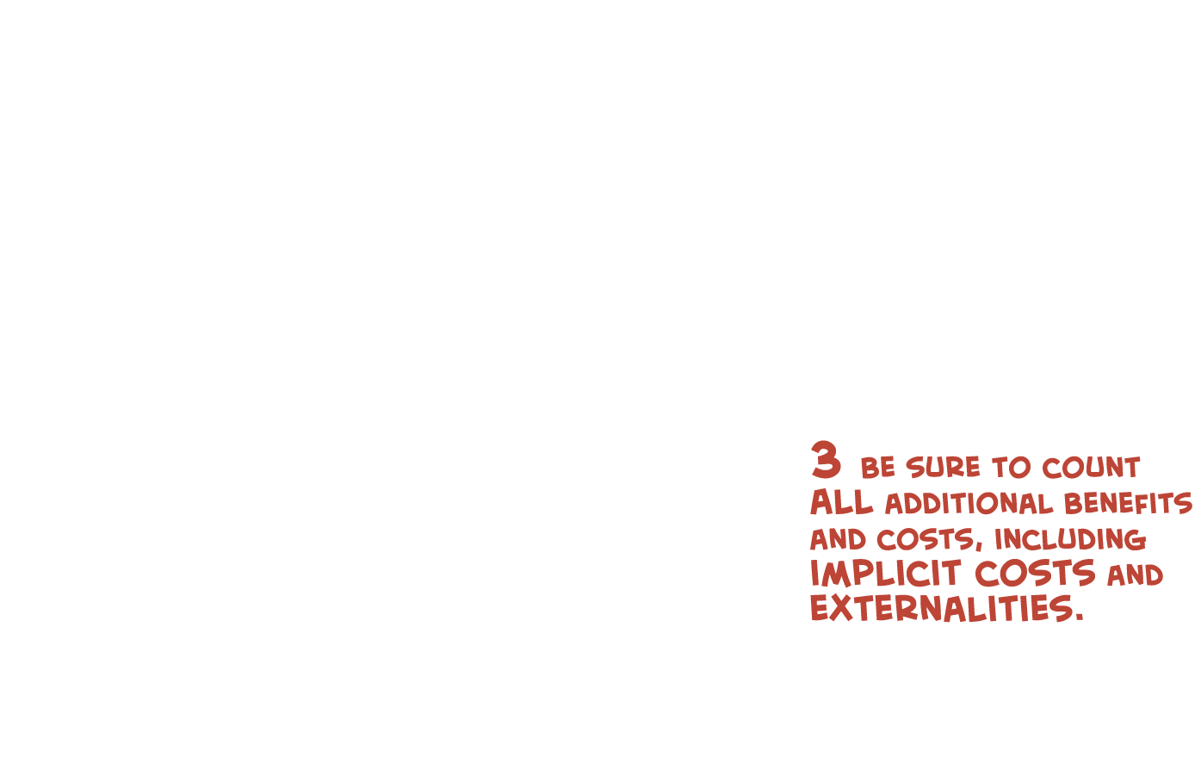

3 Keys modeL for Micro

Slide 24
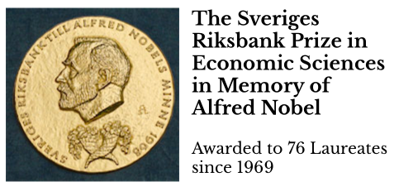
IS ECONOMICS A SCIENCE ?
Science is a systematic enterprise that builds and organizes knowledge in the form of testable explanations and predictions about the universe
Economics uses quantitative expression in mathematics and concise statement of its models in axioms and derived “theorems,” so it looks a lot like the models of science from physics
“Nobel Prize” in Economics (but see Controversies- Criticisms in Wikipedia entry)

Slide 25
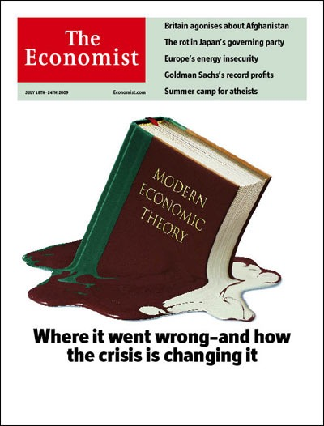
Economics lacks the most important aspect of science – “a record of improvement in predictive range and accuracy”
A. Rosenberg & T. Curtain, “What Is Economics Good For?” (New York Times 24 August 2013)
Paul Krugman, “How Did Economists Get It So Wrong?” (New York Times 6 Sept 2009)

Slide 26
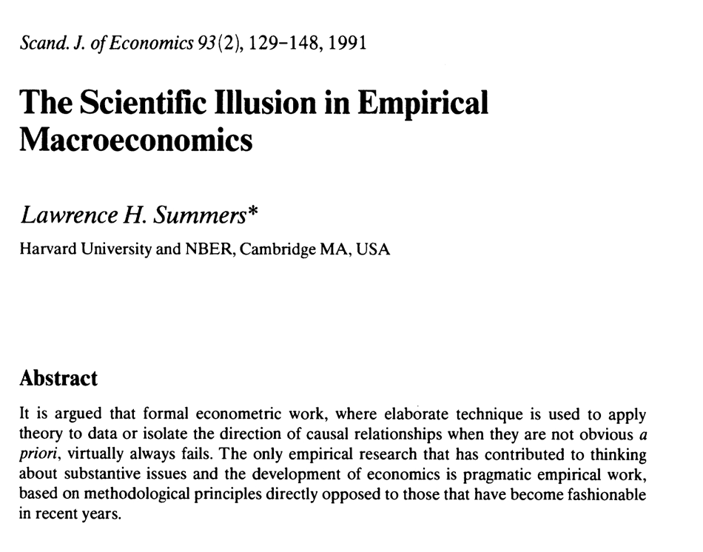


Slide 27
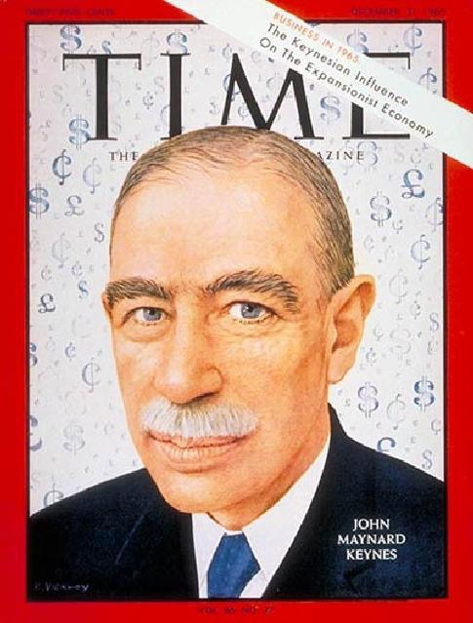
“Economics is a science of thinking in terms of models joined to the art of choosing models which are relevant to the contemporary world.
It is compelled to be this, because, unlike the typical natural science, the material to which it is applied is, in too many respects, not homogeneous through time. The object of a model is to segregate the semi-permanent or relatively constant factors from those which are transitory or fluctuating so as to develop a logical way of thinking about the latter …. ”
– John Maynard Keynes

Slide 28
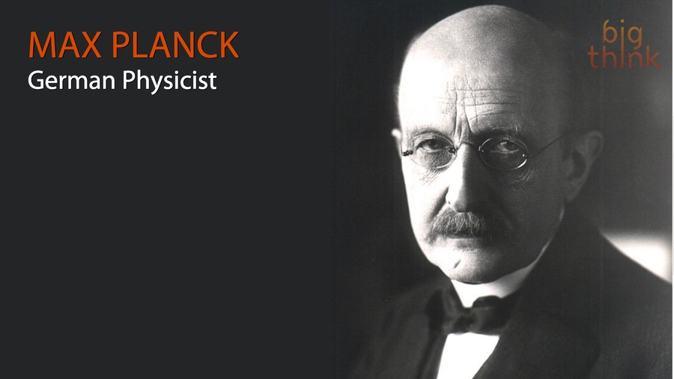
“Professor (Max) Planck, of Berlin, the famous originator of the Quantum Theory, once remarked to me that in early life he had thought of studying economics, but had found it too difficult! ”
– John Maynard Keynes

Slide 29
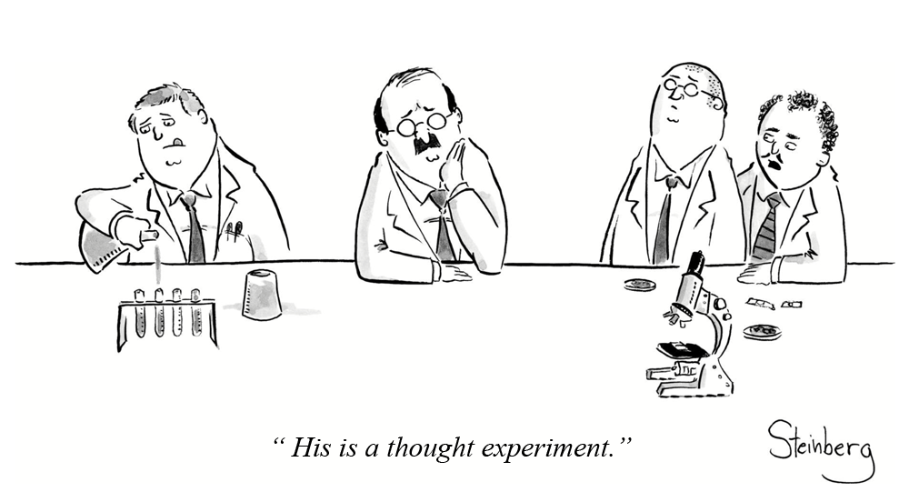
THINKING LIKE AN ECONOMIST

Slide 30

ECONOMIC FABLES
“The author of a tale seeks to impart a lesson about life to his readers. …. It is possible to dismiss any tale on the grounds that it is unrealistic, or that it is too simplistic. But this is also its advantage. The fact that it hovers between fantasy and reality means that it can be free from irrelevant details and unnecessary diversions. …. Economic theory spins tales and calls them models.
– Ariel Rubinstein

Slide 31
Economic models assume all other things not in the model do not change
Mental equivalent of controlled experiments in laboratory
Positive statements about what is; can be evaluated as true or false by checking the facts
Normative statements about what you believe should be; involve value judgments
Cannot be factually checked

Slide 32
Positive statements ⬆ Price gas ➔ ⬇ Quantity gas used ➔ ⬇ Global warming
Normative statements To ⬇ Global warming we ought to:
⬆ Price gas
Subsidize clean energy sources
We will return to connections between Economics
As science and art
Models and policies

Slide 33
MY COURSE GOAL
Not to teach you what to think, but HOW TO THINK like an economist

