Slide 1

Coordinating
Demand and Supply

Slide 2
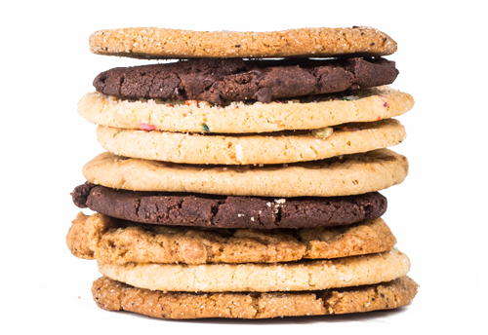

Slide 3
P | Q
$0 | 250
$2 | 200
$4 | 100
$6 | 60
$8 | 40
$10 | 30
P | Q
$12 | 20
$15 | 12
$18 | 8
$20 | 4
$25 | 5
$30 | 3
P | Q
$35 | 3
$40 | 3
$45 | 3
$50 | 3
$55 | 1

Slide 4

WEIGHING BENEFITS, COSTS & SUBSTITUTES
Your willingness to buy a product or service depends on your ability to pay, comparative benefits and costs, and the availability of substitutes.

Slide 5
Preferences your wants and their intensities
Demand consumers’ willingness and ability to pay for a particular product or service
For any choice, what you are willing to pay or give up depends on
Cost
Availability of substitutes

Slide 6
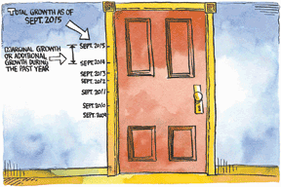
SMART CHOICES ARE MARGINAL CHOICES
Key 2 states, “Count only additional benefits and additional costs.” Additional benefits mean marginal benefits – not total benefits – and marginal benefits change the circumstances.

Slide 7
Marginal benefit
Additional benefit from a choice
Changing with circumstances
Marginal benefit explains the diamond/water paradox
Willingness to pay depends on marginal benefit, not total benefit
Water is abundant, marginal benefit is low
Diamonds are scarce, marginal benefit is high

Slide 8

THE LAW OF DEMAND
The demand curve combines two forces – switch to substitutes; willingness and ability to pay – determining quantity demanded, and can be read as a demand curve and as a marginal benefit curve.

Slide 9
Quantity demanded the amount you actually plan to buy at a given price
Market demand the sum of demands of all individuals willing and able to buy a particular product or service
Law of demand if the price of a product or service rises, quantity demanded decreases, other things remaining the same
Demand curve shows relationship between price and quantity demanded, other things remaining the same

Slide 10
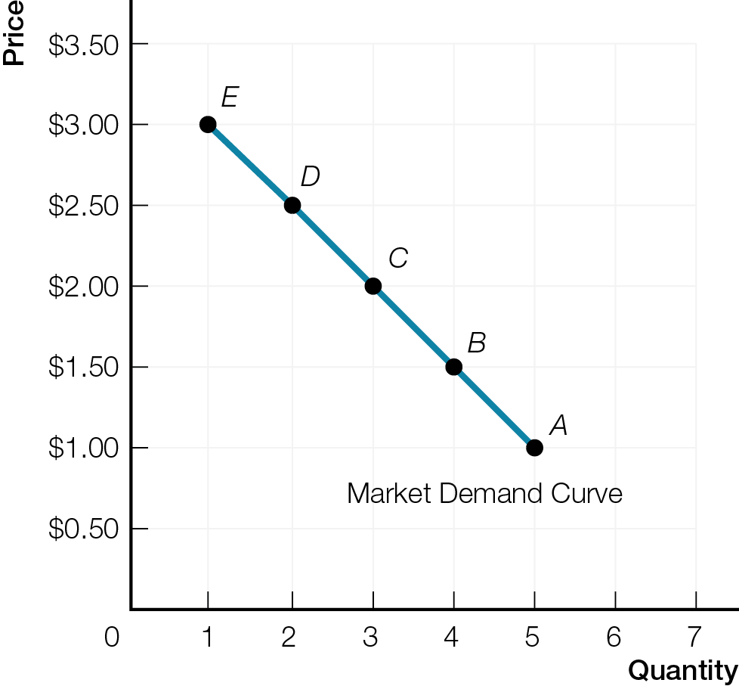
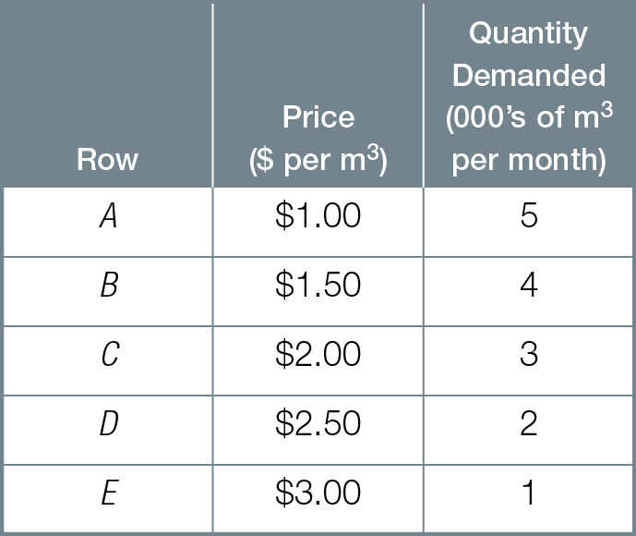
Market Demand for Water
Fig. 2.2

Slide 11
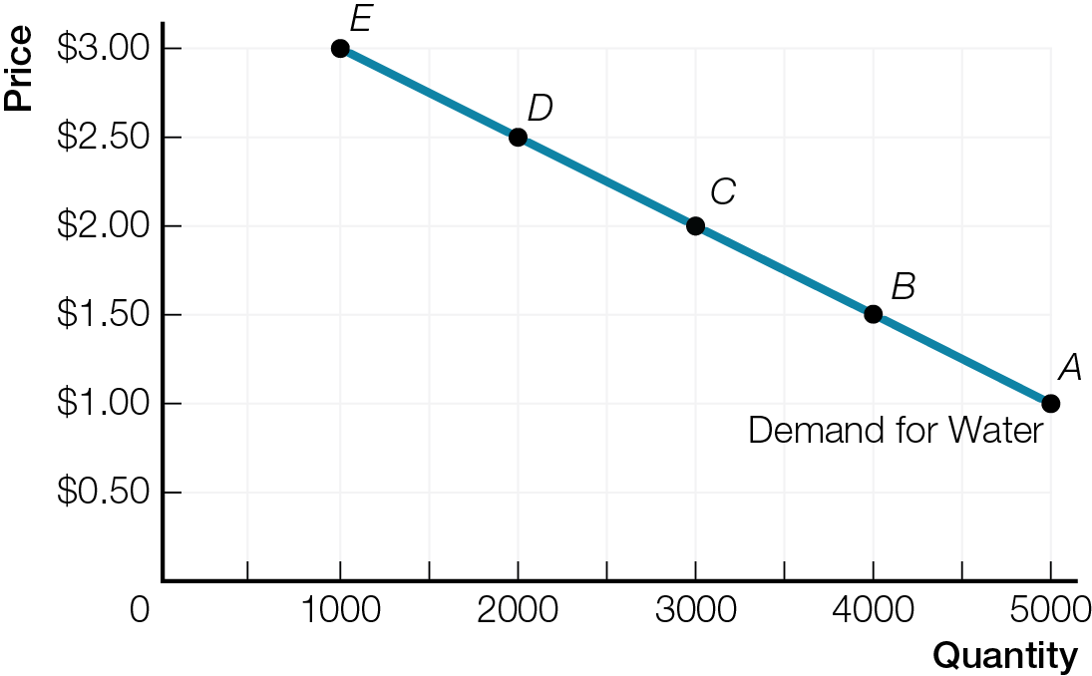


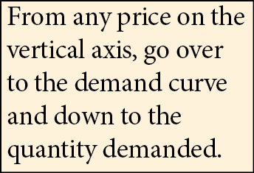
Two Ways to Read a Demand Curve: Demand Curve – Read Over and Down
Fig. 2.3a

Slide 12
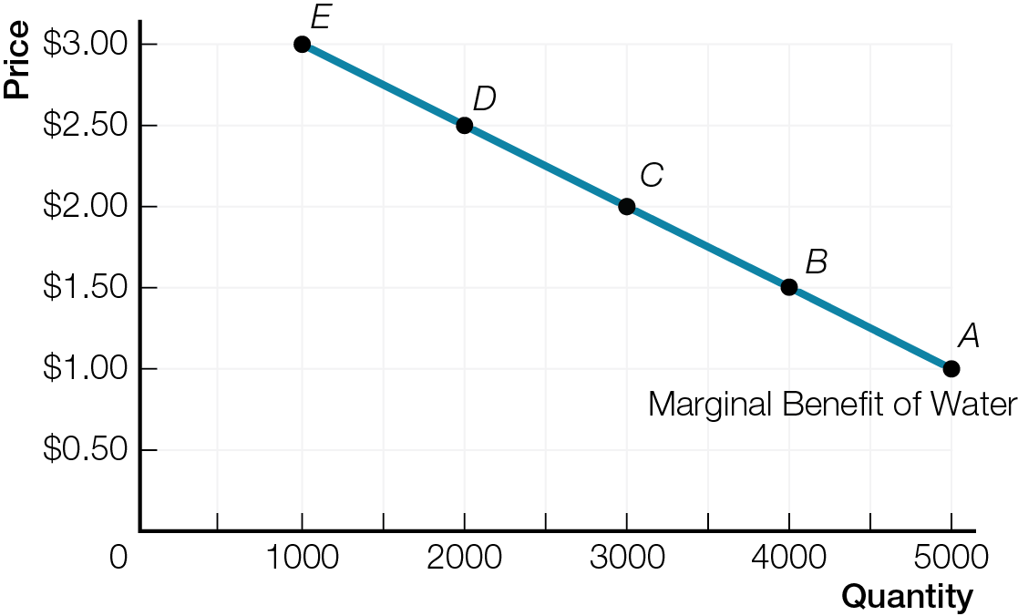

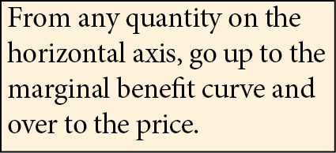
Two Ways to Read a Demand Curve: Marginal Benefit Curve – Read Up and Over
Fig. 2.3b

Slide 13
WHAT CAN CHANGE DEMAND?
Quantity demanded changes only with a change in price.
All other influences on consumer choice change demand.

Slide 14
Demand is a catch-all term summarizing all possible influences on consumers’ willingness and ability to pay for a particular product or service
Increase in demand increase in consumers’ willingness and ability to pay. Rightward shift of demand curve.
Decrease in demand decrease in consumers’ willingness and ability to pay. Leftward shift of demand curve.

Slide 15
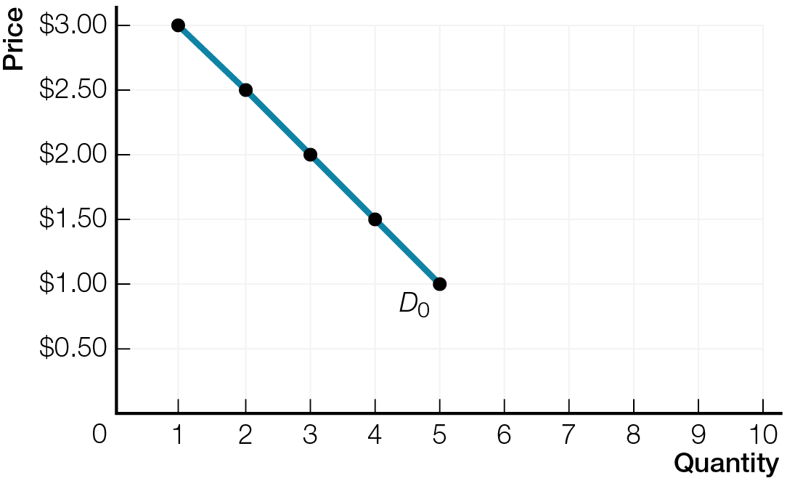
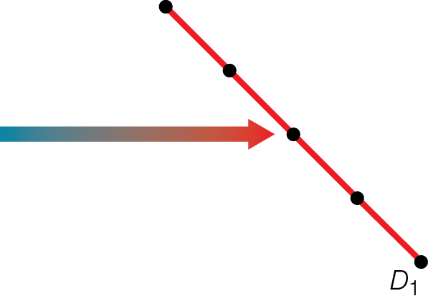
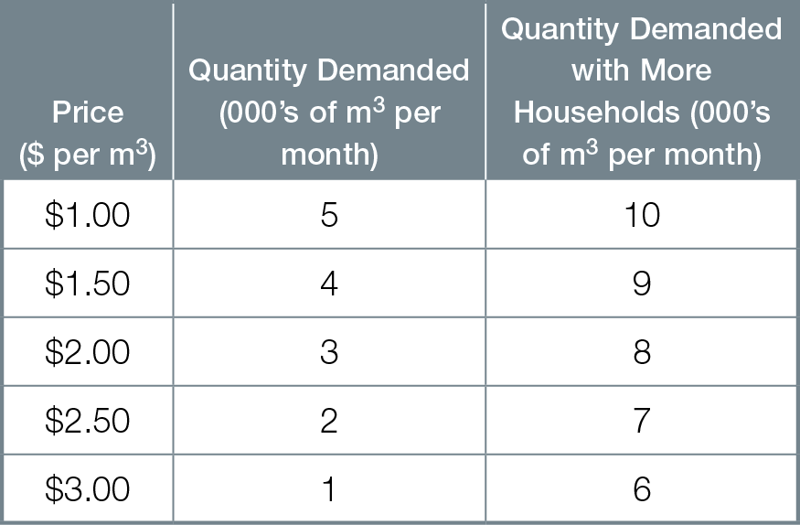
More Consumers Increase the Market Demand for Water
Fig. 2.5

Slide 16
Demand changes with changes in preferences, prices of related goods, income, expected future price, and number of consumers. For example, demand increases with:
increase in preferences
rise in price of a substitute
fall in price of a complement
increase in income for normal goods
decrease in income for inferior goods
rise in expected future prices
increase in number of consumers

Slide 17
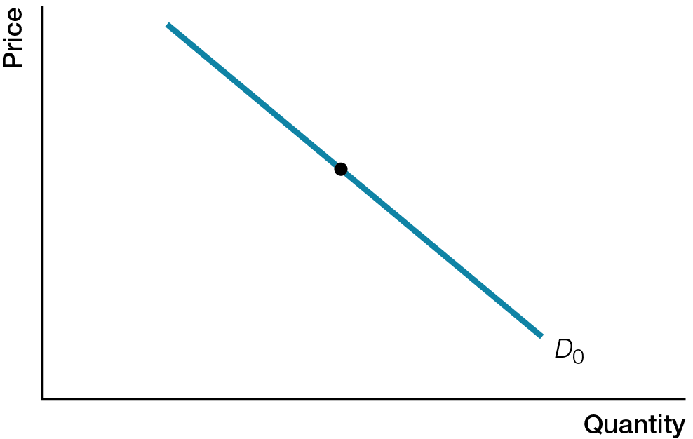
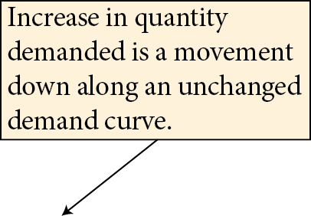

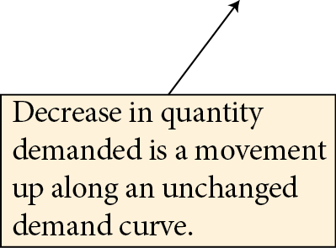

Change in Quantity Demanded
Fig. 2.6a

Slide 18
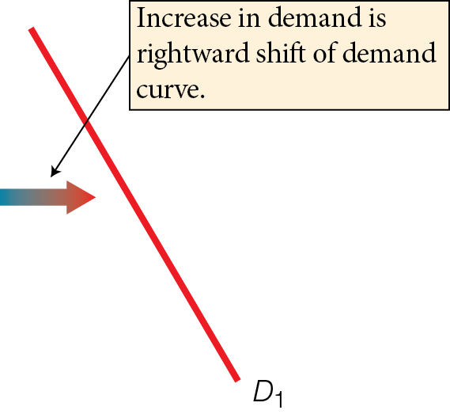
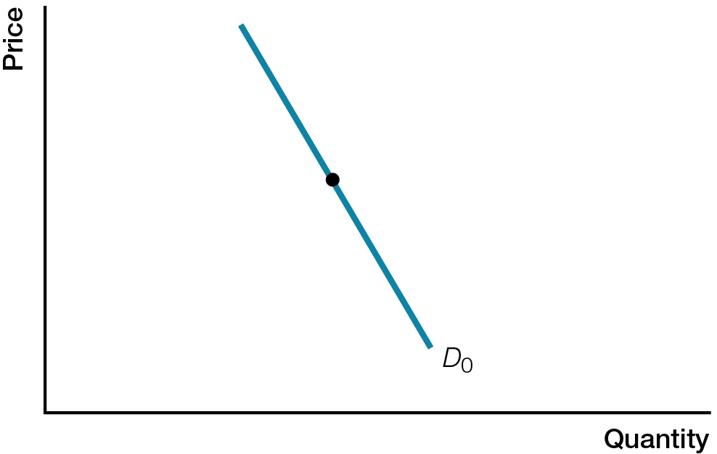
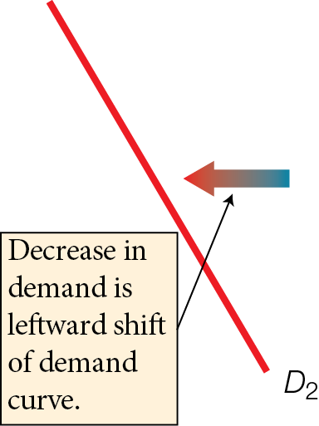
Change in Demand
Fig. 2.6b

Slide 19
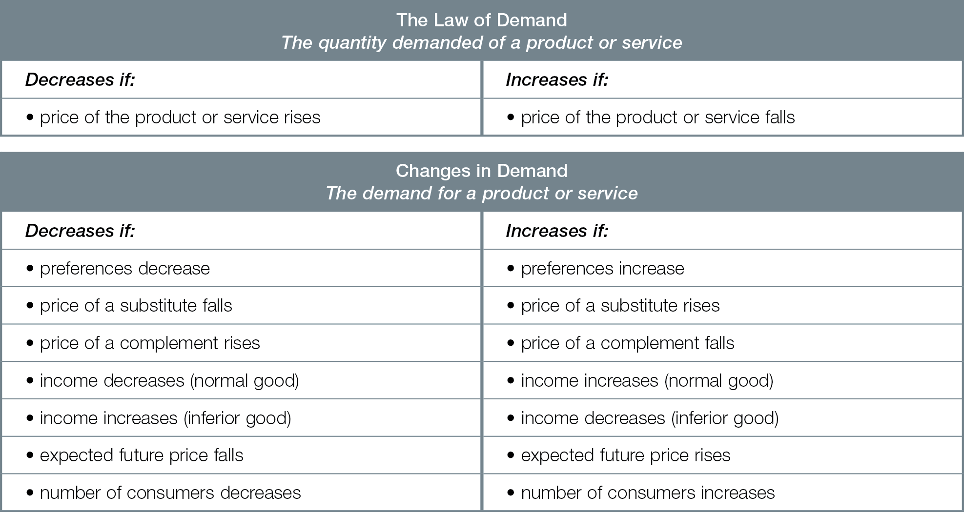
Law of Demand and Changes in Demand

