Slide 1


Slide 2
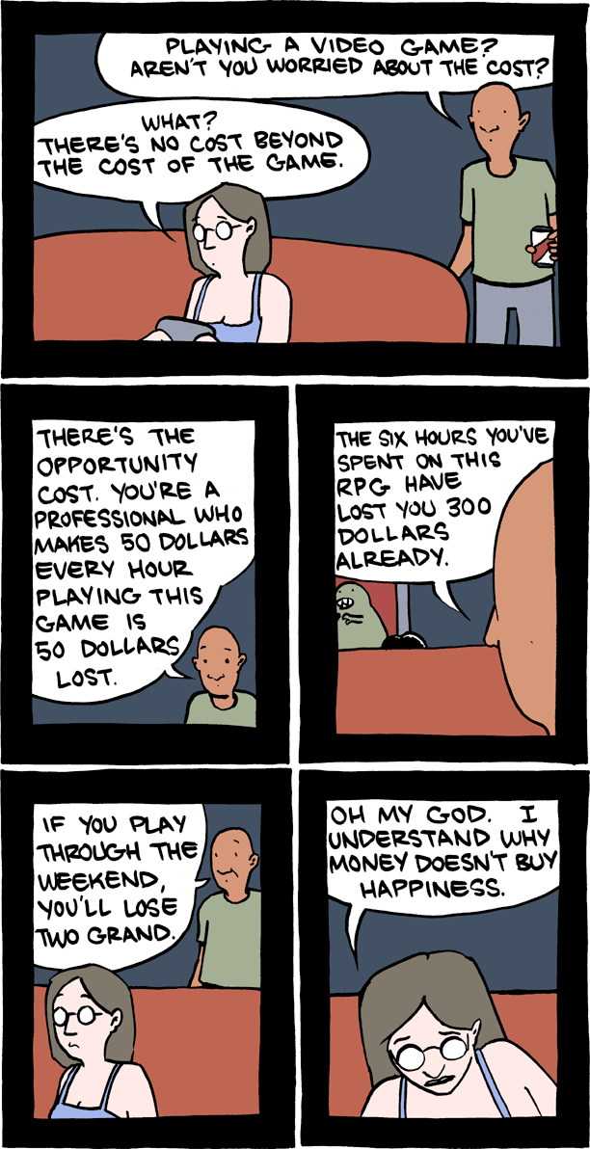
COSTS ARE OPPORTUNITY COSTS
Businesses must pay higher prices to obtain more of an input because opportunity costs change with circumstances.
The marginal costs of additional inputs (like labour) are ultimately opportunity costs — the best alternative use of the input.

Slide 3
Marginal cost additional opportunity cost of increasing quantity supplied
Marginal cost changes with circumstances
Increases as you increase quantity supplied
To buy inputs, a business must pay the price matching best opportunity cost of the input owner

Slide 4

SUNK COSTS DON’T MATTER FOR FUTURE CHOICES
Sunk costs that cannot be reversed are not part of opportunity costs. Sunk costs do not influence smart, forward-looking decisions.

Slide 5
Sunk costs past expenses that cannot be recovered
Sunk costs are the same no matter which fork in the road you take, so no influence on smart choices
Not part of opportunity costs to consider when making forward-looking choices

Slide 6
Suppose you have just paid your bus fare. A friend in a car pulls up and offers you a ride. Explain how you would decide between staying on the bus or taking the ride, and the influence of the paid fare on your choice.
Dropping a course decision …

Slide 7
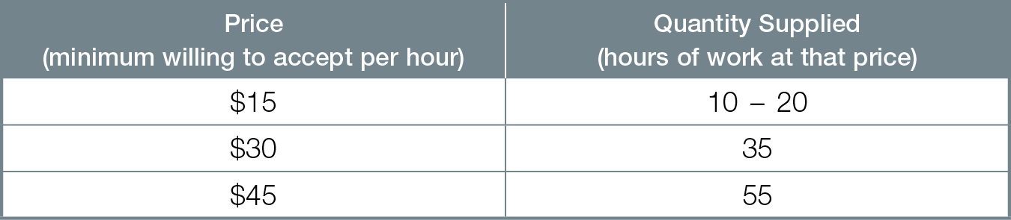
THE LAW OF SUPPLY
Your Supply of Hours Worked
If the price of a product or service rises, quantity supplied increases. Businesses increase production when higher prices either create higher profits or cover higher marginal opportunity costs of production.

Slide 8
Supply businesses’ willingness to produce a particular product or service because price covers all opportunity costs
Quantity supplied quantity you actually plan to supply at a given price
Marginal opportunity cost complete term for any cost relevant to a smart decision
All opportunity costs are marginal costs; all marginal costs are opportunity costs

Slide 9
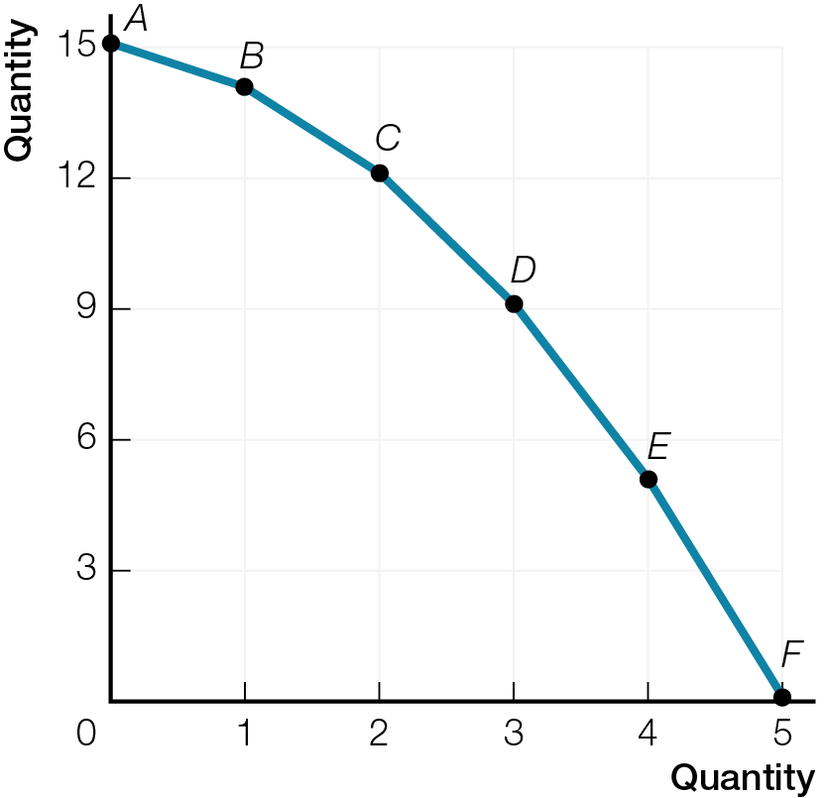
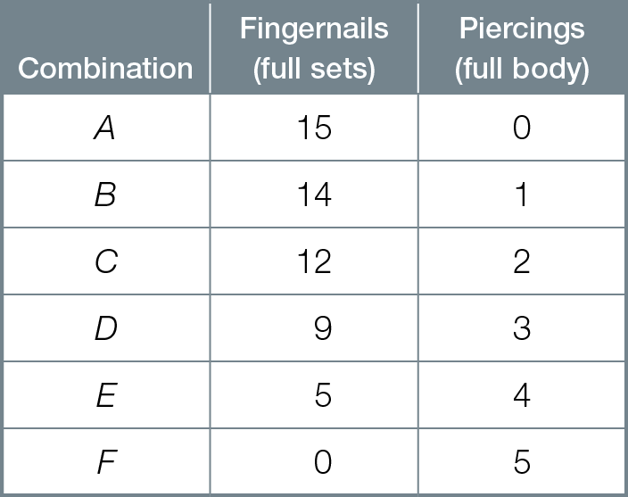
Paola’s Parlour Production Possibilities Frontier
Fig. 3.2

Slide 10
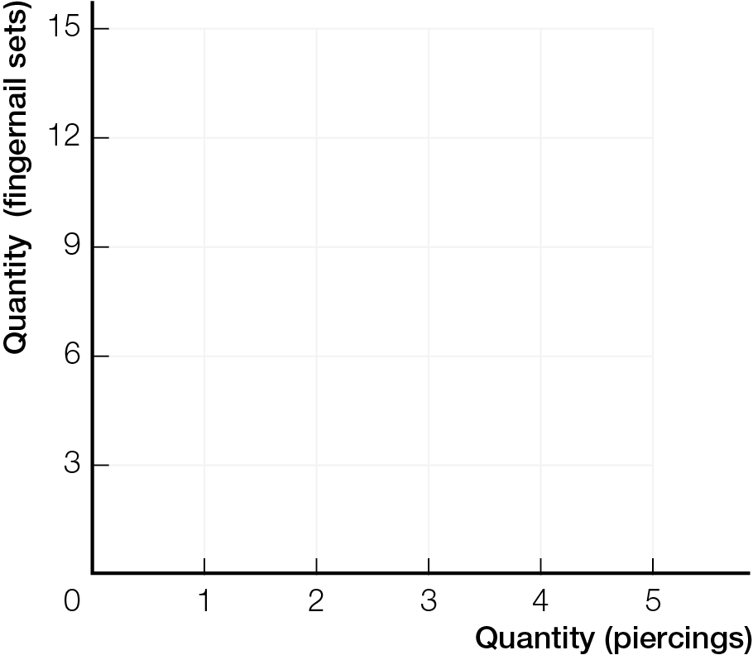
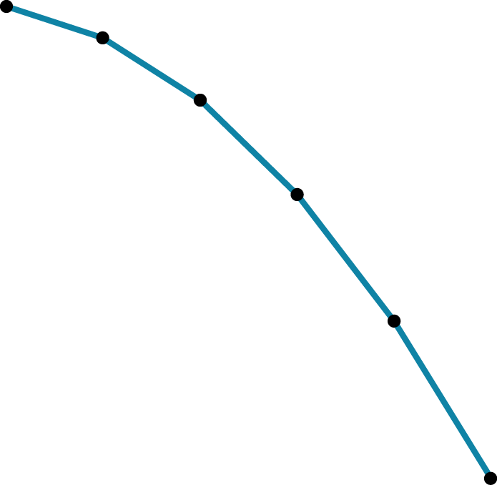

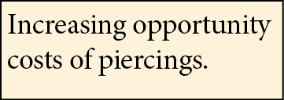
Paola’s Parlour Production Possibilities Frontier
Fig. 3.2
A
B
1
C
2
3
D
4
E
5
F

Slide 11
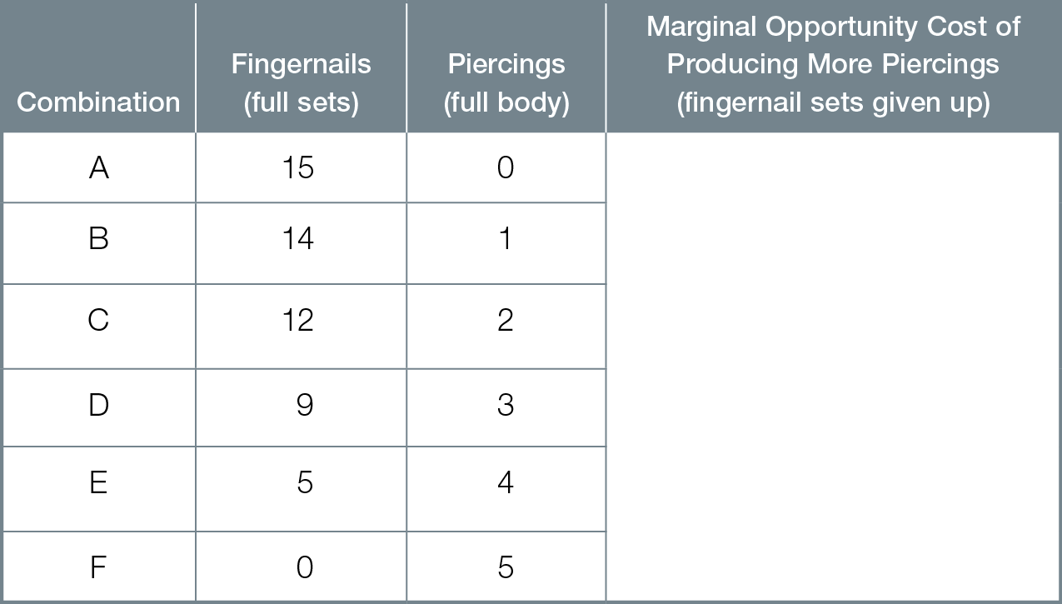
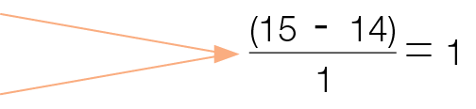
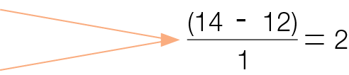
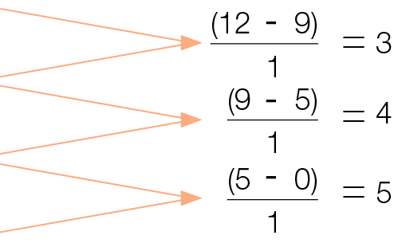
Paola’s Parlour Marginal Opportunity Costs
Fig. 3.3

Slide 12
Increasing marginal opportunity costs arise because inputs are not equally productive in all activities
Where inputs are equally productive in all activities, marginal opportunity costs are constant
Law of supply if the price of a product or service rises, quantity supplied increases
Market supply sum of supplies of all businesses willing to produce a particular product or service

Slide 13
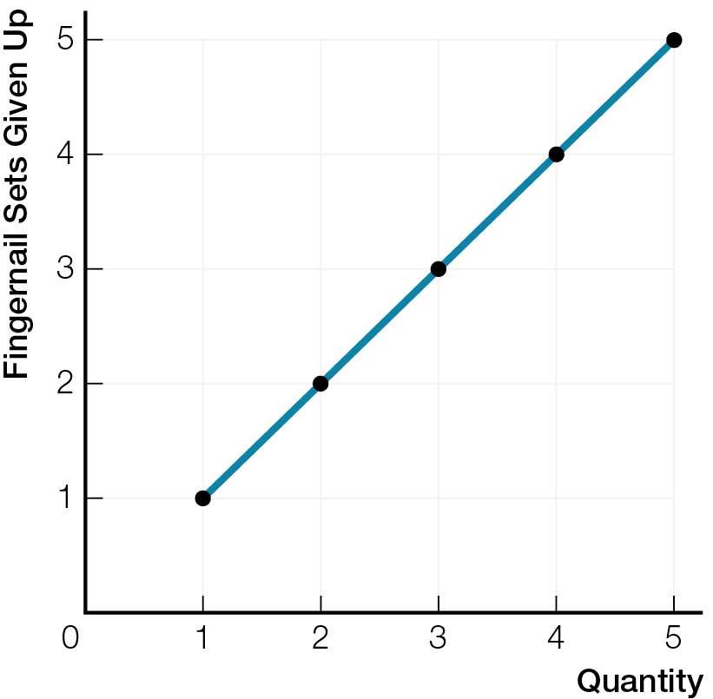
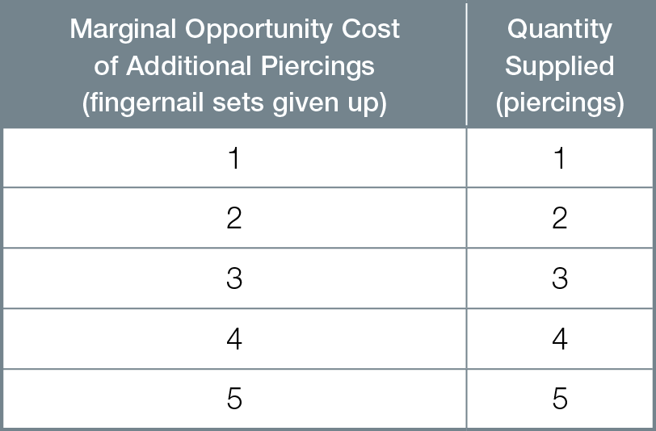
Marginal Opportunity Cost of Additional Piercings Measured in Fingernail Sets

Slide 14
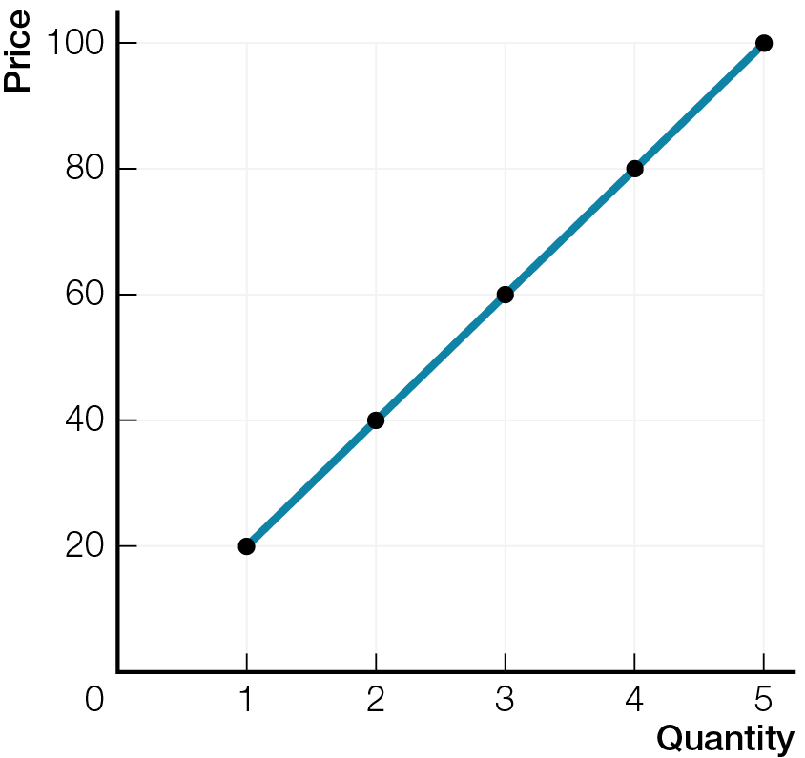
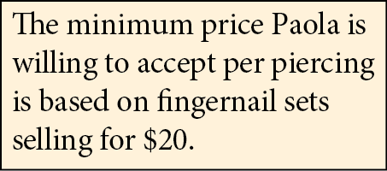
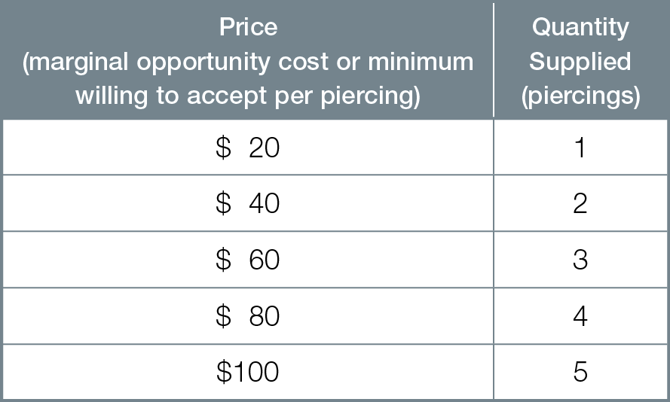
Marginal Opportunity Cost of Additional Piercings Measured in $

Slide 15
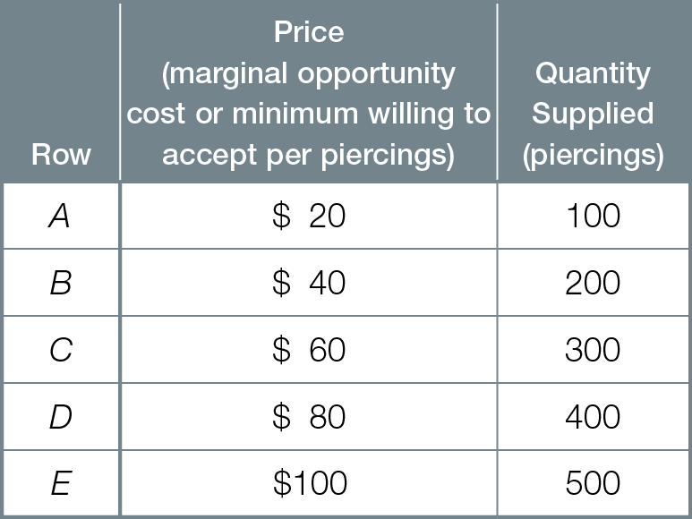
Market Supply of Piercings

Slide 16
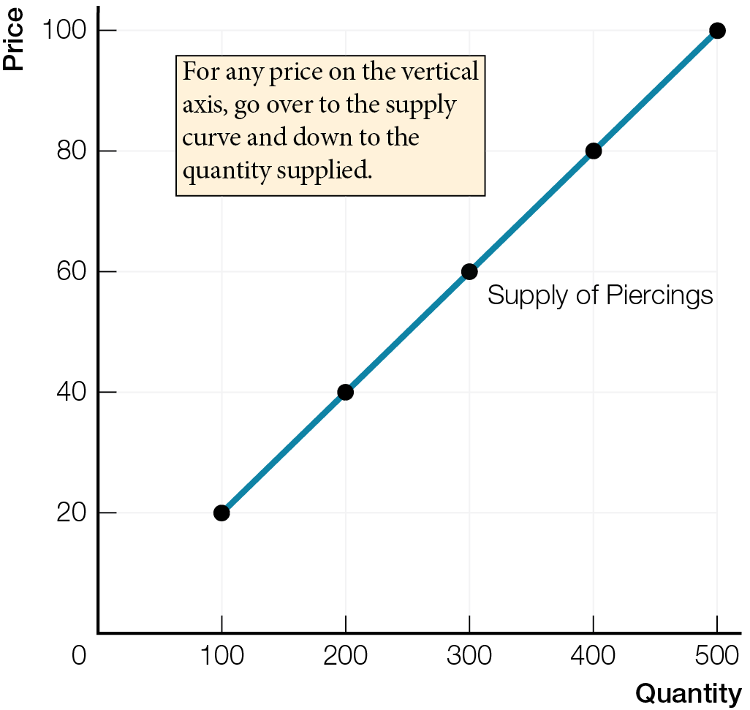
Reading the Supply Curve as a Supply Curve
Fig. 3.6a

Slide 17
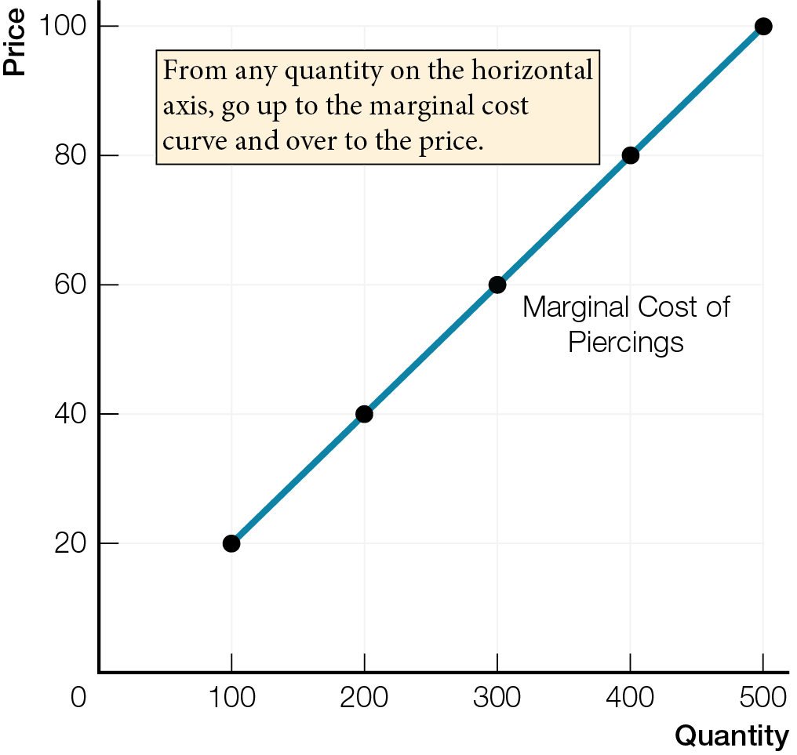
Reading Supply Curve as a Marginal Cost Curve
Fig. 3.6b

Slide 18
Supply curve shows relationship between price and quantity supplied, other things remaining the same
There are two ways to read a supply curve
As a supply curve, read over and down from price to quantity supplied
As a marginal cost curve, read up and over from quantity supplied to price
A marginal cost curve shows the minimum price businesses will accept that covers all marginal opportunity costs of production

Slide 19
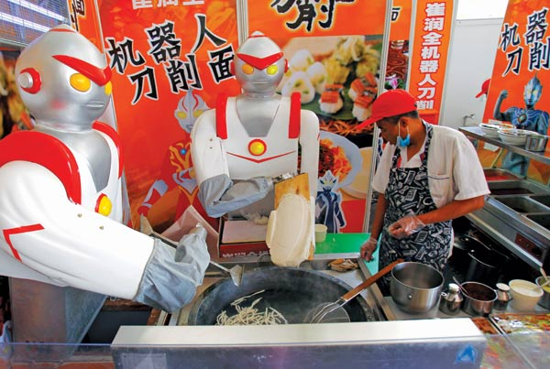
WHAT CAN CHANGE SUPPLY?
Quantity supplied is changed only by a change in price. Supply is changed by all other influences on business decisions.

Slide 20
Supply is a catch-all term summarizing all possible influences on businesses’ willingness to produce a particular product or service
Increase in supply increase in businesses’ willingness to produce. Rightward shift of supply curve.
Decrease in supply decrease in businesses’ willingness to produce. Leftward shift of supply curve

Slide 21
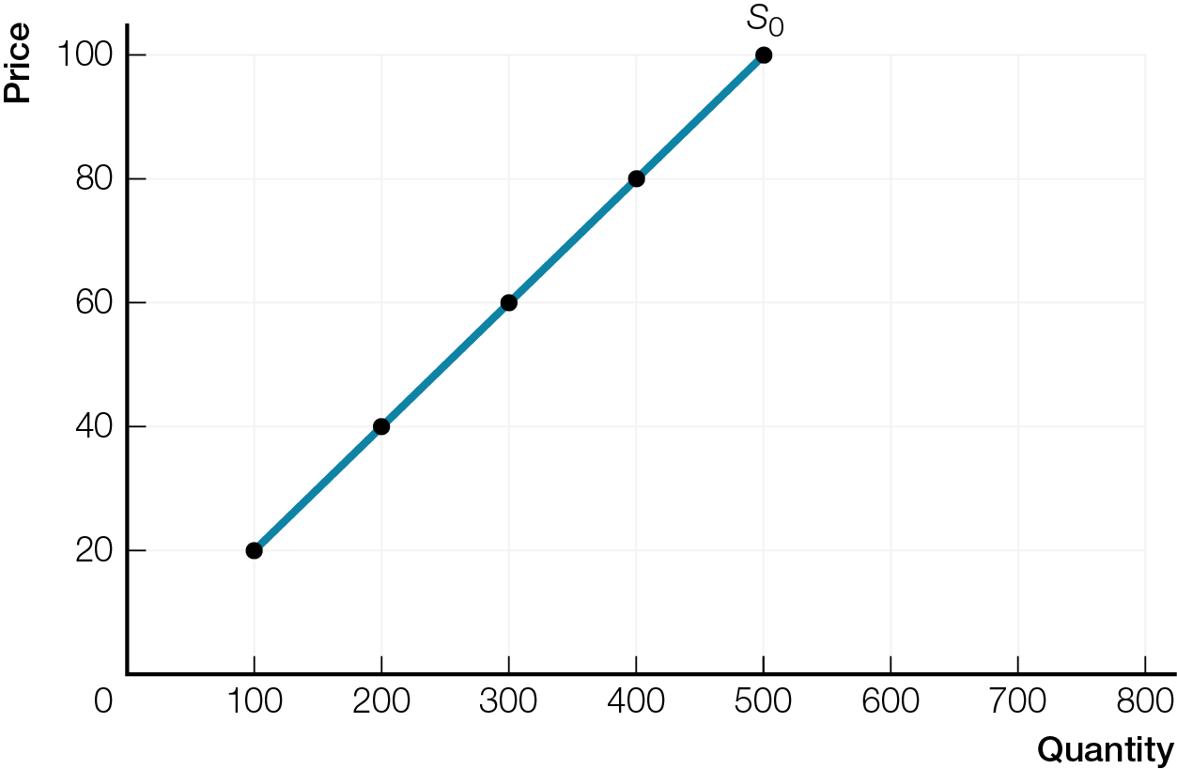
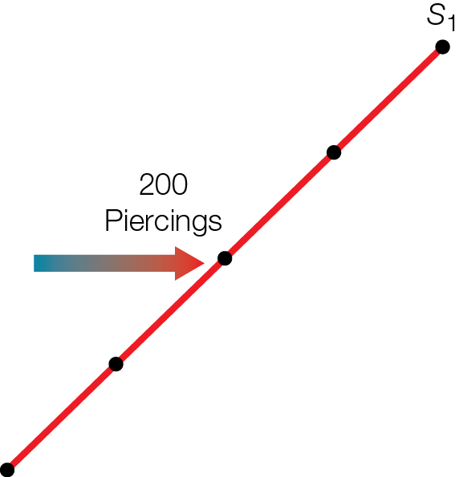
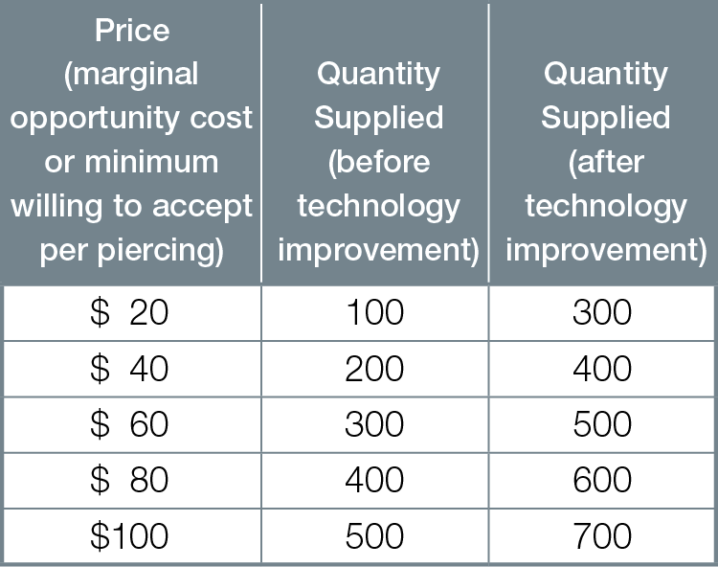
Increase in Market Supply of Piercings

Slide 22
Supply changes with changes in technology, environment, prices of inputs, prices of related products or services produced, expected future prices, number of businesses. For example, supply increases with:
improvement in technology

Slide 23
Increase in Market Supply of Piercings (Marginal Cost Reading)

Slide 24
Supply changes with changes in technology, environment, prices of inputs, prices of related products or services produced, expected future prices, number of businesses. For example, supply increases with:
improvement in technology
environmental change helping production
fall in price of an input
fall in price of a related product or service
fall in expected future price
increase in number of businesses

Slide 25
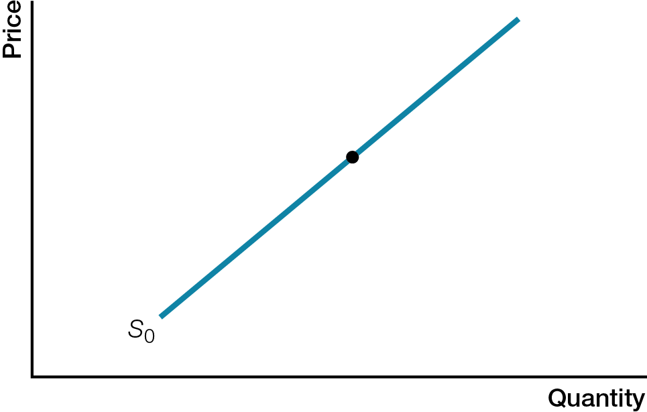
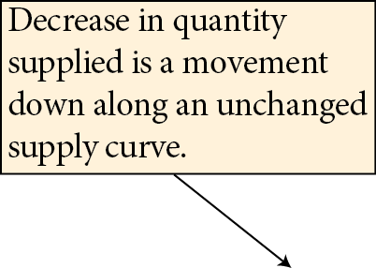

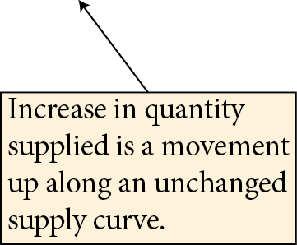

Change in Quantity Supplied
Fig. 3.8a

Slide 26
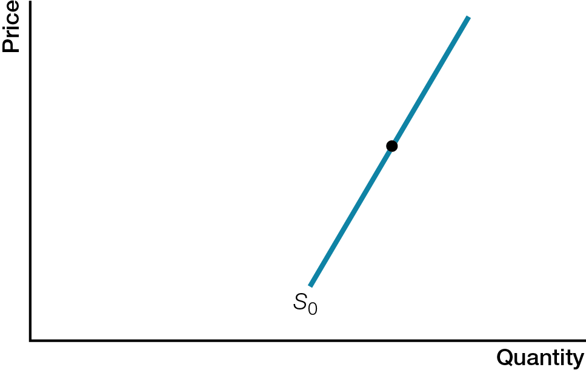
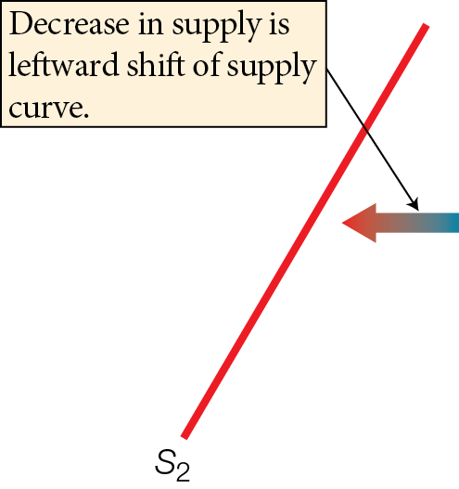
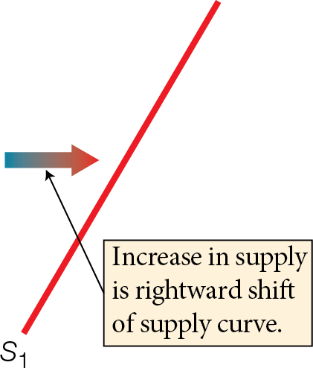
Change in Supply
Fig. 3.8b

Slide 27
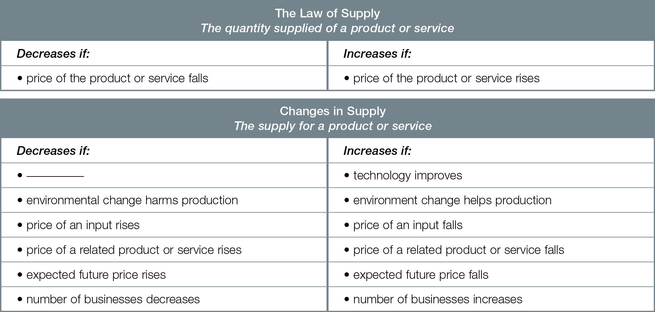
Law of Supply and Changes in Supply

