Slide 1
Tutorial 02: Swap Chain
Draw
Legends
???
???
???
+ ???
???
Timeout
Sends ??? to
Semaphore
Queue
Add ??? to Queue
Command
UINT64_MAX
Start
End
QueueSubmit
QueuePresent
Image
Image Available
wait
Rendering Finished
wait
Command Buffers[image_index]
Image
AcquireNextImage
Rendering Finished
signal
SwapChain
SwapChain
Graphics Queue
Present Queue
+ Submit
+ Present
Image Available
Command buffers
Rendering Finished
signal
End
End
STAGE_TRANSFER
Image
signal
SwapChain

Slide 2
Subset Hierarchy
Physical Device
QueueFamily
Queue
CommandPool
CommandBuffer
Instance
Device
Swap Chain
Render Pass
Image
Image View

Slide 3
Tutorial 03: First Triangle
Graphics Engine Hierarchy
Legends
???
Object(ptr)
Direct Subset
Reference
*otherwise noted, is a direct subset from ‘Device’
ex) Render Pass
Instance
Presentation Surface
Physical Device
(Physcial) Device is selected by checking:
Supporting required extensions
Vulkan version
At least one queue family supporting:
Graphics queue family
At least one queue supporting present(SurfaceSupport)
Device
Graphics Queue Family
Present Queue Family
Swap Chain
Queue
Queue
Render Pass
Image
Command Pool
Image View
Command Buffer
Pipeline
Frame Buffer

Slide 4
RenderPass
RenderPass
Image + layout
selected depending
on layout
subpass
image view
FrameBuffer(s)
load
subpass
store
*Framebuffer image count needs to
match render pass attachment count
subpass
* RenderPass and SubPass have their own attachments.
* SubPass contains Layouts.

Slide 5
Command Pool (Outdated)
Image_count만큼 VkImage만듦
Swapchain에서 image handle을 가져와 저장
Queue
Image_subresource = 이미지 설정 (밈맵, 레이어 등등)
Size : image_count
Present Queue Command Pool
allocate
Present Queue Command Buffers
VK_COMMAND_BUFFER_USAGE_SIMULTANEOUS_USE_BIT
Primary, Secondary Command
Resource Transitions
Image usage = layout
If usage need to change, it needs to shift to other layout
Default images are generally in undefined layout
But swap-chain-created images have VK_IMAGE_LAYOUT_PRESENT_SOURCE_KHR layouts
To transit from one layout to other, image memory barriers are used
Present
Clear
Present

Slide 6
Queue
Queue
Queue
signal
present
Swap Chain(s)
Semaphore
Semaphore
Semaphore

Slide 7
Queue
Queue
Queue
Semaphore
COMMAND
signal
signal
submit
Queue
P r o c e s s
Queue
present
Semaphore
Semaphore
Semaphore
acquire
Mask
Mask
Mask
IMAGE
Timeout happens if non images are available
Semaphore references.

Slide 8
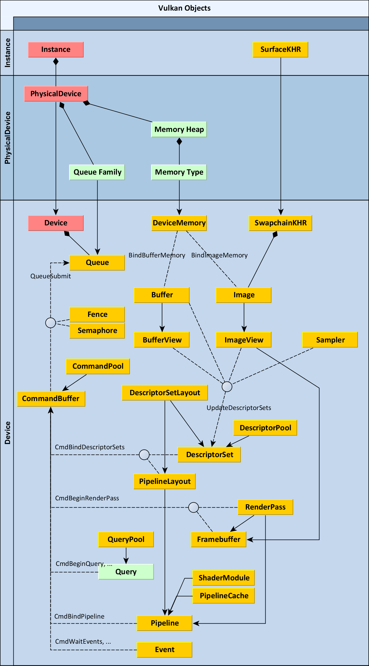

Slide 9
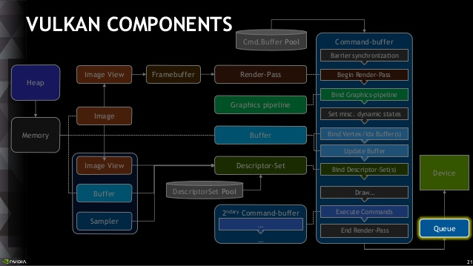

Slide 10
IMAGE
At least 2
IMAGE
return image
Screen
Draw
Unused

Slide 11
IMAGE
At least 2
IMAGE
FIFO
return image
Screen
Draw
Unused

Slide 12
IMAGE
At least 3 (or else there’s no reason of using mailbox)
IMAGE
Mailbox
IMAGE
return image
Screen
Draw
Unused

