Slide 1
PDF Query tool
Cabdul Ciise

Slide 2
AGENDA
Introduction
Project Timeline
High Level Architecture
BE/FE Implementation
Persistence Layer
Demo

Slide 3
INTRODUCTION
With the growth and adoption of AI and ML around us, I was interested to take on a project in this space.
This project is focused on creating an MVP: an app that takes in a collection of PDFs and coupled with a LLM, provide a chat-like interaction for querying documents. Essentially, ChatGPT for your PDFs. The bigger goal after this project is to take what I’ve learned and wrap this question answering bot in something like an Azure function so we can provide our customers with an easy to integrate solution….unless there’s something out there that does it already cheaply…
Notes:
With everything AI and ML going on around us, I was interested to do a project like this.
AI/ML space is growing and evolving quickly. I am realizing since having started this project, my project has quickly become absolute. ChatGPT now integrated image and file-based querying.
I spent a lot of time reading articles on how to go about this and then I discovered LangChain and it made the project doable.
LangChain is a framework for developing applications powered by language models.

Slide 4
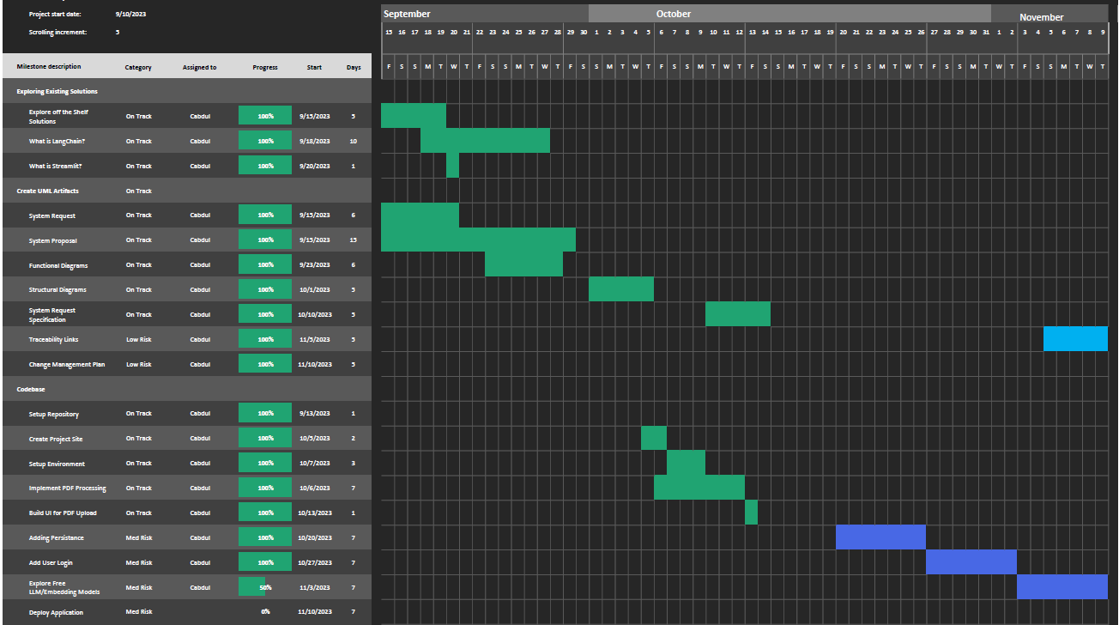
Notes:
I was able to follow the timeline and got caught on some of the development steps and was not able to complete the last two items on my list of milestones to hit.
Those items to finish still are:
Exploring free LLM/Embedding Models
Setting up CI/CD pipeline and deploying the application

Slide 5
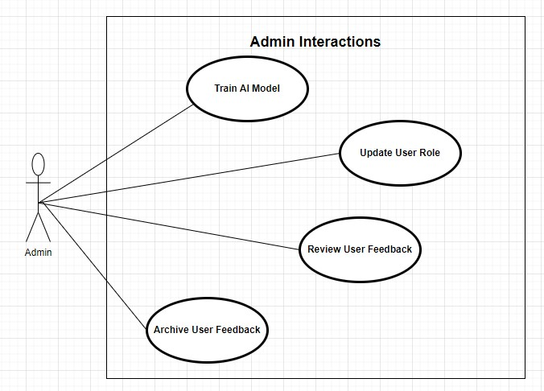
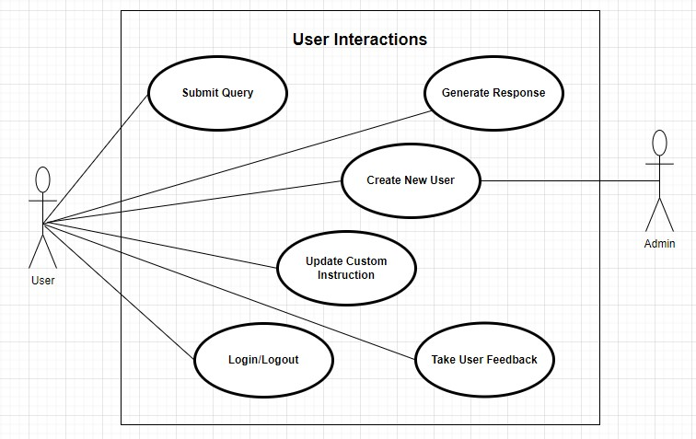
Use Case diagrams

Slide 6
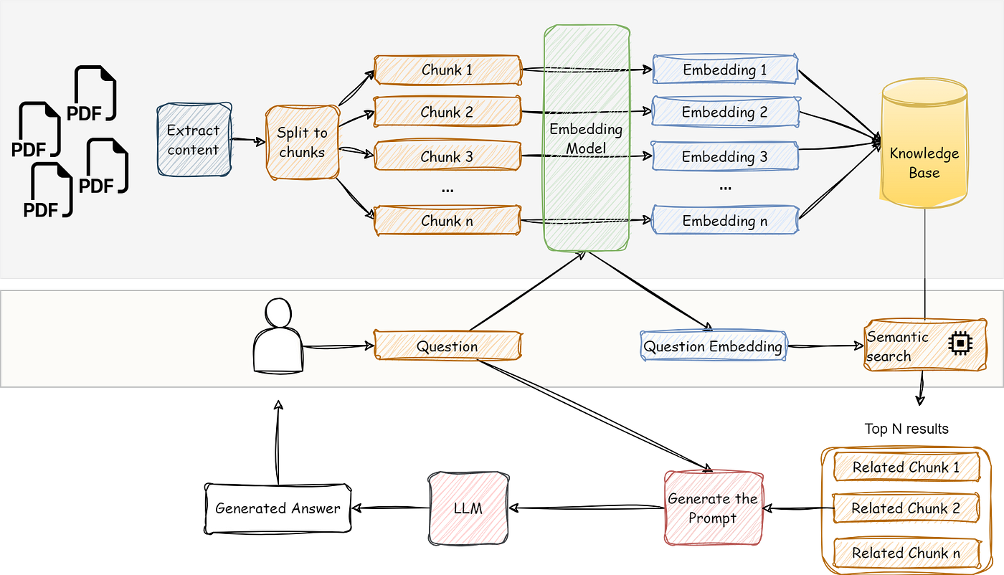
High Level architecture
Source
Notes:
There are quiet a bit of libraries that already
There are free embedding models and LLM models that run locally on your machine
Tradeoffs is that locally running models are slower
OpenAI models are expensive
This process is simplified with LangChain

Slide 7
BE Python/Flask implementation
Using the following libraries
LangChain – framework for apps using language models
Python-dotenv – virtual environment
Pypdf2 – pdf reader
Chromdb – vector store
Bcrypt – password encryption
Sqlalchemy – database ORM
Flask – web server for API support
Notes:
With this project, I went outside of my comfort zone and chose to do the BE in Python with Flask as the web framework to serve my API.
I am very new to python, and I have found that AI/ML field is saturated with use of python, so I jumped on the band wagon.
I built the FE with Vue.

Slide 8
FE Vue implementation
Using following dependencies
Vite – FE local development server
Vue – JS framework for building UI, like react and angular
Vue-Router – FE page routing
Axios – for making API calls
Fetch – for making streaming API call responses (axios does not support streaming from client side)
Moment – formatting datetime
PrimeVue – UI components (Theme, Datatable, Dialogs, Buttons, InputTexts, TextArea)
PrimeIcons – UI icons

Slide 9
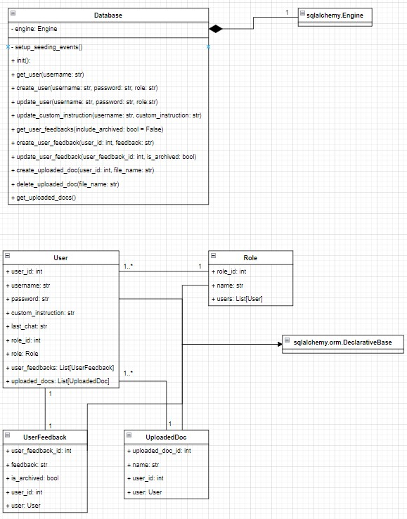
Persistence (Sqlite) Class Diagram
Notes:
Decided to use SQLite for our database.
It is a lightweight file based relational sql database that is on disk.
Chose to work with SQLite because we don’t need to host the database

Slide 10
Persistence ChromaDB
ChromaDB python library creates a SQLite database on instantiation if one does not exist.
This is where the knowledge base lives – the vector embeddings.
Semantic search is run against this knowledge base to get top N matches for user prompts.
My fav motto is, “If it ain’t broke, don’t fix it”, but with more time, I would have chosen to combine both ChromaDB’s database with my application’s SQLite database.

Slide 11
Demo time

Slide 12
Future Features
Setup CI/CD pipeline for the app and deploy it.
Explore free LLMs and embedding models which will allow me to put this site up for “free”.
Combine both ChromaDb’s and my applications SQLite databases, there’s no need to have two separate ones.
Update app to use third part authentication like Google Auth, etc. Current implementation is not the most secure approach.

Slide 13
You can run this app
The app can only be run locally (for now).
I made the GitHub repository public, so anyone can clone the repo and run the app locally.
I only ask if you do use the app, let me know what you think about it (over email).
Just follow the instructions on the source README.

Slide 14
Reflection
I am definitely happy with the “final” product.
01
There are more features I would like to add as discussed.
02
Certain implementation aspects took longer than expected since I was not familiar with Python/Flask prior.
03
I would do code reviews as well as add unit tests.
04
Add more FE/BE user input validations.
05
Notes:
Am I going to use this to study for my finals, absolutely yes!

Slide 15
Any questions

