Slide 1
PDF Query tool
Cabdul Ciise

Slide 2
AGENDA
Introduction
High Level Architecture
Project Timeline
Short Demo

Slide 3
INTRODUCTION
With the growth and adoption of AI and ML around us, I was interested to take on a project in this space.
This project is focused on creating an MVP: an app that takes in a collection of PDFs and coupled with a LLM, provide a chat-like interaction for querying documents. Essentially, ChatGPT for your PDFs. The bigger goal after this project is to take what I’ve learned and wrap this question answering bot in something like an Azure function so we can provide our customers with an easy to integrate solution….unless there’s something out there that does it already cheaply…
Notes:
With everything AI and ML going on around us, I was interested to do a project like this.
AI/ML space is growing and evolving quickly. I am realizing since having started this project, my project has quickly become absolute. ChatGPT now integrated image and file-based querying.
I spent a lot of time reading articles on how to go about this and then I discovered LangChain and it made the project doable.
LangChain is a framework for developing applications powered by language models.

Slide 4
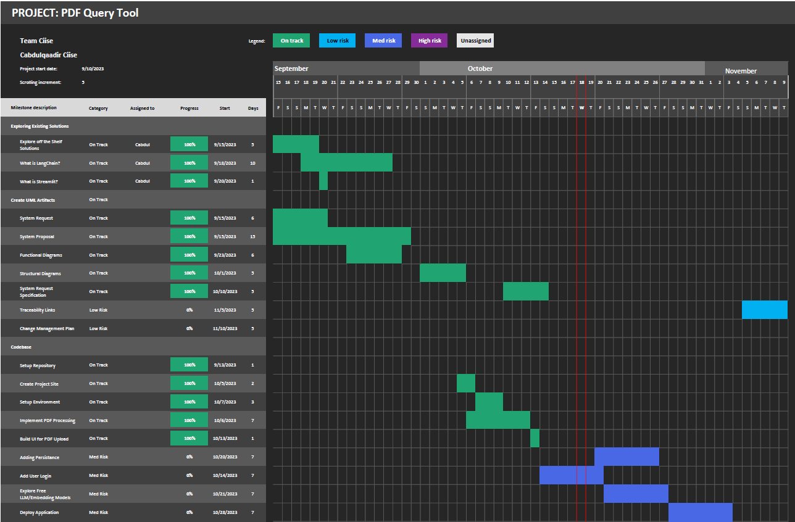
Notes:
With everything AI and ML going on around us, I was interested to do a project like this.
AI/ML space is growing and evolving quickly. I am realizing since having started this project, my project has quickly become absolute. ChatGPT now integrated image and file-based querying.
I spent a lot of time reading articles on how to go about this and then I discovered LangChain and it made the project doable.
LangChain is a framework for developing applications powered by language models.

Slide 5
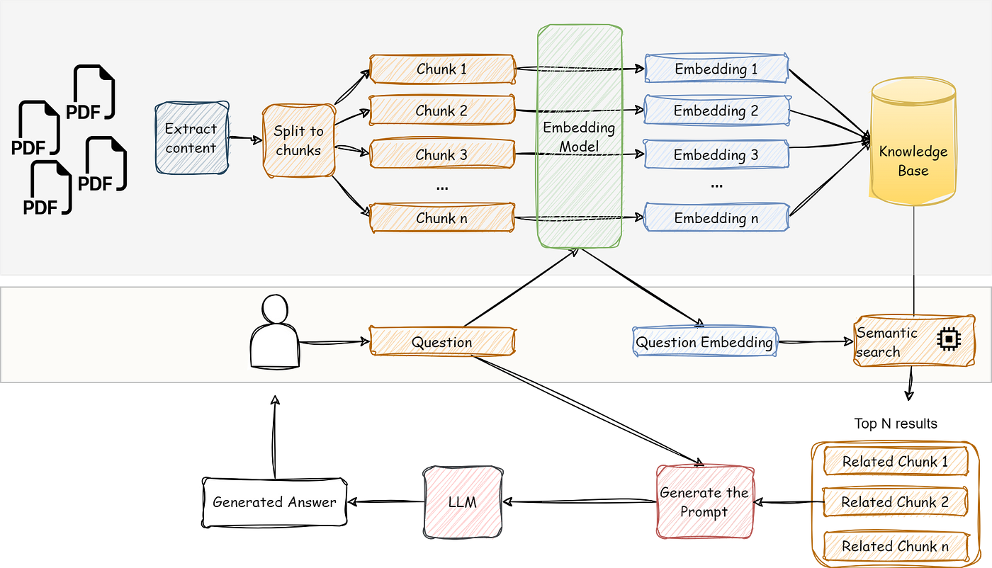
High Level architecture
Source
Notes:
There are quiet a bit of libraries that already
There are free embedding models and LLM models that run locally on your machine
Tradeoffs is that locally running models are slower
OpenAI models are expensive
This process is simplified with LangChain

Slide 6
Python implementation
Using the following libraries
LangChain – framework for apps using language models
Streamlit - UI
Python-dotenv – virtual environment
Pypdf2 – pdf reader
Faiss-cpu – vector store
Notes:
1. I am very new to python, and I have found that AI/ML field is saturated with use of python, so I jumped on the band wagon.

Slide 7
Demo time

Slide 8
Any questions

