Slide 1
PDF Query tool
Cabdul Ciise

Slide 2
AGENDA
Introduction
BE Implementation/Testing Frameworks
FE Implementation/Testing Frameworks
Demo
Questions

Slide 3
INTRODUCTION
With the growth and adoption of LLM around us, I was interested to take on a project in this space.
This project is focused on creating an app that takes in a collection of text-based documents and coupled with a LLM, provide a chat-like interaction for querying documents. Essentially, ChatGPT for your private documents.
Notes:
With everything AI and ML going on around us, I was interested to do a project like this.
AI/ML space is growing and evolving quickly. I am realizing since having started this project, my project has quickly become absolute. ChatGPT now integrated image and file-based querying.
I spent a lot of time reading articles on how to go about this and then I discovered LangChain and it made the project doable.
LangChain is a framework for developing applications powered by language models.

Slide 4
BE ASP.net CORE WEB API implementation
Using the following libraries
LangChain – does the heavy lifting with connecting w/ OpenAI
Authentication (Jwt Tokens)
Authorization (Admin vs a Basic user)
Code first w/ Entity Framework (SQLite DB)
Dependency Injection
Nunit and Moq for integration and e2e testing
Swagger for Documentation
Notes:
With this project, I went outside of my comfort zone and chose to do the BE in Python with Flask as the web framework to serve my API.
I am very new to python, and I have found that AI/ML field is saturated with use of python, so I jumped on the band wagon.
I built the FE with Vue.

Slide 5
FE Vue implementation
Using following dependencies
Vite – FE local development server
Vue – JS framework for building UI, like react and angular
Vue-Router – FE page routing
Axios – for making API calls
PrimeVue – UI components (Theme, Datatable, Dialogs, Buttons, InputTexts, TextArea)
PrimeIcons – UI icons
Selenium and Cucumber – E2e testing
ESLint and Prettier – Static analyzer and formatter

Slide 6
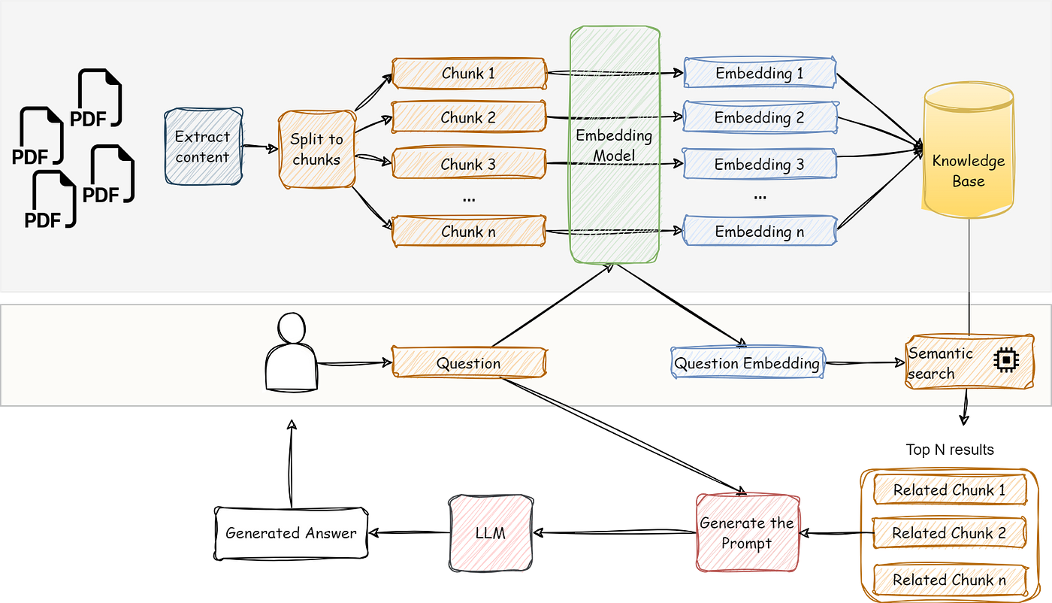
Document processing High Level architecture
Source
Notes:
There are quiet a bit of libraries that already
There are free embedding models and LLM models that run locally on your machine
Tradeoffs is that locally running models are slower
OpenAI models are expensive
This process is simplified with LangChain

Slide 7
Demo time

Slide 8
Any questions

