Slide 1
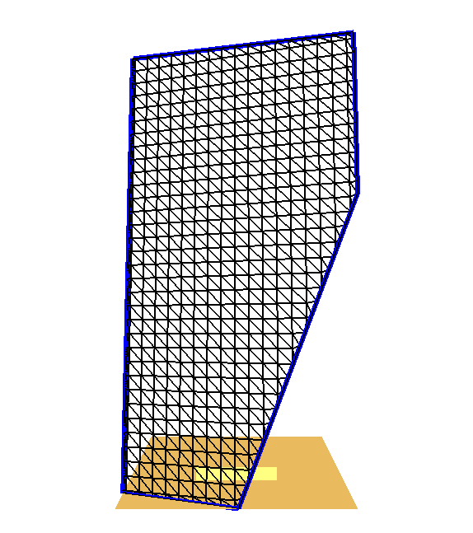
t
v
p₀
s
p_{i}
p₁
u

