Slide 1



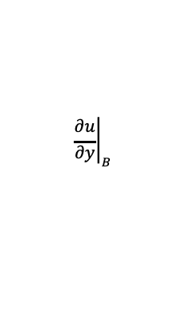



EP
EP
GAS
Boundary
E
$$u_{E}$$
RC
B
SOLID
RC
i,j,k
UB
$$u_{UB}$$
$$∆_{RC}$$
$$\frac{∆y}{2}$$
F
$$u_{F}$$
IB
B
$${\left.\frac{∂u}{∂y}\right|}_{B}$$
$$∆_{IB}$$
IB

