Slide 1
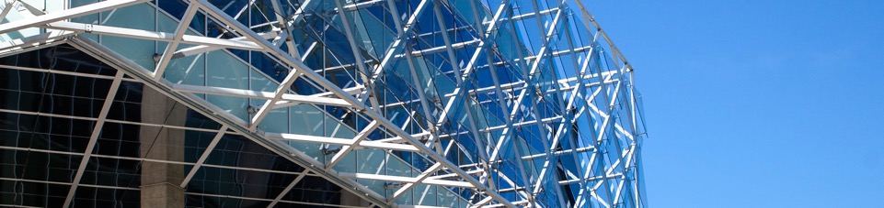
Line detection in an image
Tadas Ivanovas IFM-9/1

Slide 2
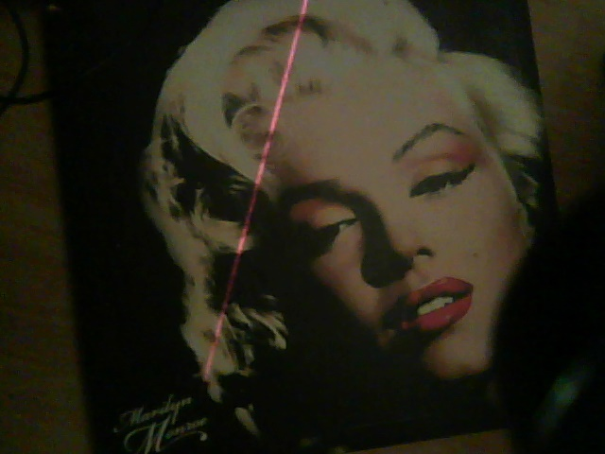
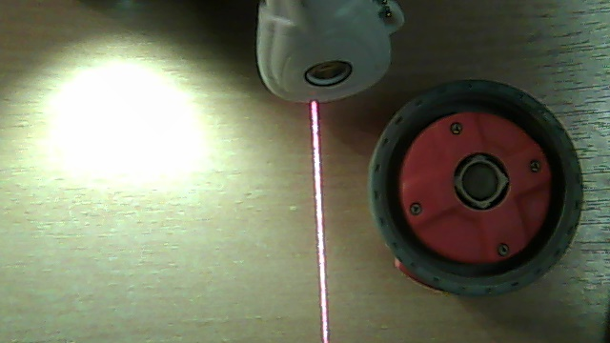
Aim and objectives
The aim of this project is to detect a red laser line in complex image. Since laser line usually has a high frequency in an image we first filter out low frequencies, then apply simple threshold and perform Hough Transform to detect a line.

Slide 3
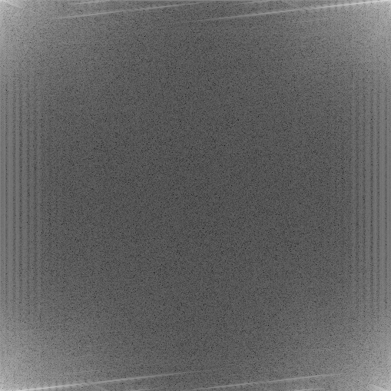
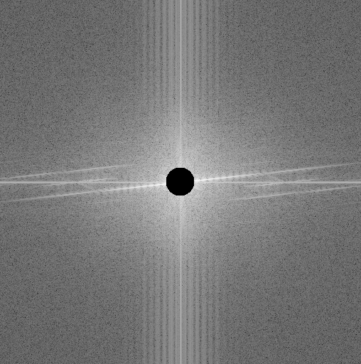
Fourier Transform
Since simple DFT takes too much time to compute, FFT(Cooley-Tukey) algorithm was used. Calculated spectrum then filtered with High Pass filter.
Because Cooley-Tukey algorithm has a limitation, that size of the signal has to be a power of 2, we simply resize the image to 512x512

Slide 4
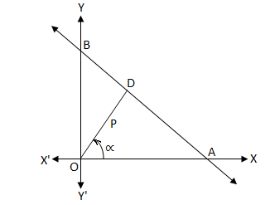

Line in Normal Form
Straight line can also be defined by angle(α) and radius (P). That is called Normal Line Form.
$$x\cos{α+y}\sin{α=p}$$

Slide 5
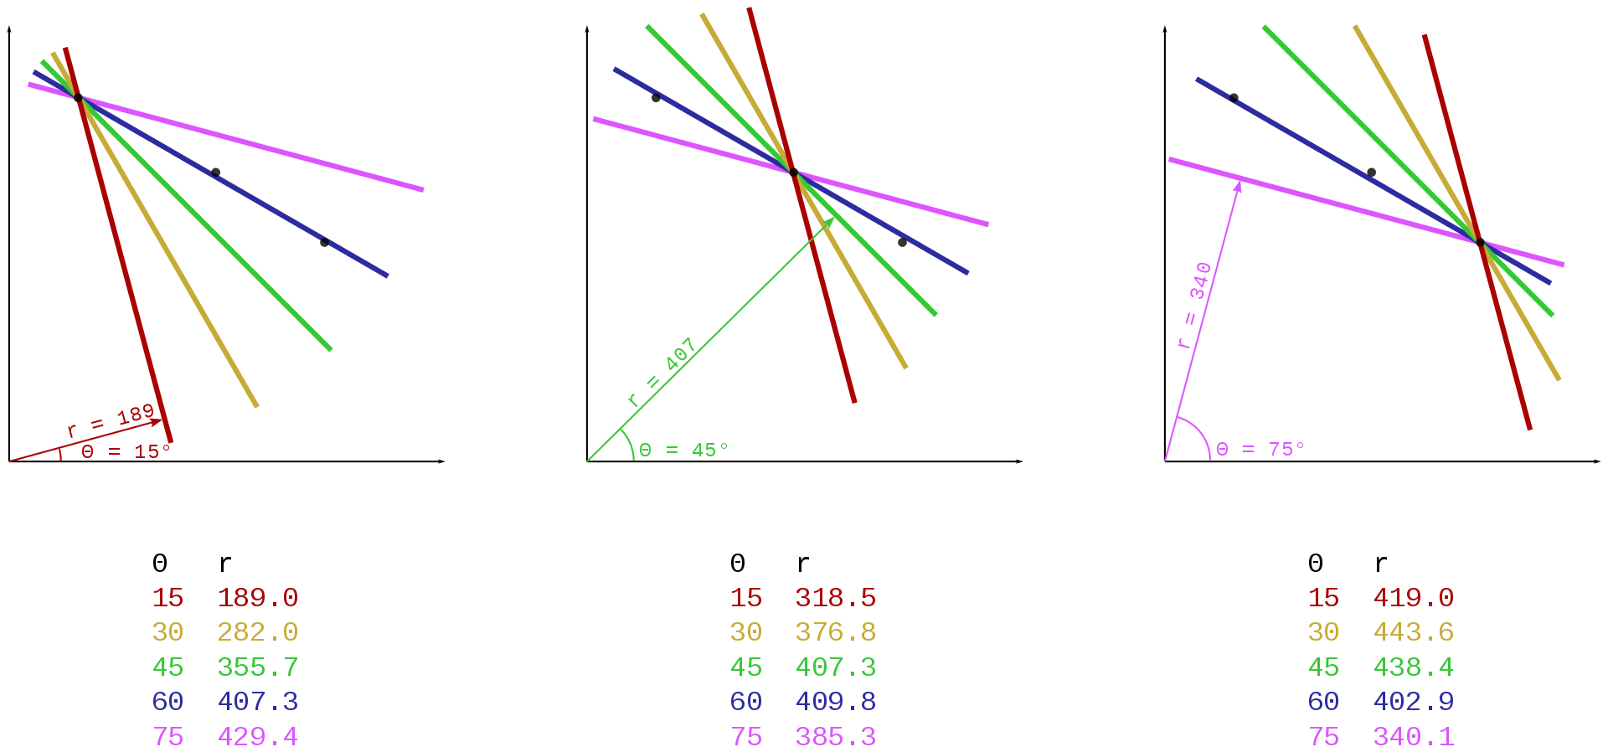
Hough Transform
Hough Transform is a feature extraction technique used in image processing. All the candidates of a line are obtained as local maxima in so called parameter space which is constructed by an algorithm.

Slide 6
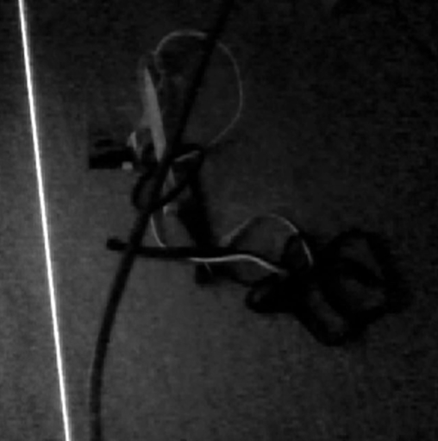
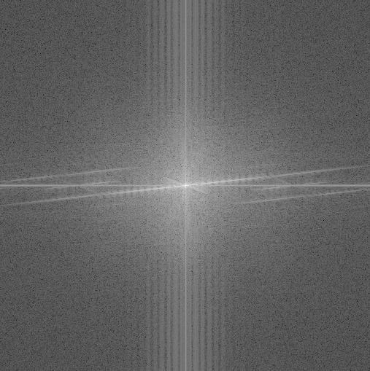
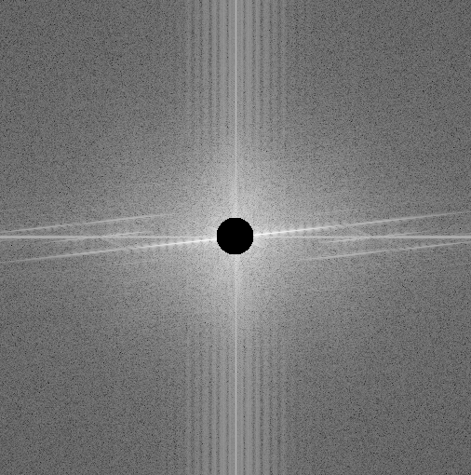
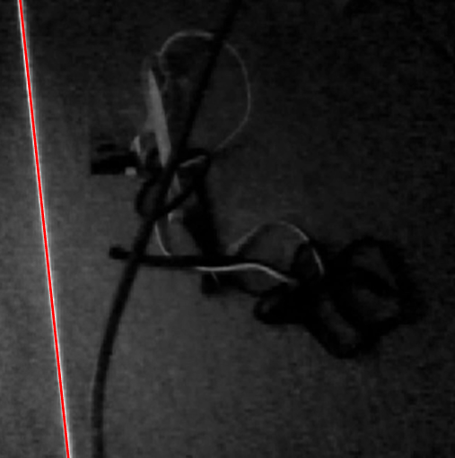
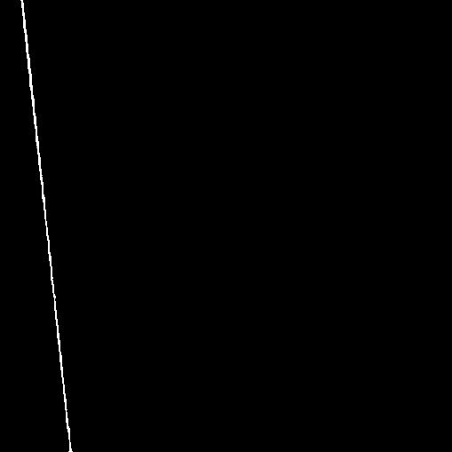
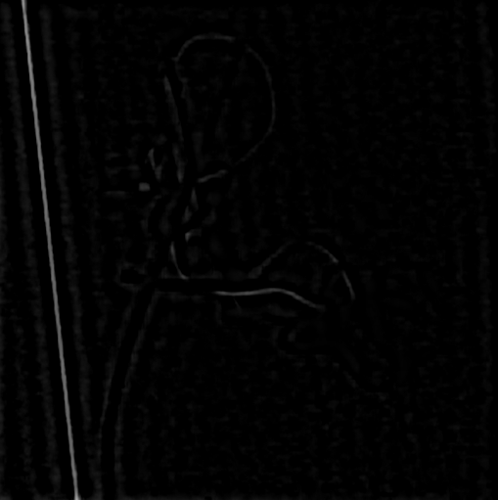
Sequence
FFT
Filter
IFFT
Hough Transform
Threshold

Slide 7
Thank you for your attention

