Slide 1
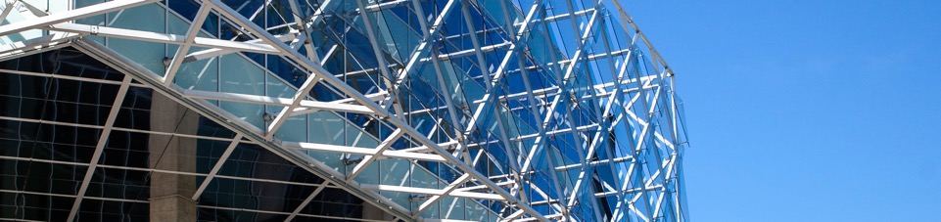
Line detection in an image
Tadas Ivanovas IFM-9/1

Slide 2
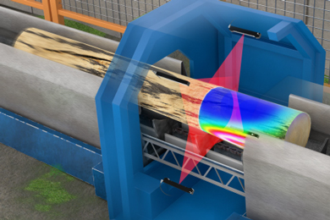
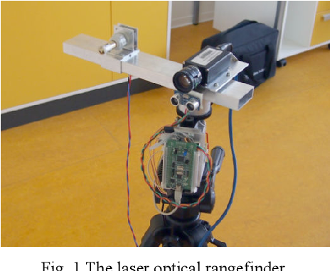
Introduction
Laser line detection is widely used in robotics and industry.
Applications like 3D object reconstruction, mobile robot autonomous mapping, obstacle detection.
Laser line detection is an essential problem in robotics and automation.

Slide 3
Problems
The most popular laser line detection algorithms require static thresholds that must be set according to environment, for example, light intensity.
These algorithms are robust only on simple/static background.
Mainly based on color segmentation.
Do not solve oversaturation problem.

Slide 4
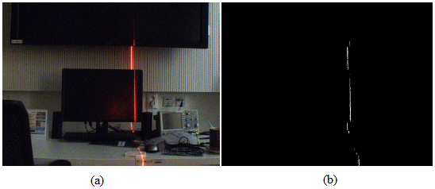

Example of laser line detection based on color segmentation
$$I_{L}=I\left({R>T}_{R}\right) \& I\left({G<T}_{G}\right) \& I({B<T}_{B})$$
I_{L} – filtered laser line pixels.
T_{R}, T_{G} and T_{B} appropriate color channels thresholds.

Slide 5
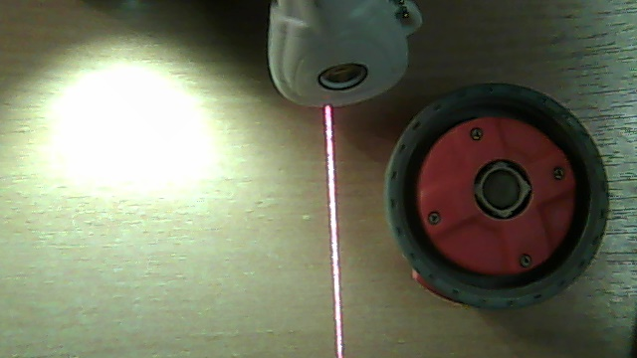
Aim and objectives
The aim of this project is to detect a red laser line in complex image.
Find the best way to filter out low frequencies in the image.
Use as few static thresholds as possible.

Slide 6



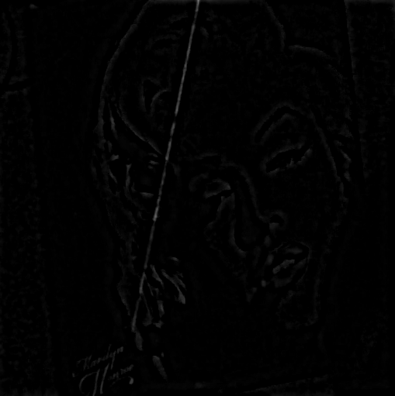
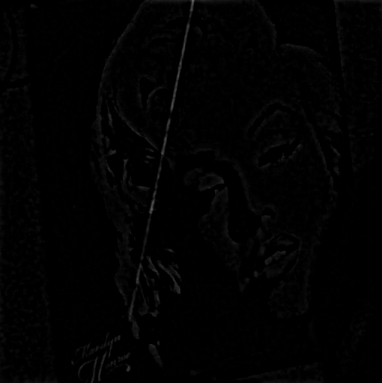
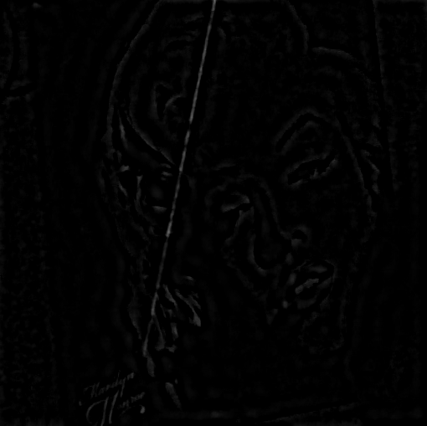
High Pass filters
Butterworth filter
Gaussian filter
Ideal filter

Slide 7
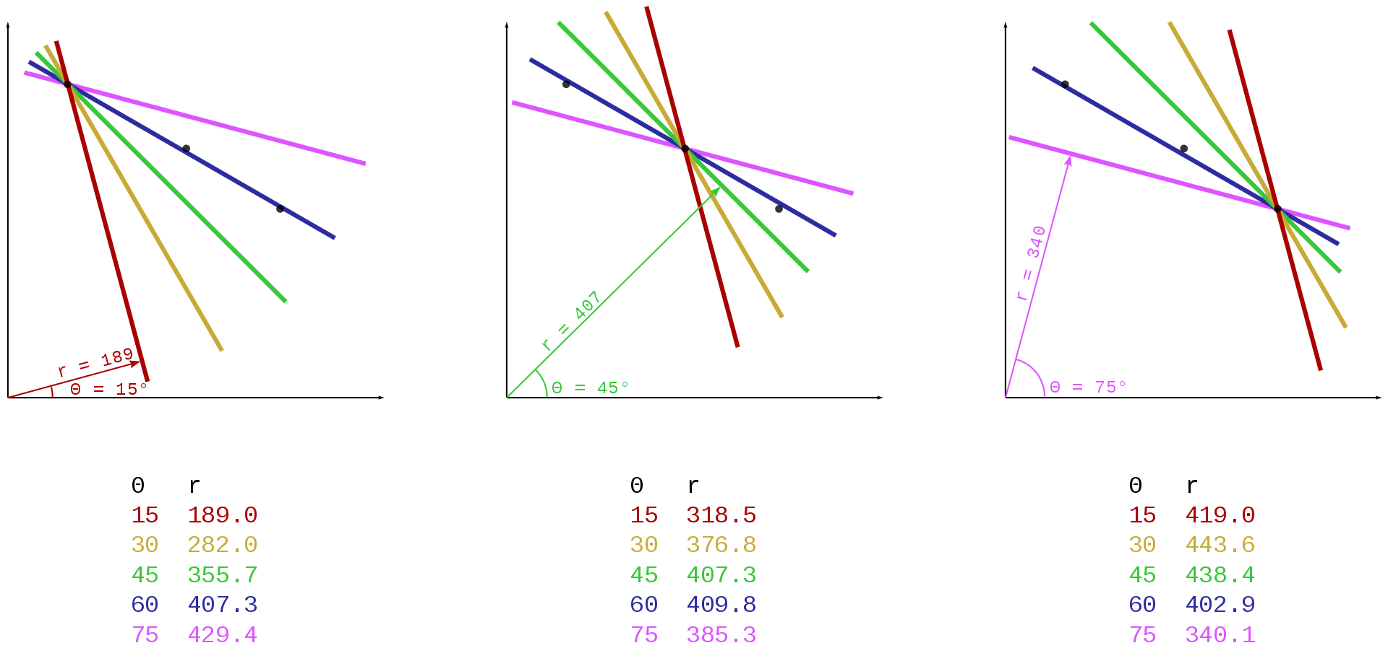
Hough Transform
Hough Transform is a feature extraction technique used in image processing. All the candidates of a line are obtained as local maxima in so called parameter space which is constructed by an algorithm.

Slide 8
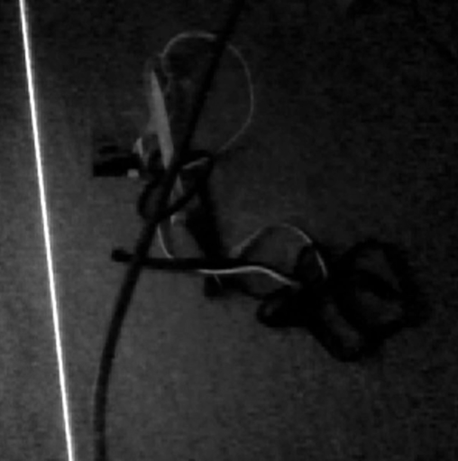
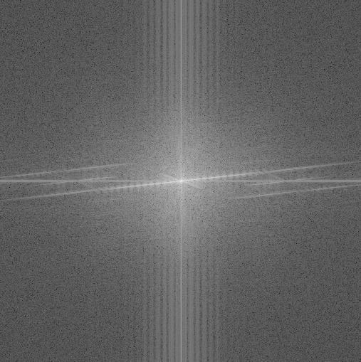
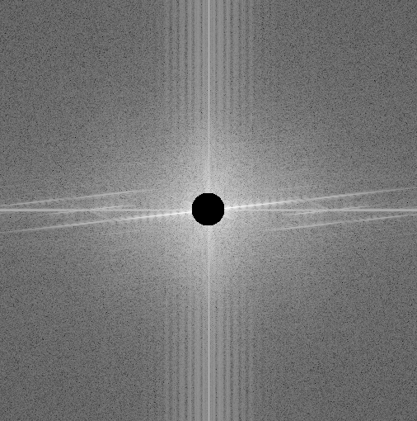
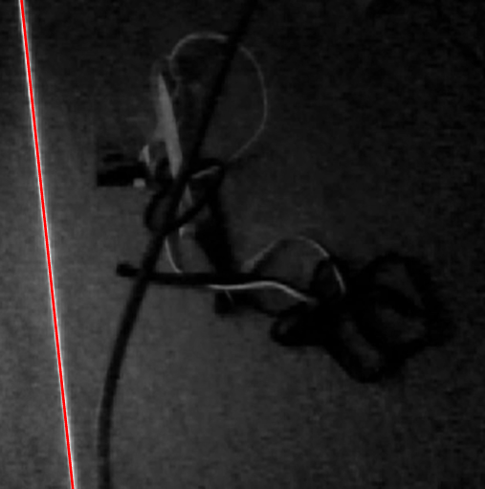
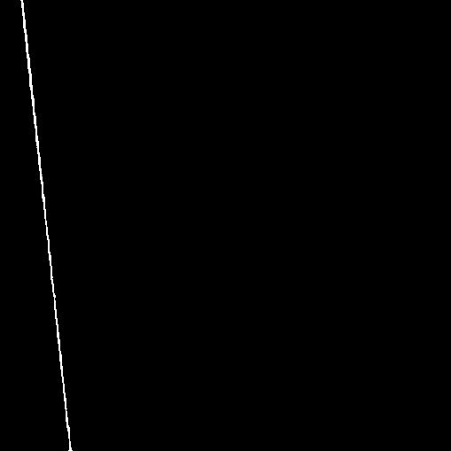
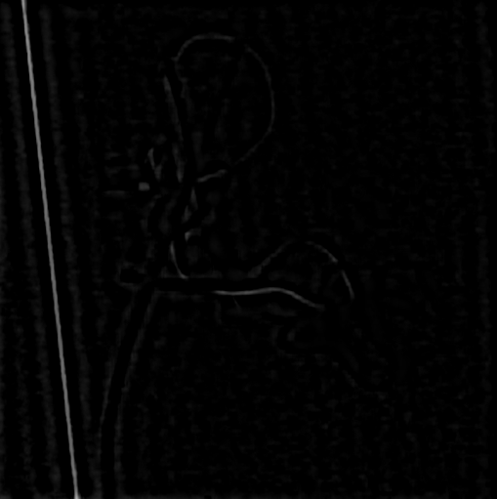
Implementation
FFT
Filter
IFFT
Hough Transform
Threshold

Slide 9
Conclusions
Frequency filtering solves oversaturation problem.
Gaussian high pass filter outputs the sharper edges which makes further processing easier.
Hough Transform is not suitable if the laser line is curved.
Static thresholds were not avoided.

Slide 10
Thank you for your attention

