Slide 1
Progresses on Dimension project
Hanyang
May 16, 2019

Slide 2
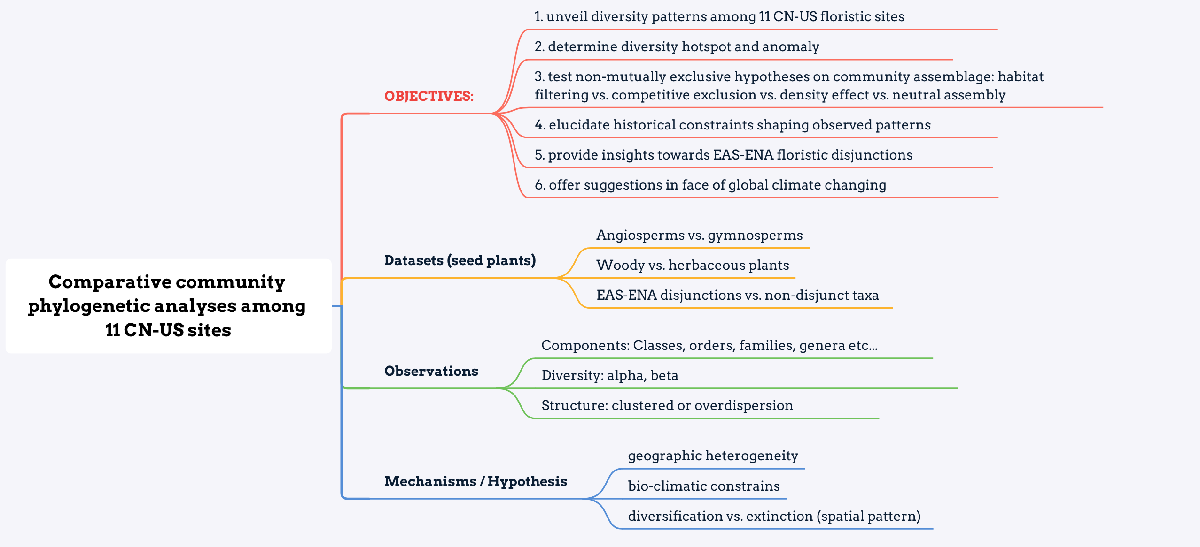
1. Community phylogeny
Notes:
conception of anomaly and analysis
NRI 和 NTI 极性不同时 应该倾向于哪一个结果
to do: more bio-climatic factors
群落年龄对于群落结构的影响 检索文献 2013 PNAS
对于不同的组分产生的PD进行PCA
对于beta PD，可以解决什么样的科学问题

Slide 3
1. Community phylogeny
Categories | ntaxa | PD | SES-PD | NRI | NTI
CN | 3667 | 66034.38 | -2.71 | -0.58 | 2.08
US | 2194 | 44617.83 | -6.40 | 1.28 | 4.94
Wood | 1845 | 38071.57 | -9.12 | -8.43 | 5.31
Herb | 3743 | 55541.59 | -22.04 | 16.08 | 12.36
Angiosperms | 5532 | 86493.48 | -12.26 | 72.62 | 3.43
Gymnosperms | 76 | 2389.24 | -8.91 | 4.46 | 7.80
Red: significant over-dispersion
Green: significant clustering
Notes:
write down results
number of gym is too small
NRI与wood相悖

Slide 4
1. Community phylogeny

Slide 5
1. Community phylogeny

Slide 6
1. Community phylogeny

Slide 7
1. Community phylogeny -α diversity
Country | Site | Area (km²) | Elevation-max (m) | MAT (℃) | MAP (mm) | ntaxa | SD | SES-PDs | SES-PDt | NRIs | NRIt | NTIs | NTIt
CN | Changbai | 1907.81 | 2744 | 2.13 | 741 | 1140 | 150.92 | -8.80 | -8.92 | 1.46 | 1.10 | 4.93 | 5.50
CN | Dongling | 60.00 | 2303 | 7.11 | 493 | 773 | 188.80 | -7.16 | -7.58 | -0.26 | -0.41 | 5.02 | 5.81
CN | Shennong | 704.67 | 3106 | 12.94 | 1156 | 1559 | 237.73 | -0.14 | -1.57 | -0.71 | -0.80 | 1.26 | 2.44
CN | Tianmu | 43 | 1505 | 12.92 | 1487 | 1188 | 315.86 | 0.59 | -0.63 | 1.23 | 0.80 | 0.83 | 1.90
CN | Gutian | 81.07 | 1258 | 15.91 | 1963.7 | 1209 | 275.07 | 1.87 | 0.56 | -0.75 | -0.89 | -1.05 | 0.17
US | White_Mountain | 15.66 | 232 | 4.8 | 1300 | 254 | 92.33 | -1.43 | -3.49 | -2.92 | -2.64 | 1.66 | 2.79
US | Havard | 49.00 | 351 | 7.2 | 1120 | 897 | 230.48 | -3.38 | -6.34 | -1.26 | -0.35 | 2.53 | 4.82
US | Mountain_Lake | 12.60 | 1160 | 9.8 | 1045 | 381 | 150.37 | -1.16 | -3.61 | -1.09 | -0.69 | 2.45 | 3.60
US | Coweeta | 16.26 | 914 | 11.9 | 1754 | 681 | 244.20 | -2.30 | -5.35 | 1.55 | 2.05 | 2.39 | 4.18
US | Talladega | 53.00 | 135 | 17.1 | 1425 | 533 | 134.25 | -0.02 | -2.89 | 0.70 | 1.17 | 0.32 | 1.94
US | Ordway | 38.44 | 45 | 20.3 | 1313 | 749 | 205.26 | -2.36 | -5.23 | 0.81 | 1.41 | 1.93 | 4.28
Notes:
放到最后

Slide 8
1. Community phylogeny -α diversity
Notes:
R包重新制作

Slide 9
1. Community phylogeny -α diversity
diversity
Country | Site | ntaxa | SES-PDs | SES-PDt | NRIs | NRIt | NTIs | NTIt
CN | Changbai | 1140 | -8.80 | -8.92 | 1.46 | 1.10 | 4.93 | 5.50
CN | Dongling | 773 | -7.16 | -7.58 | -0.26 | -0.41 | 5.02 | 5.81
CN | Shennong | 1559 | -0.14 | -1.57 | -0.71 | -0.80 | 1.26 | 2.44
CN | Tianmu | 1188 | 0.59 | -0.63 | 1.23 | 0.80 | 0.83 | 1.90
CN | Gutian | 1209 | 1.87 | 0.56 | -0.75 | -0.89 | -1.05 | 0.17
US | White_Mountain | 254 | -1.43 | -3.49 | -2.92 | -2.64 | 1.66 | 2.79
US | Havard | 897 | -3.38 | -6.34 | -1.26 | -0.35 | 2.53 | 4.82
US | Mountain_Lake | 381 | -1.16 | -3.61 | -1.09 | -0.69 | 2.45 | 3.60
US | Coweeta | 681 | -2.30 | -5.35 | 1.55 | 2.05 | 2.39 | 4.18
US | Talladega | 533 | -0.02 | -2.89 | 0.70 | 1.17 | 0.32 | 1.94
US | Ordway | 749 | -2.36 | -5.23 | 0.81 | 1.41 | 1.93 | 4.28
Red: significant over-dispersion Green: significant clustering

Slide 10
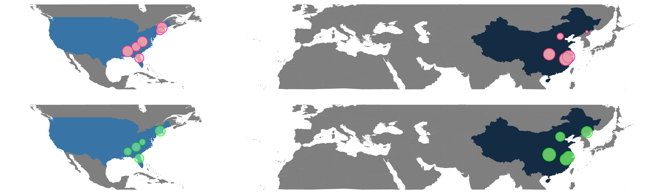
1. Community phylogeny -α diversity
SES-PD
Species diversity
Notes:
white mountain species diversity vs. ses-pd anomaly
CBS
sd

Slide 11
1. Community phylogeny -α diversity
Notes:
有没有必要比较s和t的区别。

Slide 12
1. Community phylogeny -α diversity

Slide 13
1. Community phylogeny -α diversity

Slide 14
1. Community phylogeny -α diversity

Slide 15
1. Community phylogeny -α diversity

Slide 16
1. Community phylogeny -β diversity
Phylogenetic community dissimilarity (PCD): pairwise differences between communities
PCDc:
a nonphylogenetic component that reflects nonshared species between communities
PCDp:
a phylogenetic component that reflects the evolutionary relationships among nonshared species
UniFrac:
a phylogenetic beta diversity metric of the the unique (non-shared) fraction of total phylogenetic diversity (branch-length) between two communities.
PCD is partitioned into a nonphylogenetic component that reflects shared species between communities (PCDc) and a phylogenetic component that reflects the evolutionary relationships among nonshared species (PCDp

Slide 17
1. Community phylogeny -β diversity
PCD among 5 CN sites
Site | Changbai | Dongling | Shennong | Tianmu | Gutian
Changbai |  | 0.8609 | 1.8255 | 1.5423 | 1.7929
Dongling | 0.8609 |  | 1.6250 | 1.4390 | 1.6741
Shennong | 1.8255 | 1.6250 |  | 0.9382 | 0.9681
Tianmu | 1.5423 | 1.4390 | 0.9382 |  | 0.6275
Gutian | 1.7929 | 1.6741 | 0.9681 | 0.6275
Notes:
对角删去，热图展示

Slide 18
1. Community phylogeny -β diversity
PCDc among 5 CN sites
Site | Changbai | Dongling | Shennong | Tianmu | Gutian
Changbai |  | 0.8776 | 1.3245 | 1.2093 | 1.2978
Dongling | 0.8776 |  | 1.1429 | 1.0951 | 1.1560
Shennong | 1.3245 | 1.1429 |  | 0.9206 | 0.9368
Tianmu | 1.2093 | 1.0951 | 0.9206 |  | 0.6055
Gutian | 1.2978 | 1.1560 | 0.9368 | 0.6055

Slide 19
1. Community phylogeny -β diversity
PCDp among 5 CN sites
Site | Changbai | Dongling | Shennong | Tianmu | Gutian
Changbai |  | 0.9810 | 1.3782 | 1.2754 | 1.3814
Dongling | 0.9810 |  | 1.4218 | 1.3141 | 1.4482
Shennong | 1.3782 | 1.4218 |  | 1.0191 | 1.0334
Tianmu | 1.2754 | 1.3141 | 1.0191 |  | 1.0364
Gutian | 1.3814 | 1.4482 | 1.0334 | 1.0364

Slide 20
1. Community phylogeny -β diversity
UniFrac among 5 CN sites
Site | Changbai | Dongling | Shennong | Tianmu | Gutian
Changbai |  | 0.5632 | 0.7065 | 0.6781 | 0.7132
Dongling | 0.5632 |  | 0.6945 | 0.6763 | 0.7157
Shennong | 0.7065 | 0.6945 |  | 0.4799 | 0.4984
Tianmu | 0.6781 | 0.6763 | 0.4799 |  | 0.3773
Gutian | 0.7132 | 0.7157 | 0.4984 | 0.3773

Slide 21
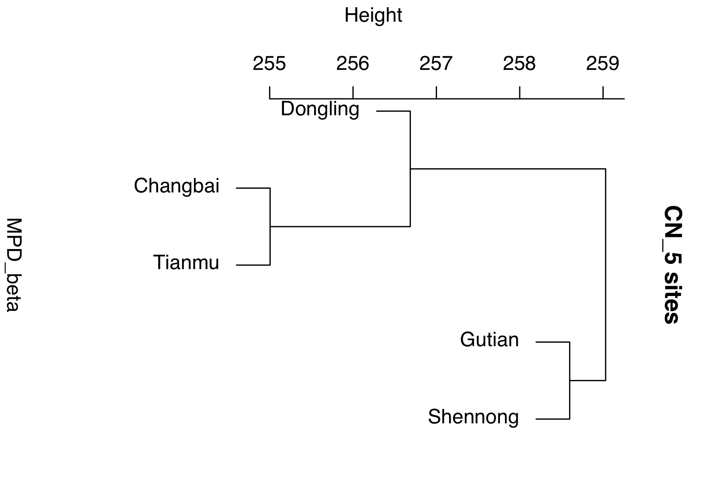
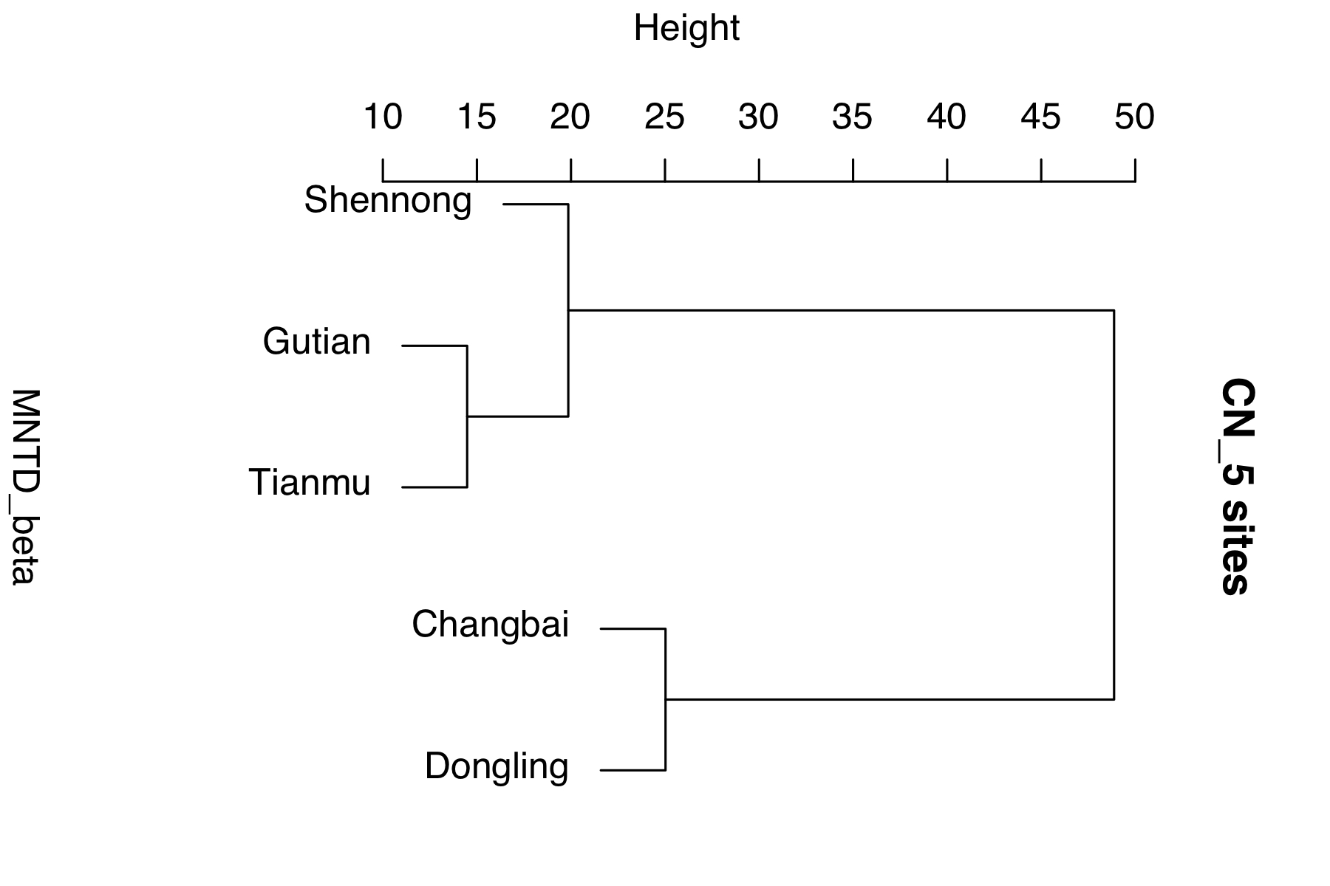
1. Community phylogeny -β diversity
Mean pairwise distance among 5 CN sites
Mean nearest taxon distance among 5 CN sites
Notes:
βPD的解读，相信哪一个？

Slide 22
1. Community phylogeny -β diversity
PCD among 6 US sites
Site | White_Mountain | Havard | Mountain_Lake | Coweeta | Talladega | Ordway
White_Mountain |  | 0.8309 | 0.9331 | 1.1040 | 1.2405 | 1.4835
Havard | 0.8309 |  | 0.8171 | 0.9998 | 1.3079 | 1.8680
Mountain_Lake | 0.9331 | 0.8171 |  | 0.6514 | 1.1911 | 1.6870
Coweeta | 1.1040 | 0.9998 | 0.6514 |  | 1.0769 | 1.7477
Talladega | 1.2405 | 1.3079 | 1.1911 | 1.0769 |  | 1.0638
Ordway | 1.4835 | 1.8680 | 1.6870 | 1.7477 | 1.0638

Slide 23
1. Community phylogeny -β diversity
PCDc among 6 US sites
Site | White_Mountain | Havard | Mountain_Lake | Coweeta | Talladega | Ordway
White_Mountain |  | 0.8216 | 0.8212 | 0.9816 | 1.0594 | 1.1560
Havard | 0.8216 |  | 0.8567 | 0.9597 | 1.1608 | 1.4261
Mountain_Lake | 0.8212 | 0.8567 |  | 0.7147 | 0.9906 | 1.2186
Coweeta | 0.9816 | 0.9597 | 0.7147 |  | 0.9149 | 1.2891
Talladega | 1.0594 | 1.1608 | 0.9906 | 0.9149 |  | 0.9956
Ordway | 1.1560 | 1.4261 | 1.2186 | 1.2891 | 0.9956

Slide 24
1. Community phylogeny -β diversity
PCDp among 6 US sites
Site | White_Mountain | Havard | Mountain_Lake | Coweeta | Talladega | Ordway
White_Mountain |  | 1.0114 | 1.1363 | 1.1247 | 1.1709 | 1.2833
Havard | 1.0114 |  | 0.9538 | 1.0418 | 1.1268 | 1.3098
Mountain_Lake | 1.1363 | 0.9538 |  | 0.9114 | 1.2024 | 1.3844
Coweeta | 1.1247 | 1.0418 | 0.9114 |  | 1.1770 | 1.3558
Talladega | 1.1709 | 1.1268 | 1.2024 | 1.1770 |  | 1.0685
Ordway | 1.2833 | 1.3098 | 1.3844 | 1.3558 | 1.0685

Slide 25
1. Community phylogeny -β diversity
UniFrac among 6 US sites
Site | White_Mountain | Havard | Mountain_Lake | Coweeta | Talladega | Ordway
White_Mountain |  | 0.6100 | 0.6229 | 0.6806 | 0.7216 | 0.7793
Havard | 0.6100 |  | 0.5531 | 0.5335 | 0.6463 | 0.7050
Mountain_Lake | 0.6229 | 0.5531 |  | 0.4577 | 0.6294 | 0.7537
Coweeta | 0.6806 | 0.5335 | 0.4577 |  | 0.5624 | 0.7050
Talladega | 0.7216 | 0.6463 | 0.6294 | 0.5624 |  | 0.5687
Ordway | 0.7793 | 0.7050 | 0.7537 | 0.7050 | 0.5687

Slide 26
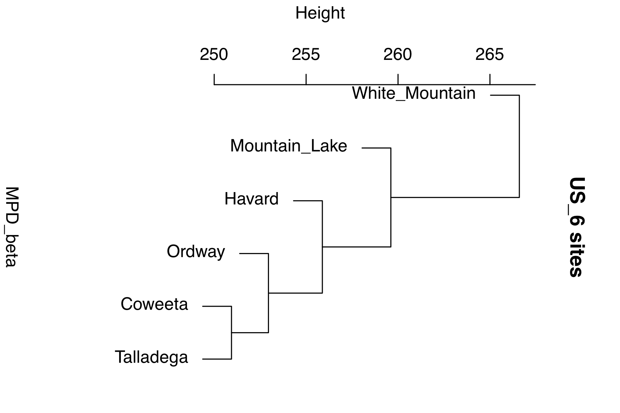
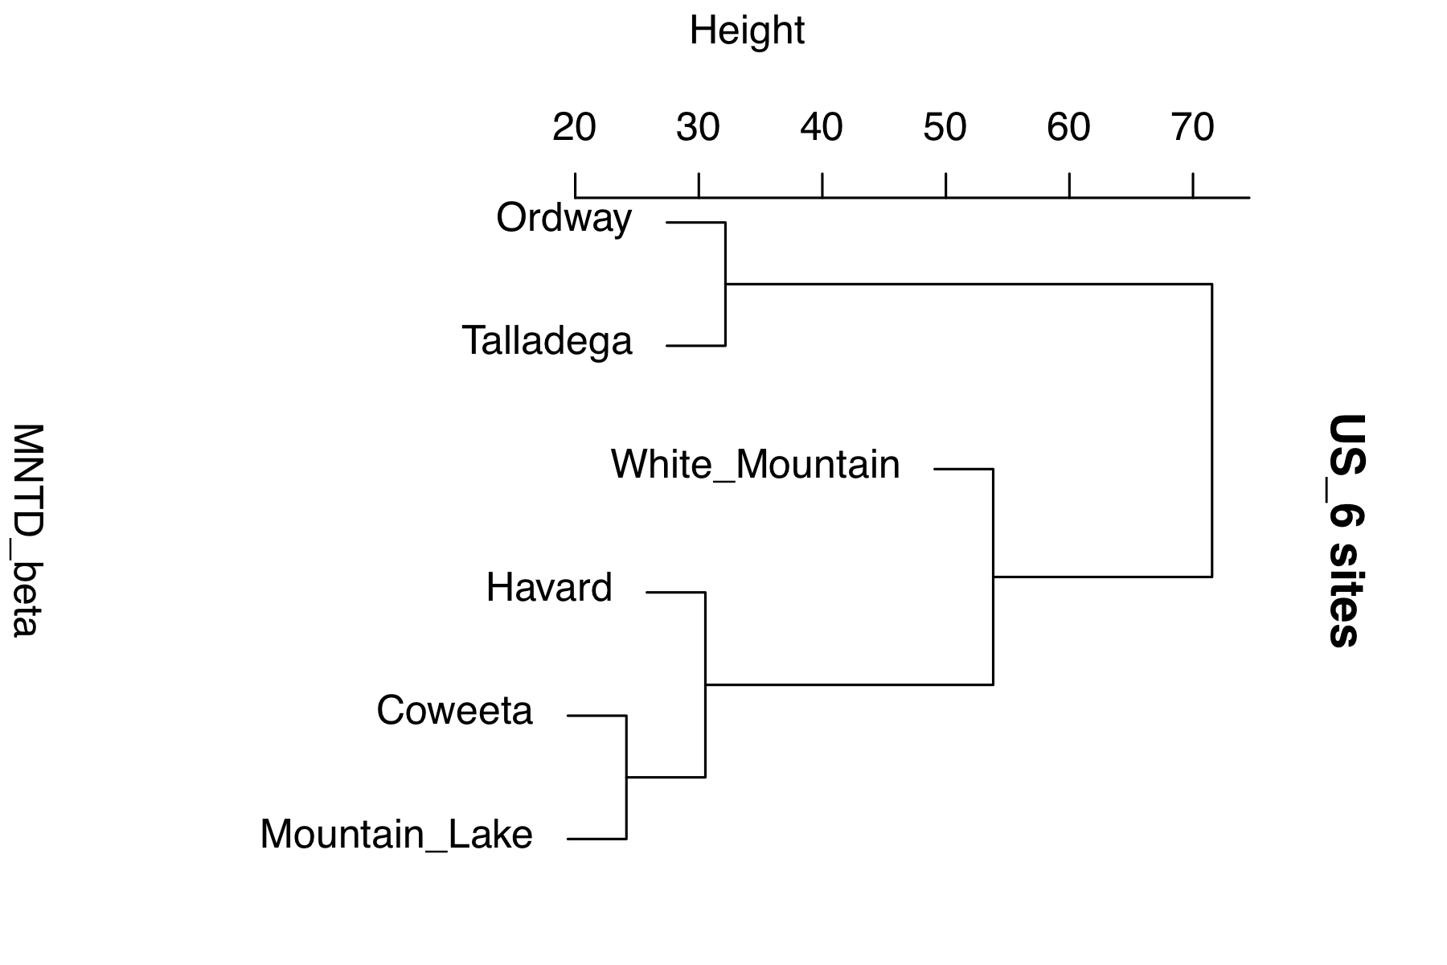
1. Community phylogeny -β diversity
Mean pairwise distance among 6 US sites
Mean nearest taxon distance among 6 US sites

Slide 27
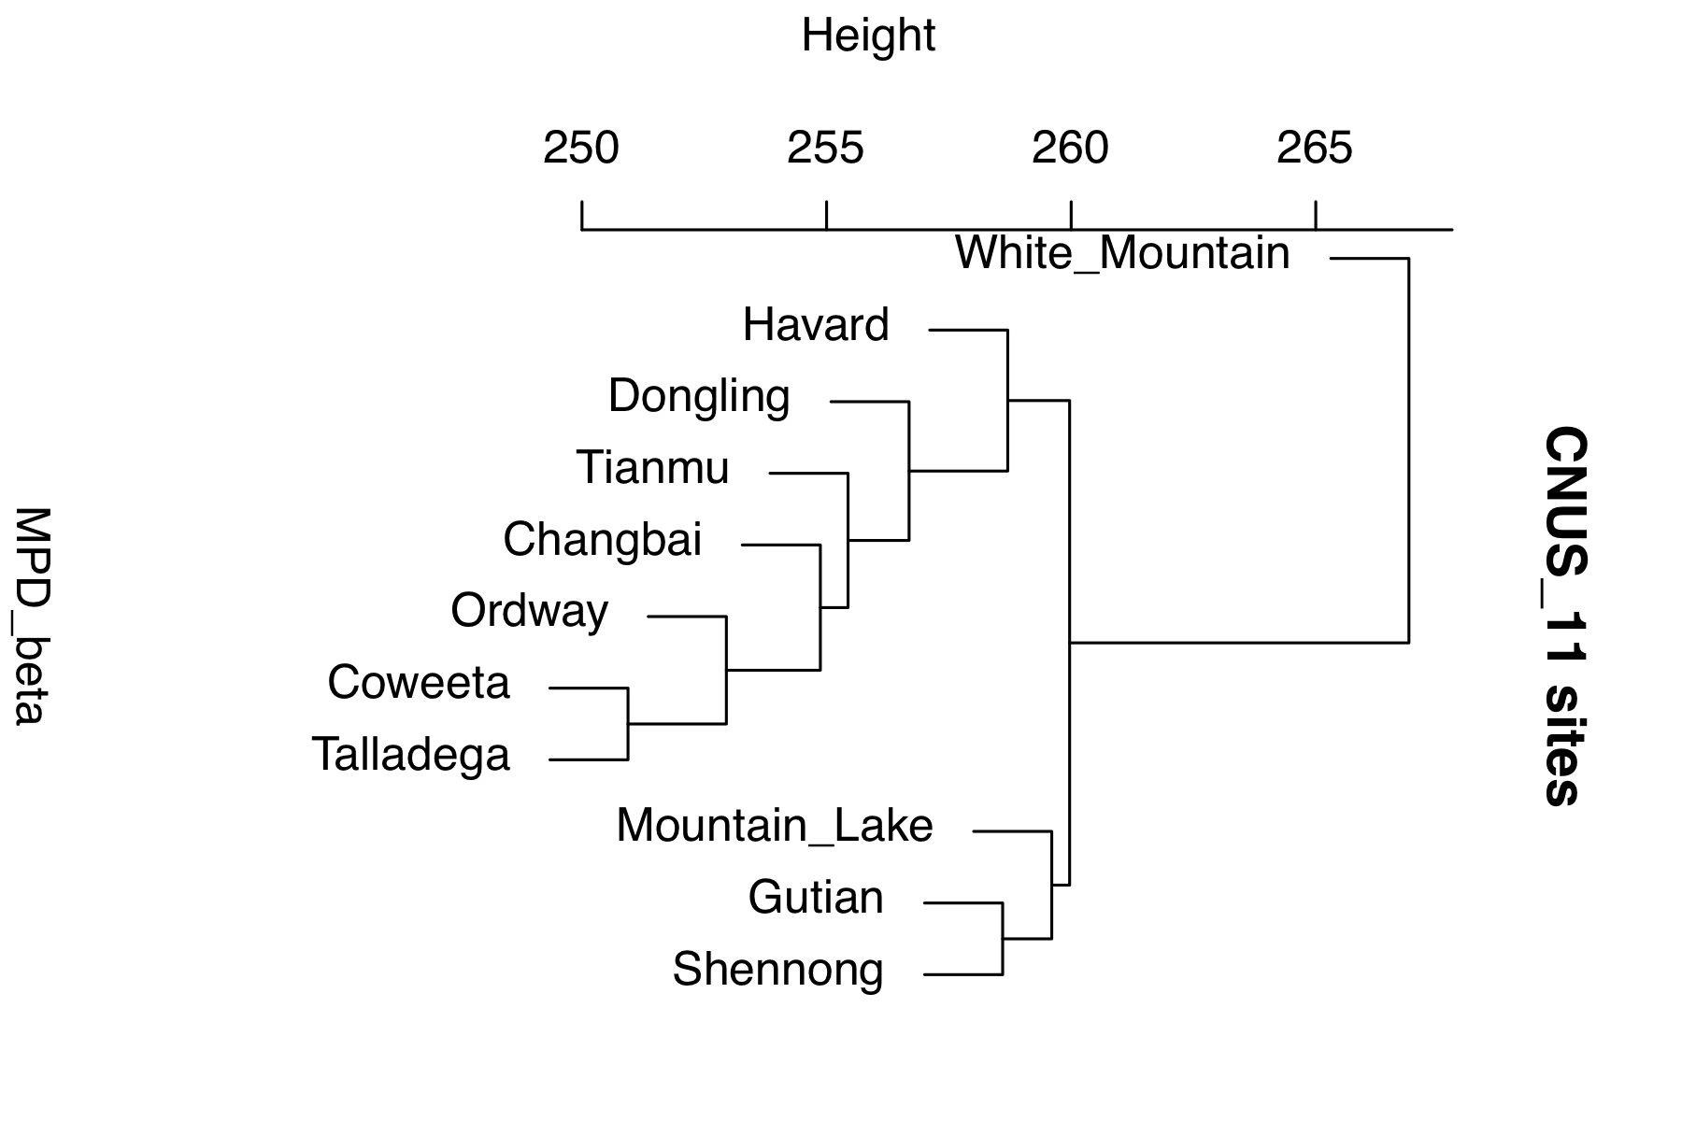
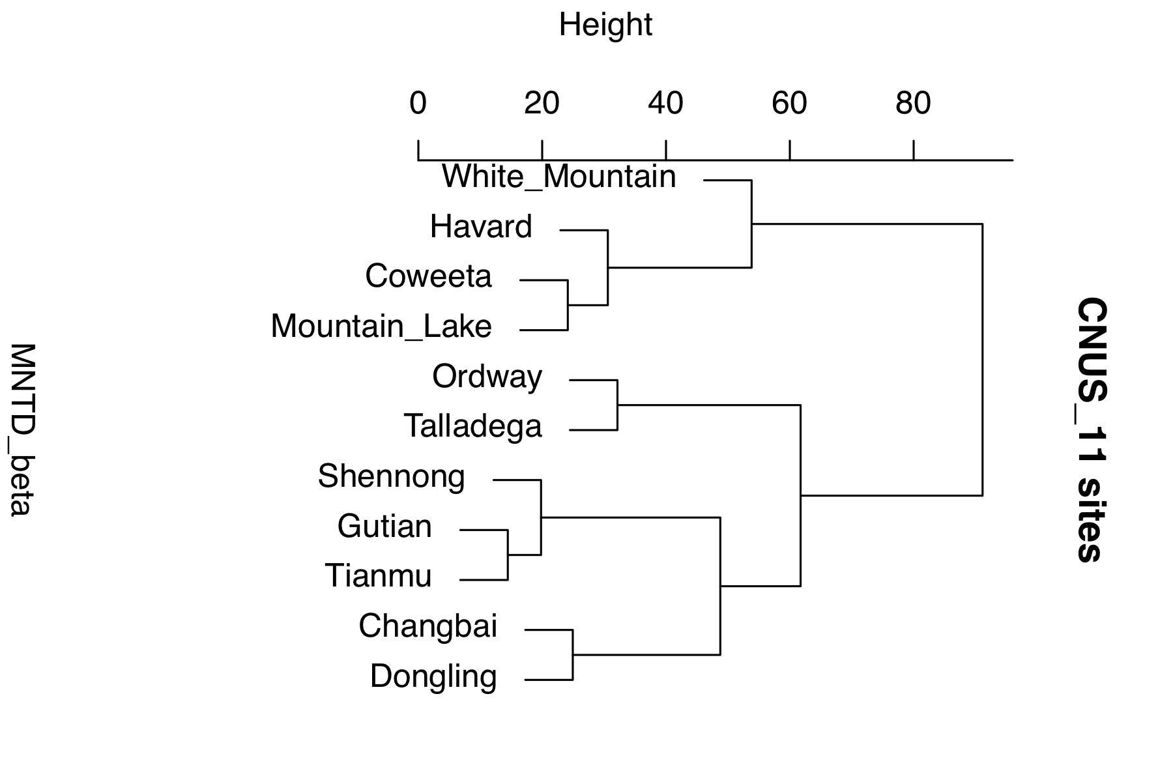
1. Community phylogeny -β diversity
Mean pairwise distance among 11 CN-US sites
Mean nearest taxon distance among 11 CN-US sites

Slide 28
1. Community phylogeny - concerning EAS-ENA disjunctions
obstacle: a complete and accurate list
<中国被子植物3097属分布类型 吴征镒 2006> may not be so accurate
Latest compilation: 75 genera ( 25 woody, 50 herbaceous)
Site | Disjunct genera | Species in disjunct genera | Species in non-disjunct genera
CN | 61 | 263 | 3404
US | 62 | 145 | 2049
Total | 70 | 395 | 5213
Notes:
非间断里面，不同成分的结构

Slide 29
1. Community phylogeny - concerning EAS-ENA disjunctions
Category | ntaxa | PD | SES-PD | NRI | NTI
CN | 3667 | 66034.38 | -2.71 | -0.58 | 2.08
US | 2194 | 44617.83 | -6.40 | 1.28 | 4.94
Disjunct-total | 395 | 9451.63 | -14.68 | -6.41 | 12.55
Nondisjunct-total | 5213 | 83492.60 | -4.25 | 10.08 | 0.47
Disjunct-CN | 263 | 7649.42 | -12.46 | -2.03 | 9.68
Nondisjunct-CN | 3404 | 62029.77 | -4.32 | 4.99 | 0.98
Disjunct-US | 145 | 6595.21 | -4.21 | -6.82 | 4.76
Nondisjunct-US | 2049 | 40850.76 | -9.51 | 9.43 | 5.42
Red: significant over-dispersion Green: significant clustering
Notes:
不同赋值/属性矩阵间是否有比较性？

Slide 30
1. Community phylogeny - concerning EAS-ENA disjunctions

Slide 31
2. Functional traits
https://docs.google.com/document/d/12bM4EBTvre0MCaMhL595891p6LDpwYq2B4fJrykRW6o/edit?ts=5caaa37f
Objective:
explore general pattern of functional traits among 18 EAS-ENA disjunct genera
determine simi- and dissi- milarities among 11 sites (site-pairs with similar latitude)
elucidate relative contributions among different factors (using phylogenetic comparative methods) leading to the observed scenarios.
Data collection:
Mearsured data: covering 18 genera, 112 species, including SLA, LMA, Cpercent, Npercent, Ppercent; Carea, Narea, P area.
Max height for each species Data from floras or MBG database.
MAP and MAT using R-package raster.

Slide 32
2. Functional traits
Genera | CN_sp_no. | CN_records._no. | US_sp_no. | US_records._no.
Acer | 20 | 108 | 6 | 142
Aesculus | 1 | 4 | 3 | 10
Carpinus | 4 | 28 | 1 | 7
Castanea | 2 | 11 | 2 | 44
Cladrastis | 1 | 5 | 1 | 1
Cornus | 5 | 32 | 6 | 31
Corylus | 5 | 29 | 2 | 4
Fagus | 1 | 1 | 1 | 25
Fraxinus | 4 | 24 | 2 | 20
Juglans | 1 | 15 | 2 | 5
Liquidambar | 1 | 10 | 1 | 21
Lyonia | 1 | 4 | 4 | 12
Magnolia | 1 | 5 | 7 | 66
Osmanthus | 1 | 1 | 1 | 5
Pinus | 7 | 36 | 7 | 45
Populus | 2 | 7 | 4 | 4
Sassafras | 1 | 2 | 1 | 15
Stewartia | 2 | 8 | 1 | 1
total | 60 | 330 | 52 | 458

Slide 33
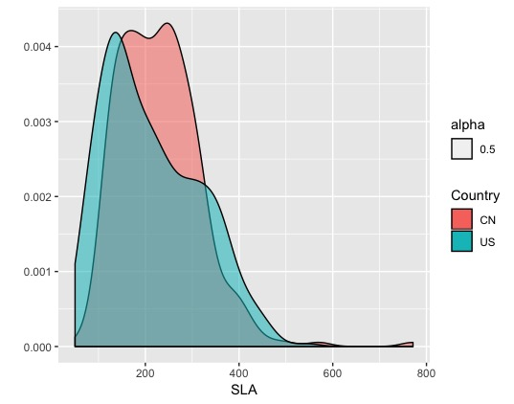
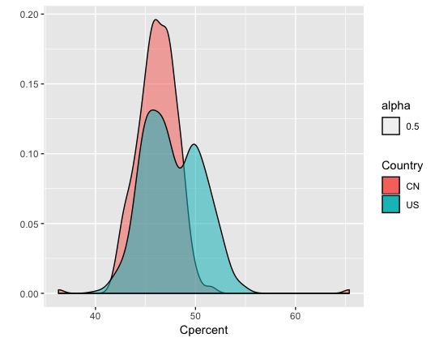
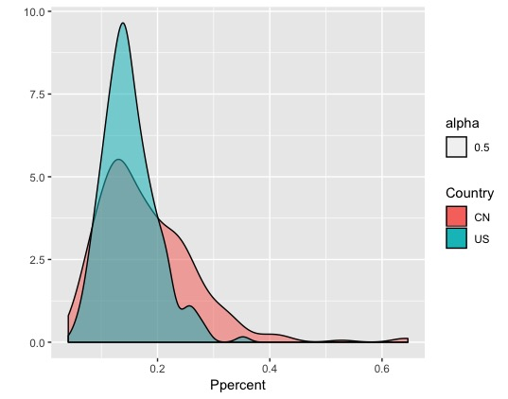
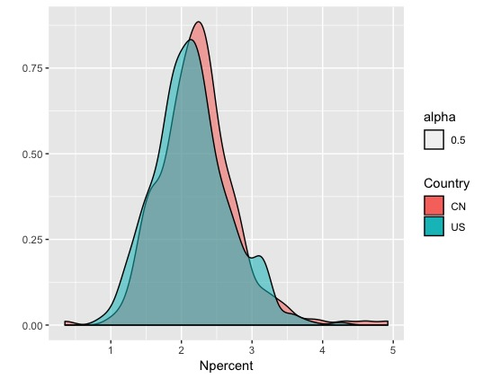
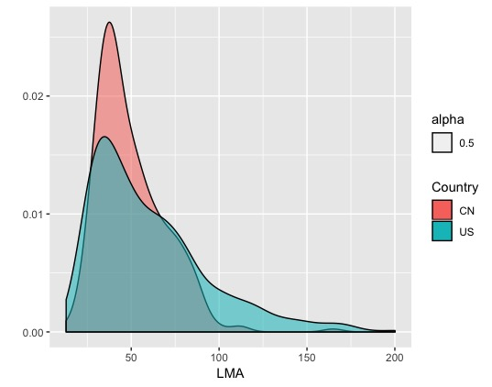
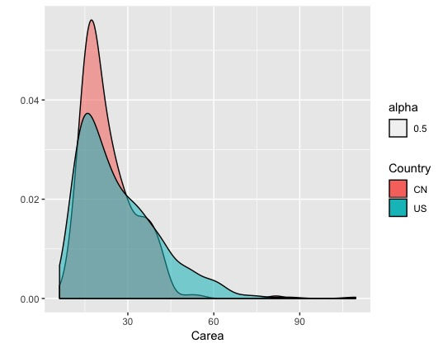
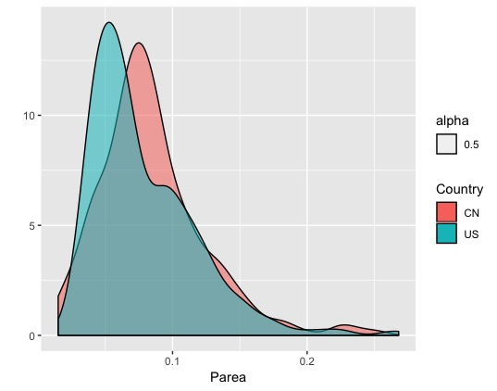
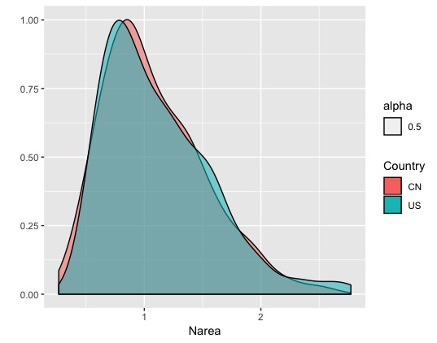
2. Functional traits
Max, min and average values of seven traits
Site | SLA | LMA | Cpercent | Carea | Ppercent | Parea | Npercent | Narea
CN | 60.67-771.22 (229.89) | 12.97-164.83 (49.85) | 36.30-65.37 (46.21) | 6.16-81.69 (23.13) | 0.04-0.65 (0.18) | 0.02-0.25 (0.08) | 0.35-4.92 (2.23) | 0.27-2.60 (1.09)
US | 49.98-545.85 (213.73) | 18.32-200.10 (60.34) | 40.20-54.73 (47.72) | 8.49-109.52 (26.87) | 0.05-0.35 (0.15) | 0.02-0.27 (0.08) | 0.85-4.25 (2.15) | 0.41-2.77 (1.12)

Slide 34
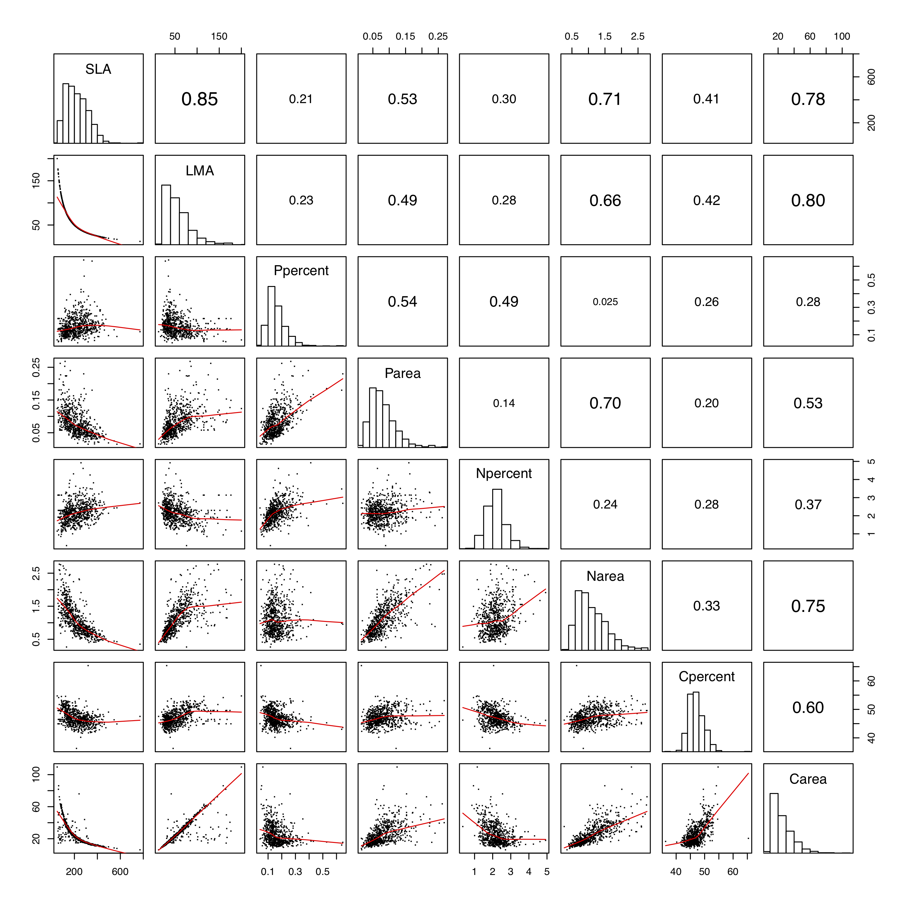
2. Functional traits
Pair correlations among five functional traits based on angiosperm dataset

Slide 35
2. Functional traits
Generate phylogenetic trees using alternative methods with all seed plants or angiosperms
R-package brranching (get tree directly, basically Phylomatic)
Python & BASH scripts Opentree_pytoy (get CN-US community tree, then get sub-tree)
Python package PyPHLAWD (get sequence matrix) (excluded for incomplete highly dataset)

Slide 36
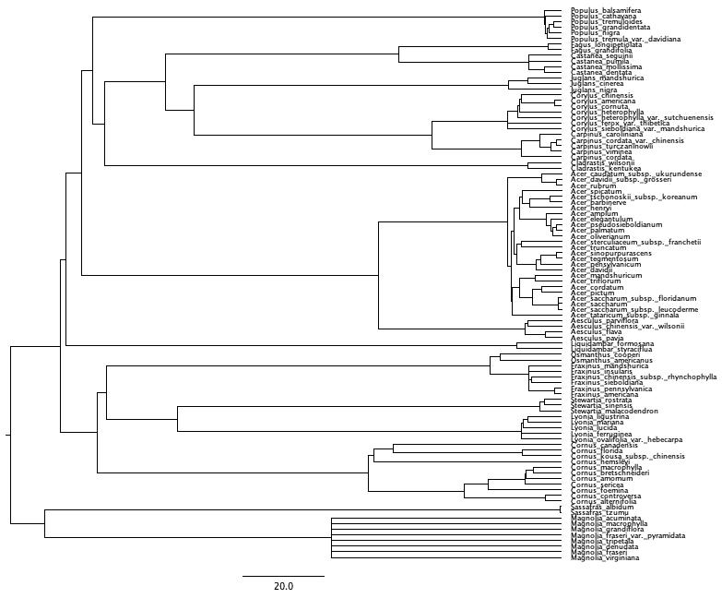
2. Functional traits
Phylogenetic signals on max height - an example for phylogenetic signal test
Species | Maxheight | Other trait
Acer_amplum | 25 | ...
Carpinus_caroliniana | 10.7 | ...
Cornus_alternifolia | 7.6 | ...
Fraxinus_americana | 24.4 | ...
... | ...
data matrix
rooted/binary phylogenetic tree
K | PIC.variance.obs | PIC.variance.rnd.mean | PIC.variance.P | PIC.variance.Z
0.0583 | 11.9808 | 15.8978 | 0.1560 | -0.9821
Phylogenetic signals on max height based on OTL tree

Slide 37
2. Functional traits
# K values closer to zero correspond to a random or convergent pattern of evolution
Phylogenetic signals on six traits based on OTL tree
Trait | K | PIC.variance.obs | PIC.variance.rnd.mean | PIC.variance.P | PIC.variance.Z
Max height | 0.0583 | 11.9808 | 15.8978 | 0.1560 | -0.9821
SLA | 0.0711 | 631.0653 | 1022.8902 | 0.0150 | -1.6131
LMA | 0.1101 | 45.2177 | 111.2063 | 0.0010 | -1.4667
Carea | 0.1146 | 11.9281 | 30.7192 | 0.0040 | -1.4329
Cpercent | 0.1048 | 0.4630 | 1.1230 | 0.0010 | -2.0441
Narea | 0.0948 | 0.0129 | 0.0278 | 0.0030 | -1.5632
Npercent | 0.1018 | 0.0203 | 0.0489 | 0.0010 | -1.7978
Parea | 0.1161 | 0.0001 | 0.0003 | 0.0010 | -2.0217
Ppercent | 0.0909 | 0.0006 | 0.0012 | 0.0200 | -0.9924
Phylogenetic signals on seven traits based on OTL tree

Slide 38
2. Functional traits
Obstacles:
it seems no one exactly knows how was the Pinus SLA measured
inaccuracy in collected data (i.e., NA data in traits and geo-info)

Slide 39
Plans
1. Talk with Pam / Daijiang. 2. Complete draft with Miao at mid June.
3. Complete analyses on functional traits at late June.

