Slide 1
What’s new in 3.0 GC
Maoni Stephens
09/18/2019

Slide 2

Hello!

Slide 3
Desktop port
SOH/LOH alloc lock split
A new provisional mode
3 new configs
GCHeapAffinitizeMask, GCHighMemPercent, GCLOHThreshold
Others

Slide 4

Wanna know some implementation details?

Slide 5
How does locking work on the GC heap during allocation?
First thing first, when would allocation actually come to the GC?
SOH and LOH shared the same lock for the same heap
LOH free list usage
LOH sweeping threads the LOH free list
LOH allocation consumes LOH free list

Slide 6
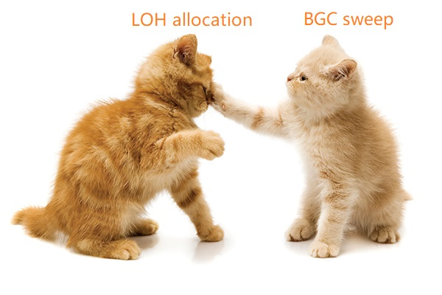
PerfView “LOH Allocation Pause (due to background GC) > 200 Msec for Process X” table “Waiting for BGC to thread free lists”

Slide 7
How to fix this
Observation – sweeping LOH usually takes much less than sweeping SOH
By splitting the SOH and LOH alloc lock, we can have BGC LOH sweep take the LOH alloc lock
Reduced Bing Backend P95 latency by 10%
Better ways to fix this but more complex

Slide 8
High memory load situation
Physical memory load >= 90%
Can be changed with the GCHighMemPercent config
New provisional mode says we will do a gen2 GC when we observe that gen1 GC increases gen2 size

Slide 9
GCLOHThreshold
You can only make it bigger
How you should use this config
New profiling API ICorProfilerInfo10::GetLOHObjectSizeThreshold
New Profiling mask COR_PRF_MONITOR_LARGEOBJECT_ALLOCATED for large object allocations

Slide 10

Container scenarios in 2.2-

Slide 11
Container scenarios – previous problems
A lot of the checking/decision was happening during a GC, examples
Check for “Is doing a gen2 going to be productive”
Heap expansion did not take commit into consideration (only reserve)
When we have multiple segments on a heap, now the tuning sees the new ephemeral seg which is not at all full
Logic to downgrade a gen2 GC to a gen1 GC
Check for “Are we short on seg when we just come out of a GC”
Based on min budget which is based on LLC size

Slide 12
Container scenarios – 3.0 implementation
Disallow heap expansion (reserve up front)
Check for limit during commit code paths in allocator
Hardened tuning parameters against limit, eg
Segment size
Allocation budget
Compact LOH if needed
Track GC’s own bookkeeping against limit
Retry for Server GC in allocator

Slide 13
Choosing alloc heap in Server GC allocator
We find a heap that’s relatively empty
But also try to keep on the current core for a while
NUMA considerations
The choosing part is done without a lock
Which means when we actually allocate, some other thread could have beat us to it
We need to retry if we are not to the limit
New alloc state introduced

Slide 14
Large pages
Need to set hardlimit config too (unless it’s already set by the virtue of having a memory limit on a container)!
Current state (for GC) –
GC heap can be on large pages
GC’s own bookkeeping is not
More support coming

Slide 15
Future focus
Continuing latency reduction
Allowing users to communicate to us which perf aspects are most important for them
Memory footprint
% CPU in GC
Individual GC latency

Slide 16

Q&A

