Slide 1
What’s New in the .NET 5 GC?
Maoni Stephens
DotNext 2020 Moscow

Slide 2

Perf improvements with no user interaction
Improvements on fundamentals
Balancing work is crucial in Server GC

Slide 3

Perf improvements with no user interaction – cont.
Ephemeral segment decommit
Completely done outside of the STW phase of a GC on a Server GC thread
Better decommit logic
Card mark stealing
GC threads that finished marking cards on their heaps will steal from other GC threads
Benefits both the mark and the relocate phase

Slide 4
Perf improvements with no user interaction – cont.
Vectorized mark list sorting
introsort (quicksort + heapsort + insertion sort) →
Vectorized quicksort + vectorized bitonic sort
(when AVX2+ is supported)
Memory reset (MEM_RESET)
Only when memory load is high enough

Slide 5

You don’t need to do anything!

Slide 6
User facing feature - POH
Pinning was explained in detail in my “What’s so hard about pinning” talk (slides, video)
For the scenarios when you know you will pin objects when you allocate them
They will stay on their own segments
They are swept in gen2 GCs

Slide 7
POH API
T[] AllocateArray<T>(int length, bool pinned);
T[] AllocateUninitializedArray<T>(int length,
bool pinned);
If pinned is true, the array cannot contain references or it’ll throw an exception.

Slide 8
Related hardlimit configs
COMPlus_GCHeapHardLimitSOH
COMPlus_GCHeapHardLimitLOH
COMPlus_GCHeapHardLimitPOH
COMPlus_GCHeapHardLimitSOHPercent
COMPlus_GCHeapHardLimitLOHPercent
COMPlus_GCHeapHardLimitPOHPercent

Slide 9
Diagnostics - API
New GC.GetGCMemoryInfo(), described in detail here
In-proc can be a real convenience, eg, use it in container without a sidecar container to collect traces from.
For both sampling and diagnostics

Slide 10
New properties
Index of this GC
Accumulative % pause time in GC
Per generation data (before GC and after GC)
Various GC attributes (compact/concurrent)
Detailed pause durations
Promoted, # of pinned objects, # objects promoted due to “ready for finalization”
Total committed bytes

Slide 11
Diagnostics - generational aware tooling
Why do we need generational aware?
Explained in detail in mem-doc
Usage example
set COMPlus_GCGenAnalysisGen=1
set COMPlus_GCGenAnalysisBytes=100000
set COMPlus_GCGenAnalysisIndex=10
Optional: set COMPlus_EventPipeCircularMB=800

Slide 12
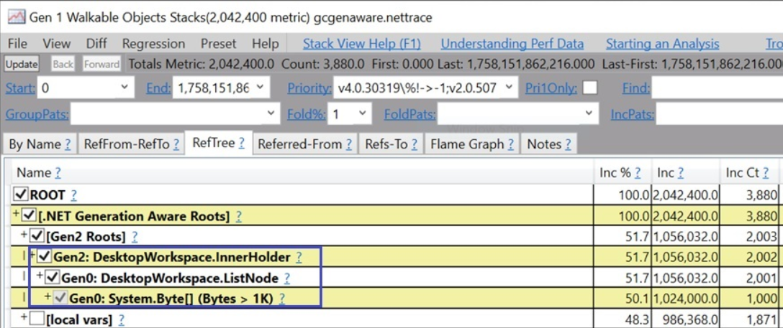

Slide 13
Resources
mem-doc
Please read this if you need to perform memory analysis on .NET!
Many of the concepts/terms in this talk are explained in detail in the doc
Ask me questions at http://twitter.com/maoni0
(response time may be very inconsistent)
File an issue on our repo: http://github.com/dotnet/runtime
Pro .NET Memory Management book

Slide 14


