Slide 1

Redo the LDA Example IRTG 1792, BERLIN.

Slide 2

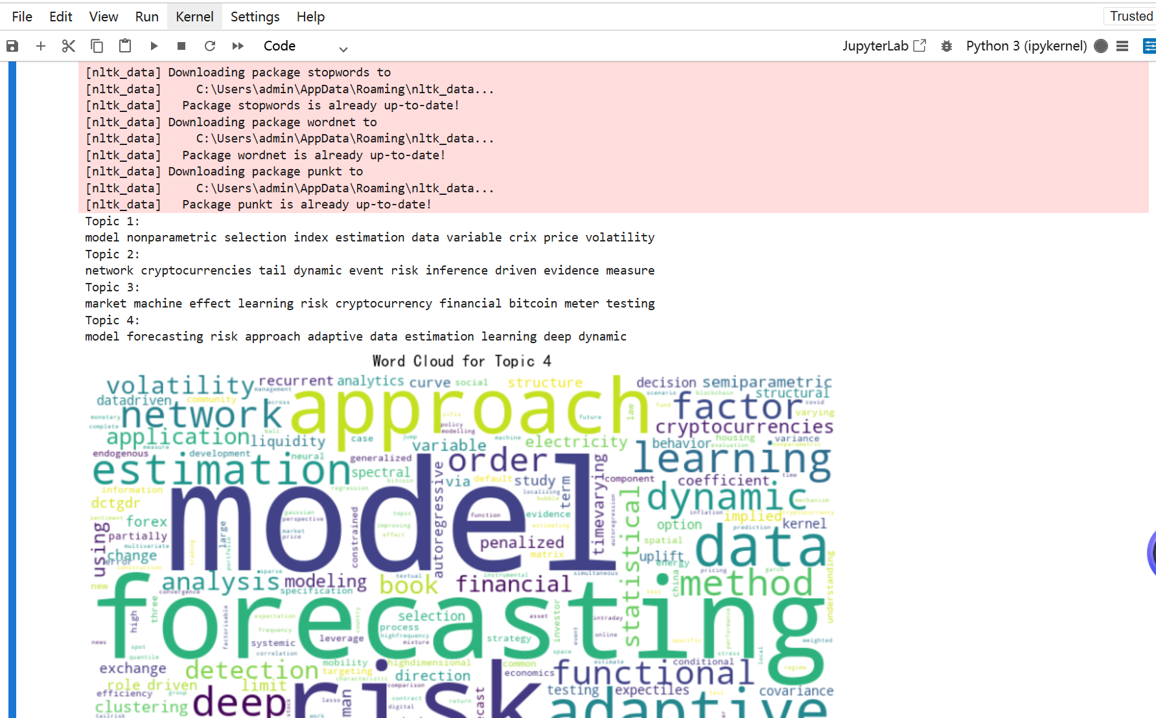

Slide 3
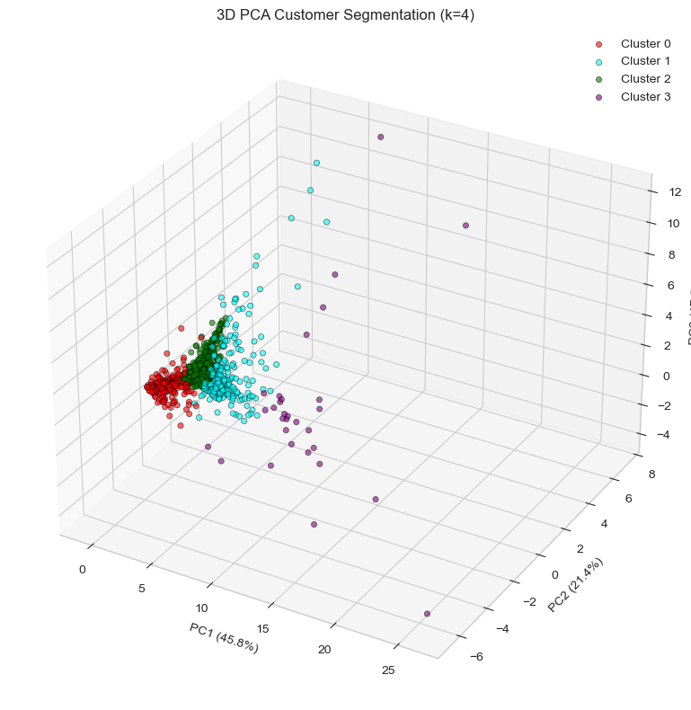

Slide 4
Thanks for Watching

