Slide 1
Embracing Digital Art
haoranli
jinhaoGuo
XiLong

Slide 2
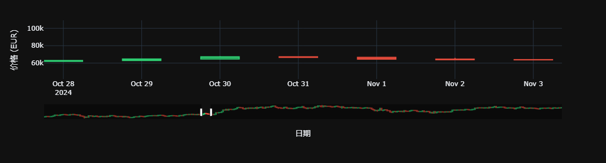
HW1.
Ourwork:
The overall tendency of BTC price in a period.

Slide 3
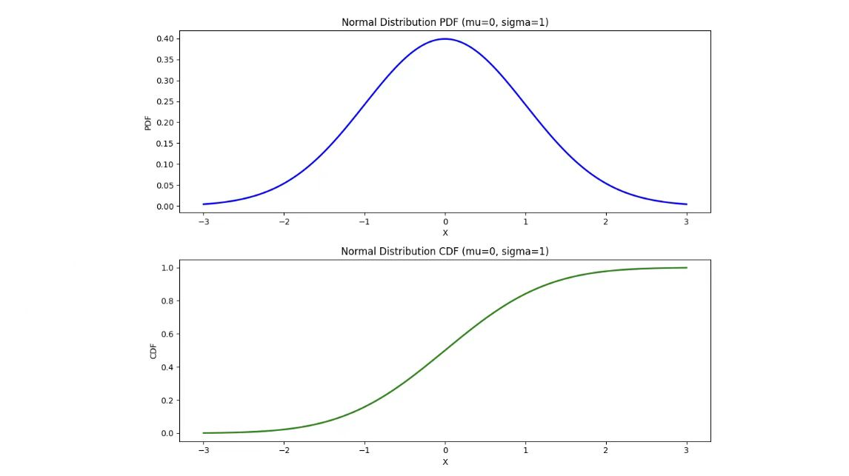
Our Work2: A plot of N(mu, Sigma)!

Slide 4
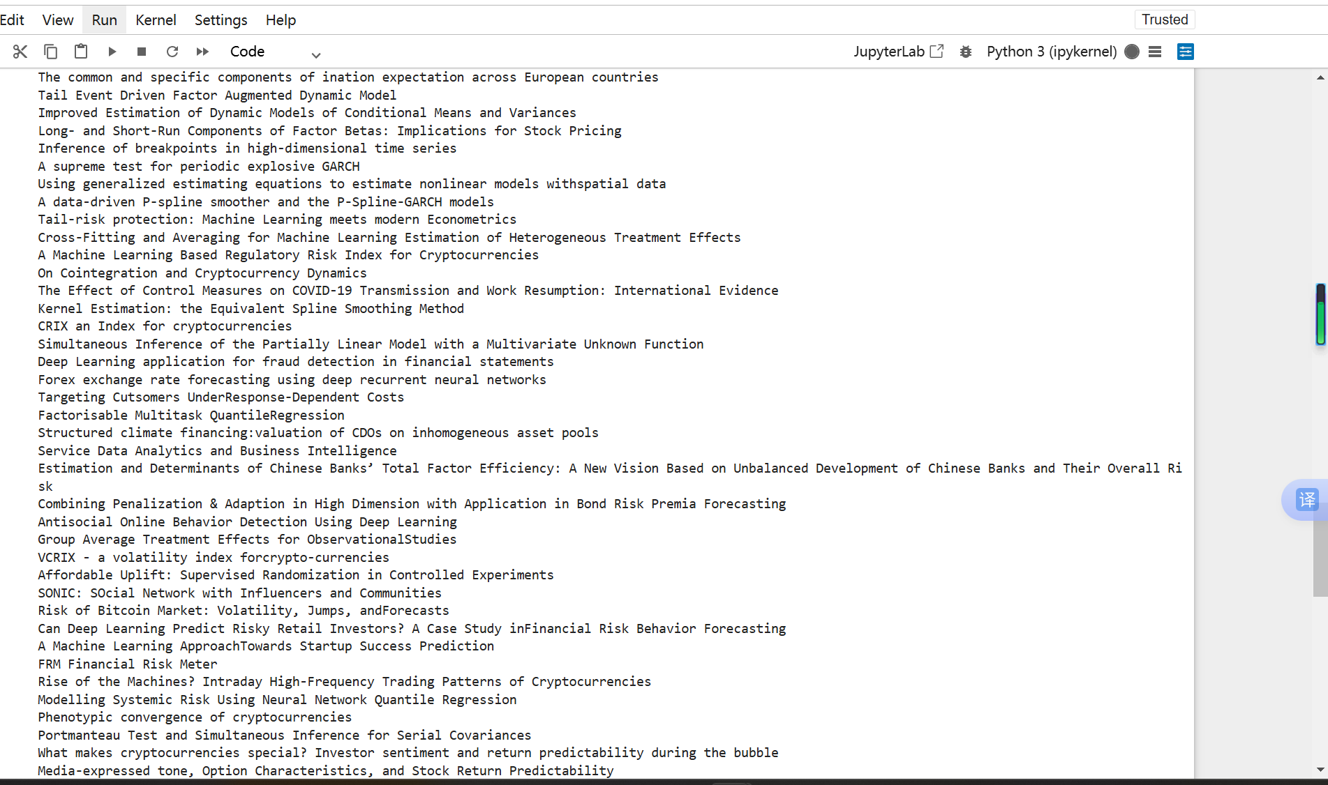

Slide 5
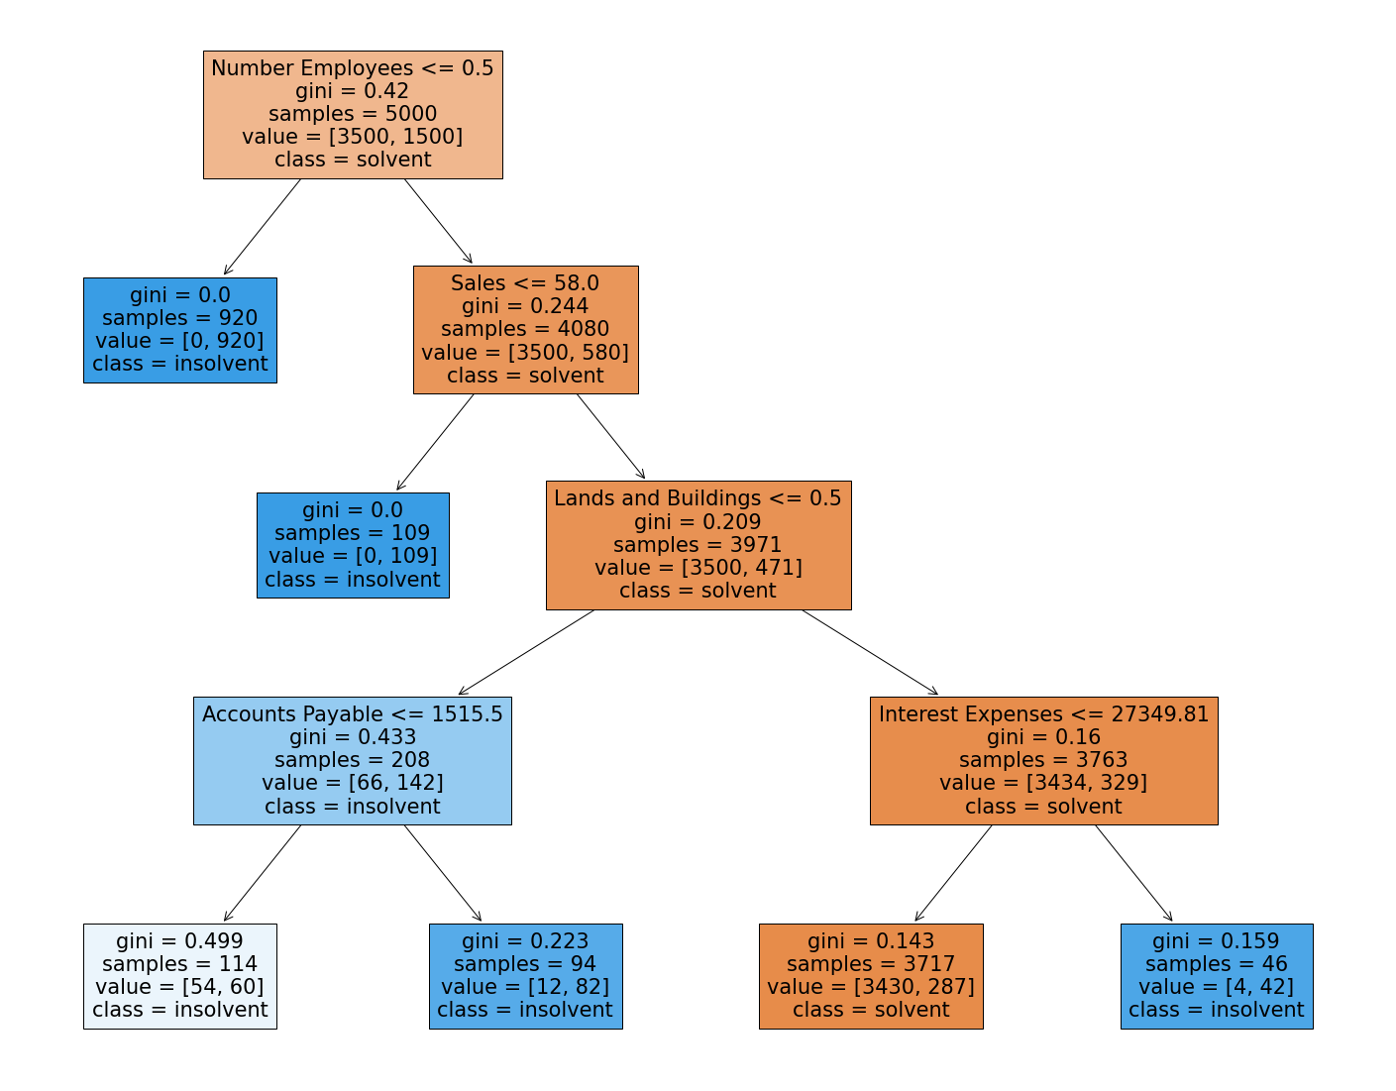
A RF Example

Slide 6

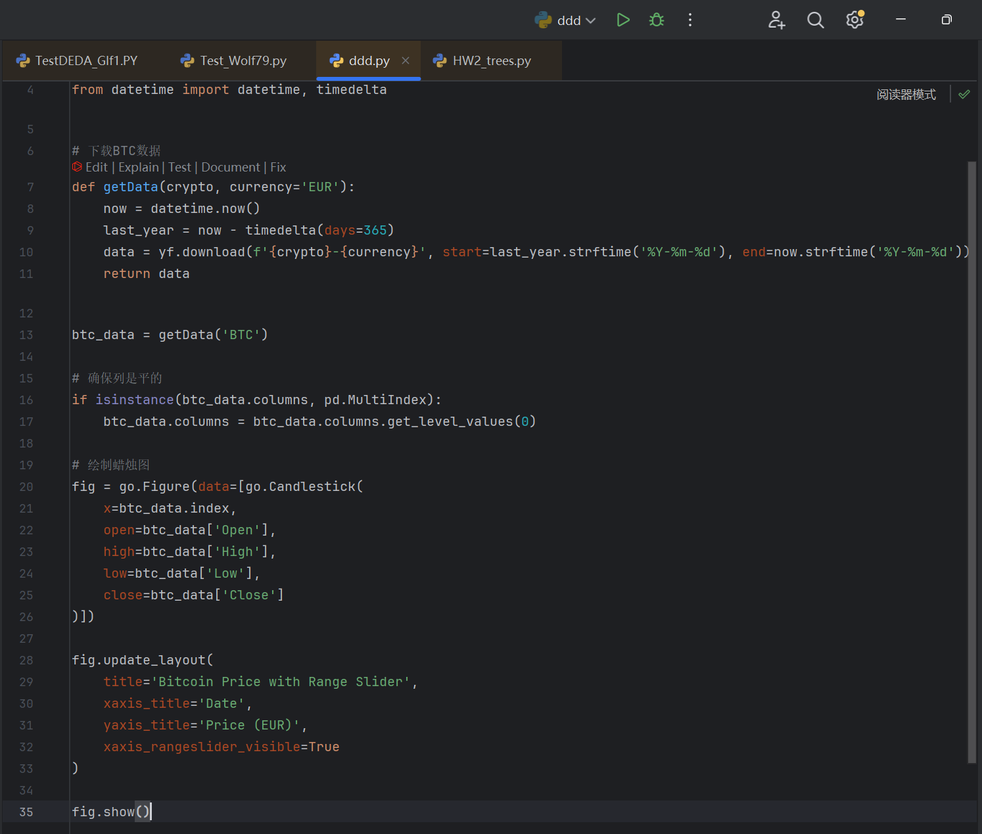

Slide 7
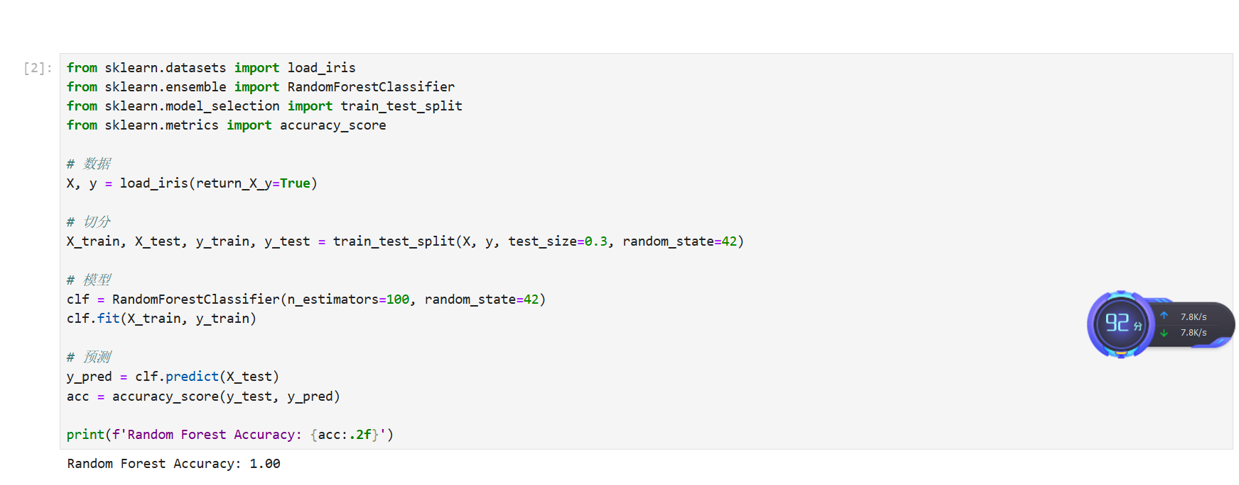
Another RF Example

Slide 8
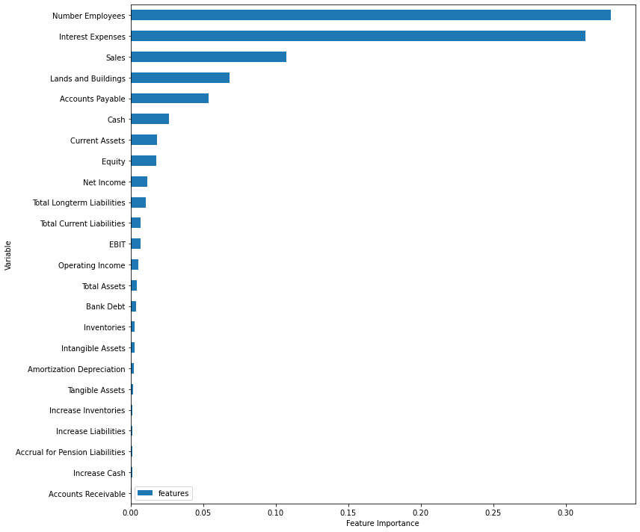

Slide 9
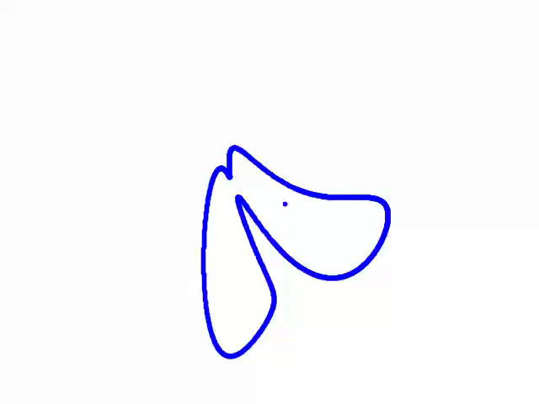
A Chewing Crocodile
parameters = [35 - 20j, 25 + 30j, -15 - 25j, -10 - 50j, 15 + 15j]

Slide 10
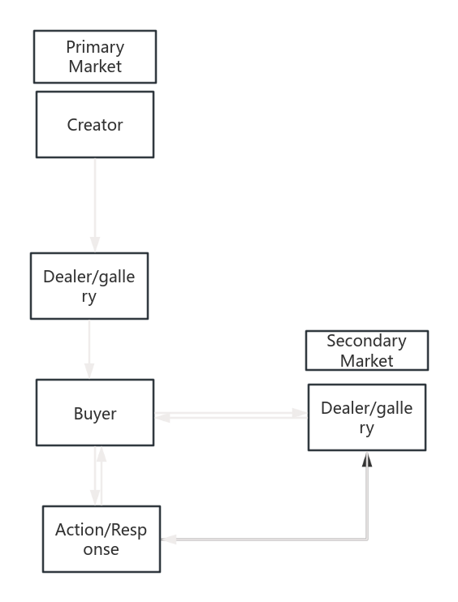
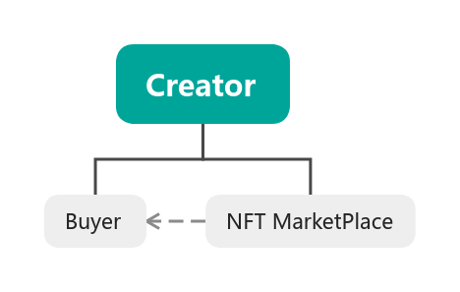
Thanks for watching!
The mindmap of Selling Process in Primary(Second) Market.

