Slide 1
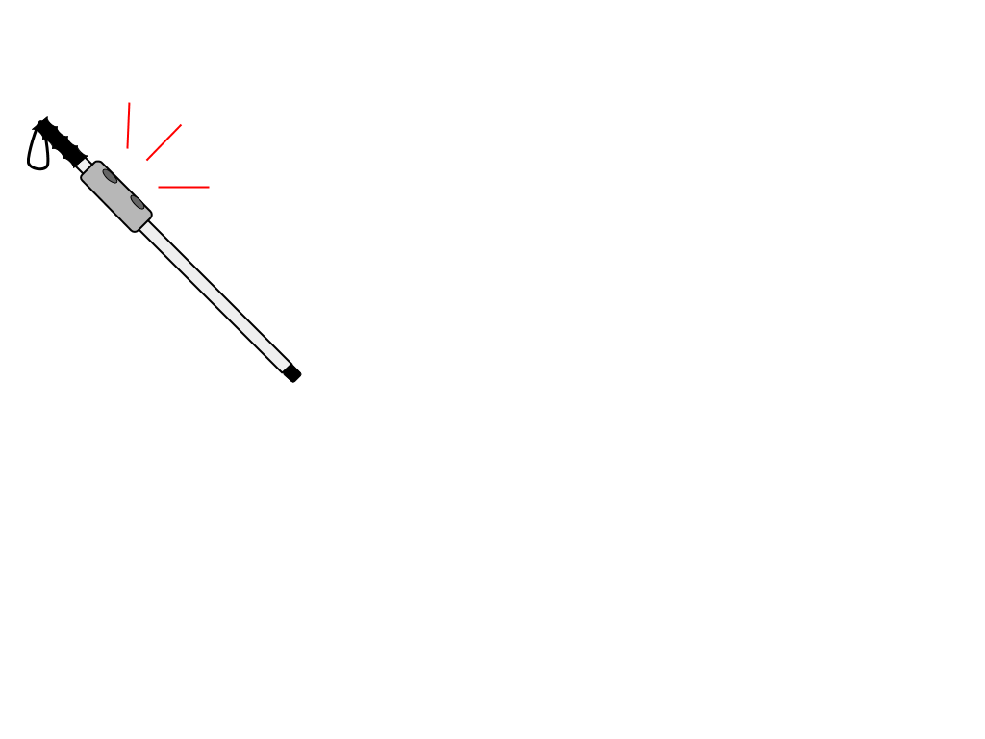
Smart Cane
Critical Design Review
CSCE 483/Spring 2020
Arthur Helmen, Baltazar Guerra, Jonathan Williams,
Matthew Giuffrida, Shawn Popal

Slide 2
Problem Statement

Slide 3
Problem Background
Navigation is something we take for granted, but can be a major concern for the blind and visually impaired.
One of the most common, and widely recognized, tools used by the blind community to address this issue is a “white cane.”
Our project is to upgrade a white cane with additional functionality - namely, directions provided through haptic/audio feedback, integration with smartphones, in-building navigation and orientation, and quick access to emergency services

Slide 4
Needs Statement
There are obstacles that a traditional white cane would be unable to, or unlikely to, detect.
Orientation inside a room or building can be difficult for the visually impaired if there are not identifiable changes in the texture of the floor.

Slide 5
Goal and Objectives
-Provide robust, consistent detection of obstacles in the path of a user
- Give clear directions to the user that leverage the accessible-friendly features of campus
-Provide orientation and directions to the user inside of buildings on request
-Allow the user to quickly contact emergency services

Slide 6
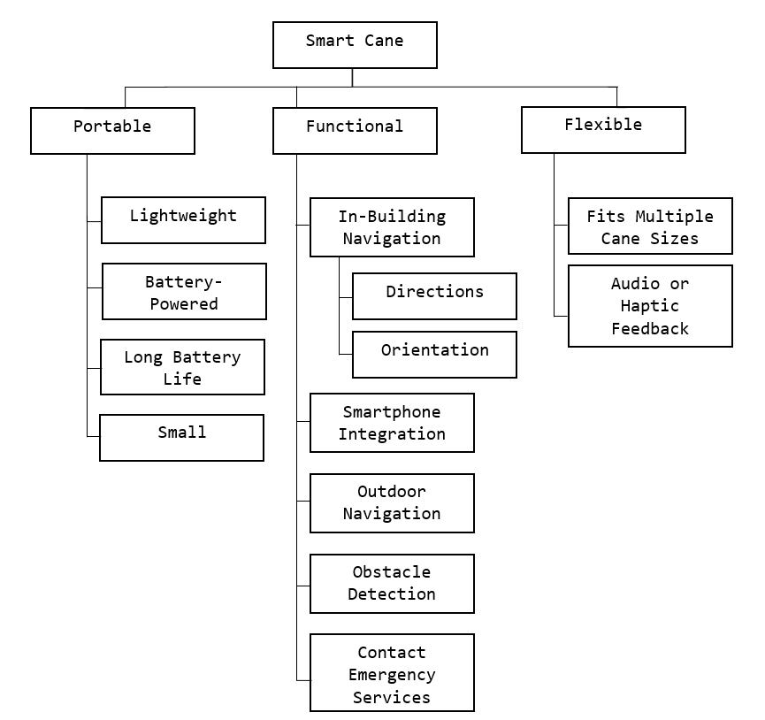
Requirements: Objective Tree

Slide 7
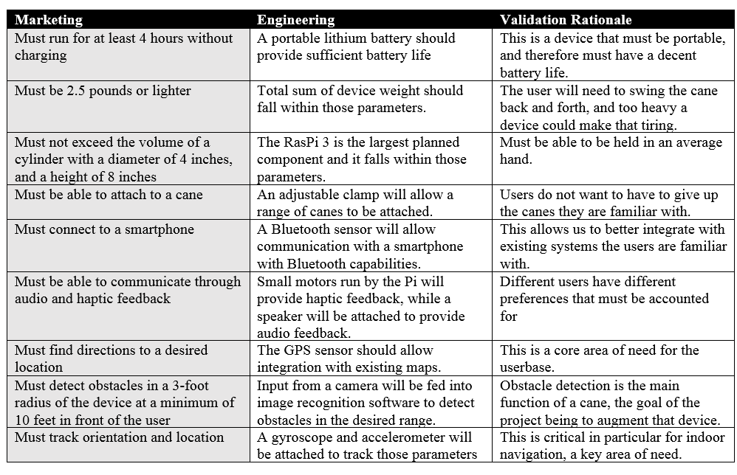
Requirements

Slide 8
Design Alternatives

Slide 9

Design Alternatives
Relying on bluetooth rather than wifi
It’s better for the scenarios that visually impaired people face.
Ex: going through campus
This also ensures a more continuous connection if the user is moving around a building.

Slide 10
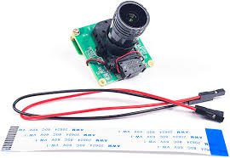
Design Alternatives
Using a camera to aid in detection
We don’t rely only on the Ultrasonic sensors.
Doesn’t put a huge burden on our budget, but it does improve our product.

Slide 11

Design Alternatives
“Breadcrumb” system to aid in tracing back route
An addition to just directing the user from point A to B.
Helps them retrace their steps a lot easier.

Slide 12

Design Alternatives
Robust system with toggle options
Rather than having a fixed system with a lot of feedback, make the feedback toggle.
Makes it better for users, since some might get very distracted with certain feedback.

Slide 13

Design Alternatives
Use Google Maps instead of the TAMU Mobile App
At first, we planned to use the TAMU App.
Due to the current circumstances, they haven’t reached back for the API.
Because of the time constraint (and also because it works well), we will use Google Maps.

Slide 14
System Description

Slide 15
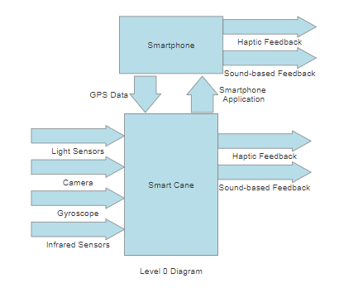
Design Specifications (Level 0)
4 Standalone Inputs
Data from light sensors
Data from camera
Data from the internal gyroscope
Data from the infrared sensors
1 Optional Input from Smartphone
GPS data
2 outputs
Haptic Feedback
Sound-based Feedback
Smartphone can mirror these outputs, but is not necessary
Human Input

Slide 16
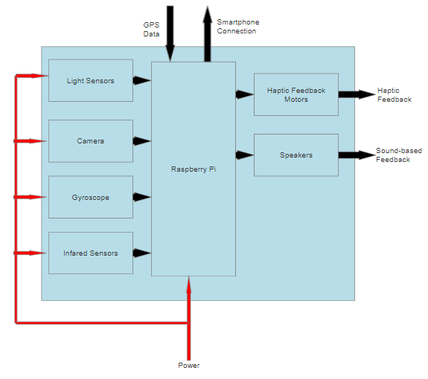
Design Specifications (Level 1)
Internal modules and their interactions within the cane itself
Raspberry Pi acts as central brain, processing all incoming data from the sensors and sending the appropriate responses through the haptic feedback motors and speakers
Smartphone connection brings in additional GPS data for map tracking and navigation
Human Input

Slide 17
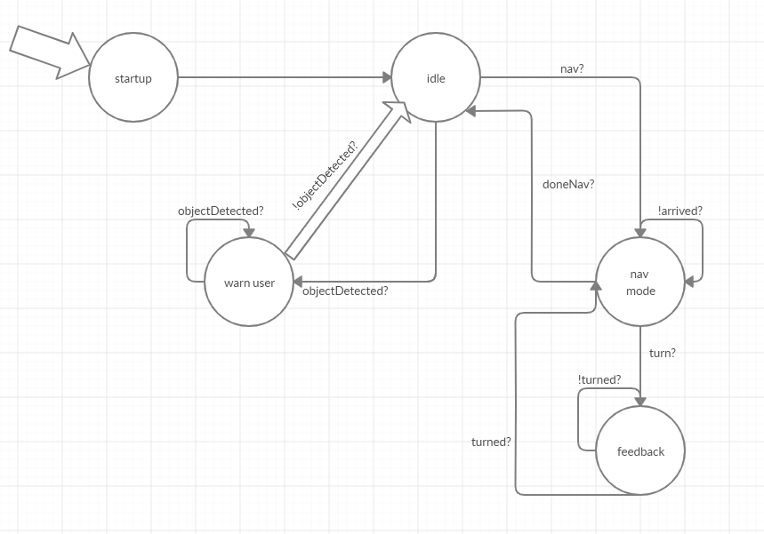
Design Specifications (FSM)
Idle - always checking for incoming objects
Nav Mode - Gives feedback based on directions

Slide 18
Preliminary Results

Slide 19
Work Done and WiP: Summary
App is well under way. Software designs and mockups were created, screen layouts were put together, and we are in the process of integrating and testing map APIs
Hardware has been significantly delayed by recent events
Components have been tested, and we are preparing to begin working on building a more robust prototype

Slide 20
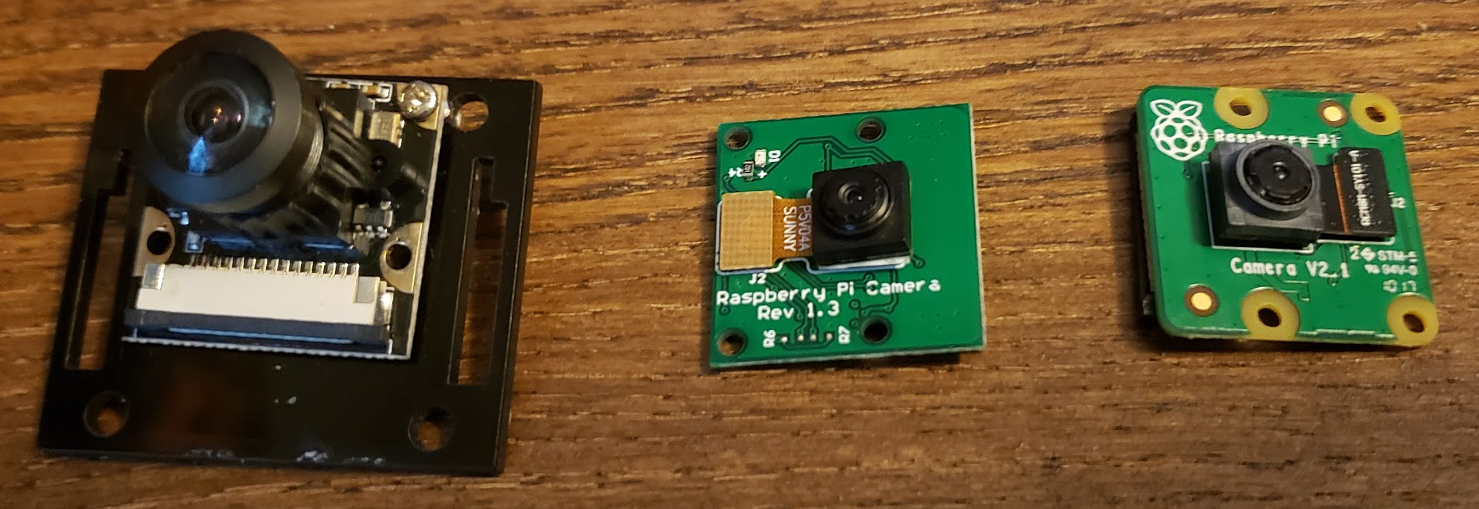
Camera Tests:
Left to right: Long lens, V1.3, V2.1

Slide 21
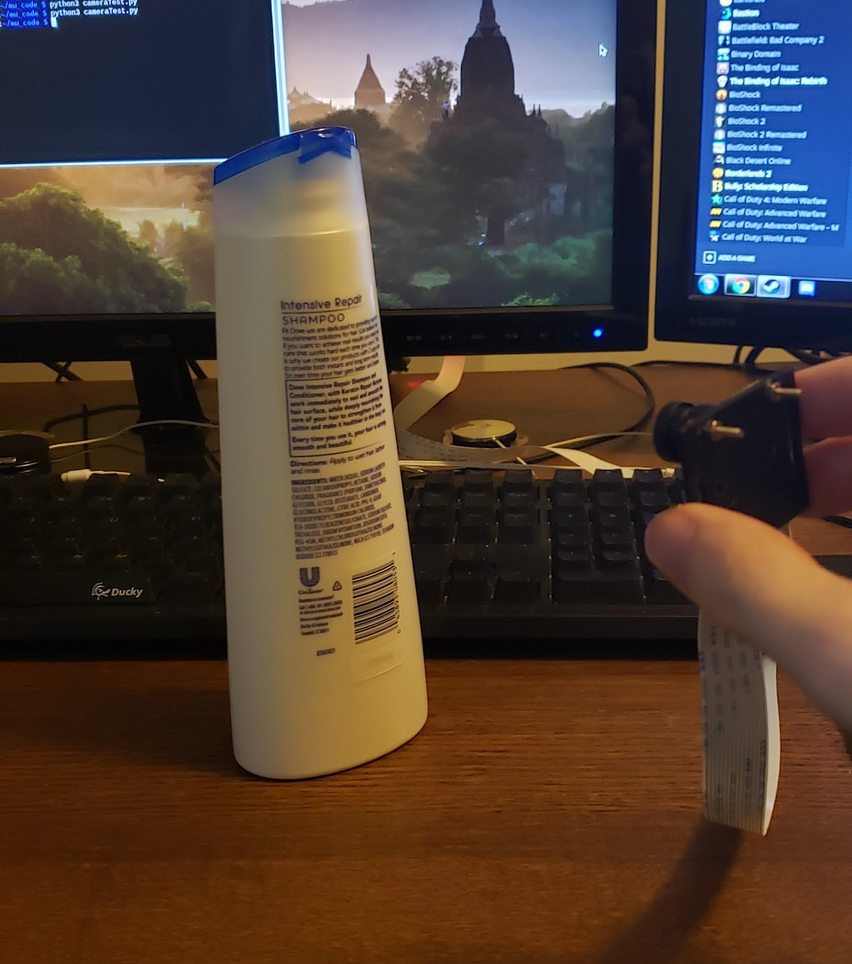
Camera Tests:
Testing environment

Slide 22
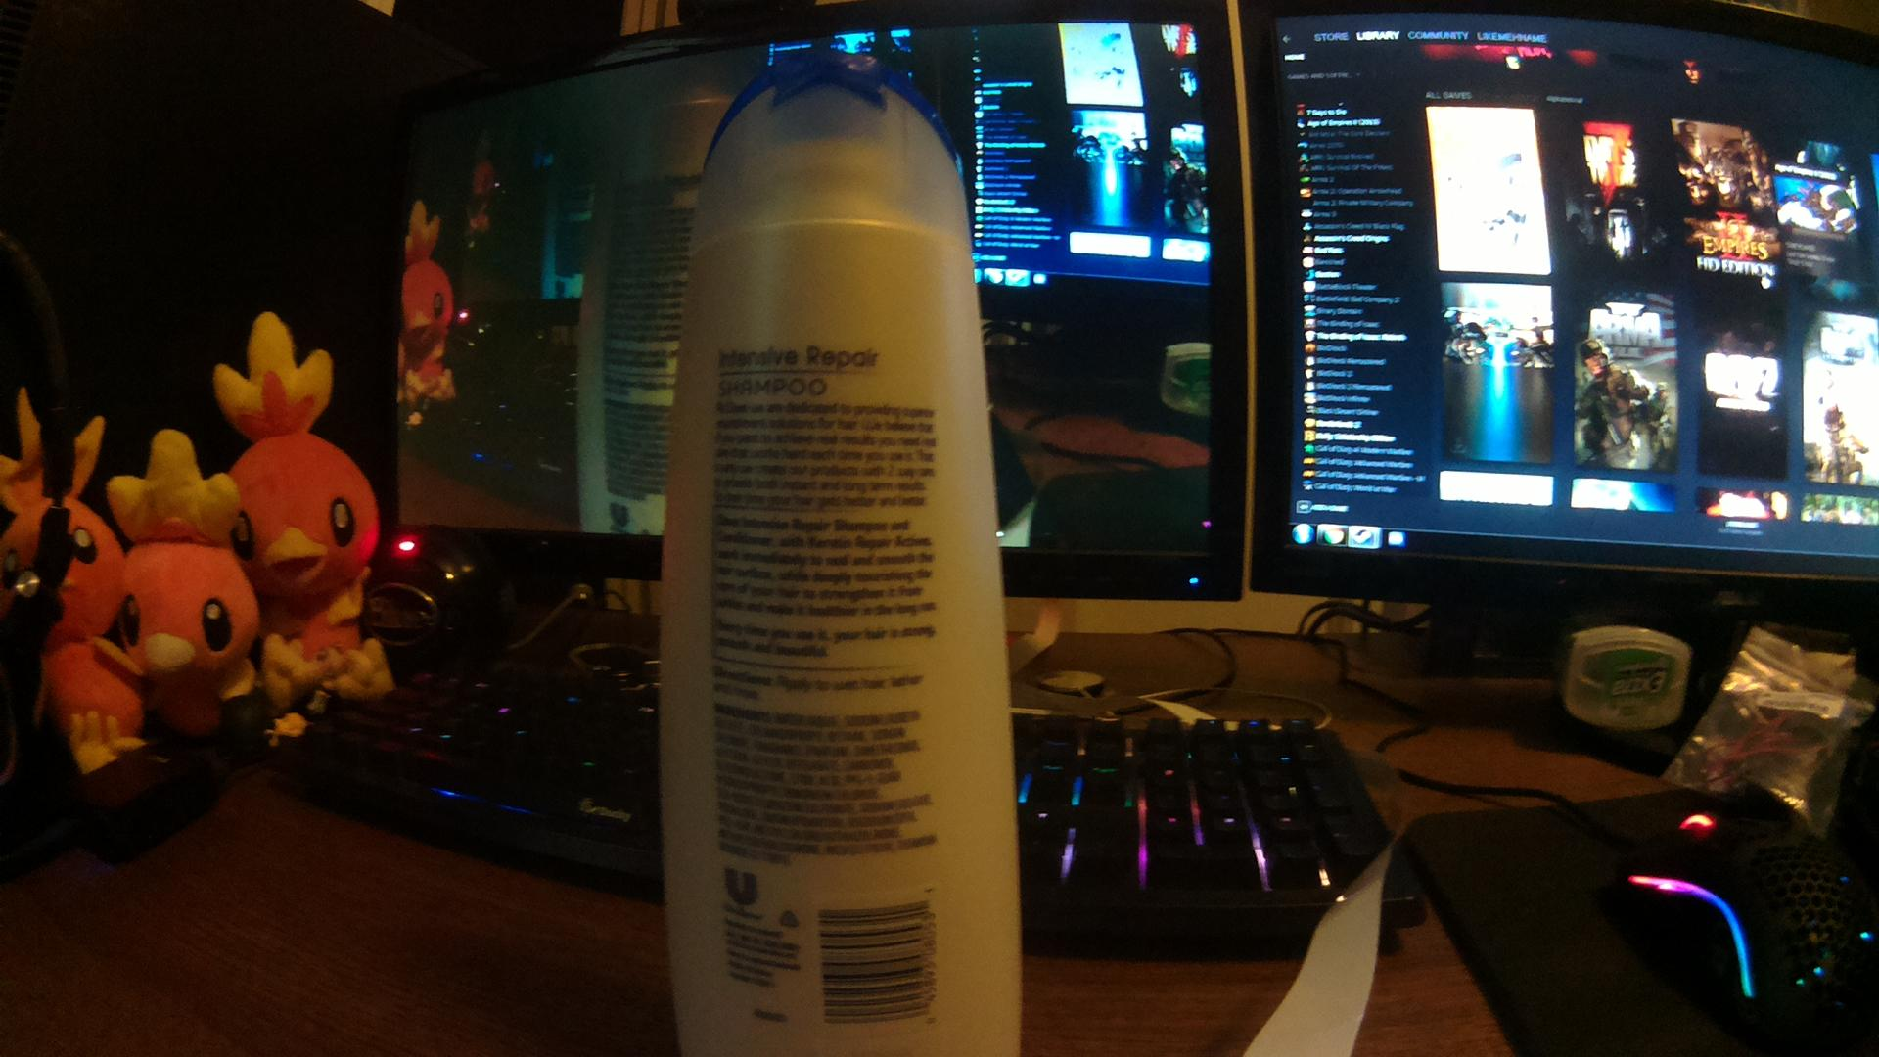
Camera Tests:
Long Lens

Slide 23
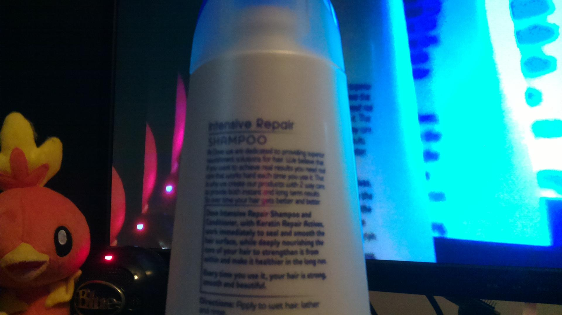
Camera Tests:
V1.3

Slide 24
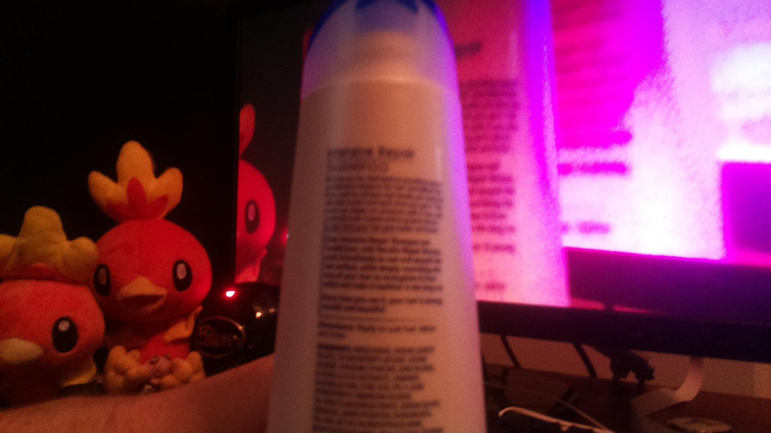
Camera Tests:
V2.1

Slide 25
Camera Tests: Results
Long Lens
Best quality
Wider angle lens
V1.3
2nd best quality
Slightly lower resolution
V2.1
Trouble focusing
Otherwise same quality as V1.3

Slide 26
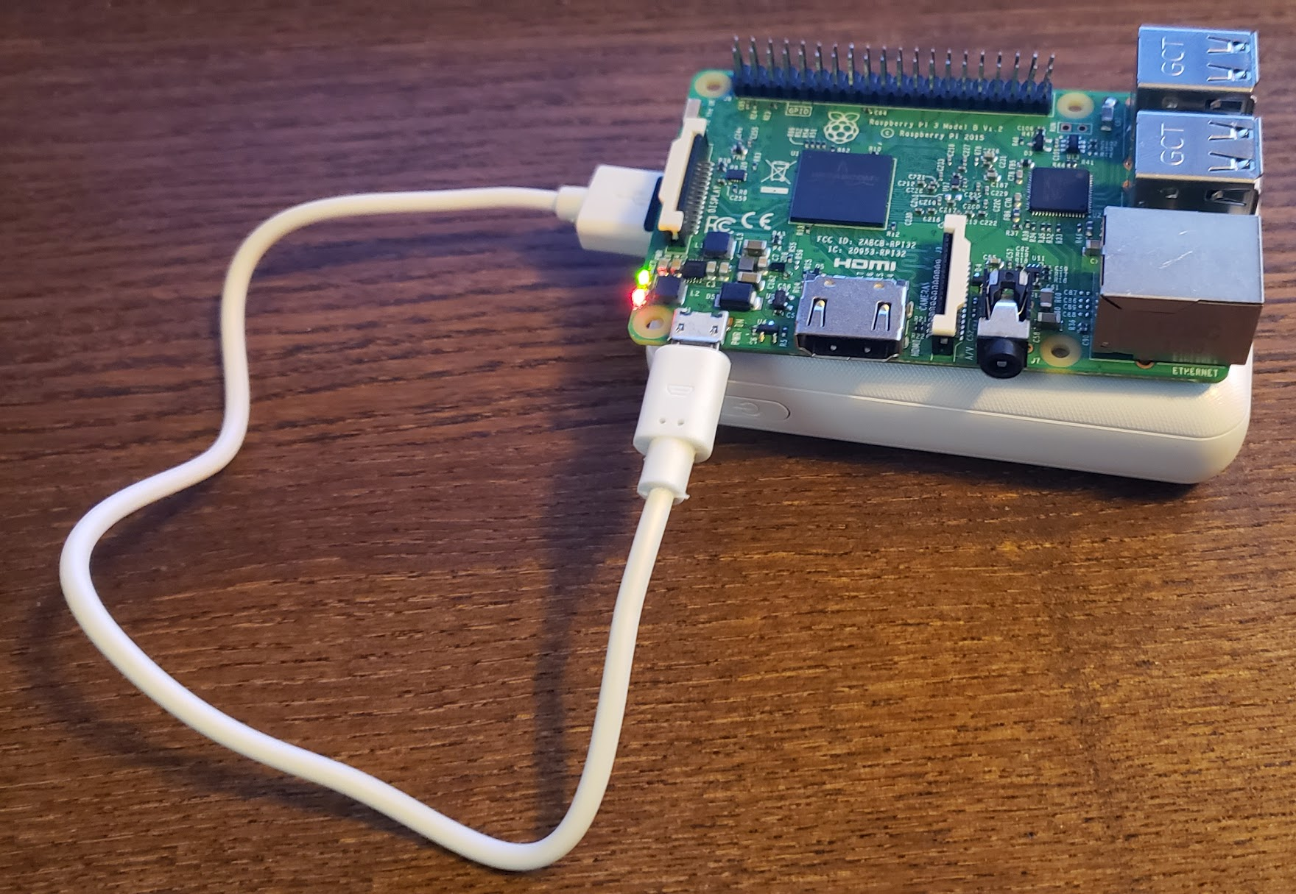
Battery Test
Lasted 13 hours on battery when idling

Slide 27
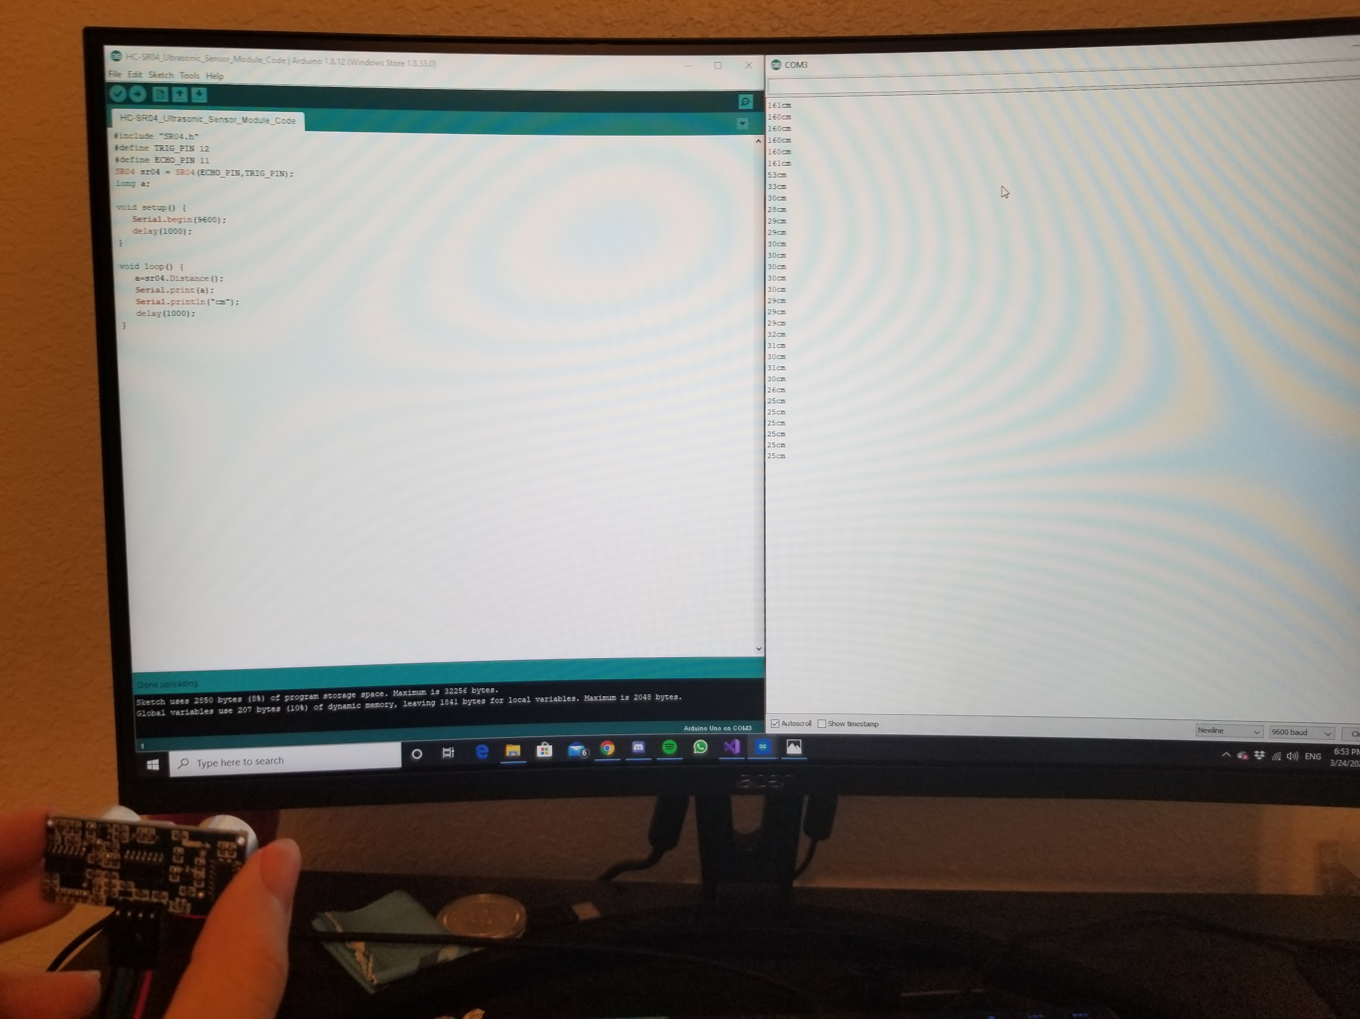
Sensor Tests:
Very accurate at a distance under 5 ft.
Anything over 5 ft can have a variation of up to 10% from the actual distance.

Slide 28

App Progress:

Slide 29
Design Validation
and Demonstration

Slide 30
Design Validation Plan
Pending Acceptance Test Cases
-Obstacle Detection
System (consisting of RaspberryPi, ultrasonic sensors, haptic motors) must be able to use the ultrasonic sensors to consistently detect objects in the users path
If an object is found, this information is communicated using haptic motors, or audio feedback
In order to test that this function is working correctly, obstacles (like a chair or a box) will be placed in the users path, if the device can consistently warn the user within our intended detection radius ( currently 10 ft infront and 3ft overhead and to the sides) it can be categorized as functional and the components can be permanently added onto the device.
-User Navigation
the user must be able to use the application to select a location (for our purpose we are using on-campus locations) using text to speech, and then they are led to that location with the app, which will use either the vibration motors or audio feedback (depending on the users choice) to guide the user.
We can test by selecting a location, and having the navigation directions accurately communicated using the cues, then this functionality works.

Slide 31
Design Validation Plan
-Indoor navigation (breadcrumb system)
The gyroscopic sensor, attached to the Pi, and the app, must work together to allow a user to set “anchors”, that the user can then be lead back to using audio or vibration cues. Multiple anchors should be able to be set, and the user is lead to each anchor in the reverse order that they were set.
Due to current events, it may be difficult to coordinate testing, and we may have to use the phone’s gyroscope.
To ensure the breadcrumb system is working correctly, we will set anchor points, then mark them on the floor, and make sure we are led back to the correct positions.
-Emergency Contact
A button will be present on the cane, if we are able to activate this button (using 2 long presses of the button), and have the Pi send the signal to the app, which will call the users emergency contact of choice, then this functionality works.

Slide 32
Design Demonstration Plan
Video Demo: Since we may not be able to demonstrate the cane in person, a video can be made that will consist of the following parts:
Emergency contact function
Demonstration of obstacle detection
Location Navigator
Demonstration of indoor navigation
Emergency Contact Function: Video of a team member pressing the button on the cane, then showing that the app makes the appropriate call
Obstacle Detection: An outdoor/indoor area is set up with cardboard box obstacles,or chairs, then one of us is shown blindfolded navigating around the area with the cane, the audio feedback option will be turned on so the cues can be heard on camera

Slide 33
Design Demonstration Plan
Location Navigator: If we are allowed/it’s safe to go on campus, we will film a blindfolded user choosing a close location (so the video isn’t long), then having the audio cues direct them to the building.
Indoor Navigation: A room will be set up with “x’s” taped to the floor, one of us will be filmed walking in and setting an anchor at each x. Then they will put a blindfold on, spin around, wait till their dizziness passes, then use the app to find their way back to each x until they are guided out of the room.
If we are able to demonstrate in person, then the obstacle detection, indoor navigation, and emergency contact can be done in person. The obstacles will be chairs set up in the room next to the classroom, and x marks will be placed on the floor. The location navigation will still be demonstrated through video.

Slide 34
Project Management
Schedule of Tasks
Economic Analysis
Itemized Budget
Societal, Safety and Environmental Analysis
Engineering Standards

Slide 35
Project Management
Baltazar Guerra: Team leader, system and software design.
Shawn Popal: Software design, app development, finance and purchases.
Arthur Helmen: Hardware and circuitry design, component testing.
Matthew Giuffrida: Hardware and software design, prototype testing.
Jonathan Williams: Software design and prototype testing.

Slide 36
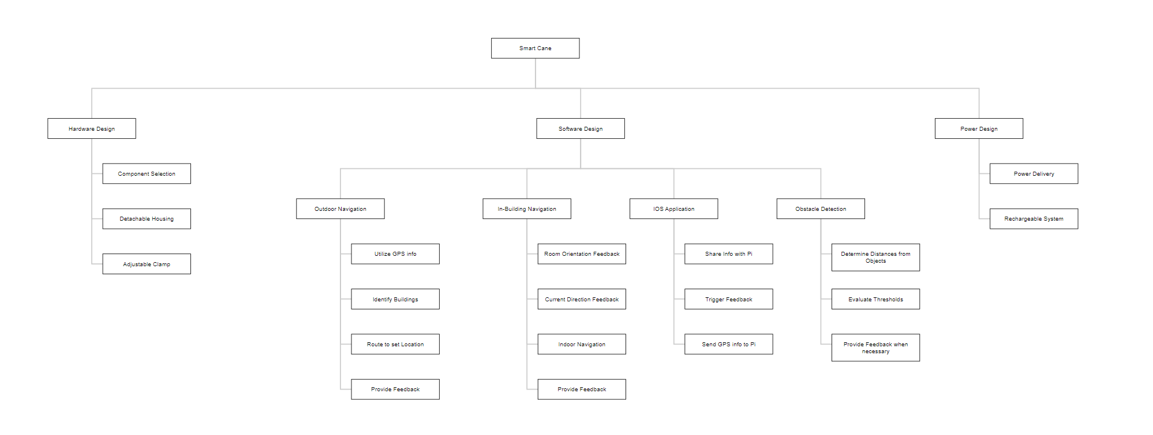
Project Management

Slide 37
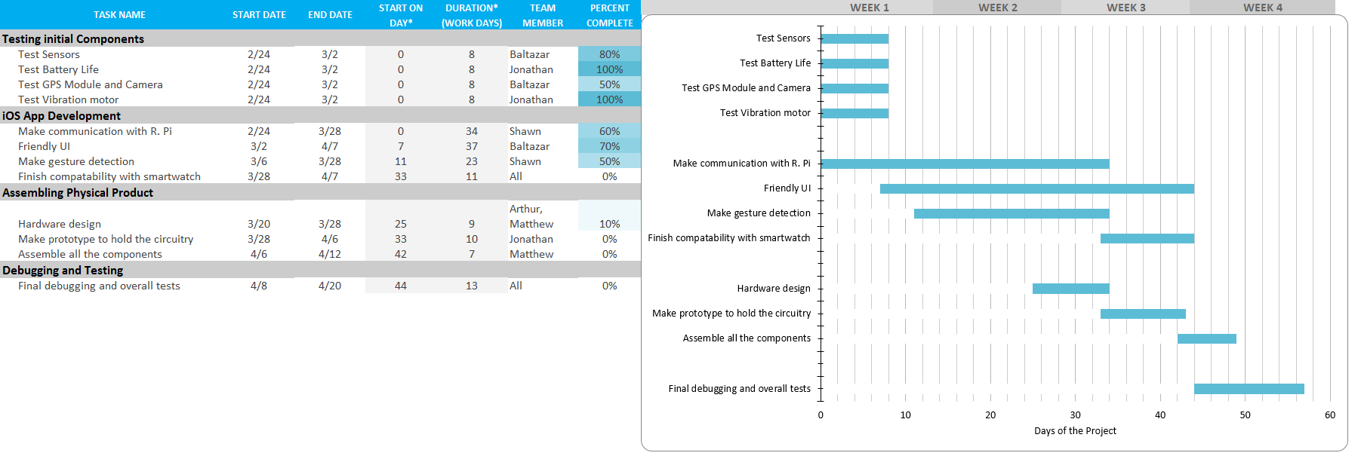
Schedule of Tasks

Slide 38
Economic Analysis
Current Market Solutions are very pricey and do not satisfy every requirement
In-Building Navigation
Outdoor Navigation
Unique Solution for the Texas A&M Campus
Modular Solution
Improve functionality while reducing price significantly
Providing solutions to key issues specific to the Campus
Parts are readily available
No maintenance required

Slide 39
Itemized Budget
Item | Quantity | Estimated Cost
Raspberry Pi 3 B | 1 | $45
Ultrasonic Sensors | 3 | $6
Infrared Sensor | 2 | $4
Light Sensor | 1 | $1
Gyroscope | 1 | $15
Camera | 2 | $60
Vibration Motor | 5 | $5
Speaker | 1 | $5
Battery | 1 | $39
White Cane | 1 | $15
GPS Module | 1 | $37
Total | 19 | $232

Slide 40
Societal, Safety and Environmental Analysis
Goal of this product is to aid the lives of those who are visually impaired, hopefully allowing them to navigate through the Texas A&M campus as seamlessly as possible
Safety naturally is the number one concern
Crosswalks, Buses, Utility Vehicles, People
Many unpredictable variables on a day to day basis
100% electric power system
Rechargeable Battery

Slide 41
REFERENCES
[1] UltraCane, “About the UltraCane,” http://www.ultracane.com/about_the_ultraca ne, (19 July 2014) [2] R. K. Megalingam, A. Nambissan, A. Thambi, A. Gopinath, and M. Nandakumar, “Sound and touch based smart cane: Better walking experience for visually challenged,” 2015.
[3] M. Aggravi, D. Prattichizzo, G. Salvietti, “Haptic Assistive Bracelets for Blind Skier
Guidance” , AH ‘16: Proceedings of the 7th Augmented Human International Conference 2016.
[4] M. Brock, P. O. Kirstensson, “ Supporting Blind Navigation Using Depth Sensing and Sonification”, UbiComp ‘13 Adjunct: Proceedings of the 2013 ACM Conference on Pervasive and Ubiquitous Computing Adjunct Publication.
[5] V. Kulyukin, C. Gharpure, J Nicholson, and S. Pavithran. Rfid in robotassisted indoor navigation for the visually impaired. 2004 IEEE/RSJ International Conference on Intelligent Robots and Systems, 2004.

Slide 42
ACKNOWLEDGEMENTS
Justin Romack (Student Disability Services, TAMU), justinr@disability.tamu.edu

