Slide 1




Slide 2
Neural Networks
ANN and CNN
AIRO Week 4
Created by Caden Wondell

Slide 3
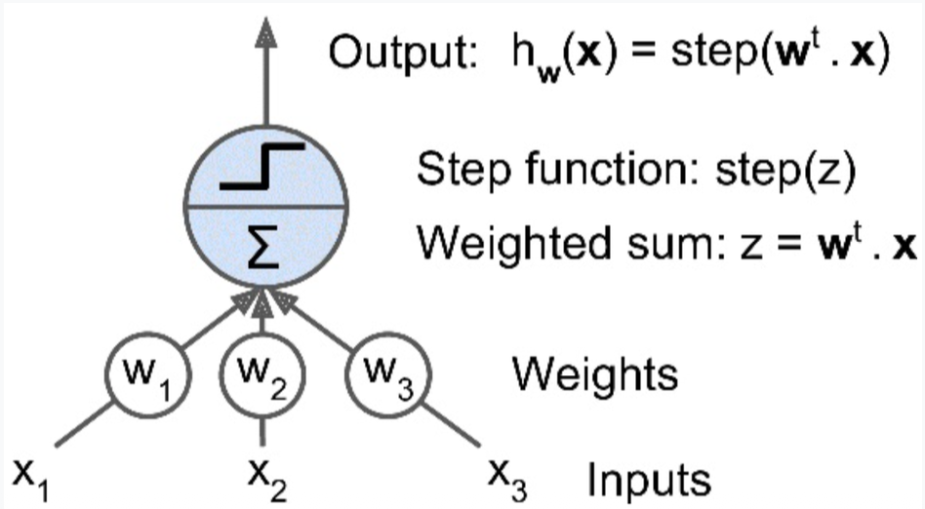
What is an Artificial Neural Network?
An artificial neural network is made of interconnected artificial neurons, also called Linear Threshold Unit (LTU), by McCulloch and Pitts, 1943.
Each neuron:
  Receives inputs
  Assigns weights to those inputs
  Calculates a weighted sum
  Applies an activation function
  Produces an output

Slide 4
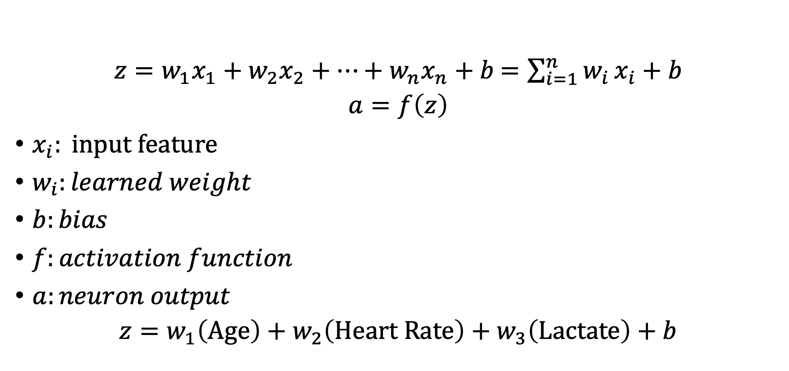
The Math Inside One Neuron
$z=w_{1}x_{1}+w_{2}x_{2}+⋯+w_{n}x_{n}+b$ $=\sum_{i=1}^{n}{w_{i}}x_{i}+b$
$$a=f\left(z\right)$$
$x_{i}: \text{input feature }$
$w_{i}:learned weight$
$b:bias$
$f:activation function$
$a:neuron output$
$$z=w_{1}\left(\text{Age}\right)+w_{2}\left(\text{Heart Rate}\right)+w_{3}\left(\text{Lactate}\right)+b$$

Slide 5
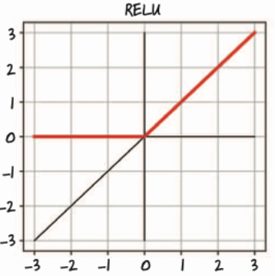
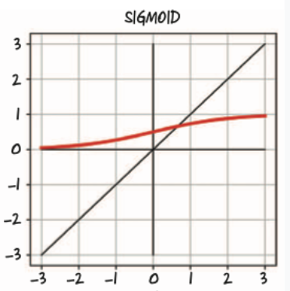
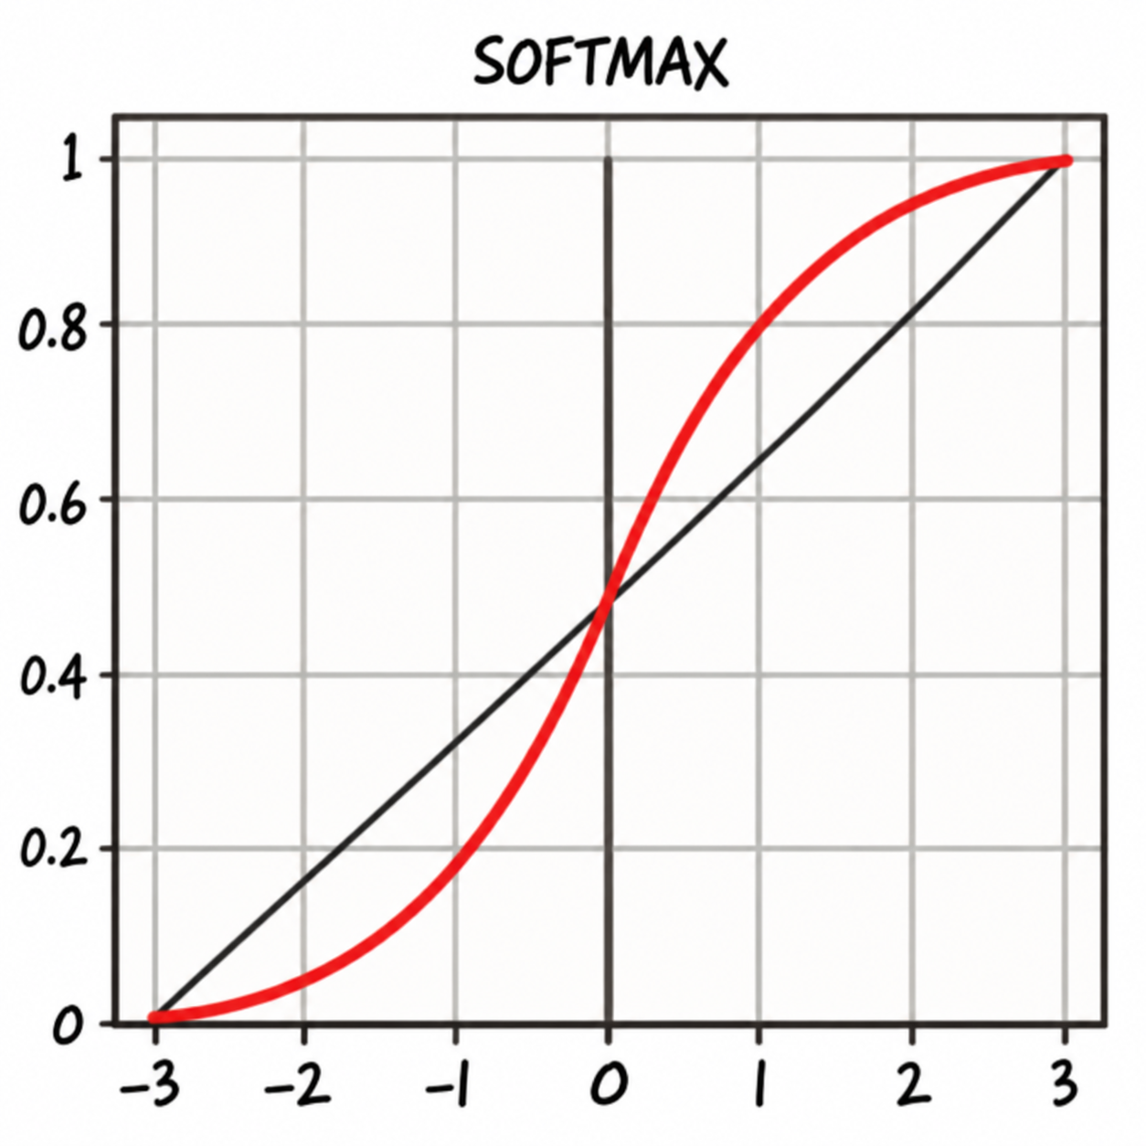

Activation Functions
ReLU: $f\left(x\right)=\max\left(0,x\right)$
Sigmoid: $σ\left(x\right)=\frac{1}{1+e^{−x}}$
Softmax: $\text{Softmax}\left(z_{i}\right)=\frac{e^{z_{i}}}{\sum_{j=1}^{K}{e^{z_{j}}}}$

Slide 6
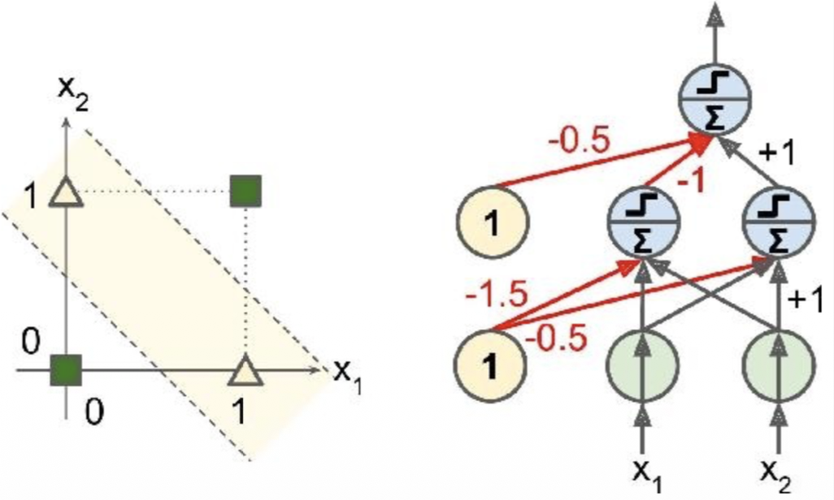
Why Do We Need Multiple Layers?
A single perception can learn relatively simple decision boundaries
However, single perceptions cannot solve trivial non-linear separable problems.
Example: XOR
Solution: Stack perceptions together
Multiple perceptron's can solve any
non-linear problem
Minsky and Papert, 1969

Slide 7
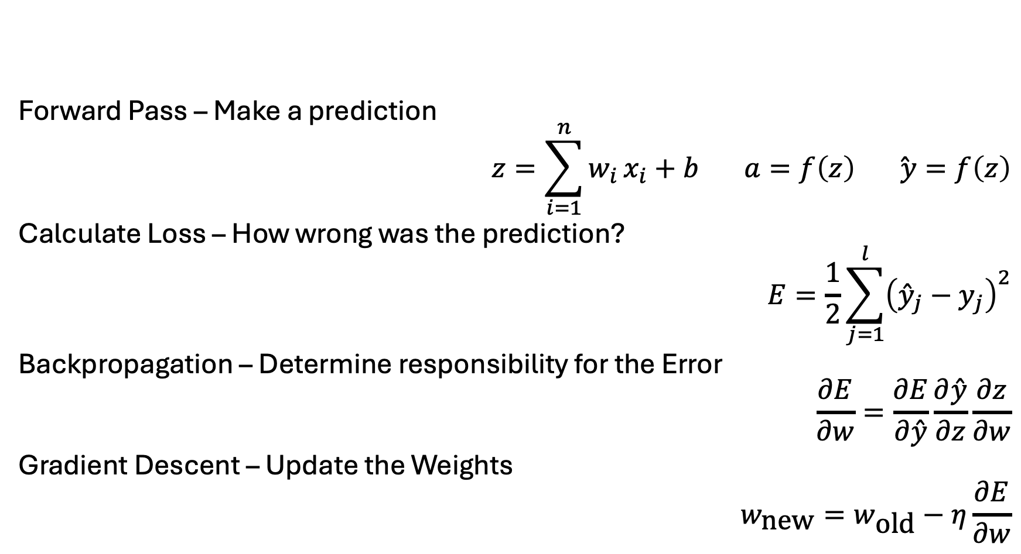
How Does a Neural Network Learn?
Forward Pass – Make a prediction
$$z=\sum_{i=1}^{n}{w_{i}}x_{i}+b a=f\left(z\right) \overset{ˆ}{ y}=f\left(z\right)$$
Calculate Loss – How wrong was the prediction?
$$E=\frac{1}{2}\sum_{j=1}^{l}{{\left({\overset{ˆ}{y}}_{j}−y_{j}\right)}^{2}}$$
Backpropagation – Determine responsibility for the Error
$$\frac{∂E}{∂w}=\frac{∂E}{∂\overset{ˆ}{y}}\frac{∂\overset{ˆ}{y}}{∂z}\frac{∂z}{∂w}$$
Gradient Descent – Update the Weights
$$w_{\text{new}}=w_{\text{old}}−η\frac{∂E}{∂w}$$

Slide 8
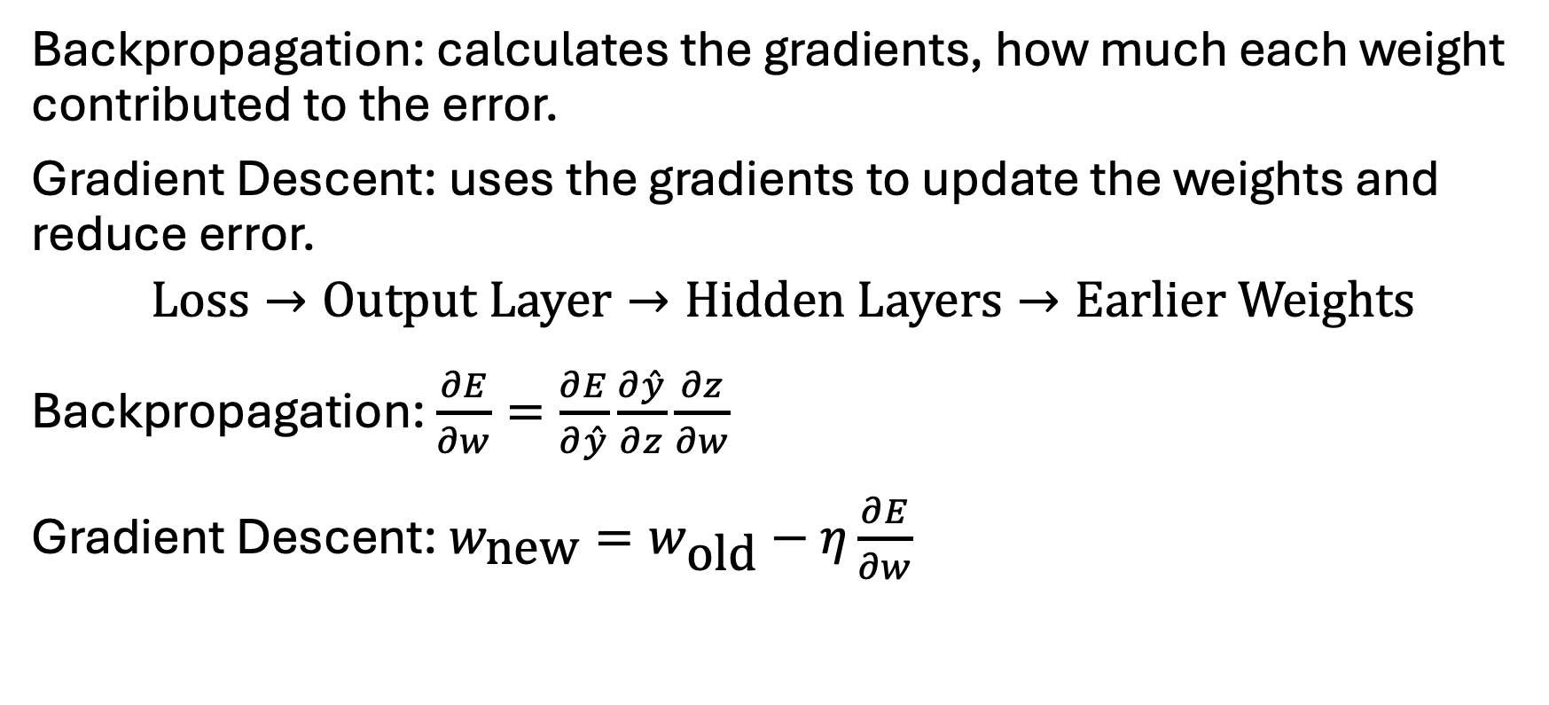
Backpropagation and Gradient Descent
Backpropagation: calculates the gradients, how much each weight contributed to the error.
Gradient Descent: uses the gradients to update the weights and reduce error.
$$\text{Loss}→\text{Output Layer}→\text{Hidden Layers}→\text{Earlier Weights}$$
Backpropagation: $\frac{∂E}{∂w}=\frac{∂E}{∂\overset{ˆ}{y}}\frac{∂\overset{ˆ}{y}}{∂z}\frac{∂z}{∂w}$
Gradient Descent: $w_{\text{new}}=w_{\text{old}}−η\frac{∂E}{∂w}$

Slide 9
Neural Network Training Vocabulary
Epoch: One complete Pass through the training dataset
Batch: A subset of training examples processed together
Batch Size: The number of examples in a single batch
Learning Rate: How large each optimization step is
Loss Function: Measures prediction error
Optimizer: Algorithm used to update network parameters

Slide 10
ANN vs CNN
A CNN is a type of Artificial Neural Network
ANN = Traditional fully connected Multi Layer Perceptron
CNN = Convolutional Neural Network
ANN’s Learn relationships tied to specific pixel positions
CNN’s learn a Kernel which can be used across the matrix

Slide 11
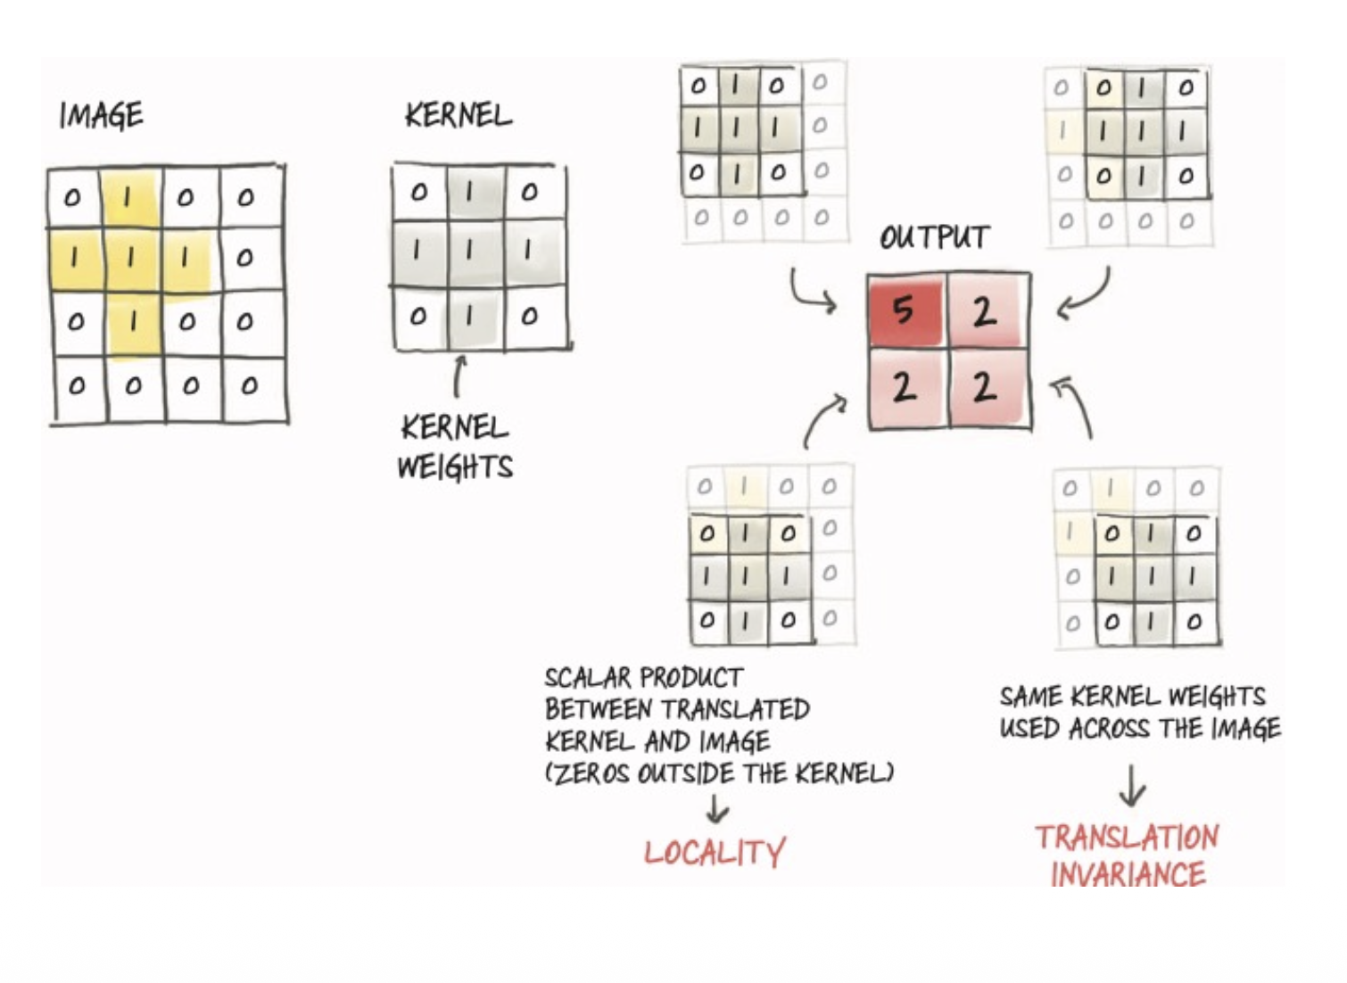
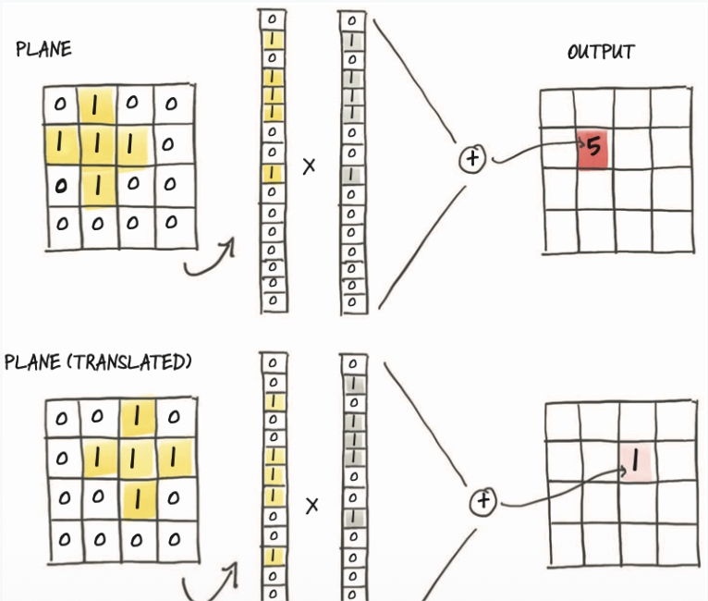
ANN vs CNN

Slide 12
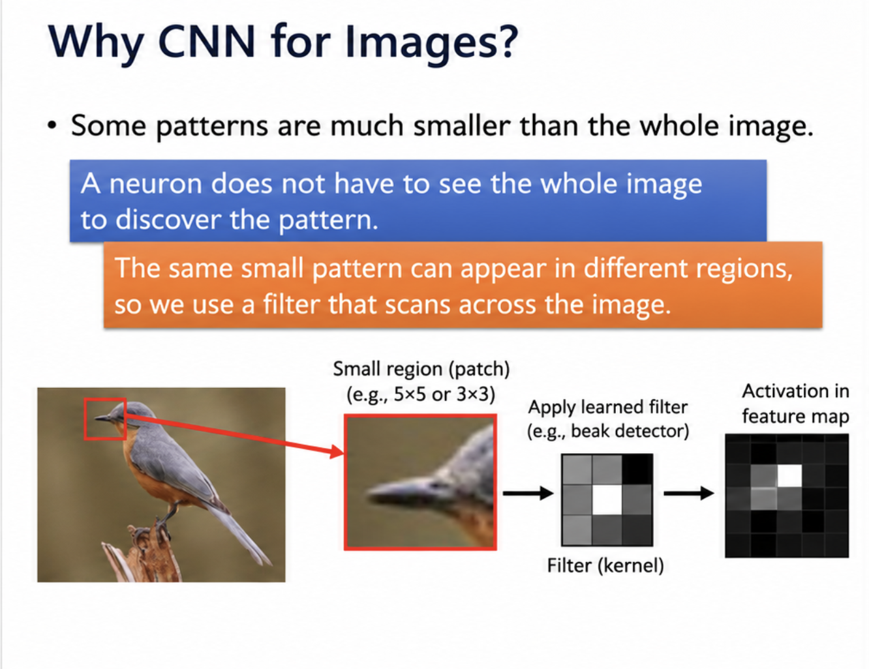
Why use CNN

Slide 13
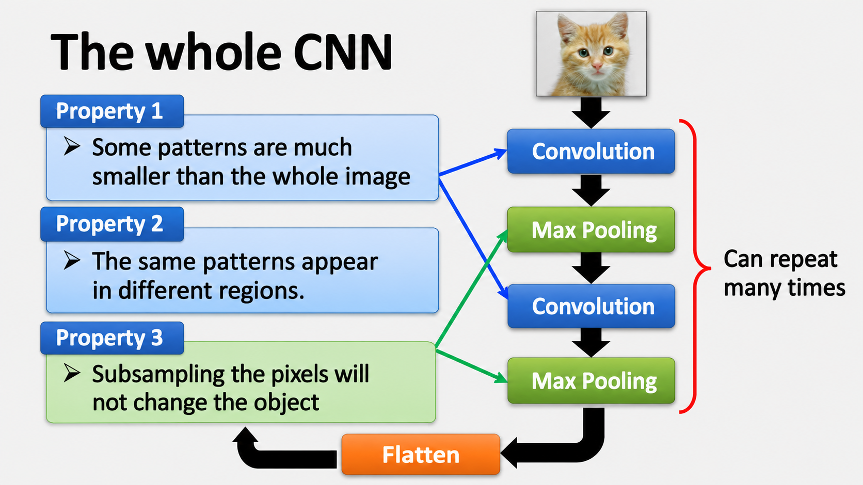
The Whole CNN

Slide 14
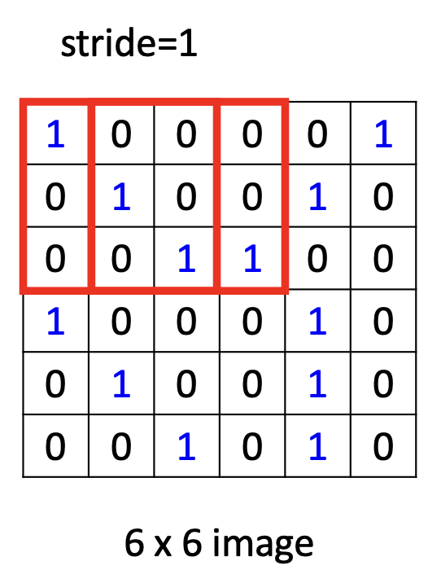
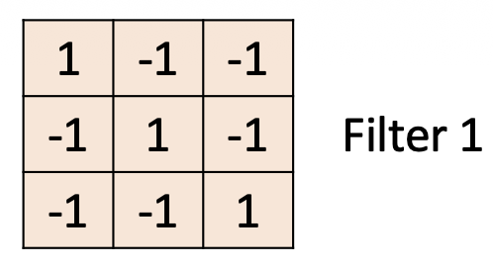
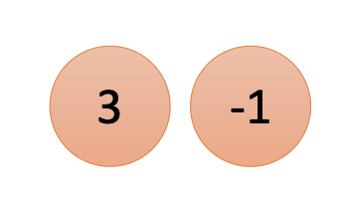
Convolution: Learning Visual Features
A small matrix called a Kernel/Filter slides across the Image.
The Kernel is used to make a Feature Map.

Slide 15
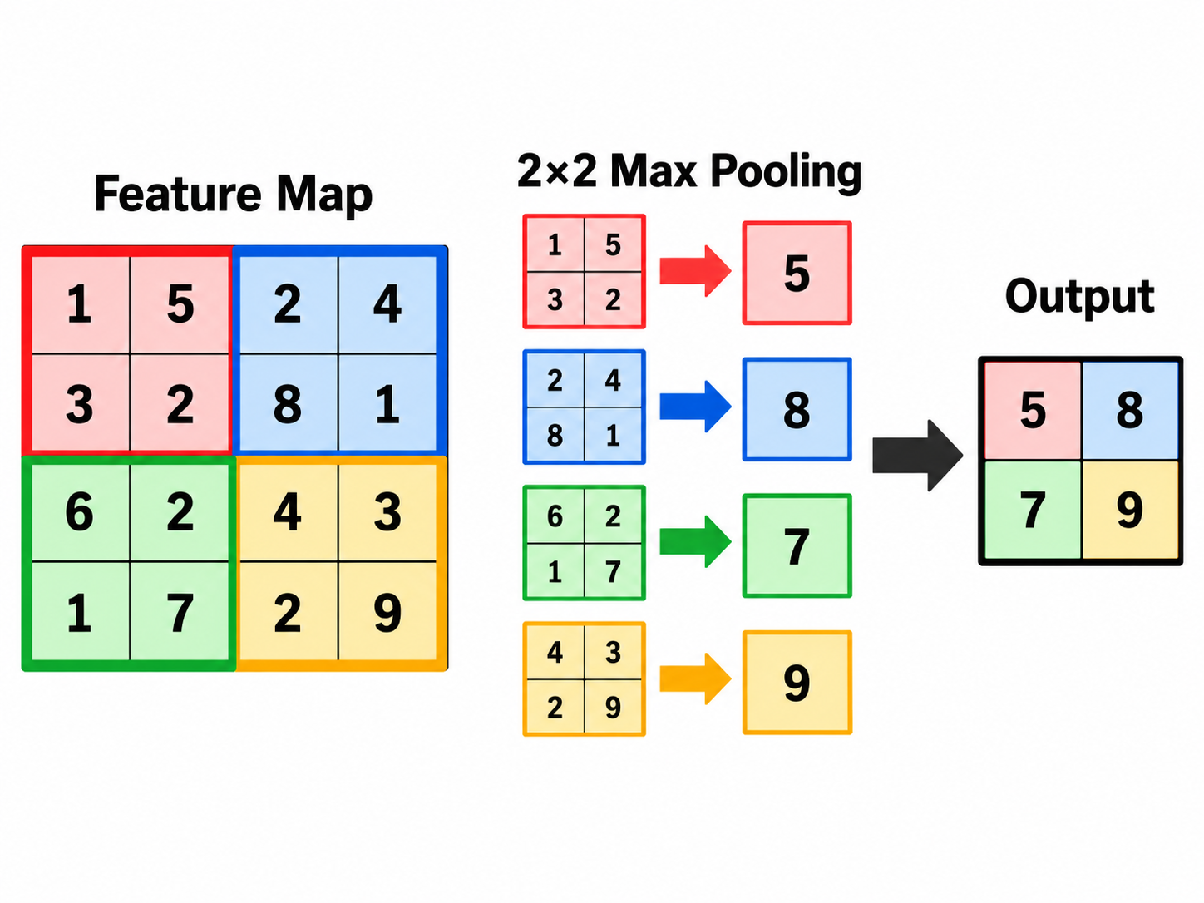
Max Pooling
Max Pooling reduces the spatial size while keeping the strongest feature responses. It does not learn weights; it simply takes the max

Slide 16
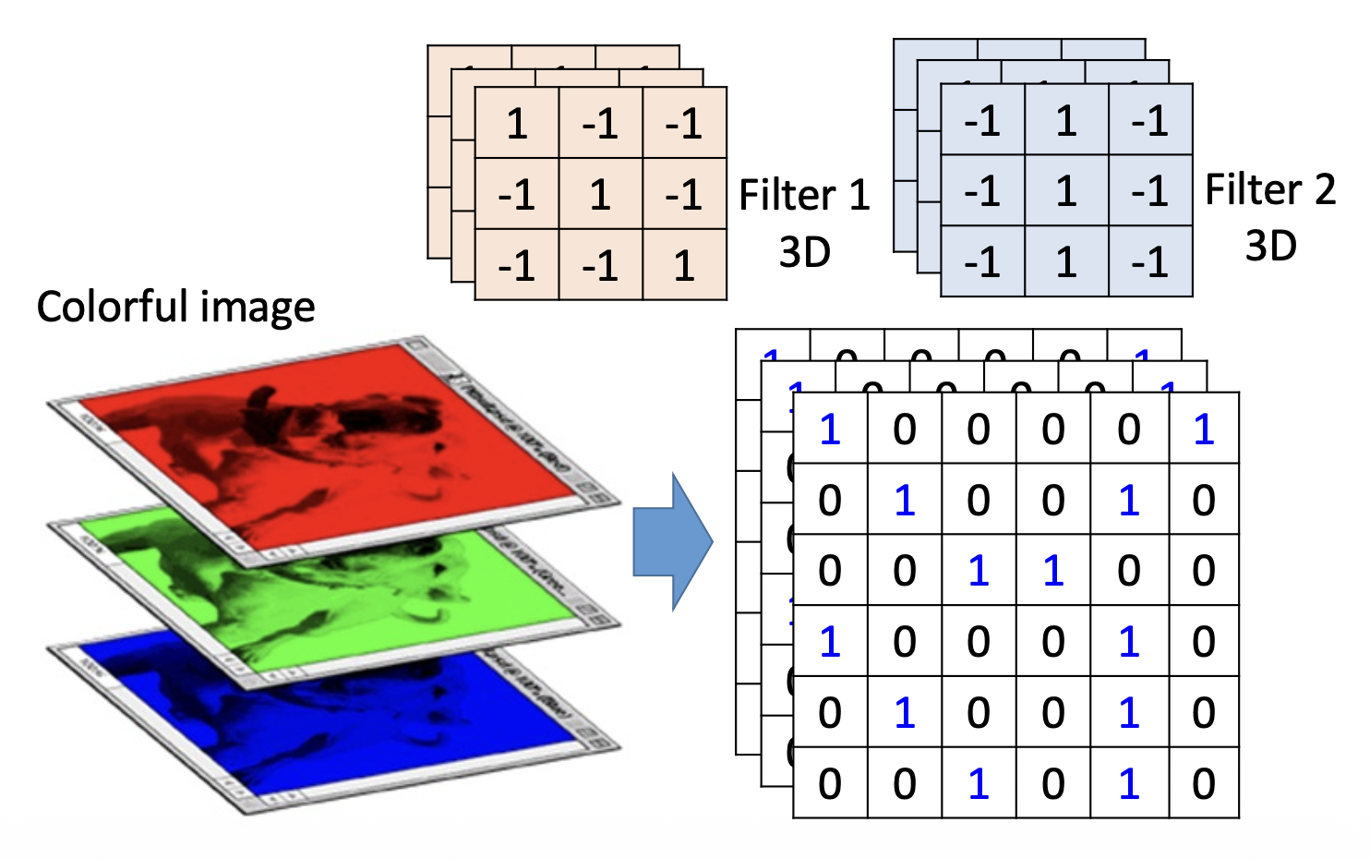
Multiple Filters = Multiple Feature Maps
Different filters detect different patterns
Each Filter creates one Feature Map
Feature maps are stacked for the next layer
Key Idea: Multiple Filters let the CNN learn multiple features at the same time.

Slide 17
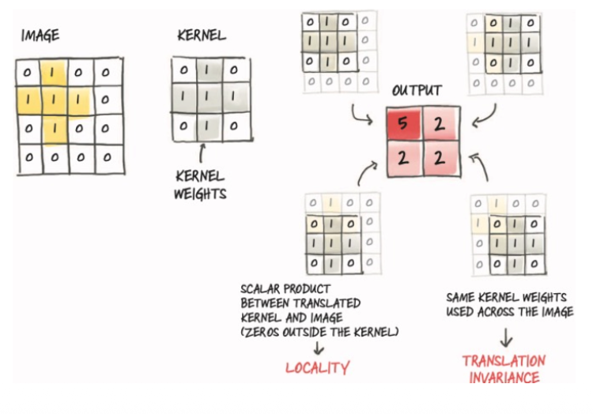
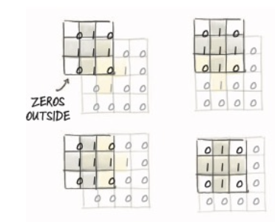
Stride and Padding
Stride = How far the filter moves each iteration
Padding = Adding pixels around the border so features near the edges are not lost.

Slide 18
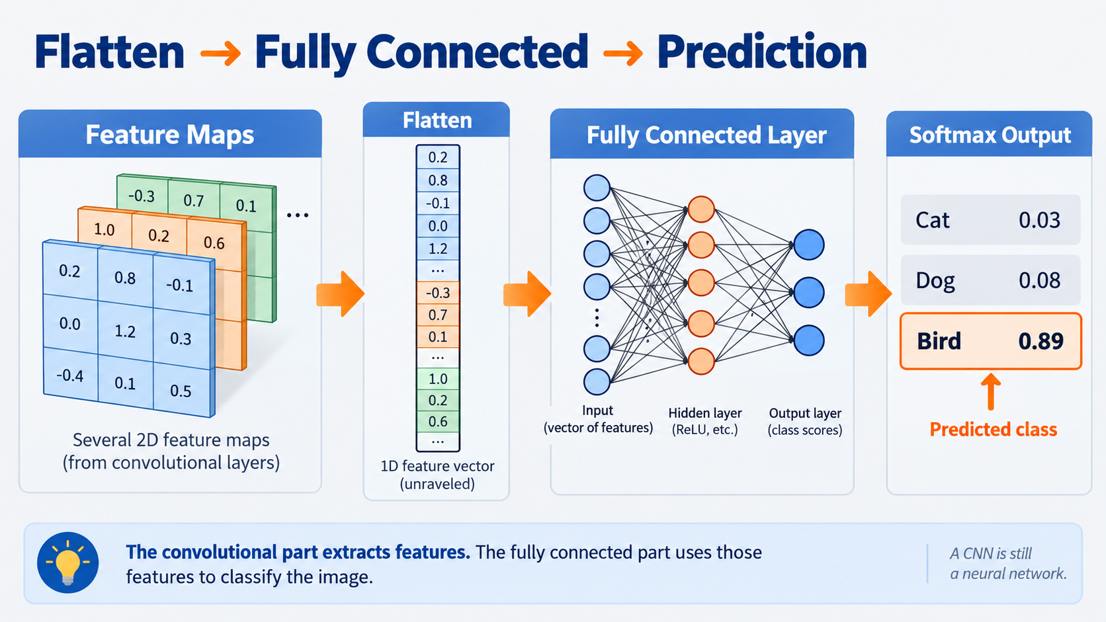
Flatten

Slide 19
ANN vs CNN Review:
ANN’s Learn relationships tied to specific pixel positions
CNN’s learn a kernel which can be used across the matrix
Data Type | Example | Best Model
Tabular | Age, WBC, HR, Weight | ANN, XGBoost, Random Forest
Image | MRI, X-ray, CT | CNN

