Slide 1




Slide 2
Project Idea: Multi-Model Clinical System
Build specialized ML models using MIMIC-IV and eICU
Each model predicts a different clinical risk
Combine all model predictions into one clinical facing system
Example Models:
Sepsis Risk, Acute Kidney Failure, SOFA score, LOS
Patient Data
ML Models
LLM
Clinical Dashboard

Slide 3
Specialized Models + LLM
Each Model focuses on a specific prediction task:
The LLM receives:
  Risk predictions
  Risk probabilities
  Important contributing factors
  Patient trends
  Predicted length of stay
LLM Output
  High / Moderate / Low severity
  Explanation of major concerns
  Structured clinician-facing summary
  Time-based outlook

Slide 4
Time-Based Patient Outlook
The Dashboard would organize clinical recommendations and considerations by time:
  Now → Current highest-priority concerns
  Within 1 Hour → Immediate considerations
  Within 6 Hours → Near-term predicted risks
  Within 24 Hours → Expected clinical trajectory
  Within 48 Hours → Longer-term predicted trajectory
Length-of-Stay Logic:
  The timeline stops at the patient's predicted discharge.

Slide 5
Research Goal
First Step: Literature Review
  Review existing clinical prediction models
  Review multi-model decision-support systems
  Review LLM clinical summarization research
  Identify gaps in current research
  Define specific research questions
Possible Research Questions
  Can an LLM effectively combine outputs from multiple specialized clinical models?
  Does combining specialized models provide more useful patient-risk summaries than a single model?
  Can models developed with MIMIC-IV generalize to eICU?
  Can an LOS-aware timeline produce more relevant clinical decision support?

Slide 6
Decision Trees, Random Forests, XGBoost
Tree-Based Machine Learning
Todays Question: Can patient data help us identify patients at increased risk of sepsis.
Created by Caden Wondell

Slide 7
What are Tree-Based Models?
Tree-based models make predictions by repeatedly asking questions about the features in the data.
Each decision divides the data into smaller groups until the model reaches a prediction.
Tree Models can solve:
  Classification
    Sepsis / Not Sepsis
    Disease / Not Disease
  Regression
    Length of hospital stay
    Recovery time

Slide 8
Our Example Medical Problem: Sepsis Risk
We will use patient data to predict a Sepsis label
Features
Heart Rate | Lactate
Temperature | Creatinine
MAP (Mean Arterial Pressure) | Age
Respiratory Rate | Gender
O2 Saturation | Stay Type
WBC (White Blood Cell Count) | Length of Stay

Slide 9
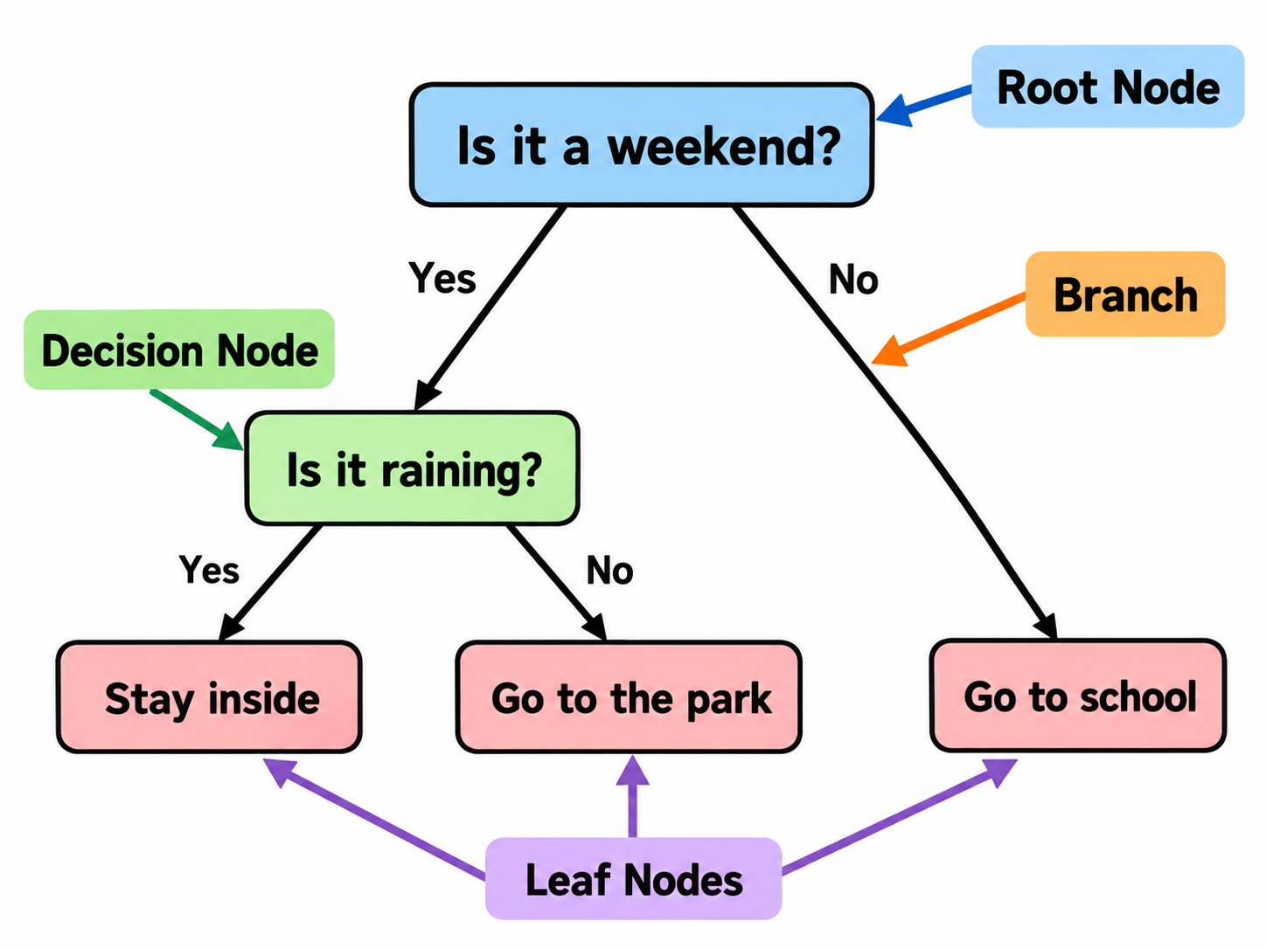
Decision Trees
A Decision Tree makes a prediction by following a sequence of rules.
Parts of a Decision Tree
  Root Node: The first decision made by the model
  Decision Node: A question about one of the features
  Branch: The result of a decision
  Leaf Node: the final prediction

Slide 10
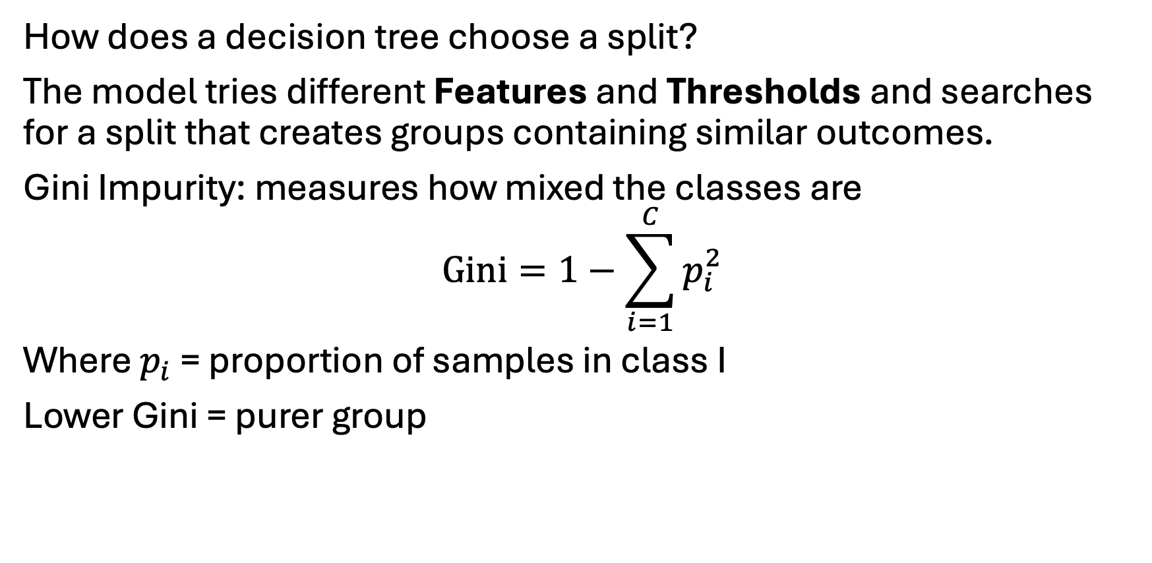
How Does a Tree Learn?
How does a decision tree choose a split?
The model tries different Features and Thresholds and searches for a split that creates groups containing similar outcomes.
Gini Impurity: measures how mixed the classes are
$$\text{Gini}=1−\sum_{i=1}^{C}{p_{i}^{2}}$$
Where $p_{i}$ = proportion of samples in class I
Lower Gini = purer group

Slide 11
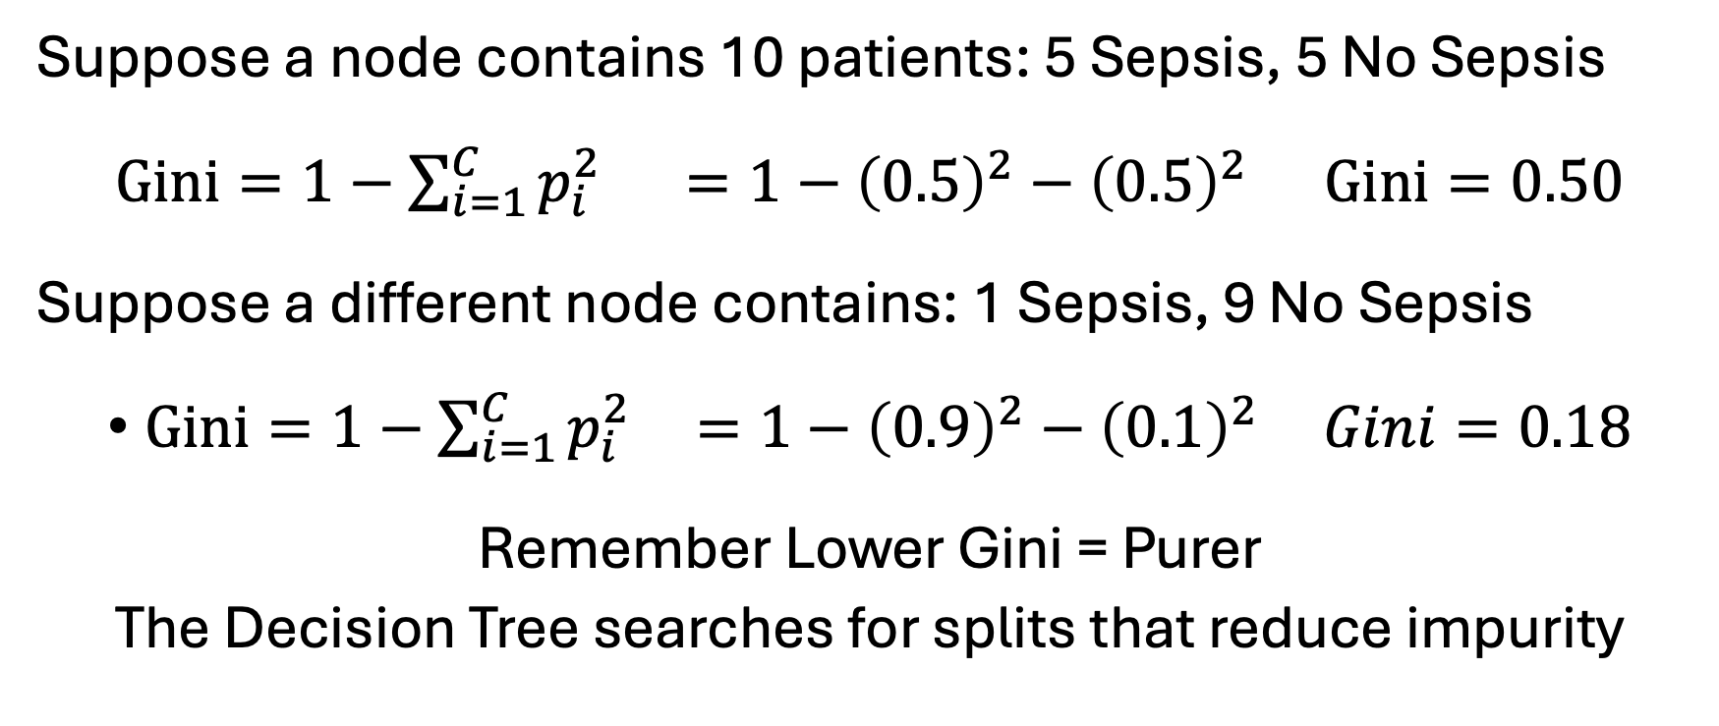
Gini Impurity Example
Suppose a node contains 10 patients: 5 Sepsis, 5 No Sepsis
$\text{Gini}=1−\sum_{i=1}^{C}{p_{i}^{2}}$ $=1−{\left(0.5\right)}^{2}−{\left(0.5\right)}^{2}$ $\text{Gini}=0.50$
Suppose a different node contains: 1 Sepsis, 9 No Sepsis
$\text{Gini}=1−\sum_{i=1}^{C}{p_{i}^{2}} =1−{\left(0.9\right)}^{2}−{\left(0.1\right)}^{2}$ $Gini=0.18$
Remember Lower Gini = Purer
The Decision Tree searches for splits that reduce impurity

Slide 12
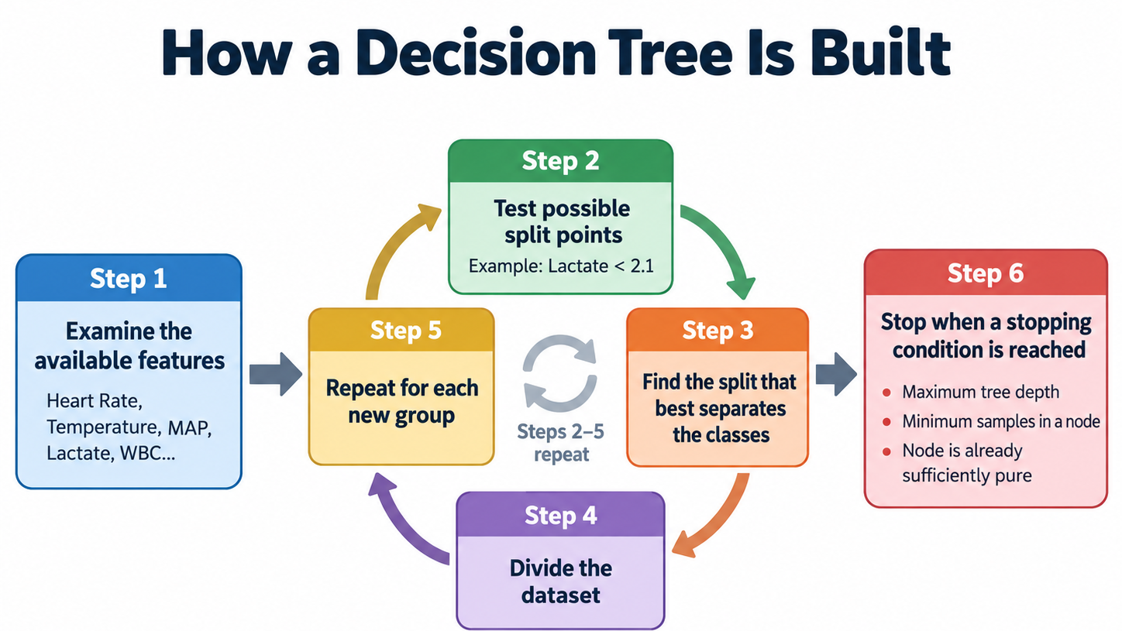

Slide 13
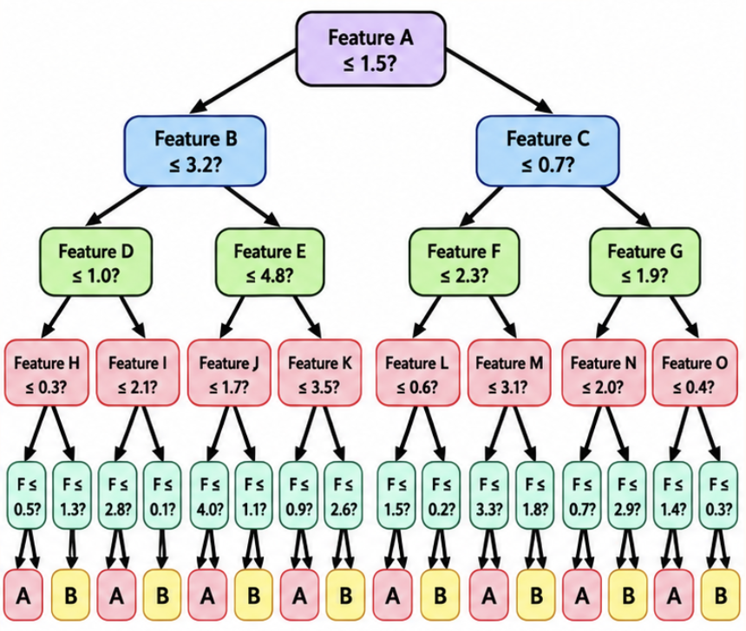
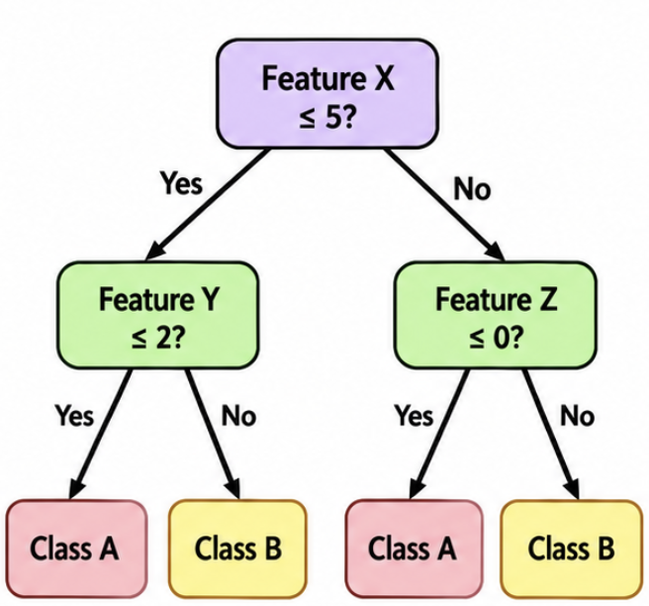


The Problem With Decision Trees: Overfitting
A Decision Tree can become so complex that it begins to learn patterns specific to the training data instead of patterns that generalize to new test data

Slide 14
From One Tree to a Forest
What if we train many trees?
Random Forest: trains many different Decision Trees and combines their predictions.
Example:
  Tree 1 → Sepsis
  Tree 2 → Sepsis Majority Vote:
  Tree 3 → No Sepsis 3 Sepsis > 2 No Sepsis
  Tree 4 → Sepsis
  Tree 5 → No Sepsis
Final Predication = Sepsis

Slide 15
How Random Forest Creates Different Trees
Random Training Samples
  Each Tree is trained using a random sample of the training data.
  This is called Bootstrap Sampling, its Aggregate is called Bagging
  Original: A B C D Bootstrap sample: ACCA
Random Feature Selection
  At each split, the tree considers only a random subset of the available features.
  Tree 1 emphasizes: Heart Rate + MAP
  Tree 2 emphasizes: WBC + Temperature
Random Forest = Bagging + Random Feature Selection

Slide 16
What is Boosting?
Initial Model
Current Errors
New Tree
Improved Model
Remaining Errors
New Tree
Random Forest builds trees that are largely independent
Boosting builds models sequentially so each new model improves the predictions made so far.
Radom Forest: Many Independent Trees
Boosting: Sequential trees that improve the current model

Slide 17
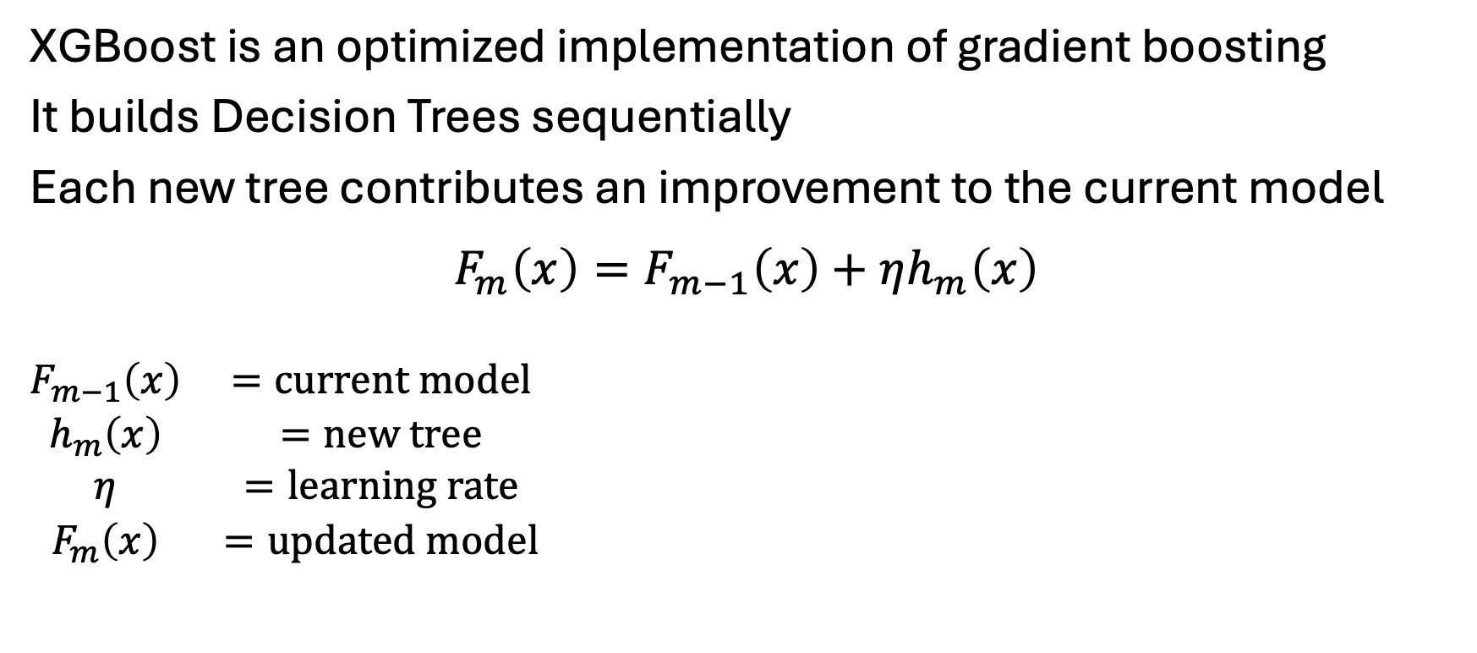
XGBoost: Extreme Gradient Boosting
XGBoost is an optimized implementation of gradient boosting
It builds Decision Trees sequentially
Each new tree contributes an improvement to the current model
$$F_{m}\left(x\right)=F_{m−1}\left(x\right)+ηh_{m}\left(x\right)$$
$$\begin{matrix}F_{m−1}\left(x\right) & =\text{current} \text{model} \\ h_{m}\left(x\right) & =\text{new} \text{tree} \\ η & =\text{learning} \text{rate} \\ F_{m}\left(x\right) & =\text{updated} \text{model}\end{matrix}$$

Slide 18
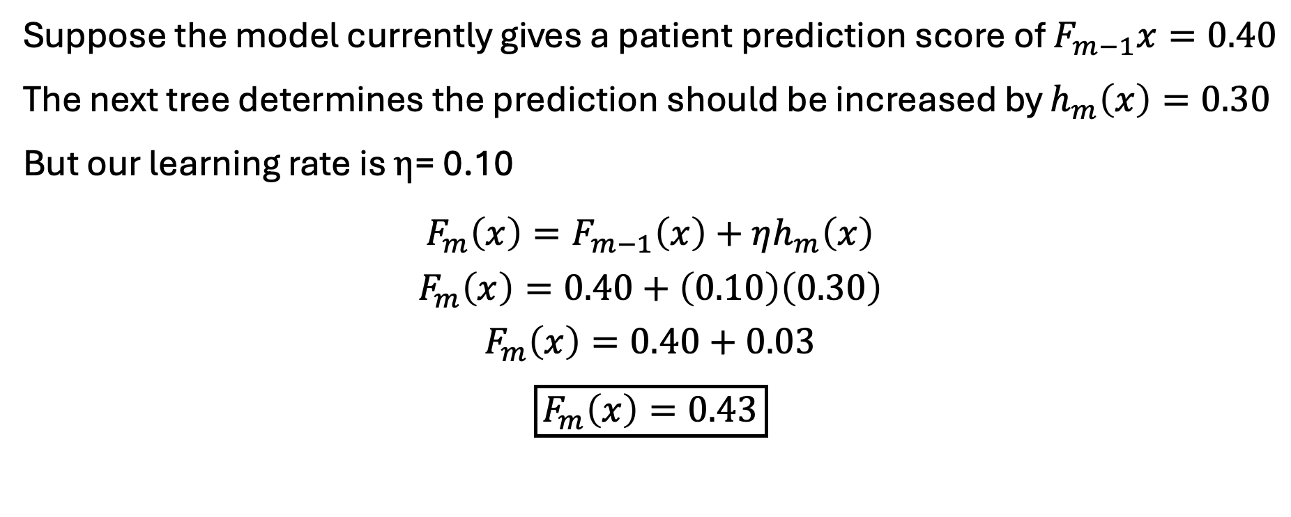
XGBoost: Example
Suppose the model currently gives a patient prediction score of $F_{m−1}x=0.40$
The next tree determines the prediction should be increased by $h_{m}\left(x\right)=0.30$
But our learning rate is $η$= 0.10
$$F_{m}\left(x\right)=F_{m−1}\left(x\right)+ηh_{m}\left(x\right)$$
$$F_{m}\left(x\right)=0.40+\left(0.10\right)\left(0.30\right)$$
$$F_{m}\left(x\right)=0.40+0.03$$
$$\boxed{F_{m}\left(x\right)=0.43}$$

Slide 19
Tree Comparison
 | Decision Tree | Random Forest | XGBoost
Technique | Single Tree | Bagging | Boosting
Trees | One Tree | Many Independent Trees | Many Sequential Trees
Training Data | Original Data | Bootstrap Samples | Current model errors
Main Goal | Learn Decision rules | Reduce variance and overfitting | Progressively reduce prediction error
Prediction | One tree’s output | Voting/Average | Combined tree
Interpretability | High | Moderate | Low

Slide 20

Model Evaluation
$\text{Accuracy}=\frac{TP+TN}{TP+TN+FP+FN}$
$\text{Precision}=\frac{TP}{TP+FP}$
$\text{Recall}=\frac{TP}{TP+FN}$
$F_{1}=2\left(\frac{\text{Precision}×\text{Recall}}{\text{Precision}+\text{Recall}}\right)$
Confusion Matrix | Predicted T | Predicted F
Actual T | True Positive | False Negative
Actual F | False Positive | True Negative

