Slide 1
Linear Regression + Logistic Regression
AIRO – Week 1
Created By: Caden Wondell

Slide 2
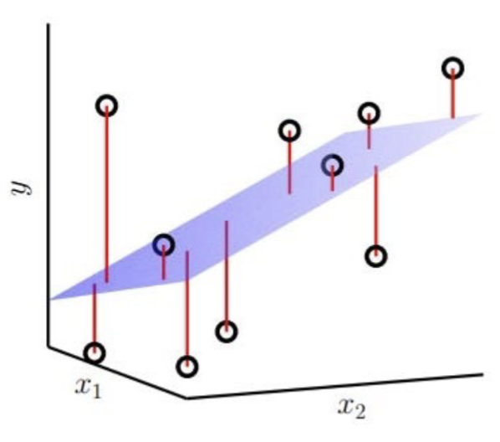
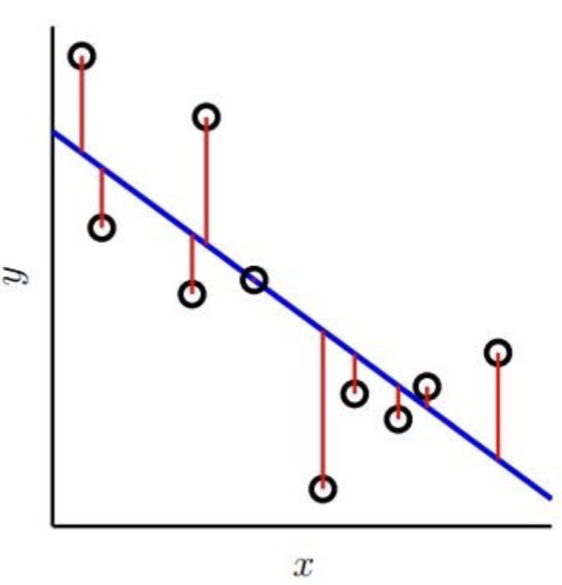
Regression & Linear Regression
Regression: Predicts a continuous numerical value.
Examples: temperature, power consumption, battery life, network latency.
Linear Regression: A simple regression model which finds the best-fit linear relationship between input and output to predict values

Slide 3
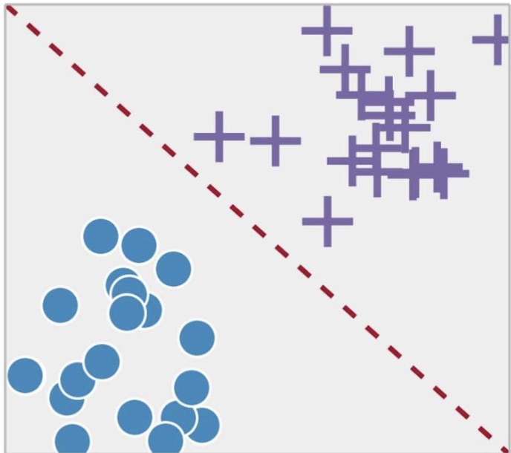
Classification & Logistic Regression
Classification: Predicts a category or class.
Examples: malicious/benign traffic, failure/no failure, spam/not spam.
Logistic Regression: A common model for binary classification. Predicts the probability that an input belongs to a class.

Slide 4
Regression vs Classification
Ask yourself: Am I predicting a quantity or a category?
Quantity → Regression
Category → Classification
Regression | Classification
Predicts a number | Predicts a category
Exam Score | Positive or Negative
House Price | Spam or Not Spam
Stock Price | Fraud or Not Fraud

Slide 5
Machine Learning Workflow:
Collect Data
Select Features and Labels
Split Training/Testing Data
Choose Model Type
Train the Model
Make Prediction
Evaluate Results

