Slide 1
K-Nearest Neighbors (KNN)
& K-means Clustering
AIRO – Week 2
Created by Caden Wondell

Slide 2
Supervised vs Unsupervised Learning
Supervised Learning
Training data includes the correct answer or label
The model learns from examples with known outcomes
Examples:
Linear Regression
Logistic Regression
K-Nearest Neighbors (KNN)
Unsupervised Learning
Training data does not include labels
The model looks for patterns or groups on its own
Examples:
K-Means
Hierarchical Clustering

Slide 3
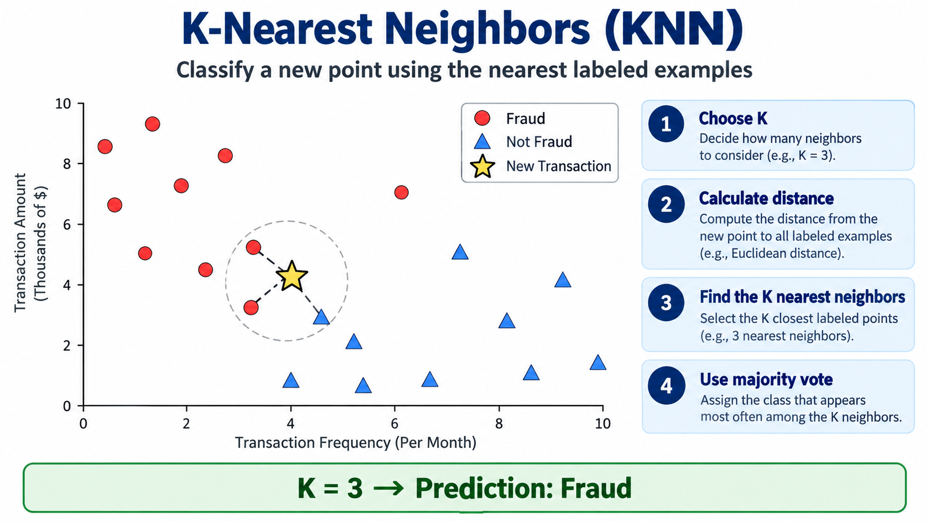
K-Nearest Neighbors (KNN): Core Idea

Slide 4
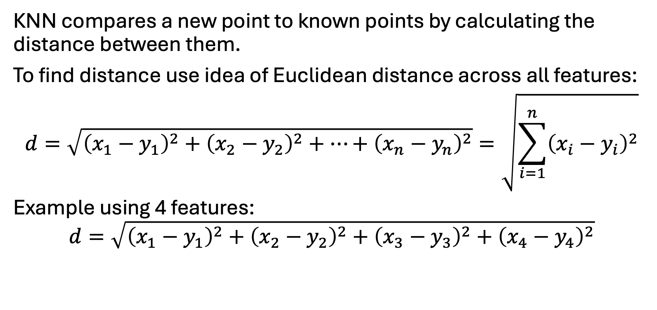
KNN: How do we Measure “Nearest”
KNN compares a new point to known points by calculating the distance between them.
To find distance use idea of Euclidean distance across all features:
$$d=\sqrt{{\left(x_{1}−y_{1}\right)}^{2}+{\left(x_{2}−y_{2}\right)}^{2}+⋯+{\left(x_{n}−y_{n}\right)}^{2}}=\sqrt{\sum_{i=1}^{n}{{\left(x_{i}−y_{i}\right)}^{2}}}$$
Example using 4 features:
$$d=\sqrt{{\left(x_{1}−y_{1}\right)}^{2}+{\left(x_{2}−y_{2}\right)}^{2}+{\left(x_{3}−y_{3}\right)}^{2}+{\left(x_{4}−y_{4}\right)}^{2}}$$

Slide 5

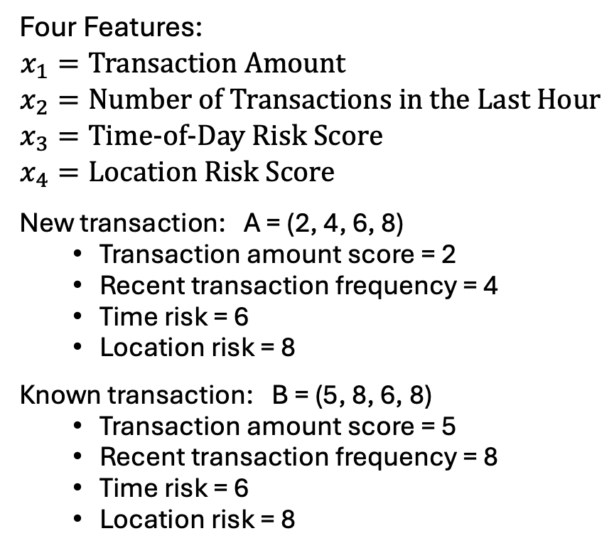
K-Nearest Neighbor Example:
Fraud Detection
Four Features:
$$\begin{aligned}x_{1}&=\text{Transaction Amount} \\ x_{2}&=\text{Number of Transactions in the Last Hour} \\ x_{3}&=\text{Time−of−Day Risk Score} \\ x_{4}&=\text{Location Risk Score}\end{aligned}$$
New transaction: A = (2, 4, 6, 8)
  Transaction amount score = 2
  Recent transaction frequency = 4
  Time risk = 6
  Location risk = 8
Known transaction: B = (5, 8, 6, 8)
  Transaction amount score = 5
  Recent transaction frequency = 8
  Time risk = 6
  Location risk = 8
Use:
$$d=\sqrt{{\left(x_{1}−y_{1}\right)}^{2}+{\left(x_{2}−y_{2}\right)}^{2}+{\left(x_{3}−y_{3}\right)}^{2}+{\left(x_{4}−y_{4}\right)}^{2}}$$
$$d=\sqrt{{\left(2−5\right)}^{2}+{\left(4−8\right)}^{2}+{\left(6−6\right)}^{2}+{\left(8−8\right)}^{2}}$$
$$d=\sqrt{{\left(−3\right)}^{2}+{\left(−4\right)}^{2}+0^{2}+0^{2}}$$
$$d =\sqrt{25}=5$$

Slide 6
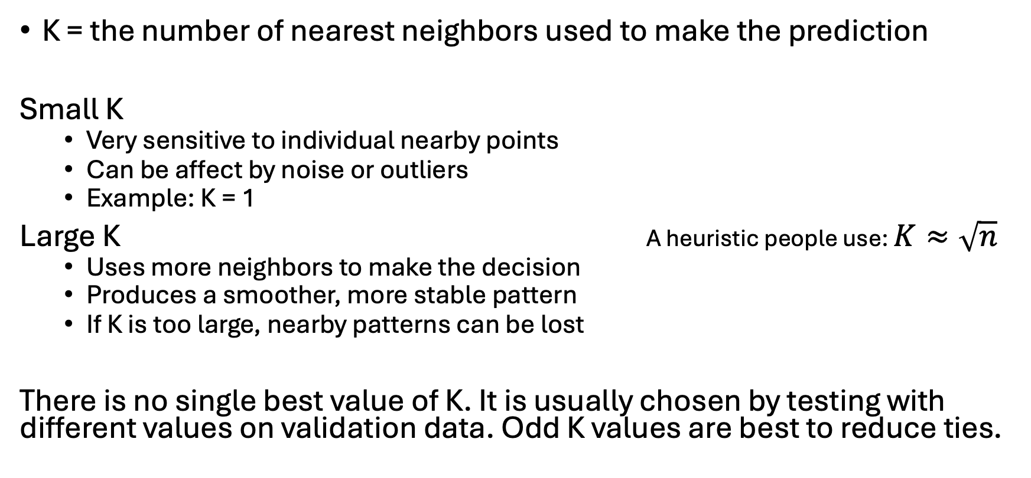
Choosing K in KNN
K = the number of nearest neighbors used to make the prediction
Small K
  Very sensitive to individual nearby points
  Can be affect by noise or outliers
  Example: K = 1
Large K A heuristic people use: $K≈\sqrt{n}$
  Uses more neighbors to make the decision
  Produces a smoother, more stable pattern
  If K is too large, nearby patterns can be lost
There is no single best value of K. It is usually chosen by testing with different values on validation data. Odd K values are best to reduce ties.

Slide 7
K-Means Clustering: Core Idea
K-Means is an unsupervised learning algorithm used to group similar data points into clusters
K-Means uses unlabeled data
K = the number of clusters
How it works:
Choose the number of K clusters and place K starting centroids
Assign each data point to its nearest centroid
Recalculate each centroid
Repeat until the clusters stop changing.

Slide 8
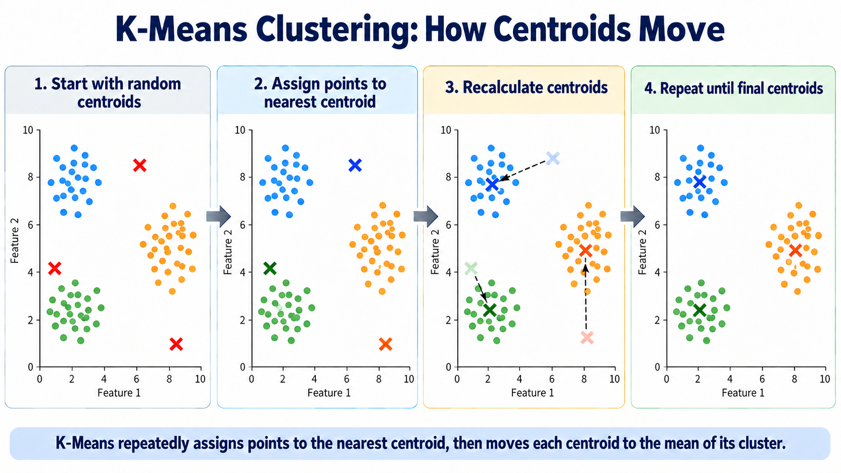

Slide 9
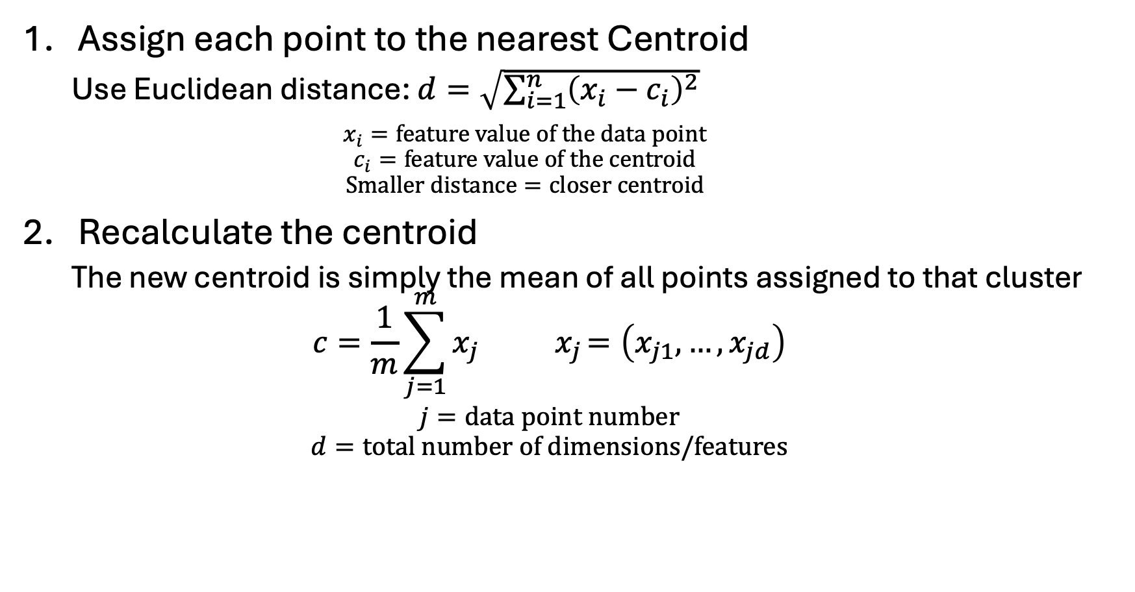
K-Means: The Math Behind the Clusters
Assign each point to the nearest Centroid
  Use Euclidean distance: $d=\sqrt{\sum_{i=1}^{n}{{\left(x_{i}−c_{i}\right)}^{2}}}$
    $$x_{i}=\text{feature value of the data point}$$
    $$c_{i}=\text{feature value of the centroid}$$
    $$\text{Smaller distance}=\text{closer centroid}$$
Recalculate the centroid
  The new centroid is simply the mean of all points assigned to that cluster
  $$c=\frac{1}{m}\sum_{j=1}^{m}{x_{j}{ x}_{j}=\left(x_{j1},…,x_{jd}\right)}$$
  $$j=\text{data point number}$$
  $$d=\text{total number of dimensions}\text{/}\text{features}$$

Slide 10
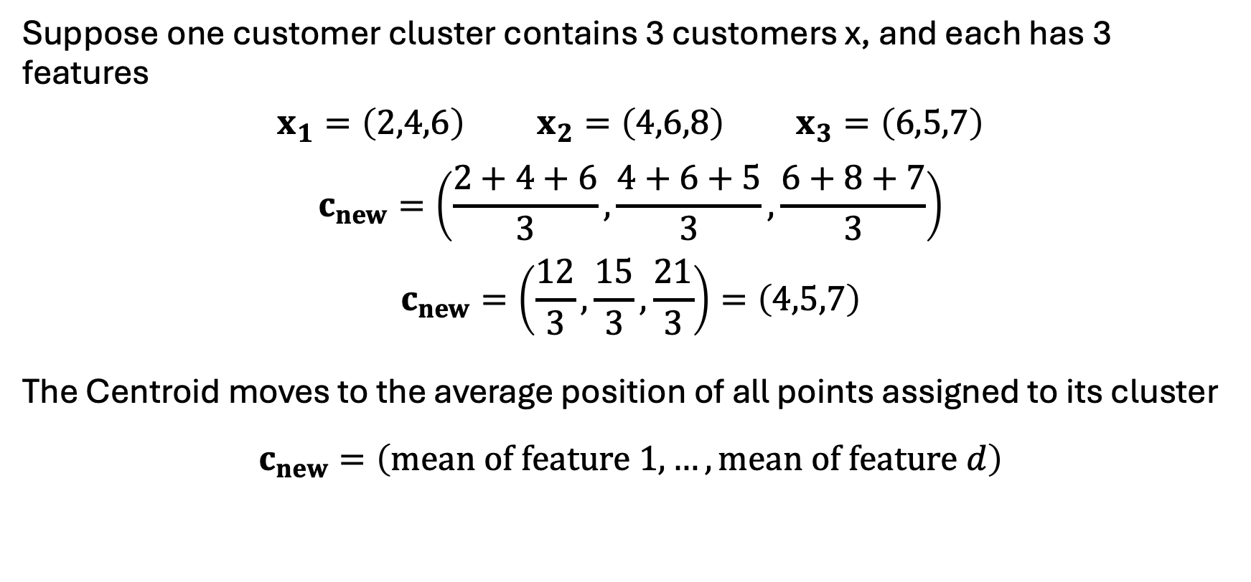
K-Means Example:
Calculating a New Centroid
Suppose one customer cluster contains 3 customers x, and each has 3 features
$$x_{1}=\left(2,4,6\right) x_{2}=\left(4,6,8\right) x_{3}=\left(6,5,7\right)$$
$$c_{new}=\left(\frac{2+4+6}{3},\frac{4+6+5}{3},\frac{6+8+7}{3}\right)$$
$$c_{new}=\left(\frac{12}{3},\frac{15}{3},\frac{21}{3}\right)=\left(4,5,7\right)$$
The Centroid moves to the average position of all points assigned to its cluster
$$c_{new}=\left(\text{mean of feature 1},…,\text{mean of feature }d\right)$$

Slide 11
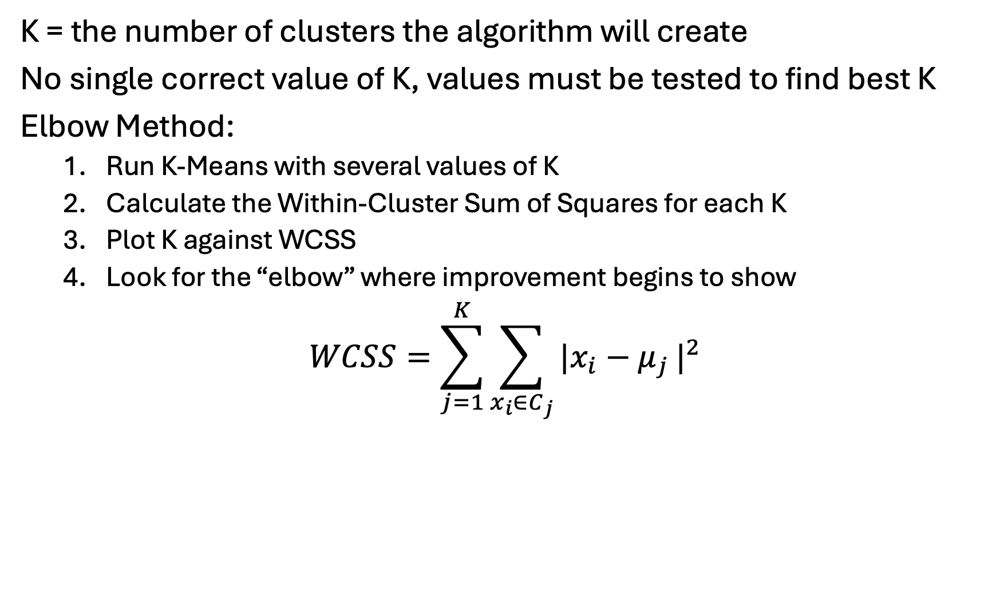
Choosing K in K-Means
K = the number of clusters the algorithm will create
No single correct value of K, values must be tested to find best K
Elbow Method:
  Run K-Means with several values of K
  Calculate the Within-Cluster Sum of Squares for each K
  Plot K against WCSS
  Look for the “elbow” where improvement begins to show
$$WCSS=\sum_{j=1}^{K}{\sum_{x_{i}∈C_{j}}{\left.|x_{i}−μ_{j}\right.|^{2}}}$$

Slide 12
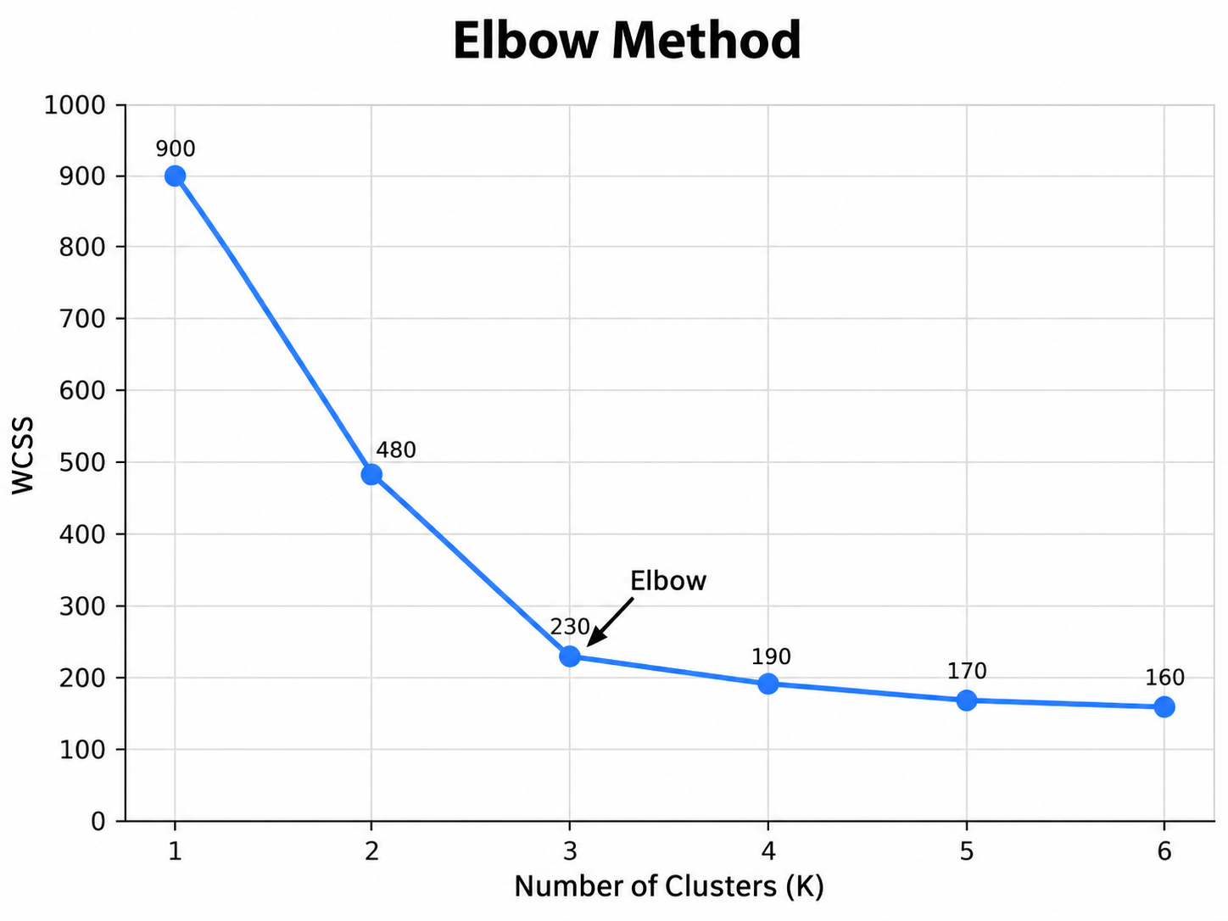
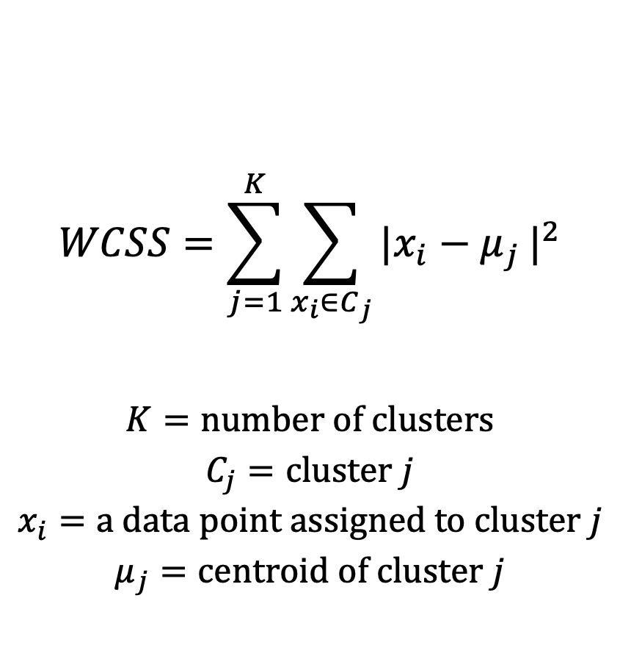
The Elbow Method - WCSS
$$WCSS=\sum_{j=1}^{K}{\sum_{x_{i}∈C_{j}}{\left.|x_{i}−μ_{j}\right.|^{2}}}$$
$$K=\text{number of clusters}$$
$$C_{j}=\text{cluster }j$$
$$x_{i}=\text{a data point assigned to cluster }j$$
$$μ_{j}=\text{centroid of cluster }j$$

Slide 13
Review: KNN vs K-Means
 | KNN | K-Means
Learning | Supervised | Unsupervised
Labels | Required | Not Required
K = | Number of Neighbors | Number of Clusters
Goal | Predict a value/class | Discover Groups
Uses Distance | Yes | Yes
Real World Applications | Fraud Detection | Customer Segmentation
 | Medical Classification | Logistics Grouping
 | Insurance Risk | User Behavior Analysis
 | Recommendation System | Network Traffic Analysis

Slide 14
Class Imbalance
Some classes occur much less than others causing an imbalance in the training data.
Fraud Detection is a common example
  We will see a database with 284k+ transactions and only 492 are fraud.
  That means the positive cases are only 0.172% of the data.
To help solve this issue we use synthetic data to help increase the number of positive cases for training

Slide 15
SMOTE
Synthetic Minority Over-sampling Technique
Creates new synthetic minority class examples
Uses nearby minority data as an example to create new points
Applied only to training data
It does not just increase the number of identical cases

Slide 16
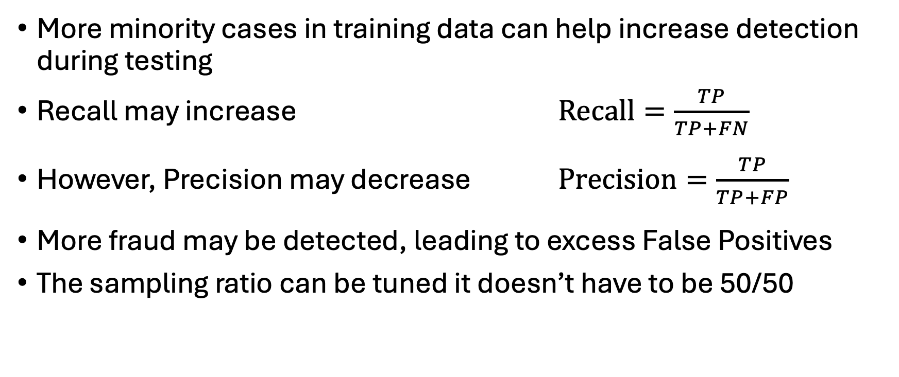
SMOTE Tradeoff
More minority cases in training data can help increase detection during testing
Recall may increase $\text{Recall}=\frac{TP}{TP+FN}$
However, Precision may decrease $\text{Precision}=\frac{TP}{TP+FP}$
More fraud may be detected, leading to excess False Positives
The sampling ratio can be tuned it doesn’t have to be 50/50

