Slide 1




Slide 2
Linear Regression + Logistic Regression Math
AIRO – Week 2
Created by Caden Wondell

Slide 3
What are we predicting?
Linear Regression | Logistic Regression
Exam Score: 82.4 | Sentiment: 87% Positive
Stock Price: $187.35 | Fraud: 17% Not Fraud
House Price: $415,000 | Spam: 91% Spam
Network Latency: 36 ms | Failure 28% Not Failure
Takeaway:
Linear Regression → “How much?” or “What value?”
Logistic Regression → “Which class?” or “How likely?”

Slide 4
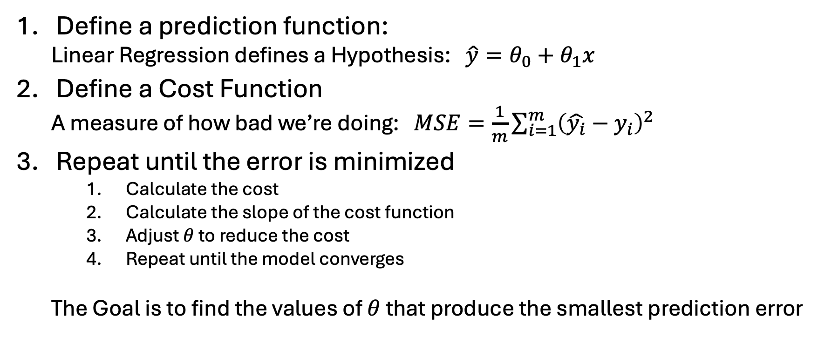
Linear Regression: Making a Prediction
Define a prediction function:
  Linear Regression defines a Hypothesis: $\hat{y}=θ_{0}+θ_{1}x$
Define a Cost Function
  A measure of how bad we’re doing: $MSE=\frac{1}{m}\sum_{i=1}^{m}{{\left(\hat{y_{i}}−y_{i}\right)}^{2}}$
Repeat until the error is minimized
    Calculate the cost
    Calculate the slope of the cost function
    Adjust $θ$ to reduce the cost
    Repeat until the model converges
  The Goal is to find the values of $θ$ that produce the smallest prediction error

Slide 5
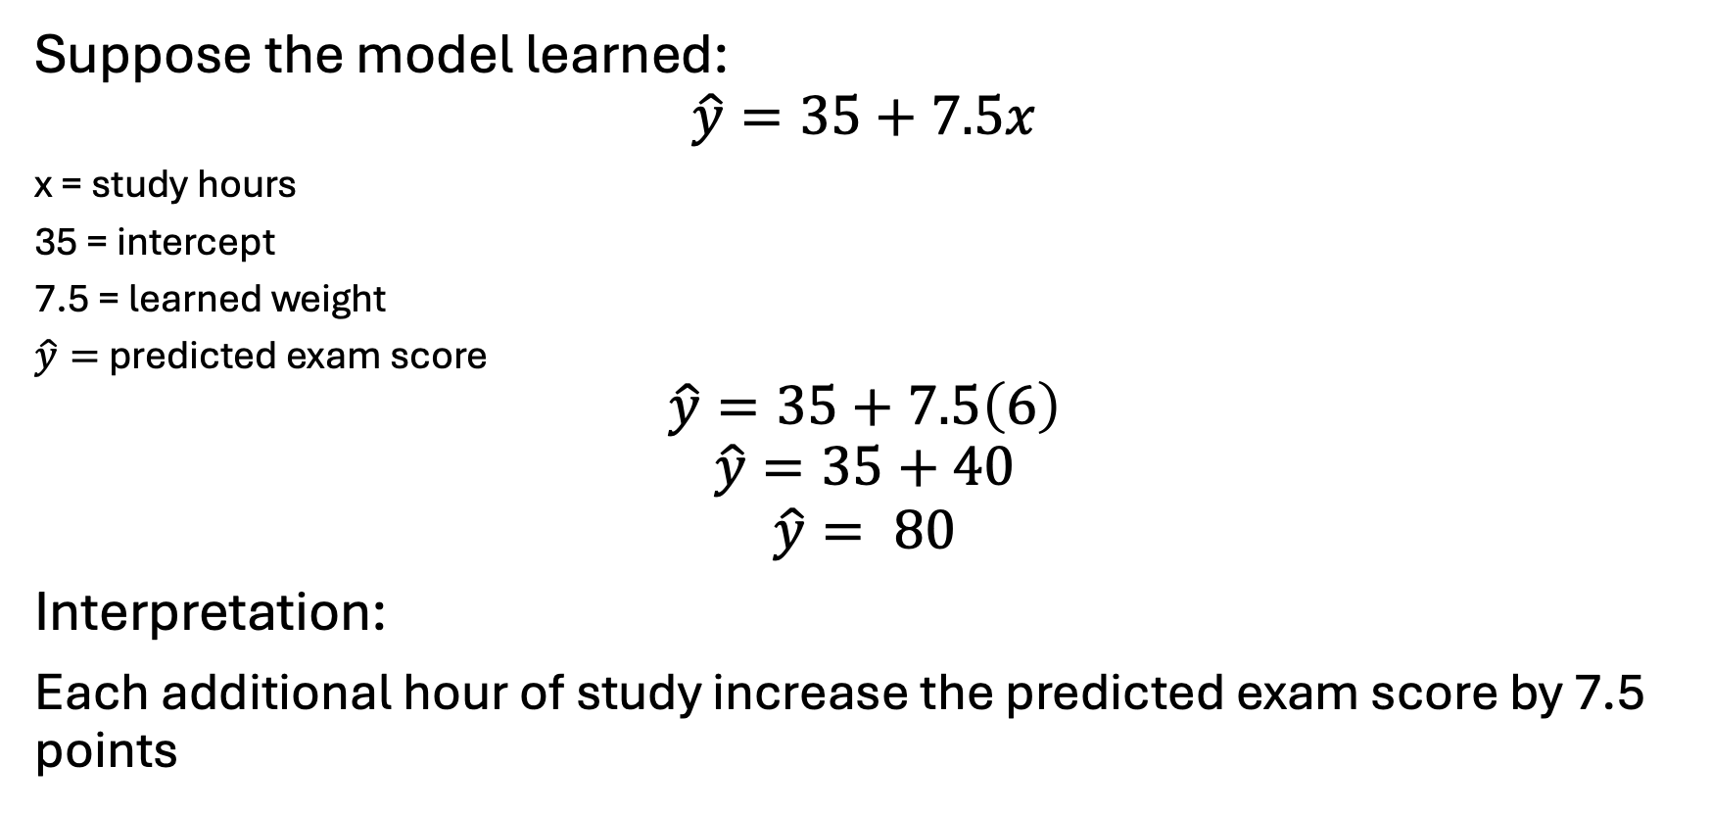
Linear Regression Example:
Predicting Exam Score for a student who studied for 6 hours
Suppose the model learned:
$$\hat{y}=35+7.5x$$
x = study hours
35 = intercept
7.5 = learned weight
$\hat{y}=$ predicted exam score
$$\hat{y}=35+7.5\left(6\right)$$
$$\hat{y}=35+40$$
$$\hat{y}= 80$$
Interpretation:
Each additional hour of study increase the predicted exam score by 7.5 points

Slide 6
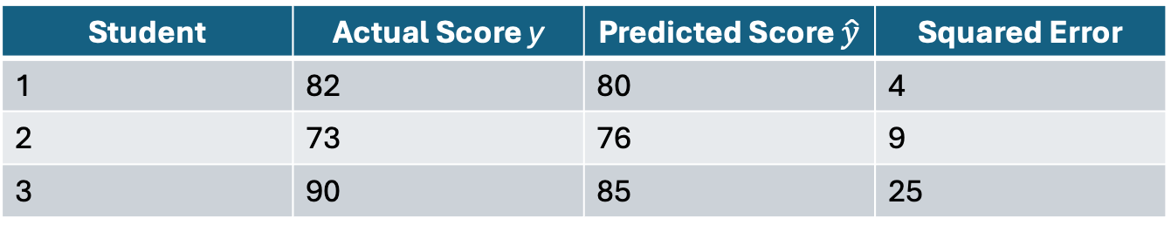
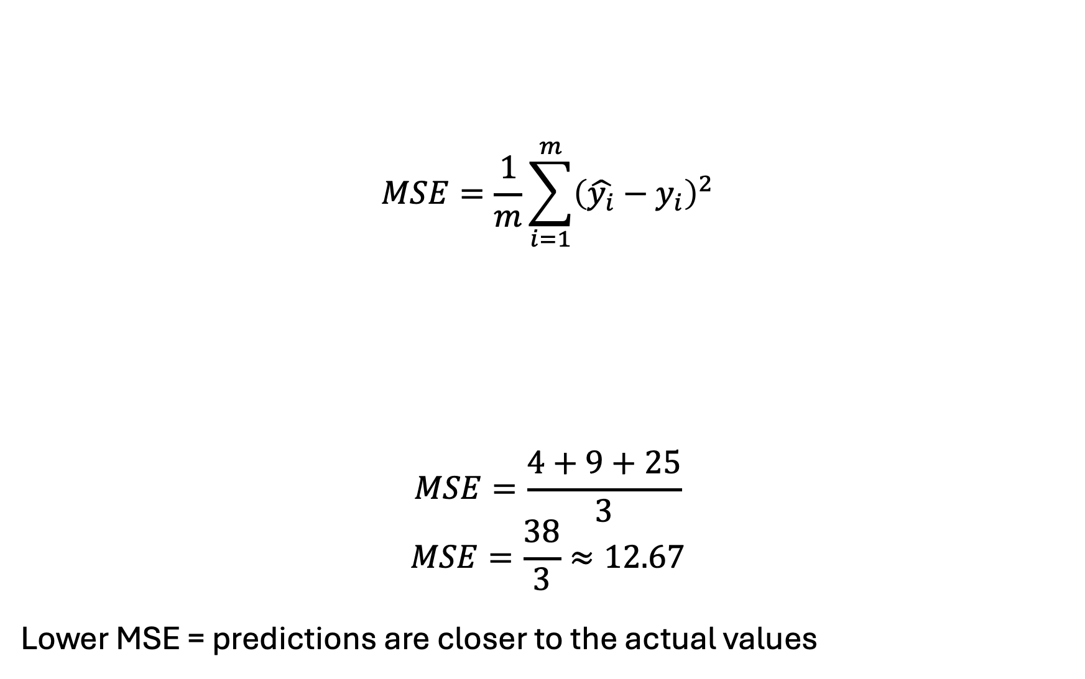
Linear Regression Example: Measuring Error
$$MSE=\frac{1}{m}\sum_{i=1}^{m}{{\left(\hat{y_{i}}−y_{i}\right)}^{2}}$$
$$MSE=\frac{4+9+25}{3}$$
$$MSE=\frac{38}{3}≈12.67$$
Lower MSE = predictions are closer to the actual values
Student | Actual Score y | Predicted Score $\hat{y}$ | Squared Error
1 | 82 | 80 | 4
2 | 73 | 76 | 9
3 | 90 | 85 | 25

Slide 7
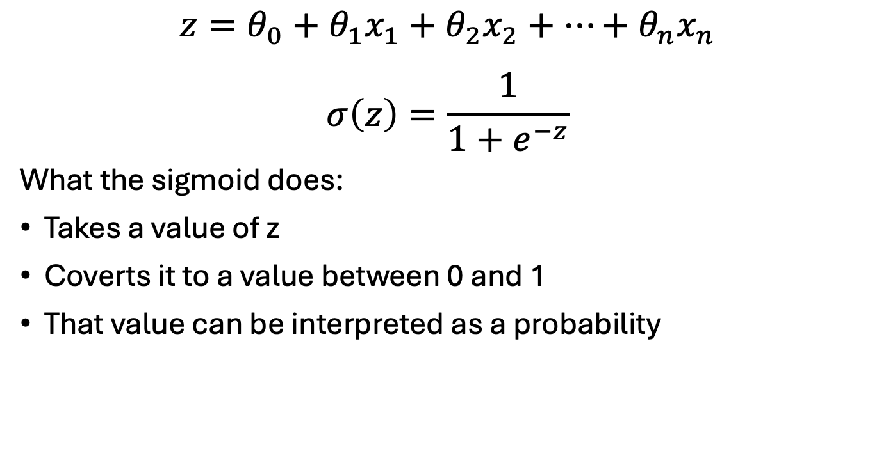
Logistic Regression: Making a Prediction
Features
Sigmoid Function
Probability (0-1)
Weighted Score (z)
$$z=θ_{0}+θ_{1}x_{1}+θ_{2}x_{2}+⋯+θ_{n}x_{n}$$
$$σ\left(z\right)=\frac{1}{1+e^{−z}}$$
What the sigmoid does:
Takes a value of z
Coverts it to a value between 0 and 1
That value can be interpreted as a probability

Slide 8
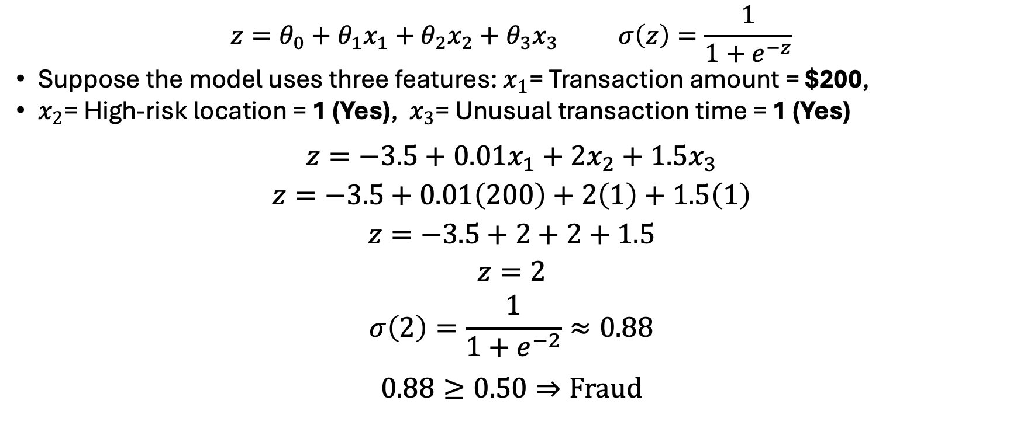
Logistic Regression Example:
Consider a fraud detector
$$z=θ_{0}+θ_{1}x_{1}+θ_{2}x_{2}+θ_{3}x_{3} σ\left(z\right)=\frac{1}{1+e^{−z}}$$
Suppose the model uses three features: $x_{1}$= Transaction amount = $200,
$x_{2}$= High-risk location = 1 (Yes), $x_{3}$= Unusual transaction time = 1 (Yes)
$$z=−3.5+0.01x_{1}+2x_{2}+1.5x_{3}$$
$$z=−3.5+0.01\left(200\right)+2\left(1\right)+1.5\left(1\right)$$
$$z=−3.5+2+2+1.5$$
$$z=2$$
$$σ\left(2\right)=\frac{1}{1+e^{−2}}≈0.88$$
$$0.88≥0.50⇒\text{Fraud}$$

Slide 9
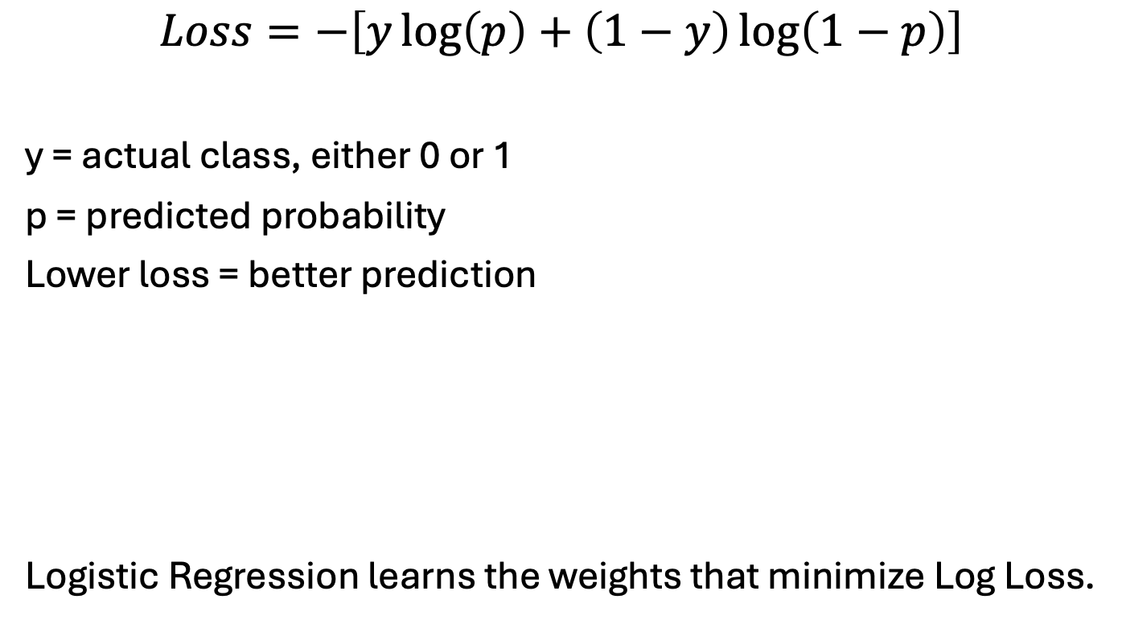
Logistic Regression: How Does the Model Learn?
Make Probability Prediction
Calculate Log Loss
Adjust Weights
Lower the Loss
Repeat
$$Loss=−\left[y\log\left(p\right)+\left(1−y\right)\log\left(1−p\right)\right]$$
y = actual class, either 0 or 1
p = predicted probability
Lower loss = better prediction
Logistic Regression learns the weights that minimize Log Loss.

Slide 10
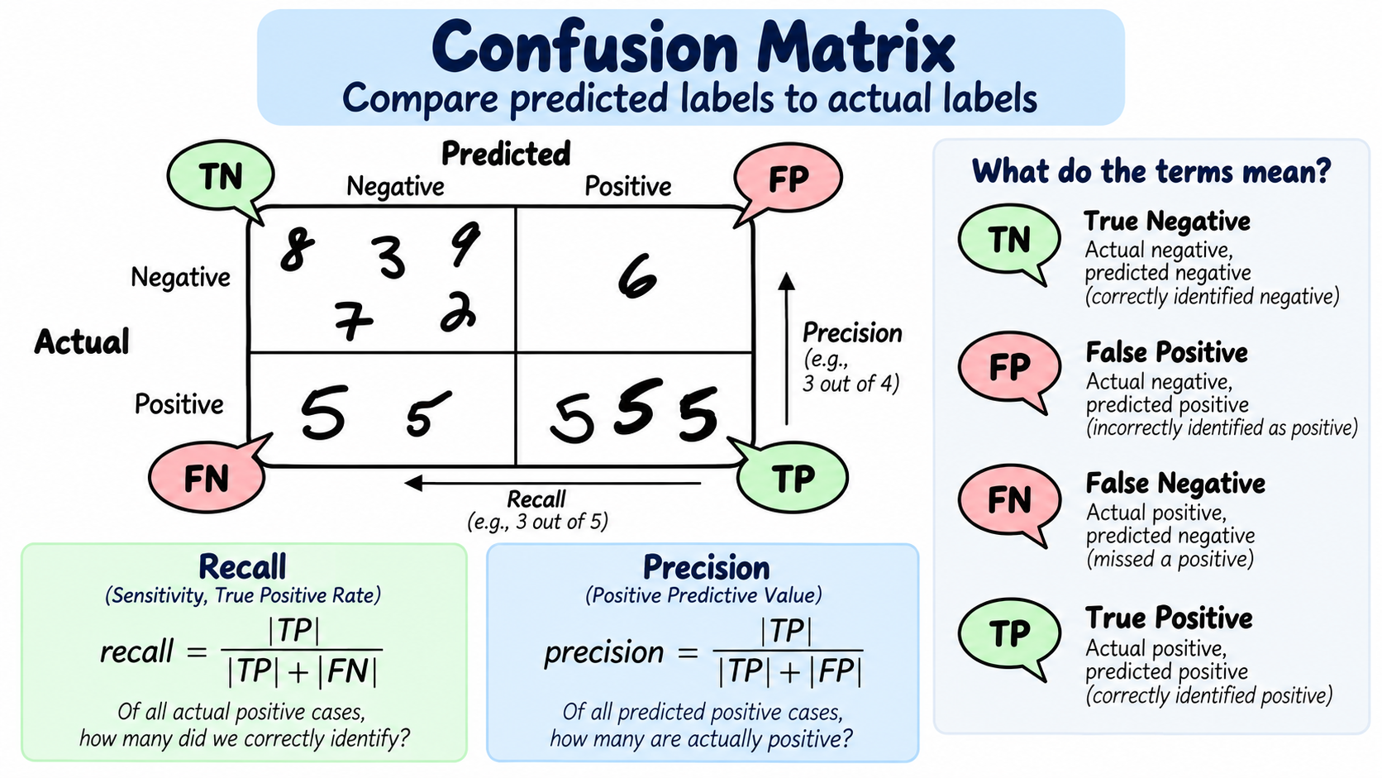
Confusion Matrix
a

Slide 11
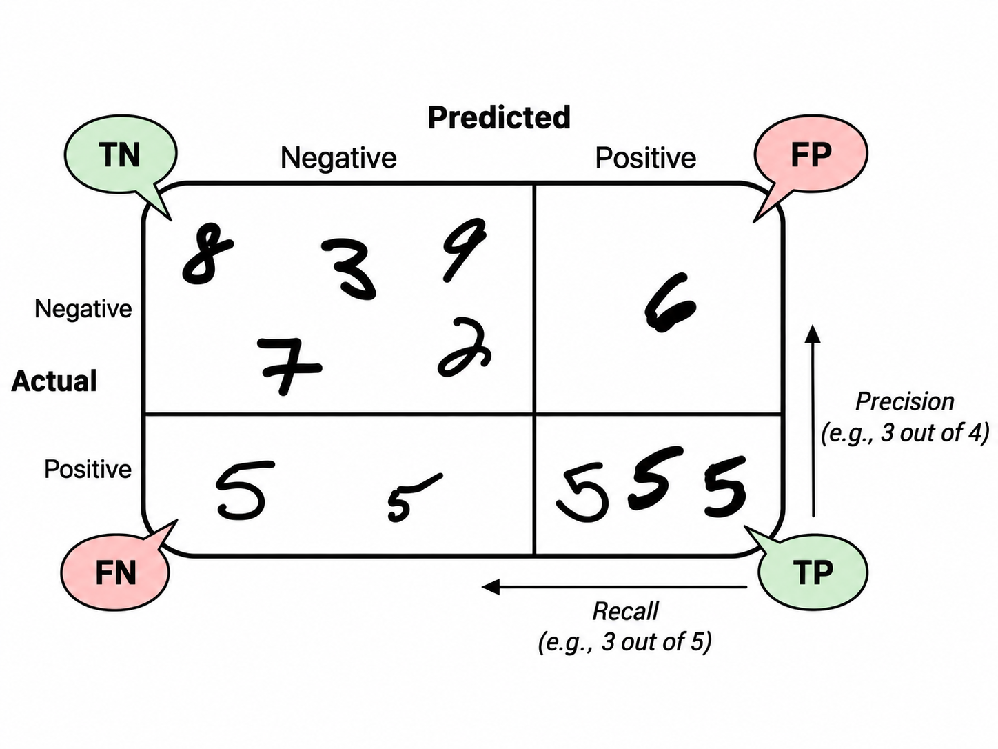
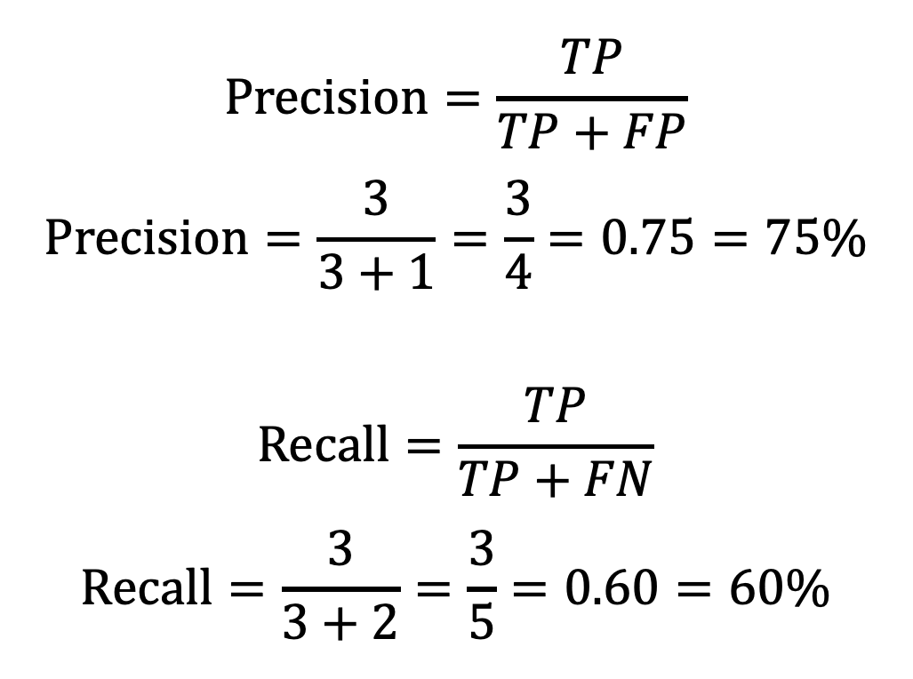
Precision and Recall
$$\text{Precision}=\frac{TP}{TP+FP}$$
$$\text{Precision}=\frac{3}{3+1}=\frac{3}{4}=0.75=75\%$$
$$\text{Recall}=\frac{TP}{TP+FN}$$
$$\text{Recall}=\frac{3}{3+2}=\frac{3}{5}=0.60=60\%$$

Slide 12
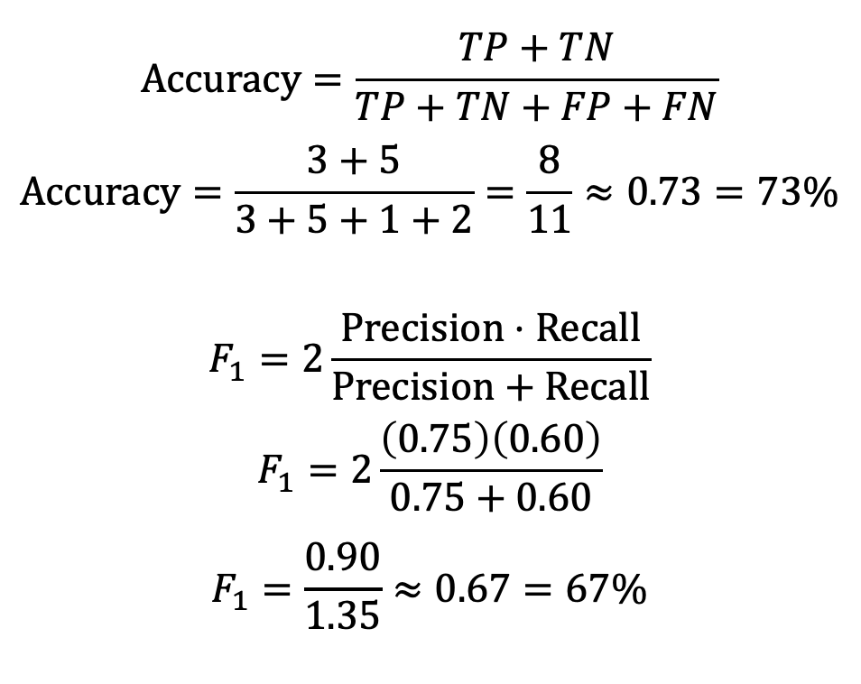
Accuracy and F1 Score
$$\text{Accuracy}=\frac{TP+TN}{TP+TN+FP+FN}$$
$$\text{Accuracy}=\frac{3+5}{3+5+1+2}=\frac{8}{11}≈0.73=73\%$$
$$F_{1}=2\frac{Precision⋅Recall}{Precision+Recall}$$
$$F_{1}=\frac{0.90}{1.35}≈0.67=67\%$$

Slide 13
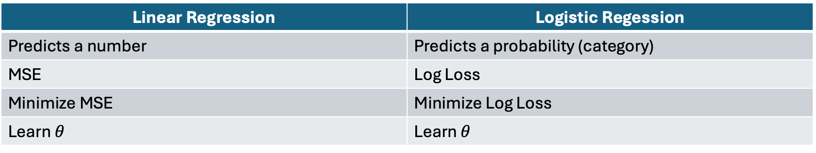
Review
Linear Regression | Logistic Regession
Predicts a number | Predicts a probability (category)
MSE | Log Loss
Minimize MSE | Minimize Log Loss
Learn $θ$ | Learn $θ$
Classification Metrics:
Accuracy — overall percentage correct
Precision — when the model says “positive,” how often is it right?
Recall — how many actual positives did it find?
F1 Score — balances precision and recall

