Slide 1

Requirements, Analysis, Design and Testing in 2 hours

Slide 2
Slides on SRS and Requirements from Frank Moisiadis

Slide 3
Software Requirements Specification (SRS) template
TABLE OF CONTENTS
1.0 Introduction
1.1 Purpose
1.2 Scope
1.3 Definitions, Acronyms, and Abbreviations
1.4 References
1.5 Overview
2.0 General Description
2.1 Product Perspective
2.2 Product Functions
2.3 User Characteristics
2.4 General Constraints
2.5 Assumptions and Dependencies

Slide 4
SRS template
3.0 Specific Requirements
3.1 Functional Requirements
3.1.1 Unit Registration
3.1.2 Retrieving and Displaying Unit Information
3.1.3 Report Generation
3.1.4 Data Entry
3.2 Design Constraints
3.3 Non-Functional Requirements
3.3.1 Security
Appendix A

Slide 5
SRS explained
1.0 INTRODUCTION
This document specifies all the requirements for
1.1 Purpose
The purpose of the …is to ….
The system should assist ….
The intended audience for this document is …
This specification describes …..
1.2 Scope
This document applies only to …...
This specification is not concerned with …..

Slide 6
SRS explained
1.3 Definitions, Acronyms, and Abbreviations
SRS - Software Requirements Specifications
IEEE - Institute of Electrical and Electronic Engineering
1.4 Reference
[1] IEEE 830-1993: IEEE Recommended Practice for Software Requirements Specifications" IEEE Standards Collection, IEEE, 1997.
1.5 Overview
In the following sections of this specification……will be presented.
In Section 2, the general product and its functions will be introduced.

Slide 7
SRS explained
In Section 3, all detailed requirements will be specified and grouped.
In Appendix …….
2.0 GENERAL DESCRIPTION
2.1 Product Perspective
This system allows stakeholders to…..
The system will display…..
The system will help ……
The system provides information about ….
2.2 Product Functions
The system provides the following functions:

Slide 8
SRS explained
2.3 User Characteristics
The users of the system are:
  Level of Users’ Computer Knowledge
  Level of Users’ Business Knowledge
  Frequency of Use
2.4 General Constraints
The system will support ….
The system will not allow ……
2.5 Assumption and Dependencies
This system relies on ……
The system must have a satisfactory interface and ……

Slide 9
Section 3 of SRS
SPECIFIC REQUIREMENTS
3.1 Functional Requirements
3.1.1 Unit Registration
The unit registration requirements are concerned with functions regarding unit registration which includes students selecting, adding, dropping, and changing a unit.
SRS-001 (3.1.1.1):
The system shall allow the user to register a unit.
SRS-002 (3.1.1.2):
STS shall allow the user to delete a unit if the user has chosen to drop that unit.
SRS-003 (3.1.1.3):
STS shall check if a unit has been filled by enough registered students.

Slide 10
SRS functional egs
SRS-004 (3.1.1.4):
STS shall allow the user to add his/her name to the unit waiting list if the user wants to register in a unit which has been filled already with enough registered students.
SRS-005 (3.1.1.5):
STS shall automatically register the unit for the user who is the first one on the waiting list if a vacancy appears for that unit.
SRS-006 (3.1.1.6):
STS shall allow the user to change practical session(s) within a unit.
SRS-007 (3.1.1.7):
STS shall allow the user to change tutorial session(s) within a unit.

Slide 11
Functional parent reqs broken into many child-reqs.
3.1.2 Retrieving and Displaying Unit Information
The retrieving and displaying requirements are concerned with how information is retrieved and presented to the user.
SRS-014 (3.1.2.1):
The system shall allow users to enter the following selection criteria to retrieve unit information: by unit code, by unit number, by title of unit, by weight of unit (credit points).
OR by unit code (3.1.2.1.1) , by unit number (3.1.2.1.2) , by title of unit (3.1.2.1.3) , by weight of unit (credit points) (3.1.2.1.4).

Slide 12
Design Constraints (3.2)
3.2 Design Constraints
SRS-031 (3.2.1):
STS shall store and retrieve persistent data.
SRS-032 (3.2.2):
STS shall support PC and/or UNIX platforms.
SRS-033 (3.2.3):
STS shall be developed using the JAVA programming language

Slide 13
Non-functional requirements
3.3 Non-Functional Requirements
SRS-034 (3.3.1):
STS shall respond to any retrieval in less than 5 seconds.
SRS-035 (3.3.2):
STS shall generate a report within 1 minute.
SRS-036 (3.3.3):
STS shall allow the user to remotely connect to the system.
SRS-041 (3.3.8):
The system will be accompanied by a comprehensive user manual.

Slide 14
Safety and security issues
3.5.3 Security
The security requirements are concerned with security and privacy issues.
SRS-029:
VSS shall provide staff ID and password verification protection to protect from unauthorised use of the system.
SRS-030:
VSS shall allow the store manager to add, remove and modify staff ID and passwords as required.

Slide 15
Other SRS template for section 3
3. Specific Requirements
3.1 External Interface Requirements
3.1.1 User Interfaces
3.1.2 Hardware Interfaces
3.1.3 Software Interfaces
3.1.4 Communication Interfaces
3.2 Functional Requirements
3.2.1 Requirement 1
3.2.1.1 Introduction
3.2.1.2 Inputs
3.2.1.3 Processing
3.2.1.4 Outputs
3.2.2 Requirement 2 …..

Slide 16
Other SRS template for section 3
3.3 Performance Requirements
3.4 Design Constraints
3.4.1 Standards Compliance
3.4.2 Hardware Limitations ……
3.5 Software System Attributes
3.5.1 Reliability
3.5.2 Availability
3.5.3 Security
3.5.4 Maintainability
3.5.5 Portability
3.5.6 Reusability
3.5.7 Usability 3.5.8 Other Factors …...
3.6 Other Requirements 3.6.1 Database 3.6.2 Operations …..

Slide 17
Characterising Requirements
Functional (action-oriented ”when the user does x, the system will do y”)
non-functional requirements (usability, reliability, performance, supportability)
and design constraints (limits on design or processes).
Strive to have few design constraints as they often restrict options for implementing other requirements, those that directly fulfil a user need.

Slide 18
Parent-child requirements
Parent-child requirements to augment certain basic requirements.
Child req. is amplification of the specificity expressed in the parent req.
Parent: device shall operate off standard North American voltage.
  Child: device shall operate in a voltage range of x-y volts AC.
  Child: device shall require not more than x AC amperes for correct operation.

Slide 19
Functional parent reqs broken into many child-reqs.
3.1.2 Retrieving and Displaying Unit Information
The retrieving and displaying requirements are concerned with how information is retrieved and presented to the user.
3.1.2.1:
The system shall allow users to enter the following selection criteria to retrieve unit information: by unit code, by unit number, by title of unit, by weight of unit (credit points).
OR by unit code (3.1.2.1.1) , by unit number (3.1.2.1.2) , by title of unit (3.1.2.1.3) , by weight of unit (credit points) (3.1.2.1.4).

Slide 20
Design Constraints (3.2)
3.2 Design Constraints
3.2.1: System shall store and retrieve persistent data.
3.2.2: System hall support PC and/or UNIX platforms.
3.2.3: STS shall be developed using the JAVA programming language

Slide 21
Non-functional requirements
Reliability Availability Security Maintainability Portability Reusability Usability
3.3 Non-Functional Requirements
3.3.1: STS shall respond to any retrieval in less than 5 seconds.
3.3.2: STS shall generate a report within 1 minute.
3.3.3: STS shall allow the user to remotely connect to the system.
3.3.8: The system will be accompanied by a comprehensive user manual.

Slide 22
Safety and security issues
3.5.3 Security
The security requirements are concerned with security and privacy issues.
3.5.3.1:
VSS shall provide staff ID and password verification protection to protect from unauthorised use of the system.
3.5.3.2:
VSS shall allow the store manager to add, remove and modify staff ID and passwords as required.

Slide 23
Usability
Ease with which the system can be learned and operated by the users
Usability is in the eye of the beholder
Required training time for users to become productive (do simple tasks)
May need to be described for novices, normal, power users.
Task times for typical tasks (can be affected by system performance issues)
Judge usability of new system with state-of-the-art systems. Must be testable, verifiable.
New system shall be judged by 90% of user community to be as usable as the existing systems.
Specify online helps, wizards, tool tips, user manuals, documentation and assistance.
Conforms to conventions and standards developed for HCI (windows).

Slide 24
Reliability
Reqs describe the degree to which the system must behave in a user- acceptable fashion.
Availability: define system must be available for operational use for a specified percentage of time (<100%).
Mean time between failures (MTBF). Define what is a “failure”, precision of time in hours.
Mean time to repair (MTTR). How long allowed to be out of operation?

Slide 25
Reliability
Precision in time: eg.”90% of system failures must be repairable within 5 minutes, 99.9% must be repairable within an hour”
Accuracy: precision in numbers, to the nearest cent or 0.0001
Maximum bugs: bugs per thousand lines of code, per function point.
Bugs per type: categorise bugs into minor, significant, critical bugs. Define criticality (loss of data, loss of functions).

Slide 26
Performance, Supportability and Survivability requirements
Performance: response time for a transaction, throughput (transactions per sec), capacity ( number of customers and transactions system can handle), degradation modes (what acceptable mode of operation when system has been degraded)
Supportability: ability of software to be easily modified to accommodate enhancements and repairs.
Survivability: What do you do in the case of a disaster? Are there any back up plans for power, data security, data integrity. What functions can/ must continue in the case of a disaster?

Slide 27
measuring requirements
Tutorial paper:
Discussion on paper by Al Davis ““Identifying and Measuring Quality in a Software Requirements Specification”
Unambiguous, Completeness, Correctness, Understandable, Verifiable, internally and externally consistent, achievable, concise, design independent, modifiable, traceable, annotated by relative importance, by version, by relative stability, not redundant, at right level of detail, precise, reusable, organised.

Slide 28
The attributes for a “good” SRS are:
Requirements must be correct.
Requirements must be feasible. One must be able to implement each requirement within the known capabilities and limitations of the system and its environment.
Requirements must be necessary for the project, Requirements must be prioritised.
Requirements must be unambiguous, Requirements must be verifiable, Requirements must be complete, Requirements must be consistent, Requirements must be modifiable, Requirements must be traceable.

Slide 29
Requirements Dependency Matrix
Compare pre and post conditions.
Work out which post condition or goal relies on the fulfilment of another requirement.
Do a traceability matrix between use cases and requirements which can help in providing the info to work out the requirements dependency matrix.
Do a traceability matrix between classes or objects and requirements to help you find the dependencies.
Y” means the use case is associated with the requirement, or the requirement comes partly or wholly from that use case.

Slide 30
Requirements Dependency Matrix
“Y” means the class or object is associated with the requirement, or the requirement uses that object/class.
Req 1 → req 2
(req 2 depends on req 1 being fulfilled)
Req 1 ← req 3
(req 1 depends on req 3 being fulfilled)
(req 1 is dependent upon the success of req 1)
Req 1 <-> req 4
(req 1 and 4 are inter-dependent upon each other)
(they rely on the success of each other’s req.)

Slide 31
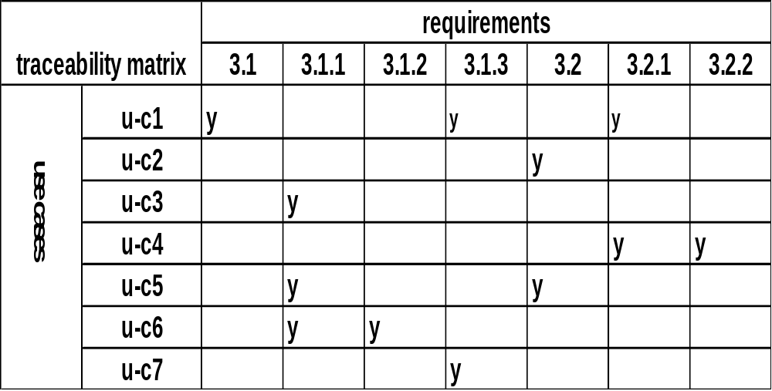
Requirements Traceability Matrix with use cases

Slide 32
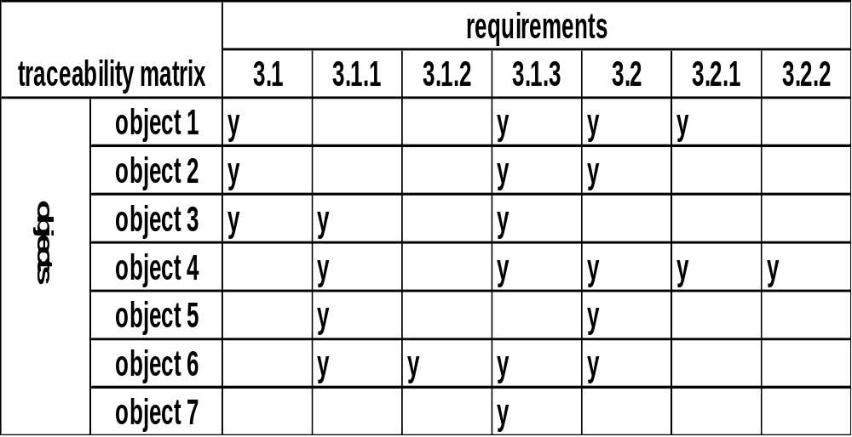
Requirements Traceability Matrix with objects/classes

Slide 33
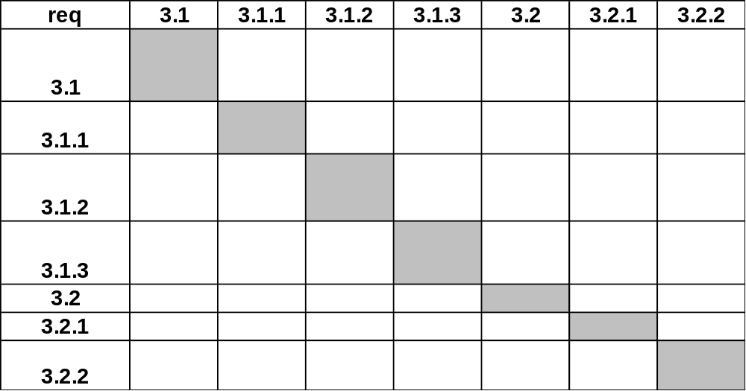
Requirements Dependency Matrix

Slide 34
Steps for converting problem statements to use cases
Look at problem statements and pull out actions, flow of events (high level functional view of system).
From these events, actions, functions, group associated ones (high level use cases).
Expand into steps (basic course of use cases)
Prioritise high level use cases
Expand most important use cases into their extensions

Slide 35
Steps for converting use cases to SRS statements
Use:
  Dependencies among the use cases
  Pre and post conditions
  Triggers
  Assumptions made in use cases
  Open issues resolved in use cases
Turn use cases into “shall” statements
Group statements under themes or functions or qualities
Use titles/basic concept of use cases as high level SRS statements
Specify all details under parent requirement statements.

Slide 36
Change management
Possible scenarios that are considered volatile
Some requirements change quicker than others (eg.tax regulations)
Domain dependent volatility
Dependence on external environmental factors (market changes)
How handle change:
  Consider plan of action if changes occur to the requirements
  Consider the criticality of the requirement
  Consider which requirements are affected
  Consider risks posed by change
  Suggest change management strategies

Slide 37
Requirements - design
transition of UML diagrams from requirements to design phase of SDLC.
Users and customers make requirement decisions being closest to the needs
Technologists make design decisions
Req: What the system needs to do
Design: How the system is to do it
Req and design are iterative activities
Example: “let’s throw out the GUI module for a browser-based interface”

Slide 38
Using scenarios in testing
Test scenarios should mirror the basic course of the functions / use cases
Any important exceptions can be used as test scenarios
Completeness can be measured by how many scenarios it can handle
Test system with strange exceptions to see if it is flexible, and how easy it crashes / causes faults and the criticality of the faults.
Use prioritised basic courses, Use most frequent extensions
Use highly ranked extensions, Use most volatile scenarios in a use case
Use other scenarios for higher business risks, functional risks, other risks.

Slide 39
From here material is taken from Sommerville – earlier editions

Slide 40
ISYS/COMP355 DESIGN LECTURE
Information systems architecture
Information systems have a generic architecture that can be organised as a layered architecture.
Layers include:
  The user interface
  User communications
  Information retrieval
  System database

Slide 41
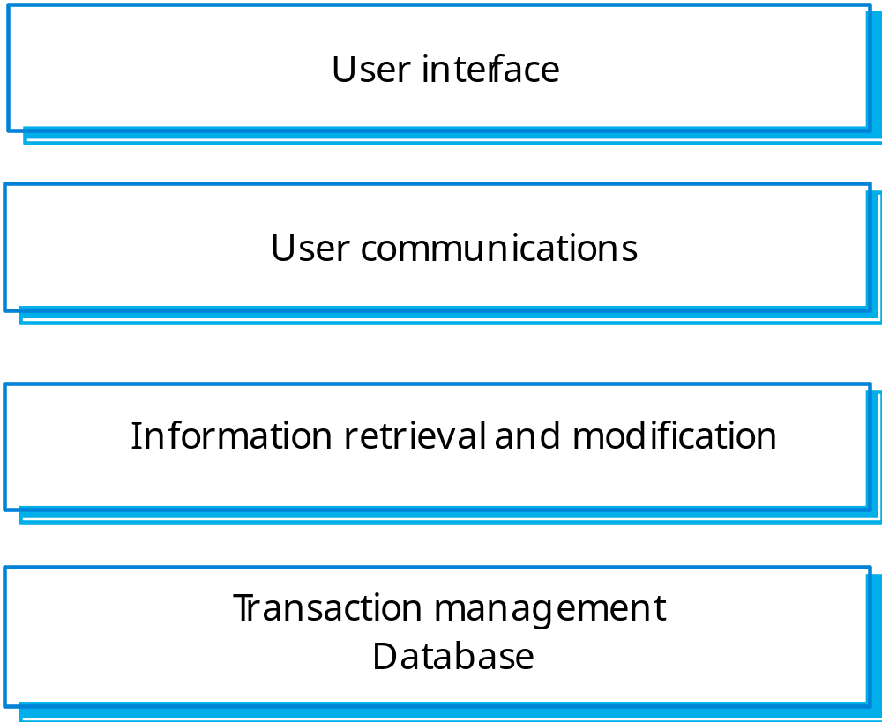
Information system structure

Slide 42
LIBSYS architecture
The library system LIBSYS is an example of an information system.
User communications layer:
  LIBSYS login component;
  Form and query manager;
  Print manager;
Information retrieval layer
  Distributed search;
  Document retrieval;
  Rights manager;
  Accounting.

Slide 43
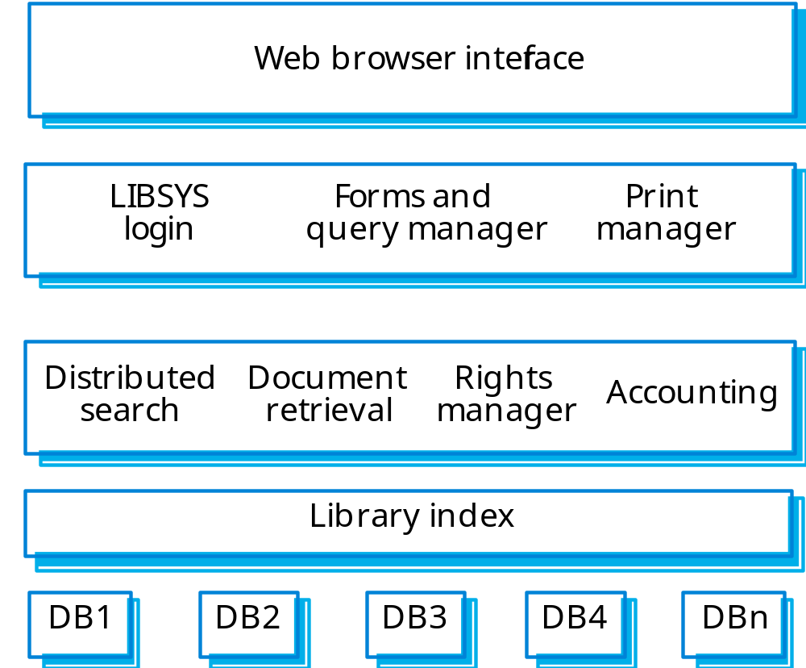
LIBSYS organisation

Slide 44
Resource allocation systems
Systems that manage a fixed amount of some resource (football game tickets, books in a bookshop, etc.) and allocate this to users.
Examples of resource allocation systems:
  Timetabling systems where the resource being allocated is a time period;
  Library systems where the resource being managed is books and other items for loan;
  Air traffic control systems where the resource being managed is the airspace.

Slide 45
Resource allocation architecture
Resource allocation systems are also layered systems that include:
  A resource database;
  A rule set describing how resources are allocated;
  A resource manager;
  A resource allocator;
  User authentication;
  Query management;
  Resource delivery component;
  User interface.

Slide 46
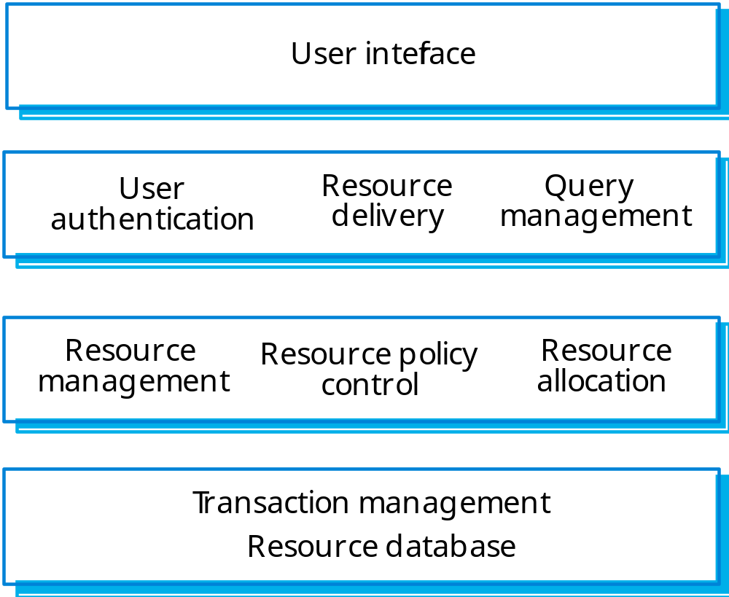
Layered resource allocation

Slide 47
Layered system implementation
Each layer can be implemented as a large scale component running on a separate server. This is the most commonly used architectural model for web-based systems.
On a single machine, the middle layers are implemented as a separate program that communicates with the database through its API.
Fine-grain components within layers can be implemented as web services.

Slide 48
Weather system description
A weather mapping system is required to generate weather maps on a regular basis using data collected from remote, unattended weather stations and other data sources such as weather observers, balloons and satellites. Weather stations transmit their data to the area computer in response to a request from that machine.
The area computer system validates the collected data and integrates it with the data from different sources. The integrated data is archived and, using data from this archive and a digitised map database a set of local weather maps is created. Maps may be printed for distribution on a special-purpose map printer or may be displayed in a number of different formats.

Slide 49
System context and models of use
Develop an understanding of the relationships between the software being designed and its external environment
System context
  A static model that describes other systems in the environment. Use a subsystem model to show other systems. Following slide shows the systems around the weather station system.
Model of system use
  A dynamic model that describes how the system interacts with its environment. Use use-cases to show interactions

Slide 50
Layered architecture
Data display layer where objects are
«subsystem»
concerned with preparing and
Data display
presenting the data in a human-
readable form
«subsystem»
Data archiving layer where objects
Data archiving
are concerned with storing the data
for future processing
«subsystem»
Data processing layer where objects
Data processing
are concerned with checking and
integ
rating the collected data
«subsystem»
Data collection layer where objects
Data collection
are concerned with acquiring data
from remote sources

Slide 51
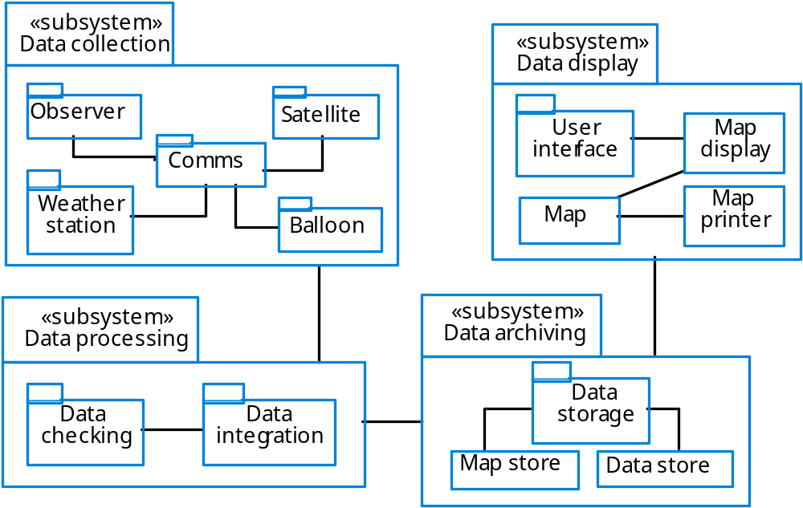
Subsystems in the weather mapping system

Slide 52
Architectural design
Once interactions between the system and its environment have been understood, you use this information for designing the system architecture.
A layered architecture is appropriate for the weather station
  Interface layer for handling communications;
  Data collection layer for managing instruments;
  Instruments layer for collecting data.
There should normally be no more than 7 entities in an architectural model.

Slide 53
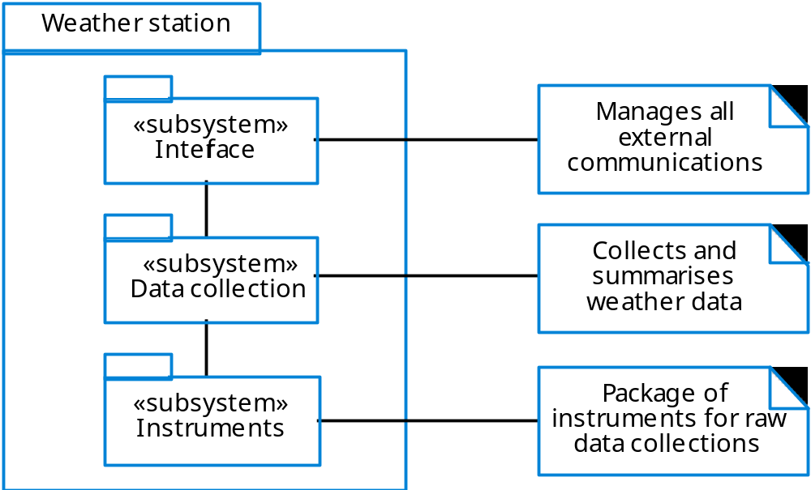
Weather station architecture

Slide 54
UI design principles
UI design must take account of the needs, experience and capabilities of the system users
Designers should be aware of people’s physical and mental limitations (e.g. limited short-term memory) and should recognise that people make mistakes
UI design principles underlie interface designs although not all principles are applicable to all designs

Slide 55
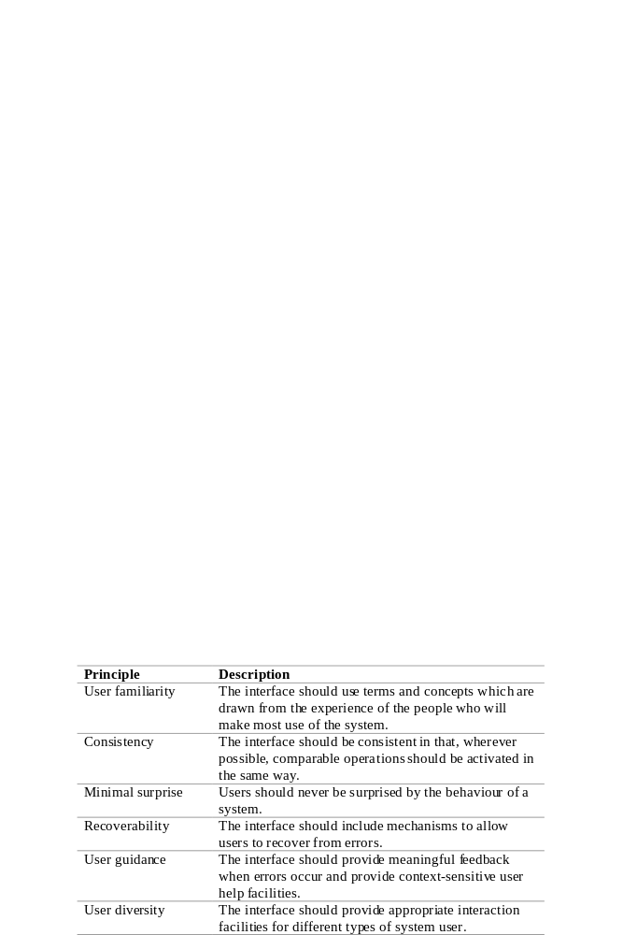
User interface design principles
COMP340

Slide 56
Design principles
User familiarity
  The interface should be based on user-oriented
  terms and concepts rather than computer concepts. For example, an office system should use concepts such as letters, documents, folders etc. rather than directories, file identifiers, etc.
Consistency
  The system should display an appropriate level
  of consistency. Commands and menus should have the same format, command punctuation should be similar, etc.
Minimal surprise
  If a command operates in a known way, the user should be
  able to predict the operation of comparable commands

Slide 57
Design principles
Recoverability
  The system should provide some resilience to
  user errors and allow the user to recover from errors. This might include an undo facility, confirmation of destructive actions, 'soft' deletes, etc.
User guidance
  Some user guidance such as help systems, on-line manuals, etc. should be supplied
User diversity
  Interaction facilities for different types of user should be supported. For example, some users have seeing difficulties and so larger text should be available

Slide 58
User-system interaction
Two problems must be addressed in interactive systems design
  How should information from the user be provided to the computer system?
  How should information from the computer system be presented to the user?
  Interaction styles
Direct manipulation
Menu selection
Form fill-in
Command language
Natural language

Slide 59
Direct manipulation advantages
Users feel in control of the computer and are less likely to be intimidated by it
User learning time is relatively short
Users get immediate feedback on their actions so mistakes can be quickly detected and corrected

Slide 60
Direct manipulation problems
The derivation of an appropriate information
space model can be very difficult
Given that users have a large information
space, what facilities for navigating around that
space should be provided?
Direct manipulation interfaces can be complex to program and make heavy demands on the computer system

Slide 61
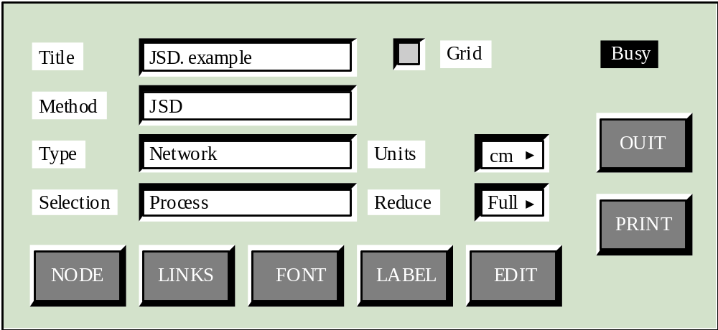
Control panel interface

Slide 62
Menu systems
Users make a selection from a list of
possibilities presented to them by the system
The selection may be made by pointing and
clicking with a mouse, using cursor keys or by
typing the name of the selection
May make use of simple-to-use terminals such as touch-screens

Slide 63
Advantages of menu systems
Users need not remember command names as they are always presented with a list of valid commands
Typing effort is minimal
User errors are trapped by the interface
Context-dependent help can be provided. The user’s context is indicated by the current menu selection

Slide 64
Problems with menu systems
Actions which involve logical conjunction (and)
or disjunction (or) are awkward to represent
Menu systems are best suited to presenting a
small number of choices. If there are many
choices, some menu structuring facility must be
used
Experienced users find menus slower than
command language

Slide 65
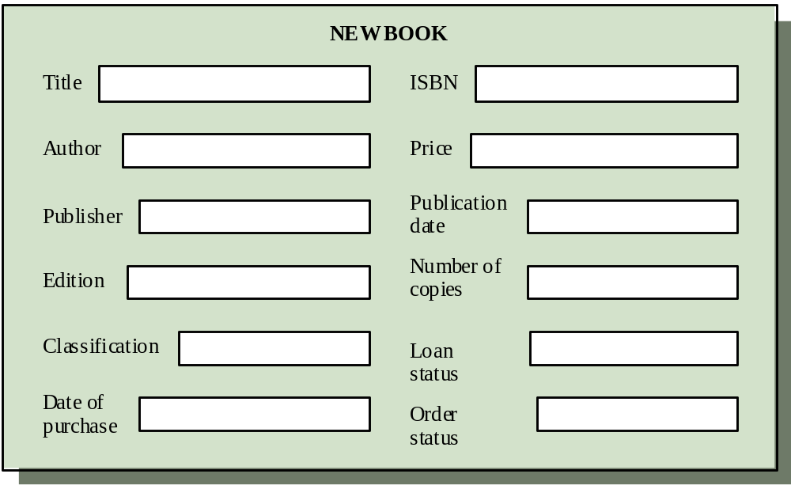
Form-based interface

Slide 66
Command interfaces
User types commands to give instructions to the system e.g. UNIX
May be implemented using cheap terminals.
Easy to process using compiler techniques
Commands of arbitrary complexity can be
created by command combination
Concise interfaces requiring minimal typing can be created

Slide 67
Problems with command interfaces
Users have to learn and remember a command language. Command interfaces are therefore unsuitable for occasional users
Users make errors in command. An error
detection and recovery system is required
System interaction is through a keyboard so
typing ability is required

Slide 68
Command languages
Often preferred by experienced users because they allow for faster interaction with the system
Not suitable for casual or inexperienced users
May be provided as an alternative to menu commands (keyboard shortcuts). In some cases, a command language interface and a menu-based interface are supported at the same time

Slide 69
Natural language interfaces
The user types a command in a natural language. Generally, the vocabulary is limited and these systems are confined to specific application domains (e.g. timetable enquiries)
NL processing technology is now good enough to make these interfaces effective for casual users but experienced users find that they require too much typing

Slide 70
User interface evaluation
Some evaluation of a user interface design
should be carried out to assess its suitability
Full scale evaluation is very expensive and
impractical for most systems
Ideally, an interface should be evaluated against a usability specification. However, it is rare for such specifications to be produced

Slide 71
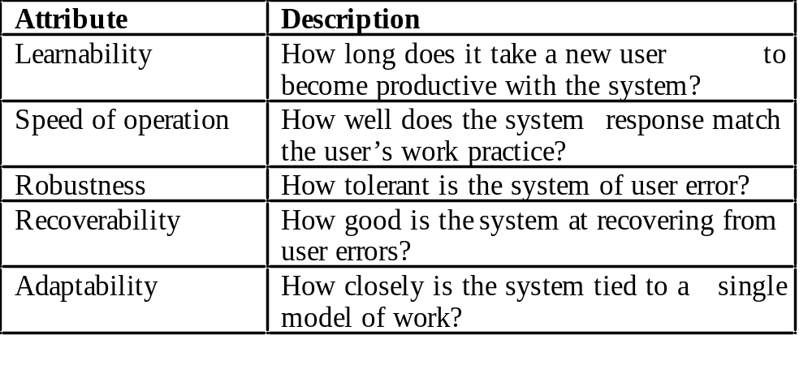
Usability attributes

Slide 72
Simple evaluation techniques
Questionnaires for user feedback
Video recording of system use and subsequent
tape evaluation.
Instrumentation of code to collect information
about facility use and user errors.
The provision of a grip button for on-line user
feedback.
COMP340

Slide 73
The structure of a software test plan
The testing process
Requirements traceability
Tested items
Testing schedule
Test recording procedures
Hardware and software requirements
Constraints

Slide 74
Verification vs validation
Verification:
"Are we building the product right"
The software should conform to its specification
Validation:
"Are we building the right product"
The software should do what the user really requires

Slide 75
The V & V process
Is a whole life-cycle process - V & V must be applied at each stage in the software process.
Has two principal objectives
  The discovery of defects in a system
  The assessment of whether or not the system is usable in an operational situation.

Slide 76
Static and dynamic verification
Software inspections Concerned with analysis of
the static system representation to discover problems (static verification)
  May be supplement by tool-based document and code analysis
Software testing Concerned with exercising and
observing product behaviour (dynamic verification)
  The system is executed with test data and its operational behaviour is observed

Slide 77
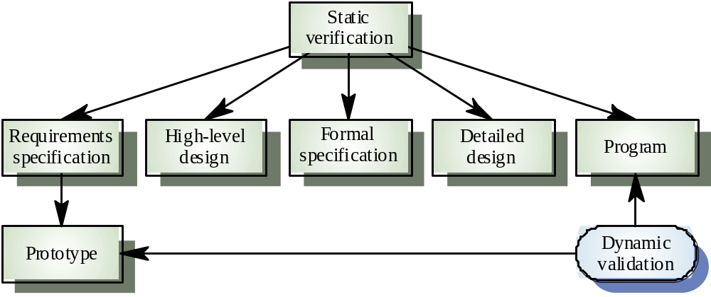
Static and dynamic V&V

Slide 78
Program testing
Can reveal the presence of errors NOT their
absence
A successful test is a test which discovers one
or more errors
The only validation technique for non-functional
requirements
Should be used in conjunction with static
verification to provide full V&V coverage

Slide 79
Types of testing
Defect testing
  Tests designed to discover system defects.
  A successful defect test is one which reveals the presence
  of defects in a system.
Statistical testing
  tests designed to reflect the frequency of user inputs. Used
  for reliability estimation.

Slide 80
V& V goals
Verification and validation should establish confidence that the software is fit for purpose
This does NOT mean completely free of defects
Rather, it must be good enough for its intended use and the type of use will determine the degree of confidence that is needed

Slide 81
V & V confidence
Depends on system’s purpose, user expectations and marketing environment
  Software function
    The level of confidence depends on how critical the software is to an organisation
  User expectations
    Users may have low expectations of certain kinds of software
  Marketing environment
    Getting a product to market early may be more important than finding defects in the program

Slide 82
Testing and debugging
Defect testing and debugging are distinct
processes
Verification and validation is concerned with establishing the existence of defects in a program
Debugging is concerned with locating and
repairing these errors
Debugging involves formulating a hypothesis
about program behaviour then testing these
hypotheses to find the system error

Slide 83
The testing process
Component testing
  Testing of individual program components
  Usually the responsibility of the component developer (except sometimes for critical systems)
  Tests are derived from the developer’s experience
Integration testing
  Testing of groups of components integrated to create a system or sub-system
  The responsibility of an independent testing team
  Tests are based on a system specification

Slide 84
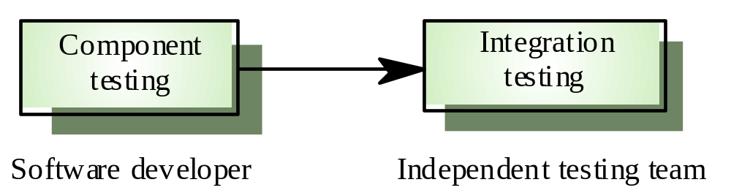
Testing phases

Slide 85
Defect testing
The goal of defect testing is to discover defects in programs
A successful defect test is a test which causes a program to behave in an anomalous way
Tests show the presence not the absence of defects

Slide 86
Testing priorities
Only exhaustive testing can show a program is
free from defects. However, exhaustive testing
is impossible
Tests should exercise a system's capabilities
rather than its components
Testing old capabilities is more important than
testing new capabilities
Testing typical situations is more important than
boundary value cases

Slide 87
Test data and test cases
Test data Inputs which have been devised to
test the system
Test cases Inputs to test the system and the
predicted outputs from these inputs if the
system operates according to its specification

Slide 88
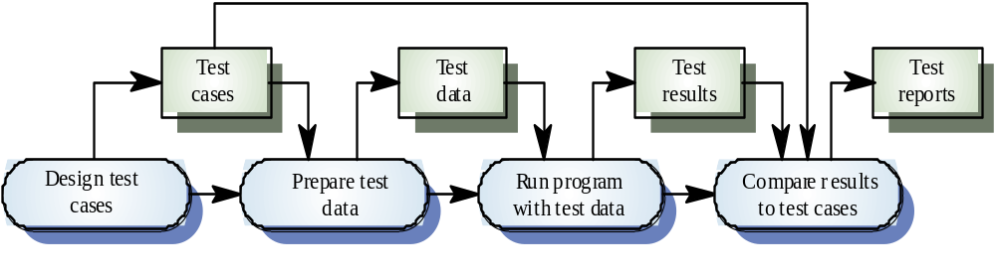
The defect testing process

Slide 89
Black-box testing
An approach to testing where the program is considered as a ‘black-box’
The program test cases are based on the system specification
Test planning can begin early in the software process

Slide 90
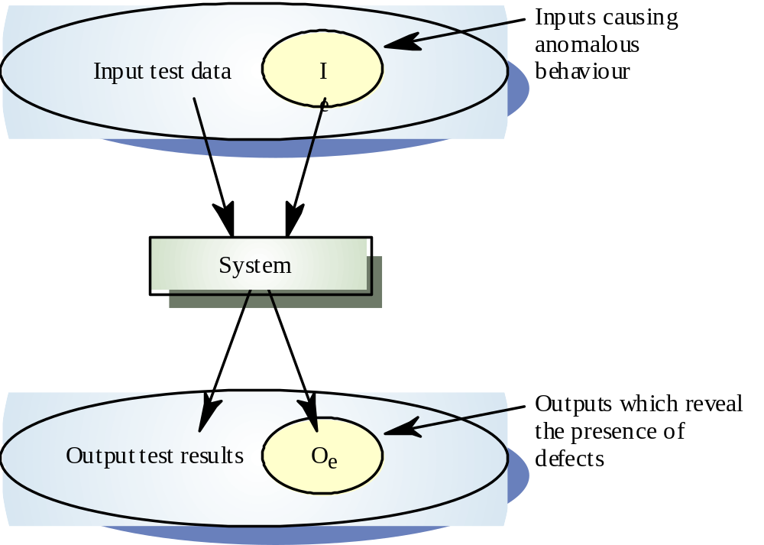
Black-box testing

Slide 91
Structural testing
Sometime called white-box testing
Derivation of test cases according to program
structure. Knowledge of the program is used to identify additional test cases
Objective is to exercise all program statements
(not all path combinations)

Slide 92
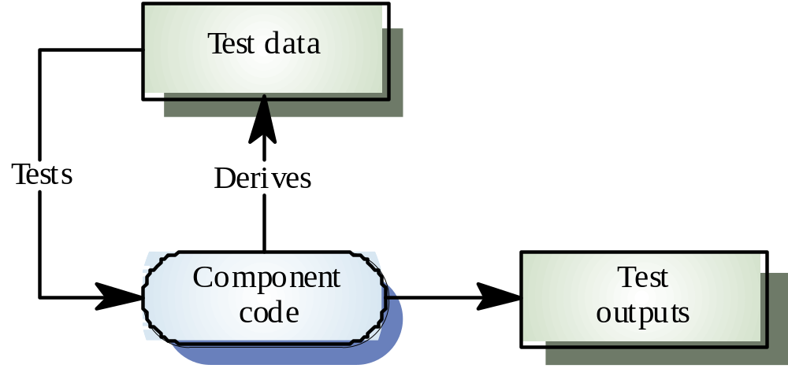
White-box testing

Slide 93
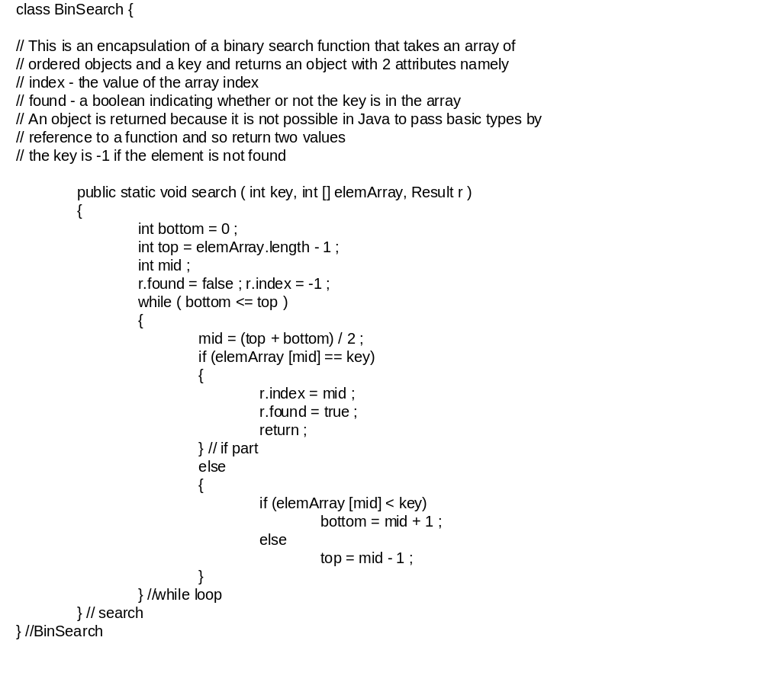
Binary search (Java)

Slide 94
Integration testing
Tests complete systems or subsystems composed of integrated components
Integration testing should be black-box testing with tests derived from the specification
Main difficulty is localising errors
Incremental integration testing reduces this problem

Slide 95
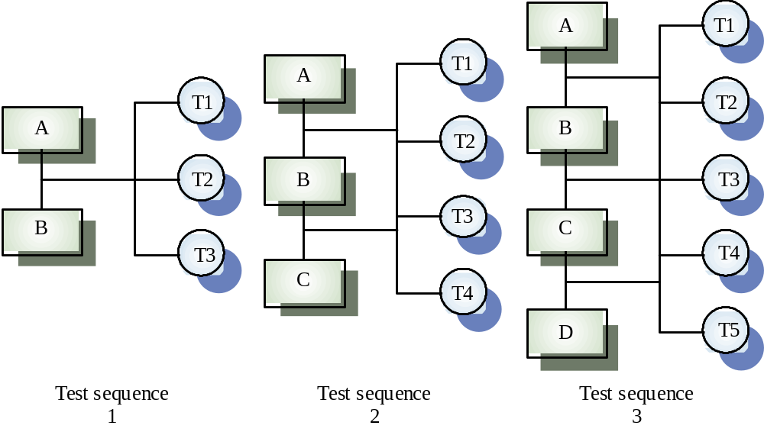
Incremental integration testing

Slide 96
Approaches to integration testing
Top-down testing
  Start with high-level system and integrate from the top-down replacing individual components by stubs where appropriate
Bottom-up testing
  Integrate individual components in levels until the complete system is created
In practice, most integration involves a combination of these strategies

Slide 97
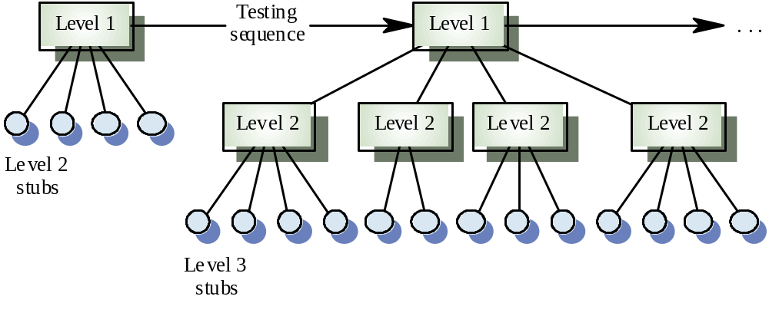
Top-down testing

Slide 98
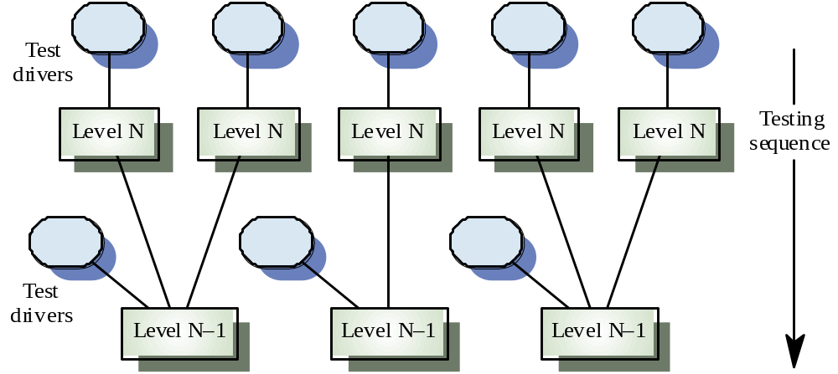
Bottom-up testing

Slide 99
Testing approaches
Architectural validation
  Top-down integration testing is better at discovering errors in the system architecture
System demonstration
  Top-down integration testing allows a limited demonstration at an early stage in the development
Test implementation
  Often easier with bottom-up integration testing
Test observation
  Problems with both approaches. Extra code may be required to observe tests

Slide 100
Interface testing
Takes place when modules or sub-systems are integrated to create larger systems
Objectives are to detect faults due to interface errors or invalid assumptions about interfaces
Particularly important for object-oriented development as objects are defined by their interfaces

Slide 101
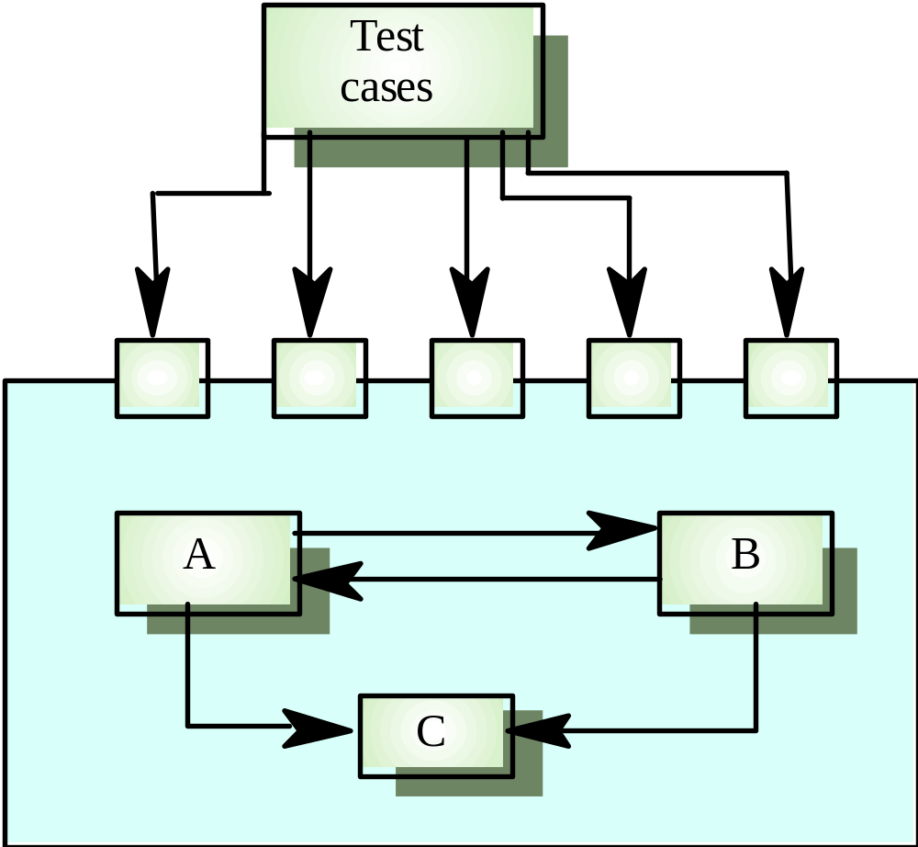
Interface testing

Slide 102
Interfaces types
Parameter interfaces
  Data passed from one procedure to another
Shared memory interfaces
  Block of memory is shared between procedures
Procedural interfaces
  Sub-system encapsulates a set of procedures to be called by other sub-systems
Message passing interfaces
  Sub-systems request services from other sub-systems

Slide 103
Interface errors
Interface misuse
  A calling component calls another component and makes an error in its use of its interface e.g. parameters in the wrong order
Interface misunderstanding
  A calling component embeds assumptions about the behaviour of the called component which are incorrect
Timing errors
  The called and the calling component operate at different speeds and out-of-date information is accessed

Slide 104
Interface testing guidelines
Design tests so that parameters to a called procedure are at the extreme ends of their ranges
Always test pointer parameters with null pointers
Design tests which cause the component to fail
Use stress testing in message passing systems
In shared memory systems, vary the order in which components are activated

Slide 105
Stress testing
Exercises the system beyond its maximum design load. Stressing the system often causes defects to
come to light
Stressing the system test failure behaviour.. Systems should not fail catastrophically. Stress testing checks for unacceptable loss of service or data
Particularly relevant to distributed systems
which can exhibit severe degradation as a
network becomes overloaded

Slide 106
Object-oriented testing
The components to be tested are object classes that are instantiated as objects
Larger grain than individual functions so approaches to white-box testing have to be extended
No obvious ‘top’ to the system for top-down integration and testing

Slide 107
Testing levels
Testing operations associated with objects
Testing object classes
Testing clusters of cooperating objects
Testing the complete OO system

Slide 108
Object class testing
Complete test coverage of a class involves
  Testing all operations associated with an object
  Setting and interrogating all object attributes
  Exercising the object in all possible states
Inheritance makes it more difficult to design object class tests as the information to be tested is not localised

Slide 109
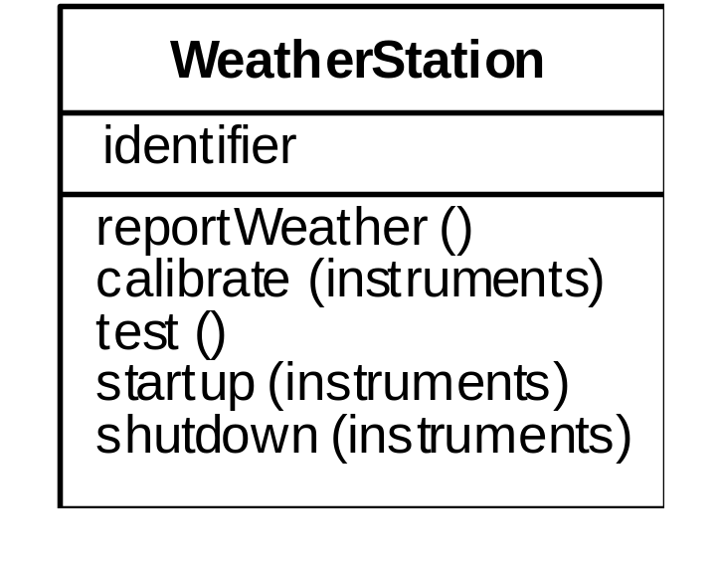
Weather station object interface
Test cases are needed for all operations
Use a state model to identify state transitions for testing
Examples of testing sequences
  Shutdown → Waiting → Shutdown
  Waiting → Calibrating → Testing → Transmitting → Waiting
  Waiting → Collecting → Waiting → Summarising → Transmitting → Waiting

Slide 110
Object integration
Levels of integration are less distinct in object-oriented systems
Cluster testing is concerned with integrating and testing clusters of cooperating objects
Identify clusters using knowledge of the operation of objects and the system features that are implemented by these clusters

Slide 111
Approaches to cluster testing
Use-case or scenario testing
  Testing is based on a user interactions with the system
  Has the advantage that it tests system features as experienced by users
Thread testing
  Tests the systems response to events as processing threads through the system
Object interaction testing
  Tests sequences of object interactions that stop when an object operation does not call on services from another object

Slide 112
Scenario-based testing
Identify scenarios from use-cases and supplement these with interaction diagrams that show the objects involved in the scenario
Consider the scenario in the weather station system where a report is generated

Slide 113
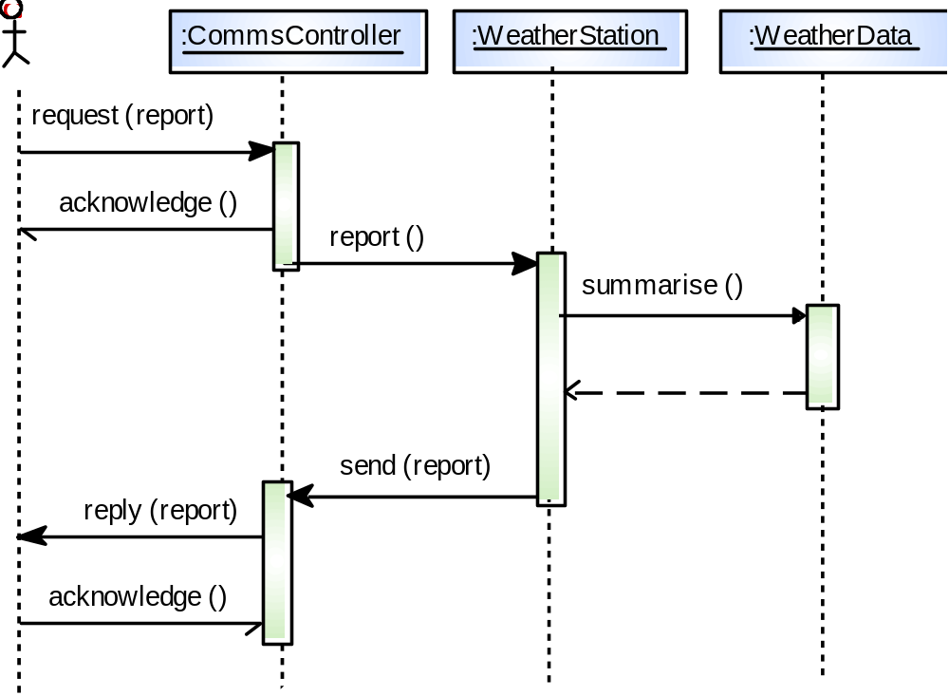
Collect weather data

Slide 114
Weather station testing
Thread of methods executed
  CommsController:request → WeatherStation:report → WeatherData:summarise
Inputs and outputs
  Input of report request with associated acknowledge and a final output of a report
  Can be tested by creating raw data and ensuring that it is summarised properly
  Use the same raw data to test the WeatherData object

Slide 115
Testing workbenches
Testing is an expensive process phase. Testing workbenches provide a range of tools to reduce the time required and total testing costs
Most testing workbenches are open systems because testing needs are organisation-specific
Difficult to integrate with closed design and analysis workbenches

Slide 116
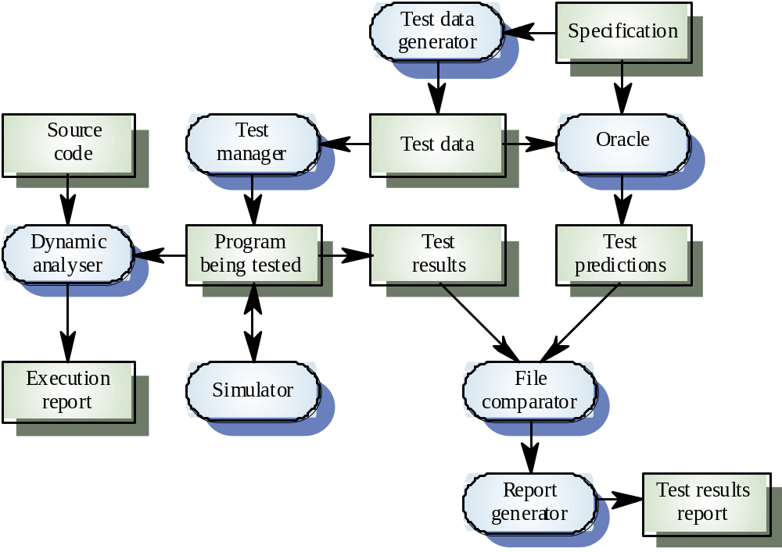
A testing workbench

Slide 117
Tetsing workbench adaptation
Scripts may be developed for user interface simulators and patterns for test data generators
Test outputs may have to be prepared manually for comparison
Special-purpose file comparators may be developed

Slide 118
Key points
Test parts of a system which are commonly used rather than those which are rarely executed
Equivalence partitions are sets of test cases where the program should behave in an equivalent way
Black-box testing is based on the system specification
Structural testing identifies test cases which cause all paths through the program to be executed

Slide 119
Key points
Test coverage measures ensure that all statements have been executed at least once.
Interface defects arise because of specification misreading, misunderstanding, errors or invalid timing assumptions
To test object classes, test all operations, attributes and states
Integrate object-oriented systems around clusters of objects

