Slide 1
Advancing Auditory Enhancement: Integrating Spleeter with Advanced Remixing Techniques in The Cadenza Challenge 2023
Group E016
Authors: Debangshu Sarkar, Arundhuti Mukherjee
Affiliation: University of Leeds, UK

Slide 2
Cadenza | Introduction
Our motivation for Cadenza 2023
Objective for the challenge
The task presented a unique opportunity to explore advancements in audio enhancement technologies.
Our submission focused on Task 1, targeting improved audio for headphone users with hearing loss.
Distinct Approach
Our motivation for Cadenza 2023
Contrary to the baseline methods of Hybrid Demucs and Open-Unmix, our project incorporated Spleeter's deep learning capabilities.
While Spleeter provided the foundation, our project went further by integrating N-ALR prescriptions, Butterworth bandpass filters, and Dynamic Range Compression.

Slide 3



Cadenza | Specifications
Working with large, complex audio datasets and heavy algorithms drove the decision to use advanced computational resources.
High Performance Computers (HPCs)
HPCs ARC4 environment provided by University of Leeds
This gave us access to 149 nodes with 40 cores and 192GB of memory each.
Graphical Processing Unit (GPUs)
Google Colab’s V100 GPU
Increased computational speed by 5-10x compared to CPU processing.
These resources helped us achieve:
High computational speeds
Parallel processing
Higher memory capacity

Slide 4

Spleeter | An Introduction
Origin of Spleeter
Pre-trained Models
TensorFlow
Spleeter was created by Deezer Research in 2015. It was designed with ease of use, separation performance, and speed in mind
Spleeter contains pre-trained models like U-Net and is trained on Deezer’s internal datasets.
TensorFlow serves as the core machine learning framework on which Spleeter is built.
This allows Spleeter to use TensorFlow's high-level APIs, like layers, activations, and other components available in the TensorFlow library
Getting to
know Spleeter
Source Separation
Spleeter's default model separates audio into 4 stems: vocals, bass, drums, and other.
Additionally, a 2 and 5 stem configurations generate vocals and accompaniment or vocals, bass, drums, piano, and other
The dynamic and adaptable nature of Spleeter encouraged us to explore further

Slide 5




Spleeter | Why choose this model?
Spleeter's integration with TensorFlow provides our project with optimized model training, efficient parameter tuning, enhanced computational efficiency, scalability, and flexibility in architecture design
Spleeter achieves competitive demixing results with relatively lower computational demands compared to Hybrid Demucs and Open-Unmix.
Spleeter is pre-trained on a diverse range of audio sources, including music genres relevant to The Cadenza Challenge.
Spleeter has the capacity for parallelized computations, harnessing the power of GPUs. With the ability to separate the entire MUSDB18 test dataset into 4 stems in less than 2 minutes on a single GeForce RTX 2080 GPU
Efficiency, speed and familiarity with a varied genre of music drove us to use Spleeter for this task

Slide 6


Demixing | Stages
Input
Training dataset of pre-separated VDBO files
Stereo audio tracks loaded at 44100Hz using AudioAdapter
Model Configuration
Training
Audio Loading and Resampling
Neural Network Processing
1
2
3
4
Initializing the 'spleeter:4stems’ model configuration
Model is trained to accurately identify and separate similar components in unseen tracks
8 stem files – voice, drums, bass and other for each ear
Output
Let us look further into the key steps

Slide 7
Demixing - Stages| Training
Deep Dive : Training
2
Diverse training dataset
TensorFlow coordinates intricate training operations, exposing the model to batches of pre-separated stems.
Internal parameters are iteratively adjusted to minimize differences between predicted and actual stems.
The well-trained model can now accurately identify and isolate vocals, drums, bass, and other components.
Provided by The Cadenza Challenge, the training dataset contains songs from various genres, each meticulously separated into vocals, drums, bass, and other elements stored as individual .wav files.
TensorFlow driven training
Multiple epochs refine the model's parameters, improving its accuracy in identifying and isolating audio components.
The model learns intricate patterns and nuances specific to vocals, drums, bass, and other elements
Iterative optimisation process
Trained model

Slide 8
Demixing - Stages| Loading & Resampling
Deep Dive : Audio Loading and Resampling
3
Loading and Configuration
The loaded audio track undergoes a resampling operation to ensure a consistent sample rate of 44100Hz.
Resampling maintains uniformity in the input data, aligning it with the expected format.
The separate method of the separator dissects the audio into its constituent stems based on the trained model, producing an ‘audio_descriptor’ as the output.
Audio tracks loaded into Spleeter framework AudioAdapter module
An instance of AudioAdapter is created by default
Resampling
The ‘load’ method is invoked, loading the audio to specified path.
The result of the loading operation is a waveform, representing the audio data, and additional information
Waveform extraction
Separation process

Slide 9
Demixing - Stages| Neural Network
Deep Dive : Neural Network Processing
4
Input preparation
The network's initial layers engage in feature extraction, identifying relevant patterns.
Raw waveforms are transformed into abstract features, enabling the network to discern distinct audio components effectively.
Applies learned representations to predict each audio component's contribution.
Separates complex audio signals effectively.
Stereo tracks, having undergone loading and resampling to 44100Hz, serve as the input to Spleeter's trained neural network.
Each audio waveform is numerically represented, forming the initial input layer of the neural network.
Feature extraction
The system utilizes convolutional layers, activation functions, and pooling layers.
Captures hierarchical and spatial dependencies in audio data.
Layered architecture
Demixing operation
At the end of these processes, we have 8 demixed audio stems; 4 for each ear

Slide 10
Remixing| Stages
Utilised audiograms for both left and right ears to tailor the audio to individual listener profiles
Combined NALR-processed stems form a remixed signal followed by padding operations for different stem durations
Implemented a custom compressor to fine-tune the dynamics of the separated stems
Applied a bandpass filter to the remixed audio
NAL-R Application
Remix Signal Creation
Dynamic Range Compression (DRC)
Butterworth Filter
1
2
3
4
Input
Demixed stem files for each audio track
Singular remixed signal
Remixed and filtered for subjective evaluation
Output
Let us look further into the key steps

Slide 11
Remixing - Stages| NAL-R
Deep Dive : NAL-R Application
1
Listener-specific audiograms
Utilized the NALR class to design adaptive FIR (Finite Impulse Response) filters based on individual audiometric data.
Adjusted gain considering listener-specific bias, critical loss, and individual hearing conditions.
Performed audiogram resampling and used individual hearing thresholds to create left and right ear Audiogram objects.
NAL-R filters
Interpolated gains and designed linear-phase FIR filters to ensure a smooth and customized frequency response.
Interpolated gains and frequency response
Adapted gain based on listener characteristics

Slide 12
Remixing - Stages| DRC
Deep Dive : Dynamic Range Compression
3
Compressor initialization
Attack and Release: Adjusts signal dynamics using user-defined attack and release times.
RMS-based Compression: Signal undergoes dynamic compression based on RMS values and makeup gain for level adjustment.
Configure Parameters: Compressor initialized with attack, release, threshold, attenuation, RMS (Root Mean Square) buffer, and makeup gain.
Dynamics adjustment
Set Threshold: Compression triggered when the signal exceeds a specified threshold, controlled by attenuation.
Threshold compression
Dynamic processing

Slide 13

Remixing - Stages| Butterworth Filter
Deep Dive : Butterworth Bandpass Filter
3
Filter design
Parameters: Defined filter settings like lowcut, highcut, order, and sample rate.
Second-Order Sections: Applied SOS for stable filtering.
Butterworth Filter: We used a bandpass Butterworth filter for audio processing.
Frequency Range: Focused on 250 Hz to 18,500 Hz for clear audio.
Filter implementation
Application: ‘apply_butter_bandpass_filter’ function filters the remixed signal.
Input/Output: Takes remixed signal, outputs filtered result.
Function application
At the end of these processes, we have 8 enhanced audio stems and the finely tuned remixed signal

Slide 14


Objective Evaluation | Metrics and Scores
HAAQI
SNR and SDR
We employed the Hearing Aid Audio Quality Index (HAAQI) as an objective measure. This metric, introduced by J. M. Kates and K. H. Arehart, evaluates audio quality in the context of hearing aids.
HAAQI considers factors crucial to music sound quality in hearing-aid use, including clarity, naturalness, and richness/fullness.
Signal to Noise Ratio (SNR) quantifies the ratio of the signal power to background noise power. It assesses the clarity and fidelity of the primary audio signal.
Signal to Distortion Ratio (SDR) measures the ratio of the signal power to the distortion introduced. It evaluates the presence of unwanted artifacts or alterations
For both metrics, a positive value implies better quality of audio.
Objective evaluations were carried out by assessing the processed audio using these metrics.

Slide 15
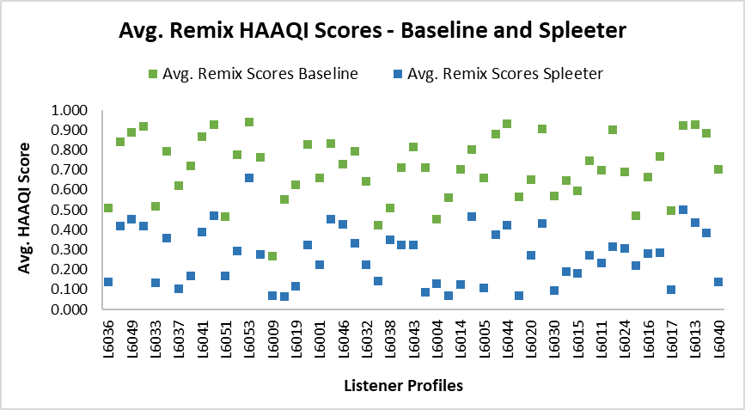
Objective Evaluation - HAAQI| Results
Comparing Average HAAQI Scores
A granular analysis of HAAQI scores for individual listeners revealed that our model's scores varied significantly from the baseline.
For example:
Listener L6036 showed a decrease from the baseline score of 0.509 to 0.136 with our model.
Conversely, Listener L6049's score decreased less dramatically, from 0.888 to 0.451, suggesting a closer performance to the baseline.
What can we explore in the future?
Impacts of diverse audiogram profiles, variation in music tracks and unfamiliar genres

Slide 16
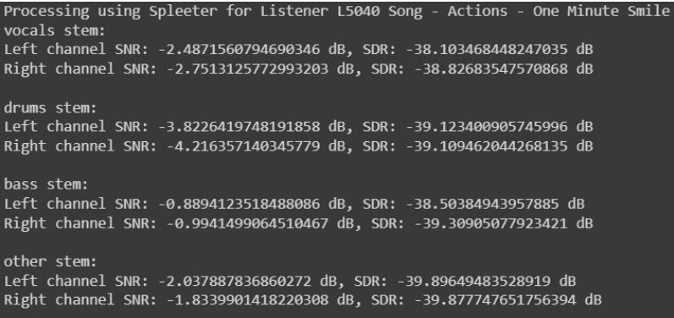
Objective Evaluation – SNR & SDR| Results
A snapshot of results for SNR and SDR
Unexpected Negativity: Encountered negative values, deviating from conventional positive expectations.
Amplification of Noise: Possible background noise or artifacts amplification during demixing, challenging standard signal-to-noise/distortion paradigms.
What can we explore in the future?
Metrics more suitable for music based audio and foolproof methods of removing external artifacts
Lower scores in objective evaluations prodded us to understand our results better with subjective scores.

Slide 17
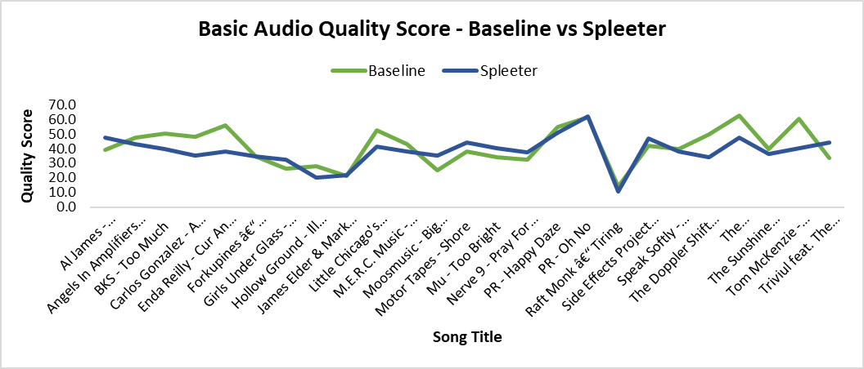
Subjective Evaluation| Results
Comparing Listening Test Scores
Despite the lower objective HAAQI scores, listener feedback on basic audio quality was revealing.
On average, listeners preferred our model's audio quality over the baseline 44% of the time.
This suggests a subjective preference for the audio processed by our model, despite what the HAAQI scores might imply.
Al James' "Schoolboy Fascination" saw an increase from a baseline score of 39.1 to 47.6 with our model.
For "Girls Under Glass - We Feel Alright", the score improved from 26.2 to 32.2, indicating an enhancement in listener perception.
This motivates us to learn about gaps in subjective and objective alignment of audio analysis.

Slide 18

Cadenza| Conclusion and Future Discussion
Conclusion and Summary
Future Scope
Spleeter Approach Validated: Successfully applied Spleeter model and customized remixing techniques, like Butterworth Bandpass filtering and Dynamic Range Compression.
User Preferences Over Metrics: Despite lower HAAQI scores, user feedback demonstrated a 44% preference for our model, emphasizing the nuanced nature of audio quality assessment.
Complexity Studies: Detailed exploration revealed the complexity of audio processing for hearing impairments, as evidenced by varied HAAQI scores, negative SNR/SDR values, and song-specific outcomes.
Concluded with a commitment to refining methodologies, embracing new metrics, and contributing to the ongoing evolution of auditory accessibility in the realm of machine learning and audio processing.
The insights gained from this challenge pave the way for further research into the intersection of machine learning and auditory perception. Future work will focus on refining our model to better address the gaps identified through the HAAQI scores while continuing to prioritise the subjective listening experience.

Slide 19
Thank You! Q&A

