Slide 1
Cadenza 2023
E012
(Advancing Accessible and Personalized Audio Technologies for Individuals with Hearing Impairments)

Slide 2
Introduction
Methodology
System Information
Results and Evaluation
Conclusion
Acknowledgements

Slide 3
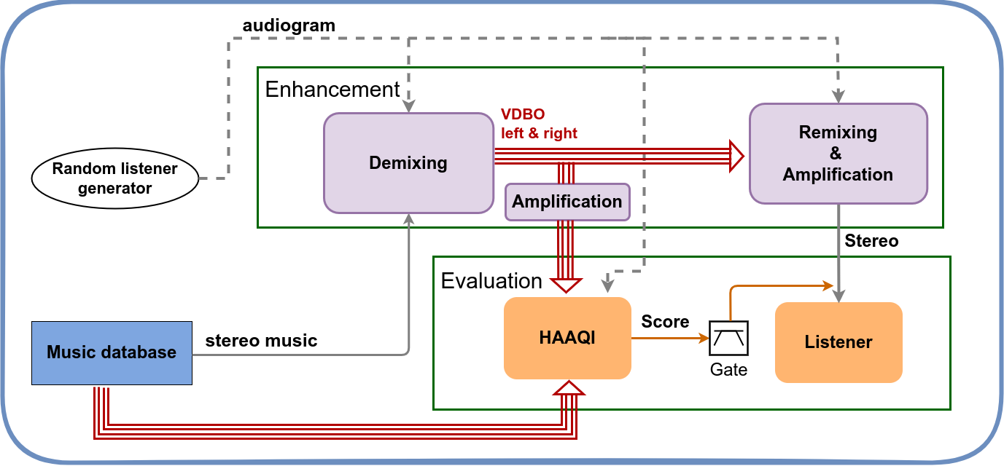
Cadenza – Challenge 1
Objective – headphones ( 1 line explanation)
Methods we used for each stage
Demixing – demucs, Spleeter
Amplification
Remixing
HAAQI
1
3
2
4

Slide 4

Introduction
Addressing the specific needs of hearing-impaired listeners
Traditional audio processing methods inadequately cater to this group
Introduction of the Hybrid Demucs model for audio source separation
Goal of creating more accessible audio experiences for individuals with hearing impairments

Slide 5
Methodology
Demixing
Model Training and Configuration
Training Dataset: MUSDB18-HQ dataset
Model Configuration: Hybrid Demucs architecture
Resampling of tracks for uniform input data
Hearing Loss Degree Classification
Volume Adjustment and Multiband Compression
Final Assembly and Quality Control
Remixing Stage

Slide 6
Methodology
Demixing
Model Training and Configuration
Training Dataset: MUSDB18-HQ dataset
Model Configuration: Hybrid Demucs architecture
Resampling of tracks for uniform input data
Hearing Loss Degree Classification
Volume Adjustment and Multiband Compression
Final Assembly and Quality Control
Remixing Stage

Slide 7
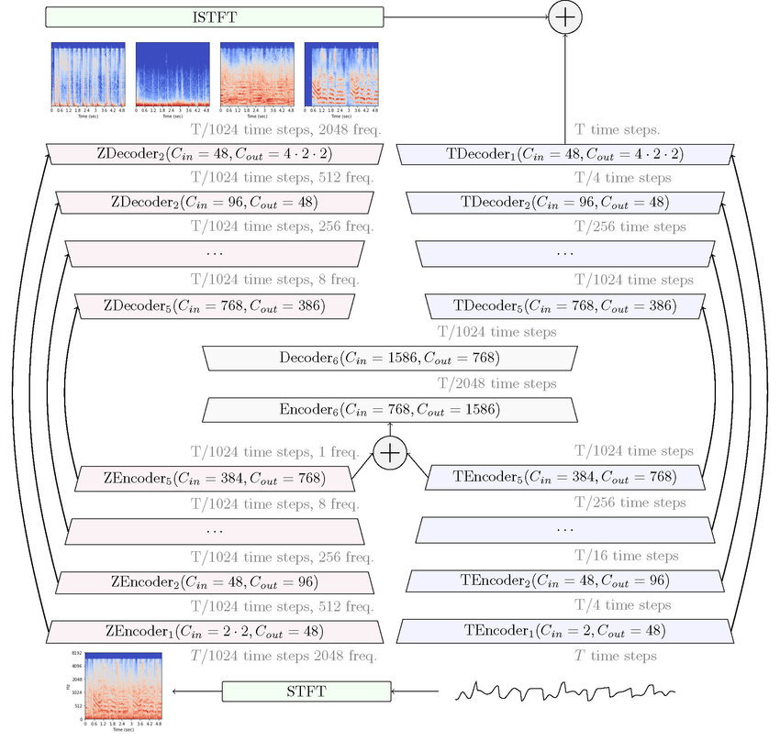
Challenge 1 - demixing
Demixing with demucs
Component Isolation
"Precise separation of audio components (e.g., vocals, drums, bass)."
Demucs excels in isolating individual elements from complex audio tracks.
High-Fidelity Remixing
Bullet Point: "Maintains high audio fidelity during remixing."
Describe how Demucs ensures that audio quality is preserved while customizing output.
K Deep Learning Flexibility
"Adaptable deep learning model for personalized audio processing."
flexibility in adapting to individual audiograms and preferences.

Slide 8
Methodology
Demixing
Model Training and Configuration
Training Dataset: MUSDB18-HQ dataset
Model Configuration: Hybrid Demucs architecture
Resampling of tracks for uniform input data
Hearing Loss Degree Classification
Volume Adjustment and Multiband Compression
Final Assembly and Quality Control
Remixing Stage

Slide 9
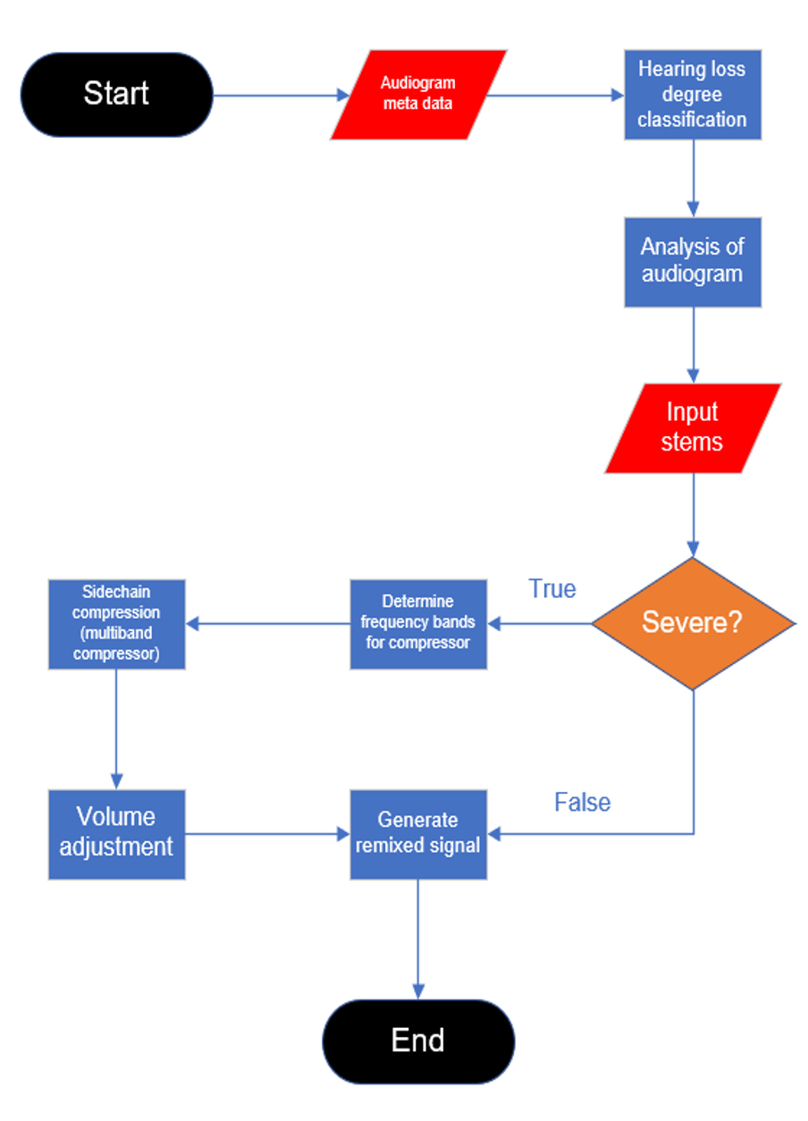
Remixing Workflow

Slide 10
Challenge 1 - remixing
Remixing – key methods
Filters:
Multiband compression
Sidechain compression
What did we achieve
What did we achieve
What did we achieve

Slide 11
Challenge 1 - remixing
Remixing – key methods
Filters: Filters were likely used to tailor the audio frequencies based on the hearing profile of listeners as indicated by their audiograms Func used : selectbands()
Multiband compression
Sidechain compression
The precise application of filters based on hearing loss classification allowed for a customized listening experience, enabling clear audio perception for individuals with various degrees of hearing impairment.
What did we achieve
What did we achieve

Slide 12
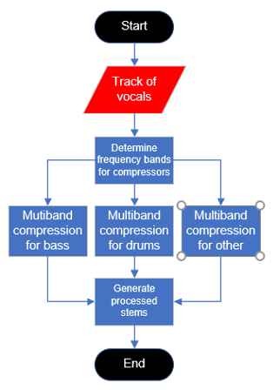
Multiband Compression
Multiband Compression:
The multiband compressor dynamically adjusted audio levels within targeted frequency bands, enhancing clarity and ensuring a balanced audio experience for the listener, especially for those with hearing loss at particular frequencies. Func Used : multibandCompressor()
Sidechain Compression:
Achievement: The smart application of sidechain compression improved the overall audio quality by ensuring that primary audio elements like vocals were more prominent, greatly enhancing the listening experience for the intended audience. Func Used : choosesidechain, choosecompressor

Slide 13
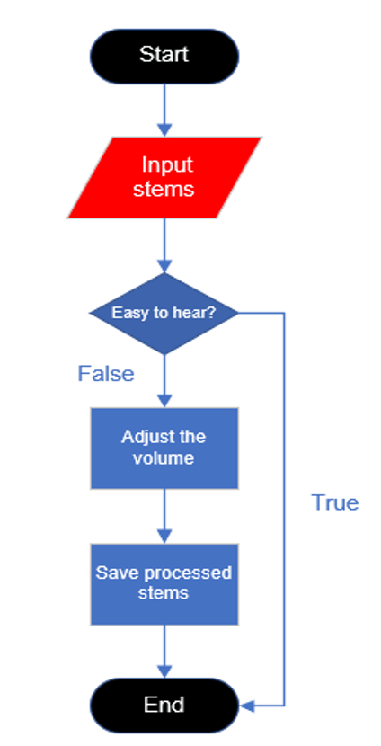
Volume Adjustment
Functions Utilized:
change_volume: Adjusts track loudness by scaling the audio signal array.
judge_volume: Determines the dB adjustment needed per track, then calls change_volume.
Dynamic Loudness Control: Tailored volume adjustments to individual hearing profiles.
Balanced Audio Mix: Ensured essential audio elements were appropriately emphasized for clarity.
Enhanced Listening Experience: Improved music enjoyment and intelligibility for listeners with hearing impairments.
Volume adjustments were meticulously calculated based on detailed audiogram analysis for precision in audio delivery.
The implementation of these functions has significantly contributed to the customization of the listening experience, adhering to the unique needs of each user.

Slide 14
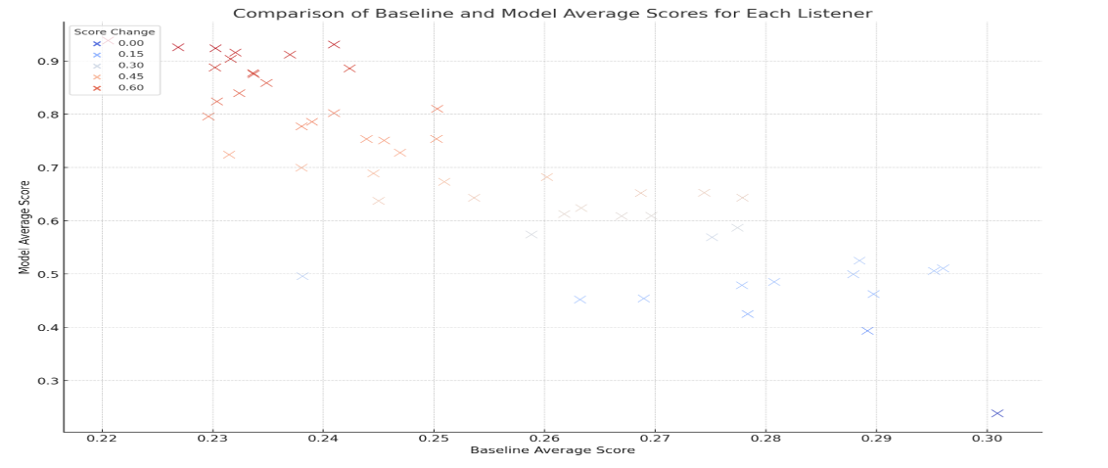
Challenge 1 - evaluation
HAAQI Score
The scores vary across different songs, with some songs scoring relatively high (e.g., 'Enda Reilly - Cur An Long Ag Seol' with 57.4) and others scoring lower (e.g., 'Al James - Schoolboy Facination' with 38.3). The standard deviations range from around 22 to 25, suggesting moderate variability in listener perceptions for each song.

Slide 15
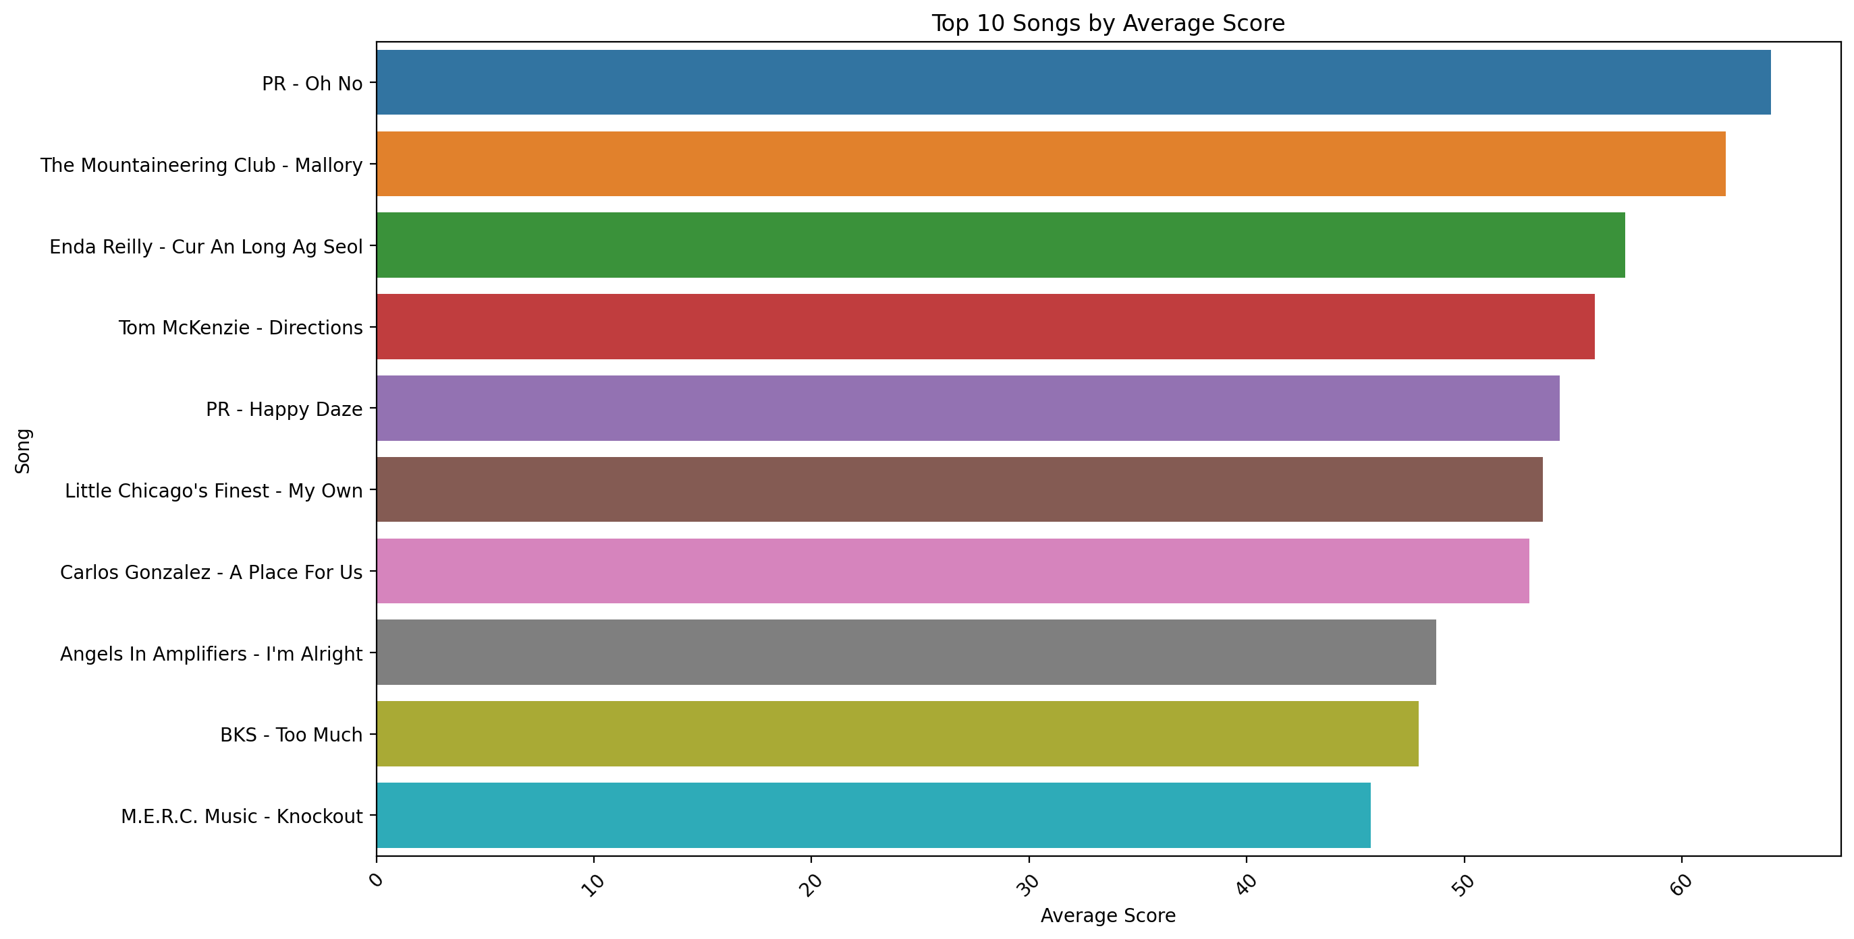
Subjective Listener Feedback
In addition to the quantitative analysis, subjective listener feedback was collected to evaluate the real-world applicability of the audio processing system. On average, 44% of listeners preferred our model's audio quality over the baseline, highlighting subjective preference and the potential of our approach.
Detailed Analysis
Neutral: 25 listeners
Bad: 8 listeners
Good: 8 listeners
Very Good: 6 listeners
Very Bad: 6 listeners

Slide 16
Analysis of Specific Listener and Song Cases
Girls Under Glass - We Feel Alright:
Baseline Average Score: 0.246
Model Average Score: 0.588
Al James - Schoolboy Fascination:
Baseline Average Score: 0.268
Model Average Score: 0.628
Carlos Gonzalez - A Place For Us:
Baseline Average Score: 0.258
Model Average Score: 0.863
It appears that while the original versions of the songs generally received below-average ratings, particularly in bass and drum quality, the remixed versions were much better received. The higher ratings for 'other instruments' and 'vocals' suggest these were the stronger elements in the original mixes. The consistency in ratings across different listeners indicates a relatively uniform perception of the audio quality. ​

Slide 17
Conclusion
Developed personalized remixing for hearing loss.
Utilized Hybrid Demucs for demixing.
Implemented techniques for audio track enhancement.
Validated through listener feedback and tests
Future Work
Optimize audio processing techniques.
Investigate alternative audio enhancement methods.
Further development based on Cadenza team feedback.
Participation in sensory evaluation studies.

