Slide 1


SOSCIP GPU
First Steps
Andre Rosa - Seneca College - 2018

Slide 2
SOSCIP GPU - First Steps
SUMMARY
  - Preconditions;
  - Understanding Nodes and File Systems;
  - Log-in;
  - Modules Loading;
  - Environment Setup;
  - File Transfer;
  - Job Submission – Parallel Programs x Parallel Code;
  - Special notes on jobs.

Slide 3
SOSCIP GPU - First Steps
Preconditions
  ▶To be able to login at SOSCIP it is necessary to request an account in SCINET. https://portal.scinet.utoronto.ca/authentication/login
  ▶After receiving your SCINET credentials it is necessary to contact soscip-support@scinet.utoronto.ca where you must provide:
    - SCINET Account Name;
    - SOSCIP Project Number;
    - A statement declaring you meet the SOSCIP requirements.*
    * individuals of some countries are restricted from accessing SOSCIP GPU platform.

Slide 4
SOSCIP GPU - First Steps
Understanding Nodes and File Systems
  ▶ SOSCIP GPU cluster is part of a bigger cluster of High Performance Computers (HPC). Each different HPC in the cluster is called a node. Imagine a node as an individual computer.
  ▶ It is important to learn how to navigate between the different clusters to get to the SOSCIP node. SOSCIP node’s name is sgc.
  ▶ Additionally there are different data systems. Imagine the data systems as different hard drives in the same computer.
  ▶ The data systems are shared among all nodes. Therefore you can access the same files even when located in different nodes.
  ▶ In SOSCIP we will use two file systems: $HOME and $SCRATCH

Slide 5
Nodes and File Systems
  When you log-in you are directed to the BG/Q node (also known as the access node). You can move between nodes and access different file systems.
Login
BGC01
SGC01
Other Nodes
SGC01
NODES
SGC01
$HOME
$SCRATCH
…...
FILE SYSTEMS
home
scratch
scratch

Slide 6
Nodes and File Systems
There are two file systems available:
$HOME – backup and 50GB available
$SCRATCH – no backup but with 20TB of disk space
The absolute path to $HOME of a user with name ‘user’ and work group name ‘work’ is:
/home/w/work/user
Similarly the absolute path to $SCRATCH for a user with name ‘andrevr’ from the group ‘vida’ is:
/scratch/v/vida/andrevr
It is also possible to access $HOME and $SCRATCH with the command line ‘cd’ as in: cd $HOME

Slide 7
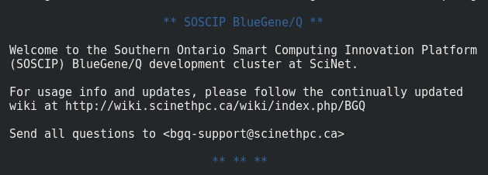
Login
1) From the terminal type:
ssh -l <username> bgqdev.scinet.utoronto.ca
The system will ask your password. This leads you to Blue Gene/Q node.

Slide 8
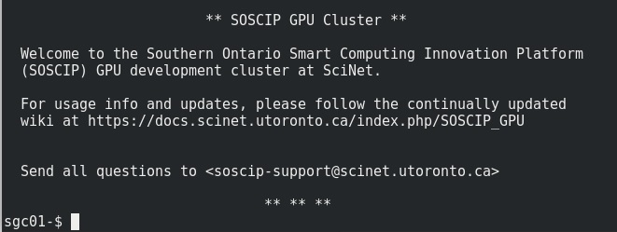
Login (cont.)
2) Move to SOSCIP GPU Platform node with the command:
ssh -X sgc01-ib0
This leads you to SOSCIP GPU node (sgc01).

Slide 9
Modules Loading
SOSCIP has several pre-installed modules that must be activated each time you log in to allow run Python programs.
Therefore you must type the following commands:
  module load anaconda3
  module load cuda/9.2
  module load cudnn/cuda9.2/7.2.1
  module load nccl/2.2.13
  module load powerAI-5.3/Tensorflow-1.10.0-py3
It is possible to check the available modules with ‘module avail’. To check the currently loaded modules type ‘module list’.

Slide 10
Environment Setup
  The safest way to run your code in SOSCIP is with the use of Python environments. An environment is an encapsulated structure where an user can install different versions of libraries that only work when running from inside the environment.
  - The advantages of environments are:
    - possibility to install different versions of libraries in different environments;
    - protect your system from experimental installations;
    - easiness to clean any problems when working with packages;
    - recreate the same environment to run a program in a different computer.
  The two most popular tools to manage environments are PIP and Conda.
  For our SOSCIP TensorFlow experiment we will create an environment with Conda (from module anaconda3) and install several packages on it.

Slide 11
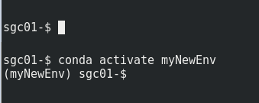
Environment Setup (cont.)
To create a new environment with name ‘myNewEnv’:
  conda create –-name myNewEnv python=3.6
Activate your new environment:
  conda activate myNewEnv
Note that your command prompt changes with environment activation, as seem bellow:
regular prompt
conda activate
‘myNewEnv’ active

Slide 12
Environment Setup (cont.)
OpenCV and other python libraries not included in the modules must be installed manually in the environment.
These are the libraries used in the research:
1) pillow – pip install pillow
2) six – conda install six
3) openCV – conda install -c menpo opencv
4) protobuf – pip install -- force protobuf
5) scipy – conda install scipy
6) matplotlib – conda install matplotlib

Slide 13
Testing the Environment
With the environment ready it is a good idea to make a backup od the environment with the command:
conda create --name myBackup --clone myPythonEnv
These are links for some ready to use code to test your installation:
https://github.com/Cadesh/TensorFlow/tree/master/FramesOpenCV3
https://github.com/Cadesh/TensorFlow/tree/master/InceptionTest_SCINET_GPU

Slide 14
File Transfer
SOSCIP works with SCP (Secure Copy Protocol).
To transfer a file from your computer to $HOME:
scp file.txt <username>@bgqdev.scinet.utoronto.ca:~/
To transfer a file to $SCRATCH, user ‘andrevr’, group ‘vida’:
scp myDoc.pdf andrevr@bgqdev.scinet.utoronto.ca:/scratch/v/vida/andrevr
To transfer a directory with all contents:
scp -r myFolder andrevr@bgqdev.scinet.utoronto.ca:/scratch/v/vida/andrevr
It is also possible to transfer files with products as Filezilla.
(filezilla-project.org)

Slide 15
Job Submission in SOSCIP
To run your code in SOSCIP it is necessary to submit a job. The job will join a queue and then will be assigned to a node (1 to 14) where it will have access to the 4x Tesla P100 GPUs.
There are two ways to run a a job in SOSCIP:
  - A single GPU program that will run in parallel 4x times, one for each GPU;
  - A parallel code that will access directly all 4 GPUs.
The next slide shows the two ways to run a job in SOSCIP.

Slide 16
Job Submission (cont.)
output
output
output
output
output
GPU
GPU
GPU
GPU
GPU
GPU
GPU
GPU
main.py
main.py
main.py
main.py
main.py
main.py
node
node
input
main.py
main.py
JOB
script
JOB
script
SOSCIP job – Same code executed in parallel
SOSCIP job – Parallel program execution

Slide 17
Job for Multiprocessing Programs
output
To run a program that can access the four GPUs at the same time you need to use some kind of multithread technique. An example of Multiprocessing program with GPU access (with Tensorflow and Keras) can be found here:
https://github.com/Cadesh/TensorFlow/tree/master/Parallel_GPU_Basic
Note that the Job needs a script file to run.
An explanation on the script file is in the next slide.
GPU
GPU
GPU
GPU
main.py
node
JOB
main.py
script

Slide 18
Parallel code Script file
#!/bin/bash
#SBATCH --nodes=1
#SBATCH --ntasks-per-node=20
#SBATCH --time=00:40:00 #line 4 - time needed to finish job
#SBATCH --gres=gpu:4
. /etc/profile.d/modules.sh #enable module command
cd $SLURM_SUBMIT_DIR #moves to the directory where the batch is
#line 11 to 16 load modules
module purge
module load anaconda3
module load cuda/9.2
module load cudnn/cuda9.2/7.2.1
module load nccl/2.2.13
module load powerAI-5.3/Tensorflow-1.10.0-py3
source activate envFao #line 18 - conda environment
export OMP_NUM_THREADS=1
python main.py pics 0,1,2,3 #line 22 - program and parameters
hostname
nvidia-smi #use this to get the cuda report
Some comments:
Line 4 – Amount of time to run the job. You must estimate this correctly because if your program takes longer the process will be killed.
Lines 11 to 16 – Modules necessary for your program.
Line 18 – activate Conda environment for the program.
Line 22 – The command line to run the program with parameters, if necessary.

Slide 19
Job for Multiprocessing Programs
output
output
output
output
To run different programs in parallel it is necessary to use a script file and an input file.
In the example on the left the same program main.py is running 4x times directed to 4 different GPUs. This is possible because of the directives in the script file.
It is a good practice to use all the 4 GPUs. SOSCIP technical team receives reports on the use of GPU for every user.
GPU
GPU
GPU
GPU
main.py
main.py
main.py
main.py
main.py
node
input
main.py
JOB
script

Slide 20
Script for single GPU Program in Parallel
#!/bin/bash
#SBATCH --nodes=1
#SBATCH --ntasks-per-node=20
#SBATCH --time=00:45:00 # H:M:S
#SBATCH --gres=gpu:4 # Ask for 4 GPUs per node
. /etc/profile.d/modules.sh #enable module command
cd $SLURM_SUBMIT_DIR #moves to the directory where the batch is
# loads modules
module purge
module load gnu-parallel/20180422 #line 10 – use 4 programs in parallel
module load anaconda3
module load cuda/9.2
module load cudnn/cuda9.2/7.2.1
module load nccl/2.2.13
module load powerAI-5.3/Tensorflow-1.10.0-py3
source activate envFao #name of your previously created conda environment
export OMP_NUM_THREADS=1
parallel -a command.input --colsep ' ' -j 4 'CUDA_VISIBLE_DEVICES=$(( {%} - 1 )) numactl -N $(( ({%} -1) / 2 )) python {1} {2} {3} {4} {5} {6} &> jobname-{#}.out' #line 23 and 24
hostname
nvidia-smi
Some comments:
Line 10 – Add this module in your script for programs in parallel.
Line 23, 24 – ‘command.input’ is the file that will be used as input of the command line. The number ‘4’ is the number of GPUs to be used. The numbers in curly brackets {..} are the parameters of the command line. If to run your code you need to issue the command ‘python main.py param1 param2’ this line will look like ‘python {1} {2} {3}’.

Slide 21
Input File for Programs in Parallel
- As mentioned previously, to run different programs in parallel it is necessary to use a .input file.
- The input file has one line for each program to be launched with the parameters.
- In this example the program ‘main.py’ will run four times with different parameters.
Example of .input file.
main.py c11250 12k.csv 80 11001 11250
main.py c11500 12k.csv 80 11251 11500
main.py c11750 12k.csv 80 11501 11750
main.py c12000 12k.csv 80 11751 12000

Slide 22
END

