Slide 1
Software Frameworks Project Plan
Martin Burko | Cade Reynaud https://github.com/Cadezzz/SoftwareFrameworks

Slide 2
Our Project
We collect real-time data from diverse sources such as
weather,
precipitation,
water levels,
and new snowfall
Our Goal: Present a complete picture of the natural environment
Proactive Risk Management for flood risks, snowfall accumulation, and other environmental challenges through real-time data analysis
Target Group: environmental professionals, urban planners, and policy-makers

Slide 3
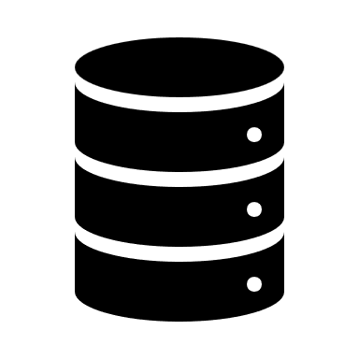

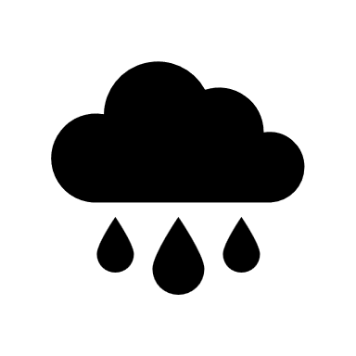



Our Architecture
Different Data-Sources
Real Estate Backend
(C# )
MongoDB
Stream
REST-API
Frontend
(Angular-Application)

